Slide 1
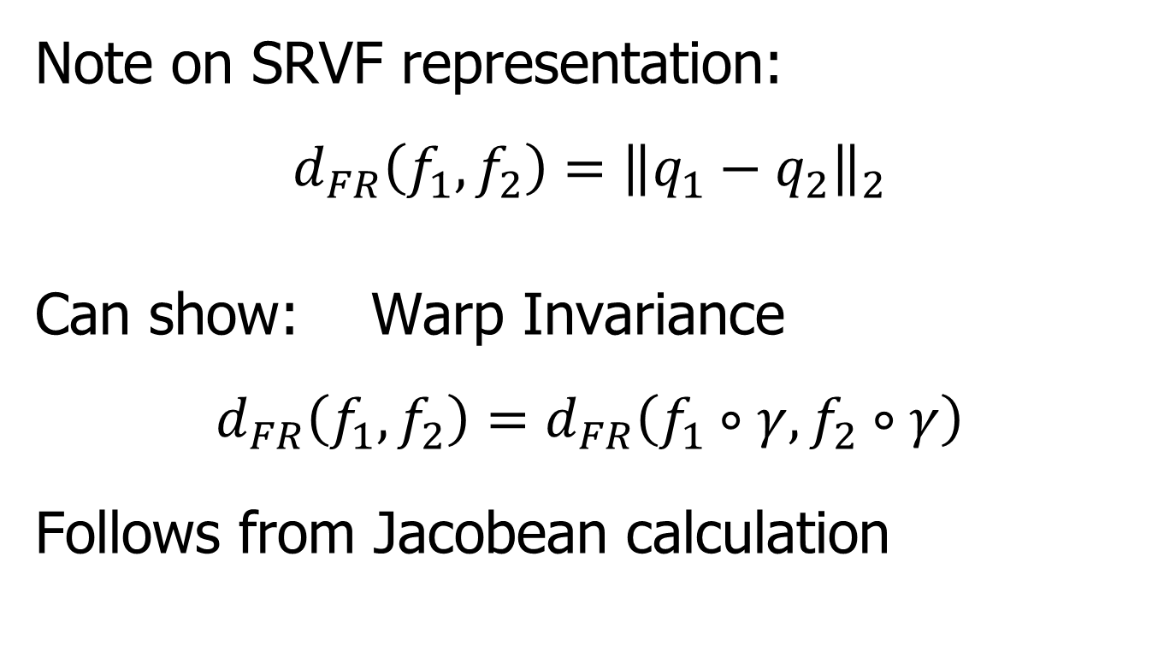
Metrics in Curve Space
Note on SRVF representation:
$$d_{FR}\left(f_{1},f_{2}\right)={\left\|q_{1}−q_{2}\right\|}_{2}$$
Can show: Warp Invariance
$$d_{FR}\left(f_{1},f_{2}\right)=d_{FR}\left(f_{1}∘γ,f_{2}∘γ\right)$$
Follows from Jacobean calculation

Slide 2
Metrics in Curve Quotient Space
Above was Invariance for Individual Curves
Now extend to:
Equivalence Classes of Curves
I.e. Orbits as Data Objects
I.e. Quotient Space

Slide 3
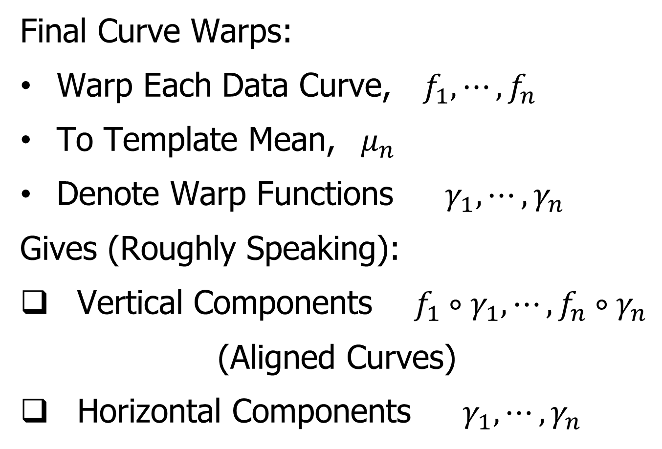
More Data Objects
Final Curve Warps:
Warp Each Data Curve, $f_{1}, ⋯,f_{n}$
To Template Mean, $μ_{n}$
Denote Warp Functions $γ_{1}, ⋯,γ_{n}$
Gives (Roughly Speaking):
Vertical Components $f_{1}∘γ_{1}, ⋯,f_{n}∘γ_{n}$
(Aligned Curves)
Horizontal Components $γ_{1}, ⋯,γ_{n}$

Slide 4
More Data Objects
Data Objects II
Final Curve Warps:
Warp Each Data Curve, $f_{1}, ⋯,f_{n}$
To Template Mean, $μ_{n}$
Denote Warp Functions $γ_{1}, ⋯,γ_{n}$
Gives (Roughly Speaking):
Vertical Components $f_{1}∘γ_{1}, ⋯,f_{n}∘γ_{n}$
(Aligned Curves)
Horizontal Components $γ_{1}, ⋯,γ_{n}$
~ Kendall’s Shapes

Slide 5
More Data Objects
Data Objects III
Final Curve Warps:
Warp Each Data Curve, $f_{1}, ⋯,f_{n}$
To Template Mean, $μ_{n}$
Denote Warp Functions $γ_{1}, ⋯,γ_{n}$
Gives (Roughly Speaking):
Vertical Components $f_{1}∘γ_{1}, ⋯,f_{n}∘γ_{n}$
(Aligned Curves)
Horizontal Components $γ_{1}, ⋯,γ_{n}$
~ Chang’s Transfo’s

Slide 6
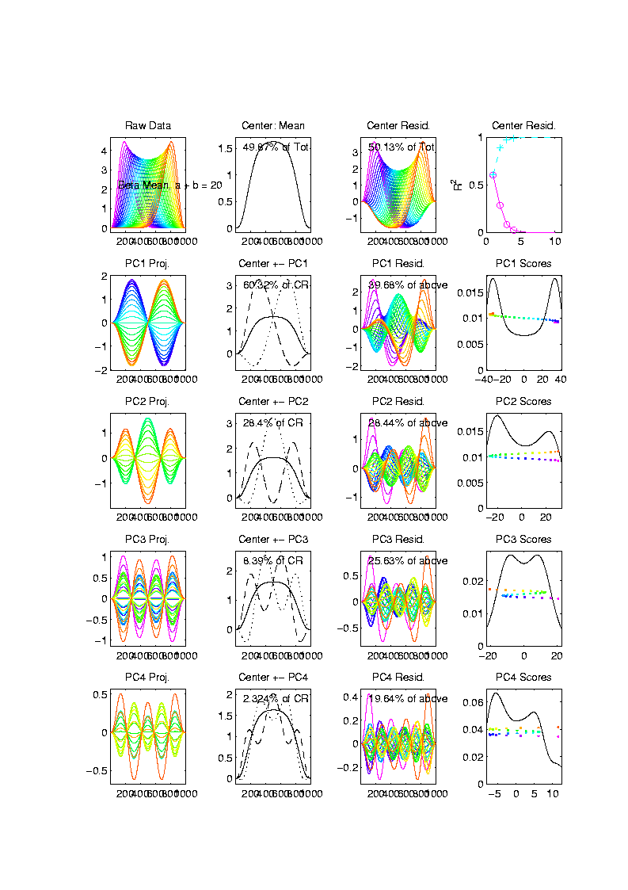
Toy Example
Conventional
PCA
Projections
Power
Spread
Across
Spectrum

Slide 7
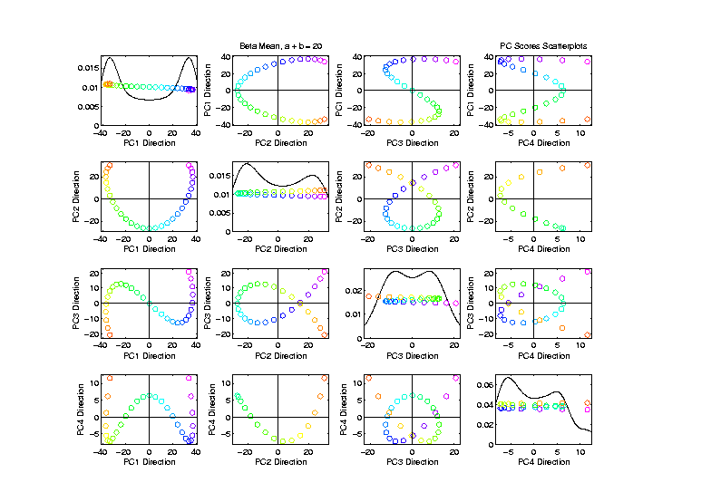
Toy Example
Conventional
PCA
Scores
Views of
1-d Curve
Bending
Through
4 Dim’ns’

Slide 8
Toy Example
Conventional
PCA
Scores
Patterns
Are
“Harmonics”
In Scores

Slide 9
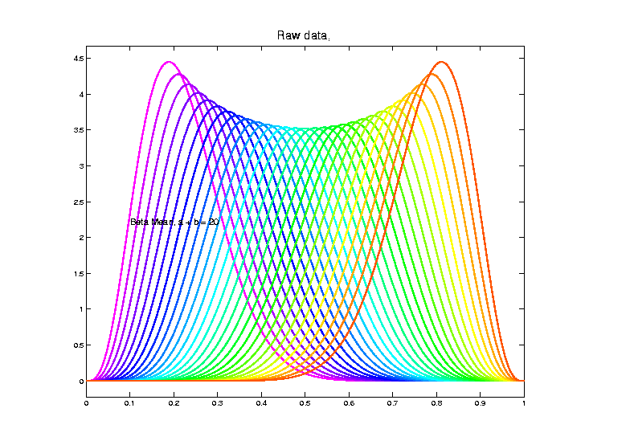
Toy Example
Scores Plot
Shows Data
Are “1”
Dimensional
So Need
Improved
PCA Decomp.

Slide 10
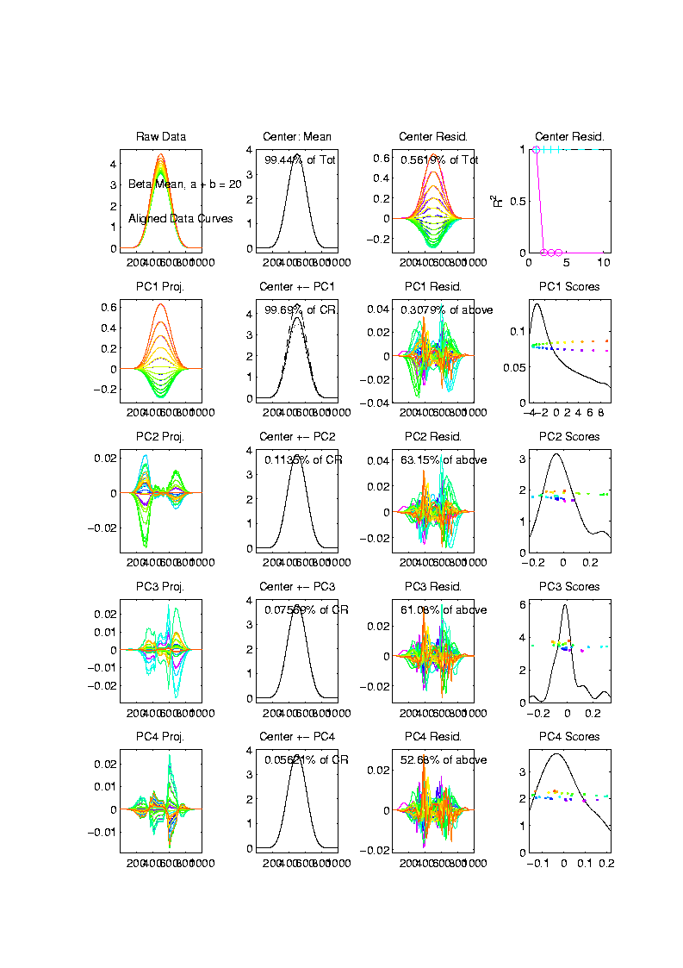
Toy Example
Aligned
Curve
PCA
Projections
All Var’n
In 1st
Component

Slide 11
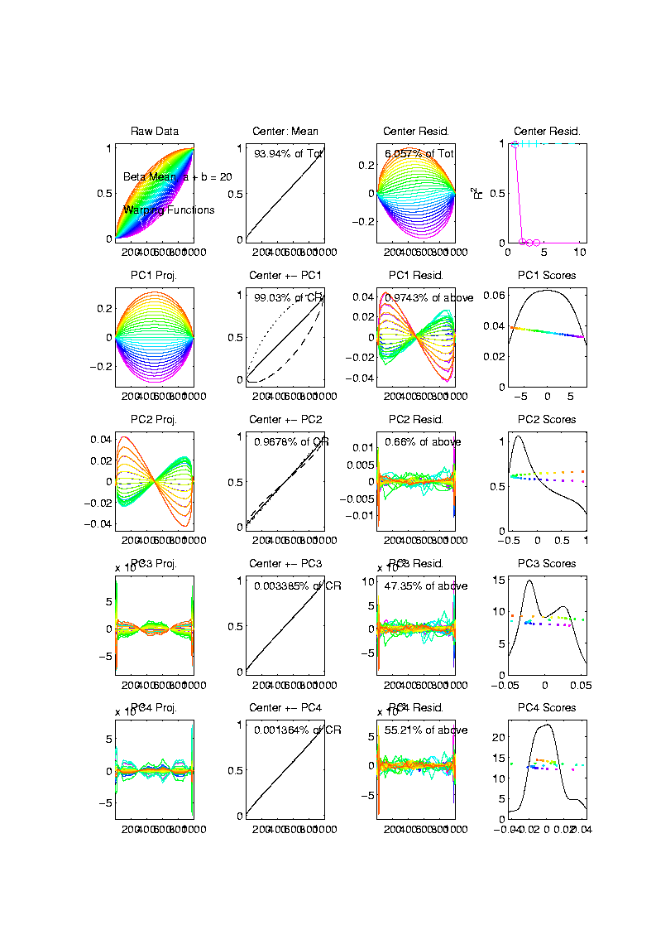
Toy Example
Warps,
PC
Projections
Mostly
1st PC,
But 2nd
Helps Some

Slide 12
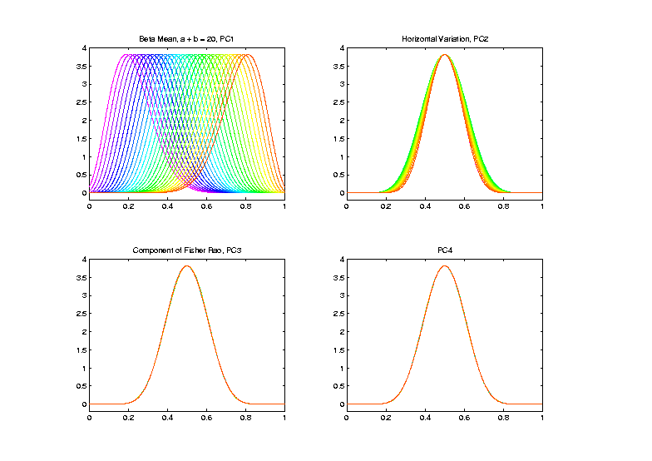
Toy Example
Warp
Compon’ts
(+ Mean)
Applied to
Template
Mean

Slide 13
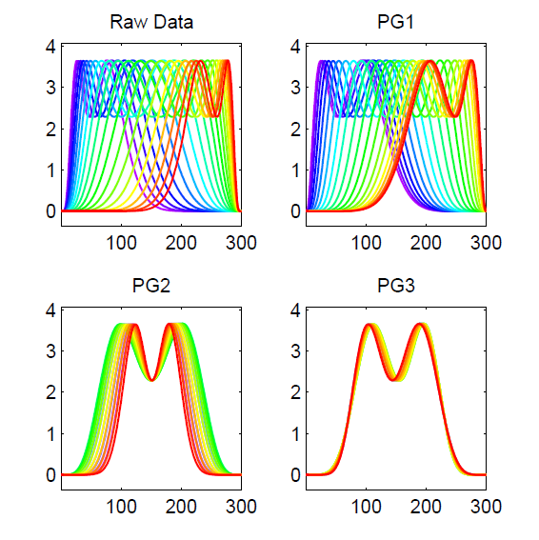
PNS on SRVF Sphere
Toy Example
Tangent Space PCA
(on Horiz. Var’n)
Thanks to Xiaosun Lu

Slide 14
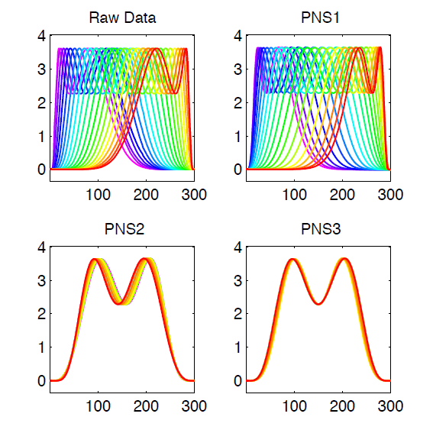
PNS on SRVF Sphere
Toy Example
PNS Projections
(Fewer Modes)

Slide 15
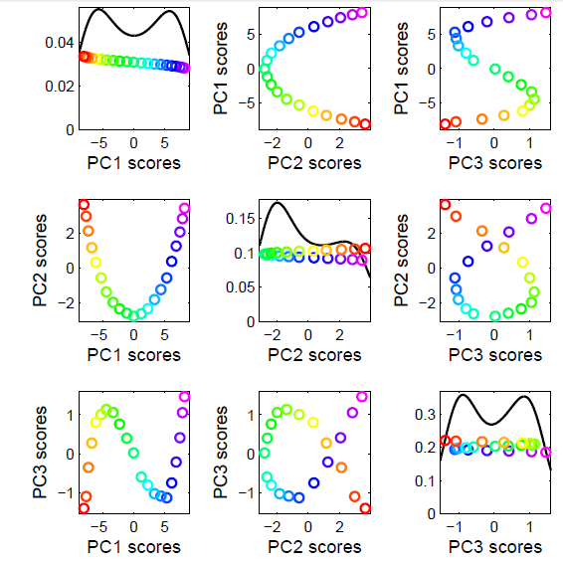
PNS on SRVF Sphere
Toy Example
Tangent Space PCA
Note: 3 Comp’s
Needed for This

Slide 16
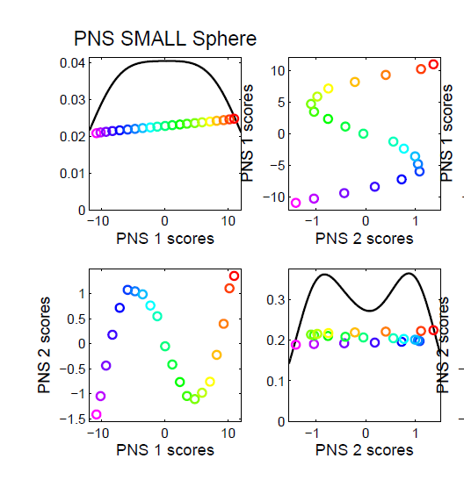
PNS on SRVF Sphere
Toy Example
PNS Projections
Only 2 for This

Slide 17
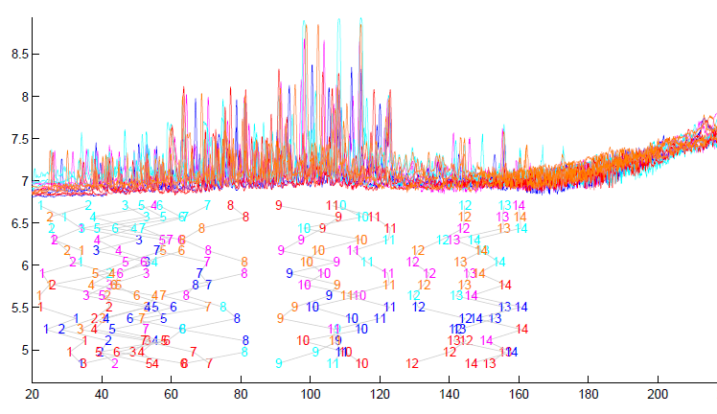
TIC testbed
Special Feature: Answer Key of Known Peaks
Goal:
Find
Warps
To Align
These

Slide 18
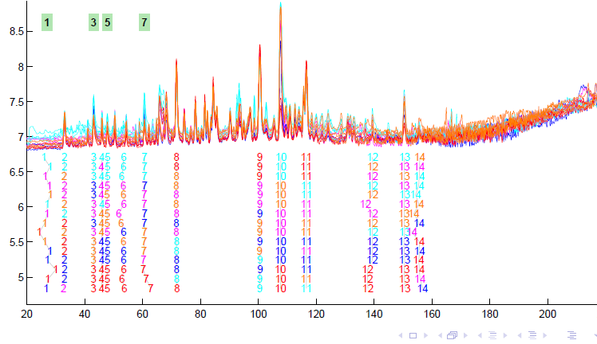
TIC testbed
Fisher – Rao Alignment

Slide 19
Non - Euclidean Data Spaces
What is “Strongly Non-Euclidean” Case?
Trees as Data

Slide 20
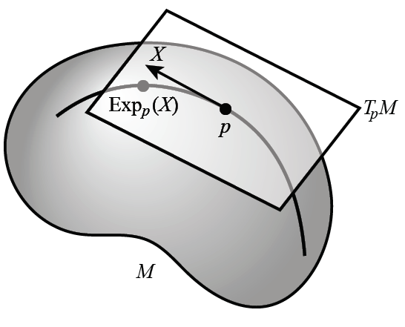
Non - Euclidean Data Spaces
What is “Strongly Non-Euclidean” Case?
Trees as Data
Special Challenge:
No Tangent Plane
Must Re-Invent
Data Analysis

Slide 21
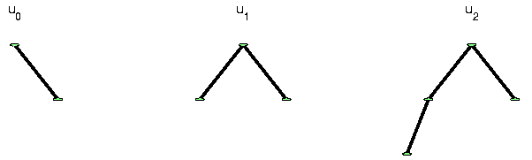
Strongly Non-Euclidean Spaces
Trees as Data Objects
Thanks to Burcu Aydin
Notes:
FIGp8correct.eps

Slide 22
Strongly Non-Euclidean Spaces
Trees as Data Objects
From Graph Theory:
Graph is set of nodes and edges
Thanks to Burcu Aydin
Notes:
FIGp8correct.eps

Slide 23
Strongly Non-Euclidean Spaces
Trees as Data Objects
From Graph Theory:
Graph is set of nodes and edges
Tree has root and direction
Thanks to Burcu Aydin
Notes:
FIGp8correct.eps

Slide 24
Strongly Non-Euclidean Spaces
Trees as Data Objects
From Graph Theory:
Graph is set of nodes and edges
Tree has root and direction
Data Objects: set of trees
Thanks to Burcu Aydin
Notes:
FIGp8correct.eps

Slide 25
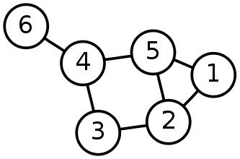
Strongly Non-Euclidean Spaces
General Graph:
Thanks to Sean Skwerer

Slide 26
Strongly Non-Euclidean Spaces
Special Case Called “Tree”
Directed
Acyclic
5
3
4
1
2
0

Slide 27
Strongly Non-Euclidean Spaces
Special Case Called “Tree”
Directed
Acyclic
5
3
4
1
2
Graphical note:
Sometimes “grow up”
Others “grow down”
0

Slide 28
Strongly Non-Euclidean Spaces
Special Case Called “Tree”
Directed
Acyclic
5
3
4
1
2
Terminology:
Root
0

Slide 29
Strongly Non-Euclidean Spaces
Special Case Called “Tree”
Directed
Acyclic
5
3
4
Terminology:
Children
Of
Parent
1
2
0

Slide 30

Strongly Non-Euclidean Spaces
Motivating Example:
From Dr. Elizabeth Bullitt
  Dept. of Neurosurgery, UNC

Slide 31
Strongly Non-Euclidean Spaces
Motivating Example:
From Dr. Elizabeth Bullitt
  Dept. of Neurosurgery, UNC
Blood Vessel Trees in Brains
Segmented from MRAs

Slide 32
Strongly Non-Euclidean Spaces
Motivating Example:
From Dr. Elizabeth Bullitt
  Dept. of Neurosurgery, UNC
Blood Vessel Trees in Brains
Segmented from MRAs
Study population of trees
Forest of Trees

Slide 33
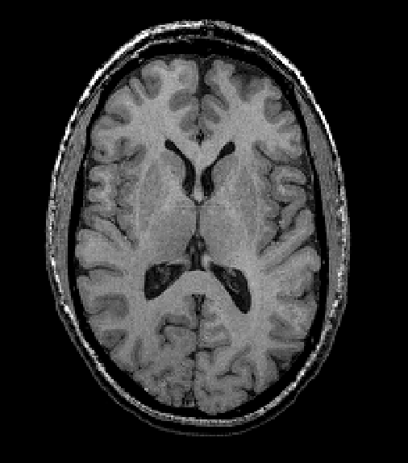
Blood vessel tree data
Marron’s brain:
MRI (T1) view
Single Slice
From 3-d Image

Slide 34
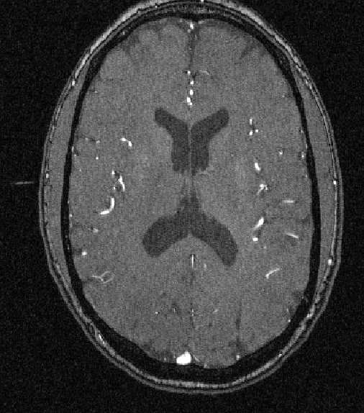
Blood vessel tree data
Marron’s brain:
MRA view
“A” for “Angiography”
Finds blood vessels
(show up as white)
Track through 3d

Slide 35

Blood vessel tree data
Marron’s brain:
MRA view
“A” for “Angiography”
Finds blood vessels
(show up as white)
Track through 3d

Slide 36

Blood vessel tree data
Marron’s brain:
MRA view
“A” for “Angiography”
Finds blood vessels
(show up as white)
Track through 3d

Slide 37
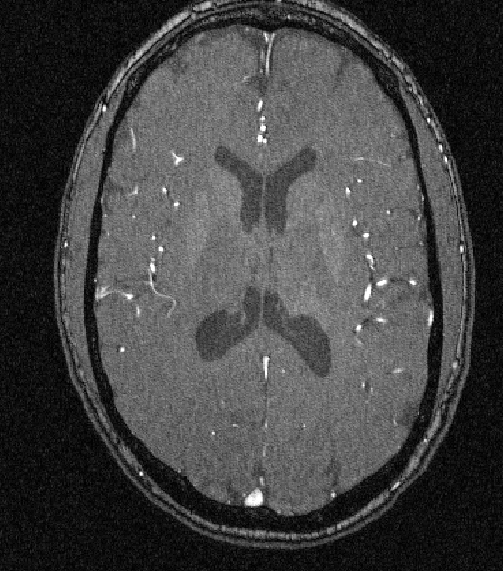
Blood vessel tree data
Marron’s brain:
MRA view
“A” for “Angiography”
Finds blood vessels
(show up as white)
Track through 3d

Slide 38
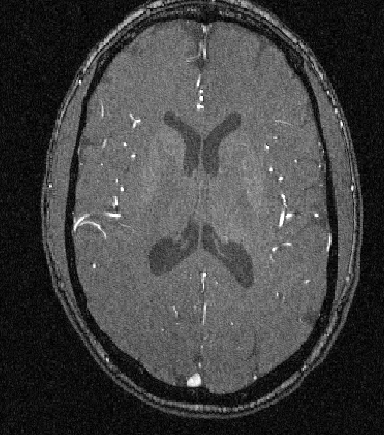
Blood vessel tree data
Marron’s brain:
MRA view
“A” for “Angiography”
Finds blood vessels
(show up as white)
Track through 3d

Slide 39

Blood vessel tree data
Marron’s brain:
MRA view
“A” for “Angiography”
Finds blood vessels
(show up as white)
Track through 3d

Slide 40
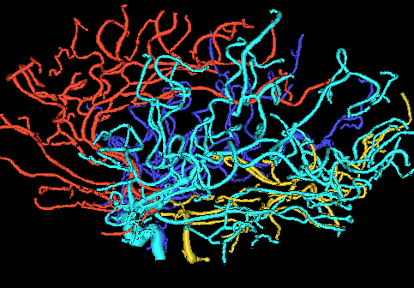
Blood vessel tree data
Marron’s brain:
From MRA
Segment tree
of vessel segments
Using tube tracking
Bullitt and Aylward (2002)

Slide 41
Blood vessel tree data
Marron’s brain:
From MRA
Reconstruct trees
in 3d
Rotate to view

Slide 42
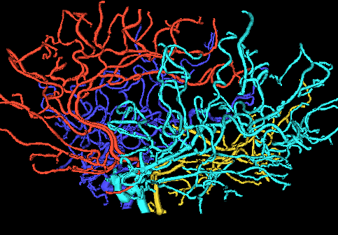
Blood vessel tree data
Marron’s brain:
From MRA
Reconstruct trees
in 3d
Rotate to view

Slide 43
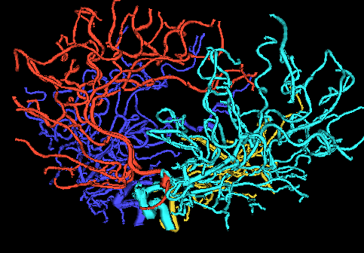
Blood vessel tree data
Marron’s brain:
From MRA
Reconstruct trees
in 3d
Rotate to view

Slide 44
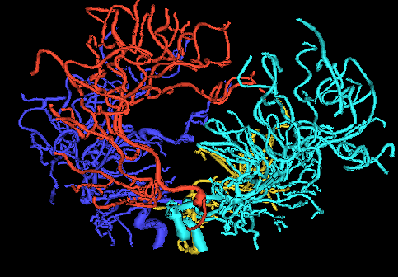
Blood vessel tree data
Marron’s brain:
From MRA
Reconstruct trees
in 3d
Rotate to view

Slide 45
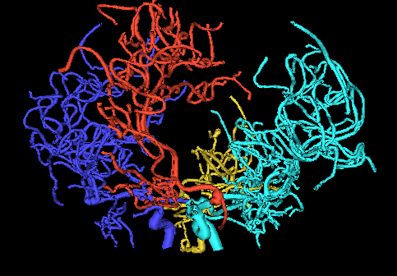
Blood vessel tree data
Marron’s brain:
From MRA
Reconstruct trees
in 3d
Rotate to view

Slide 46
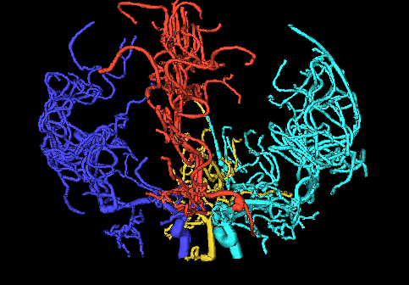
Blood vessel tree data
Marron’s brain:
From MRA
Reconstruct trees
in 3d
Rotate to view

Slide 47
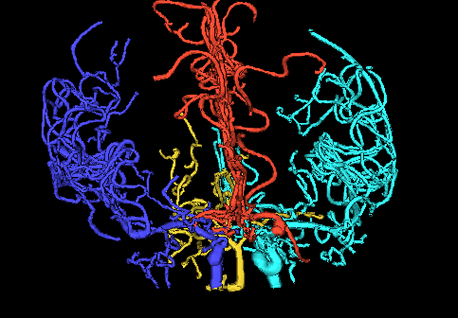
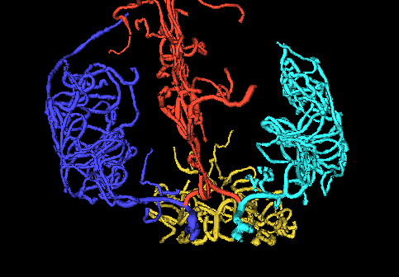
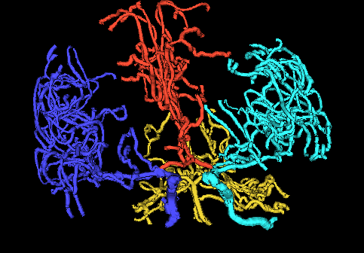
Blood vessel tree data
,
, ... ,
Now look over many people (data objects)
Structure of population (understand variation?)
PCA in strongly non-Euclidean Space???

Slide 48
Blood vessel tree data
,
, ... ,
Examples of Potential Specific Goals

Slide 49
Blood vessel tree data
,
, ... ,
Examples of Potential Specific Goals
(not accessible by traditional methods)
Predict Stroke Tendency (Collateral Circulation)

Slide 50
Blood vessel tree data
,
, ... ,
Examples of Potential Specific Goals
(not accessible by traditional methods)
Predict Stroke Tendency (Collateral Circulation)
Screen for Loci of Pathology

Slide 51
Blood vessel tree data
,
, ... ,
Examples of Potential Specific Goals
(not accessible by traditional methods)
Predict Stroke Tendency (Collateral Circulation)
Screen for Loci of Pathology
Explore how age affects connectivity

Slide 52
Blood vessel tree data
,
, ... ,
Examples of Potential Specific Goals
(not accessible by traditional methods)
Predict Stroke Tendency (Collateral Circulation)
Screen for Loci of Pathology
Explore how age affects connectivity

Slide 53
Blood vessel tree data
Big Picture: 4 Approaches
Purely Combinatorial
Euclidean Orthant (Phylogenetics)
Dyck Path
Persistent Homologies Topological DA

Slide 54
Blood vessel tree data
Big Picture: 4 Approaches
Purely Combinatorial
Euclidean Orthant (Phylogenetics)
Dyck Path
Persistent Homologies Topological DA

Slide 55
Blood vessel tree data
Purely Combinatorial Data Analyses
(Study Connectivity Only)
Wang and Marron (2007)
Aydin et al (2009)
Wang et al (2012)
Aydin et al (2012)
Alfaro et al (2014)

Slide 56
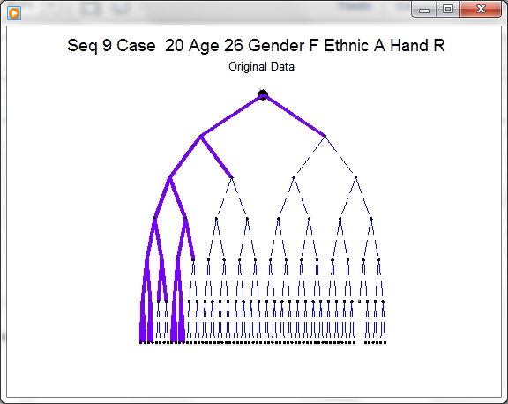
D-L Visualization of Trees
Challenge:
Visual
Display of
Full Tree
Structure

Slide 57
D-L Visualization of Trees
Challenge:
Visual
Display of
Full Tree
Structure
Actually
Goes to
Level 17
(Truncated
in View)

Slide 58
D-L Visualization of Trees
Approach: Different Coordinate System
Aydin, et al (2011)

Slide 59
D-L Visualization of Trees
Approach: Different Coordinate System
Idea: Focus on Important Aspects (of Nodes)
Level of Node
Number of Children

Slide 60
D-L Visualization of Trees
Approach: Different Coordinate System
Idea: Focus on Important Aspects (of Nodes)
Level of Node
Number of Children
Using These as Coordinates

Slide 61
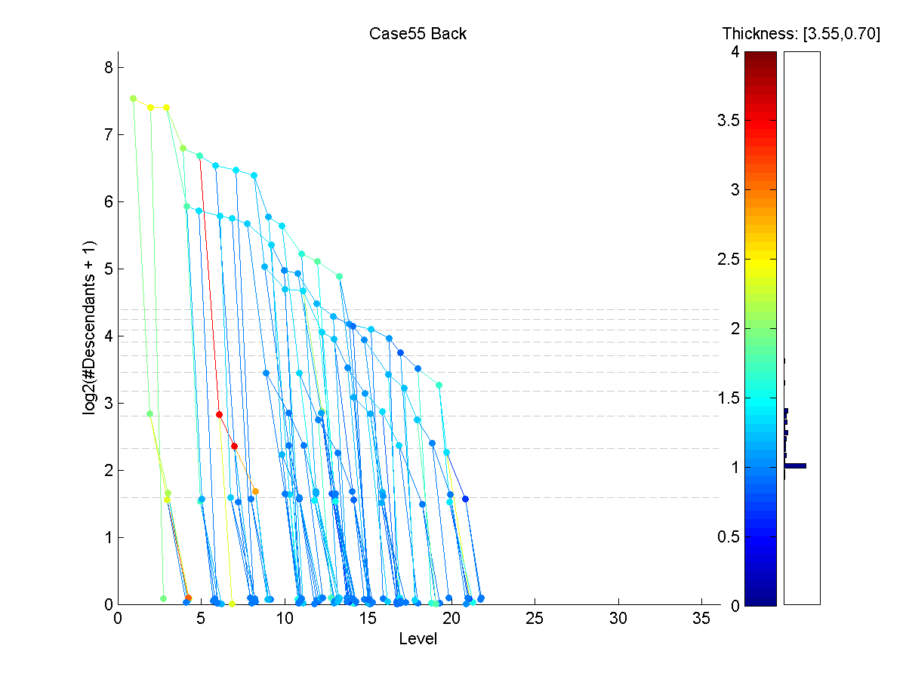
D-L Visualization of Trees
D-L
View

Slide 62
D-L Visualization of Trees
D-L
View
Nodes

Slide 63
D-L Visualization of Trees
D-L
View
Level

Slide 64
D-L Visualization of Trees
D-L
View
Level
Much
Deeper
Than
Early
View

Slide 65
D-L Visualization of Trees
D-L
View
# Des-
cend-
ants
(log
scale)

Slide 66
D-L Visualization of Trees
D-L
View
Color
Codes
Branch
Thick-
ness

Slide 67
D-L Visualization of Trees
D-L
View
Reveals
Strange
Struc-
ture

Slide 68
D-L Visualization of Trees
D-L
View
Reveals
Strange
Struc-
ture
Linking
Errors

Slide 69

D-L Visualization of Trees
D-L
View
Fixed
Version

Slide 70
Blood vessel tree data
Big Picture: 4 Approaches
Purely Combinatorial
Euclidean Orthant (Phylogenetics)
Dyck Path
Persistent Homologies Topological DA

Slide 71
Euclidean Orthant Approach
People:
Scott Provan
Sean Skwerer
Megan Owen
Ezra Miller
Martin Styner
Ipek Oguz

Slide 72
Euclidean Orthant Approach
Setting: Connectivity & Length

Slide 73
Euclidean Orthant Approach
Setting: Connectivity & Length
Background: Phylogenetic Trees

Slide 74
Euclidean Orthant Approach
Setting: Connectivity & Length
Background: Phylogenetic Trees
Important Concept from Evolutionary Biology

Slide 75
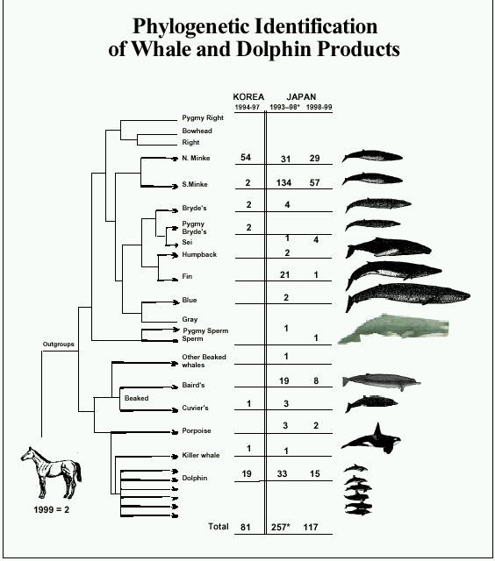
Phylogenetic Trees
Idea: Study
“Common
Ancestry”
Via a tree
Species are leaves
thanks to Susan Holmes

Slide 76
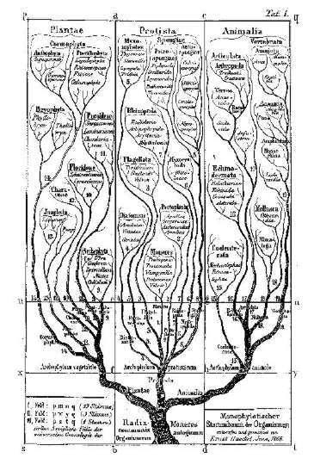
Phylogenetic Trees
Very Early Reference:
E. Schröder (1870),
Zeit. für. Math. Phys.,
15, 361-376.
thanks to Susan Holmes

Slide 77
Phylogenetic Trees
Important Reference:
Billera L, Holmes S, & Vogtmann K (2001)

Slide 78
Phylogenetic Trees
Important Reference:
Billera L, Holmes S, & Vogtmann K (2001)
Put Large Field on Firm Mathematical Basis

Slide 79
Euclidean Orthant Approach
Setting: Connectivity & Length
Background: Phylogenetic Trees
Major Restriction: Need common leaves

Slide 80
Euclidean Orthant Approach
Setting: Connectivity & Length
Background: Phylogenetic Trees
Major Restriction: Need common leaves
Big Payoff: Data space nearly Euclidean
sort of Euclidean

Slide 81
Euclidean Orthant Approach
Major Restriction: Need common leaves

Slide 82
Euclidean Orthant Approach
Major Restriction: Need common leaves
Approach:
Find common cortical landmarks (Oguz)
corresponding across cases

Slide 83
Euclidean Orthant Approach
Major Restriction: Need common leaves
Approach:
Find common cortical landmarks (Oguz)
corresponding across cases
Oguz (2009)

Slide 84
Euclidean Orthant Approach
Major Restriction: Need common leaves
Approach:
Find common cortical landmarks (Oguz)
corresponding across cases
Treat as pseudo – leaves
by projecting to points on tree

Slide 85
Labeled n-Trees
5-tree
e.g. n = 5
Thanks to Sean Skwerer

Slide 86
Labeled n-Trees
leaves - fixed a priori
5-tree

Slide 87
Labeled n-Trees
leaves - fixed a priori
5-tree
root

Slide 88
Labeled n-Trees
leaves - fixed a priori
labeled {0,1, . . . ,n}
5-tree
root

Slide 89
Labeled n-Trees
leaves - fixed a priori
labeled {0,1, . . . ,n}
Internal (nonleaf)
vertices degree ≥ 3
5-tree
root

Slide 90
Labeled n-Trees
leaves - fixed a priori
labeled {0,1, . . . ,n}
Internal (nonleaf)
vertices degree ≥ 3
# edges
from node
5-tree
root

Slide 91
Labeled n-Trees
leaves - fixed a priori
labeled {0,1, . . . ,n}
Internal (nonleaf)
vertices degree ≥ 3
(note: not labelled)
5-tree
root

Slide 92
Labeled n-Trees
leaves - fixed a priori
labeled {0,1, . . . ,n}
Internal (nonleaf)
vertices degree ≥ 3
edge e has
nonneg. length
5-tree
root
|e₁|=3
|e₂|=4
|e₃|=6

Slide 93
Labeled n-Trees
Note: To study
‘topology’,
(i.e. tree structure)
5-tree
root
|e₁|=3
|e₂|=4
|e₃|=6

Slide 94
Labeled n-Trees
Note: To study
‘topology’,
(i.e. tree structure)
Enough to consider
only lengths of
internal edges
5-tree
root
|e₁|=3
|e₂|=4
|e₃|=6

Slide 95
Labeled n-Trees
Terminology:
Leaf edges called
‘pendants’
(Care about lengths
of pendants in
brain arteries)
5-tree
root
|e₁|=3
|e₂|=4
|e₃|=6

Slide 96
Toy Examples
=
Same tree, since same internal edges

Slide 97
Toy Examples
=
Different tree, since different connections

Slide 98
Toy Examples
A valid tree, called “Star tree” or “0 tree” (since all internal edge lengths are 0)

Slide 99
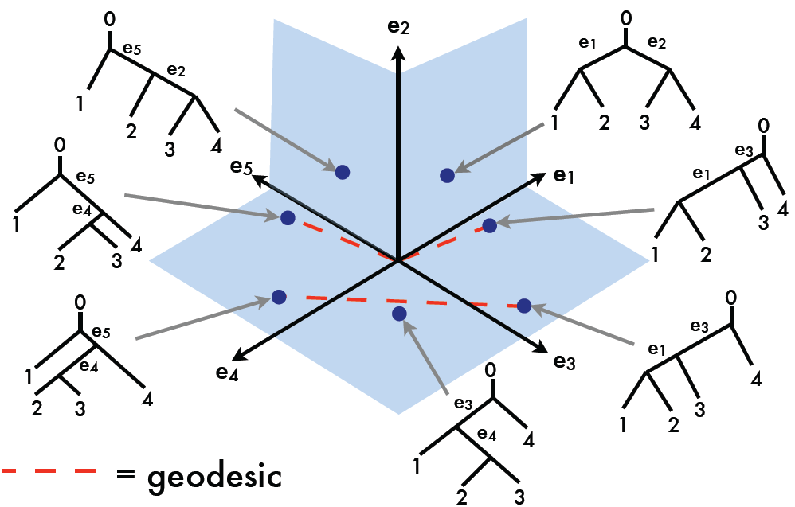
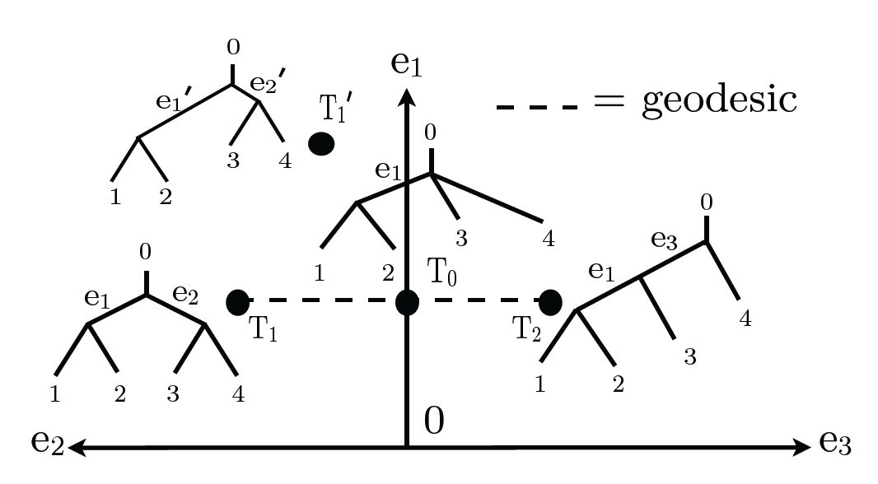
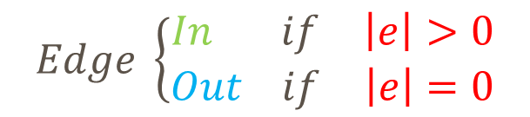
Tree Space Examples, T-4
$$Edge \left\{\begin{matrix}In if & \left|e\right|>0 \\ Out if & \left|e\right|=0\end{matrix}\right.$$
Set of mutually compatible splits ⬄ tree
Thanks to Megan Owen

Slide 100
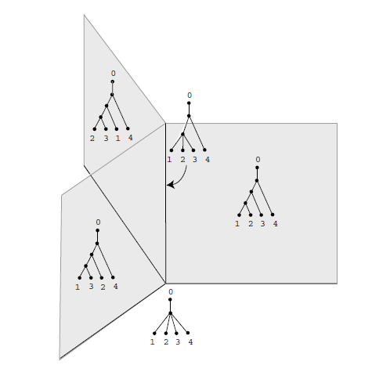
Three quadrants meeting at common axis

Slide 101
Three quadrants meeting at common axis
Star Tree = 0 Tree

Slide 102
Three quadrants meeting at common axis
Star Tree
(point)

Slide 103
Three quadrants meeting at common axis
Star Tree
(point)
1-edge Trees
(line)

Slide 104
Three quadrants meeting at common axis
Star Tree
(point)
1-edge Trees
(line)
2-edge Trees
(planes)

Slide 105
Three quadrants meeting at common axis
Mathematical
Construct:
Manifold Stratified
Space

Slide 106
Three quadrants meeting at common axis
Mathematical
Construct:
Manifold Stratified
Space
Manifolds (planes)
of Different Dimensions
Glued Together

Slide 107
Three quadrants meeting at common axis
Mathematical
Construct:
Manifold Stratified
Space
Manifolds (planes)
of Different Dimensions
Glued Together

Slide 108
Three quadrants meeting at common axis
Mathematical
Construct:
Manifold Stratified
Space
Manifolds (planes)
of Different Dimensions
Glued Together

Slide 109
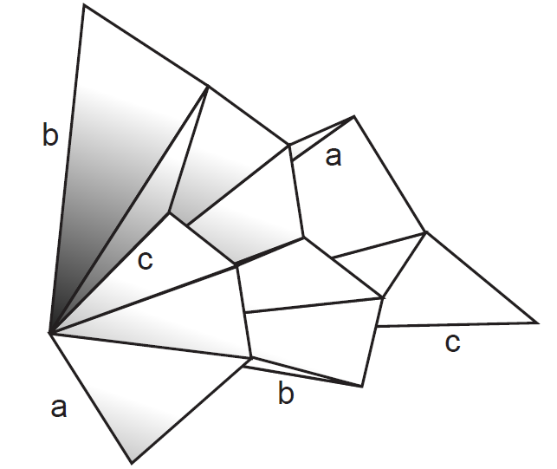
‘Connectivity’ of T-4

Slide 110
‘Connectivity’ of T-4
Cone Structure
(Reflects edge
lengths > 0)

Slide 111
‘Connectivity’ of T-4
Cone Structure
Star (0) Tree
(At Origin)

Slide 112
‘Connectivity’ of T-4
Cone Structure
Star (0) Tree
Single Edge
Trees
(On Boundary
Lines)

Slide 113
‘Connectivity’ of T-4
Cone Structure
Star (0) Tree
Single Edge
Trees
Full (2 Edge)
Trees
(On Planes)

Slide 114
‘Connectivity’ of T-4
Each Line
Connects to
3 planes
(# compatible
edges)

Slide 115
‘Connectivity’ of T-4
Each Line
Connects to
3 planes
(# compatible
edges)

Slide 116
Geodesic Paths
  Given 2 trees,
  Shortest path
  Some math:
  Can show unique in this space
  Both geodesics & shortest paths

Slide 117
Geodesic Examples, T-4
Very
Interesting
Geometry
Thanks to Megan Owen

Slide 118
Geodesic Examples, T-4
Recall:
Manifold
Stratified
Space
Thanks to Megan Owen

Slide 119
Geodesic Examples, T-4
Recall:
Manifold
Stratified
Space
2-d Strata
(Orthants)
Thanks to Megan Owen

Slide 120
Geodesic Examples, T-4
Recall:
Manifold
Stratified
Space
2-d Strata
(Orthants)
Glued With
1-d Strata
(Lines)
Thanks to Megan Owen

Slide 121
Geodesic Examples, T-4
Recall:
Manifold
Stratified
Space
0-d Stratum
(Origin =
Star Tree)
Thanks to Megan Owen

Slide 122
Geodesic Examples, T-4
3-Orthant
Geodesic
(angle
< 180º)
Thanks to Megan Owen

Slide 123
Geodesic Examples, T-4
Cone Path
Geodesic
(angle
> 180º)
Thanks to Megan Owen

Slide 124
Geodesic Examples, T-4
Endpoints
In Same
Orthants
Thanks to Megan Owen

Slide 125
Geodesic Paths
  Given 2 trees,
  Shortest path between is called the
  geodesic
  Fast Computation (polynomial time):
Owen & Provan (2011)

Slide 126
The Geodesic Path Algorithm
  Owen & Provan (2011)’s polynomial algorithm for finding geodesics between n-trees

Slide 127
The Geodesic Path Algorithm
  Owen & Provan (2011)’s polynomial algorithm for finding geodesics between n-trees:
    Start with the cone path connecting the two trees through the origin (“star tree”).

Slide 128
Geodesic Paths in Tree Space
Thanks to Sean Skwerer

Slide 129
The Geodesic Path Algorithm
  Owen & Provan (2011)’s polynomial algorithm for finding geodesics between n-trees:
    Start with the cone path connecting the two trees through the origin (“star tree”).
    Successively “slide” the path into successively larger sets of orthants, each time decreasing the length of the path.

Slide 130
Geodesic Paths in Tree Space

Slide 131
Geodesic Paths in Tree Space

Slide 132
The Geodesic Path Algorithm
  Owen & Provan (2011)’s polynomial algorithm for finding geodesics between n-trees:
    Start with the cone path connecting the two trees through the origin (“star tree”).
    Successively “slide” the path into successively larger sets of orthants, each time decreasing the length of the path.
    Stop when shortest path is found.

Slide 133
Geodesics for Artery Trees
,
, ... ,

Slide 134
Geodesics for Artery Trees
To illustrate geodesics
Study trees along geodesic,
From Case 2
To Case 3
Common Edges

Slide 135
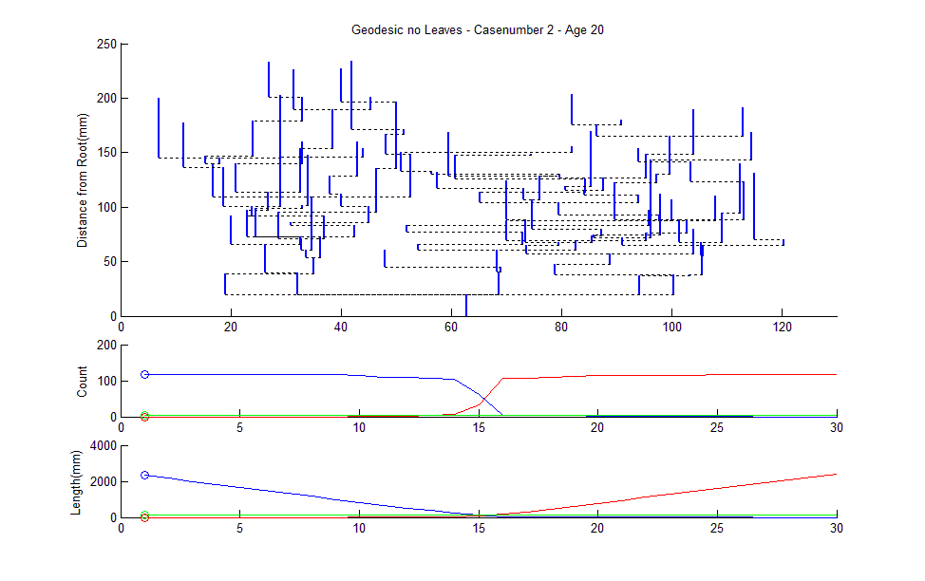
March Along 2 to 3 Geodesic
Thanks to Sean Skwerer

Slide 136
March Along 2 to 3 Geodesic
Leaf Node
Numbers
Thanks to Sean Skwerer

Slide 137
March Along 2 to 3 Geodesic
Interior
Edge
Lengths
Thanks to Sean Skwerer

Slide 138
March Along 2 to 3 Geodesic
Distance From Root
Thanks to Sean Skwerer

Slide 139
March Along 2 to 3 Geodesic
Show Interior Edges
Midway Between
Children
Thanks to Sean Skwerer

Slide 140
March Along 2 to 3 Geodesic
Unfortunate Consequence: Crossing Branches
General Problem Embedding 3-d Trees in 2-d
Thanks to Sean Skwerer

Slide 141
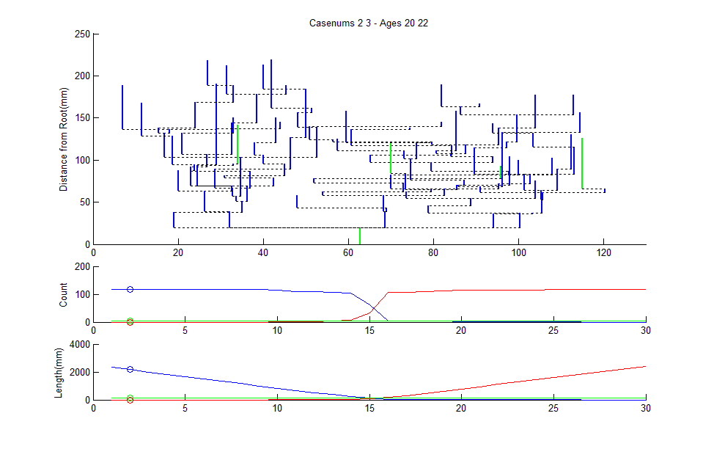
March Along 2 to 3 Geodesic

Slide 142
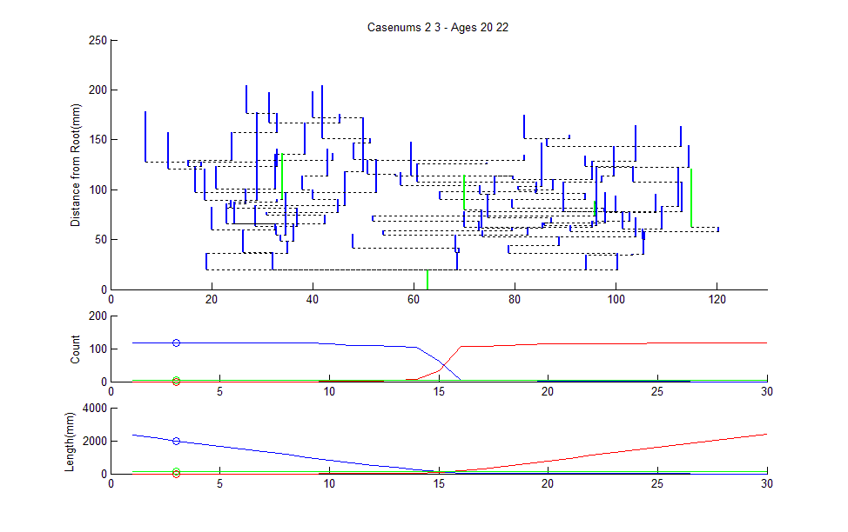
March Along 2 to 3 Geodesic

Slide 143
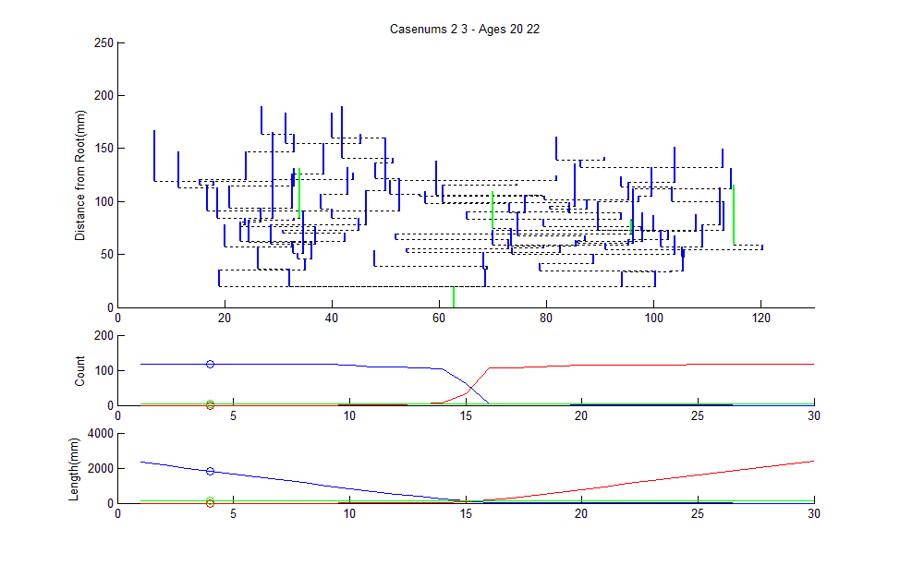
March Along 2 to 3 Geodesic

Slide 144
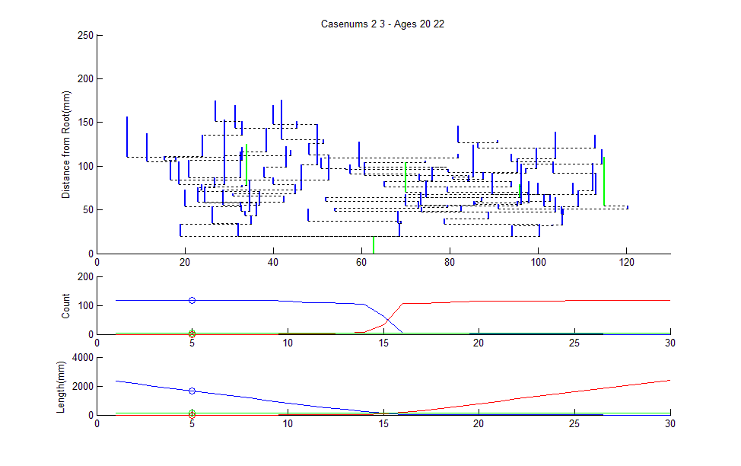
March Along 2 to 3 Geodesic

Slide 145
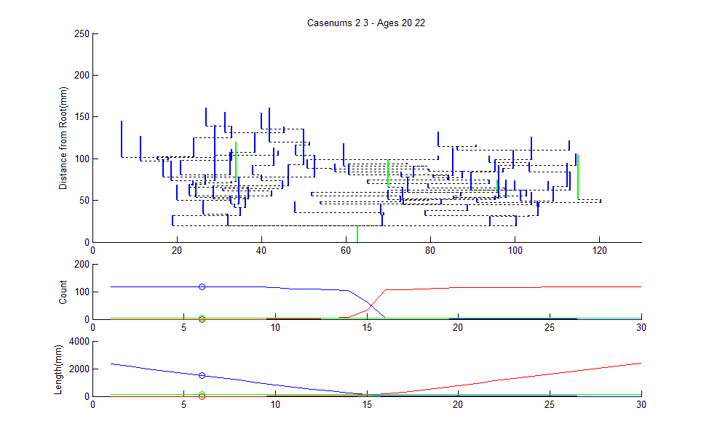
March Along 2 to 3 Geodesic

Slide 146
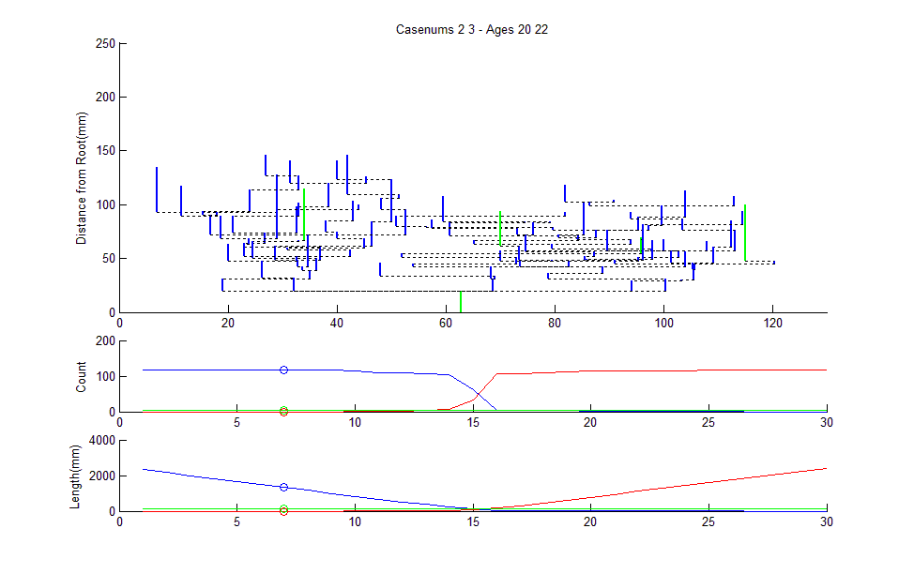
March Along 2 to 3 Geodesic

Slide 147
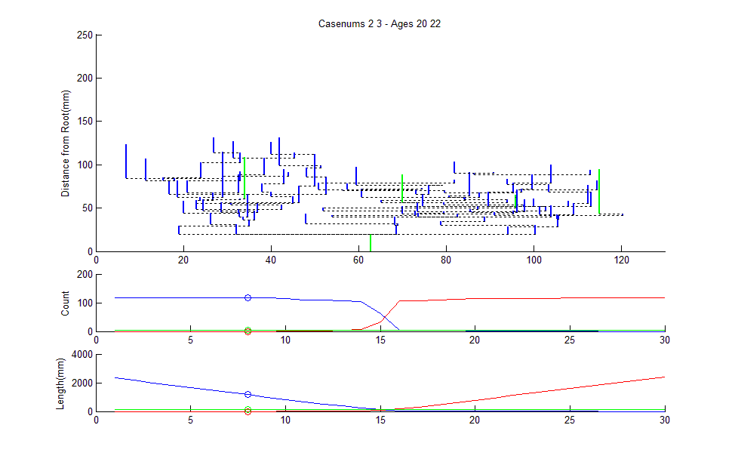
March Along 2 to 3 Geodesic

Slide 148

March Along 2 to 3 Geodesic

Slide 149
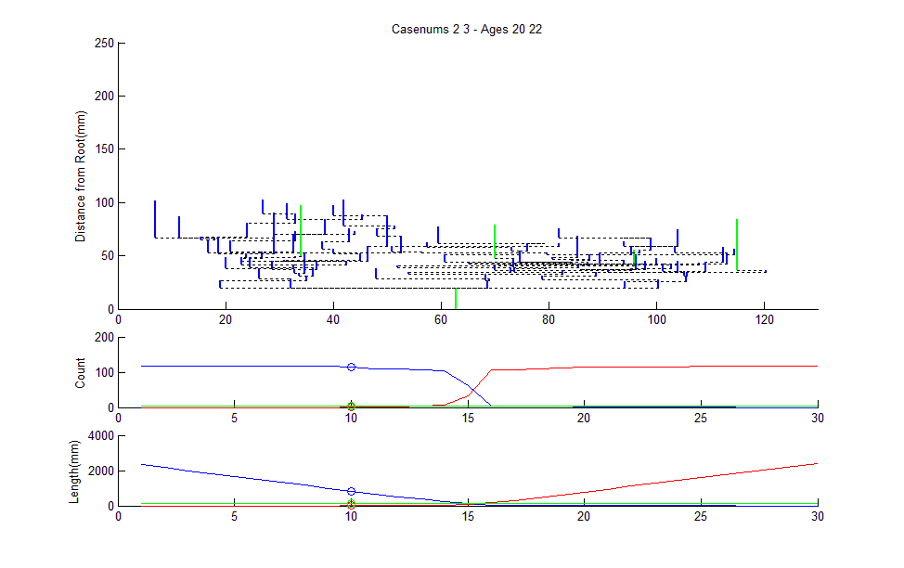
March Along 2 to 3 Geodesic

Slide 150
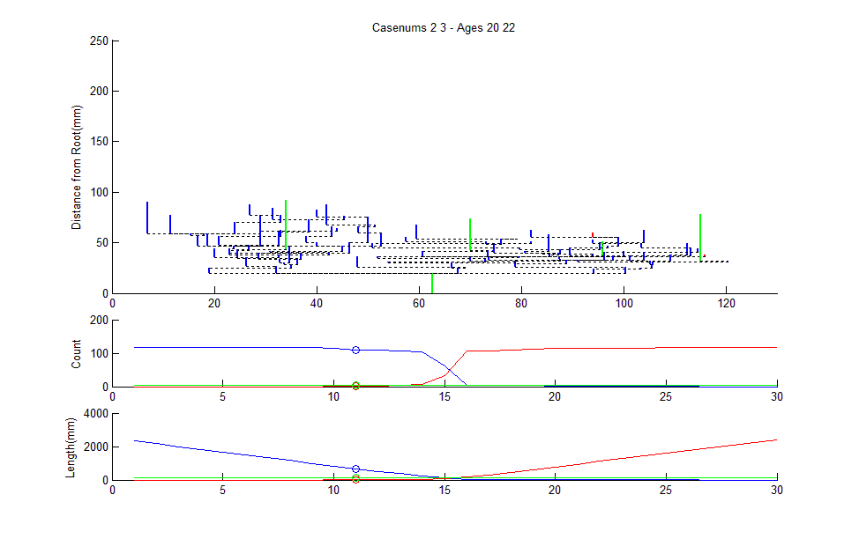
March Along 2 to 3 Geodesic

Slide 151
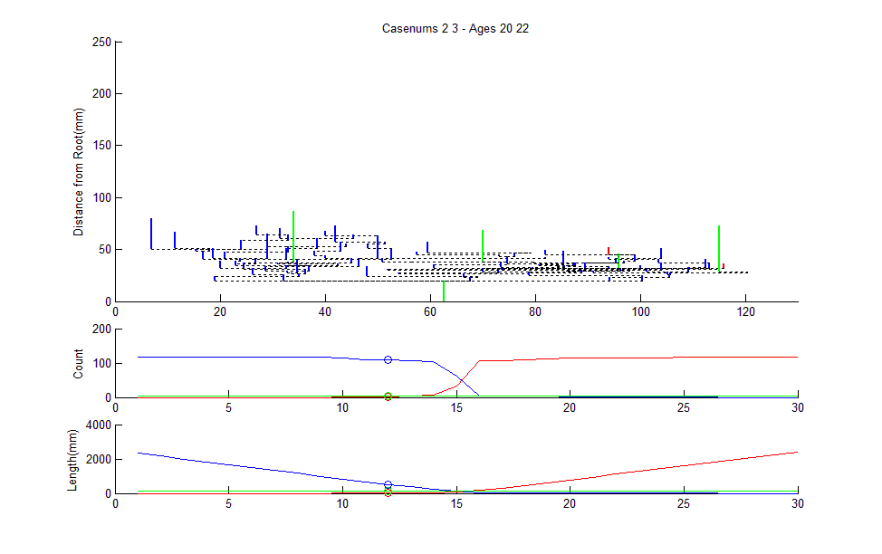
March Along 2 to 3 Geodesic

Slide 152

March Along 2 to 3 Geodesic

Slide 153

March Along 2 to 3 Geodesic

Slide 154

March Along 2 to 3 Geodesic

Slide 155

March Along 2 to 3 Geodesic

Slide 156

March Along 2 to 3 Geodesic

Slide 157

March Along 2 to 3 Geodesic

Slide 158

March Along 2 to 3 Geodesic

Slide 159

March Along 2 to 3 Geodesic

Slide 160

March Along 2 to 3 Geodesic

Slide 161

March Along 2 to 3 Geodesic

Slide 162

March Along 2 to 3 Geodesic

Slide 163

March Along 2 to 3 Geodesic

Slide 164

March Along 2 to 3 Geodesic

Slide 165

March Along 2 to 3 Geodesic

Slide 166

March Along 2 to 3 Geodesic

Slide 167

March Along 2 to 3 Geodesic

Slide 168

March Along 2 to 3 Geodesic

Slide 169

March Along 2 to 3 Geodesic

Slide 170
March Along 2 to 3 Geodesic
Count of # of Nodes

Slide 171
March Along 2 to 3 Geodesic
Count of # of Nodes, as Function of Geodesic Step

Slide 172
March Along 2 to 3 Geodesic
Also Total Branch Length

Slide 173
Geodesics for Artery Trees
Summarize Lessons:
Very few Common Edges (only 5)
Most edges swap out

Slide 174
Geodesics for Artery Trees
Summarize Lessons:
Very few Common Edges (only 5)
Most edges swap out
Edges get much shorter (bottom plot)
Recall this Later

Slide 175
Geodesics for Artery Trees
Summarize Lessons:
Very few Common Edges (only 5)
Most edges swap out
Edges get much shorter (bottom plot)
Recall this Later
# of edges roughly constant (middle plot)

Slide 176
Euclidean Orthant Approach
Reference for More:
Skwerer et al (2013)
Some Related Probability Theory:
Hotz et al (2013)

Slide 177
Blood vessel tree data
Big Picture: 4 Approaches
Purely Combinatorial
Euclidean Orthant (Phylogenetics)
Dyck Path
Persistent Homologies

Slide 178
Blood vessel tree data
Persistent Homology Approach
Topological Data Analysis
Bendich et al (2014)
Gave Deepest Results to Date

Slide 179
Carry Away Concept
OODA is more than a “framework”
It Provides a Focal Point
Highlights Pivotal Choices:
What should be the Data Objects?
How should they be Represented?

