Slide 1
Nonnegative Matrix Factorization
Standard Approach:
Lee et al (1999):
Formulate & Solve Optimization
Major Challenge:
Not Nested, ($k=3 ≉ k=4$)

Slide 2
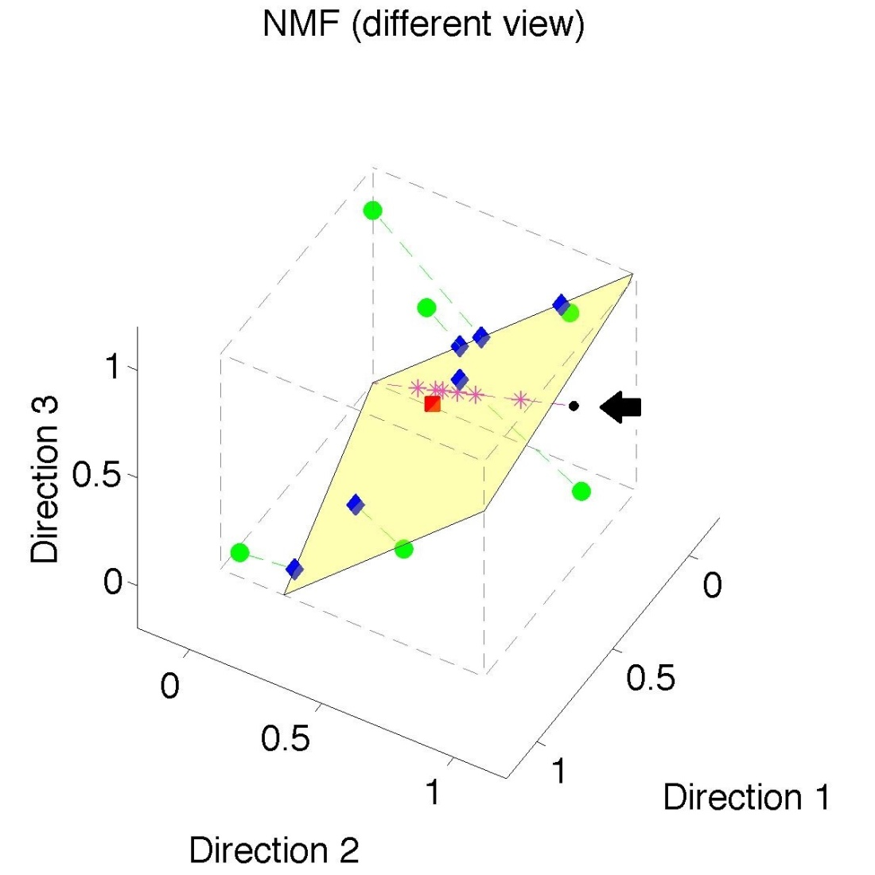
Nonnegative Matrix Factorization
Standard NMF
But Note
Not Nested
No “Multi-scale”
Analysis
Possible (Scores Plot?!?)

Slide 3
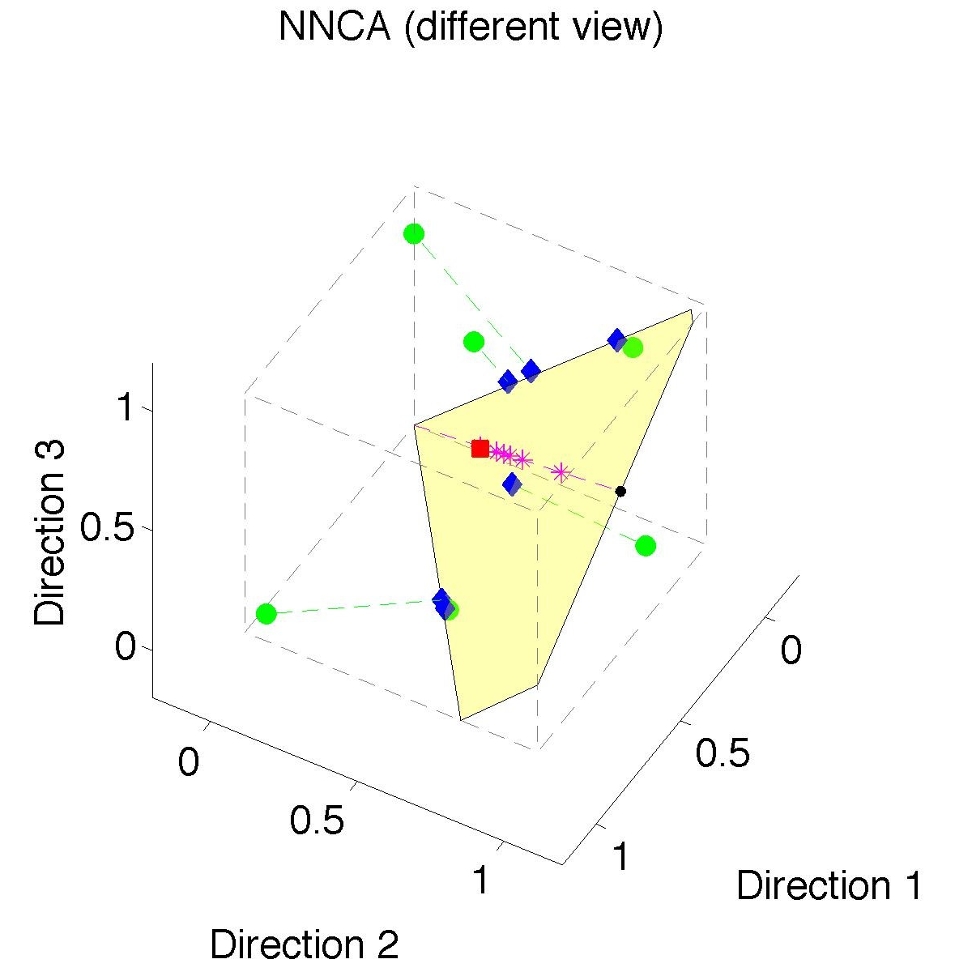
Nonnegative Nested Cone Analysis
Same Toy
Data Set
Rank 1
Approx.
Properly
Nested

Slide 4
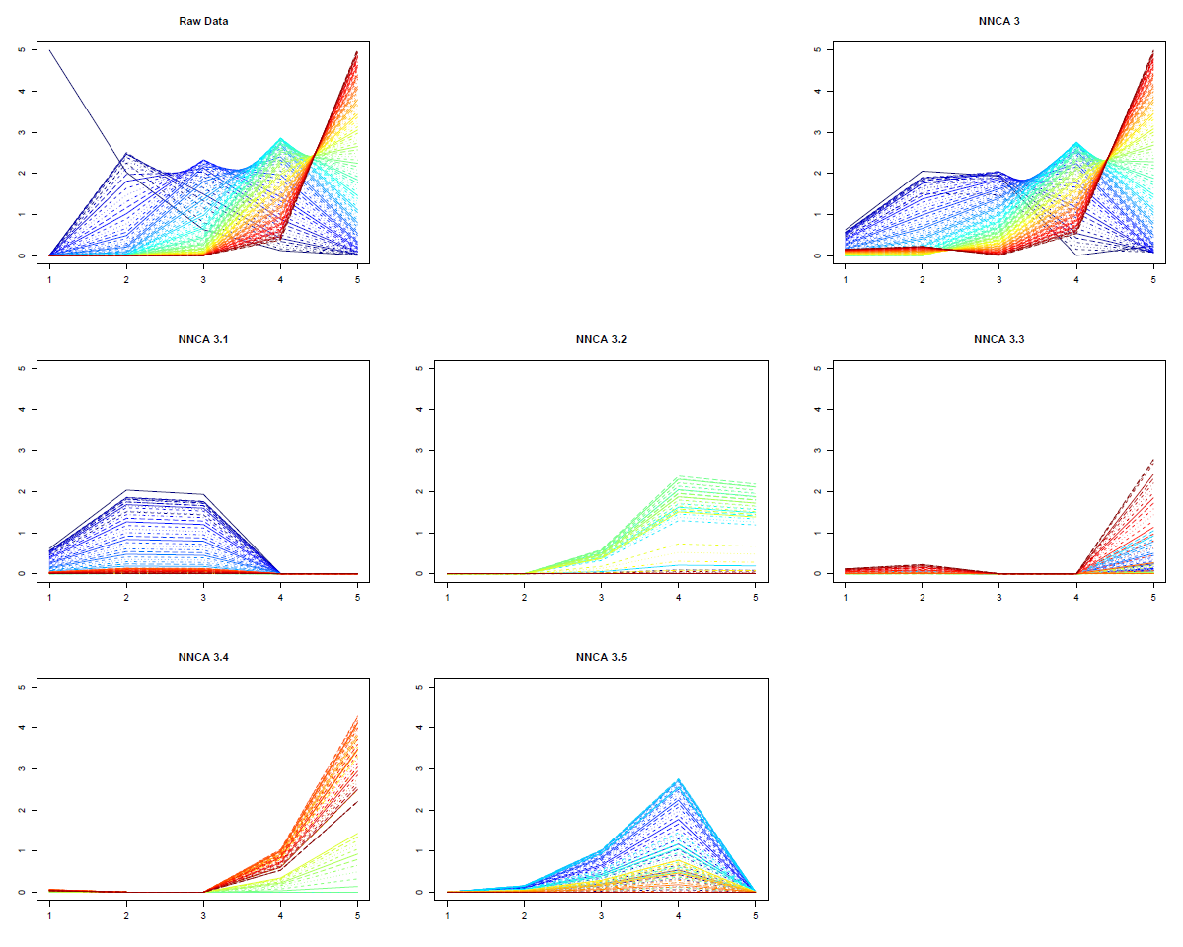
Nonnegative Nested Cone Analysis
5-d Toy Example Rank 3 NNCA Approx.
Current
Research:
How Many
Nonneg.
Basis El’ts
Needed?

Slide 5
An Interesting Question
How generally applicable is
Backwards approach to PCA?
Potential Application: Principal Curves
Hastie & Stuetzle, (1989)
(Foundation of Manifold Learning)

Slide 6
An Interesting Question
How generally applicable is
Backwards approach to PCA?
An Attractive Answer:
James Damon, UNC Mathematics
Key Idea: Express Backwards PCA as
Nested Series of Constraints

Slide 7
New Topic
Curve Registration

Slide 8
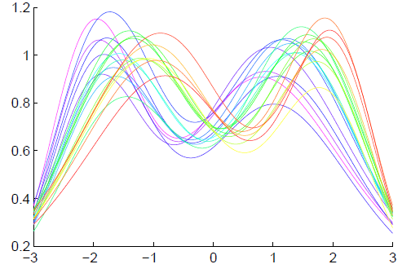
Context
Functional Data Analysis
Curves as Data Objects
Toy Example:
How Can We
Understand
Variation?

Slide 9
Context
Functional Data Analysis
Curves as Data Objects
Toy Example:
How Can We
Understand
Variation?

Slide 10
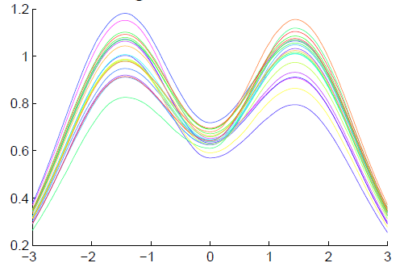
Functional Data Analysis
Insightful
Decomposition
Vertical Variation
Horiz’l
Var’n

Slide 11
Challenge
Fairly Large Literature
Many (Diverse) Past Attempts
Limited Success (in General)
Surprisingly Slippery
(even mathematical formulation)

Slide 12
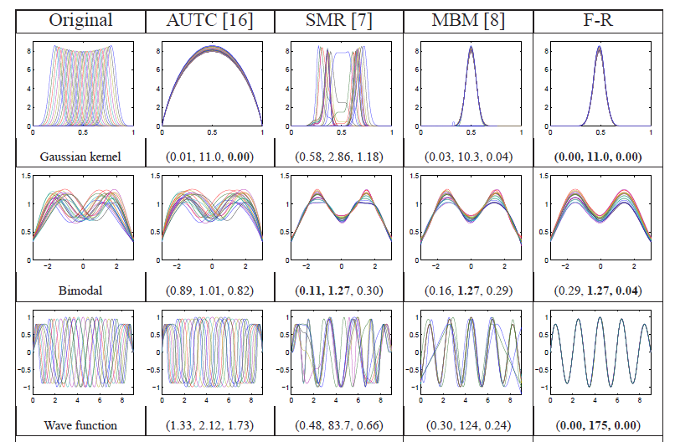
Challenge (Illustrated)
Thanks to Wei Wu

Slide 13
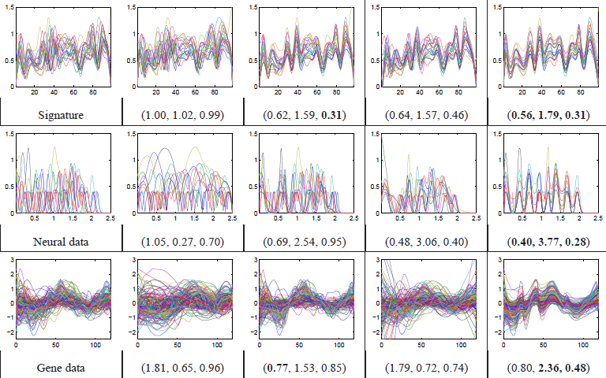
Challenge (Illustrated)
Thanks to Wei Wu

Slide 14
Functional Data Analysis
Appropriate
Mathematical
Framework?
Vertical Variation
Horiz’l
Var’n

Slide 15
Landmark Based Shape Analysis
Approach: Identify objects that are:
Translations
Rotations
Scalings
of each other
Mathematics: Equivalence Relation
Results in: Equivalence Classes
Which become the Data Objects

Slide 16
Curve Registration
What are the Data Objects?
Consider “Time Warpings”
$γ:\left[0,1\right] → [0,1]$ (smooth)
More Precisely: Diffeomorphisms

Slide 17
Time Warping Intuition
Elastically Stretch & Compress Axis
$γ\left(x\right)$

Slide 18
Curve Registration
Say curves $f_{1}(x)$ and $f_{2}(x)$ are equivalent,
$$f_{1}≈f_{2}$$
When $∃γ$ so that
$$f_{1}\left(γ\left(x\right)\right)=f_{1}∘γ\left(x\right)=f_{2}(x)$$

Slide 19
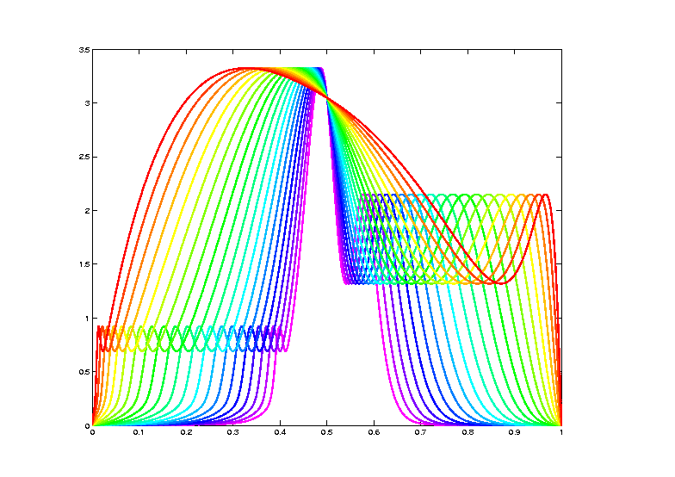
Data Objects I
Equivalence Classes of Curves
(Set of All
Warps of
Given Curve)
Notation: $\left[f\right]=\left\{f∘γ: γ∈Γ\right\}$
for a “representor” $f\left(x\right)$

Slide 20
Data Objects I
Equivalence Classes of Curves
(Set of All
Warps of
Given Curve)
Next Task:
Find Metric on Equivalence Classes

Slide 21
Metrics in Curve Space
Find Metric on Equivalence Classes
Start with Warp Invariance on Curves
& Extend

Slide 22
Metrics in Curve Space
Traditional Approach to Curve Registration:
Align curves, say $f_{1}$ and $f_{2}$
By finding optimal time warp, $γ$, so:
$$\inf_{γ}\left\|f_{1}−\left(f_{2}∘γ\right)\right\|$$
Vertical var’n: PCA after alignment
Horizontal var’n: PCA on $γ$s

Slide 23
Metrics in Curve Space
Problem:
Don’t have proper metric
Since:
$$d\left(f_{1},f_{2}\right)≠d\left(f_{2},f_{1}\right)$$
Because:
$$\inf_{γ}\left\|f_{1}−\left(f_{2}∘γ\right)\right\|≠\inf_{γ}\left\|f_{2}−\left(f_{1}∘γ\right)\right\|$$

Slide 24
Metrics in Curve Space
$$\inf_{γ}\left\|f_{1}−\left(f_{2}∘γ\right)\right\|≠\inf_{γ}\left\|f_{2}−\left(f_{1}∘γ\right)\right\|$$
Thanks to
Xiaosun Lu

Slide 25
Metrics in Curve Space
$$\inf_{γ}\left\|f_{1}−\left(f_{2}∘γ\right)\right\|≠\inf_{γ}\left\|f_{2}−\left(f_{1}∘γ\right)\right\|$$
Note:
Very
Different
L² norms
Thanks to
Xiaosun Lu

Slide 26
Metrics in Curve Space
Solution:
Look for Warp Invariant Metric $d$
Where:
$$d\left(f_{1},f_{2}\right)=d\left(f_{1}∘γ,f_{2}∘γ\right)$$

Slide 27
Metrics in Curve Space
$$d\left(f_{1},f_{2}\right)=d\left(f_{1}∘γ,f_{2}∘γ\right)$$
I.e. Have “Parallel”
Representatives
Of Equivalence
Classes

Slide 28
Metrics in Curve Space
Warping Invariant Metric $d$
Developed in context of:
Likelihood Geometry
Fisher – Rao Metric:
$$d_{FR}\left(f_{1},f_{2}\right)=d_{FR}\left(f_{1}∘γ,f_{2}∘γ\right)$$

Slide 29
Metrics in Curve Space
Fisher – Rao Metric:
Computation Based on
Square Root Velocity Function (SRVF)
$$q_{f}\left(t\right)=\frac{\dot{f}\left(t\right)}{\sqrt{\left|\dot{f}\left(t\right)\right|}}$$

Slide 30
Metrics in Curve Space
Square Root Velocity Function (SRVF)
$$q_{f}\left(t\right)=\frac{\dot{f}\left(t\right)}{\sqrt{\left|\dot{f}\left(t\right)\right|}}$$
$$f\left(t\right)=f\left(0\right)+\int_{0}^{t}{q_{f}\left(s\right)\left|q_{f}\left(s\right)\right|ds}$$

Slide 31
Metrics in Curve Space
Fisher – Rao Metric:
Computation Based on SRVF:
$$d_{FR}\left(f_{1},f_{2}\right)={\left\|q_{1}−q_{2}\right\|}_{2}$$
So work with SRVF

Slide 32
Metrics in Curve Space
Why
square
roots?

Slide 33
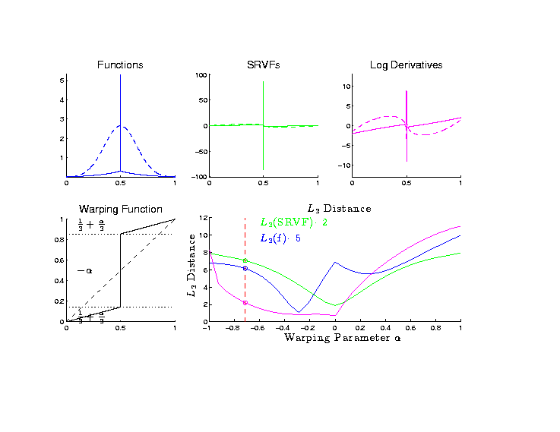
Metrics in Curve Space
Why
square
roots?
Thanks to
Xiaosun Lu

Slide 34
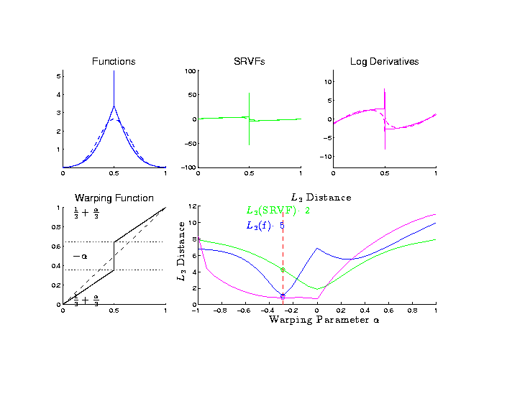
Metrics in Curve Space
Why
square
roots?

Slide 35
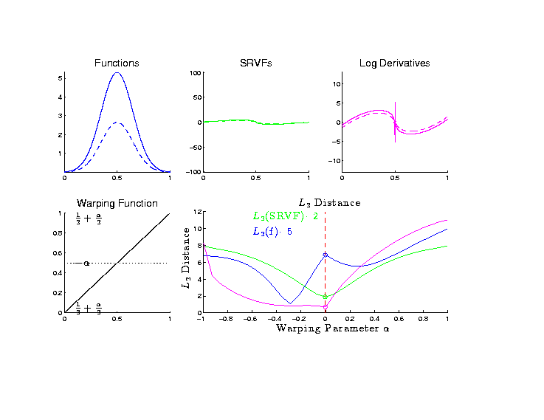
Metrics in Curve Space
Why
square
roots?

Slide 36
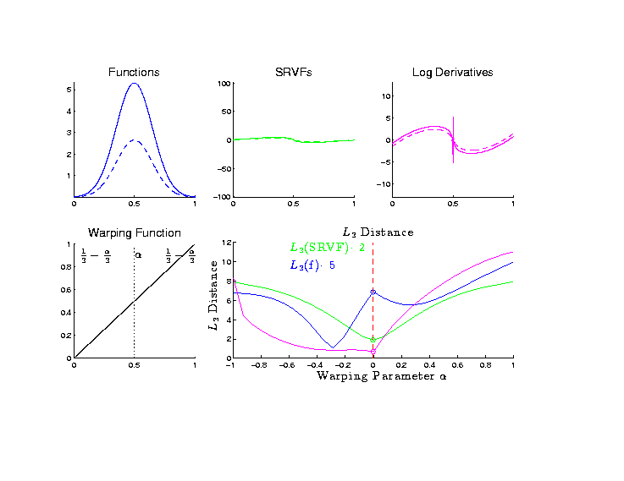
Metrics in Curve Space
Why
square
roots?

Slide 37
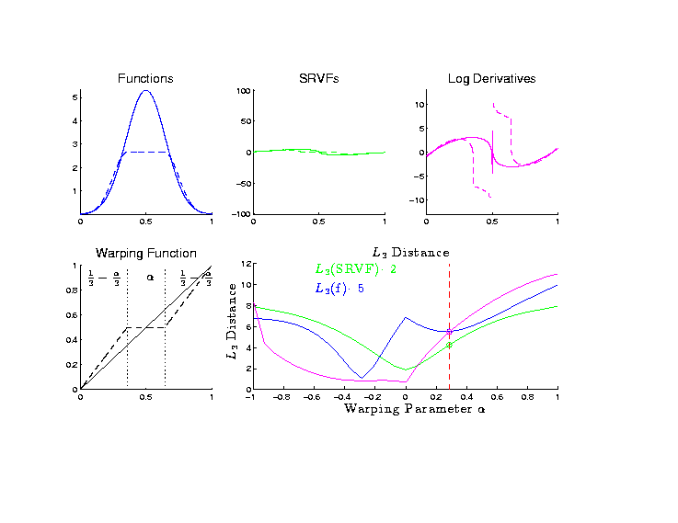
Metrics in Curve Space
Why
square
roots?

Slide 38
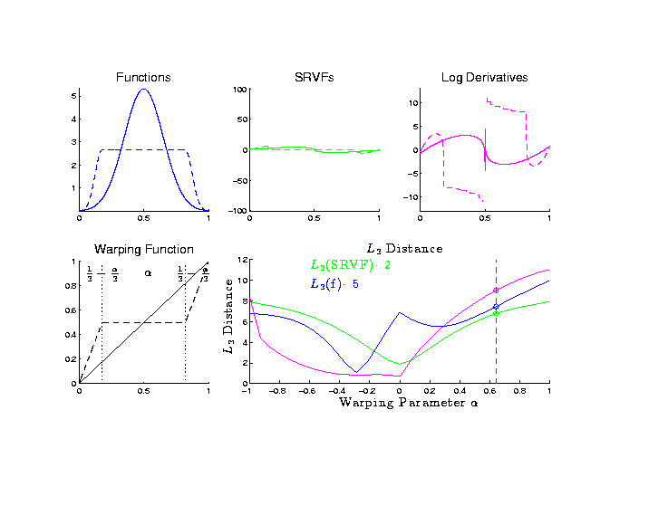
Metrics in Curve Space
Why
square
roots?

Slide 39
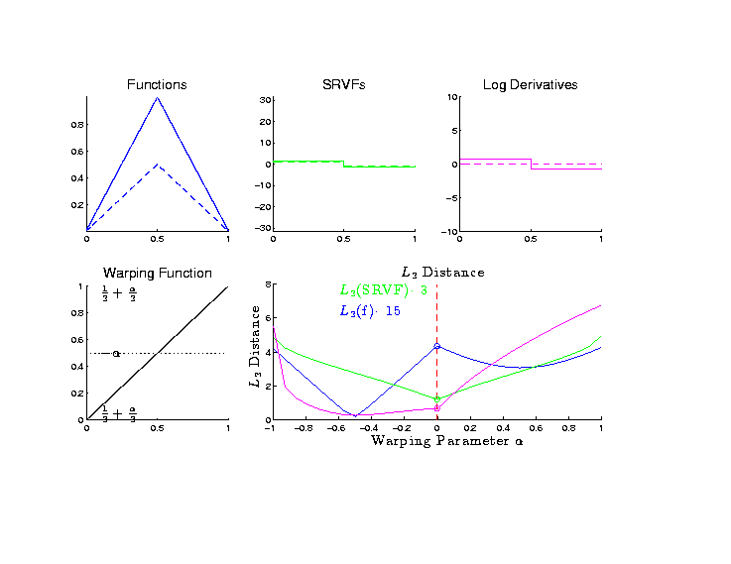
Metrics in Curve Space
Why
square
roots?

Slide 40
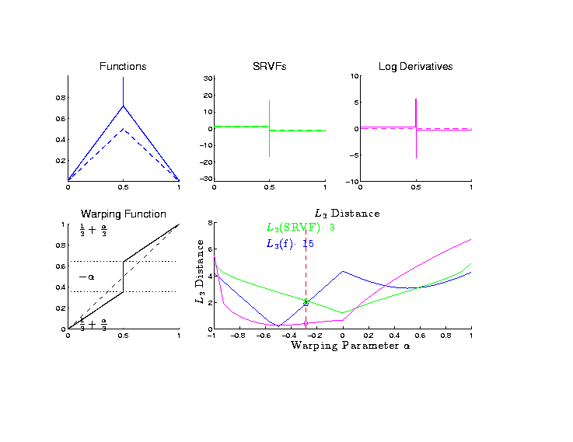
Metrics in Curve Space
Why
square
roots?

Slide 41
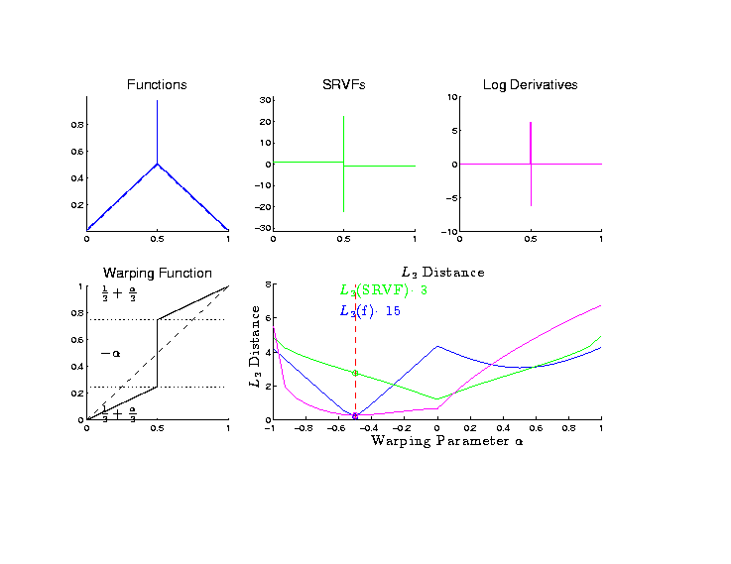
Metrics in Curve Space
Why
square
roots?

Slide 42
Metrics in Curve Space
Why
square
roots? Dislikes Pinching
Focusses Well On
Peaks of Unequal Height

Slide 43
Metrics in Curve Space
Note on SRVF representation:
$$d_{FR}\left(f_{1},f_{2}\right)={\left\|q_{1}−q_{2}\right\|}_{2}$$
Can show: Warp Invariance
$$d_{FR}\left(f_{1},f_{2}\right)=d_{FR}\left(f_{1}∘γ,f_{2}∘γ\right)$$
Follows from Jacobean calculation

Slide 44
Metrics in Curve Quotient Space
Above was Invariance for Individual Curves
Now extend to:
Equivalence Classes of Curves
I.e. Orbits as Data Objects
I.e. Quotient Space

Slide 45
Metrics in Curve Quotient Space
Define Metric on Equivalence Classes:
For $\left[f_{1}\right]$ & $\left[f_{2}\right]$, i.e. $\left[q_{1}\right]$ & $\left[q_{2}\right]$
$$d\left(\left[f_{1}\right],\left[f_{2}\right]\right)=\inf_{γ∈Γ}\left\|q_{1}−q_{2}∘γ\right\|$$
Independent of Choice of $f_{1}$ & $f_{2}$
By Warping Invariance

Slide 46
Mean in Curve Quotient Space
Benefit of a Metric:
Allows Definition of a “Mean”
Fréchet Mean
Geodesic Mean
Barycenter
Karcher Mean

Slide 47
Mean in Curve Quotient Space
Given Equivalence Class Data Objects:
$$\left[f_{1}\right], \left[f_{2}\right], ⋯,\left[f_{n}\right]$$
The Karcher Mean is:
$$\left[μ\right]={argmin}_{\left[q\right]}\sum_{i=1}^{n}{{d\left(\left[q\right],\left[q_{i}\right]\right)}^{2}}$$

Slide 48
Mean in Curve Quotient Space
The Karcher Mean is:
$$\left[μ\right]={argmin}_{\left[q\right]}\sum_{i=1}^{n}{{d\left(\left[q\right],\left[q_{i}\right]\right)}^{2}}$$
Intuition: Can Show, for Euclidean Data
Minimizer = Conventional $\overline{X}$

Slide 49
Mean in Curve Quotient Space
Next Define “Most Representative”
Choice of $μ_{n}$
As Representer of$\left[μ\right]$

Slide 50
Mean in Curve Quotient Space
“Most Representative” $μ_{n}$ in$\left[μ\right]$
Given a candidate $μ$
Consider warps to each $q_{i}$
Choose $μ_{n}$ to make
Karcher mean of warps = Identity
(under Fisher Rao metric)

Slide 51
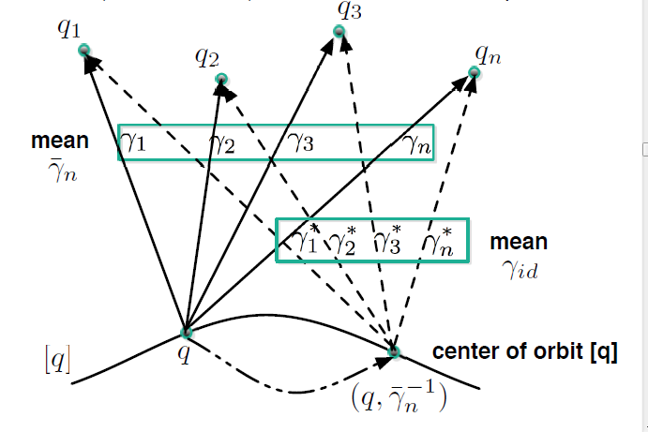
Mean in Curve Quotient Space
“Most Representative” $μ_{n}$ in$\left[μ\right]$
Thanks to Anuj Srivastava

Slide 52
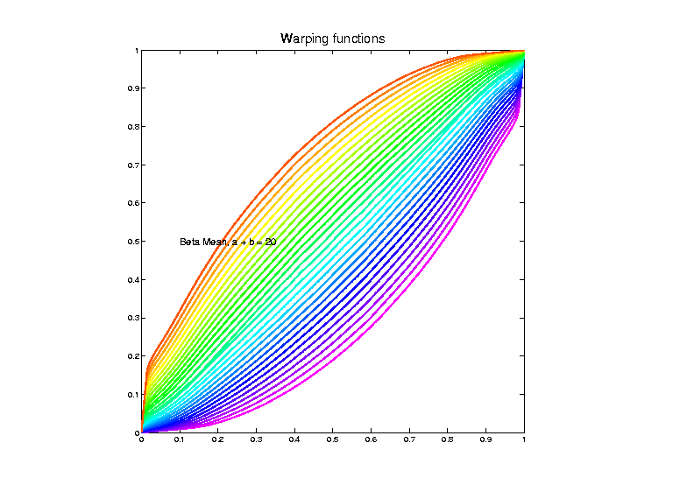
Toy Example – (Details Later)
Estimated
Warps
(Note:
Represented
With Karcher
Mean At
Identity)

Slide 53
Mean in Curve Quotient Space
“Most Representative” $μ_{n}$ in$\left[μ\right]$
Terminology: The “Template Mean”

Slide 54
More Data Objects
Final Curve Warps:
Warp Each Data Curve, $f_{1}, ⋯,f_{n}$
To Template Mean, $μ_{n}$
Denote Warp Functions $γ_{1}, ⋯,γ_{n}$
Gives (Roughly Speaking):
Vertical Components $f_{1}∘γ_{1}, ⋯,f_{n}∘γ_{n}$
(Aligned Curves)
Horizontal Components $γ_{1}, ⋯,γ_{n}$

Slide 55
More Data Objects
Data Objects II
Final Curve Warps:
Warp Each Data Curve, $f_{1}, ⋯,f_{n}$
To Template Mean, $μ_{n}$
Denote Warp Functions $γ_{1}, ⋯,γ_{n}$
Gives (Roughly Speaking):
Vertical Components $f_{1}∘γ_{1}, ⋯,f_{n}∘γ_{n}$
(Aligned Curves)
Horizontal Components $γ_{1}, ⋯,γ_{n}$

Slide 56
More Data Objects
Data Objects II
Final Curve Warps:
Warp Each Data Curve, $f_{1}, ⋯,f_{n}$
To Template Mean, $μ_{n}$
Denote Warp Functions $γ_{1}, ⋯,γ_{n}$
Gives (Roughly Speaking):
Vertical Components $f_{1}∘γ_{1}, ⋯,f_{n}∘γ_{n}$
(Aligned Curves)
Horizontal Components $γ_{1}, ⋯,γ_{n}$
~ Kendall’s Shapes

Slide 57
More Data Objects
Data Objects III
Final Curve Warps:
Warp Each Data Curve, $f_{1}, ⋯,f_{n}$
To Template Mean, $μ_{n}$
Denote Warp Functions $γ_{1}, ⋯,γ_{n}$
Gives (Roughly Speaking):
Vertical Components $f_{1}∘γ_{1}, ⋯,f_{n}∘γ_{n}$
(Aligned Curves)
Horizontal Components $γ_{1}, ⋯,γ_{n}$

Slide 58
More Data Objects
Data Objects III
Final Curve Warps:
Warp Each Data Curve, $f_{1}, ⋯,f_{n}$
To Template Mean, $μ_{n}$
Denote Warp Functions $γ_{1}, ⋯,γ_{n}$
Gives (Roughly Speaking):
Vertical Components $f_{1}∘γ_{1}, ⋯,f_{n}∘γ_{n}$
(Aligned Curves)
Horizontal Components $γ_{1}, ⋯,γ_{n}$
~ Chang’s Transfo’s

Slide 59
Computation
Several Variations of
Dynamic Programming
Done by Eric Klassen, Wei Wu

Slide 60
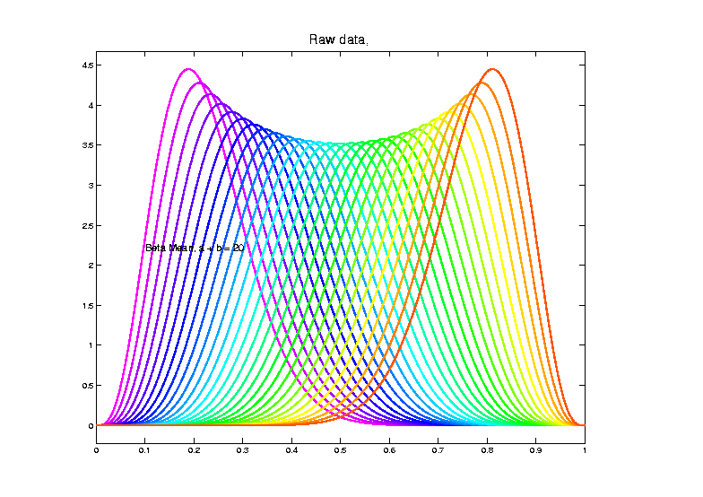
Toy Example
Raw
Data

Slide 61
Toy Example
Raw
Data
Both
Horizontal
And
Vertical
Variation

Slide 62
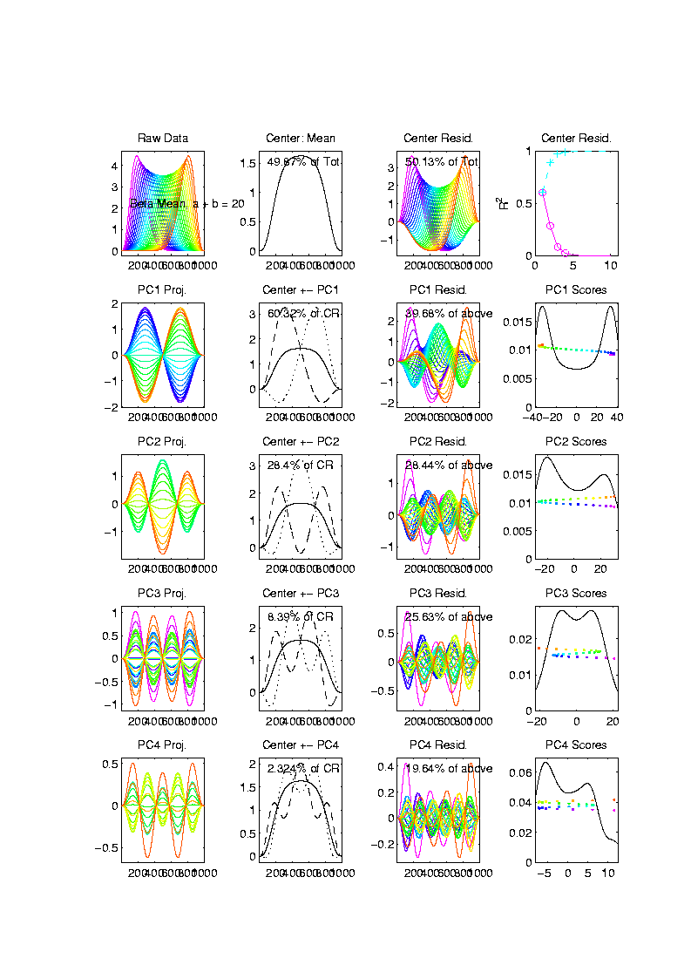
Toy Example
Conventional
PCA
Projections

Slide 63
Toy Example
Conventional
PCA
Projections
Power
Spread
Across
Spectrum

Slide 64
Toy Example
Conventional
PCA
Projections
Power
Spread
Across
Spectrum

Slide 65
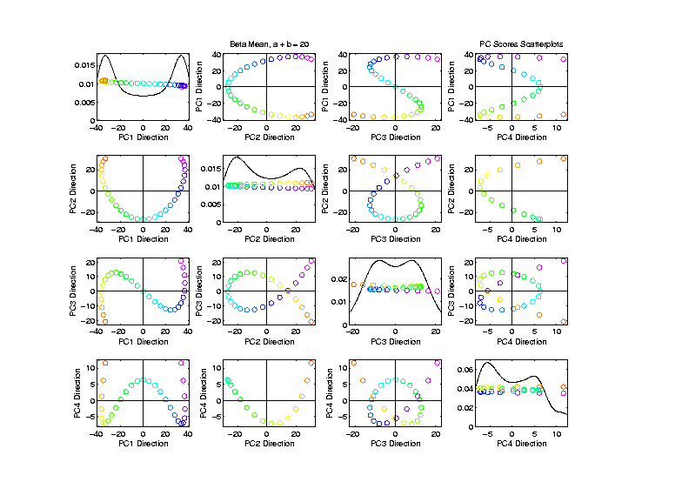
Toy Example
Conventional
PCA
Scores

Slide 66
Toy Example
Conventional
PCA
Scores
Views of
1-d Curve
Bending
Through
4 Dim’ns’

Slide 67
Toy Example
Conventional
PCA
Scores
Patterns
Are
“Harmonics”
In Scores

Slide 68
Toy Example
Scores Plot
Shows Data
Are “1”
Dimensional
So Need
Improved
PCA Decomp.

Slide 69
Visualization
Vertical Variation:
PCA on Aligned Curves, $f_{1}∘γ_{1}, ⋯,f_{n}∘γ_{n}$
Projected Curves

Slide 70
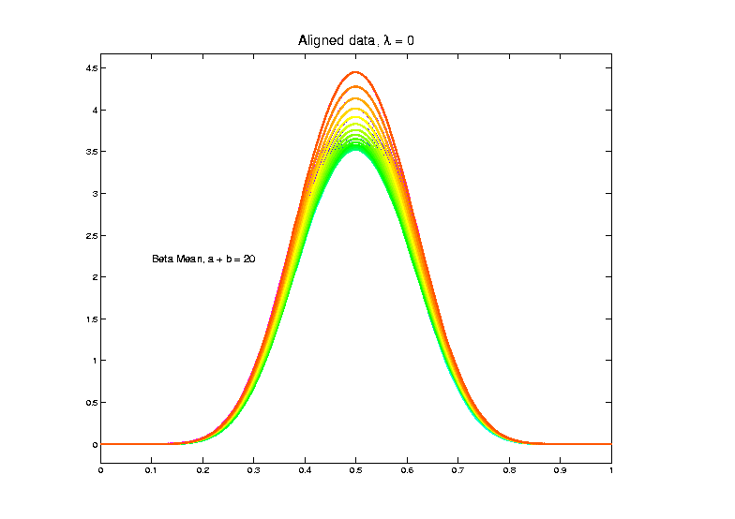
Toy Example
Aligned
Curves
(Clear
1-d
Vertical
Var’n)

Slide 71
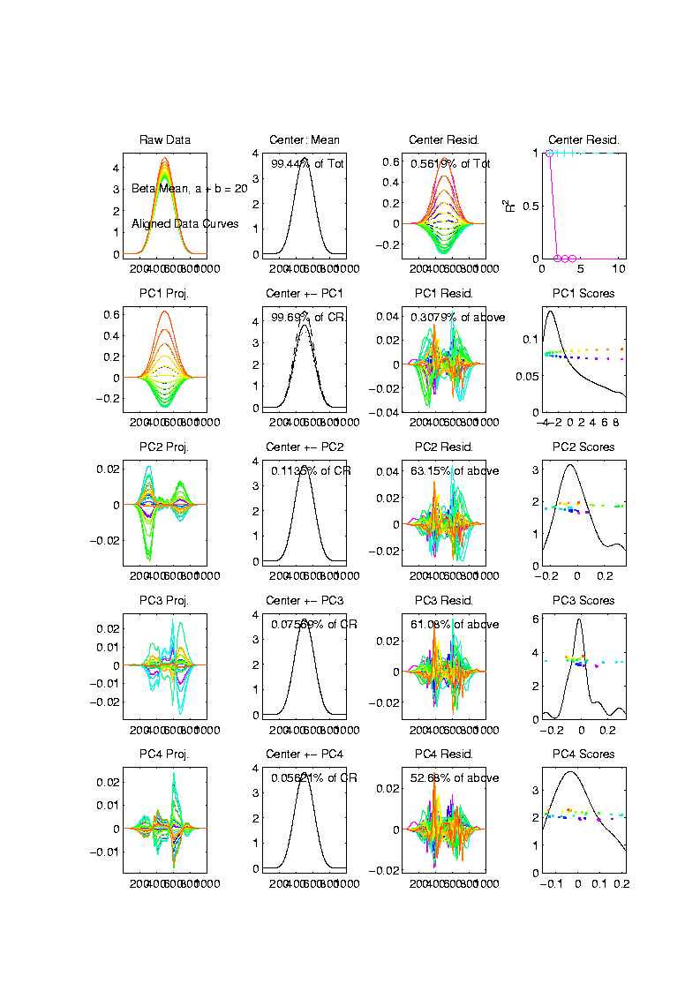
Toy Example
Aligned
Curve
PCA
Projections
All Var’n
In 1st
Component

Slide 72
Visualization
Horizontal Variation:
PCA on Warps, $γ_{1}, ⋯,γ_{n}$
Projected Curves

Slide 73
Toy Example
Estimated
Warps

Slide 74
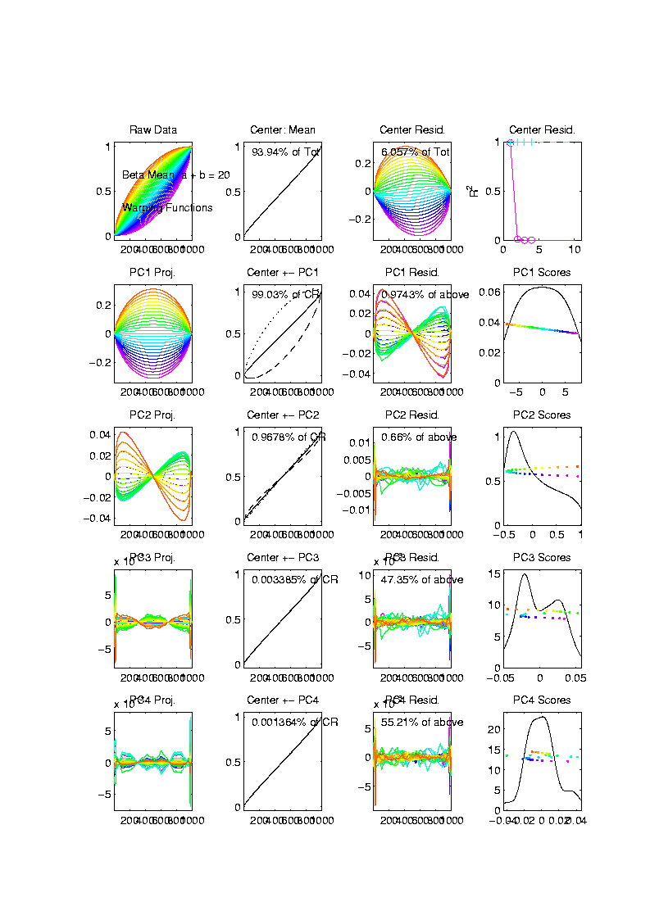
Toy Example
Warps,
PC
Projections

Slide 75
Toy Example
Warps,
PC
Projections
Mostly
1st PC

Slide 76
Toy Example
Warps,
PC
Projections
Mostly
1st PC,
But 2nd
Helps Some

Slide 77
Toy Example
Warps,
PC
Projections
Rest is
Not
Important

Slide 78
Toy Example
Horizontal Var’n Visualization Challenge:
(Complicated) Warps Hard to Interpret
Approach:
Apply Warps to Template Mean
(PCA components)

Slide 79
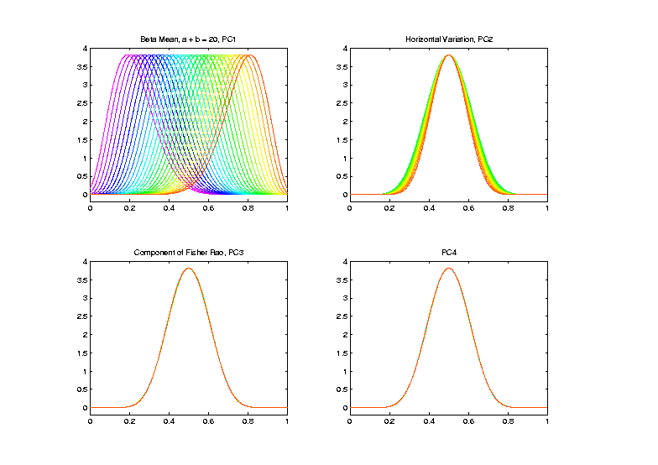
Toy Example
Warp
Compon’ts
(+ Mean)
Applied to
Template
Mean

Slide 80
Refined Calculations
Current Development:
Better Exploit Manifold Data Space:
$$q_{i}∈S^{d}, γ_{i}∈S^{d}$$
Principal Nested Spheres

Slide 81
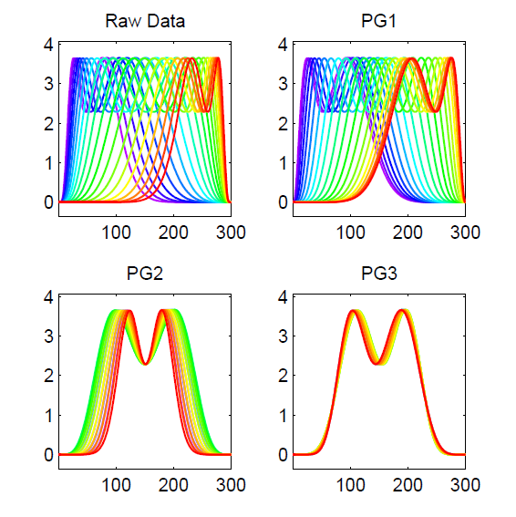
PNS on SRVF Sphere
Toy Example
Tangent Space PCA
(on Horiz. Var’n)
Thanks to Xiaosun Lu

Slide 82
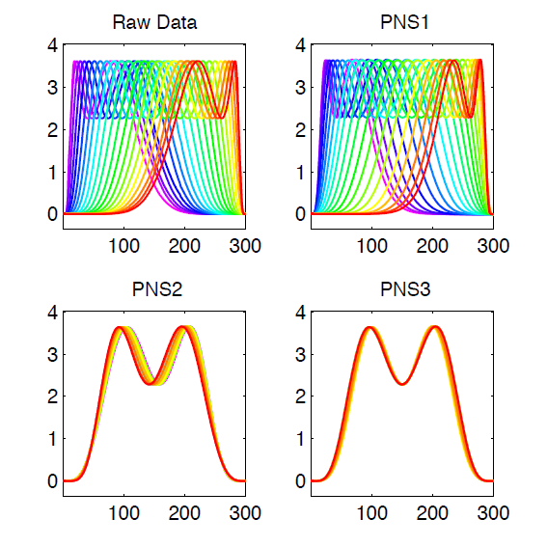
PNS on SRVF Sphere
Toy Example
PNS Projections
(Fewer Modes)

Slide 83
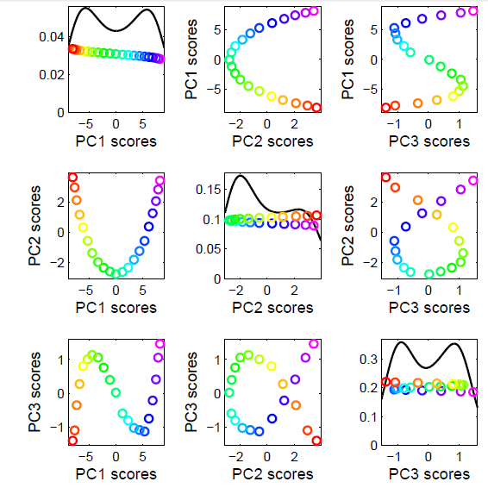
PNS on SRVF Sphere
Toy Example
Tangent Space PCA
Note: 3 Comp’s
Needed for This

Slide 84
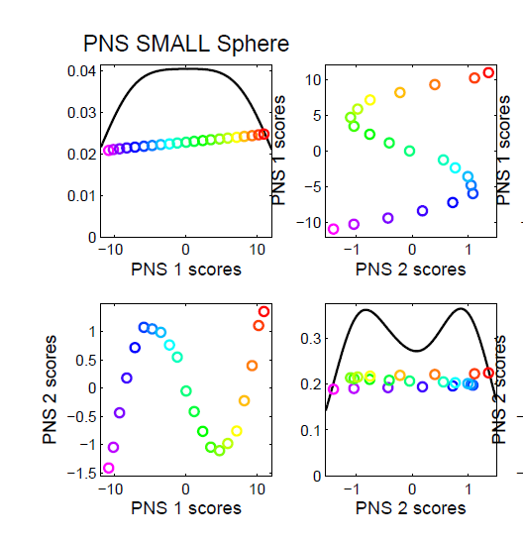
PNS on SRVF Sphere
Toy Example
PNS Projections
Only 2 for This

Slide 85
TIC testbed
Serious Data Challenge:
TIC (Total Ion Count) Chromatograms
Modern type of “chemical spectra”
Thanks to Peter
Hoffmann

Slide 86
TIC testbed
Raw Data: 15 TIC Curves (5 Colors)

Slide 87
TIC testbed
Special Feature: Answer Key of Known Peaks
Found by
Major
Time &
Labor
Investment

Slide 88
TIC testbed
Special Feature: Answer Key of Known Peaks
Goal:
Find
Warps
To Align
These

Slide 89
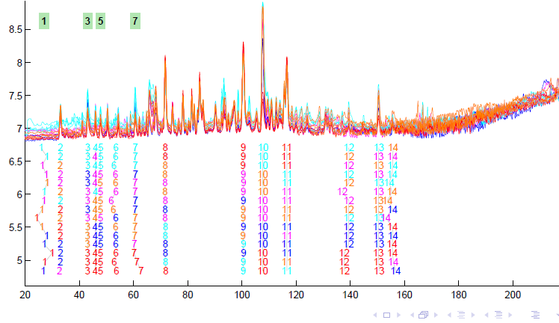
TIC testbed
Fisher – Rao Alignment

Slide 90
TIC testbed
Fisher – Rao Alignment
Spike-In
Peaks

Slide 91
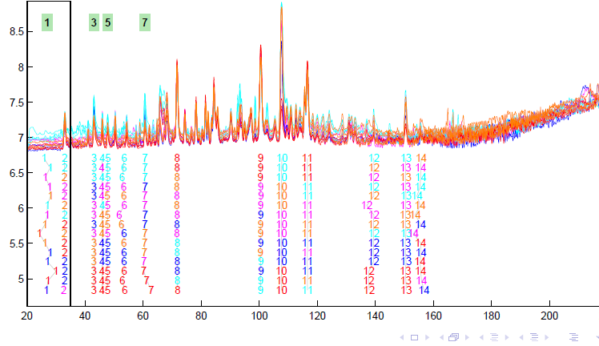
TIC testbed
Next Zoom in on This Region

Slide 92
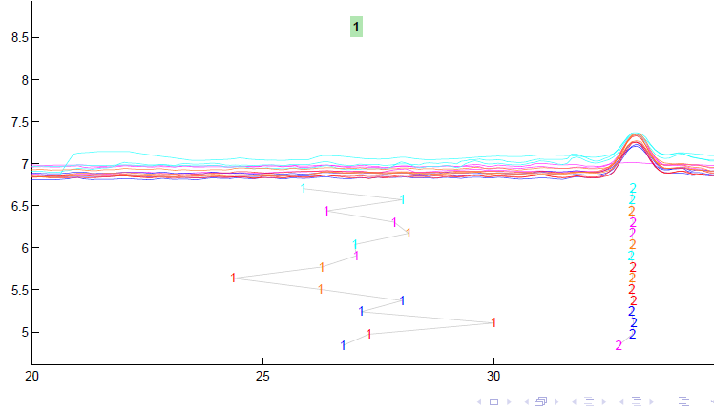
TIC testbed
Zoomed Fisher – Rao Alignment

Slide 93
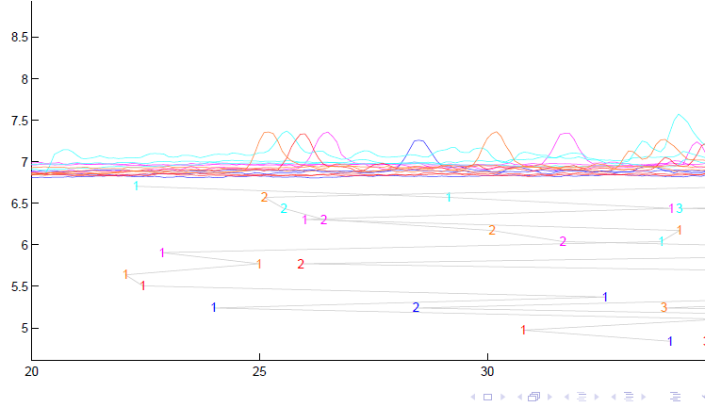
TIC testbed
Before Alignment

Slide 94
TIC testbed
Next Zoom in on This Region

Slide 95
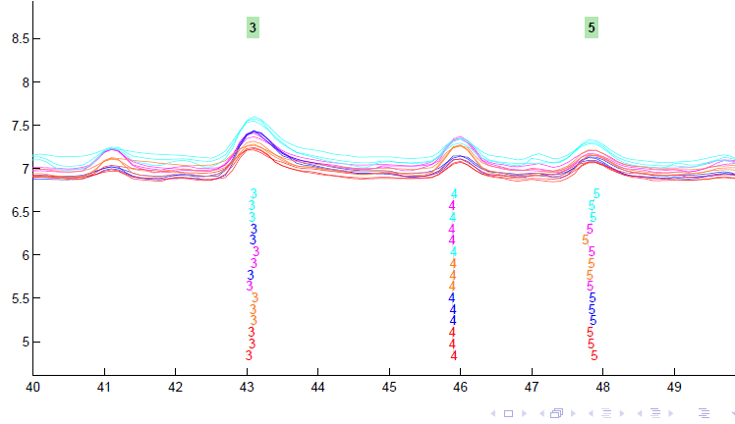
TIC testbed
Zoomed Fisher – Rao Alignment

Slide 96
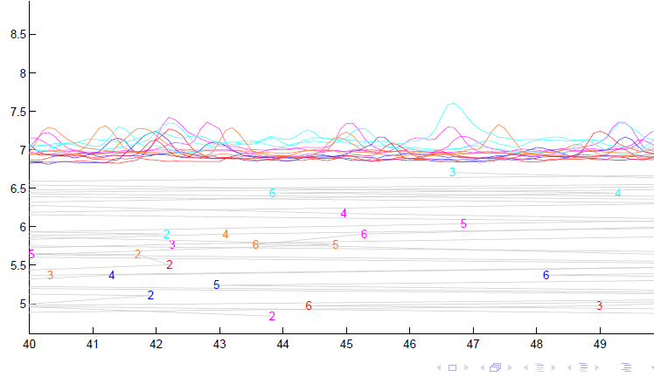
TIC testbed
Before Alignment

Slide 97
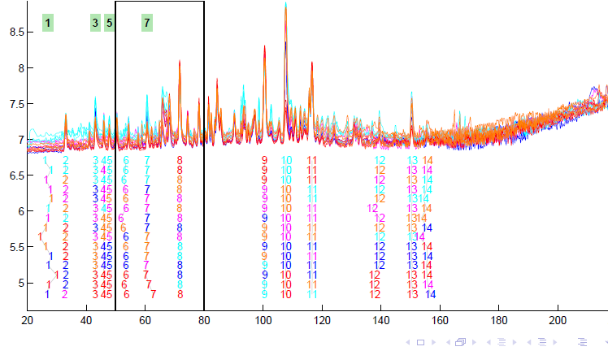
TIC testbed
Next Zoom in on This Region

Slide 98
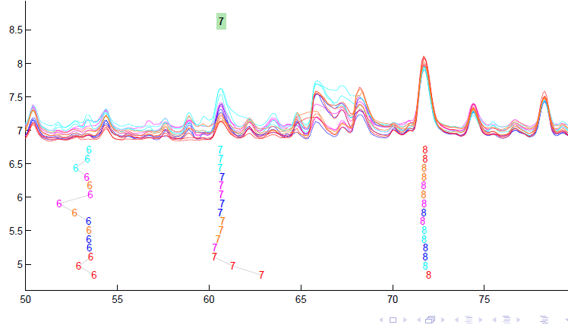
TIC testbed
Zoomed Fisher – Rao Alignment

Slide 99
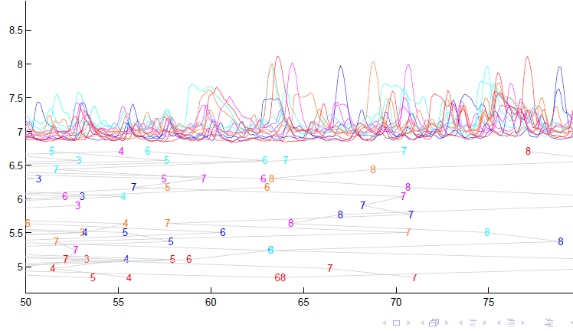
TIC testbed
Before Fisher-Rao Alignment

Slide 100
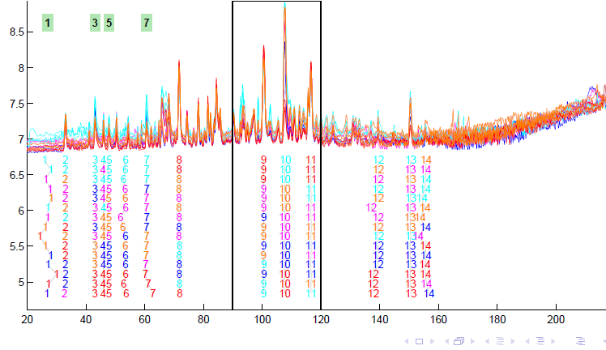
TIC testbed
Next Zoom in on This Region

Slide 101
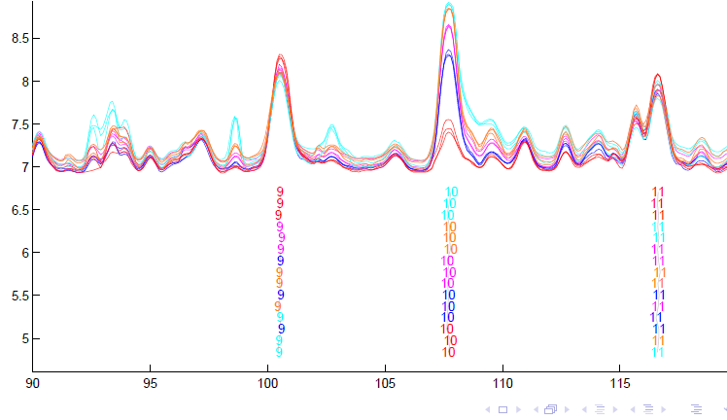
TIC testbed
Zoomed Fisher – Rao Alignment

Slide 102
TIC testbed
Zoomed Fisher – Rao Alignment
Note:
Very
Challenging

Slide 103
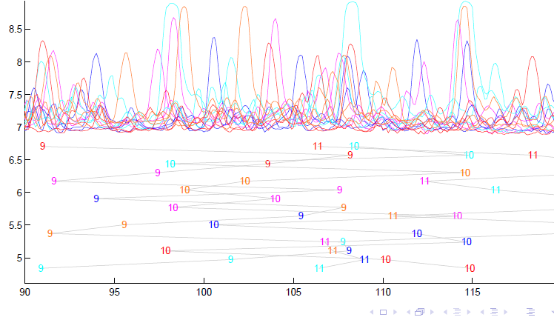
TIC testbed
Before Alignment

Slide 104
TIC testbed
Next Zoom in on This Region

Slide 105
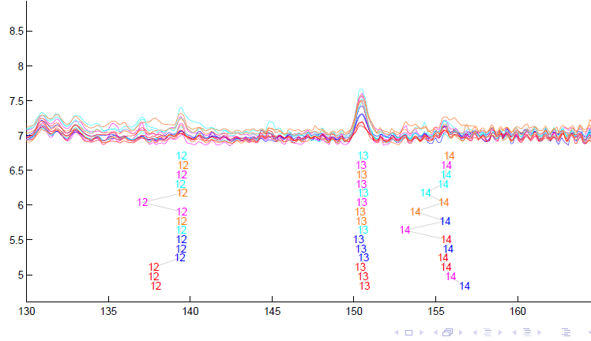
TIC testbed
Zoomed Fisher – Rao Alignment

Slide 106
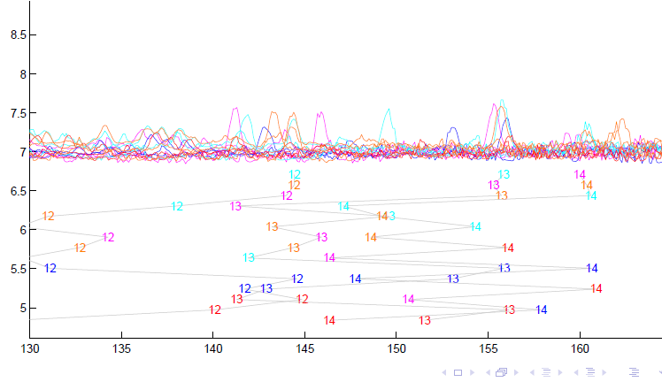
TIC testbed
Before Alignment

Slide 107
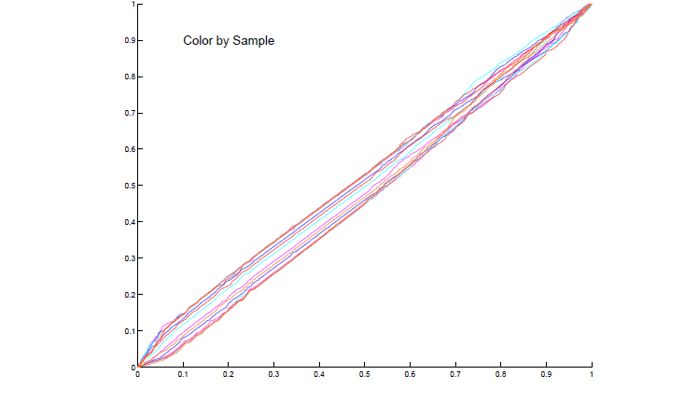
TIC testbed
Warping Functions

Slide 108
References for Much More
Big Picture Survey:
Marron, Ramsay, Sangalli & Srivastava (2014)
TIC Proteomics Example:
Koch, Hoffman & Marron (2014)

Slide 109
Take Away Message
Curve Registration is Slippery
Thus, Careful Mathematics is Useful
Fisher-Rao Approach:
Gets the Math Right
Intuitively Sensible
Computable
Generalizable
Worth the Complication

