Slide 1
Principal Nested Spheres Analysis
Main Goal:
Extend Principal Arc Analysis (S² to S^{k})
Jung, Dryden & Marron (2012)
Impact on Segmentation:
PGA Segmentation: used ~20 comp’s
PNS Segmentation: only need ~13
Resulted in visually better fits to data

Slide 2
Principal Nested Spheres Analysis
Main Goal:
Extend Principal Arc Analysis (S² to S^{k})
Jung, Dryden & Marron (2012)
Important Landmark: This Motivated
Backwards PCA

Slide 3
Principal Nested Spheres Analysis
Key Idea:
Replace usual forwards view of PCA
With a backwards approach to PCA

Slide 4
Terminology
Multiple linear regression:

Slide 5
Terminology
Multiple linear regression:
Stepwise approaches:
Forwards: Start small, iteratively add variables to model

Slide 6
Terminology
Multiple linear regression:
Stepwise approaches:
Forwards: Start small, iteratively add variables to model
Backwards: Start with all, iteratively remove variables from model

Slide 7
Illust’n of PCA View: Recall Raw Data
Notes:
EgView1p1RawData.ps

Slide 8
Illust’n of PCA View: PC1 Projections
Notes:
EgView1p51proj3dPC1.ps

Slide 9
Illust’n of PCA View: PC2 Projections
Notes:
EgView1p52proj3dPC2.ps

Slide 10
Illust’n of PCA View: Projections on PC1,2 plane
Notes:
EgView1p54proj3dPC12.ps

Slide 11
Principal Nested Spheres Analysis
Replace usual forwards view of PCA
Data → PC1 (1-d approx)

Slide 12
Principal Nested Spheres Analysis
Replace usual forwards view of PCA
Data → PC1 (1-d approx)
→ PC2 (1-d approx of Data-PC1)
→ PC1 U PC2 (2-d approx)

Slide 13
Principal Nested Spheres Analysis
Replace usual forwards view of PCA
Data → PC1 (1-d approx)
→ PC2 (1-d approx of Data-PC1)
→ PC1 U PC2 (2-d approx)
→ PC1 U … U PCr
(r-d approx)

Slide 14
Principal Nested Spheres Analysis
With a backwards approach to PCA
Data → PC1 U … U PCr (r-d approx)

Slide 15
Principal Nested Spheres Analysis
With a backwards approach to PCA
Data → PC1 U … U PCr (r-d approx)
→ PC1 U … U PC(r-1)

Slide 16
Principal Nested Spheres Analysis
With a backwards approach to PCA
Data → PC1 U … U PCr (r-d approx)
→ PC1 U … U PC(r-1)
→ PC1 U PC2 (2-d approx)

Slide 17
Principal Nested Spheres Analysis
With a backwards approach to PCA
Data → PC1 U … U PCr (r-d approx)
→ PC1 U … U PC(r-1)
→ PC1 U PC2 (2-d approx)
→ PC1 (1-d approx)

Slide 18
Principal Component Analysis
Euclidean Settings:
Forwards PCA = Backwards PCA
(Pythagorean Theorem,
ANOVA Decomposition)
So Not Interesting
But Very Different in Non-Euclidean Settings
(Backwards is Better !?!)

Slide 19
Principal Component Analysis
Important Property of PCA:
Nested Series of Approximations
$$\left\{{PC}_{1}\right\}⊆\left\{{PC}_{1}{,PC}_{2}\right\}⊆\left\{{PC}_{1}{,PC}_{2},{PC}_{3}\right\}⊆⋯$$
(Often taken for granted)
(Desirable in Non-Euclidean Settings)

Slide 20
Non-Euclidean PCA
Desirability of Nesting:
Multi-Scale Analysis Makes Sense
Scores Visualization Makes Sense

Slide 21
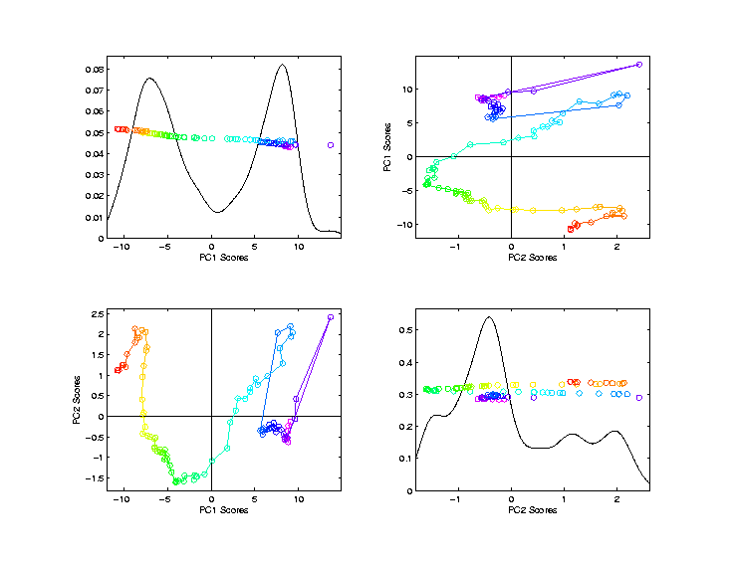
Scores Visualization in PCA

Slide 22
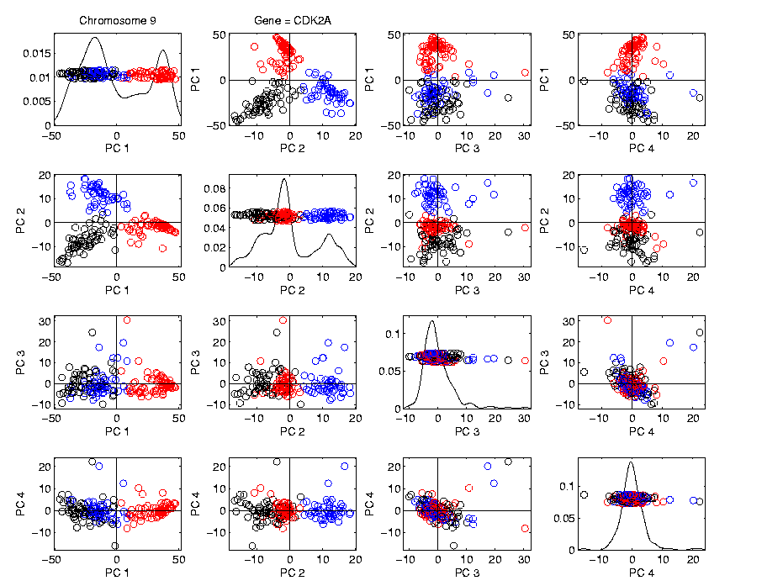
Scores Visualization in PCA

Slide 23
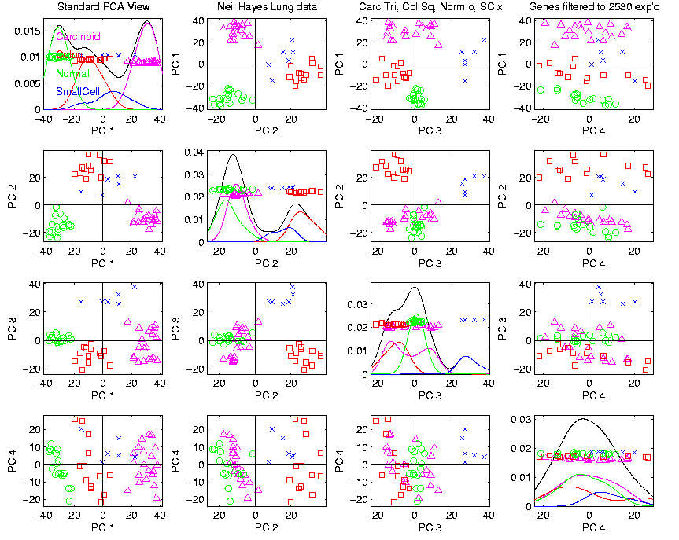
Scores Visualization in PCA

Slide 24
An Interesting Question
How generally applicable is
Backwards approach to PCA?

Slide 25
An Interesting Question
How generally applicable is
Backwards approach to PCA?
Where is this already being done???

Slide 26
An Interesting Question
How generally applicable is
Backwards approach to PCA?
Discussion:
Jung et al (2010)
Pizer et al (2012)

Slide 27
An Interesting Question
How generally applicable is
Backwards approach to PCA?
Anywhere this is already being done???

Slide 28
An Interesting Question
How generally applicable is
Backwards approach to PCA?
An Application:
Nonnegative Matrix Factorization
= PCA in Positive Orthant

Slide 29
An Interesting Question
How generally applicable is
Backwards approach to PCA?
An Application:
Nonnegative Matrix Factorization
= PCA in Positive Orthant
Think $X ≈LS$
With ≥ 0 Constraints (on both $L$ & $S$)

Slide 30
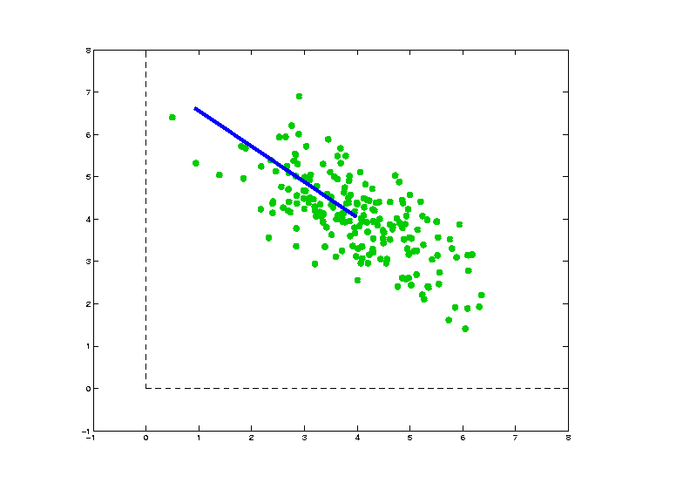
Nonnegative Matrix Factorization
Isn’t This
Just PCA?
In the
Nonnegative
Orthant?
No, Most PC Directions Leave Orthant

Slide 31
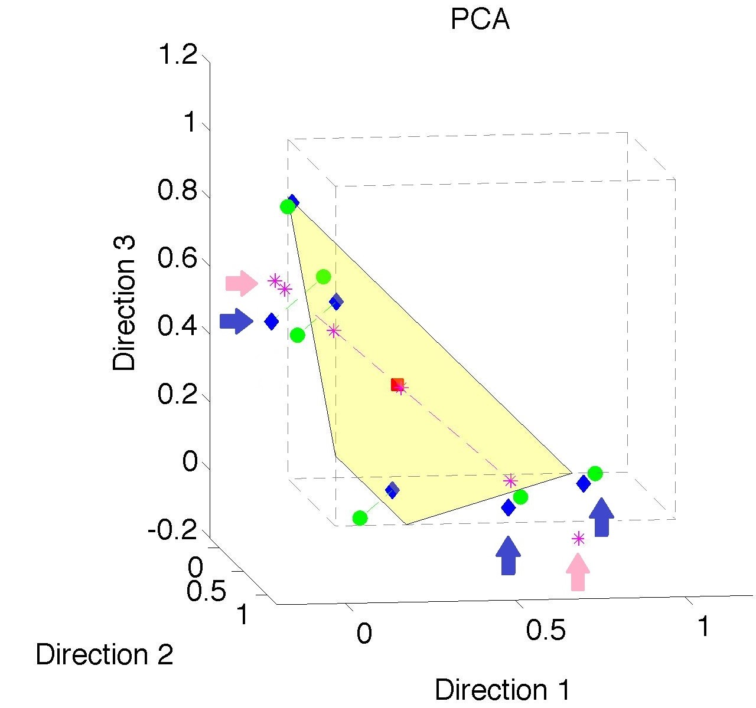
Nonnegative Matrix Factorization
Isn’t This
Just PCA?
Data
(Near
Orthant
Faces)

Slide 32
Nonnegative Matrix Factorization
Isn’t This
Just PCA?
Data
Mean
(Centered
Analysis)

Slide 33
Nonnegative Matrix Factorization
Isn’t This
Just PCA?
Data
Mean
PC1 Projections
Leave Orthant!

Slide 34
Nonnegative Matrix Factorization
Isn’t This
Just PCA?
Data
Mean
PC1 Projections
PC1 $⋃$ 2 Proj’ns
Leave Orthant!

Slide 35
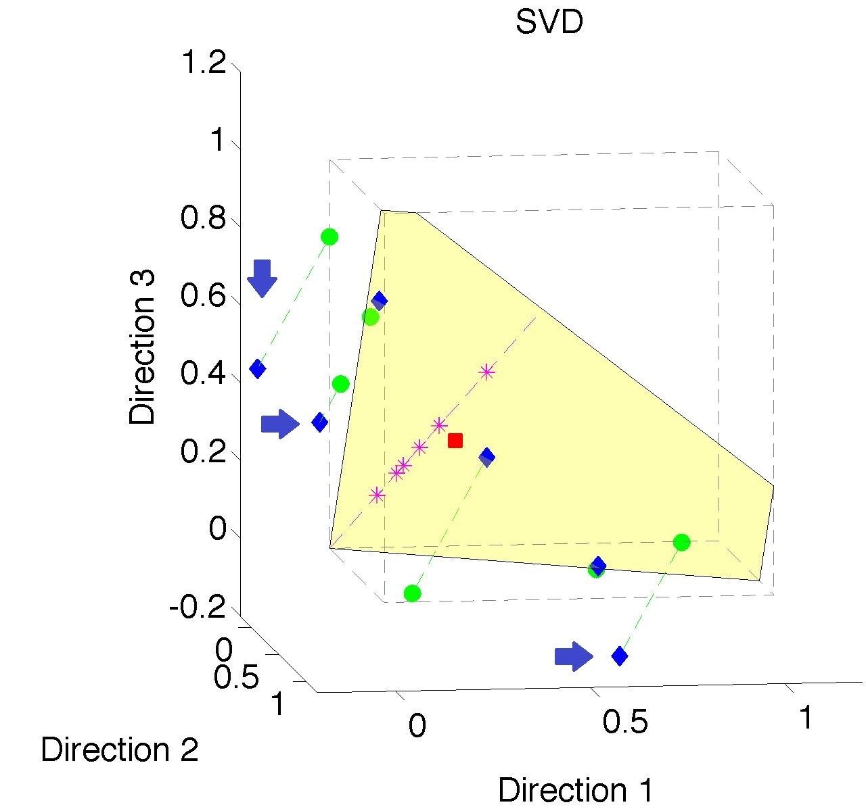
Nonnegative Matrix Factorization
Note:
Problem not
Fixed by
SVD
(“Uncentered
PCA”)
Orthant Leaving Gets Worse

Slide 36
Nonnegative Matrix Factorization
Standard Approach:
Lee et al (1999):
Formulate & Solve Optimization

Slide 37
Nonnegative Matrix Factorization
Standard Approach:
Lee et al (1999):
Formulate & Solve Optimization
Major Challenge:
Not Nested, ($k=3 ≉ k=4$)

Slide 38
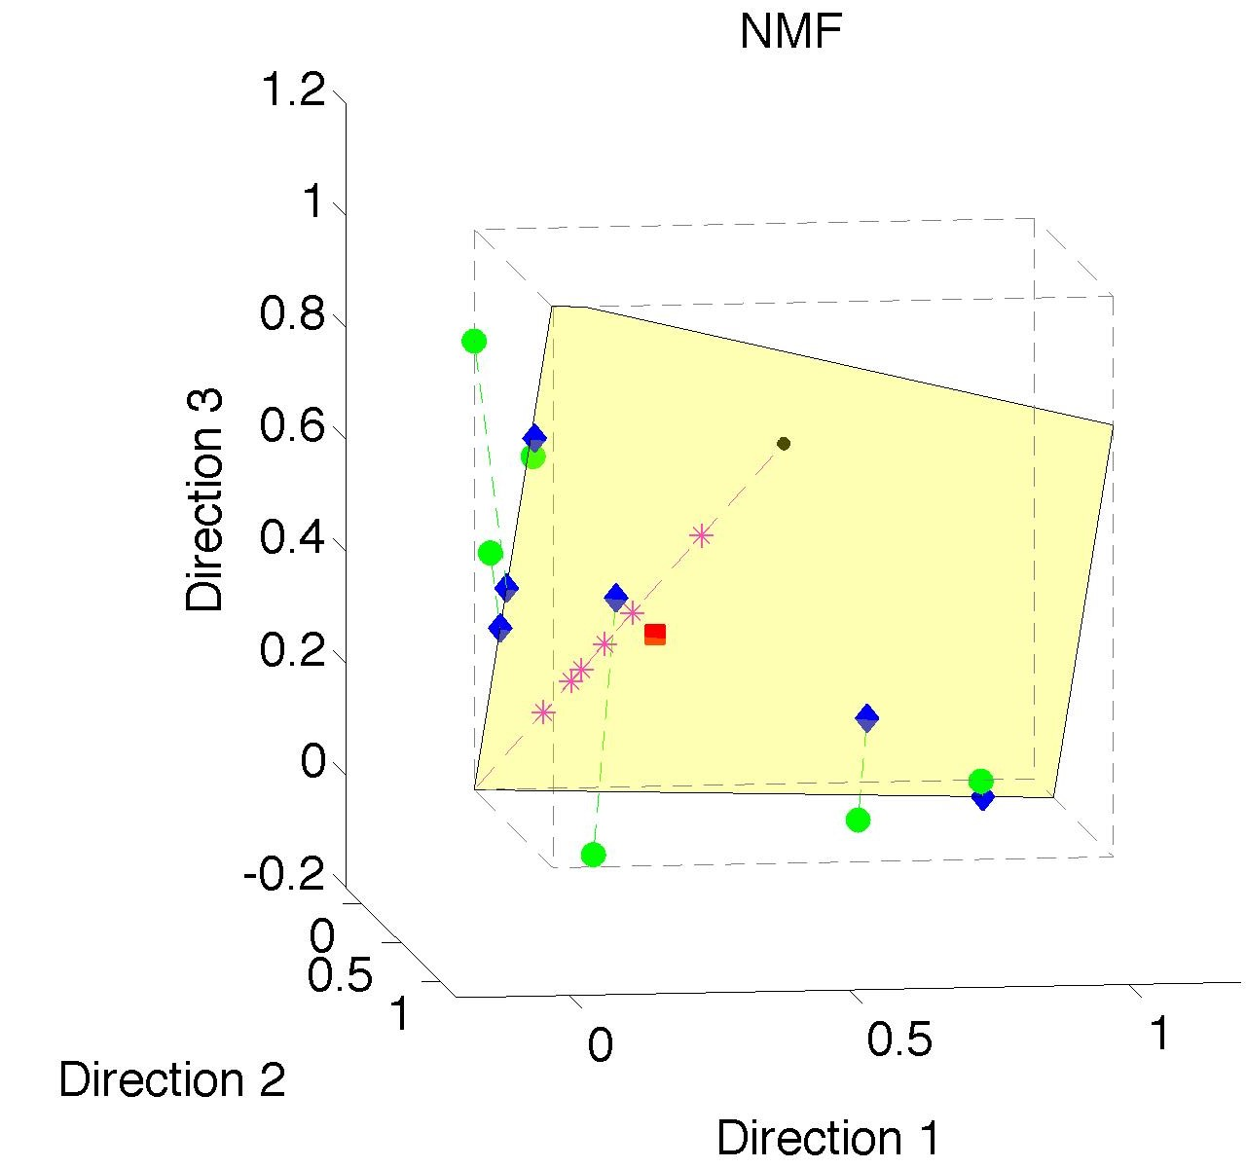
Nonnegative Matrix Factorization
Standard NMF
(Projections
All Inside
Orthant)

Slide 39
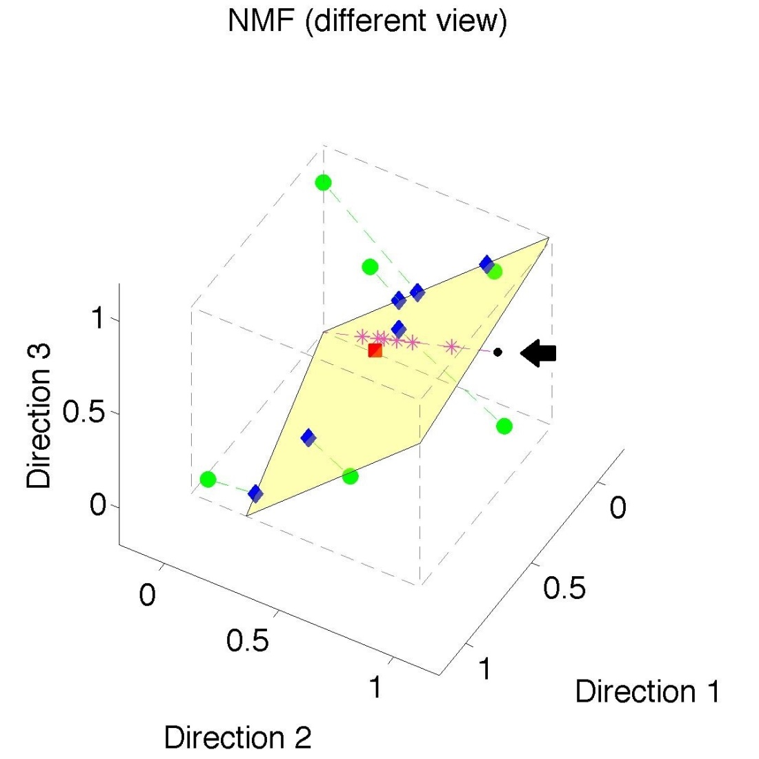
Nonnegative Matrix Factorization
Standard NMF
But Note
Not Nested
No “Multi-scale”
Analysis
Possible (Scores Plot?!?)

Slide 40
Nonnegative Matrix Factorization
Improved Version:
Use Backwards PCA Idea
“Nonnegative Nested Cone Analysis”
Collaborator:
Lingsong Zhang (Purdue)
Zhang, Marron, Lu (2013)

Slide 41
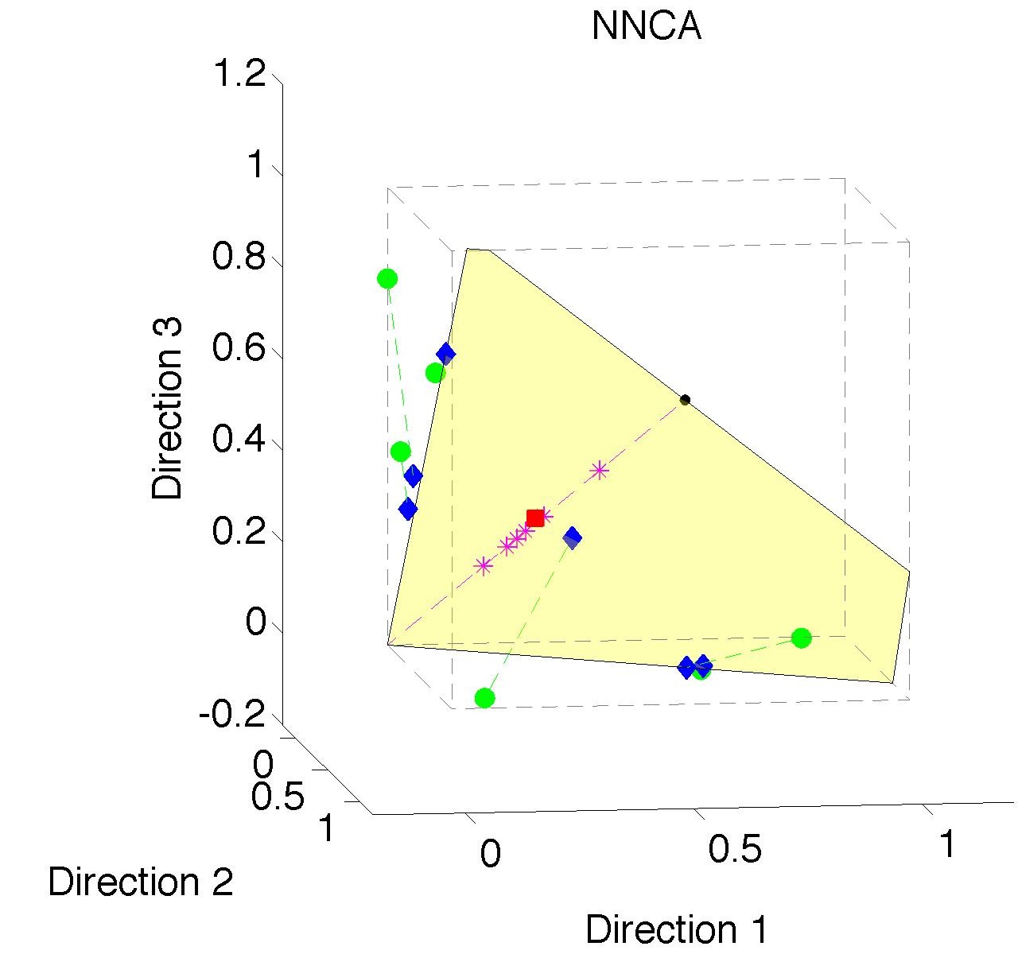
Nonnegative Nested Cone Analysis
Same Toy
Data Set
All
Projections
In Orthant

Slide 42
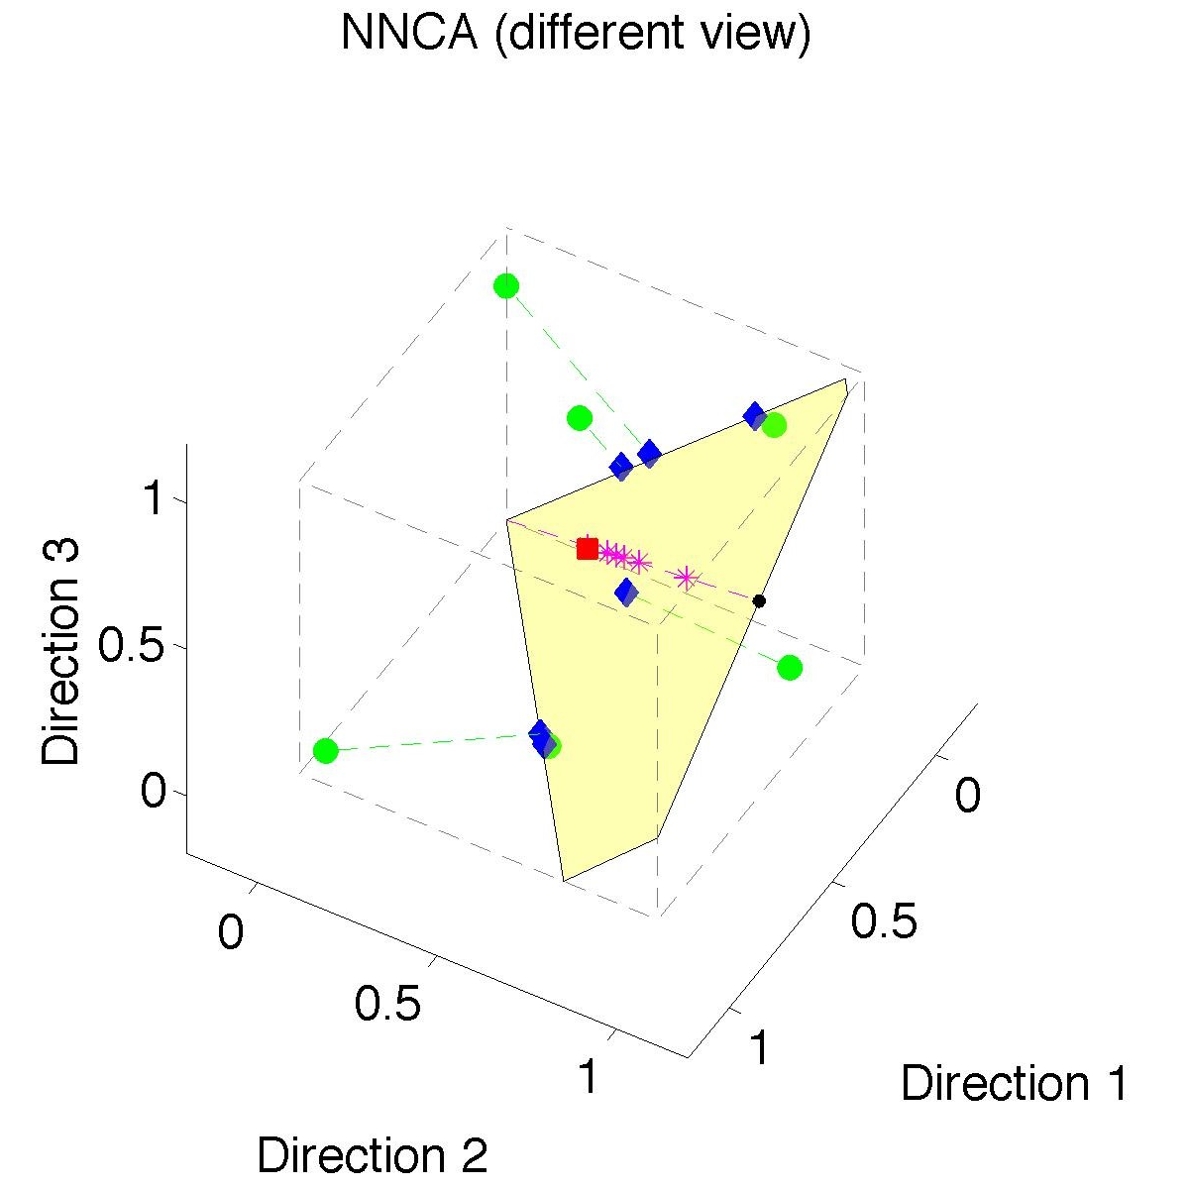
Nonnegative Nested Cone Analysis
Same Toy
Data Set
Rank 1
Approx.
Properly
Nested

Slide 43
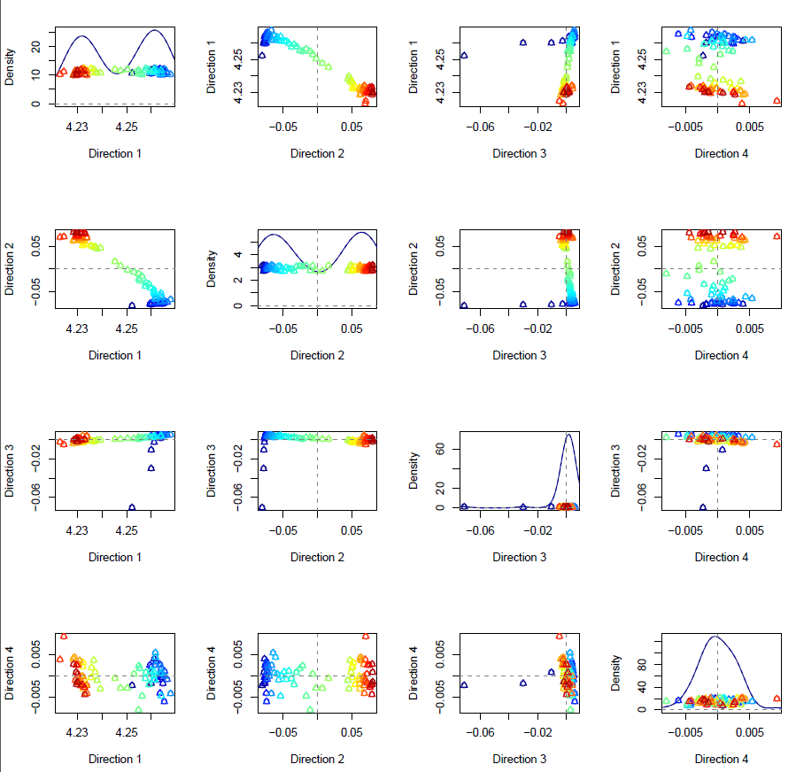
Nonnegative Nested Cone Analysis
Chemical
Spectra
Data
Scores Plot
Rainbow
Ordering

Slide 44
Nonnegative Nested Cone Analysis
2 Nonneg.
Components
For Major
Reaction

Slide 45
Nonnegative Nested Cone Analysis
3rd Comp.
Something
Early?
(Known Lab
Error)

Slide 46
Nonnegative Nested Cone Analysis
4th Comp.
Much Less
Variation
(Random
Noise)

Slide 47
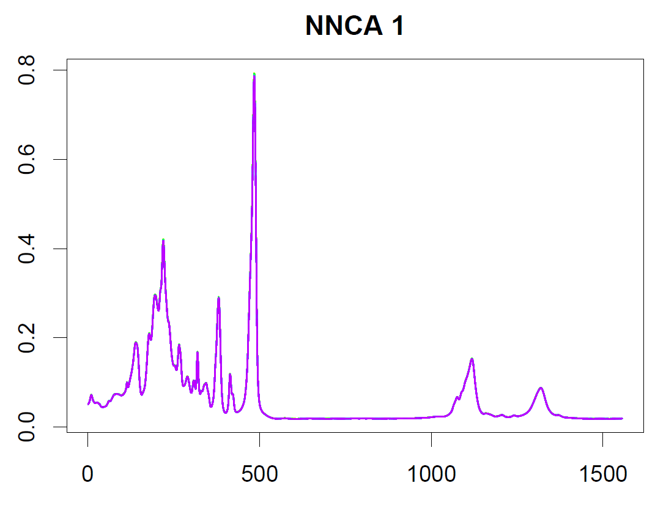
Nonnegative Nested Cone Analysis
Chemical
Spectral
Data
Loadings
Interpretation

Slide 48
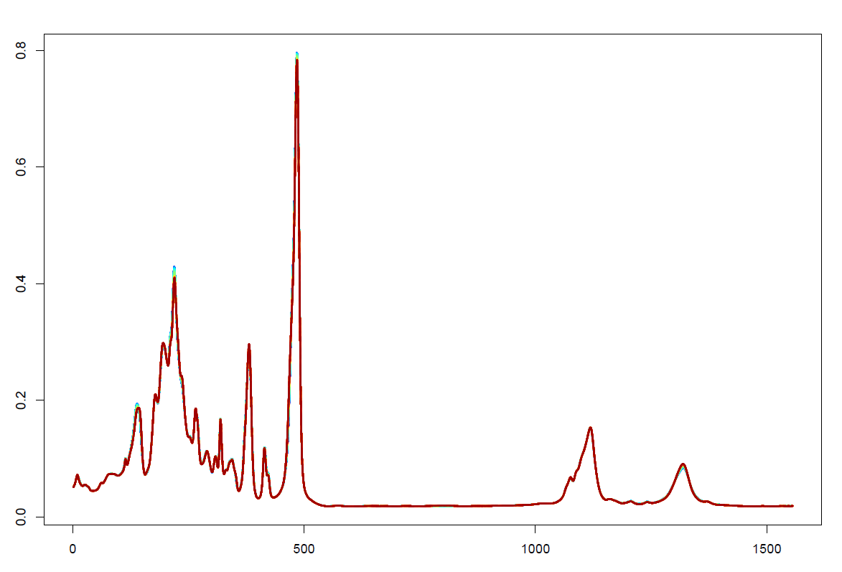
Nonnegative Nested Cone Analysis
Chemical
Spectral
Data
NNCA 2
Looks very similar?!?

Slide 49
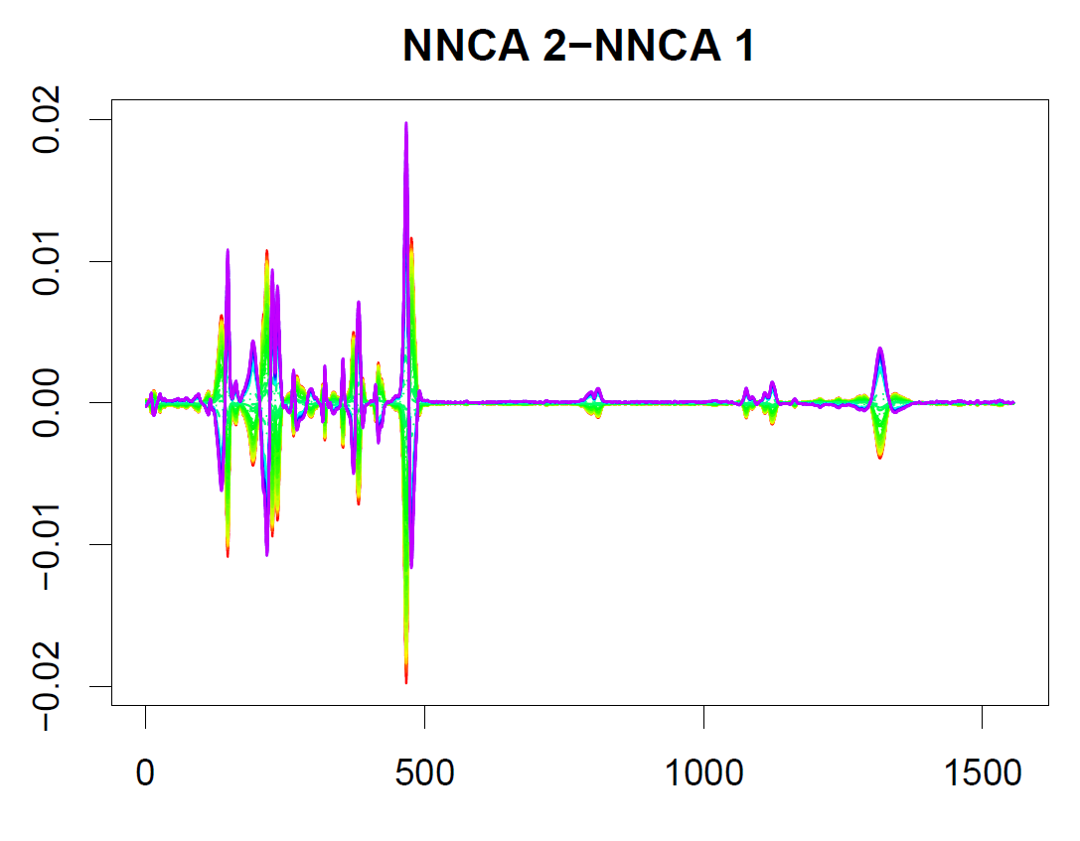
Nonnegative Nested Cone Analysis
Chemical
Spectral
Data
Study
Difference
NNCA2 – NNCA1

Slide 50
Nonnegative Nested Cone Analysis
Chemical
Spectral
Data
Rainbow
Shows
2 Components
Very Close, but Chemically Distinct

Slide 51
Nonnegative Nested Cone Analysis
Chemical
Spectral
Data
Zoomed
View
Is Also Interesting

Slide 52
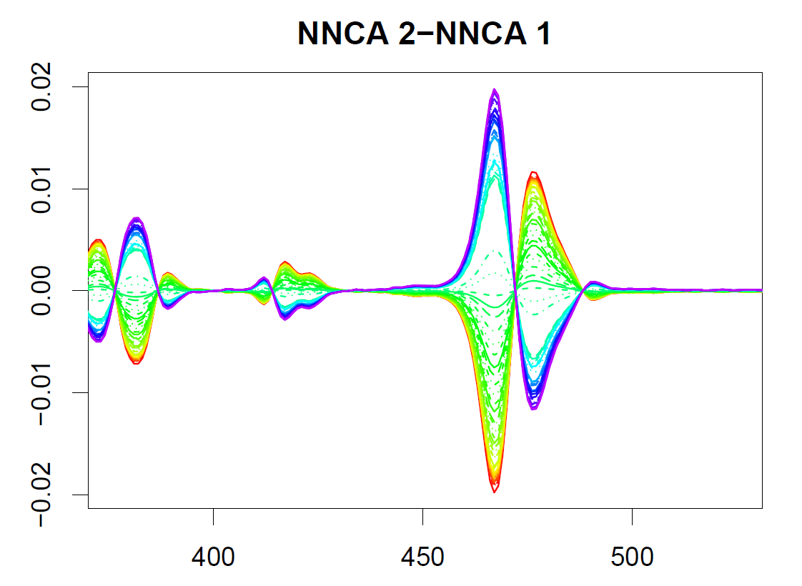
Nonnegative Nested Cone Analysis
Chemical
Spectral
Data
Gives
Clearer
View

Slide 53
Nonnegative Nested Cone Analysis
Chemical
Spectral
Data
Rank 3
Approximation Highlights Lab Early Error

Slide 54
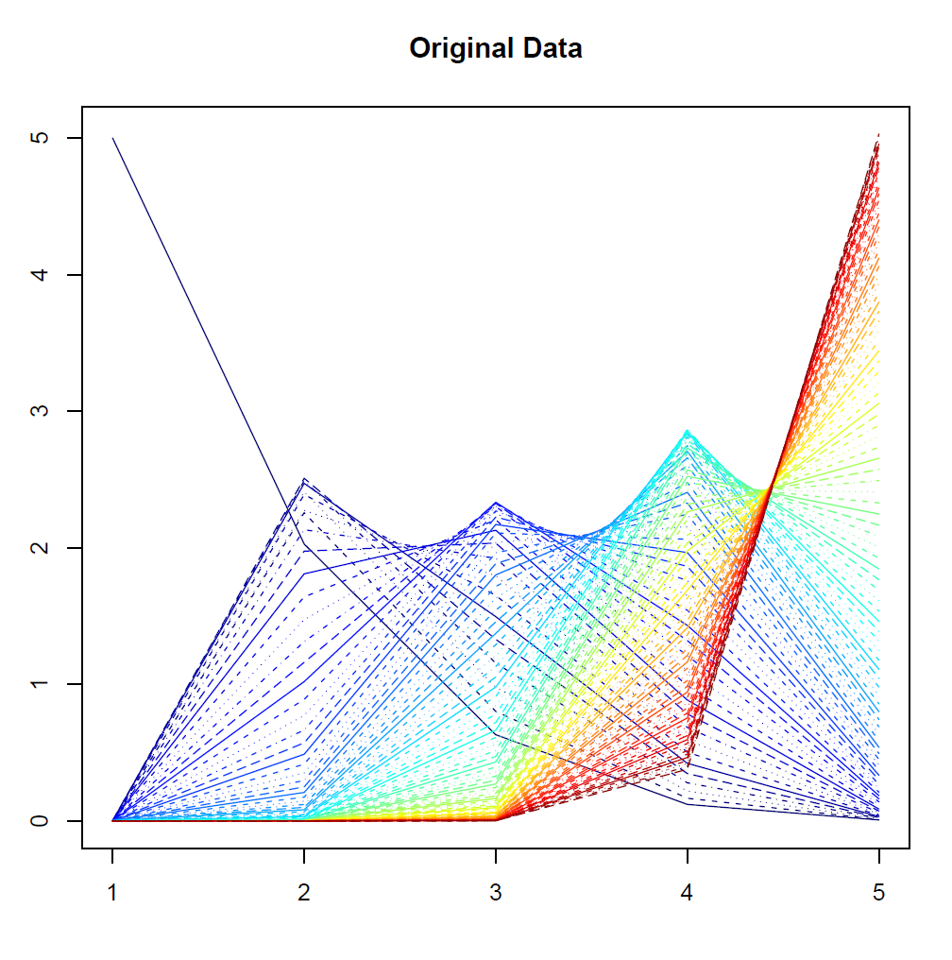
Nonnegative Nested Cone Analysis
5-d Toy
Example
(Rainbow
Colored
by Peak
Order)

Slide 55
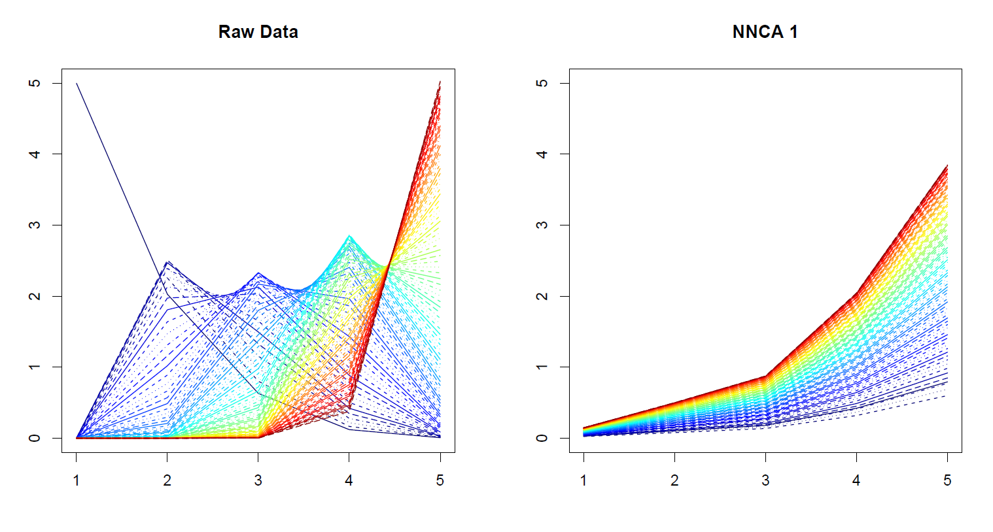
Nonnegative Nested Cone Analysis
5-d Toy Example Rank 1 NNCA Approx.

Slide 56
Nonnegative Nested Cone Analysis
5-d Toy Example Rank 2 NNCA Approx.

Slide 57
Nonnegative Nested Cone Analysis
5-d Toy Example Rank 2 NNCA Approx.
Nonneg.
Basis
Elements
(Not Trivial)

Slide 58
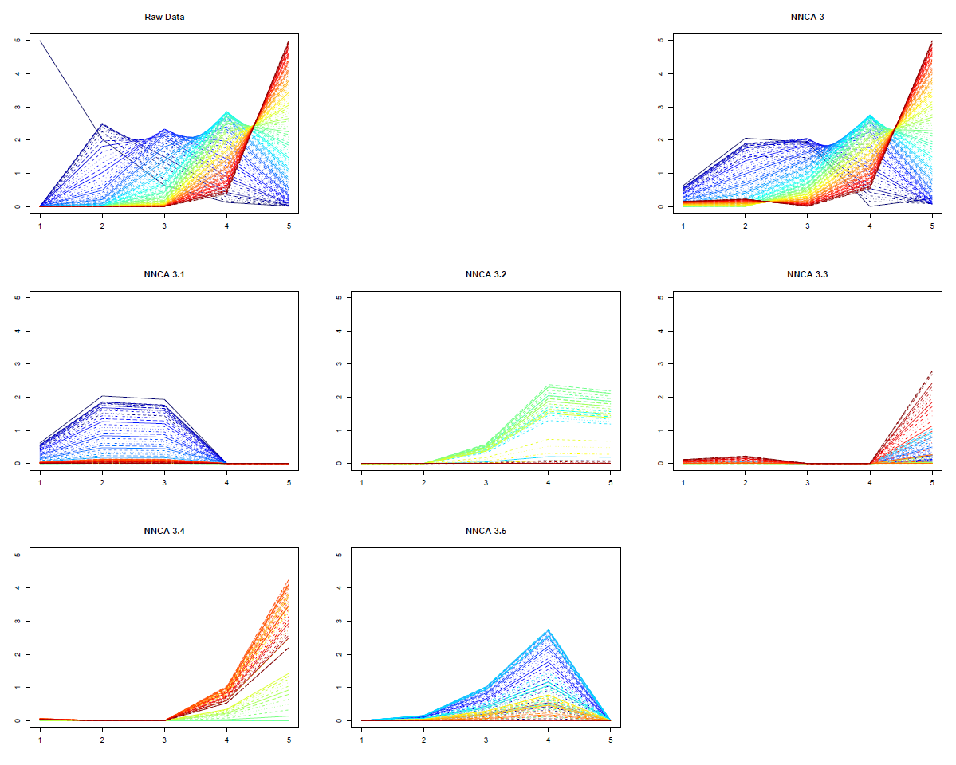
Nonnegative Nested Cone Analysis
5-d Toy Example Rank 3 NNCA Approx.
Current
Research:
How Many
Nonneg.
Basis El’ts
Needed?

Slide 59
An Interesting Question
How generally applicable is
Backwards approach to PCA?
Potential Application: Principal Curves
Hastie & Stuetzle, (1989)
(Foundation of Manifold Learning)

Slide 60
Manifold Learning
Goal: Find lower dimensional manifold that well approximates data
ISOmap
Tennenbaum (2000)
Local Linear Embedding
Roweis & Saul (2000)

Slide 61
1st Principal Curve
Linear Reg’n
Usual Smooth

Slide 62
1st Principal Curve
Linear Reg’n
Proj’s Reg’n
Usual Smooth

Slide 63
1st Principal Curve
Linear Reg’n
Proj’s Reg’n
Usual Smooth
Princ’l Curve

Slide 64
An Interesting Question
How generally applicable is
Backwards approach to PCA?
Potential Application: Principal Curves
Perceived Major Challenge:
How to find 2nd Principal Curve?
Backwards approach???

Slide 65
An Interesting Question
Key Component:
Principal Surfaces
LeBlanc & Tibshirani (1996)

Slide 66
An Interesting Question
Key Component:
Principal Surfaces
LeBlanc & Tibshirani (1996)
Challenge:
Can have any dimensional surface,
But how to nest???

Slide 67
An Interesting Question
How generally applicable is
Backwards approach to PCA?
Another Potential Application:
Trees as Data
(early days)

Slide 68
An Interesting Question
How generally applicable is
Backwards approach to PCA?
An Attractive Answer

Slide 69
An Interesting Question
How generally applicable is
Backwards approach to PCA?
An Attractive Answer:
James Damon, UNC Mathematics
Geometry
Singularity
Theory

Slide 70
An Interesting Question
How generally applicable is
Backwards approach to PCA?
An Attractive Answer:
James Damon, UNC Mathematics
Damon and Marron (2013)

Slide 71
An Interesting Question
How generally applicable is
Backwards approach to PCA?
An Attractive Answer:
James Damon, UNC Mathematics
Key Idea: Express Backwards PCA as
Nested Series of Constraints

Slide 72
General View of Backwards PCA
Define Nested Spaces via Constraints
Satisfying More Constraints $⇒$
$⇒$ Smaller Subspaces

Slide 73
General View of Backwards PCA
Define Nested Spaces via Constraints
E.g. SVD
(Singular Value Decomposition =
= Not Mean Centered PCA)
(notationally very clean)

Slide 74
General View of Backwards PCA
Define Nested Spaces via Constraints
E.g. SVD
Have $k$ Nested Subspaces:
$$S_{1}⊆S_{2}⊆⋯⊆S_{d}$$

Slide 75
General View of Backwards PCA
Define Nested Spaces via Constraints
E.g. SVD $S_{k}=\left\{x :x=\sum_{j=1}^{k}{c_{j}\vec{u_{j}}}\right\}$
$k$-th SVD Subspace
Scores
Loading Vectors

Slide 76
General View of Backwards PCA
Define Nested Spaces via Constraints
E.g. SVD $S_{k}=\left\{x :x=\sum_{j=1}^{k}{c_{j}\vec{u_{j}}}\right\}$
Now Define:
$$S_{k−1}=\left\{x∈S_{k} :\left\langle x,\vec{u_{k}}\right\rangle =0\right\}$$

Slide 77
General View of Backwards PCA
Define Nested Spaces via Constraints
E.g. SVD $S_{k}=\left\{x :x=\sum_{j=1}^{k}{c_{j}\vec{u_{j}}}\right\}$
Now Define:
$$S_{k−1}=\left\{x∈S_{k} :\left\langle x,\vec{u_{k}}\right\rangle =0\right\}$$
Constraint Gives Nested Reduction of Dim’n

Slide 78
General View of Backwards PCA
Define Nested Spaces via Constraints
Backwards PCA
Reduce Using Affine Constraints

Slide 79
General View of Backwards PCA
Define Nested Spaces via Constraints
Backwards PCA
Principal Nested Spheres
Use Affine Constraints (Planar Slices)
In Ambient Space

Slide 80
General View of Backwards PCA
Define Nested Spaces via Constraints
Backwards PCA
Principal Nested Spheres
Principal Surfaces
Spline Constraint Within Previous?

Slide 81
General View of Backwards PCA
Define Nested Spaces via Constraints
Backwards PCA
Principal Nested Spheres
Principal Surfaces
Spline Constraint Within Previous?
{Been Done Already???}

Slide 82
General View of Backwards PCA
Define Nested Spaces via Constraints
Backwards PCA
Principal Nested Spheres
Principal Surfaces
Other Manifold Data Spaces
Sub-Manifold Constraints??
(Algebraic Geometry)

Slide 83
General View of Backwards PCA
Define Nested Spaces via Constraints
Backwards PCA
Principal Nested Spheres
Principal Surfaces
Other Manifold Data Spaces
Tree Spaces
Suitable Constraints???

