Slide 1
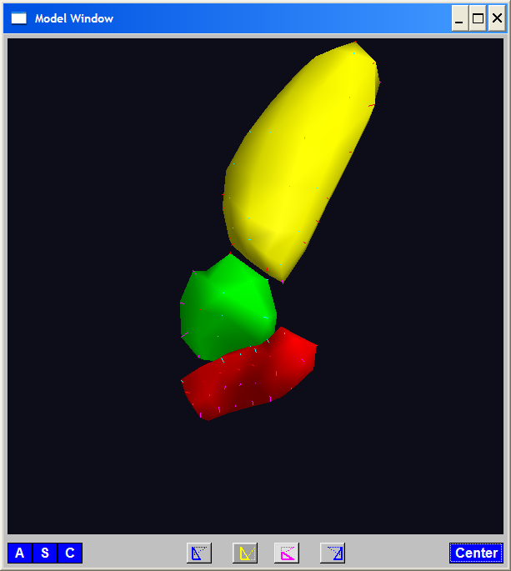
A Challenging Example
Male Pelvis
Bladder – Prostate – Rectum

Slide 2
A Challenging Example
Male Pelvis
Bladder – Prostate – Rectum
How do they move over time (days)?
(all within same person)

Slide 3
A Challenging Example
Male Pelvis
Bladder – Prostate – Rectum
How do they move over time (days)?
Critical to Radiation Treatment (cancer)

Slide 4
A Challenging Example
Male Pelvis
Bladder – Prostate – Rectum
How do they move over time (days)?
Critical to Radiation Treatment (cancer)
Work with 3-d CT
(“Computed Tomography”,
= 3d version of X-ray)

Slide 5
A Challenging Example
Male Pelvis
Bladder – Prostate – Rectum
How do they move over time (days)?
Critical to Radiation Treatment (cancer)
Work with 3-d CT
Very Challenging to Segment
Find boundary of each object?
Represent each Object?

Slide 6
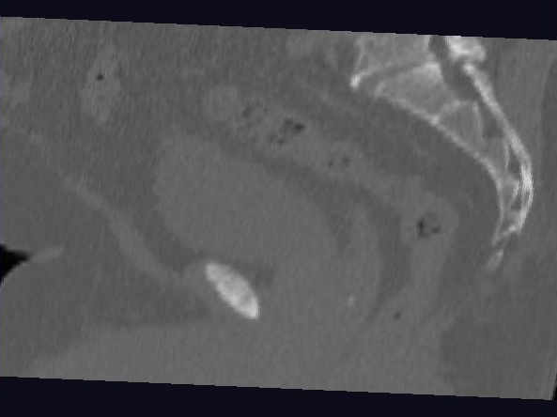
Male Pelvis – Raw Data
One CT Slice
(in 3d image)
Like X-ray:
White = Dense
(Bone)
Black = Gas

Slide 7
Male Pelvis – Raw Data
One CT Slice
(in 3d image)
Tail Bone

Slide 8
Male Pelvis – Raw Data
One CT Slice
(in 3d image)
Tail Bone
Rectum

Slide 9
Male Pelvis – Raw Data
One CT Slice
(in 3d image)
Tail Bone
Rectum
Bladder

Slide 10
Male Pelvis – Raw Data
One CT Slice
(in 3d image)
Tail Bone
Rectum
Bladder
Prostate

Slide 11
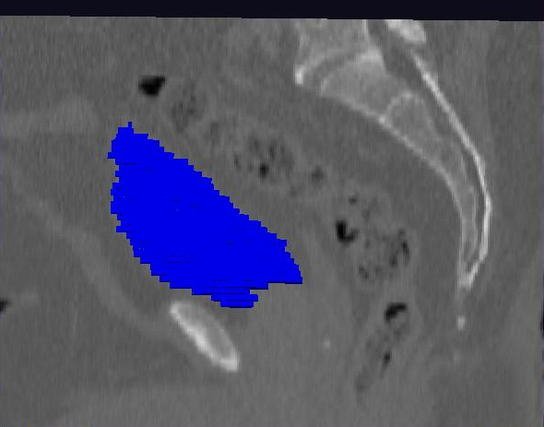
Male Pelvis – Raw Data
Bladder:
manual segmentation
Slice by slice
Reassembled

Slide 12
Male Pelvis – Raw Data
Bladder:
Slices:
Reassembled in 3d
How to represent?
Thanks: Ja-Yeon Jeong

Slide 13
Object Representation
Landmarks (hard to find)

Slide 14
Object Representation
Landmarks (hard to find)
Boundary Rep’ns (no correspondence)

Slide 15
Object Representation
Landmarks (hard to find)
Boundary Rep’ns (no correspondence)
Medial representations
Find “skeleton”
Discretize as “atoms” called M-reps

Slide 16
3-d m-reps
Bladder – Prostate – Rectum (multiple objects, J. Y. Jeong)
Medial Atoms provide “skeleton”
Implied Boundary from “spokes” → “surface”

Slide 17
3-d m-reps
M-rep model fitting
Easy, when starting from binary (blue)

Slide 18
3-d m-reps
M-rep model fitting
Easy, when starting from binary (blue)
But very expensive (30 – 40 minutes technician’s time)
Want automatic approach

Slide 19
3-d m-reps
M-rep model fitting
Easy, when starting from binary (blue)
But very expensive (30 – 40 minutes technician’s time)
Want automatic approach
Challenging, because of poor contrast, noise, …
Need to borrow information across training sample

Slide 20
3-d m-reps
M-rep model fitting
Easy, when starting from binary (blue)
But very expensive (30 – 40 minutes technician’s time)
Want automatic approach
Challenging, because of poor contrast, noise, …
Need to borrow information across training sample
Use Bayes approach: prior & likelihood → posterior
(A surrogate for “atomical knowledge”)

Slide 21
3-d m-reps
M-rep model fitting
Easy, when starting from binary (blue)
But very expensive (30 – 40 minutes technician’s time)
Want automatic approach
Challenging, because of poor contrast, noise, …
Need to borrow information across training sample
Use Bayes approach: prior & likelihood → posterior
~Conjugate Gaussians
(Embarassingly Straightforward?)

Slide 22
3-d m-reps
M-rep model fitting
Easy, when starting from binary (blue)
But very expensive (30 – 40 minutes technician’s time)
Want automatic approach
Challenging, because of poor contrast, noise, …
Need to borrow information across training sample
Use Bayes approach: prior & likelihood → posterior
~Conjugate Gaussians, but there are issues:
Major HLDSS challenges
Manifold aspect of data

Slide 23
3-d m-reps
M-rep model fitting
Very Successful
Jeong (2009)

Slide 24
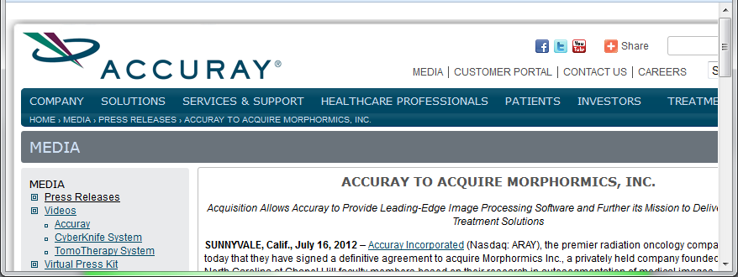
3-d m-reps
M-rep model fitting
Very Successful
Jeong (2009)
Basis of Startup Company: Morphormics

Slide 25
Mildly Non-Euclidean Spaces
Statistical Analysis of M-rep Data
Recall: Many direct products of:
Locations
Radii
Angles

Slide 26
Mildly Non-Euclidean Spaces
Statistical Analysis of M-rep Data
Recall: Many direct products of:
Locations
Radii
Angles
I.e. points on smooth manifold

Slide 27
Mildly Non-Euclidean Spaces
Statistical Analysis of M-rep Data
Recall: Many direct products of:
Locations
Radii
Angles
I.e. points on smooth manifold
Data in non-Euclidean Space
But only mildly non-Euclidean

Slide 28
PCA for m-reps, II
PCA on non-Euclidean spaces?
(i.e. on Lie Groups / Symmetric Spaces)

Slide 29
PCA for m-reps, II
PCA on non-Euclidean spaces?
(i.e. on Lie Groups / Symmetric Spaces)
T. Fletcher: Principal Geodesic Analysis
(2004 UNC CS PhD Dissertation)

Slide 30
PCA for m-reps, II
PCA on non-Euclidean spaces?
(i.e. on Lie Groups / Symmetric Spaces)
T. Fletcher: Principal Geodesic Analysis
Idea: replace “linear summary of data”
With “geodesic summary of data”…

Slide 31
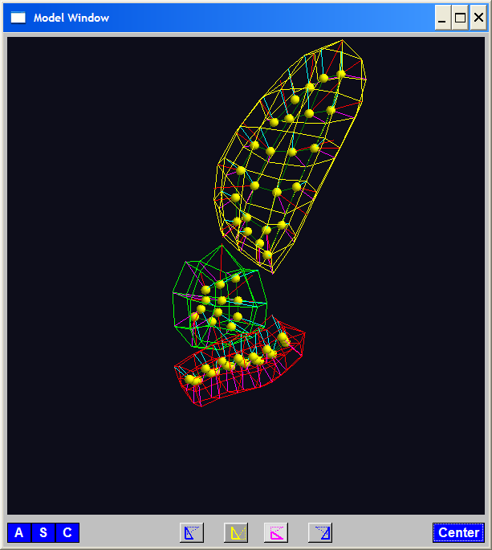
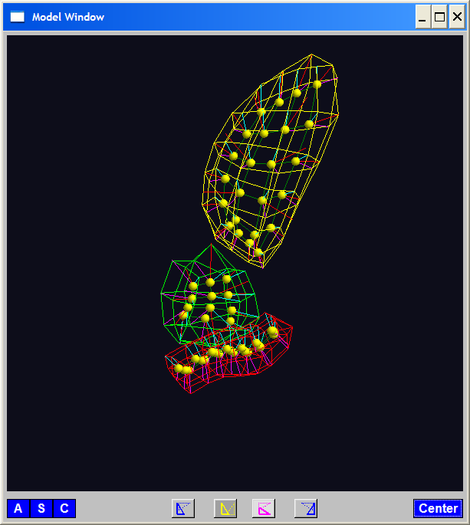
PGA for m-reps, Bladder-Prostate-Rectum
Bladder – Prostate – Rectum, 1 person, 17 days
PG 1 PG 2 PG 3
(analysis by Ja Yeon Jeong)

Slide 32
PGA for m-reps, Bladder-Prostate-Rectum
Bladder – Prostate – Rectum, 1 person, 17 days
PG 1 PG 2 PG 3
(analysis by Ja Yeon Jeong)

Slide 33
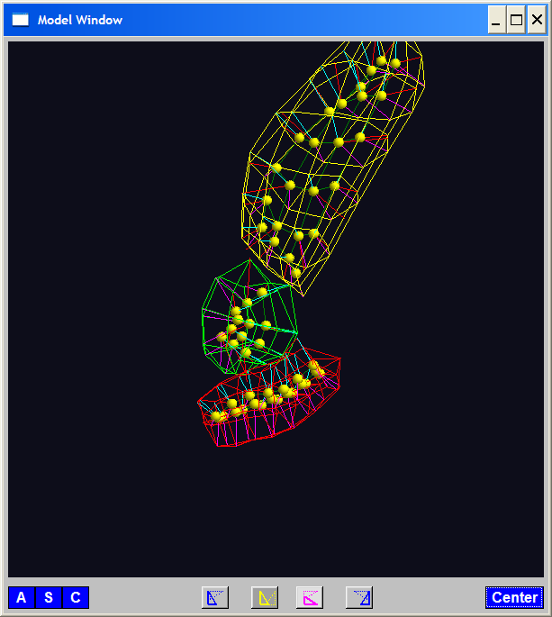
PGA for m-reps, Bladder-Prostate-Rectum
Bladder – Prostate – Rectum, 1 person, 17 days
PG 1 PG 2 PG 3
(analysis by Ja Yeon Jeong)

Slide 34
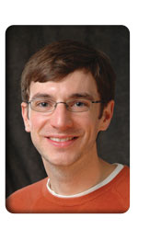
PCA Extensions for Data on Manifolds
Fletcher (Principal Geodesic Anal.)
Best fit of geodesic to data

Slide 35
PCA Extensions for Data on Manifolds
Fletcher (Principal Geodesic Anal.)
Best fit of geodesic to data
Constrained to go through geodesic mean

Slide 36
PCA Extensions for Data on Manifolds
Fletcher (Principal Geodesic Anal.)
Best fit of geodesic to data
Constrained to go through geodesic mean
Happens mean
Naturally contained
in $ℝ^{d}$ in best
fit line

Slide 37
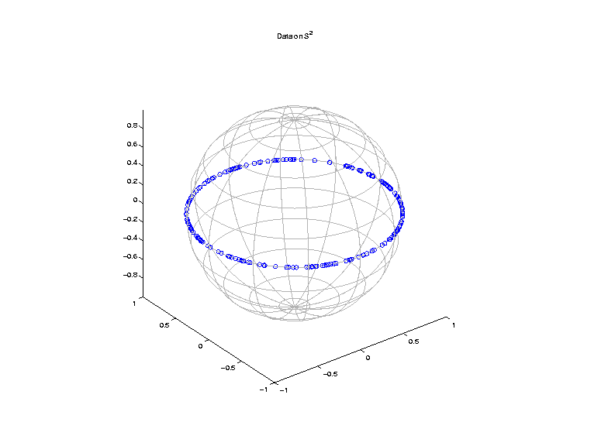
PCA Extensions for Data on Manifolds
Fletcher (Principal Geodesic Anal.)
Best fit of geodesic to data
Constrained to go through geodesic mean
But Not In
Non-Euclidean
Spaces

Slide 38
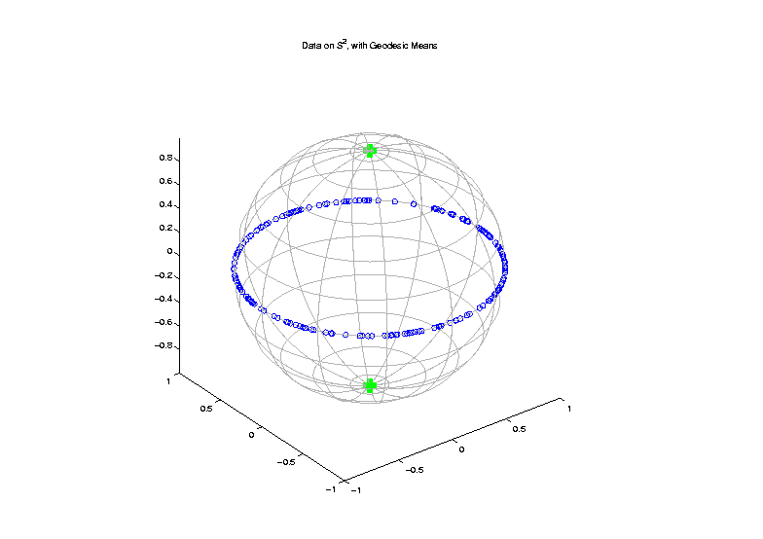
PCA Extensions for Data on Manifolds
Fletcher (Principal Geodesic Anal.)
Best fit of geodesic to data
Constrained to go through geodesic mean
Counterexample:
Data on sphere,
along equator

Slide 39
PCA Extensions for Data on Manifolds
Fletcher (Principal Geodesic Anal.)
Best fit of geodesic to data
Constrained to go through geodesic mean
Extreme
3 Point
Examples

Slide 40
PCA Extensions for Data on Manifolds
Fletcher (Principal Geodesic Anal.)
Best fit of geodesic to data
Constrained to go through geodesic mean
Huckemann, Hotz & Munk (Geod. PCA)

Slide 41
PCA Extensions for Data on Manifolds
Fletcher (Principal Geodesic Anal.)
Best fit of geodesic to data
Constrained to go through geodesic mean
Huckemann, Hotz & Munk (Geod. PCA)
Best fit of any geodesic to data

Slide 42
PCA Extensions for Data on Manifolds
Fletcher (Principal Geodesic Anal.)
Best fit of geodesic to data
Constrained to go through geodesic mean
Huckemann, Hotz & Munk (Geod. PCA)
Best fit of any geodesic to data
Counterexample:
Data follows Tropic of Capricorn

Slide 43
PCA Extensions for Data on Manifolds
Fletcher (Principal Geodesic Anal.)
Best fit of geodesic to data
Constrained to go through geodesic mean
Huckemann, Hotz & Munk (Geod. PCA)
Best fit of any geodesic to data
Jung, Foskey & Marron (Princ. Arc Anal.)

Slide 44
PCA Extensions for Data on Manifolds
Fletcher (Principal Geodesic Anal.)
Best fit of geodesic to data
Constrained to go through geodesic mean
Huckemann, Hotz & Munk (Geod. PCA)
Best fit of any geodesic to data
Jung, Foskey & Marron (Princ. Arc Anal.)
Best fit of any circle to data
(motivated by conformal maps)

Slide 45
PCA Extensions for Data on Manifolds

Slide 46
Principal Arc Analysis
Jung, Foskey & Marron (2011)
Best fit of any circle to data
Can give better fit than geodesics

Slide 47
Principal Arc Analysis
Jung, Foskey & Marron (2011)
Best fit of any circle to data
Can give better fit than geodesics
Observed for simulated m-rep example

Slide 48
Challenge being addressed

Slide 49
Composite Nested Spheres
Idea: Use Principal Arc Analysis
Over Large Products of $S^{2}$

Slide 50
Landmark Based Shape Analysis
Kendall
Bookstein
Dryden &
Mardia
(recall major monographs)

Slide 51
Landmark Based Shape Analysis
Kendall
Bookstein
Dryden &
Mardia
Digit 3 Data

Slide 52
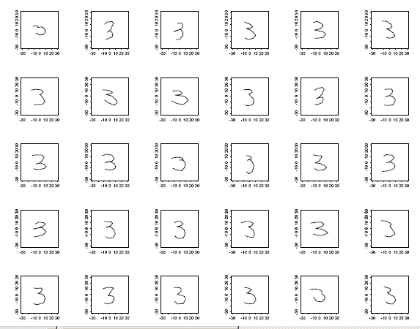
Landmark Based Shape Analysis
Kendall
Bookstein
Dryden &
Mardia
Digit 3 Data

Slide 53
Landmark Based Shape Analysis
Kendall
Bookstein
Dryden &
Mardia
Digit 3 Data
(digitized to 13 landmarks)

Slide 54
Landmark Based Shape Analysis
Key Step: mod out
Translation
Scaling
Rotation

Slide 55
Landmark Based Shape Analysis
Key Step: mod out
Translation
Scaling
Rotation
Result:
Data Objects ←→
←→ points on Manifold ( ~ S^{2k-4})

Slide 56
Landmark Based Shape Analysis
Currently popular approaches to PCA on S^{k}:
Early: PCA on projections
(Tangent Plane Analysis)

Slide 57
Landmark Based Shape Analysis
Currently popular approaches to PCA on S^{k}:
Early: PCA on projections
Fletcher: Geodesics through mean

Slide 58
Landmark Based Shape Analysis
Currently popular approaches to PCA on S^{k}:
Early: PCA on projections
Fletcher: Geodesics through mean
Huckemann, et al: Any Geodesic

Slide 59
Landmark Based Shape Analysis
Currently popular approaches to PCA on S^{k}:
Early: PCA on projections
Fletcher: Geodesics through mean
Huckemann, et al: Any Geodesic
New Approach:
Principal Nested Sphere Analysis
Jung, Dryden & Marron (2012)

Slide 60
Principal Nested Spheres Analysis
Main Goal:
Extend Principal Arc Analysis (S² to S^{k})

