Slide 1
HDLSS Asy’s: Geometrical Represent’n
Assume , let
Study Subspace Generated by Data
Hyperplane through 0,
of dimension
Points are “nearly equidistant to 0”,
& dist
Within plane, can
“rotate towards Unit Simplex”
All Gaussian data sets are:
“near Unit Simplex Vertices”!!!
“Randomness” appears
only in rotation of simplex
Hall, Marron & Neeman (2005)

Slide 2
HDLSS Additional Results
Batch Adjustment: Xuxin Liu
Recall Intuition from above:
Key is sizes of biological subtypes
Differing ratio trips up mean
But DWD more robust
Mathematics behind this?

Slide 3
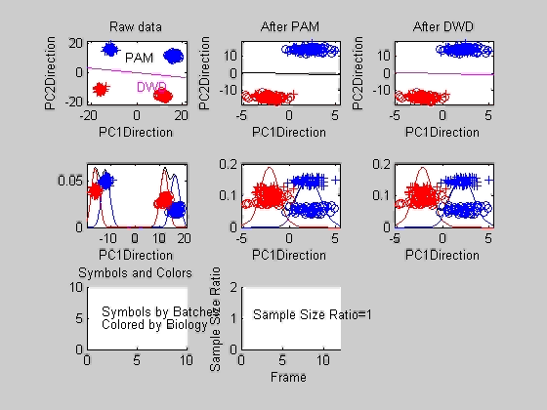
Liu: Twiddle ratios of subtypes

Slide 4
HDLSS Asymptotics
Personal Observations:
HDLSS world is…
Surprising (many times!)
[Think I’ve got it, and then …]
Mathematically Beautiful (?)
Practically Relevant

Slide 5
Independent Component Analysis
Personal Viewpoint:
Directions that maximize independence
Motivating Context: Signal Processing
“Blind Source Separation”

Slide 6
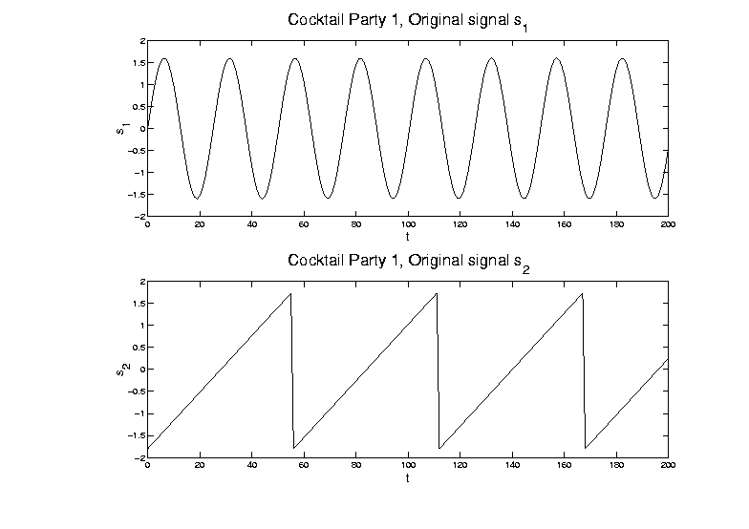
ICA, Motivating Example
Model for “conversations”: time series

Slide 7
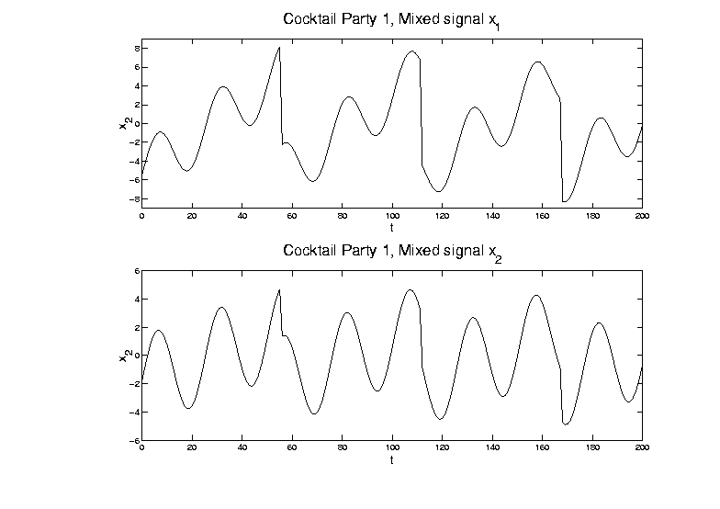
ICA, Motivating Example
Mixed version of signals:

Slide 8
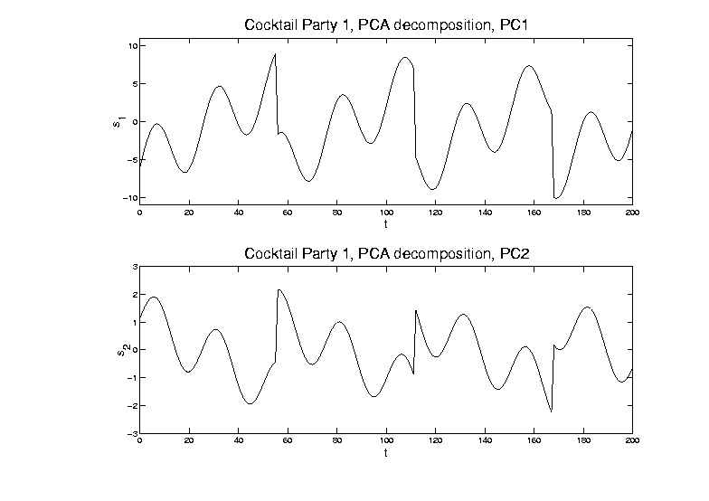
ICA, Motivating Example
PCA (on population of 2-d vectors)
Maximal
Variance
Minimal
Variance

Slide 9
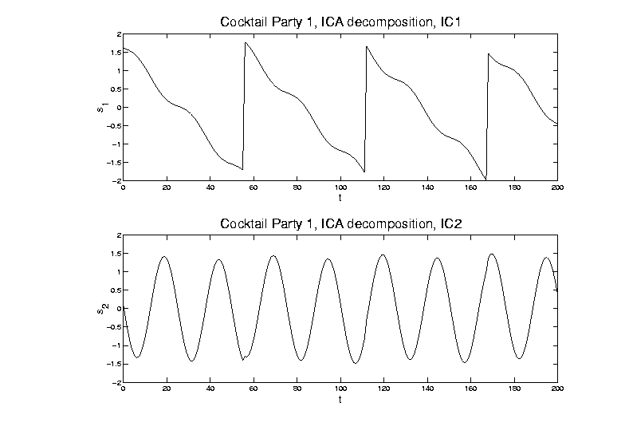
ICA, Motivating Example
ICA (will describe method later)

Slide 10
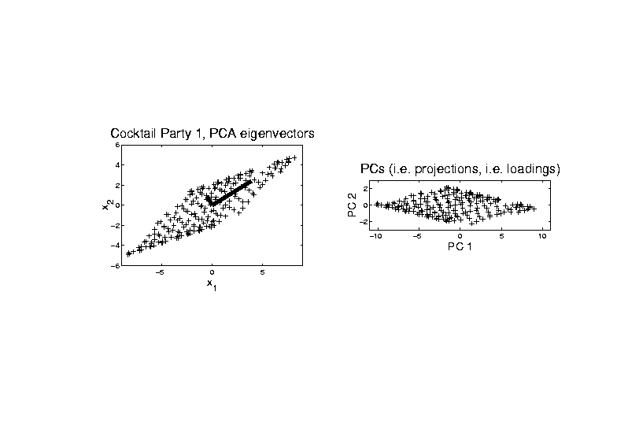
ICA, Motivating Example
PCA - Finds direction of greatest variation

Slide 11
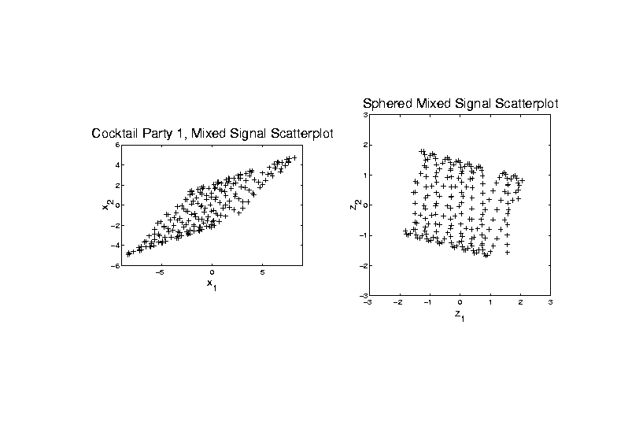
ICA, Algorithm
ICA Step 1: sphere the data

Slide 12
ICA, Algorithm
Matlab Algorithm (optimizing any of above):
“FastICA”
Numerical gradient search method
Can find directions iteratively
Or by simultaneous optimization
(note: PCA does both, but not ICA)
Appears fast, with good defaults
Careful about local optima
(Recco: several random restarts)

Slide 13
ICA & Non-Gaussianity
Illustrative examples (d = 100, n = 500)
Uniform Marginals
Exponential Marginals
Bimodal Marginals
Study over range of values of k

Slide 14
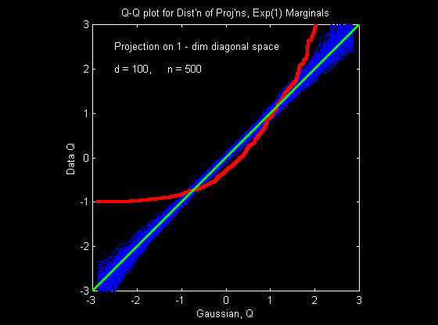
ICA & Non-Gaussianity
Illustrative example - Exponential Marginals

Slide 15
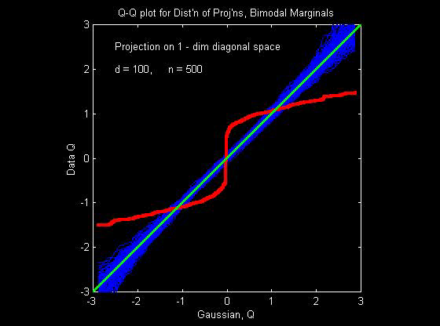
ICA & Non-Gaussianity
Illustrative example - Bimodal Marginals

Slide 16
ICA & Non-Gaussianity
Illustrative examples (d = 100, n = 500)
Bimodal Marginals
Convergence to Gaussian,
Surprisingly fast
Quite close for k = 9

Slide 17
ICA & Non-Gaussianity
Projections farther from coordinate axes
are more Gaussian
Conclusions:
Expect most proj’ns are Gaussian
Non-G’n proj’ns (ICA target) are special
Is a given sample really “random”???
(could test???)
High dim’al space is a strange place

Slide 18
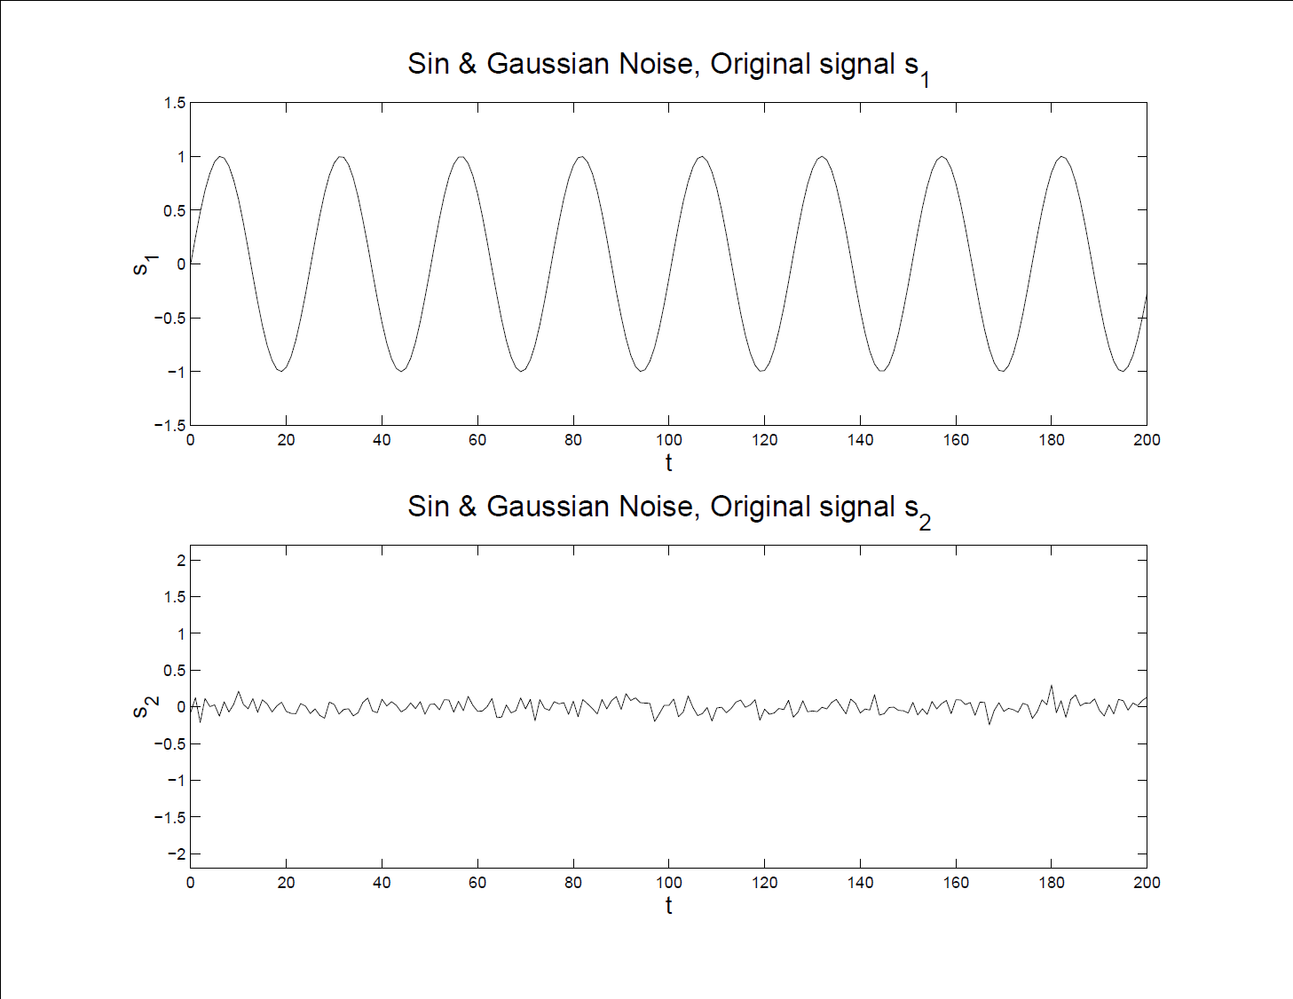
More ICA Examples
Sine and Gaussian – Original Signals

Slide 19
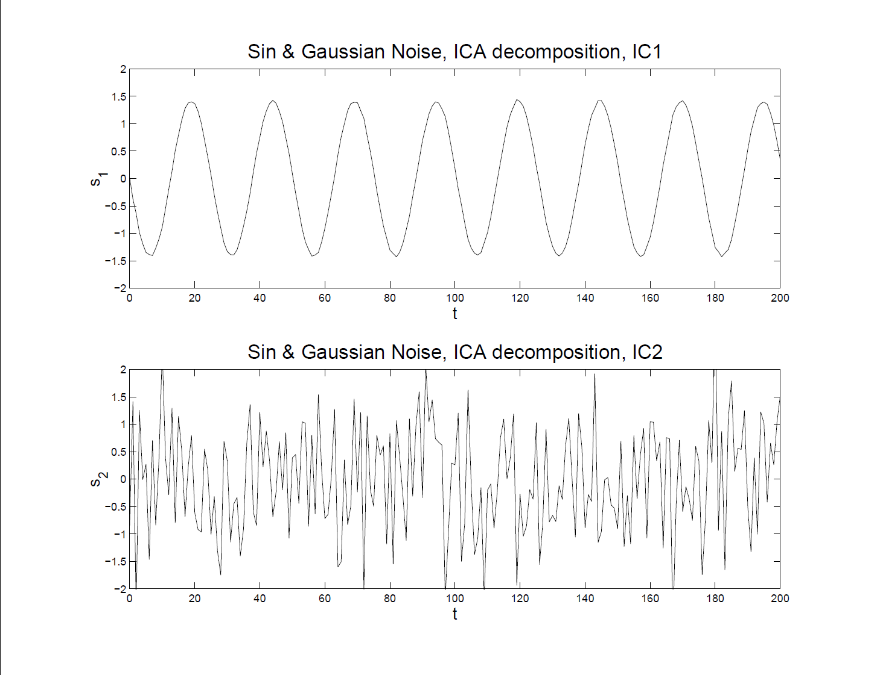
More ICA Examples
Sine and Gaussian – ICA Reconstruction

Slide 20
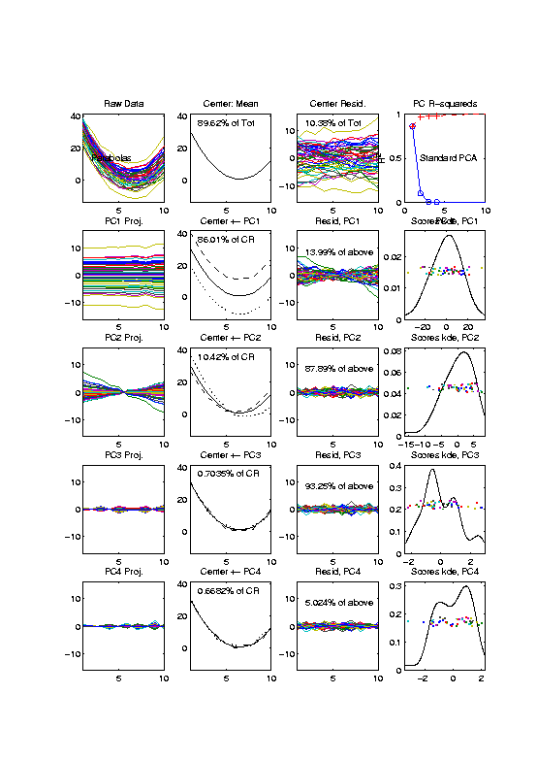
More ICA Examples
Now Try FDA examples – Recall Parabolas
Curves As
Data Objects

Slide 21
More ICA Examples
Now Try FDA examples – Parabolas
PCA Gives
Interpretable
Decomposition

Slide 22
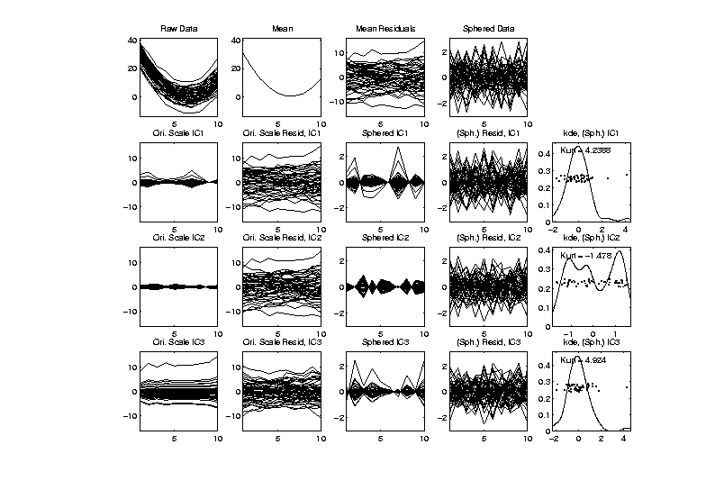
More ICA Examples
Now Try FDA examples – Parabolas
Sphered Data

Slide 23
More ICA Examples
Now Try FDA examples – Parabolas
Sphered Data
Sphered
Components

Slide 24
More ICA Examples
Now Try FDA examples – Parabolas
Sphered Data
Sphered
Components
Sphered
Residuals

Slide 25
More ICA Examples
Now Try FDA examples – Parabolas
Sphered Data
Sphered
Components
Sphered
Residuals
Scores

Slide 26
More ICA Examples
Now Try FDA examples – Parabolas
Original
Components
Not Very
Interpretable

Slide 27
More ICA Examples
Now Try FDA examples – Parabolas
Doesn’t Find Interesting Structure Well
(Since had Gaussian Scores)
But Does Find Outliers
Next Investigate This

Slide 28
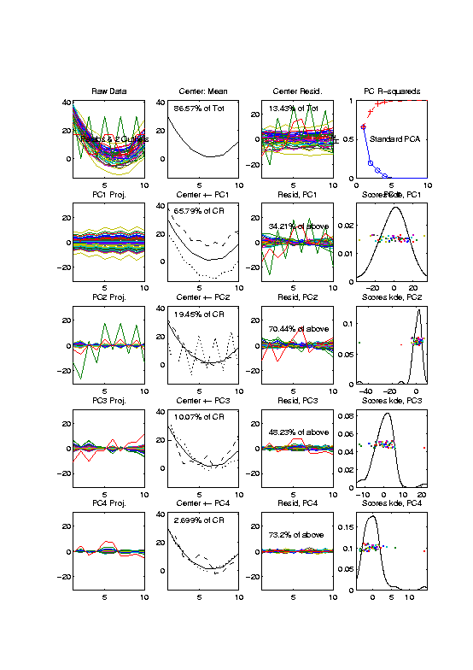
More ICA Examples
FDA example – Parabolas w/ 2 Outliers
Same Curves
plus “Outliers”

Slide 29
More ICA Examples
FDA example – Parabolas w/ 2 Outliers
Impact all of:
Mean
PC1 (slightly)
PC2 (dominant)
PC3 (tilt???)

Slide 30
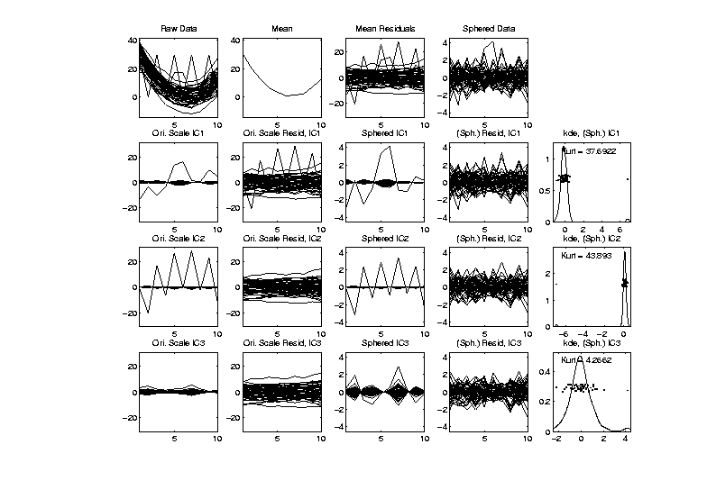
More ICA Examples
FDA example – Parabolas w/ 2 Outliers
ICA:
Misses Main
Directions
But Finds
Outliers
(non-Gaussian!)

Slide 31
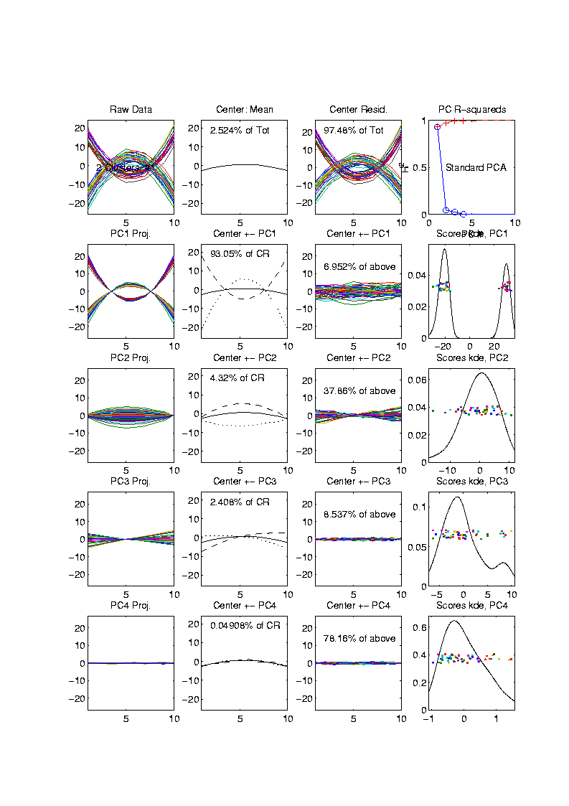
More ICA Examples
FDA example – Parabolas Up and Down
Recall 2 Clear
Clusters

Slide 32
More ICA Examples
FDA example – Parabolas Up and Down
PCA:
Clusters
& Other
Structure

Slide 33
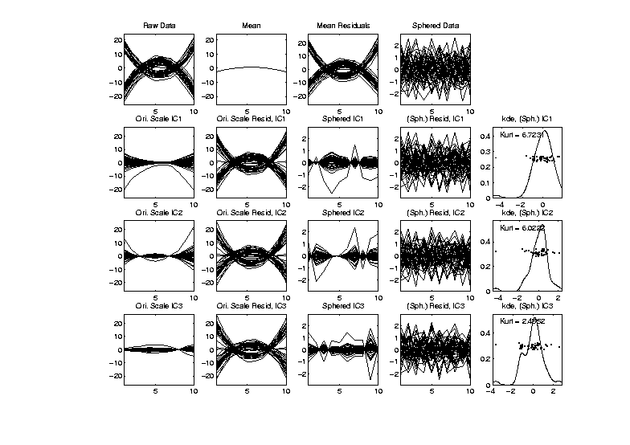
More ICA Examples
FDA example – Parabolas Up and Down
ICA:
Does Not
Find Clusters
Reason:
Random Start

Slide 34
More ICA Examples
FDA example – Parabolas Up and Down
ICA: Scary Issue
Local Minima in Optimization

Slide 35
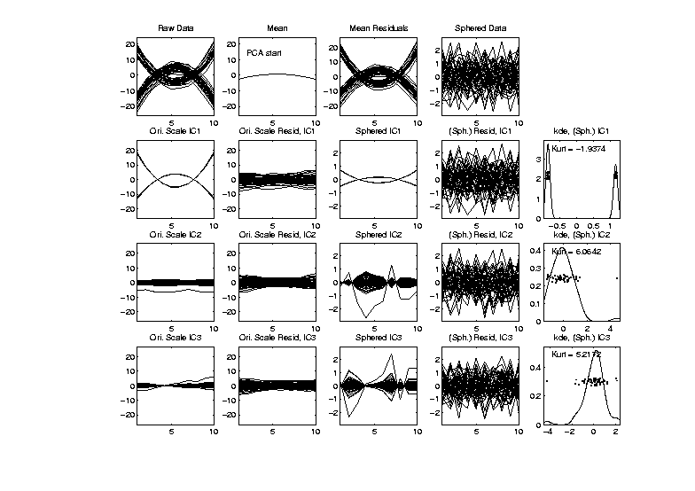
More ICA Examples
FDA example – Parabolas Up and Down
ICA Solution 1: Use PCA to Start
Worked Here
But Not
Always

Slide 36
More ICA Examples
FDA example – Parabolas Up and Down
ICA Solution 2:
Use Multiple Random Starts
Shows When Have Multiple Minima
Range Should Turn Up Good Directions
More to Look At / Interpret

Slide 37
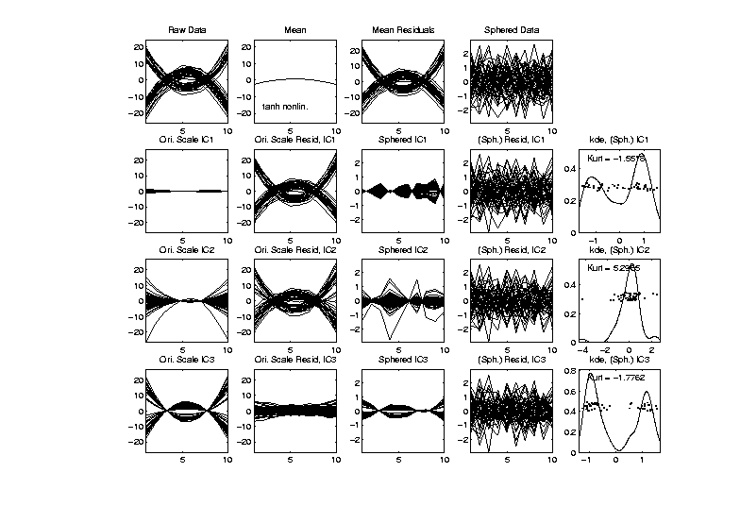
More ICA Examples
FDA example – Parabolas Up and Down
ICA Solution 2: Multiple Random Starts
3rd IC Dir’n
Looks Good

Slide 38
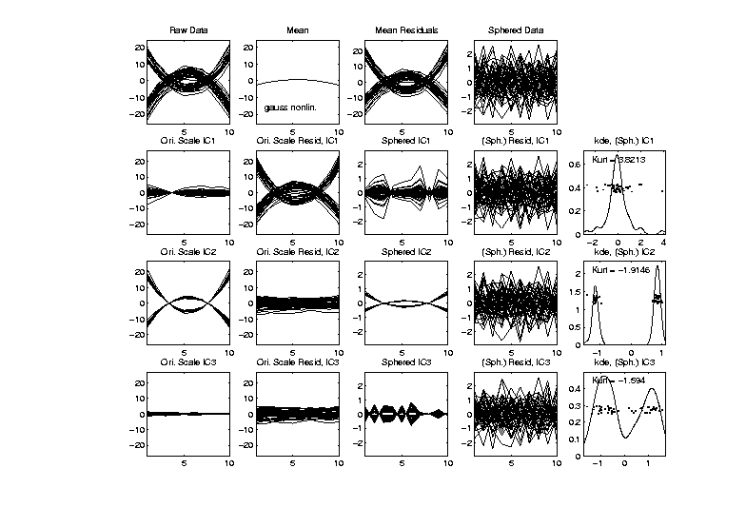
More ICA Examples
FDA example – Parabolas Up and Down
ICA Solution 2: Multiple Random Starts
2nd
Looks
Good

Slide 39
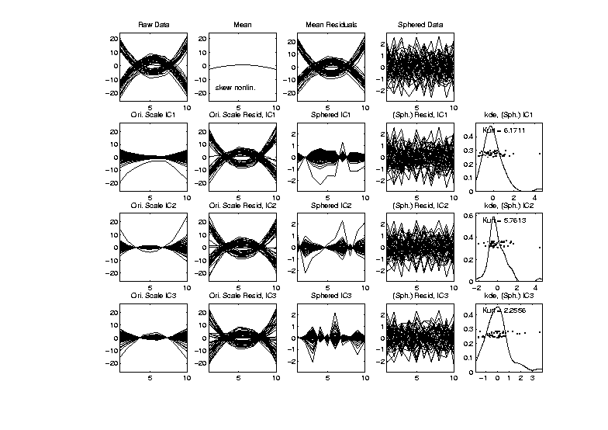
More ICA Examples
FDA example – Parabolas Up and Down
ICA Solution 2: Multiple Random Starts?
Never
Finds
Clusters?

Slide 40
ICA Overview
Interesting Method, has Potential
Great for Directions of Non-Gaussianity
  E.g. Finding Outliers
Common Application Area: FMRI
Has Its Costs
  Slippery Optimization
  Interpetation Challenges

Slide 41
HDLSS & Sparsity
New Area Opened in PhD Work by Dan Shen
Uses Spike Index,
And Sparsity Index,
Explores Consistency
& Strong Inconsistency
Sparsity Gives Broad New Region

Slide 42
1
0≤ α < β ≤1
0.7
β
0≤ α = β ≤1
Sparsity Index
α>1
0 ≤ β ≤1
0.5
0.3
0≤β<α≤1
0.1
0
0
0.2
0.4
0.6
0.8
1
Jung and Marron
α
Spike Index

Slide 43
HDLSS & Other Asymptotics
Larger Context: PhD Work by Dan Shen
Explores PCA Consistency under all of:
Classical: d fixed, n → ∞
Portnoy: d, n → ∞, d << n
Random Matrices: d, n → ∞, d ~ n
HDMSS: d, n → ∞, d >> n
HDLSS: d → ∞, n fixed

Slide 44
HDLSS & Other Asymptotics
Larger Context: PhD Work by Dan Shen
Explores PCA Consistency under all of:
Classical: d fixed, n → ∞
Portnoy: d, n → ∞, d << n
Random Matrices: d, n → ∞, d ~ n
HDMSS: d, n → ∞, d >> n
HDLSS: d → ∞, n fixed
1980s asymptotics
High Dimension, Medium Sample Size

Slide 45
(A) Single Spike - Example 1.1
(B) Multi Spike - Example 1.2
Consistency
1
1
Sample Index
α + γ >1
γ
α + γ >1, γ >0
Sample Index (Johnstone and Lu (2009))
γ
Strong Inconsistency
0≤ α + γ <1
0≤ α + γ <1
(0,0)
Strong Inconsistency
1
Consistency
(0,0)
Strong Inconsistency
1
α
α
Subspace Consistency
Spike Index (Jung and Marron (2009))
Spike Index (Jung and Marron (2009))

Slide 46
HDLSS & Other Asymptotics
Larger Context: PhD Work by Dan Shen
Explores PCA Consistency under all of:
Classical: d fixed, n → ∞
Portnoy: d, n → ∞, d << n
Random Matrices: d, n → ∞, d ~ n
HDMSS: d, n → ∞, d >> n
HDLSS: d → ∞, n fixed

Slide 47
HDLSS & Other Asymptotics
Larger Context: PhD Work by Dan Shen
Explores PCA Consistency under all of:
Classical: d fixed, n → ∞
Portnoy: d, n → ∞, d << n
Random Matrices: d, n → ∞, d ~ n
HDMSS: d, n → ∞, d >> n
HDLSS: d → ∞, n fixed
Interesting and Surprising Case

Slide 48
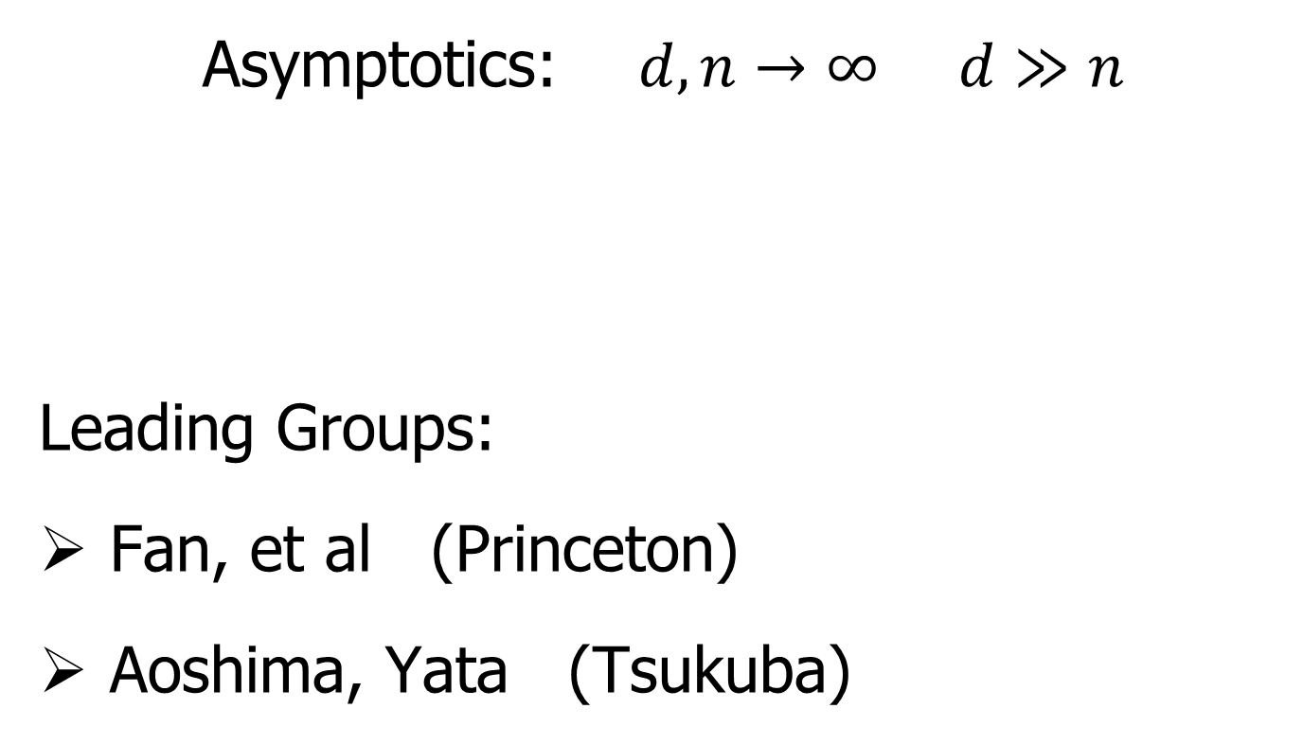
HDMSS
Asymptotics: $d,n→∞$ $d≫n$
Leading Groups:
Fan, et al (Princeton)
Aoshima, Yata (Tsukuba)

Slide 49
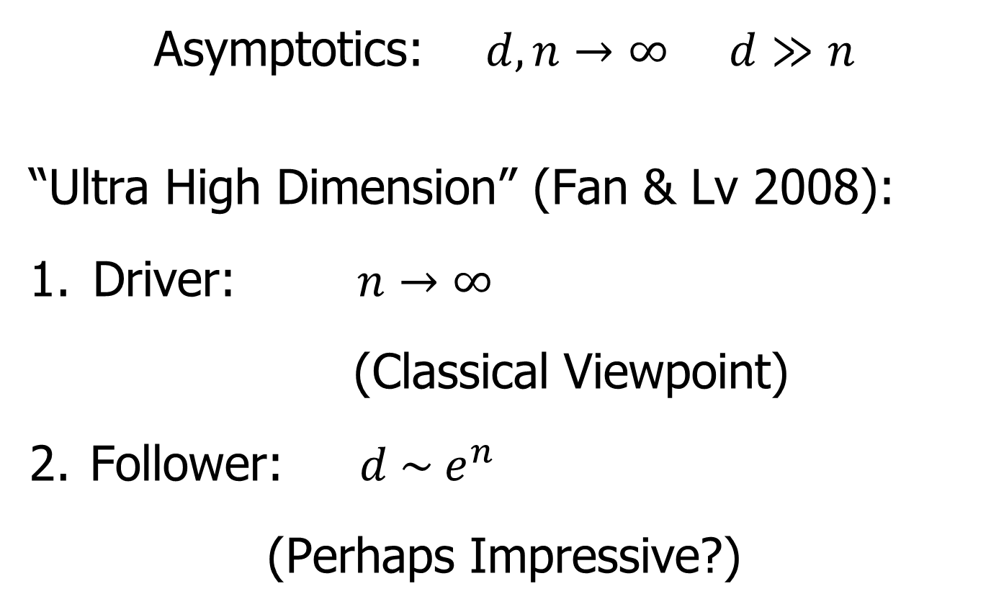
HDMSS, Fan View
Asymptotics: $d,n→∞$ $d≫n$
“Ultra High Dimension” (Fan & Lv 2008):
Driver: $n→∞$
(Classical Viewpoint)
Follower: $d \sim e^{n}$
(Perhaps Impressive?)

Slide 50
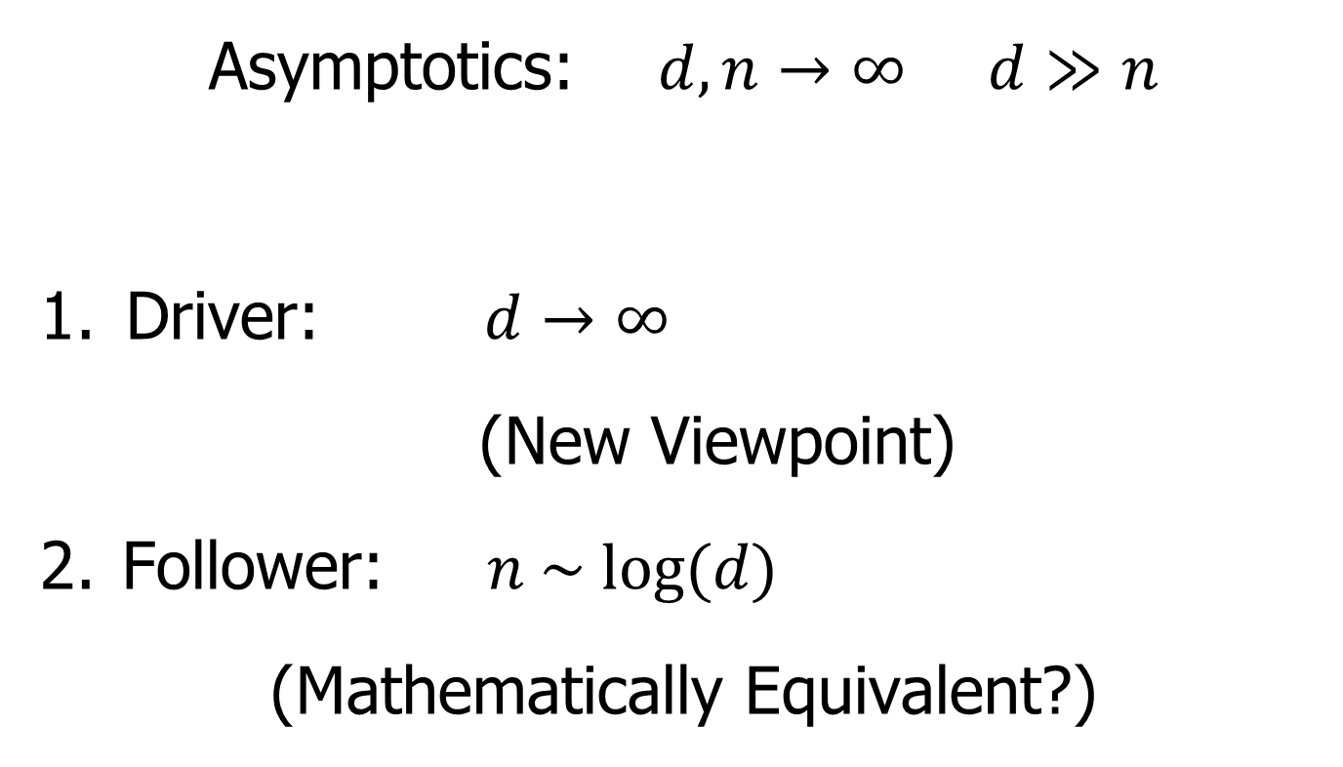
HDMSS, Aoshima View
Asymptotics: $d,n→∞$ $d≫n$
Driver: $d→∞$
(New Viewpoint)
Follower: $n \sim log⁡(d)$
(Mathematically Equivalent?)

Slide 51
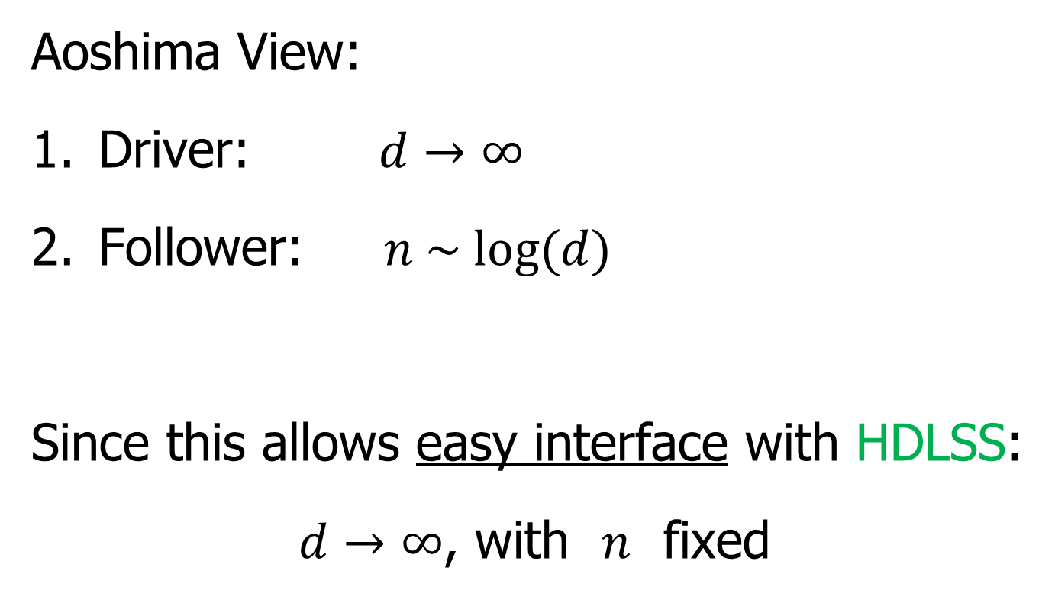
HDMSS, Personal Choice
Aoshima View:
Driver: $d→∞$
Follower: $n \sim log⁡(d)$
Since this allows easy interface with HDLSS:
$d→∞$, with $n$ fixed

Slide 52
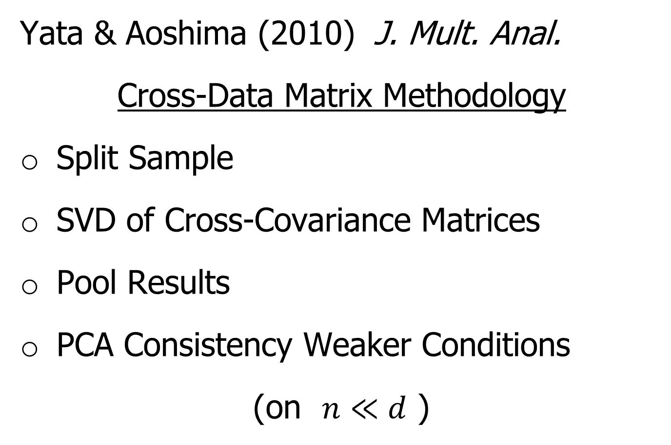
HDMSS, Surprising Result
Yata & Aoshima (2010) J. Mult. Anal.
Cross-Data Matrix Methodology
Split Sample
SVD of Cross-Covariance Matrices
Pool Results
PCA Consistency Weaker Conditions
(on $n≪d$ )

Slide 53
Shapes As Data Objects
Several Different Notions of Shape

Slide 54
Shapes As Data Objects
Several Different Notions of Shape
Oldest and Best Known (in Statistics):
Landmark Based

Slide 55
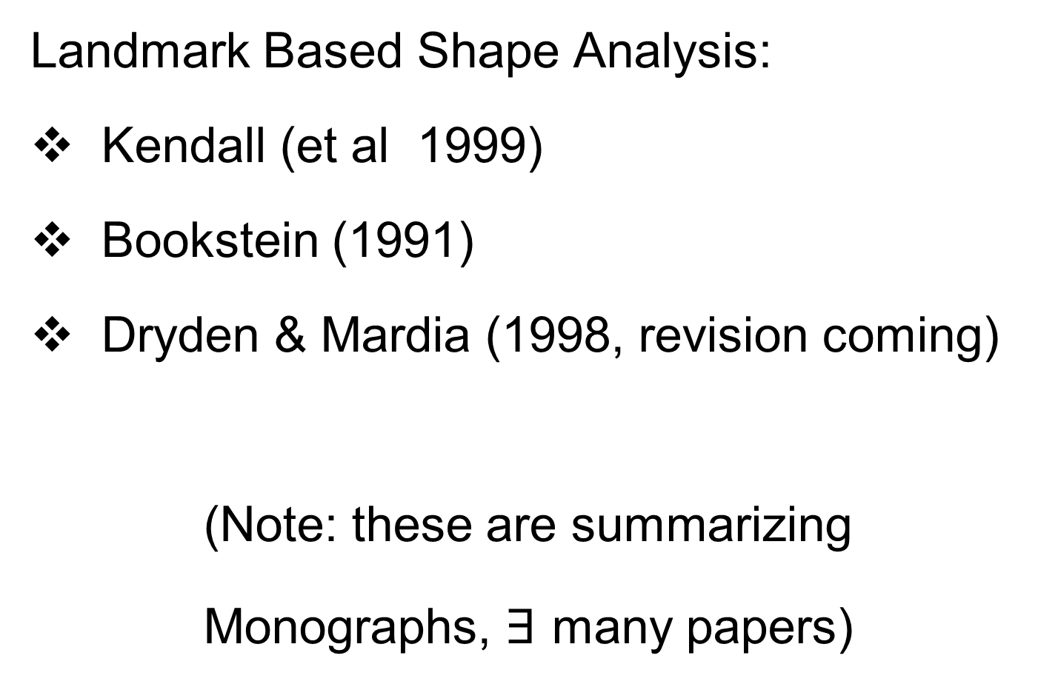
Shapes As Data Objects
Landmark Based Shape Analysis:
Kendall (et al 1999)
Bookstein (1991)
Dryden & Mardia (1998, revision coming)
(Note: these are summarizing
Monographs, $∃$ many papers)

Slide 56
Shapes As Data Objects
Landmark Based Shape Analysis:
Kendall (et al 1999)
Bookstein (1991)
Dryden & Mardia (1998, revision coming)
Recommended as Most Accessible

Slide 57
Landmark Based Shape Analysis
Start by Representing Shapes

Slide 58



Landmark Based Shape Analysis
Start by Representing Shapes by
Landmarks (points in R² or R³)
$$\left(x_{1},y_{1}\right)$$
$$\left(x_{2},y_{2}\right)$$
$$\left(x_{3},y_{3}\right)$$

Slide 59
Landmark Based Shape Analysis
Start by Representing Shapes by
Landmarks (points in R² or R³)
$$\left(x_{1},y_{1}\right)$$
$$\left(x_{2},y_{2}\right)$$
$$\left(x_{3},y_{3}\right)$$

Slide 60
Landmark Based Shape Analysis
Clearly different shapes:

Slide 61
Landmark Based Shape Analysis
Clearly different shapes:
But what about: ?

Slide 62
Landmark Based Shape Analysis
Clearly different shapes:
But what about: ?
(just translation and rotation of,
but different points in R⁶)

Slide 63
Landmark Based Shape Analysis
Note: Shape should be same over different:
Translations

Slide 64
Landmark Based Shape Analysis
Note: Shape should be same over different:
Translations
Rotations

Slide 65
Landmark Based Shape Analysis
Note: Shape should be same over different:
Translations
Rotations
Scalings

Slide 66
Landmark Based Shape Analysis
Approach: Identify objects that are:
Translations
Rotations
Scalings
of each other

Slide 67
Landmark Based Shape Analysis
Approach: Identify objects that are:
Translations
Rotations
Scalings
of each other
Mathematics: Equivalence Relation

Slide 68
Equivalence Relations
Useful Mathematical Device
Weaker generalization of “=“ for a set
Main consequence:
  Partitions Set Into Equivalence Classes
  For “=“, Equivalence Classes Are Singletons

Slide 69
Equivalence Relations
Common Example: Modulo Arithmetic
(E.g. Clock Arithmetic, mod 12)
3 hours after 11:00 is 2:00 …

Slide 70
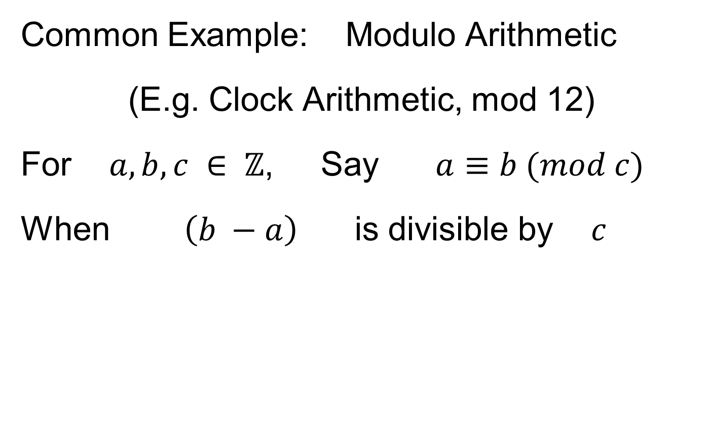
Equivalence Relations
Common Example: Modulo Arithmetic
(E.g. Clock Arithmetic, mod 12)
For $a, b, c ∈ ℤ$, Say $a≡b (mod c)$
When $\left(b −a\right)$ is divisible by $c$

Slide 71
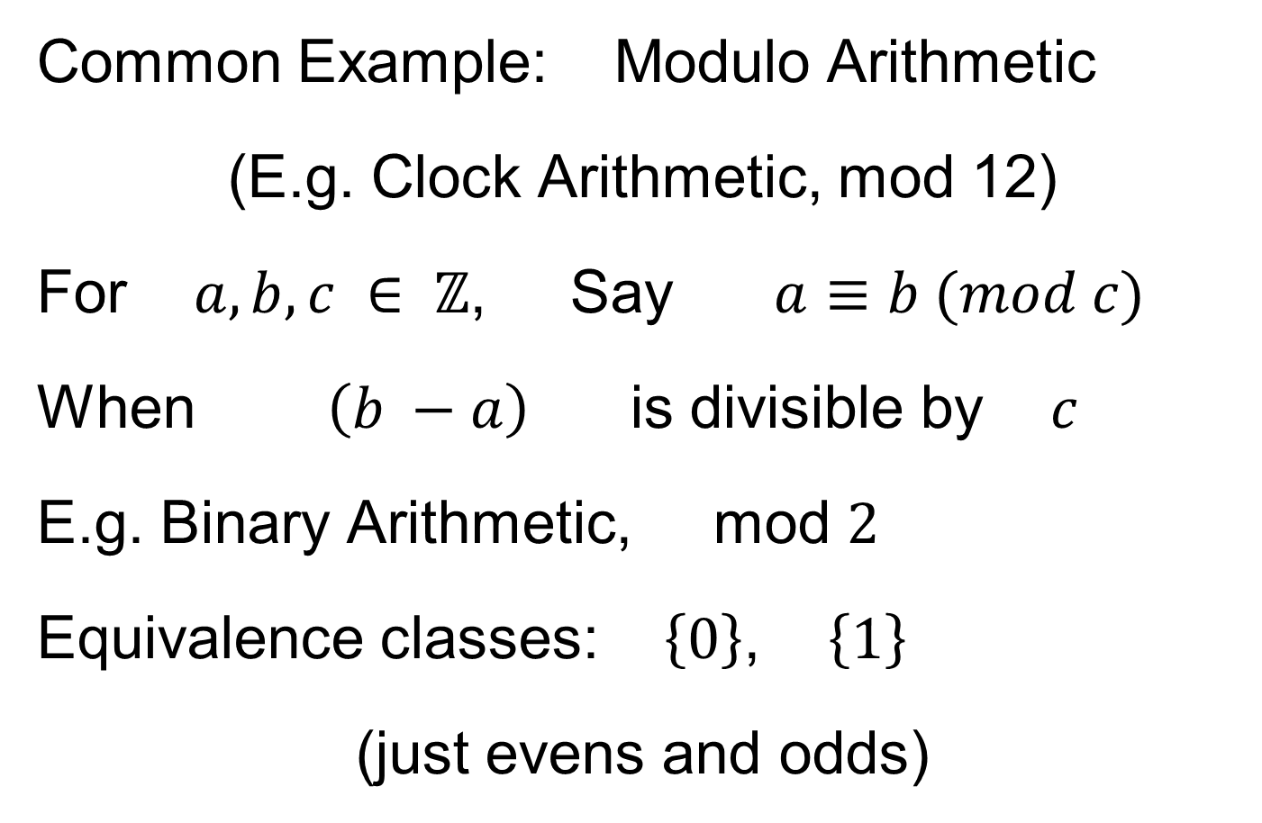
Equivalence Relations
Common Example: Modulo Arithmetic
(E.g. Clock Arithmetic, mod 12)
For $a, b, c ∈ ℤ$, Say $a≡b (mod c)$
When $\left(b −a\right)$ is divisible by $c$
E.g. Binary Arithmetic, mod $2$
Equivalence classes: $\left\{0\right\}$, $\left\{1\right\}$
(just evens and odds)

Slide 72

Equivalence Relations
Another Example: Vector Subspaces
E.g. Say $\left(\begin{matrix}x_{1} \\ y_{1}\end{matrix}\right)≈\left(\begin{matrix}x_{2} \\ y_{2}\end{matrix}\right)$ when $y_{1}=y_{2}$

Slide 73
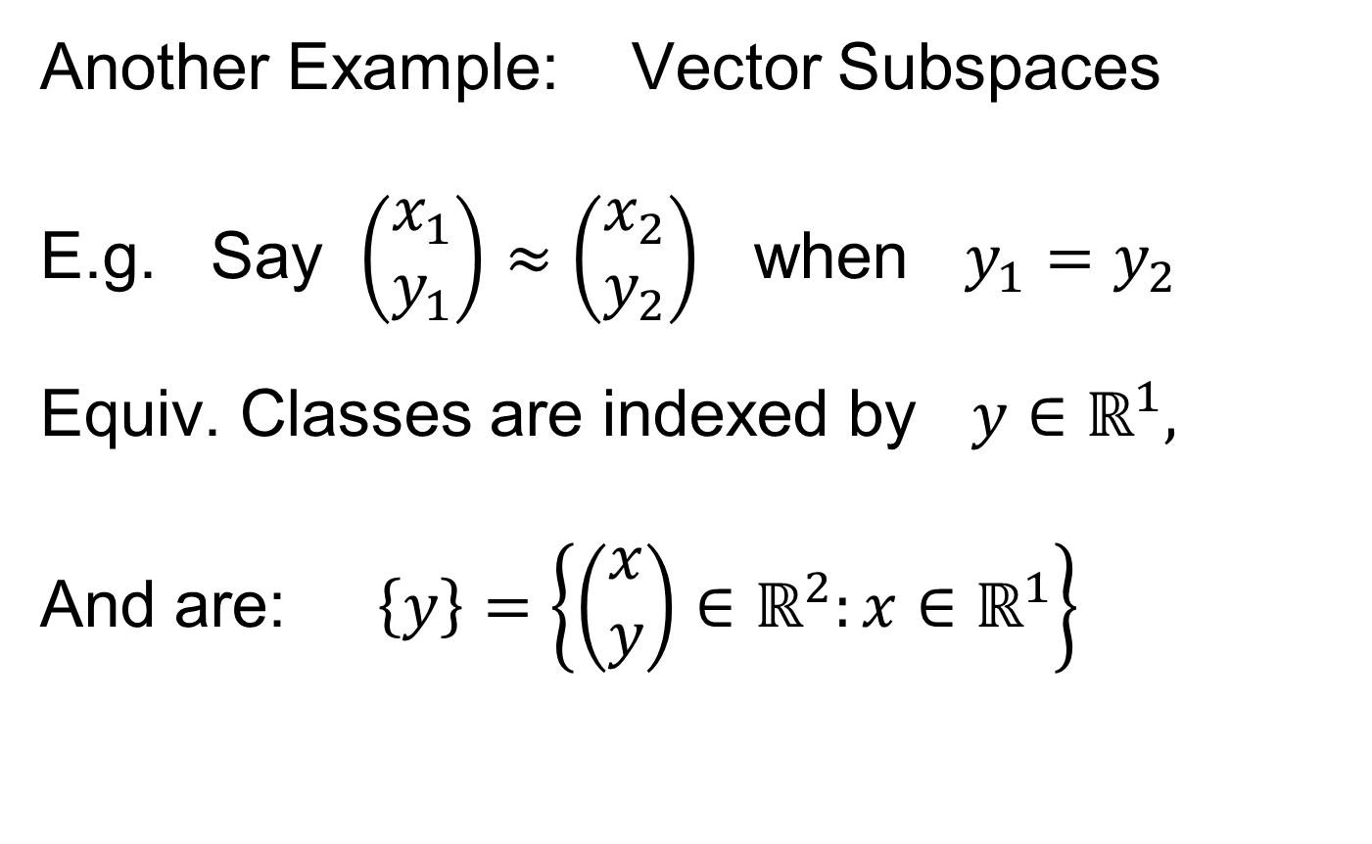
Equivalence Relations
Another Example: Vector Subspaces
E.g. Say $\left(\begin{matrix}x_{1} \\ y_{1}\end{matrix}\right)≈\left(\begin{matrix}x_{2} \\ y_{2}\end{matrix}\right)$ when $y_{1}=y_{2}$
Equiv. Classes are indexed by $y∈ℝ^{1},$
And are: $\left\{y\right\}=\left\{\left(\begin{matrix}x \\ y\end{matrix}\right)∈ℝ^{2}:x∈ℝ^{1}\right\}$

Slide 74
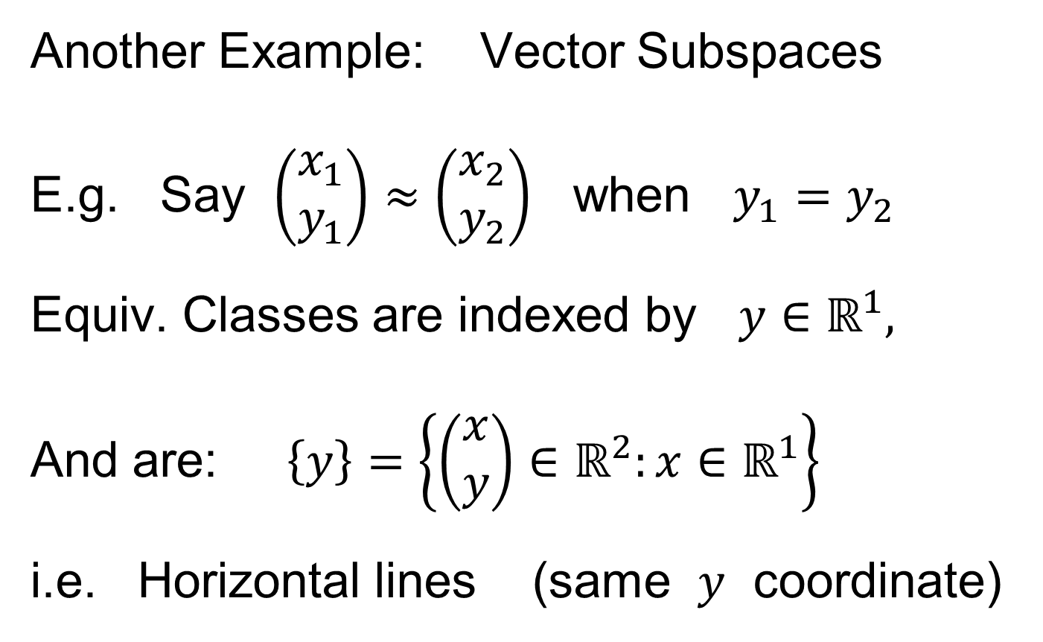
Equivalence Relations
Another Example: Vector Subspaces
E.g. Say $\left(\begin{matrix}x_{1} \\ y_{1}\end{matrix}\right)≈\left(\begin{matrix}x_{2} \\ y_{2}\end{matrix}\right)$ when $y_{1}=y_{2}$
Equiv. Classes are indexed by $y∈ℝ^{1},$
And are: $\left\{y\right\}=\left\{\left(\begin{matrix}x \\ y\end{matrix}\right)∈ℝ^{2}:x∈ℝ^{1}\right\}$
i.e. Horizontal lines (same $y$ coordinate)

Slide 75

Equivalence Relations
Deeper Example: Transformation Groups
For $g∈G$, operating on a set $S$
Say $s_{1}≈s_{2}$ when $∃$ $g$ where $g\left(s_{1}\right)=s_{2}$

Slide 76
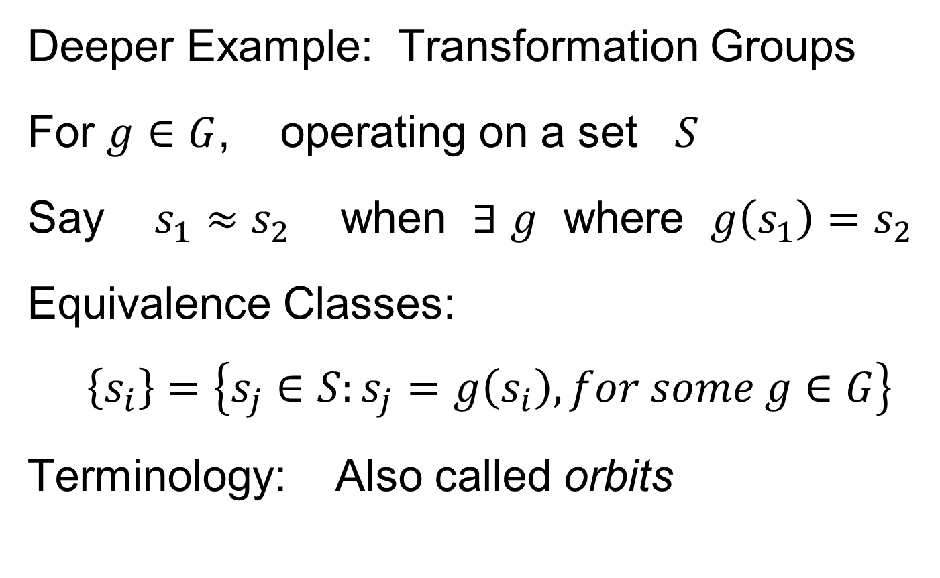
Equivalence Relations
Deeper Example: Transformation Groups
For $g∈G$, operating on a set $S$
Say $s_{1}≈s_{2}$ when $∃$ $g$ where $g\left(s_{1}\right)=s_{2}$
Equivalence Classes:
$$\left\{s_{i}\right\}=\left\{s_{j}∈S:s_{j}=g\left(s_{i}\right), for some g∈G\right\}$$
Terminology: Also called orbits

Slide 77
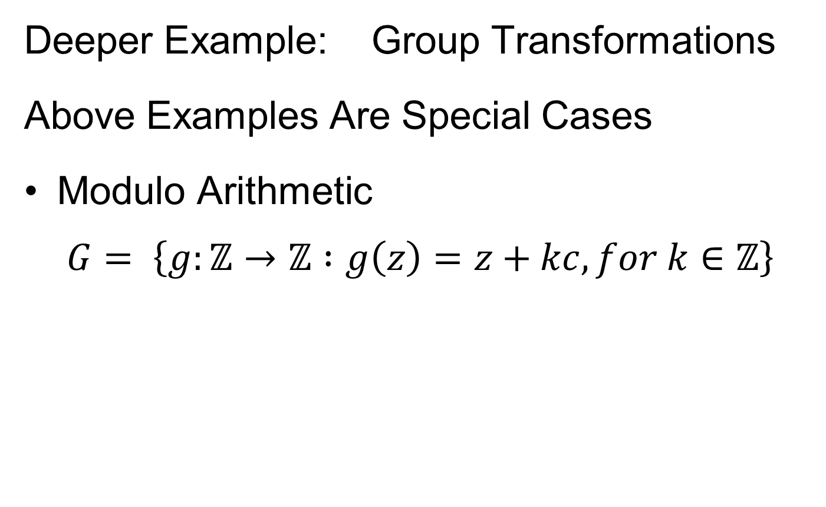
Equivalence Relations
Deeper Example: Group Transformations
Above Examples Are Special Cases
Modulo Arithmetic
$$G= \left\{g:ℤ→ℤ :g\left(z\right)=z+kc, for k∈ℤ\right\}$$

Slide 78
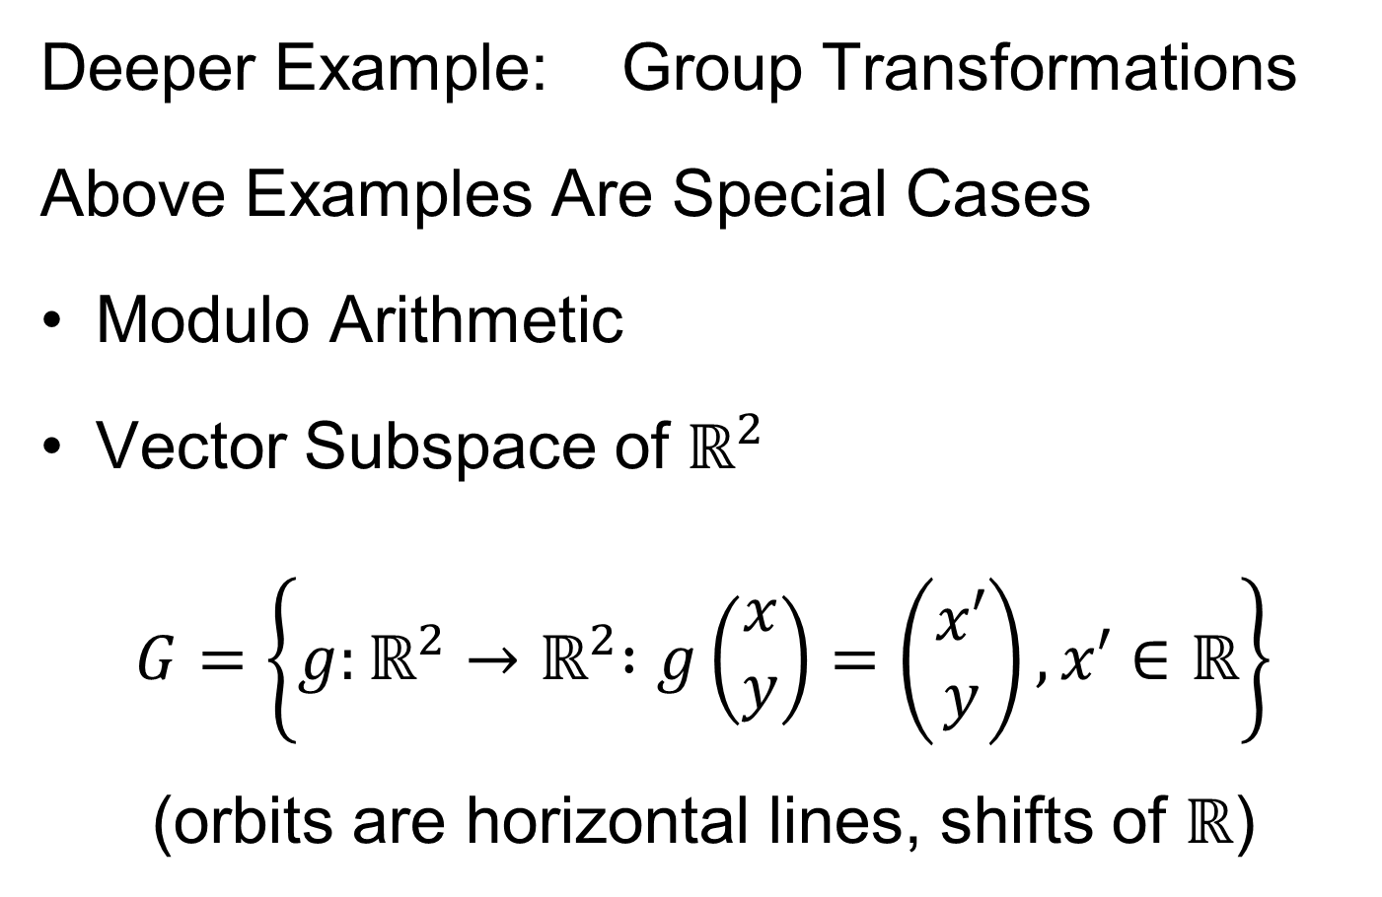
Equivalence Relations
Deeper Example: Group Transformations
Above Examples Are Special Cases
Modulo Arithmetic
Vector Subspace of $ℝ^{2}$
$$G=\left\{g:ℝ^{2}{→ℝ}^{2} :g\left(\begin{matrix}x \\ y\end{matrix}\right)=\left(\begin{matrix}x′ \\ y\end{matrix}\right), x′∈ℝ\right\}$$
(orbits are horizontal lines, shifts of $ℝ$)

Slide 79
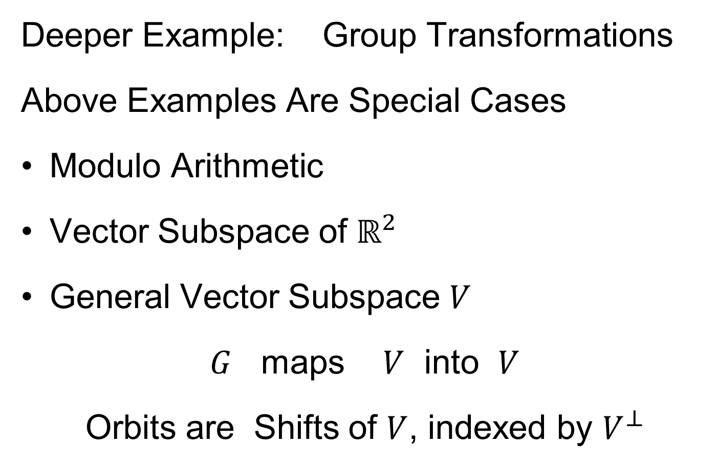
Equivalence Relations
Deeper Example: Group Transformations
Above Examples Are Special Cases
Modulo Arithmetic
Vector Subspace of $ℝ^{2}$
General Vector Subspace $V$
$G$ maps $V$ into $V$
Orbits are Shifts of $V$, indexed by $V^{⊥}$

Slide 80
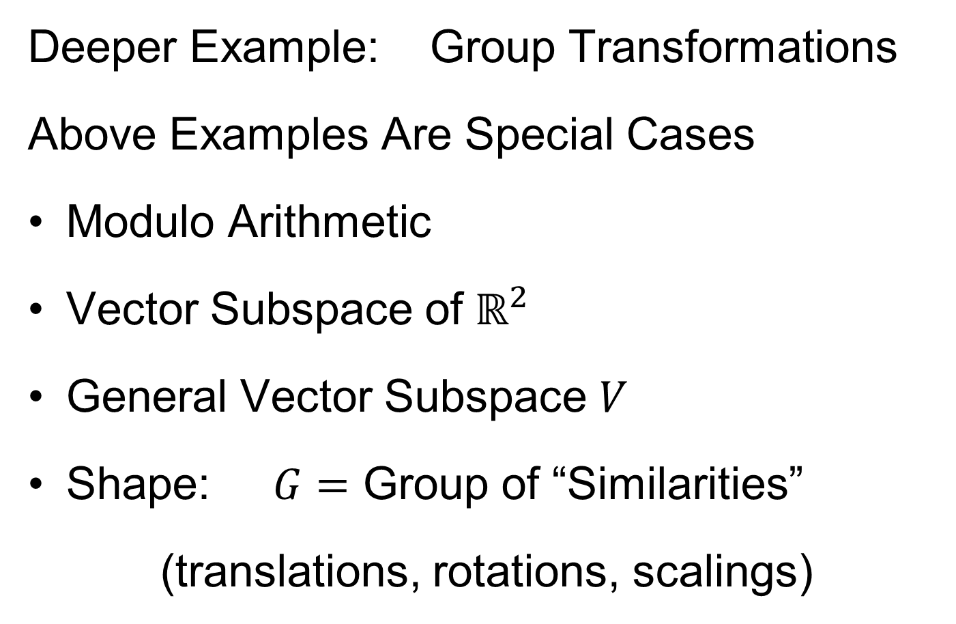
Equivalence Relations
Deeper Example: Group Transformations
Above Examples Are Special Cases
Modulo Arithmetic
Vector Subspace of $ℝ^{2}$
General Vector Subspace $V$
Shape: $G=$ Group of “Similarities”
(translations, rotations, scalings)

Slide 81
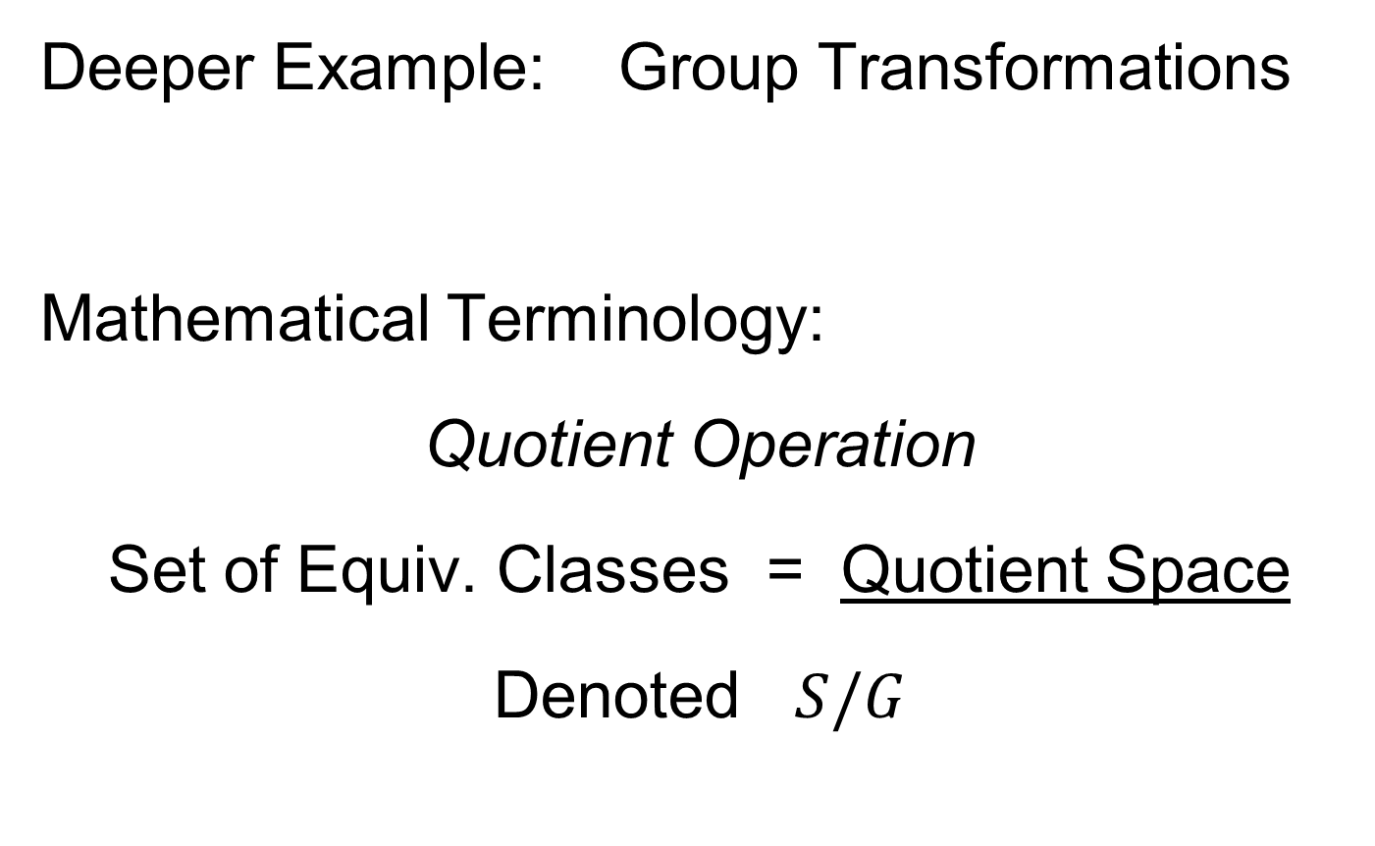
Equivalence Relations
Deeper Example: Group Transformations
Mathematical Terminology:
Quotient Operation
Set of Equiv. Classes = Quotient Space
Denoted $S/G$

Slide 82
Landmark Based Shape Analysis
Approach: Identify objects that are:
Translations
Rotations
Scalings
of each other
Mathematics: Equivalence Relation
Results in: Equivalence Classes (orbits)

Slide 83
Landmark Based Shape Analysis
Approach: Identify objects that are:
Translations
Rotations
Scalings
of each other
Mathematics: Equivalence Relation
Results in: Equivalence Classes (orbits)
Which become the Data Objects

Slide 84
Landmark Based Shape Analysis
Equivalence Classes become Data Objects
, , , , , ,

Slide 85
Landmark Based Shape Analysis
Equivalence Classes become Data Objects
Mathematics: Called “Quotient Space”
, , , , , ,

Slide 86
Landmark Based Shape Analysis
Equivalence Classes become Data Objects
Mathematics: Called “Quotient Space”
Intuitive Representation: Manifold
(curved surface)
, , , , , ,

Slide 87
Landmark Based Shape Analysis
Triangle Shape Space: Represent as Sphere
, , , , , ,

Slide 88
Landmark Based Shape Analysis
Triangle Shape Space: Represent as Sphere:
R⁶ → R⁴
translation
, , , , , ,

Slide 89
Landmark Based Shape Analysis
Triangle Shape Space: Represent as Sphere:
R⁶ → R⁴ → R³
rotation
, , , , , ,

Slide 90
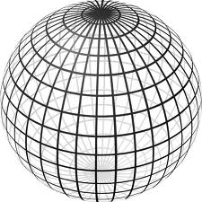
Landmark Based Shape Analysis
Triangle Shape Space: Represent as Sphere:
R⁶ → R⁴ → R³ →
scaling
(thanks to Wikipedia)
, , , , , ,

Slide 91
Shapes As Data Objects
Common Property of Shape Data Objects:
Natural Feature Space is Curved
I.e. a Manifold (from Differential Geometry)

Slide 92
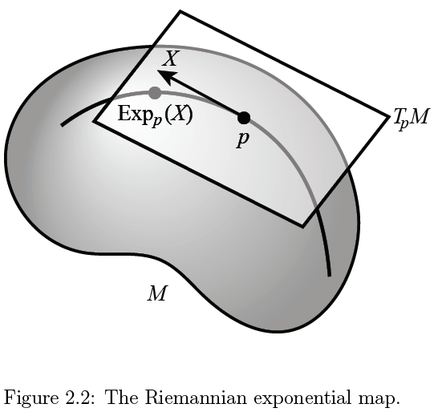
Manifold Feature Spaces
(Elegant
Illustrative
Graphic)
Thanks to P. T. Fletcher

Slide 93
Manifold Feature Spaces
Data Lie in Curved
Surface

Slide 94
Manifold Feature Spaces
At Each Point

Slide 95

Manifold Feature Spaces
At Each Point,
$∃$ Approx’ing
Tangent Plane
(in limit of shrinking
neighborhoods of p)

Slide 96

Manifold Feature Spaces
Important Mappings:
Plane → Surface:
$\exp_{p}$

Slide 97
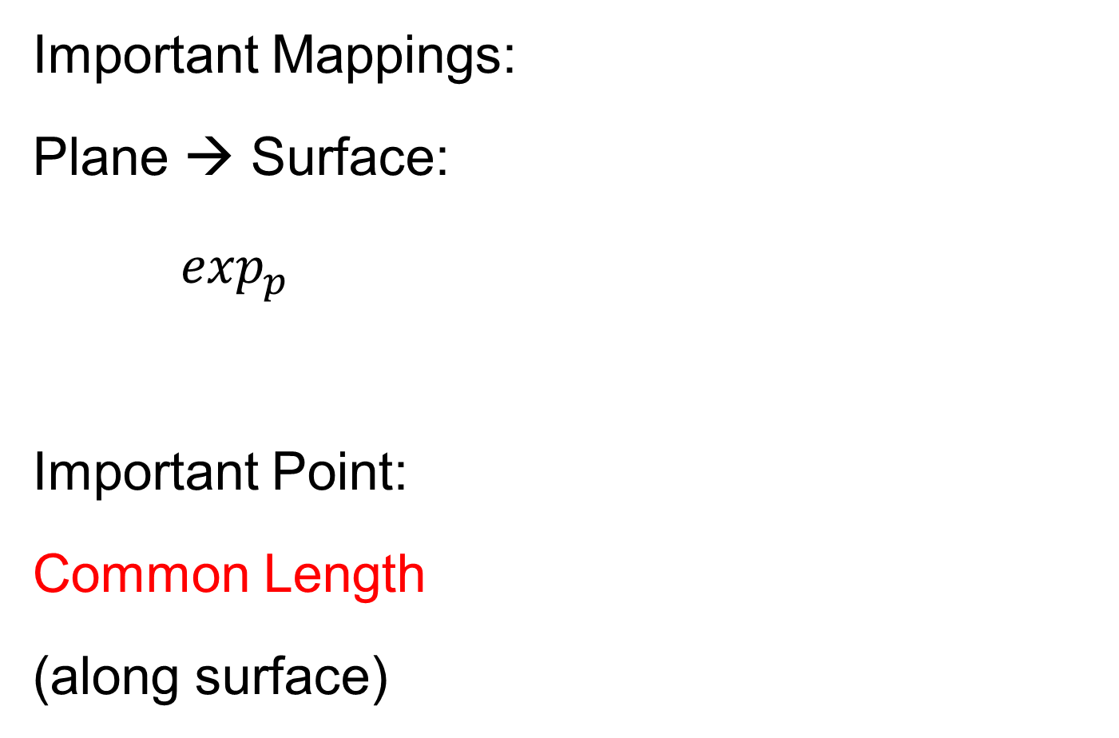
Manifold Feature Spaces
Important Mappings:
Plane → Surface:
$\exp_{p}$
Important Point:
Common Length
(along surface)

Slide 98

Manifold Feature Spaces
Important Mappings:
Plane → Surface:
$\exp_{p}$
Surface → Plane
$\log_{p}$

Slide 99

Manifold Feature Spaces
Important Mappings:
Plane → Surface:
$\exp_{p}$
Surface → Plane
$\log_{p}$
(matrix versions)

Slide 100
Manifold Feature Spaces
Log & Exp Memory Device:
Complex Numbers

Slide 101
Manifold Feature Spaces
Log & Exp Memory Device:
Complex Numbers
Exponential:
Tangent Plane → Manifold

Slide 102
Manifold Feature Spaces
Log & Exp Memory Device:
Complex Numbers
Exponential:
Tangent Plane → Manifold
Logarithm:
Manifold → Tangent Plane

Slide 103
Manifold Feature Spaces
Standard Statistical Example:
Directional Data (aka Circular Data)

Slide 104
Manifold Feature Spaces
Standard Statistical Example:
Directional Data (aka Circular Data)
Idea: Angles as Data Objects
Wind Directions
Magnetic Compass Headings
Cracks in Mines

Slide 105
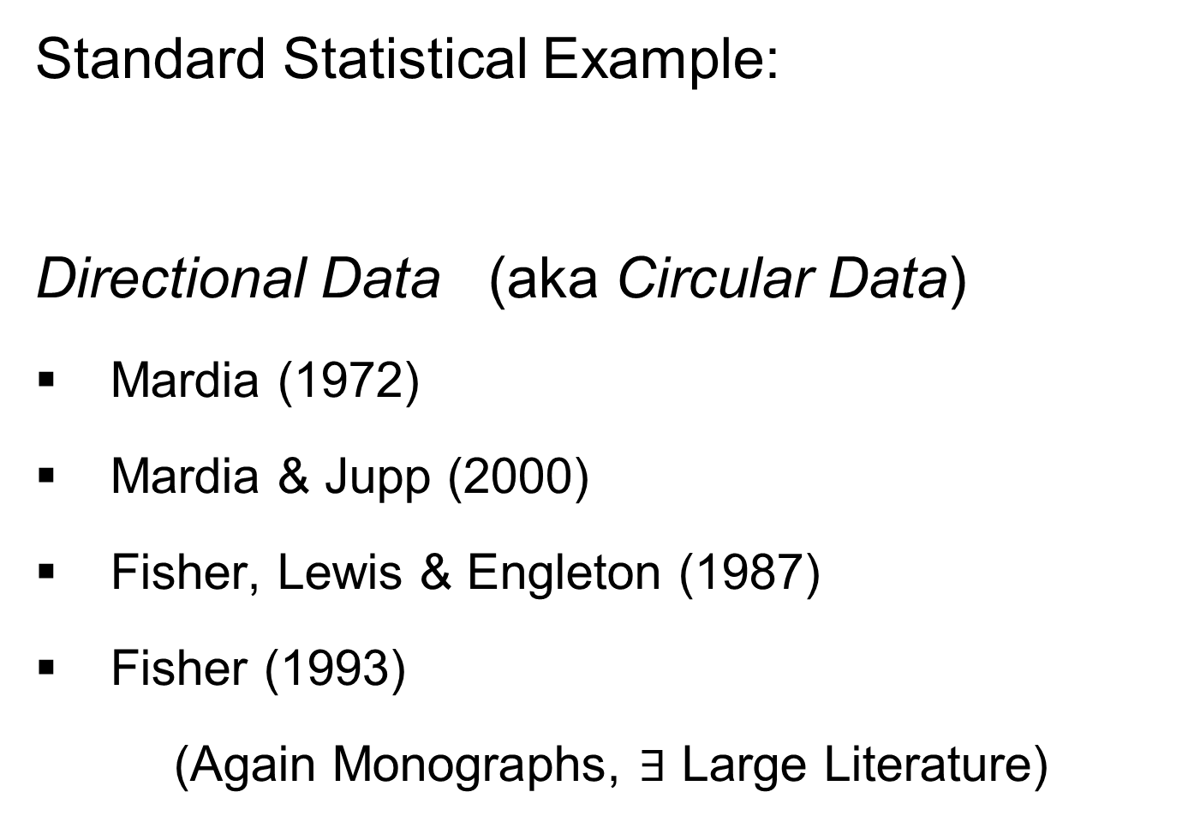
Manifold Feature Spaces
Standard Statistical Example:
Directional Data (aka Circular Data)
Mardia (1972)
Mardia & Jupp (2000)
Fisher, Lewis & Engleton (1987)
Fisher (1993)
(Again Monographs, $∃$ Large Literature)

Slide 106
Manifold Feature Spaces
Standard Statistical Example:
Directional Data (aka Circular Data)
Reasonable View:
Points on Unit Circle

Slide 107
Manifold Feature Spaces
Directional Data
(Already Challenging)

Slide 108

Manifold Feature Spaces
Directional Data
E.g. “average” of: $2^{°}$, $3^{°}$, ${358}^{°}$, ${359}^{°}$, = ???

Slide 109

Manifold Feature Spaces
Directional Data
E.g. “average” of: $2^{°}$, $3^{°}$, ${358}^{°}$, ${359}^{°}$, = ???
$\sum_{i}{{θ_{i}}/4}$ ?

Slide 110

Manifold Feature Spaces
Directional Data
E.g. “average” of: $2^{°}$, $3^{°}$, ${358}^{°}$, ${359}^{°}$, = ???
$\sum_{i}{{θ_{i}}/4}$
x
x
x
x

Slide 111

Manifold Feature Spaces
Directional Data
E.g. “average” of: $2^{°}$, $3^{°}$, ${358}^{°}$, ${359}^{°}$, = ???
$\sum_{i}{{θ_{i}}/4}$
Clearly Inappropriate
x
x
x
x

Slide 112

Manifold Feature Spaces
Directional Data
E.g. “average” of: $2^{°}$, $3^{°}$, ${358}^{°}$, ${359}^{°}$, = ???
Should
Use Unit
Circle
Structure
x
x
x
x

Slide 113

Manifold Feature Spaces
Directional Data
E.g. “average” of: $2^{°}$, $3^{°}$, ${358}^{°}$, ${359}^{°}$, = ???
Recommended Approach:
(There are a Number of Others)

Slide 114

Manifold Feature Spaces
Directional Data
E.g. “average” of: $2^{°}$, $3^{°}$, ${358}^{°}$, ${359}^{°}$, = ???
Recommended Approach:
Fréchet Mean

Slide 115

Manifold Feature Spaces
Directional Data
E.g. “average” of: $2^{°}$, $3^{°}$, ${358}^{°}$, ${359}^{°}$, = ???
Recommended Approach:
Fréchet Mean
Fréchet (1948)

Slide 116

Manifold Feature Spaces
Fréchet Mean
Synonyms:
Geodesic Mean
Barycenter
Karcher Mean
$⋮$

Slide 117
Manifold Feature Spaces
Fréchet Mean of Numbers:
Point Nearest to Data Points in L. S. Sense

Slide 118
Manifold Feature Spaces
Fréchet Mean of Numbers:
(Easy to Check by Calculus)

Slide 119

Manifold Feature Spaces
Fréchet Mean of Numbers:
Fréchet Mean in Euclidean Space ($ℝ^{d}$):

Slide 120

Manifold Feature Spaces
Fréchet Mean of Numbers:
Fréchet Mean in Euclidean Space ($ℝ^{d}$):
(Also Can Check with Calculus)

Slide 121

Manifold Feature Spaces
Fréchet Mean of Numbers:
Fréchet Mean in Euclidean Space ($ℝ^{d}$):
Fréchet Mean on a Manifold:
Replace Euclidean by Geodesic

Slide 122
Manifold Feature Spaces
Geodesics:
Idea:
March Along Manifold Without Turning

Slide 123
Manifold Feature Spaces
Geodesics:
Idea:
March Along Manifold Without Turning
(Defined in Tangent Plane)

Slide 124
Manifold Feature Spaces
Geodesics:
Idea:
March Along Manifold Without Turning
(Defined in Tangent Plane)
E.g. Surface of the Earth: Great Circle
(but not small circles)

Slide 125
Manifold Feature Spaces
Geodesics:
Idea:
March Along Manifold Without Turning
(Defined in Tangent Plane)
E.g. Surface of the Earth: Great Circle
E.g. Lines of Longitude (Not Latitude…)

Slide 126

Manifold Feature Spaces
Geodesic Distance:
Given Points $x$ & $y$, define
$$d\left(x,y\right)=\min_{g:geodesic from x to y}{length(g)}$$

Slide 127

Manifold Feature Spaces
Geodesic Distance:
Given Points $x$ & $y$, define
$$d\left(x,y\right)=\min_{g:geodesic from x to y}{length(g)}$$
Can Show:
$d$ is a metric (distance)

Slide 128
Manifold Feature Spaces
Fréchet Mean of Numbers:
Fréchet Mean in Euclidean Space ($ℝ^{d}$):
Fréchet Mean on a Manifold:
Replace Euclidean by Geodesic

Slide 129
Manifold Feature Spaces
Fréchet Mean of Numbers:
Well Known in Robust Statistics
(Recall Resistant to Outliers)

Slide 130
Manifold Feature Spaces
Fréchet Mean of Numbers:
Well Known in Robust Statistics:
Replace Euclidean Distance
With Robust Distance, e.g. $L^{2}$ with $L^{1}$

Slide 131

Manifold Feature Spaces
Fréchet Mean of Numbers:
Well Known in Robust Statistics:
Replace Euclidean Distance
With Robust Distance, e.g. $L^{2}$ with $L^{1}$
Reduces Influence of Outliers
Gives Other Notions of Robust Median

Slide 132
Manifold Feature Spaces
Fréchet Mean in General:
Big Advantage:
Works in Any Metric Space

Slide 133

Manifold Feature Spaces
Directional Data Examples of Fréchet Mean

Slide 134

Manifold Feature Spaces
Directional Data Examples of Fréchet Mean:
Not always easily interpretable

Slide 135

Manifold Feature Spaces
Directional Data Examples of Fréchet Mean:
Not always easily interpretable
  Think about distances along arc
  Not about “points in $ℝ^{2}$”
  Sum of squared distances
  strongly feels the largest

Slide 136

Manifold Feature Spaces
Directional Data Examples of Fréchet Mean:
Not always easily interpretable
  Think about distances along arc
  Not about “points in $ℝ^{2}$”
  Sum of squared distances
  strongly feels the largest
Not always unique

Slide 137

Manifold Feature Spaces
Directional Data Examples of Fréchet Mean:
Not always easily interpretable
  Think about distances along arc
  Not about “points in $ℝ^{2}$”
  Sum of squared distances
  strongly feels the largest
Not always unique
  But unique with probability one
  (for data from distribution absolutely
  continuous w. r. t. Lebesgue Measure)

Slide 138

Manifold Feature Spaces
Directional Data Examples of Fréchet Mean:
Not always easily interpretable
  Think about distances along arc
  Not about “points in $ℝ^{2}$”
  Sum of squared distances
  strongly feels the largest
Not always unique
  But unique with probability one
  Non-unique requires strong symmetry
  But possible to have many means

Slide 139

Manifold Feature Spaces
Directional Data Examples of Fréchet Mean:
Not always sensible notion of center

Slide 140
Manifold Feature Spaces
Directional Data Examples of Fréchet Mean:
Not always sensible notion of center
  Sometimes prefer top & bottom?
  At end: farthest points from data

Slide 141
Manifold Feature Spaces
Directional Data Examples of Fréchet Mean:
Not always sensible notion of center
  Sometimes prefer top & bottom?
  At end: farthest points from data
Not continuous Function of Data
  Jump from 1 – 2
  Jump from 2 – 8

Slide 142
Manifold Feature Spaces
Directional Data Examples of Fréchet Mean:
Not always sensible notion of center
  Sometimes prefer top & bottom?
  At end: farthest points from data
Not continuous Function of Data
  Jump from 1 – 2
  Jump from 2 – 8
All False for Euclidean Mean
But all happen generally for Manifold Data

Slide 143
Manifold Feature Spaces
Directional Data Examples of Fréchet Mean:
Also of interest is Fréchet Variance:
Works like Euclidean sample variance

Slide 144
Manifold Feature Spaces
Directional Data Examples of Fréchet Mean:
Also of interest is Fréchet Variance:
Works like Euclidean sample variance
Note values in movie, reflecting spread in data

Slide 145
Manifold Feature Spaces
Directional Data Examples of Fréchet Mean:
Also of interest is Fréchet Variance:
Works like Euclidean sample variance
Note values in movie, reflecting spread in data
Note theoretical version:
Useful for Laws of Large Numbers, etc.

