Slide 1
HDLSS Asy’s: Geometrical Represent’n
Assume , let
Study Subspace Generated by Data
Hyperplane through 0,
of dimension
Points are “nearly equidistant to 0”,
& dist
Within plane, can
“rotate towards Unit Simplex”
All Gaussian data sets are:
“near Unit Simplex Vertices”!!!
“Randomness” appears
only in rotation of simplex
Hall, Marron & Neeman (2005)

Slide 2
HDLSS Asy’s: Geometrical Represen’tion
Explanation of Observed (Simulation) Behavior:
“everything similar for very high d ”
2 popn’s are 2 simplices (i.e. regular n-hedrons)
All are same distance from the other class
i.e. everything is a support vector
i.e. all sensible directions show “data piling”
so “sensible methods are all nearly the same”

Slide 3
2nd Paper on HDLSS Asymptotics
Notes on Kent’s Normal Scale Mixture
Data Vectors are indep’dent of each other
But entries of each have strong depend’ce
However, can show entries have cov = 0!
Recall statistical folklore:
Covariance = 0 Independence

Slide 4
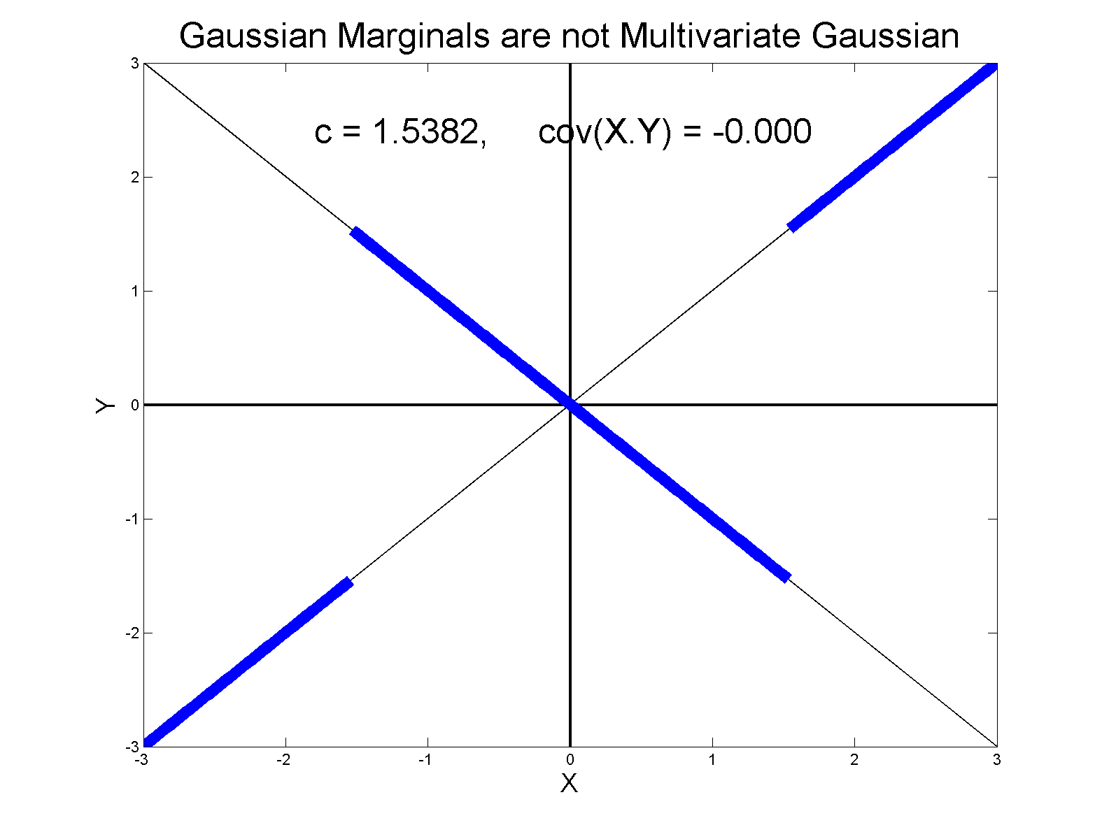
0 Covariance is not independence
Simple Example, c to make cov(X,Y) = 0

Slide 5
0 Covariance is not independence
Result:
Joint distribution of and :
  Has Gaussian marginals
  Has
  Yet strong dependence of and
  Thus not multivariate Gaussian
Shows Multivariate Gaussian means more
than Gaussian Marginals

Slide 6
HDLSS Asy’s: Geometrical Represen’tion
Further Consequences of Geometric Represen’tion
1. DWD more stable than SVM
(based on deeper limiting distributions)
(reflects intuitive idea feeling sampling variation)
(something like mean vs. median)
Hall, Marron, Neeman (2005)
2. 1-NN rule inefficiency is quantified.
Hall, Marron, Neeman (2005)
3. Inefficiency of DWD for uneven sample size
(motivates weighted version)
Qiao, et al (2010)

Slide 7
HDLSS Math. Stat. of PCA
Consistency & Strong Inconsistency:
Spike Covariance Model, Paul (2007)
For Eigenvalues:
1st Eigenvector:
How Good are Empirical Versions,
as Estimates?

Slide 8
HDLSS Math. Stat. of PCA
Consistency (big enough spike):
For ,
Strong Inconsistency (spike not big enough):
For ,

Slide 9
HDLSS Math. Stat. of PCA
PC Scores (i.e. projections)
Not Consistent
So how can PCA find Useful Signals in Data?
Key is “Proportional Errors”
Axes have Inconsistent Scales,
But Relationships are Still Useful

Slide 10
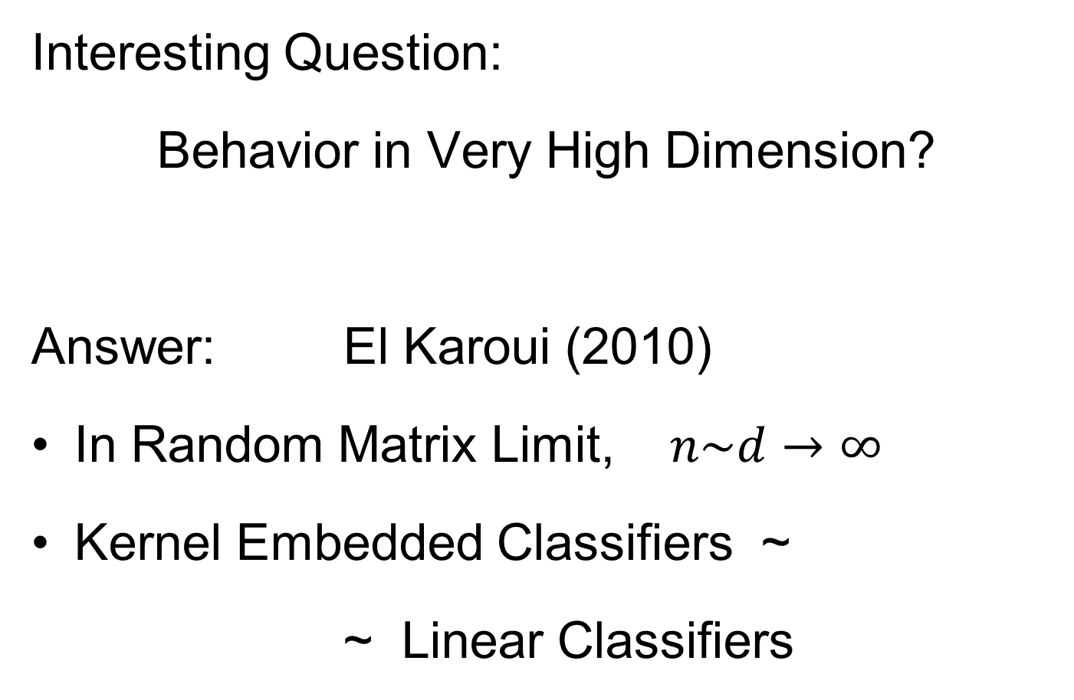

HDLSS Asymptotics & Kernel Methods
Interesting Question:
Behavior in Very High Dimension?
Answer: El Karoui (2010)
In Random Matrix Limit, $n\sim d→∞$
Kernel Embedded Classifiers ~
~ Linear Classifiers

Slide 11
HDLSS Asymptotics & Kernel Methods
Interesting Question:
Behavior in Very High Dimension?
Implications for DWD:
Recall Main Advantage is for High d

Slide 12
HDLSS Asymptotics & Kernel Methods
Interesting Question:
Behavior in Very High Dimension?
Implications for DWD:
Recall Main Advantage is for High d
So not Clear Embedding Helps
Thus not yet Implemented in DWD

Slide 13
HDLSS Additional Results
Batch Adjustment: Xuxin Liu
Recall Intuition from above:
Key is sizes of biological subtypes
Differing ratio trips up mean
But DWD more robust
Mathematics behind this?

Slide 14
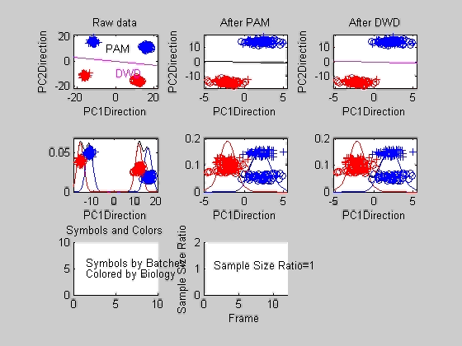
Liu: Twiddle ratios of subtypes

Slide 15
HDLSS Data Combo Mathematics
Xuxin Liu Dissertation Results:
Simple Unbalanced Cluster Model
Growing at rate as
Answers depend on
Visualization of setting….

Slide 16
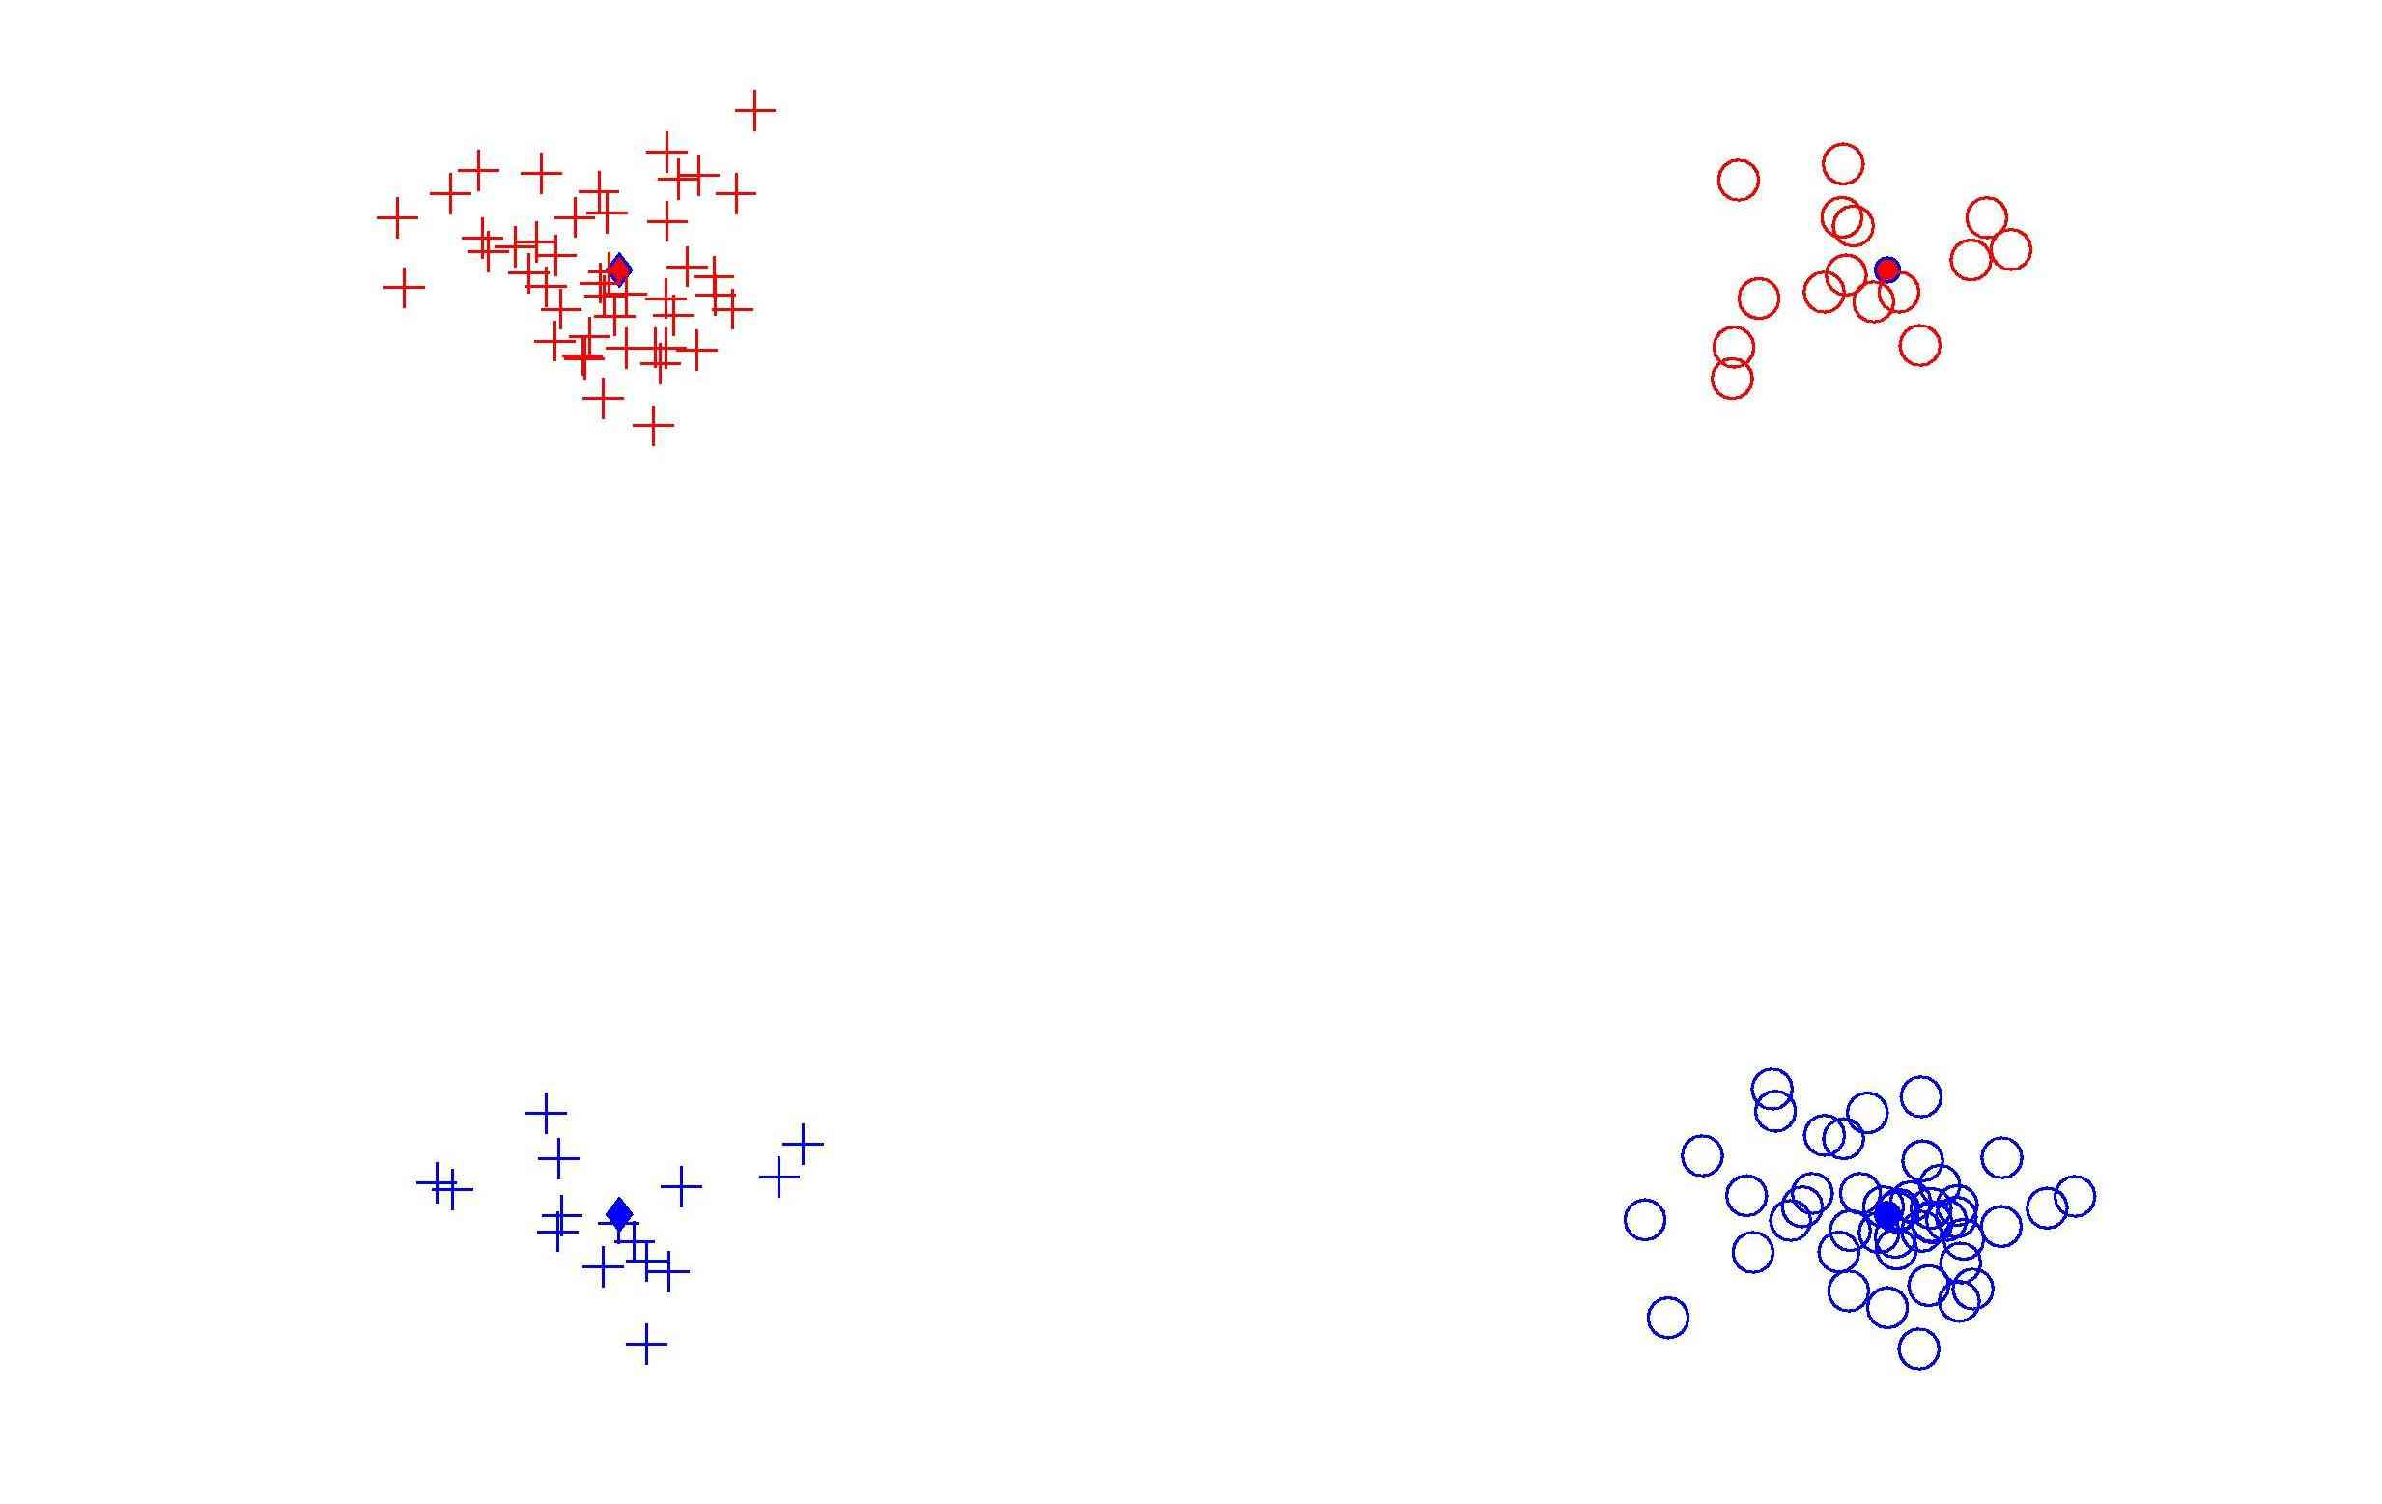
HDLSS Data Combo Mathematics

Slide 17
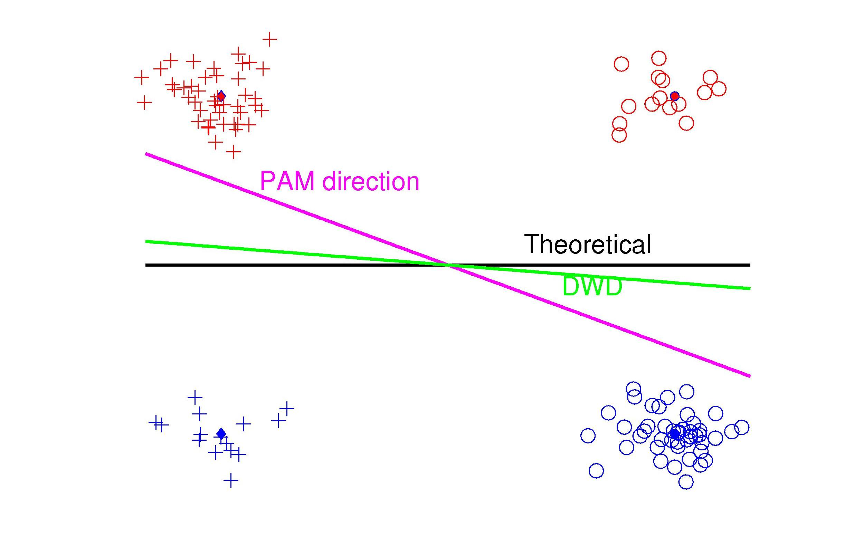
HDLSS Data Combo Mathematics

Slide 18
HDLSS Data Combo Mathematics
Asymptotic Results (as )
Let denote ratio between subgroup sizes

Slide 19
HDLSS Data Combo Mathematics
Asymptotic Results (as ):
For , PAM Inconsistent
Angle(PAM,Truth)
For , PAM Strongly Inconsistent
Angle(PAM,Truth)

Slide 20
HDLSS Data Combo Mathematics
Asymptotic Results (as ):
For , DWD Inconsistent
Angle(DWD,Truth)
For , DWD Strongly Inconsistent
Angle(DWD,Truth)

Slide 21
HDLSS Data Combo Mathematics
Value of and , for sample size ratio :
, only when
Otherwise for , both are Inconsistent

Slide 22
HDLSS Data Combo Mathematics
Comparison between PAM and DWD?
I.e. between and ?

Slide 23
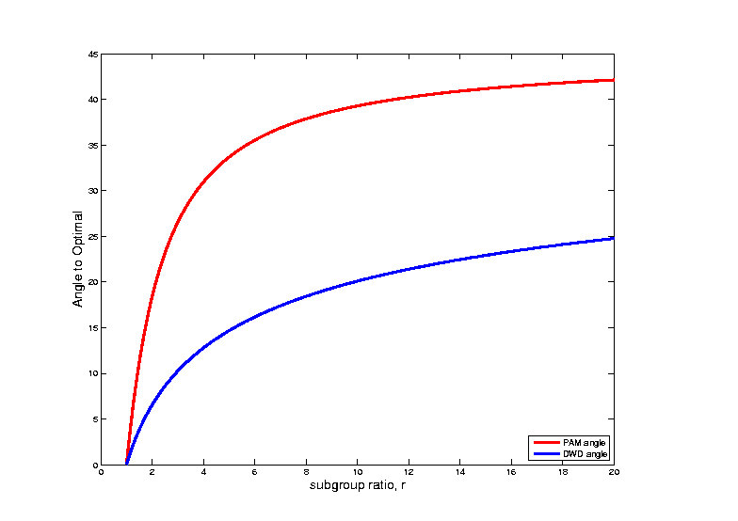
HDLSS Data Combo Mathematics
Comparison between PAM and DWD?

Slide 24
HDLSS Data Combo Mathematics
Comparison between PAM and DWD?
I.e. between and ?
Shows Strong Difference
Explains Above Empirical Observation

Slide 25
HDLSS Asymptotics
Personal Observations:
HDLSS world is…

Slide 26
HDLSS Asymptotics
Personal Observations:
HDLSS world is…
Surprising (many times!)
[Think I’ve got it, and then …]

Slide 27
HDLSS Asymptotics
Personal Observations:
HDLSS world is…
Surprising (many times!)
[Think I’ve got it, and then …]
Mathematically Beautiful (?)

Slide 28
HDLSS Asymptotics
Personal Observations:
HDLSS world is…
Surprising (many times!)
[Think I’ve got it, and then …]
Mathematically Beautiful (?)
Practically Relevant

Slide 29
The Future of HDLSS Asymptotics
“Contiguity” in Hypo Testing?
Rates of Convergence?
Improvements of DWD?
(e.g. other functions of distance than inverse)
Many Others?
It is still early days …

Slide 30

State of HDLSS Research?
Development
Of Methods
Mathematical
Assessment
…
(thanks to:
defiant.corban.edu/gtipton/net-fun/iceberg.html)

Slide 31
Independent Component Analysis
Personal Viewpoint:
Directions
(e.g. PCA, DWD)

Slide 32
Independent Component Analysis
Personal Viewpoint:
Directions that maximize independence

Slide 33
Independent Component Analysis
Personal Viewpoint:
Directions that maximize independence
Motivating Context: Signal Processing
“Blind Source Separation”

Slide 34
Independent Component Analysis
References:
Cardoso (1993) (1st paper)
Lee (1998) (early book, not recco’ed)
Hyvärinen & Oja (1998)
(excellent short tutorial)
Hyvärinen, Karhunen & Oja (2001)
(detailed monograph)

Slide 35
ICA, Motivating Example
“Cocktail party problem”

Slide 36
ICA, Motivating Example
“Cocktail party problem”:
Hear several simultaneous conversations
Would like to
separate them

Slide 37
ICA, Motivating Example
“Cocktail party problem”:
Hear several simultaneous conversations
Would like to
separate them
Model for “conversations”: time series
and

Slide 38
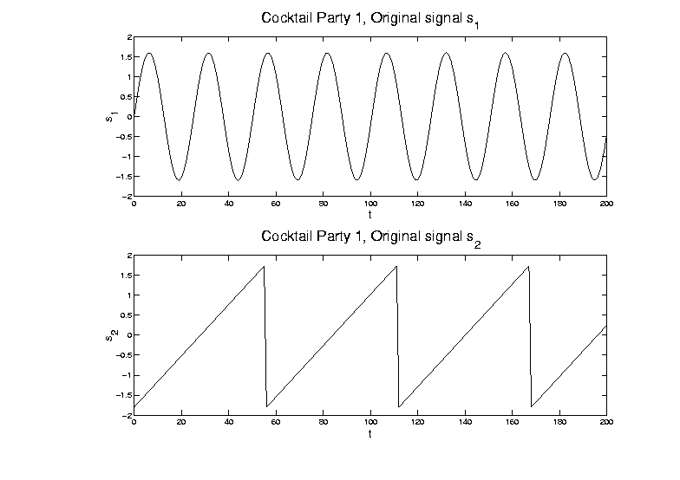
ICA, Motivating Example
Model for “conversations”: time series

Slide 39
ICA, Motivating Example
Mixed version of signals
And also a 2nd mixture:

Slide 40
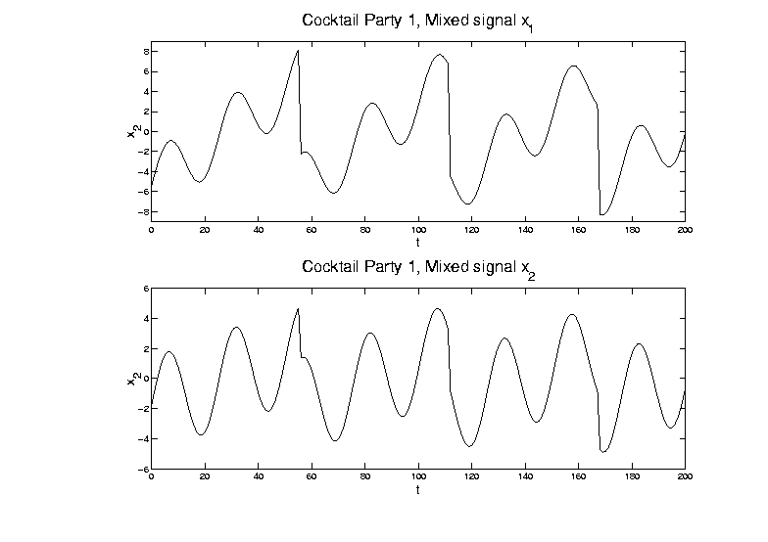
ICA, Motivating Example
Mixed version of signals:

Slide 41
ICA, Motivating Example
Goal: Recover signal
From data
For unknown mixture matrix
where for all

Slide 42
ICA, Motivating Example
Goal is to find separating weights
so that for all

Slide 43
ICA, Motivating Example
Goal is to find separating weights
so that for all
Problem: would be fine,
but is unknown

Slide 44
ICA, Motivating Example
Solutions for Cocktail Party Problem:
PCA (on population of 2-d vectors)
= matrix of eigenvectors

Slide 45
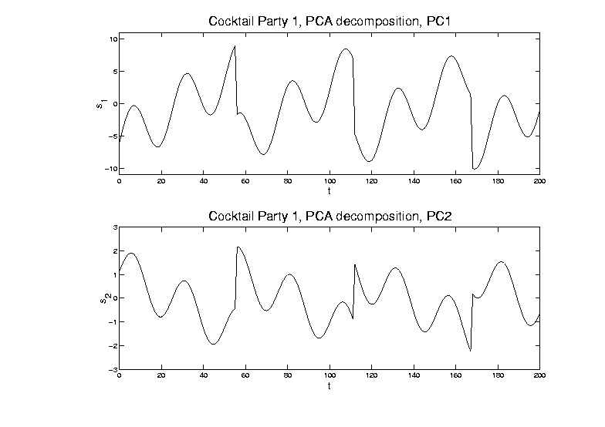
ICA, Motivating Example
PCA (on population of 2-d vectors)
Maximal
Variance
Minimal
Variance

Slide 46
ICA, Motivating Example
Solutions for Cocktail Party Problem:
PCA (on population of 2-d vectors)
[direction of maximal variation
doesn’t solve this problem]
ICA (will describe method later)

Slide 47
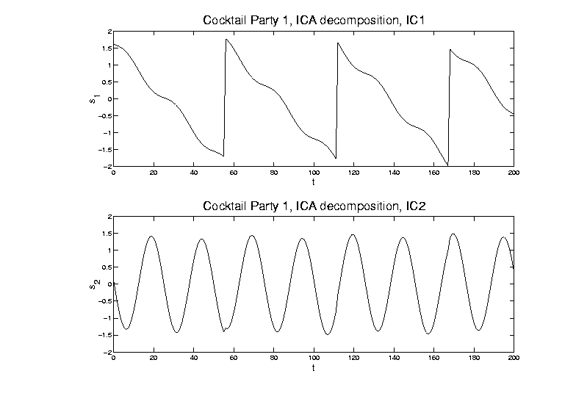
ICA, Motivating Example
ICA (will describe method later)

Slide 48
ICA, Motivating Example
Solutions for Cocktail Party Problem:
PCA (on population of 2-d vectors)
[direction of maximal variation
doesn’t solve this problem]
ICA (will describe method later)
[Independent Components do solve it]
[modulo sign changes and identification]

Slide 49
ICA, Motivating Example
Recall original time series:

Slide 50
ICA, Motivating Example
Relation to OODA: recall data matrix

Slide 51
ICA, Motivating Example
Relation to OODA: recall data matrix
Signal Processing: focus on rows
( time series, indexed by )
OODA: focus on columns as data objects
( data vectors)

Slide 52
ICA, Motivating Example
Relation to OODA: recall data matrix
Signal Processing: focus on rows
( time series, indexed by )
OODA: focus on columns as data objects
( data vectors)
Note: 2 viewpoints like “duals” for PCA

Slide 53
ICA, Motivating Example
Scatterplot View (signal processing): Study
Signals

Slide 54
ICA, Motivating Example
Study Signals

Slide 55
ICA, Motivating Example
Scatterplot View (signal processing): Study
Signals
Corresponding Scatterplot

Slide 56
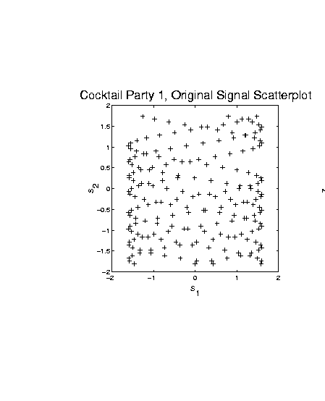
ICA, Motivating Example
Signals - Corresponding Scatterplot

Slide 57
ICA, Motivating Example
Scatterplot View (signal processing): Study
Signals
Corresponding Scatterplot
Data

Slide 58
ICA, Motivating Example
Study Data

Slide 59
ICA, Motivating Example
Scatterplot View (signal processing): Study
Signals
Corresponding Scatterplot
Data
Corresponding Scatterplot

Slide 60
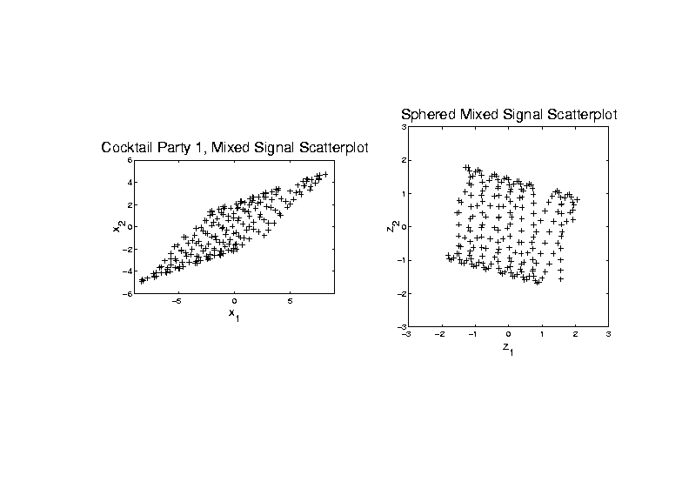
ICA, Motivating Example
Data - Corresponding Scatterplot

Slide 61
ICA, Motivating Example
Scatterplot View (signal processing): Plot
Signals & Scat’plot
Data & Scat’plot
Scatterplots give hint how ICA is possible
Affine transformation
Stretches indep’t signals into dep’t
Inversion is key to ICA
(even w/ unknown)

Slide 62
ICA, Motivating Example
Signals - Corresponding Scatterplot
Note: Independent
Since Known Value
Of s₁ Does Not
Change Distribution
of s₂

Slide 63
ICA, Motivating Example
Data - Corresponding Scatterplot
Note: Dependent
Since Known Value
Of s₁ Changes
Distribution of s₂

Slide 64
ICA, Motivating Example
Why not PCA?
Finds direction of greatest variation

Slide 65
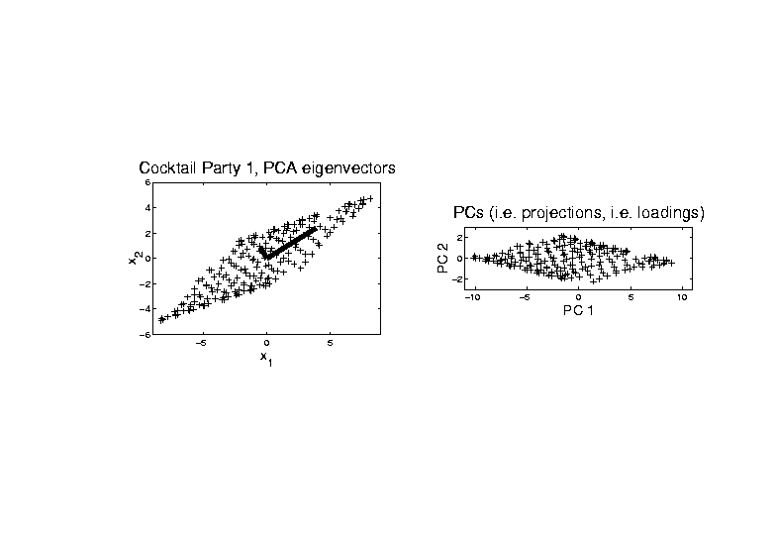
ICA, Motivating Example
PCA - Finds direction of greatest variation

Slide 66
ICA, Motivating Example
Why not PCA?
Finds direction of greatest variation
Which is wrong for signal separation

Slide 67
ICA, Motivating Example
PCA - Wrong for signal separation

Slide 68
ICA, Motivating Example
Why not PCA?
Finds direction of greatest variation
Which is wrong for signal separation

Slide 69
ICA, Algorithm
ICA Step 1:
sphere the data
(shown on right in scatterplot view)

Slide 70
ICA, Algorithm
ICA Step 1: sphere the data

Slide 71
ICA, Algorithm
ICA Step 1:
“sphere the data”
(shown on right in scatterplot view)
i.e. find linear transf’n to make
mean = , cov =
i.e. work with

Slide 72
ICA, Algorithm
ICA Step 1:
“sphere the data”
(shown on right in scatterplot view)
i.e. find linear transf’n to make
mean = , cov =
i.e. work with
requires of full rank
(at least , i.e. no HDLSS)

Slide 73
ICA, Algorithm
ICA Step 1:
“sphere the data”
(shown on right in scatterplot view)
i.e. find linear transf’n to make
mean = , cov =
i.e. work with
requires of full rank
(at least , i.e. no HDLSS)
search for independent, beyond
linear and quadratic structure

Slide 74
ICA, Algorithm
ICA Step 2:
Find dir’ns that make (sphered) data
independent as possible

Slide 75
ICA, Algorithm
ICA Step 2:
Find dir’ns that make (sphered) data
independent as possible
Recall “independence” means:
joint distribution is product of marginals
In cocktail party example:

Slide 76
ICA, Algorithm
ICA Step 2: Cocktail party example

Slide 77
ICA, Algorithm
ICA Step 2:
Find dir’ns that make (sphered) data
independent as possible
Recall “independence” means:
joint distribution is product of marginals
In cocktail party example:
  Happens only when support parallel to axes
  Otherwise have blank areas,
  but marginals are non-zero

Slide 78
ICA, Algorithm
Parallel Idea (and key to algorithm):
Find directions that maximize
non-Gaussianity

Slide 79
ICA, Algorithm
Parallel Idea (and key to algorithm):
Find directions that maximize
non-Gaussianity
Based on assumption: starting from
independent coordinates
Note: “most” projections are Gaussian
(since projection is “linear combo”)

Slide 80
ICA, Algorithm
Parallel Idea (and key to algorithm):
Find directions that maximize
non-Gaussianity
Based on assumption: starting from
independent coordinates
Note: “most” projections are Gaussian
(since projection is “linear combo”)
Mathematics behind this:
Diaconis and Freedman (1984)

Slide 81
ICA, Algorithm
Worst case for ICA: Gaussian
Then sphered data are independent
So have independence in all (ortho) dir’ns
Thus can’t find useful directions
Gaussian distribution is characterized by:
Independent & spherically symmetric

Slide 82
ICA, Algorithm
Criteria for non-Gaussianity / independence:
Kurtosis
(4th order cumulant)
Negative Entropy
Mutual Information
Nonparametric Maximum Likelihood
“Infomax” in Neural Networks
Interesting connections between these

Slide 83
ICA, Algorithm
Matlab Algorithm (optimizing any of above):
“FastICA”
Numerical gradient search method
Can find directions iteratively

Slide 84
ICA, Algorithm
Matlab Algorithm (optimizing any of above):
“FastICA”
Numerical gradient search method
Can find directions iteratively
Or by simultaneous optimization
(note: PCA does both, but not ICA)

Slide 85
ICA, Algorithm
Matlab Algorithm (optimizing any of above):
“FastICA”
Numerical gradient search method
Can find directions iteratively
Or by simultaneous optimization
(note: PCA does both, but not ICA)
Appears fast, with good defaults
Careful about local optima
(Recco: several random restarts)

Slide 86
ICA, Algorithm
FastICA Notational Summary:
First sphere data:
Apply ICA: Find to make
rows of “indep’t”
Can transform back to:
original data scale:

Slide 87
ICA, Algorithm
Careful look at identifiability
Seen already in above example
Could rotate “square of data” in several ways, etc.

Slide 88
ICA, Algorithm
Careful look at identifiability

Slide 89
ICA, Algorithm
Identifiability: Swap Flips

Slide 90
ICA, Algorithm
Identifiability problem 1:
Generally can’t order rows of (& )
(seen as swap above)
Since for a “permutation matrix”
(pre-multiplication by “swaps rows”)
(post-multiplication by “swaps columns”)
For each column, i.e.
i.e.

Slide 91
ICA, Algorithm
Identifiability problem 1:
Generally can’t order rows of (& )
Since for a “permutation matrix”
For each column,
So and are also ICA solut’ns
(i.e. )
FastICA: appears to order in terms of “how non-Gaussian”

Slide 92
ICA, Algorithm
Identifiability problem 2:
Can’t find scale of elements of
(seen as flips above)
Since for a (full rank) diagonal matrix
(pre-multipl’n by is scalar mult’n of rows)
(post-multipl’n by is scalar mult’n of col’s)
Again for each col’n,
i.e.
So and are also ICA solutions

Slide 93
ICA, Algorithm
Signal Processing Scale identification:
(Hyvärinen and Oja, 1999)
Choose scale so each signal
has “unit average energy”:
(preserves energy along rows of data matrix)
Explains “same scales” in
Cocktail Party Example

Slide 94
ICA & Non-Gaussianity
Explore main ICA principle:
For indep., non-Gaussian,
standardized, r.v.’s:
Projections farther from coordinate axes are more Gaussian

Slide 95
ICA & Non-Gaussianity
Explore main ICA principle:
Projections farther from coordinate axes are more Gaussian:
For the dir’n vector ,
where
(thus ),
have , for large and

Slide 96
ICA & Non-Gaussianity
Illustrative examples (d = 100, n = 500)
Uniform Marginals
Exponential Marginals
Bimodal Marginals
Study over range of values of k

Slide 97
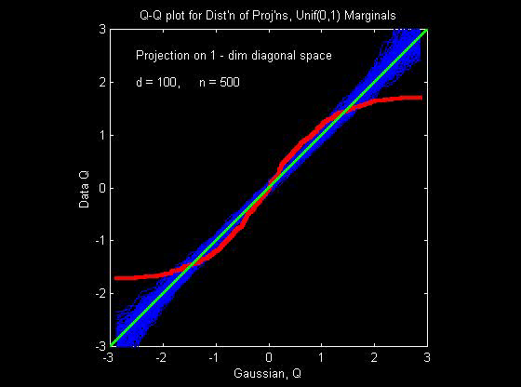
ICA & Non-Gaussianity
Illustrative example - Uniform marginals

Slide 98
ICA & Non-Gaussianity
Illustrative examples (d = 100, n = 500)
Uniform Marginals
k = 1: very poor fit
(Uniform far from Gaussian)
k = 2: much closer?
(Triangular closer to Gaussian)
k = 4: very close,
but still have stat’ly sig’t difference
k >= 6: all diff’s could be sampling var’n

Slide 99
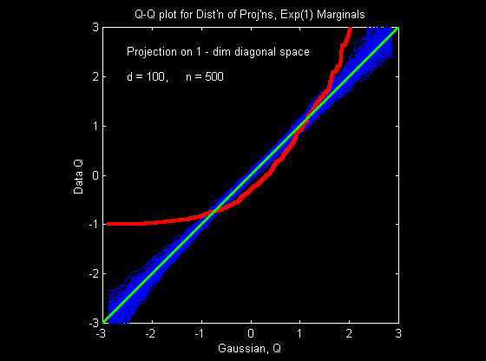
ICA & Non-Gaussianity
Illustrative example - Exponential Marginals

Slide 100
ICA & Non-Gaussianity
Illustrative examples (d = 100, n = 500)
Exponential Marginals
still have convergence to Gaussian,
but slower
(“skewness” has stronger
impact than “kurtosis”)
now need k >= 25 to see no difference

Slide 101

ICA & Non-Gaussianity
Illustrative example - Bimodal Marginals

Slide 102
ICA & Non-Gaussianity
Illustrative examples (d = 100, n = 500)
Bimodal Marginals
Convergence to Gaussian,
Surprisingly fast
Quite close for k = 9

Slide 103
ICA & Non-Gaussianity
Summary:
For indep., non-Gaussian,
standardized, r.v.’s: ,
Projections farther from coordinate axes
are more Gaussian

Slide 104
ICA & Non-Gaussianity
Projections farther from coordinate axes
are more Gaussian
Conclusions:
Expect most proj’ns are Gaussian
Non-G’n proj’ns (ICA target) are special
Is a given sample really “random”???
(could test???)
High dim’al space is a strange place

Slide 105
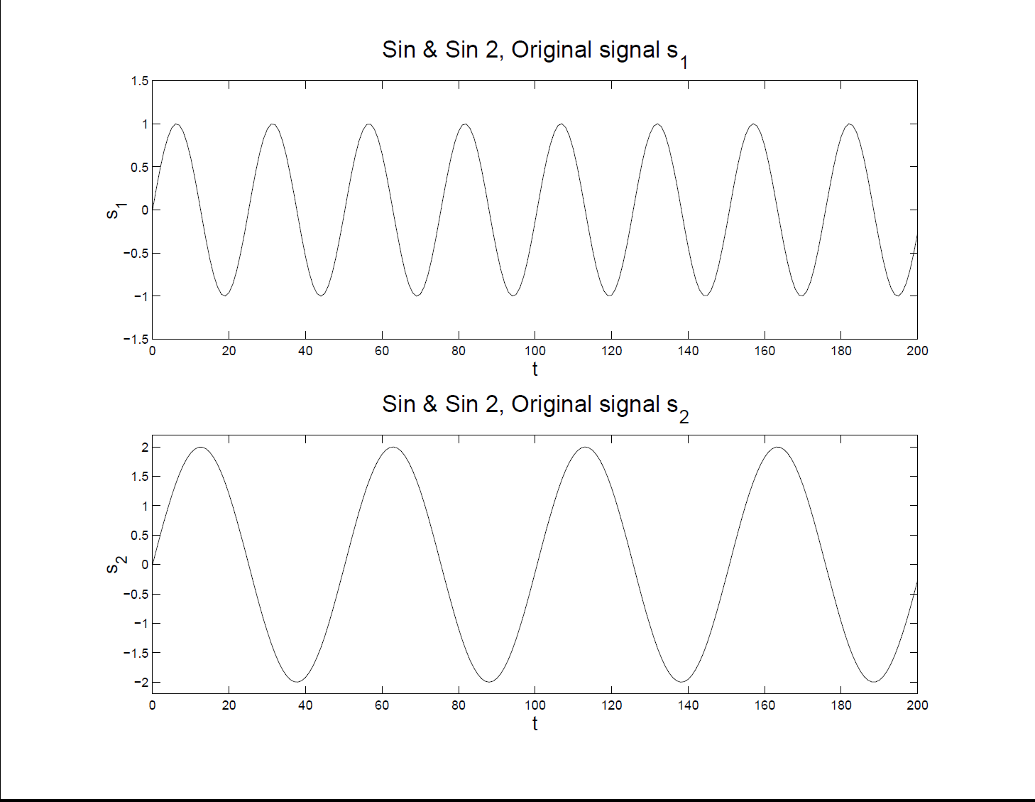
More ICA Examples
Two Sine Waves – Original Signals

Slide 106
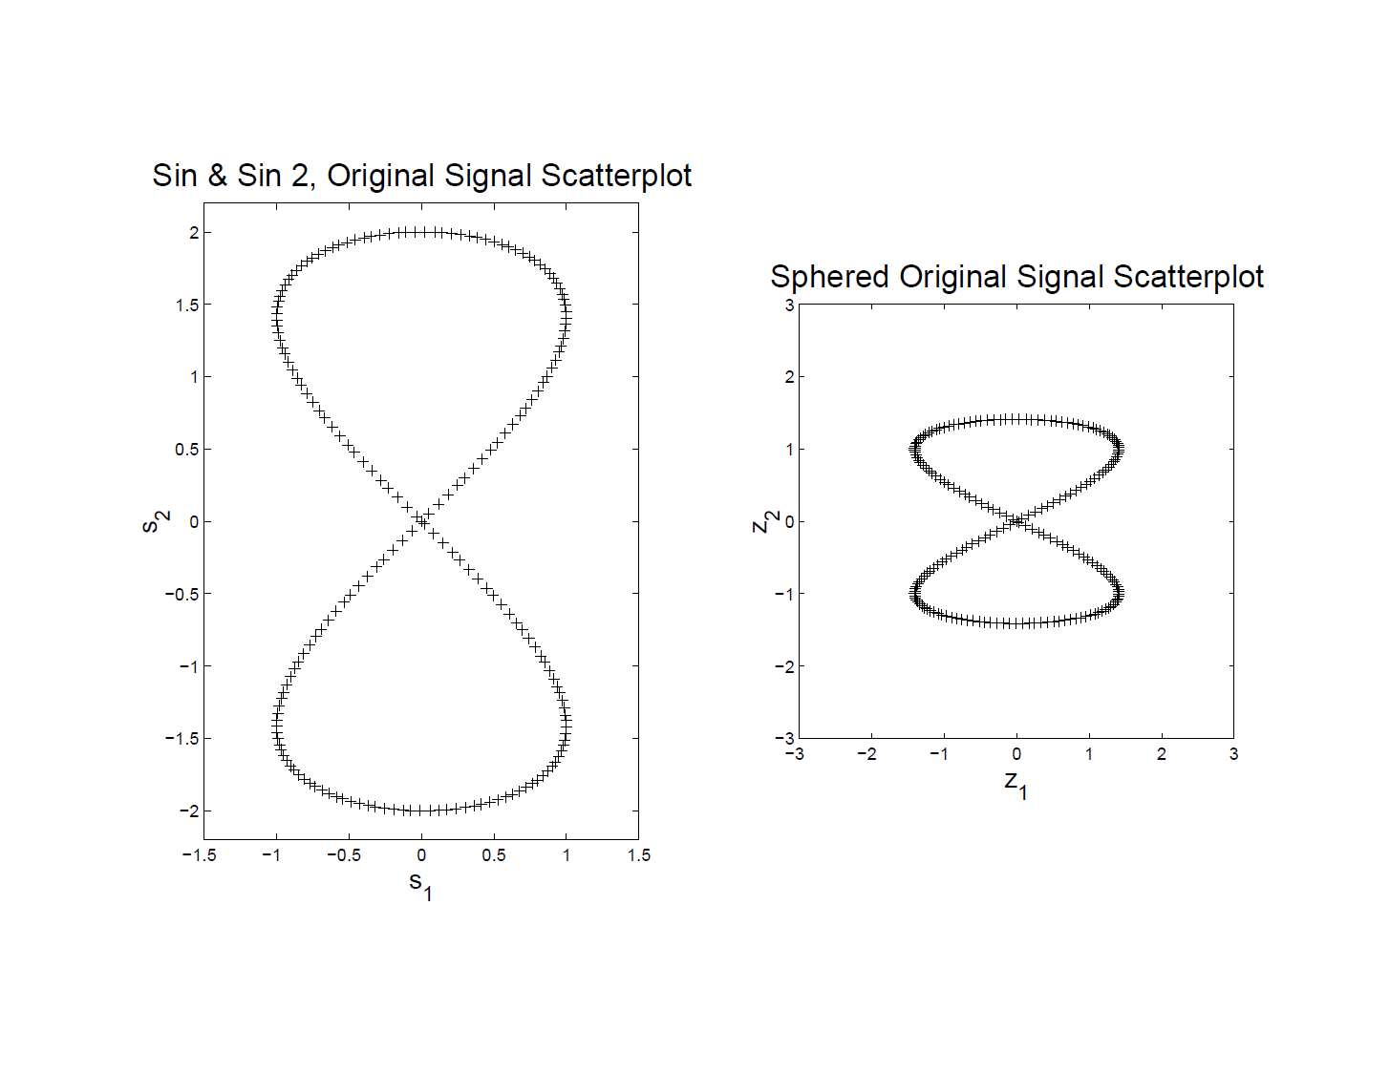
More ICA Examples
Two Sine Waves – Original Scatterplot
Far
From
Indep’t
!!!

Slide 107
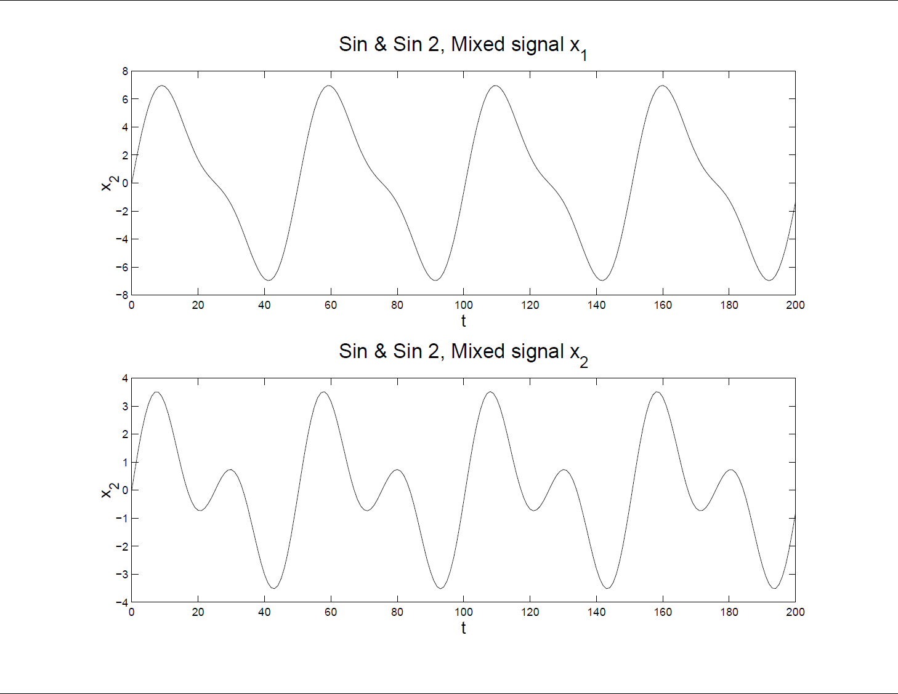
More ICA Examples
Two Sine Waves – Mixed Input Data

Slide 108
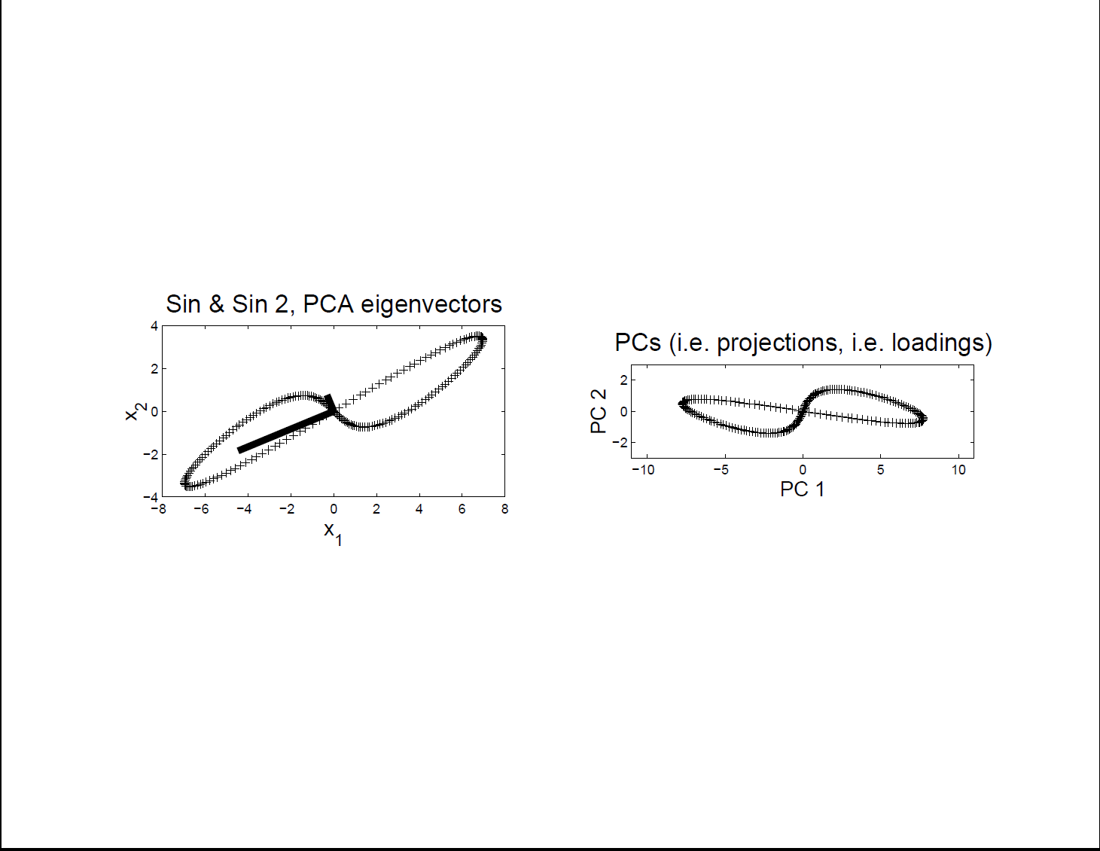
More ICA Examples
Two Sine Waves – Scatterplot & PCA
Clearly
Wrong
Recovery

Slide 109
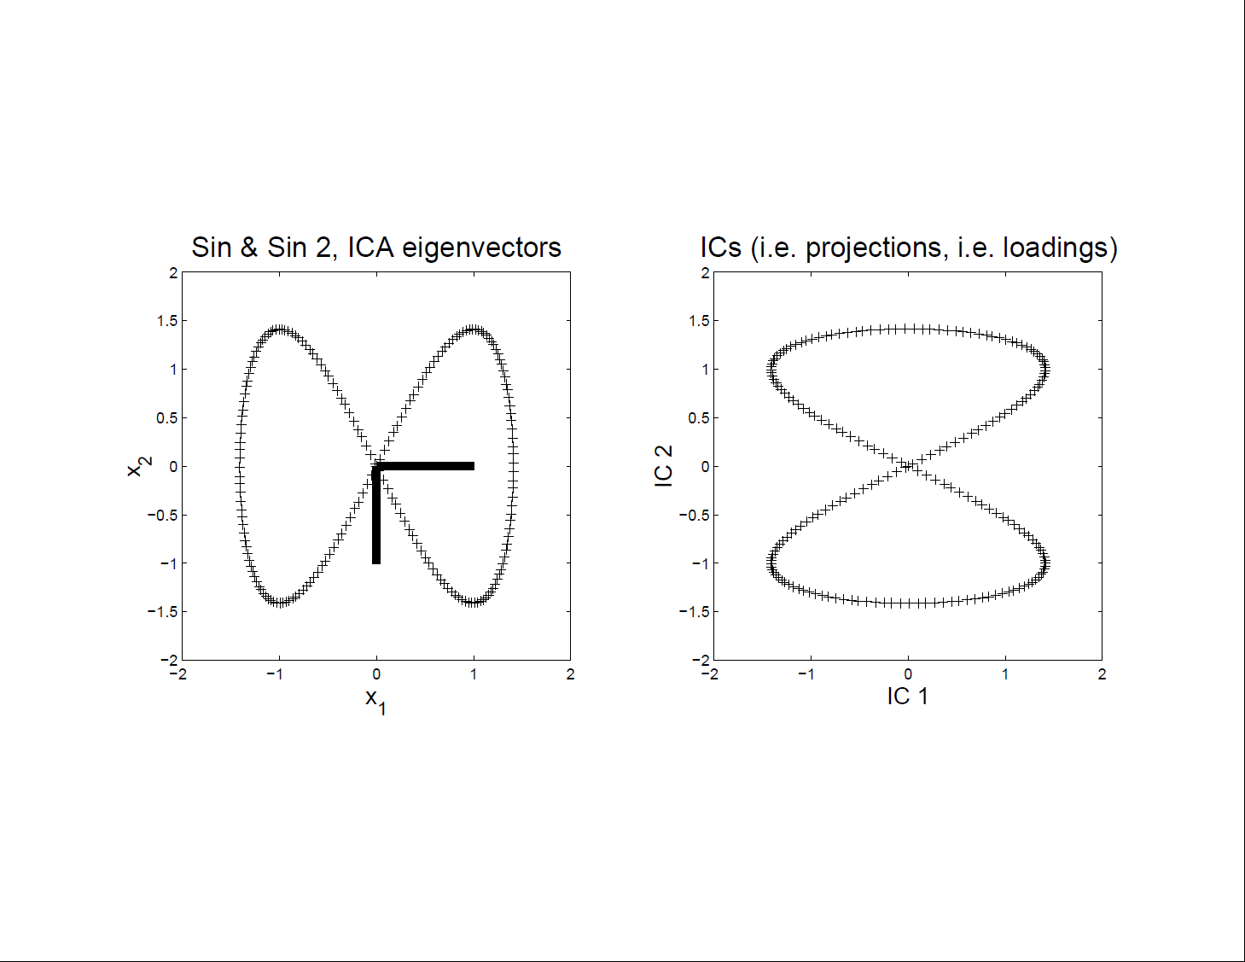
More ICA Examples
Two Sine Waves – Scatterplot for ICA
Looks
Very
Good

Slide 110
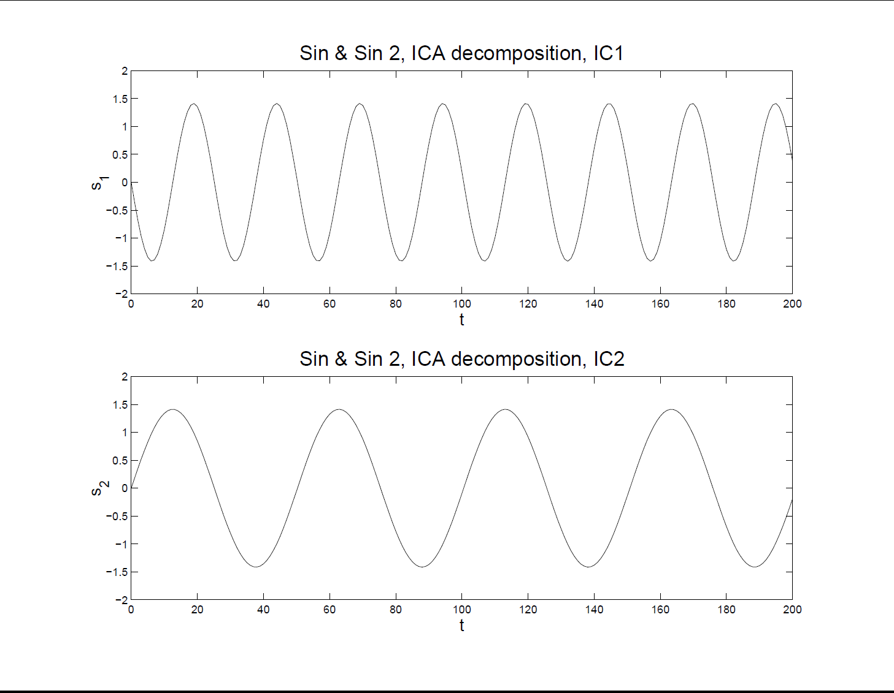
More ICA Examples
Two Sine Waves – ICA Reconstruction
Excellent,
Despite
Non-Indep’t
Scatteplot

Slide 111
More ICA Examples
Sine and Gaussian
Try Another Pair of Signals
More Like “Signal + Noise”

Slide 112
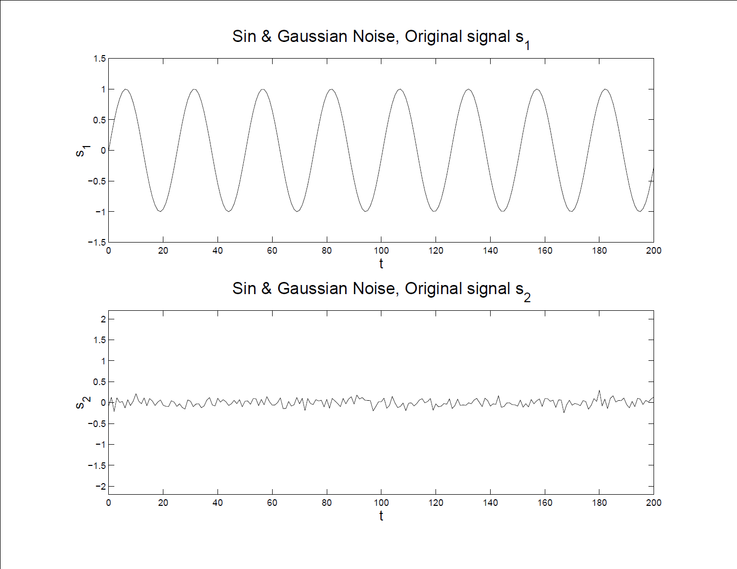
More ICA Examples
Sine and Gaussian – Original Signals

Slide 113
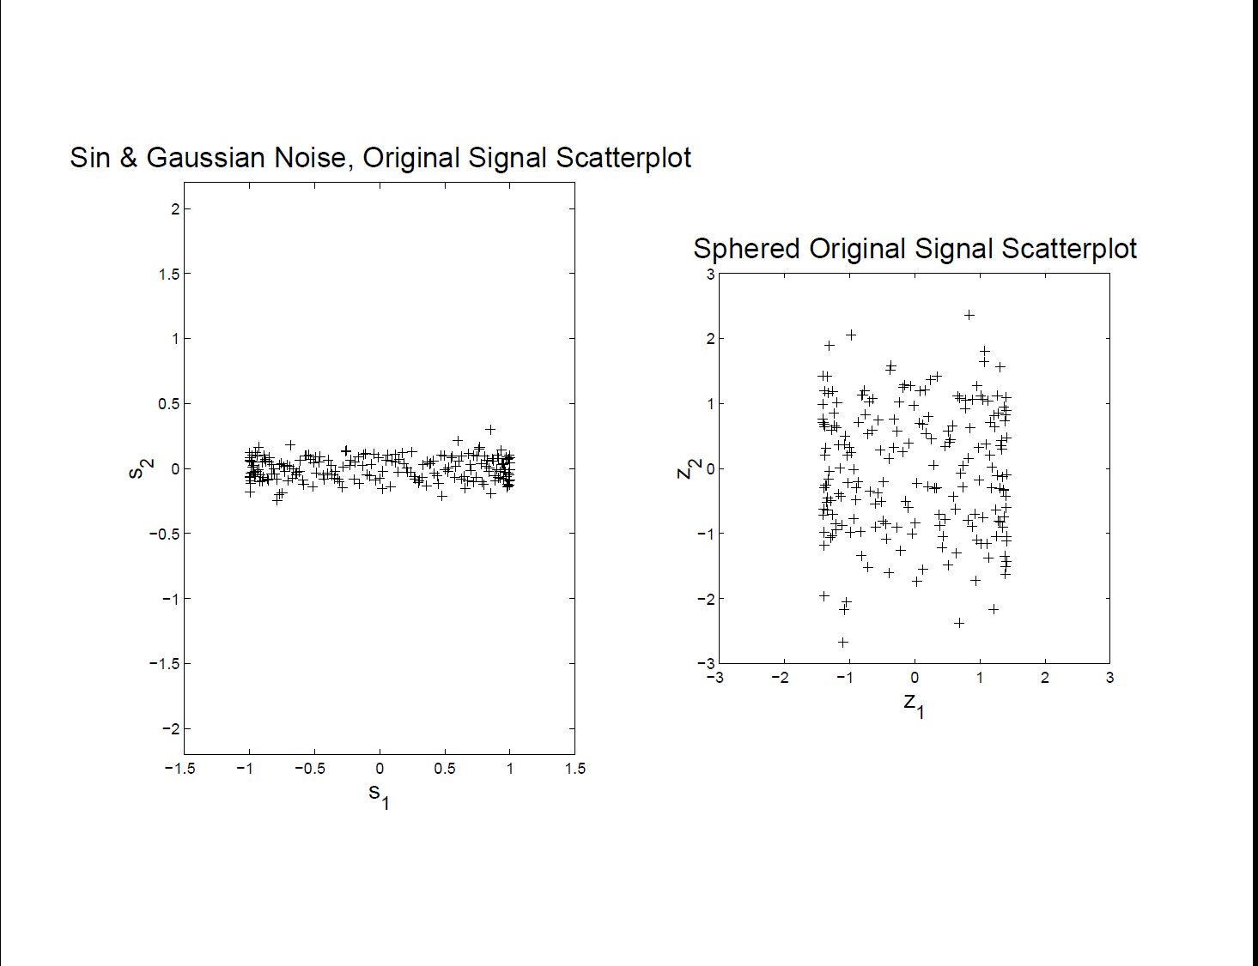
More ICA Examples
Sine and Gaussian – Original Scatterplot
Well
Set
For
ICA

Slide 114
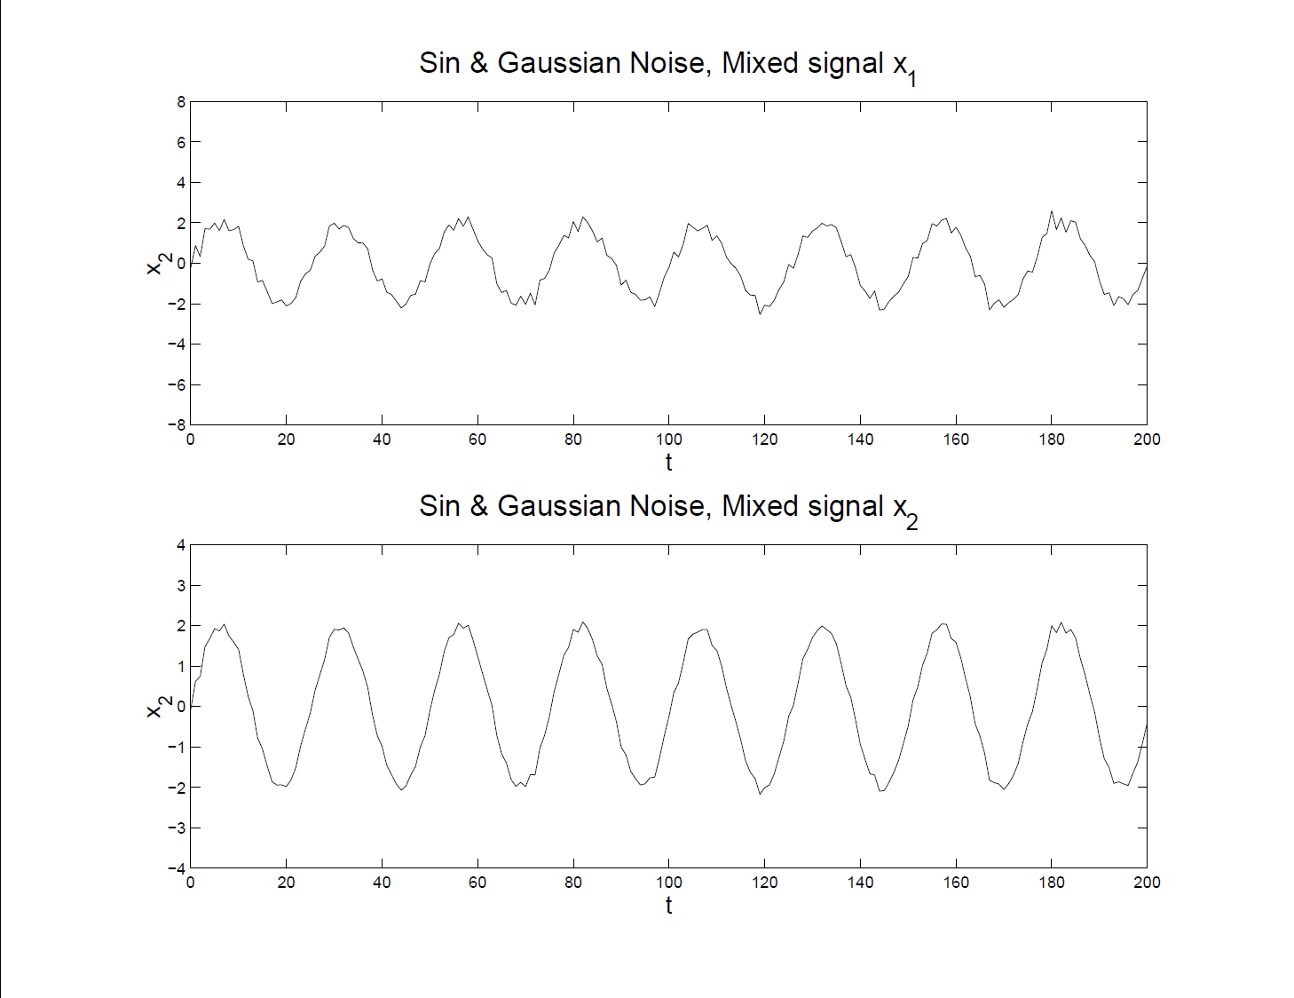
More ICA Examples
Sine and Gaussian – Mixed Input Data

Slide 115
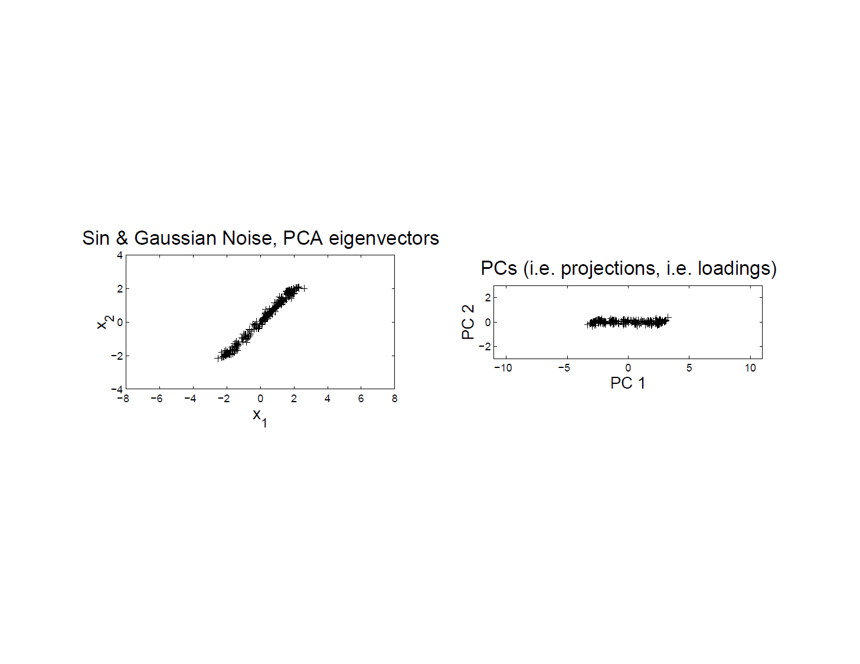
More ICA Examples
Sine and Gaussian – Scatterplot & PCA

Slide 116
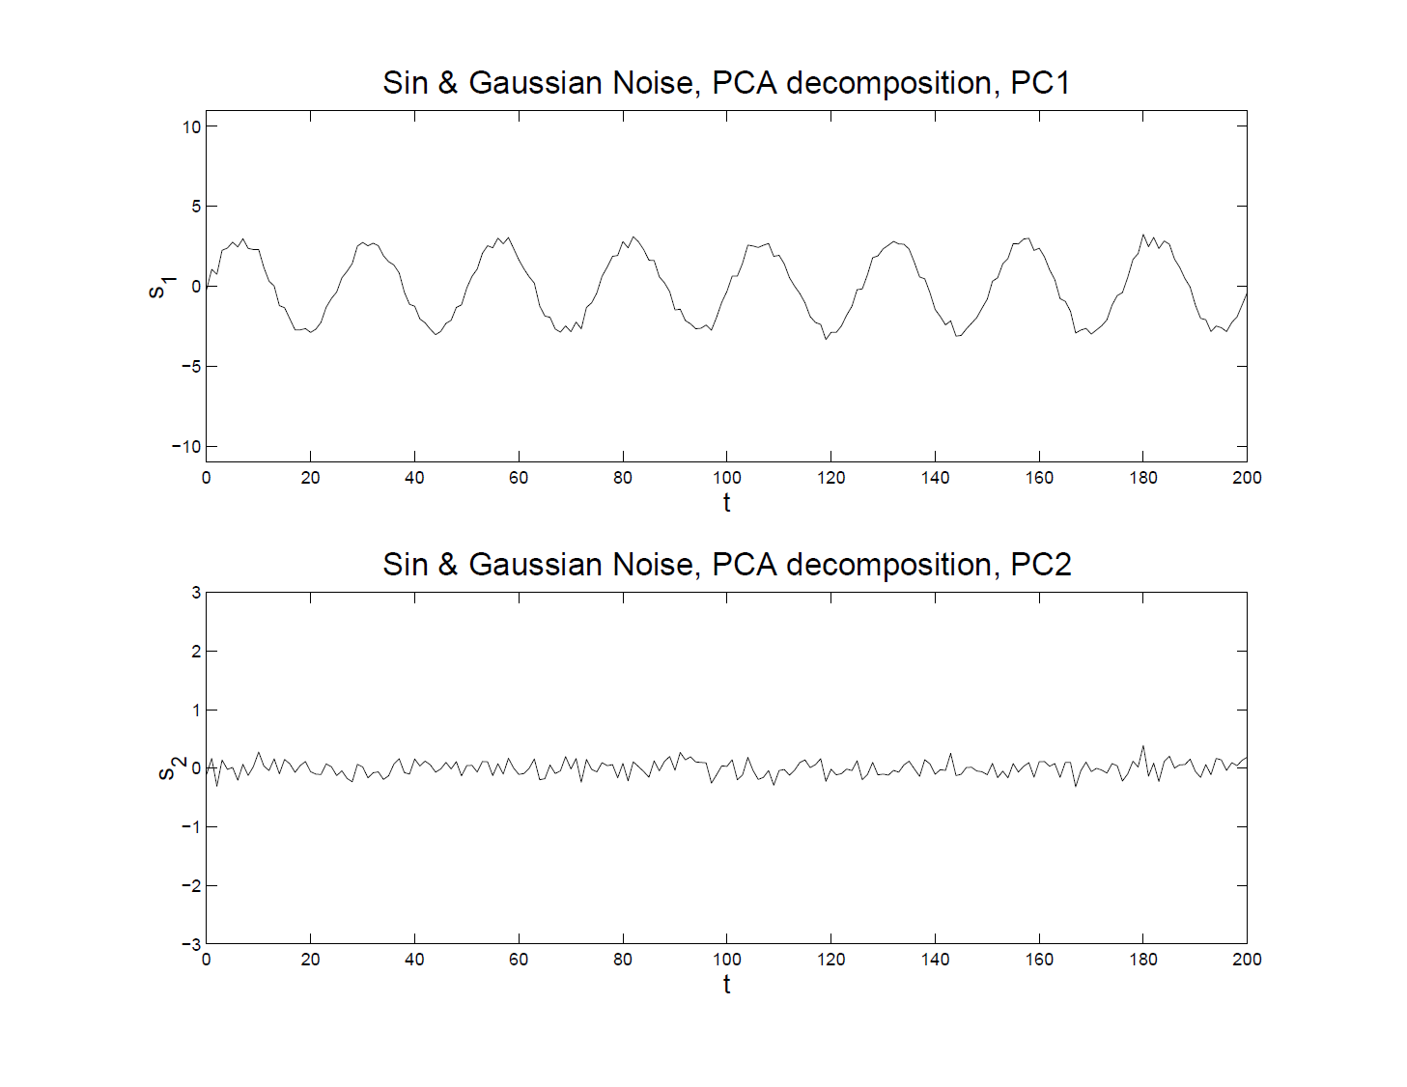
More ICA Examples
Sine and Gaussian – PCA Reconstruction
Got Sine
Wave
+
Noise

Slide 117
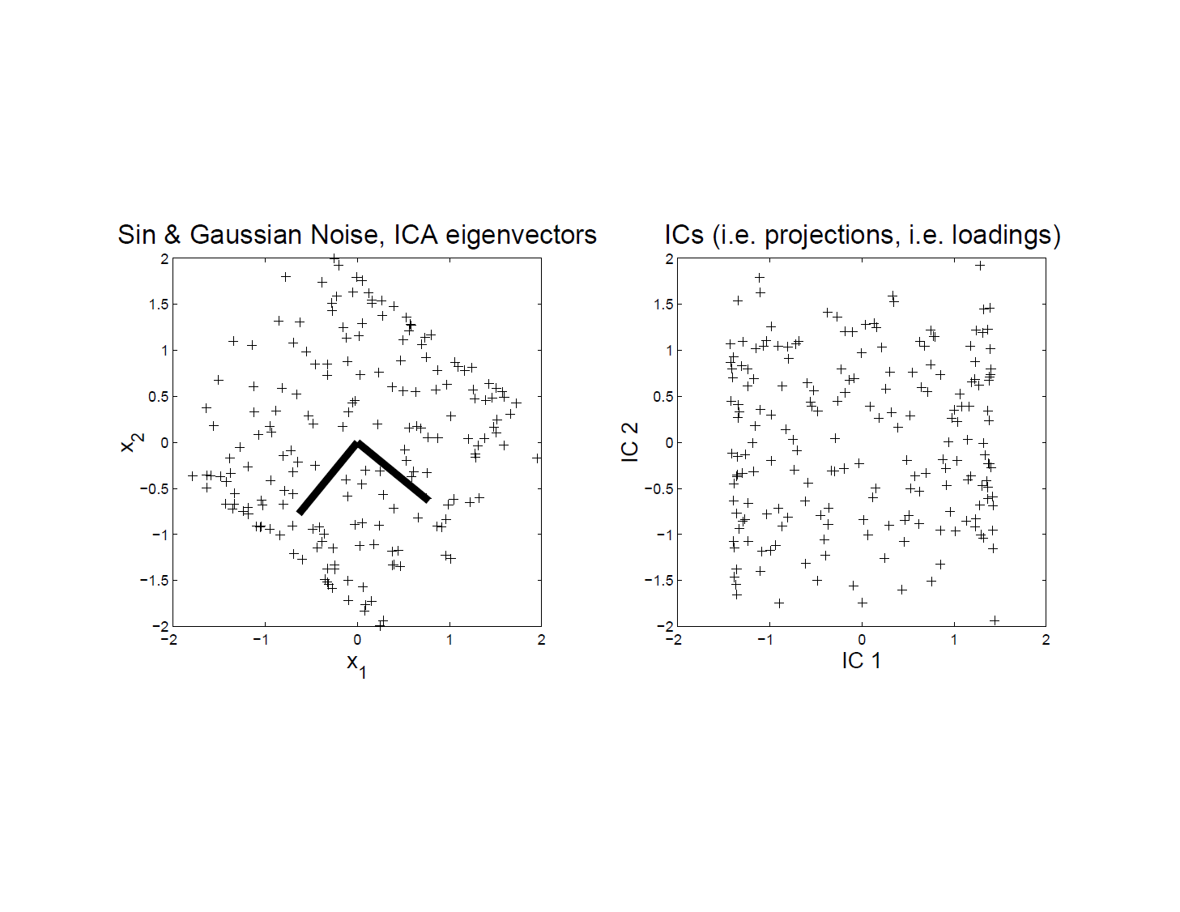
More ICA Examples
Sine and Gaussian – Scatterplot ICA

Slide 118
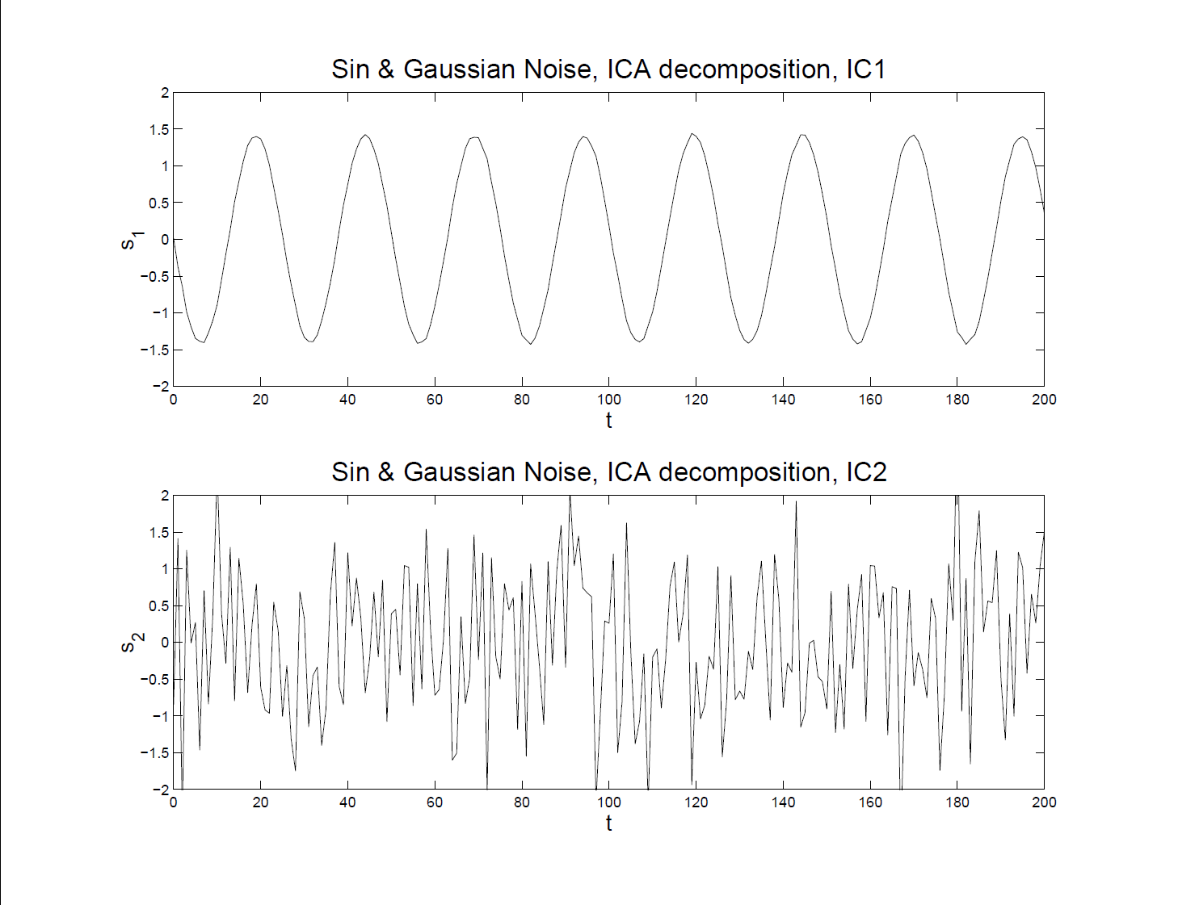
More ICA Examples
Sine and Gaussian – ICA Reconstruction

Slide 119
More ICA Examples
Both Gaussian
Try Another Pair of Signals
Understand Assumption of
One Not Gaussian

Slide 120
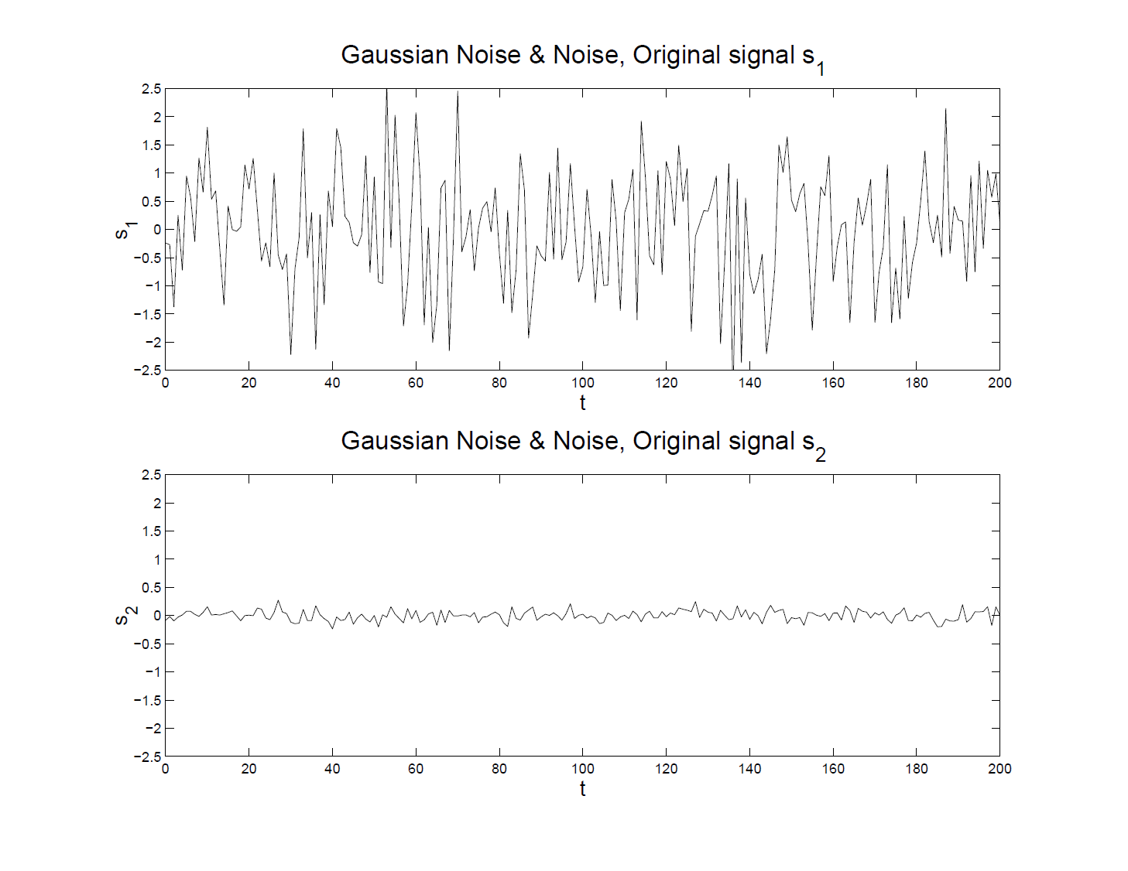
More ICA Examples
Both Gaussian – Original Signals

Slide 121
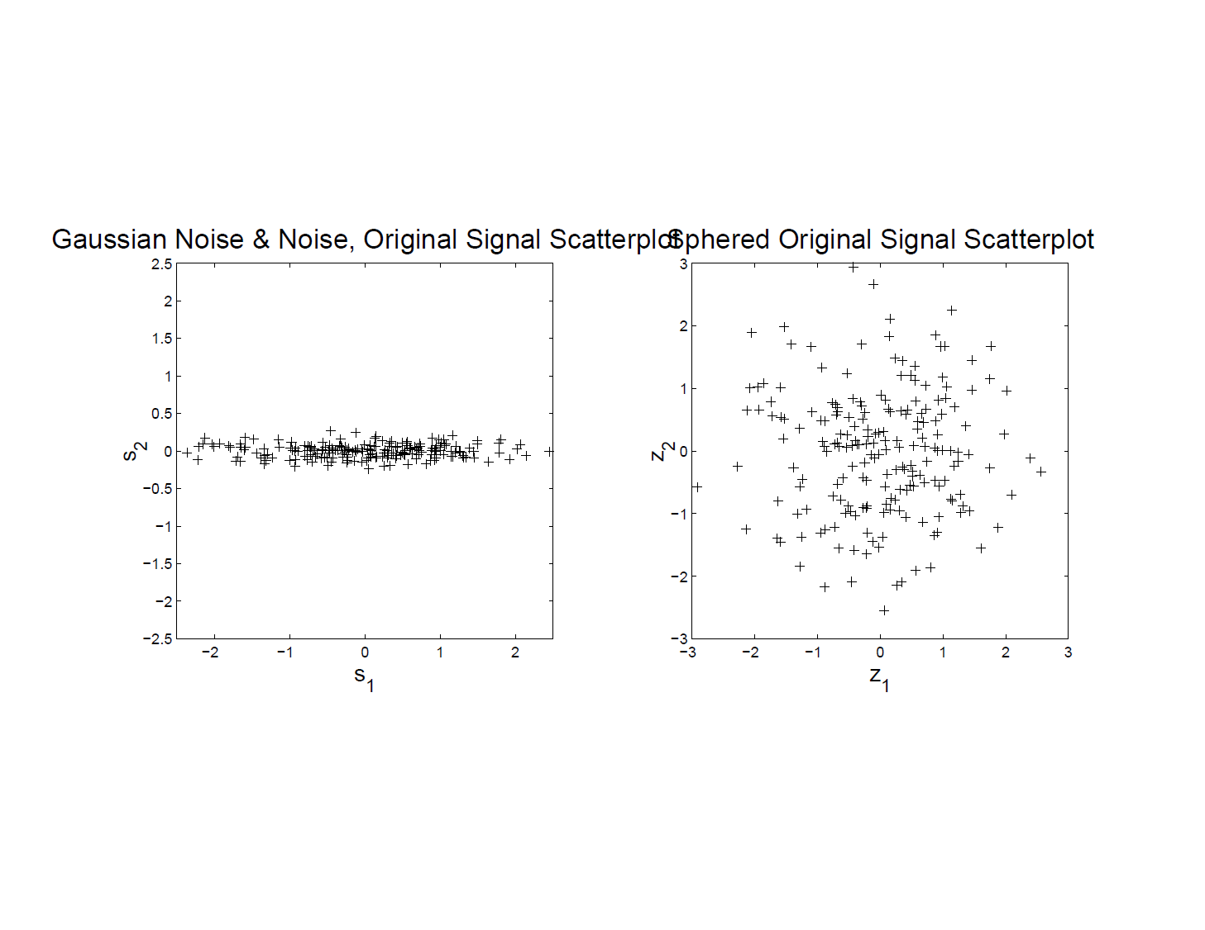
More ICA Examples
Both Gaussian – Original Scatterplot
Caution:
Indep’t
In All
Directions!

Slide 122
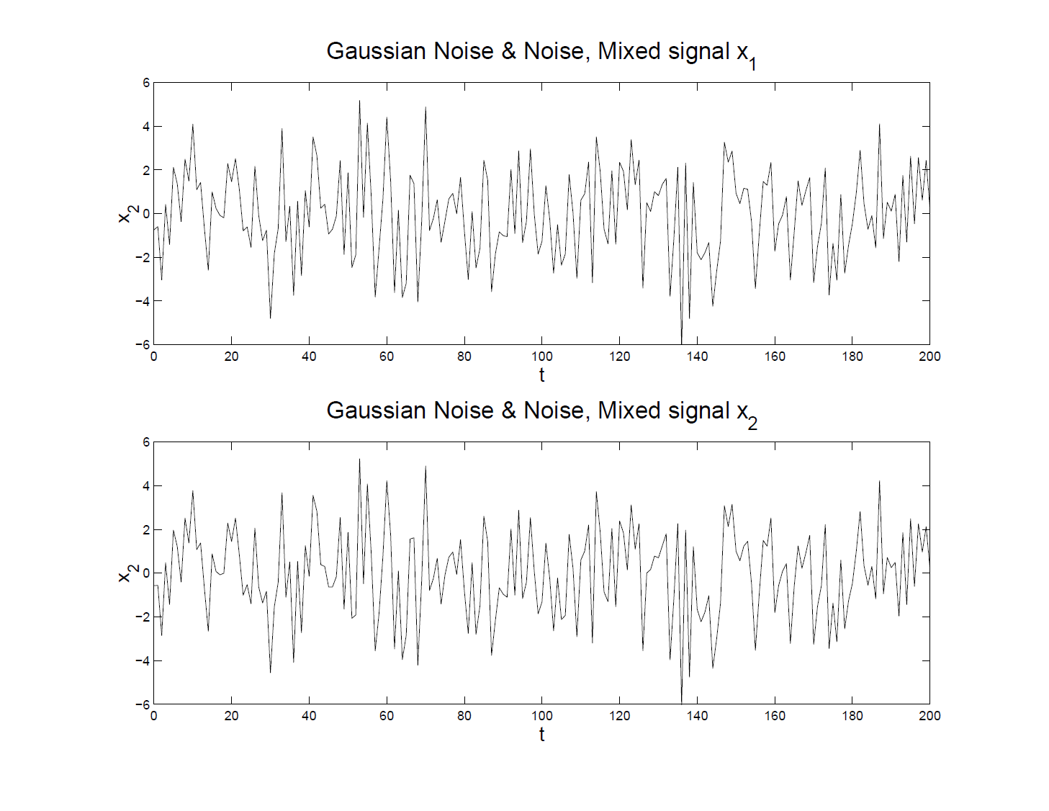
More ICA Examples
Both Gaussian – Mixed Input Data

Slide 123
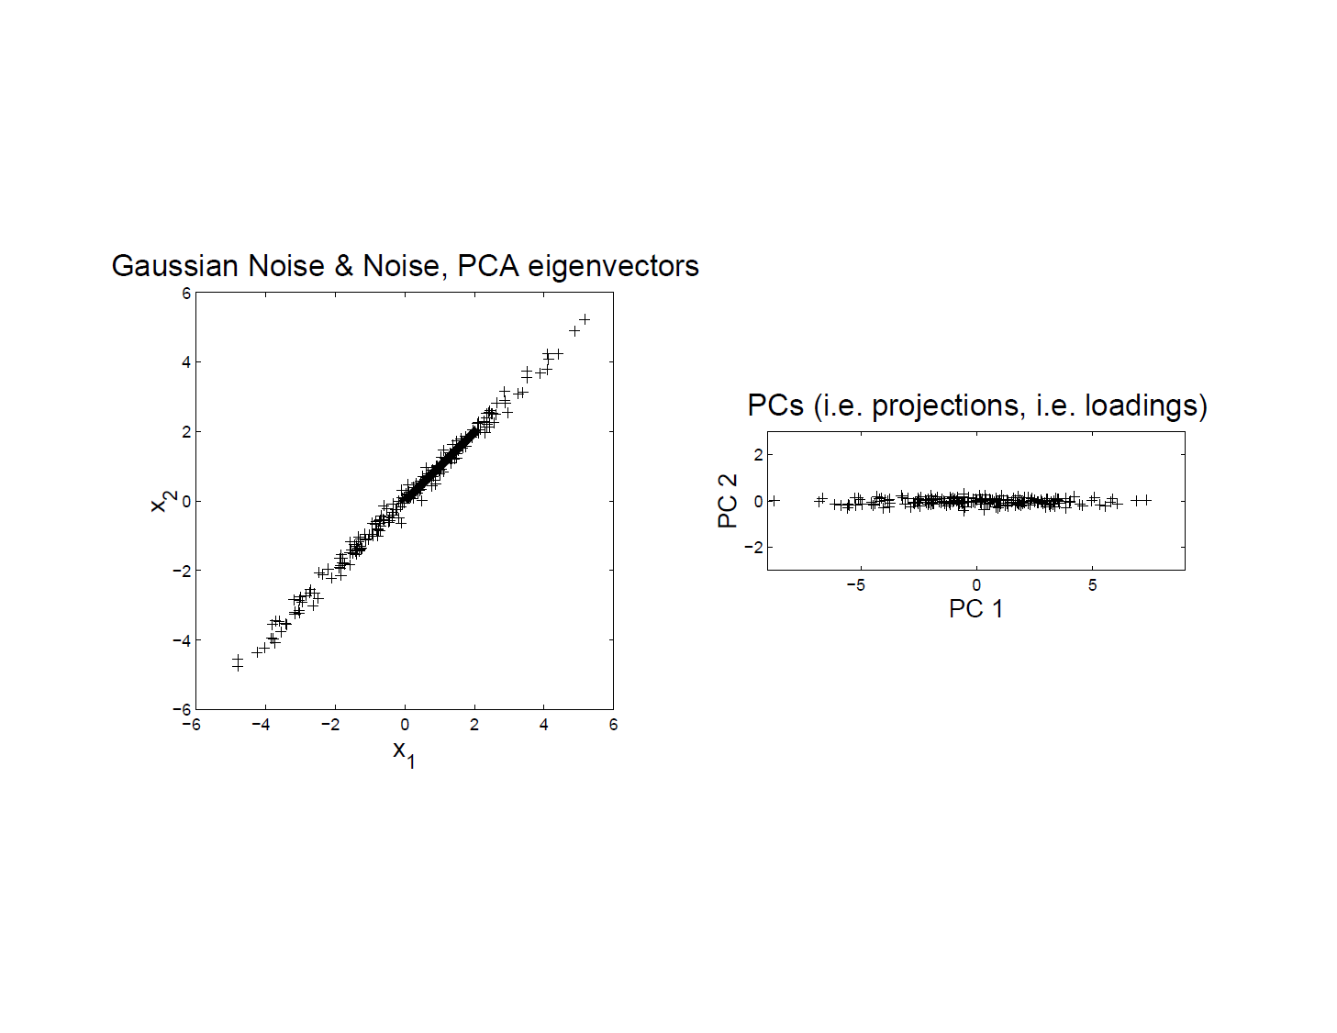
More ICA Examples
Both Gaussian – PCA Scatterplot
Exploits
Variation
To Give
Good
Diredtions

Slide 124
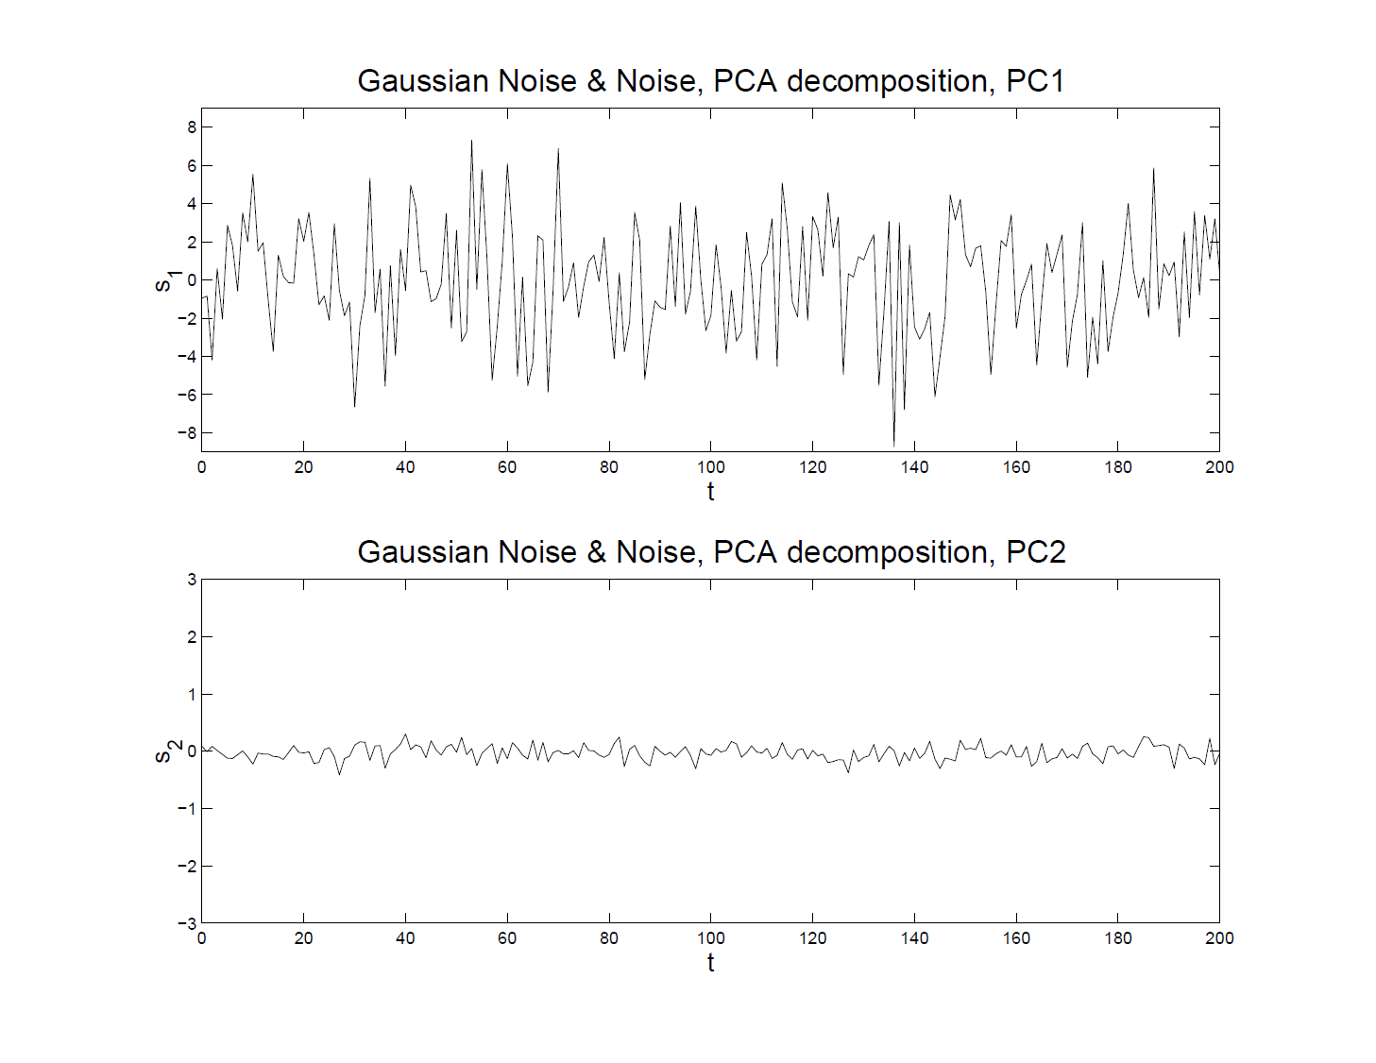
More ICA Examples
Both Gaussian – PCA Reconstruction
Looks
Good?

Slide 125
More ICA Examples
Both Gaussian – Original Signals
Check
Against
Original

Slide 126
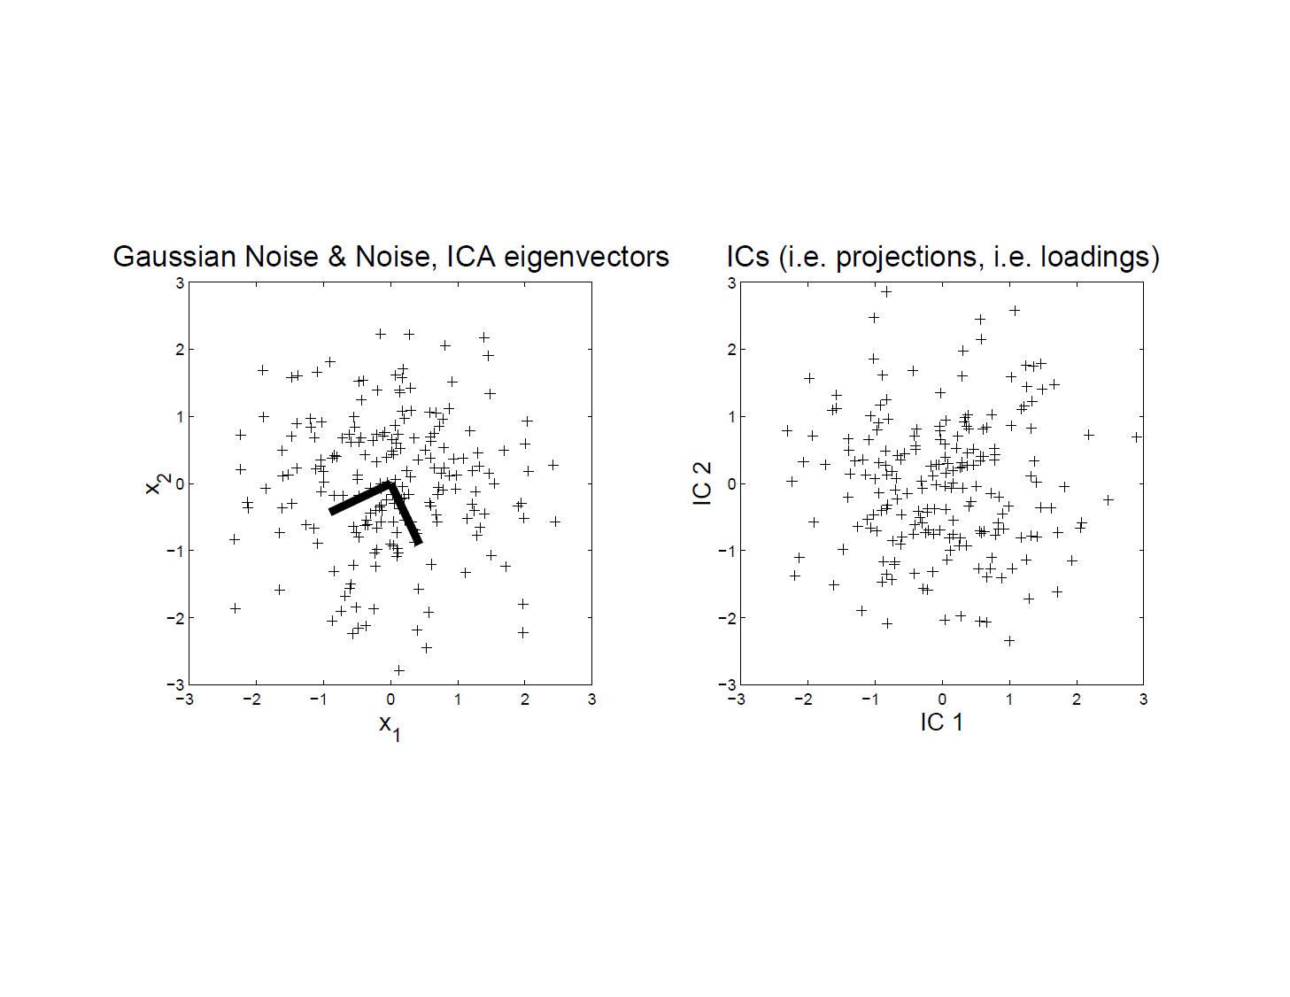
More ICA Examples
Both Gaussian – ICA Scatterplot
No Clear
Good
Rotation?

Slide 127
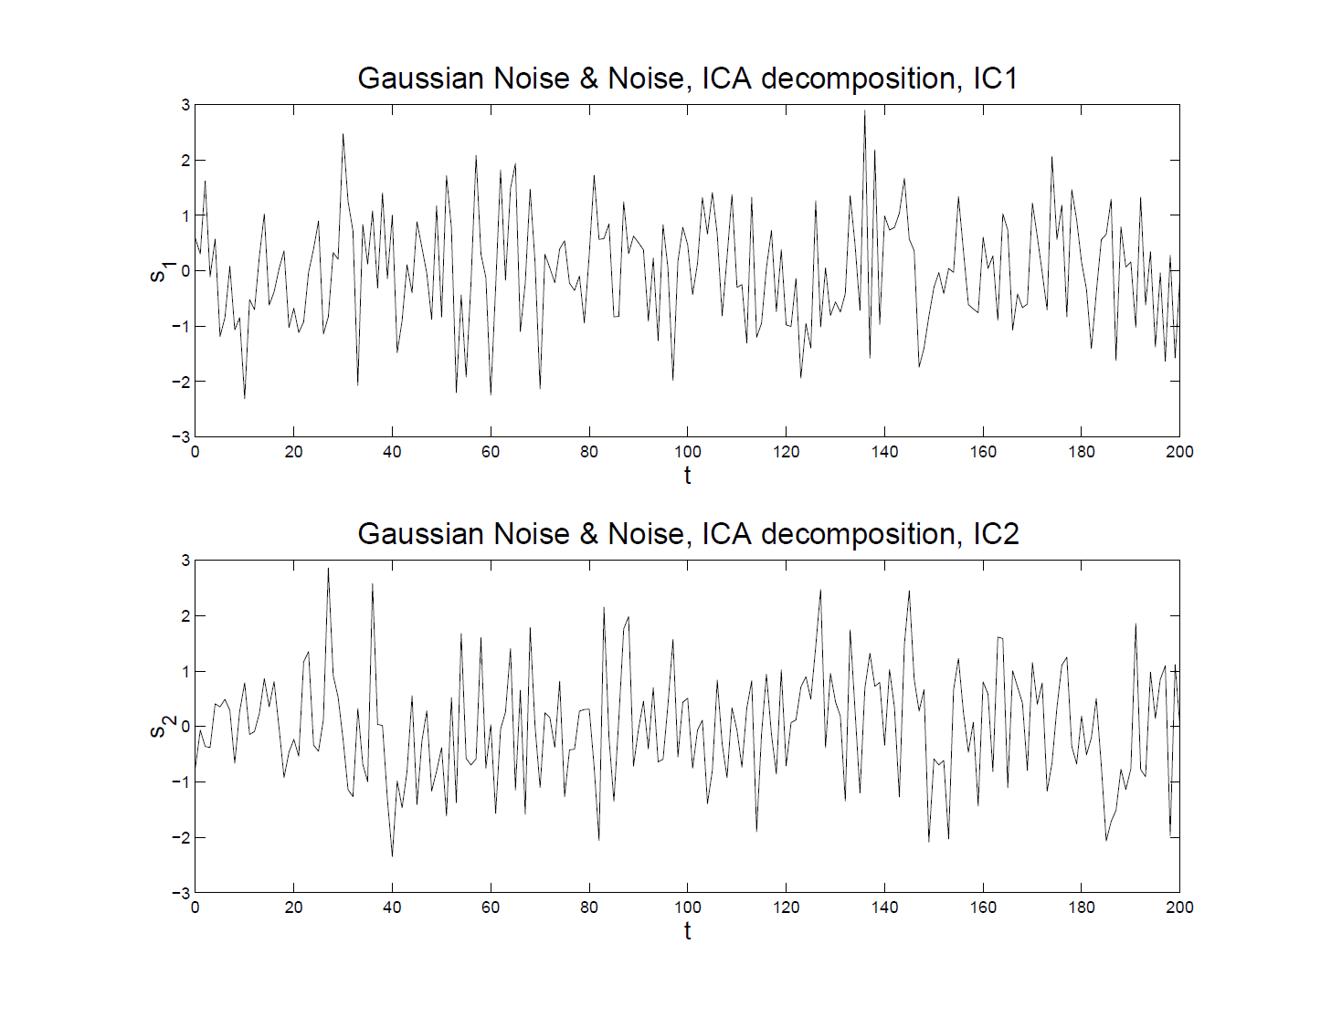
More ICA Examples
Both Gaussian – ICA Reconstruction
Is It
Bad?

Slide 128
More ICA Examples
Both Gaussian – Original Signals
Check
Against
Original

Slide 129
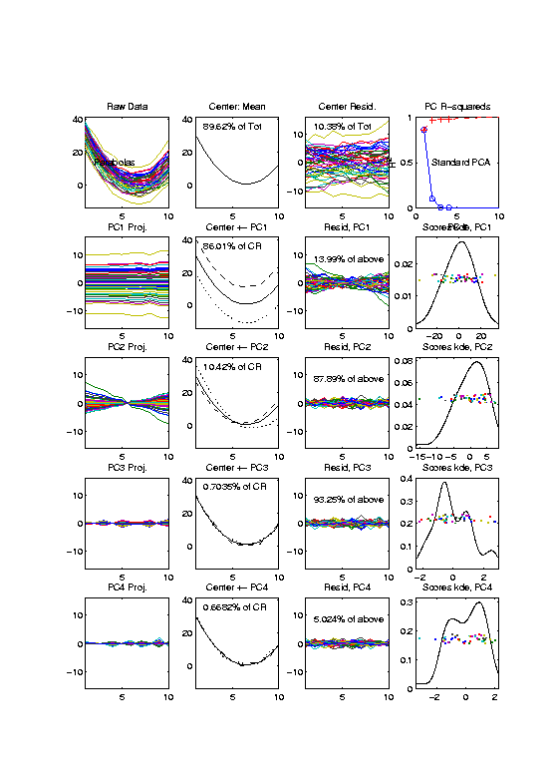
More ICA Examples
Now Try FDA examples – Recall Parabolas
Curves As
Data Objects

Slide 130
More ICA Examples
Now Try FDA examples – Parabolas
PCA Gives
Interpretable
Decomposition

Slide 131
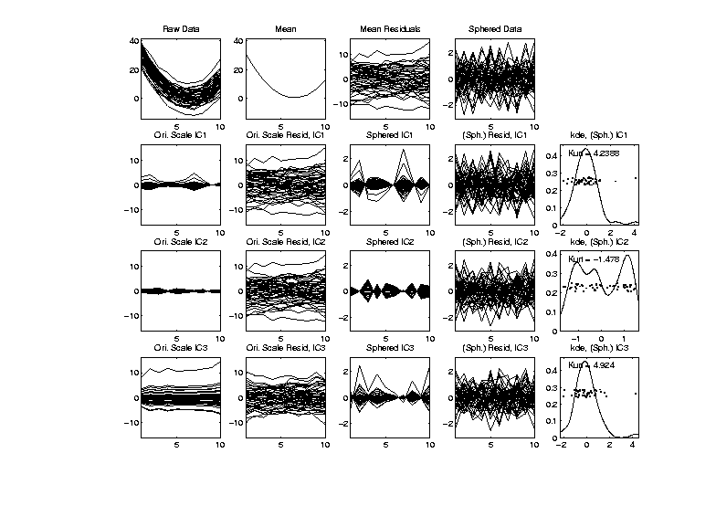
More ICA Examples
Now Try FDA examples – Parabolas
Sphering
Loses
Structure
ICA Finds
Outliers

Slide 132
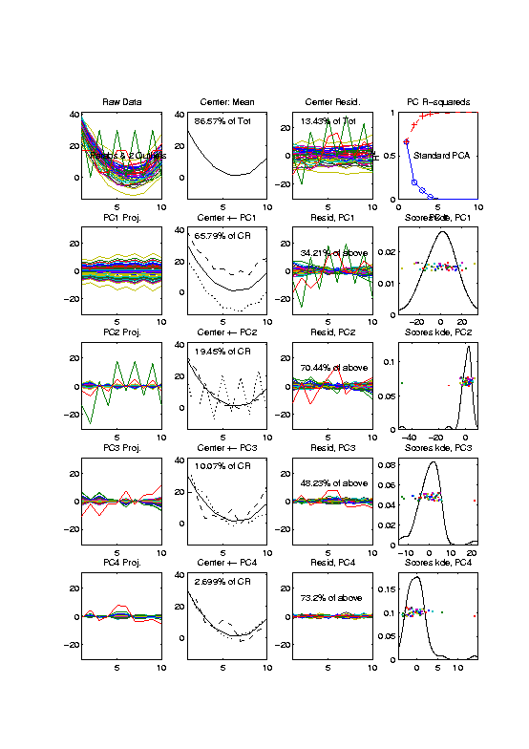
More ICA Examples
FDA example – Parabolas w/ 2 Outliers
Same Curves
plus “Outliers”

Slide 133
More ICA Examples
FDA example – Parabolas w/ 2 Outliers
Impact all of:
Mean
PC1 (slightly)
PC2 (dominant)
PC3 (tilt???)

Slide 134
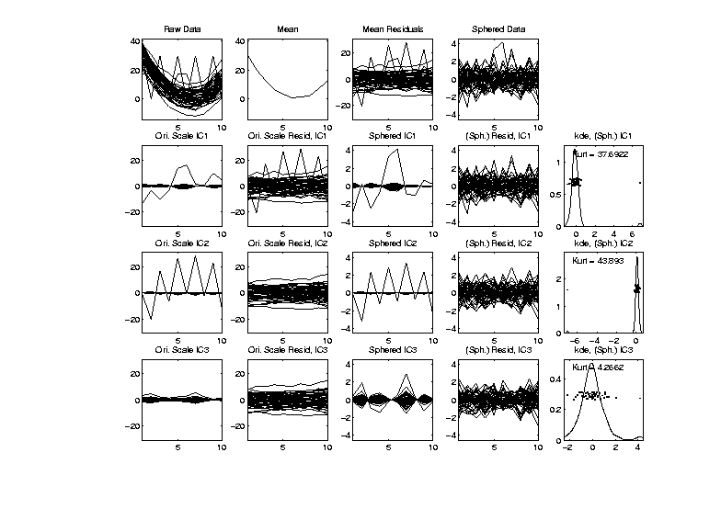
More ICA Examples
FDA example – Parabolas w/ 2 Outliers
ICA:
Misses Main
Directions
But Finds
Outliers
(non-Gaussian!)

Slide 135
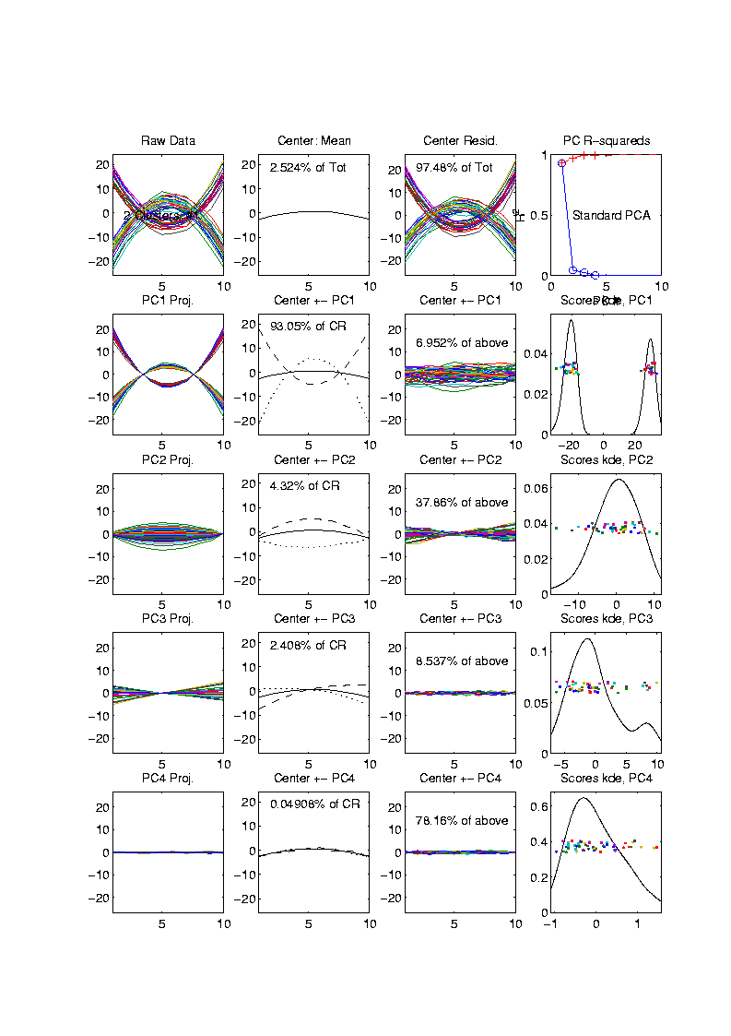
More ICA Examples
FDA example – Parabolas Up and Down
Recall 2 Clear
Clusters

Slide 136
More ICA Examples
FDA example – Parabolas Up and Down
PCA:
Clusters
& Other
Structure

Slide 137
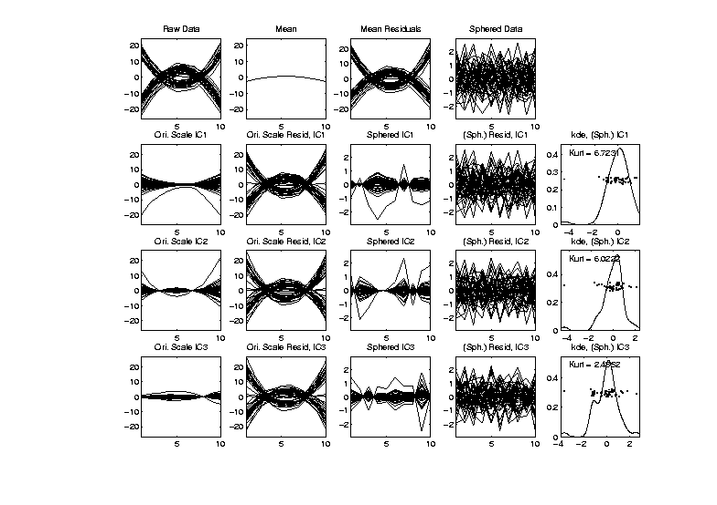
More ICA Examples
FDA example – Parabolas Up and Down
ICA:
Does Not
Find Clusters
Reason:
Random Start

Slide 138
More ICA Examples
FDA example – Parabolas Up and Down
ICA: Scary Issue
Local Minima in Optimization

Slide 139
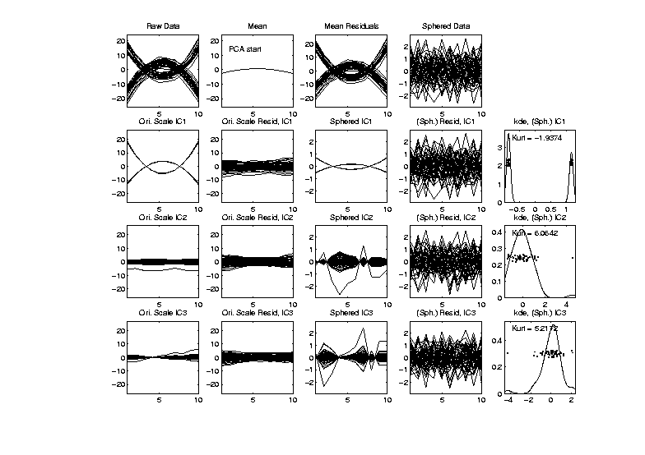
More ICA Examples
FDA example – Parabolas Up and Down
ICA Solution 1: Use PCA to Start
Worked Here
But Not
Always

Slide 140
More ICA Examples
FDA example – Parabolas Up and Down
ICA Solution 2:
Use Multiple Random Starts
Shows When Have Multiple Minima
Range Should Turn Up Good Directions
More to Look At / Interpret

Slide 141
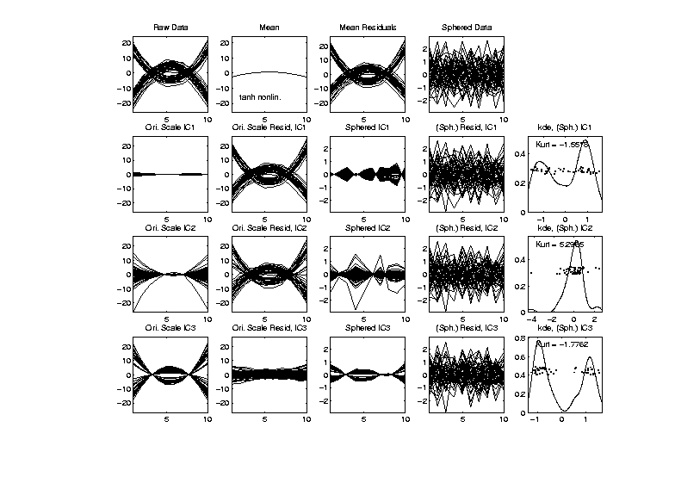
More ICA Examples
FDA example – Parabolas Up and Down
ICA Solution 2: Multiple Random Starts
3rd IC Dir’n
Looks Good

Slide 142
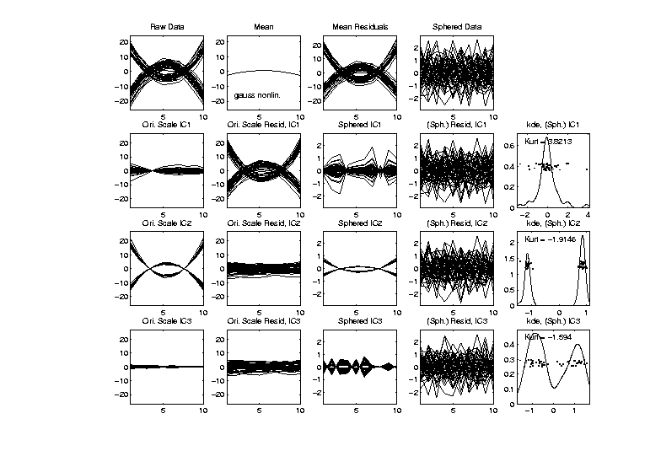
More ICA Examples
FDA example – Parabolas Up and Down
ICA Solution 2: Multiple Random Starts
2nd
Looks
Good

Slide 143
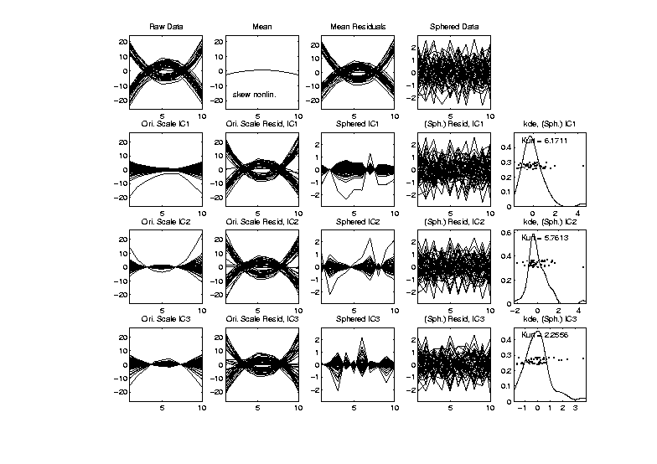
More ICA Examples
FDA example – Parabolas Up and Down
ICA Solution 2: Multiple Random Starts?
Never
Finds
Clusters?

Slide 144
ICA Overview
Interesting Method, has Potential
Great for Directions of Non-Gaussianity
  E.g. Finding Outliers
Common Application Area: FMRI
Has Its Costs
  Slippery Optimization
  Interpetation Challenges

