Slide 1
Class Sensitive Principal Components Analysis
Di Miao
Advised by J. S. Marron
Department of Statistics and Operations Research
UNC – Chapel Hill
September 30, 2014
STOR 892 Object Oriented Data Analysis

Slide 2
Outline
Visualization
  How do we look at data
Exploratory Methods
  Principal Components Analysis
  Canonical Correlation Analysis
Class Discrimination Methods
  Fisher Linear Discrimination
  Support Vector Machine
  Maximal Data Piling
Class Sensitive Principal Components Analysis

Slide 3
Visualization
How do we look at data?
  We use projection onto directions of interests
There are many “directions of interest” onto which projections are useful
  Large variation: e.g. Principal Components
  Accurate classification: e.g. Linear classifiers
CSPCA considers BOTH!
We first review PCA and some useful linear classifiers

Slide 4
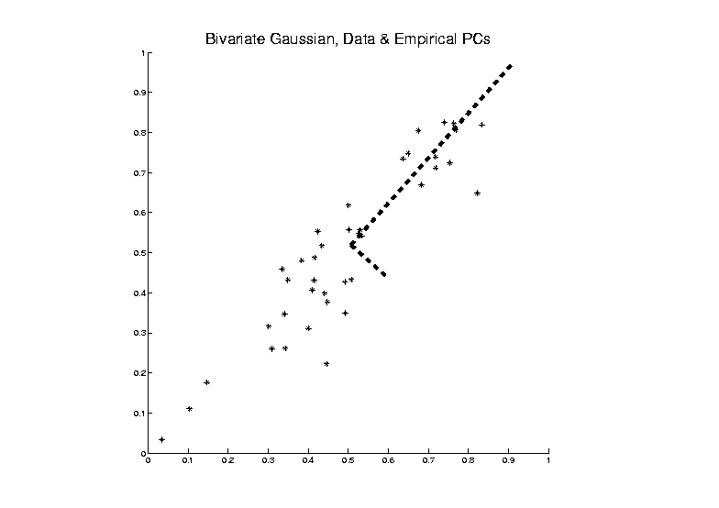
Principal Components Analysis
PCA can be viewed as an optimization problem which finds “Directions of Greatest Variability”:

Slide 5
Principal Components Analysis
Assume is centered so that each row has mean 0.
The 1st PC direction onto which the variation of projected data is maximized in the sense that
After subtracting the first principal components from
The k^{th} PC direction satisfies

Slide 6
Principal Components Analysis (cont.)
We know that for a row centered data matrix , the variance
Then the 1st PC direction is the solution of the following optimization problem
where
The k^{th} PC directions can be computed sequentially on the orthogonal subspace of the first k-1 PC directions.
They are also the first k loading vectors corresponding to the largest k eigenvalues of

Slide 7
Limitation of PCA
PCA can provide useful projection directions
But cannot “see everything”

Slide 8
Limitation of PCA (cont.)
Projections onto the first 3 PC directions
Projections are overlapped!
No apparent classes difference can be observed!

Slide 9
Limitation of PCA (cont.)
Projections onto the first 4 PC directions
Projections are overlapped in the first 3 PC directions
Clear classes difference can be observed in the projection onto the 4th PC direction
Not visible in the first 3 PCs

Slide 10
Limitation of PCA
PCA can provide useful projection directions
But cannot “see everything”
Important structure may not be visible in the first few PCs
Reason:
  PCA finds directions of maximal variation, which may obscure interesting structure
  PCA ignores class labels

Slide 11
Canonical Correlation Analysis (Hotelling, 1936)
Study the relationship between two multivariate data matrices.
Seeks two vectors (i.e. linear combination of features) that maximizes correlation between projections
Two row centered data matrices: Two vectors:
Projections:

Slide 12
CCA (cont.)
Correlation between projections
Vectors are the solutions of the following optimization problem

Slide 13
CCA (cont.)
The solution are the first pair of canonical direction vectors.
The maximized correlation is the canonical correlation.
The projections are the first pair of canonical variables.

Slide 14
Canonical correlation and size of data
Canonical correlation is the maximum of all possible correlations
When , the canonical correlation is 1 (with prob 1)
d=4, small ρ
d=30, moderate overfitting
d=50, strong overfitting

Slide 15
Classification (i.e. discrimination)
Background: Two-class (Binary) version:
“Training data”:
“Class indicator vector”:
We have two classes:
Develop a “rule” for
assigning new data to a class

Slide 16
Linear classification
Linear rule:
Project data onto a d-dimensional vector and perform classification in this 1-dimensional space.
How to find the vector?
Fisher Linear Discrimination
Support Vector Machine
Maximal Data Piling
…

Slide 17
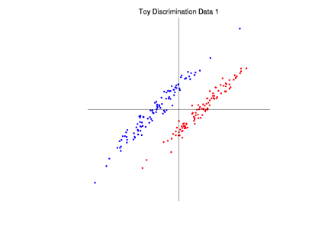
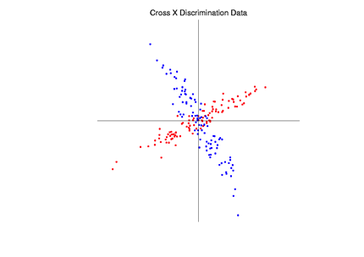
Fisher Linear Discrimination (Fisher, 1936)
Covariances:
based on centered data matrices
Major assumption: Class covariances are the same (or “similar”)
Like this: Not this:

Slide 18
Fisher Linear Discrimination (cont.)
Define:
“Between-class scatter matrix”:
“Within-class scatter matrix”:
The FLD normal vector is the solution of the following optimization problem

Slide 19
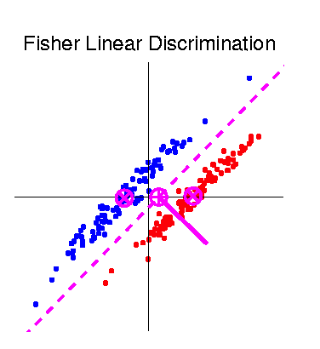

Fisher Linear Discrimination (cont.)
FLD normal vector and separating hyperplane

Slide 20
Support Vector Machine
Graphical View, using simulated example
Find separating hyperplane
To maximize distances from data to plane
In particular smallest distance

Slide 21
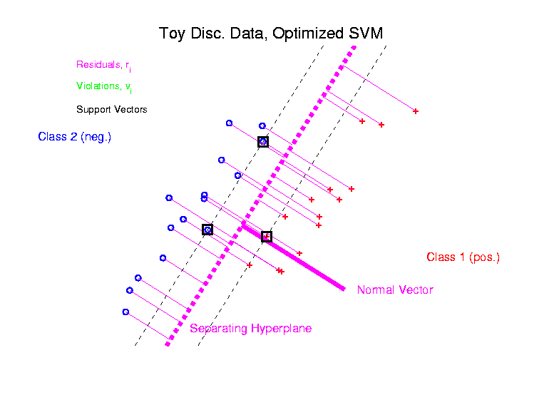
Support Vector Machine (cont.)
Graphical View, using simulated example

Slide 22
Support Vector Machine
Graphical View, using simulated example
Find separating hyperplane
To maximize distances from data to plane
In particular smallest distance
Optimization problem
Solve (convex problem) by quadratic programming

Slide 23
Maximal Data Piling
Strange FLD effect at HDLSS boundary
Data Piling:
For each class, all
data samples are
projected onto a
single value

Slide 24
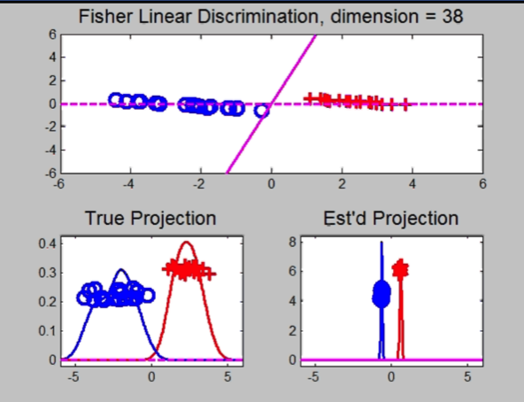
Maximal Data Piling
Strange FLD effect at HDLSS boundary
Data Piling:
For each class, all
data samples are
projected onto a
single value

Slide 25
Maximal Data Piling (cont.)
Data piling direction makes Class +1 data project onto one point and Class -1 data also project onto one point.
It can be shown that
When , data piling direction always exists.
Among all data piling directions, the one onto which the
distance between these two projected points are maximized
is called
Maximal Data Piling Direction

Slide 26
Maximal Data Piling (cont.)
How to compute ?
Assume the training data set has been centered to have row mean of 0.
Recall that is the row centered matrix for each class resp.
Let , the MDP direction is the solution of
is the square of the distance of projected means

Slide 27
Maximal Data Piling (cont.)
It can been shown (in Ahn and Marron, 2010) that the MDP direction is also the solution of the following optimization problem:
where is the global sample covariance matrix.
Recall that the optimization problem of FLD is
Only difference is global vs. within-class Covariance estimates!

Slide 28
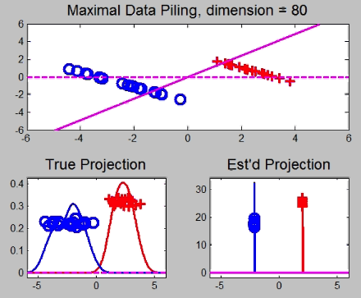
Maximal Data Piling (cont.)
A point of terminology (Ahn and Marron, 2009):
MDP is “maximal” in 2 senses:
# of data piled
Size of gap
(within subspace
generated by data)

Slide 29
Maximal Data Piling (cont.)
Usefulness for Classification?
In HDLSS settings: The classification performance of MDP is competitive against others
Simulation results
Good performance (better than FLD, MDP and SVM) when the errors are autocorrelated
Reason: HDLSS geometric structure. Strong correlations make the data more concentrated and behave lower-dimensionally. (See Ahn and Marron, 2010)

Slide 30
MDP and FLD
Recall that MDP direction is the solution of
and FLD direction is the solution of
We can show that if , and are equivalent in spite of a sign

Slide 31
MDP and SVM
In HDLSS settings, we observe a large portion of the data lie on the SVM margin boundaries.
None piling
Complete piling
Moderate piling

Slide 32
MDP and SVM
As dimension increases, SVM tends to have complete data piling
In extremely high
dimension, SVM
and MDP become
identical.

Slide 33
MDP and CCA
If is a class indicator vector such that
then the MDP direction is the direction in the first pair of canonical correlation directions of
Because when , there always exist at least one pair of solutions such that the canonical correlation
The correlation between the projection of onto the MDP direction and is also as perfect as 1

Slide 34
Advantages of MDP
Better classification performance when errors are autocorrelated
MDP direction = FLD normal vector (±) when
Much better than FLD when
MDP direction = SVM direction (±) as
Closed form solution which other sophisticated classifiers don’t share

Slide 35
Limitation of MDP
Less generalizability (the training data is separable, but the classification for the new samples could be bad) in HDLSS settings
Data are piled completely ➔ ignores the variation within classes
Hard to visualize within class structure
Recall limitation of PCA …

Slide 36
Limitation of PCA (recall)
Ignores class labels
Important classes difference may not be visible in the first few PCs
How can we find directions which can preserve good properties of PCA and MDP and overcome their limitations?

Slide 37
Class Sensitive PCA (CSPCA)
A hybrid of PCA and MDP to seek new directions which can provide
  Large variation of the data &
  Clear classification of different groups
Combines the quadratic objective functions of PCA and MDP
where

Slide 38
CSPCA (cont.)
Tuning parameter controls the balance between the amount of variation explained and the amount of discrimination
When , CSPCA optimization problem becomes
Same as PCA!
When , CSPCA optimization problem becomes
Same as MDP!

Slide 39
CSPCA for classification (Simulation)
Search from 0 to 1, find the optimal with the lowest misclassification rate
Distribution:

Slide 40
CSPCA for classification (Real Data Analysis)
Thyroid Cancer Data
Expression of 2500 most variably expressed genes, 482 samples
Two ways to label the samples:
RNA_Class_k=4
n₁ = 134, n₂ = 52, n₃ = 97, n₄ = 199
RNA_Class_k=5
n₁ = 134, n₂ = 67, n₃ = 82, n₄ = 106, n₅ = 93

Slide 41
CSPCA for classification (Thyroid cancer)
Misclassification rate

Slide 42
CSPCA for visualization
In stead of solving for a fixed , we solve the optimal pair from the CSPCA optimization problem
Then the pair will have relatively large variation explained & clear classification
The classification with relatively large generalizability can be captured by the 1st CSPC direction!

Slide 43
Computation of CSPC directions
Solve from the optimization problem
Once is given, like PCA
For fixed , compute the k^{th} CSPC direction using the above criterion sequentially on the
orthogonal subspace of the first k-1 CSPC directions

Slide 44
CSPCA for visualization (Simulation)
PC scatter plots
Recall the simulated data we have seen
Projected onto the first 4 PC directions

Slide 45
CSPCA for visualization (Simulation)
CSPC scatter plots
Projected onto the first 4 CSPC directions
The important classes difference shown in the 1st CSPC direction
Other important structures shown in other CSPC directions

Slide 46
CSPCA for visualization (Simulation)
Absolute value of loadings
(clusters are in the 4th variable)

Slide 47
CSPCA for visualization (Simulation)
Angle to the optimal (4th coordinate) and Variation Explained
Small Angle to Optimal &
Large Variation Explained

Slide 48
CSPCA for visualization (Real Data Analysis)
PC scatter plots
Thyroid Cancer Data:
3 classes
Union of Class 2 and Class 3 vs. Class 4
n₊ = 90, n₋=130 &
n_{testing}= 128
Classes difference shown on the 2nd PC direction

Slide 49
CSPCA for visualization (Real Data Analysis)
CSPC scatter plots
Classes difference shown in the 1st CSPC direction
Proj’s onto 2nd and 3rd CSPC directions ≈ Proj’s onto 1st and 3rd PC directions

Slide 50
CSPCA for visualization (Real Data Analysis)
AUC of Testing data and Variation Explained of Training data
Large AUC of Testing &
Large Variation Explained of Training

