Slide 1
Interesting Statistical Problem
For HDLSS data:
When clusters seem to appear
  E.g. found by clustering method
How do we know they are really there?
  Question asked by Neil Hayes
  Define appropriate statistical significance?
  Can we calculate it?

Slide 2
Statistical Significance of Clusters
Basis of SigClust Approach:
What defines: A Single Cluster?
  A Gaussian distribution (Sarle & Kou 1993)
So define SigClust test based on:
  2-means cluster index (measure) as statistic
  Gaussian null distribution
  Currently compute by simulation
  Possible to do this analytically???

Slide 3
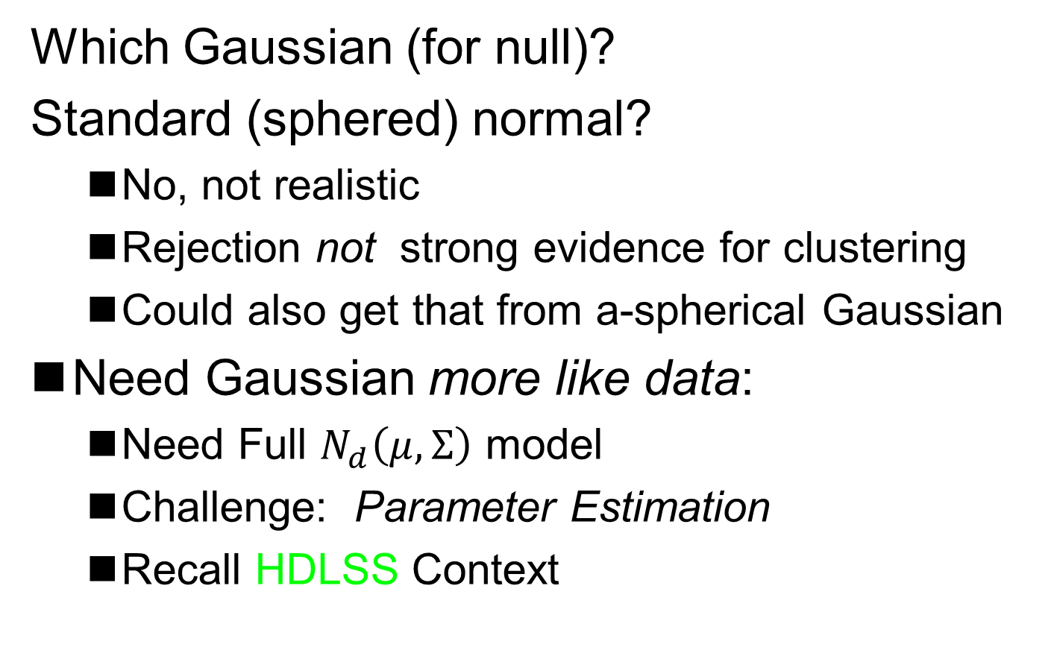
SigClust Gaussian null distribut’n
Which Gaussian (for null)?
Standard (sphered) normal?
  No, not realistic
  Rejection not strong evidence for clustering
  Could also get that from a-spherical Gaussian
Need Gaussian more like data:
  Need Full $N_{d}\left(μ,Σ\right)$ model
  Challenge: Parameter Estimation
  Recall HDLSS Context

Slide 4
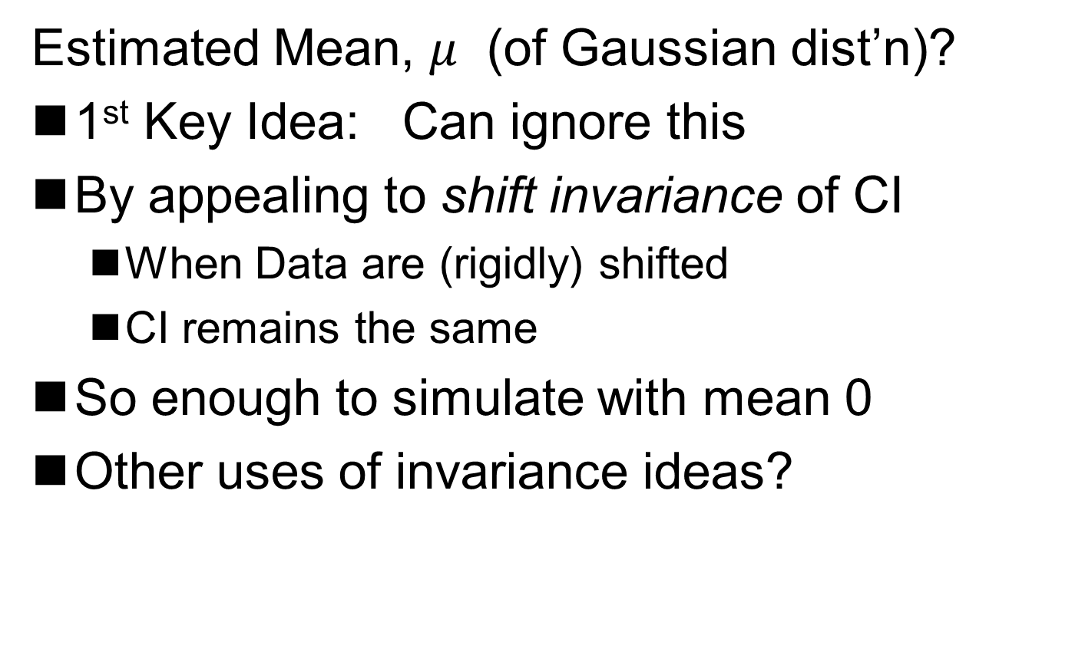
SigClust Gaussian null distribut’n
Estimated Mean, $μ$ (of Gaussian dist’n)?
1st Key Idea: Can ignore this
By appealing to shift invariance of CI
  When Data are (rigidly) shifted
  CI remains the same
So enough to simulate with mean 0
Other uses of invariance ideas?

Slide 5
SigClust Gaussian null distribut’n
2nd Key Idea: Mod Out Rotations
Replace full Cov. by diagonal matrix
As done in PCA eigen-analysis
But then “not like data”???
OK, since k-means clustering (i.e. CI) is
rotation invariant
(assuming e.g. Euclidean Distance)

Slide 6
SigClust Gaussian null distribut’n
2nd Key Idea: Mod Out Rotations
Only need to estimate diagonal matrix
But still have HDLSS problems?
E.g. Perou 500 data:
Dimension
Sample Size
Still need to estimate param’s

Slide 7
SigClust Gaussian null distribut’n
3rd Key Idea: Factor Analysis Model
Model Covariance as: Biology + Noise
Where
is “fairly low dimensional”
is estimated from background noise

Slide 8
SigClust Gaussian null distribut’n
Estimation of Background Noise :

Slide 9
SigClust Gaussian null distribut’n
Estimation of Background Noise :
Reasonable model (for each gene):
Expression = Signal + Noise
“noise” is roughly Gaussian
“noise” terms essentially independent
(across genes)

Slide 10
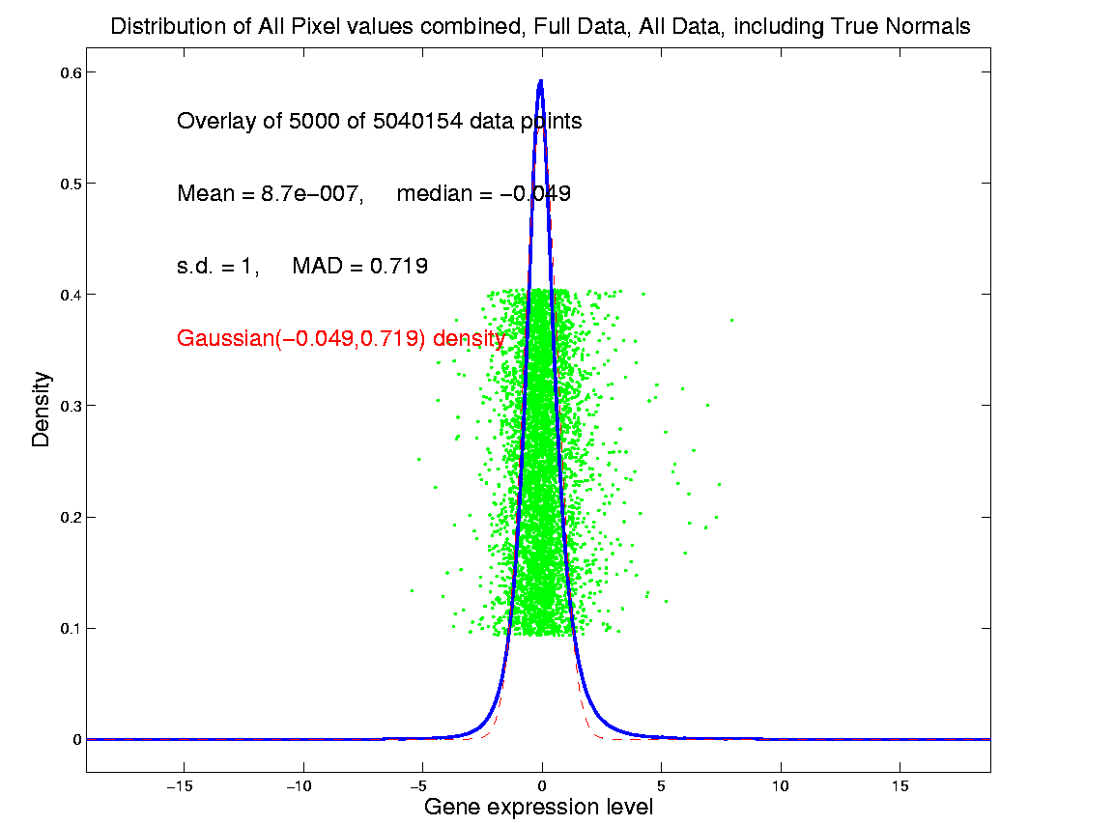
SigClust Estimation of Background Noise
Hope: Most
Entries are
“Pure Noise,
(Gaussian)”
A Few (<< ¼)
Are Biological
Signal –
Outliers
How to Check?

Slide 11
Q-Q plots
Background: Graphical Goodness of Fit
Basis:
Cumulative Distribution Function (CDF)
Probability quantile notation:
for "probability” and "quantile"

Slide 12
Q-Q plots
Two types of CDF:
Theoretical
Empirical, based on data

Slide 13
Q-Q plots
Comparison Visualizations:
(compare a theoretical with an empirical)
P-P plot:
plot vs.
for a grid of values
Q-Q plot:
plot vs.
for a grid of values

Slide 14
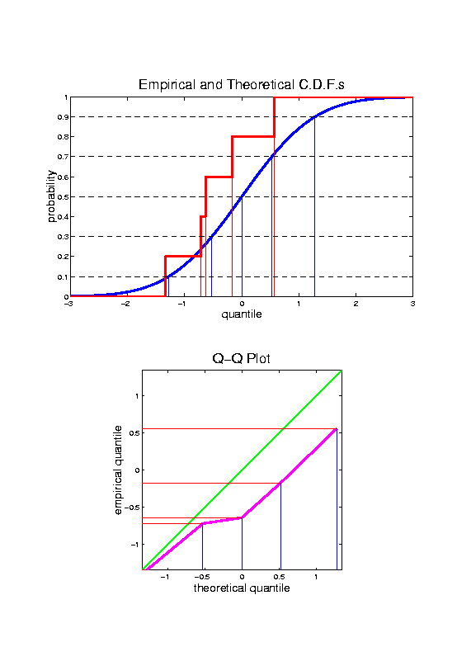
Q-Q plots
Illustrative graphic (toy data set):

Slide 15
Q-Q plots
Illustrative graphic (toy data set):

Slide 16
Q-Q plots
Illustrative graphic (toy data set):
Empirical Qs near Theoretical Qs
when
Q-Q curve is near 45⁰ line
(general use of Q-Q plots)

Slide 17
Alternate Terminology
Q-Q Plots = ROC curves
P-P Plots = “Precision Recall” Curves
Highlights Different Distributional Aspects
Statistical Folklore: Q-Q Highlights Tails,
So Usually More Useful

Slide 18
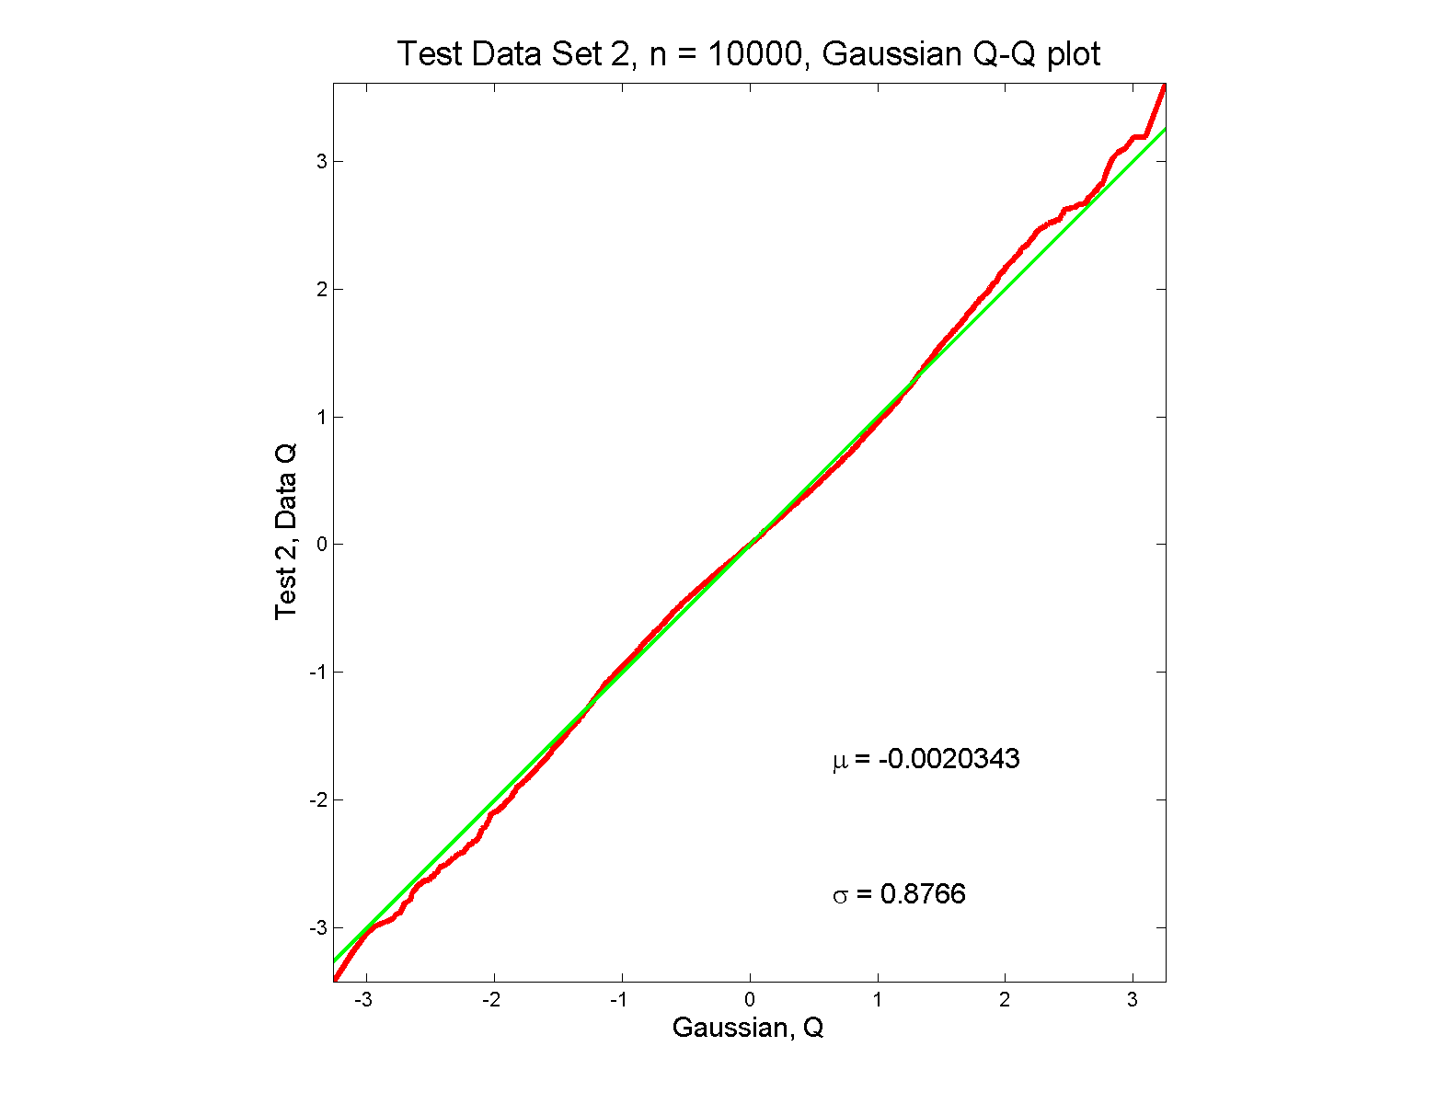
Q-Q plots
Gaussian? departures from line?

Slide 19
Q-Q plots
Gaussian? departures from line?
Looks much like?
Wiggles all random variation?
But there are n = 10,000 data points…
How to assess signal & noise?
Need to understand sampling variation

Slide 20
Q-Q plots
Need to understand sampling variation
Approach: Q-Q envelope plot
  Simulate from Theoretical Dist’n
  Samples of same size
  About 100 samples gives
  “good visual impression”
  Overlay resulting 100 QQ-curves
  To visually convey natural sampling variation

Slide 21
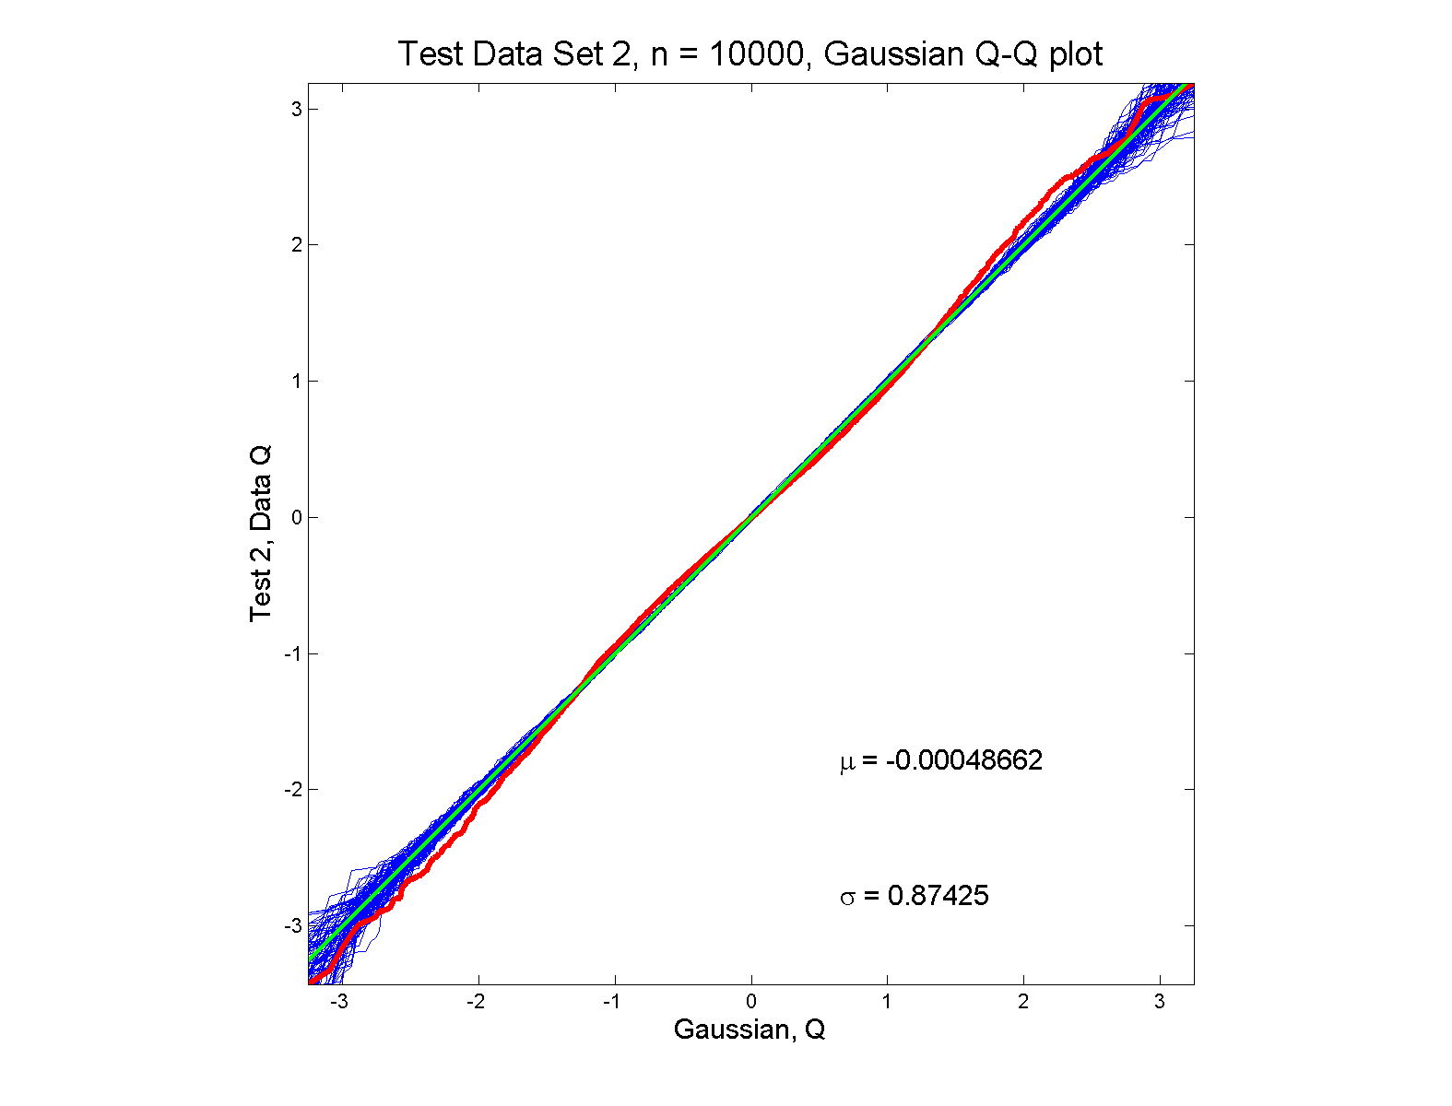
Q-Q plots
Gaussian? departures from line?

Slide 22
Q-Q plots
Gaussian? departures from line?
Harder to see
But clearly there
Conclude non-Gaussian
Really needed n = 10,000 data points…
(why bigger sample size was used)
Envelope plot reflects sampling variation

Slide 23
SigClust Estimation of Background Noise
n = 533, d = 9456

Slide 24
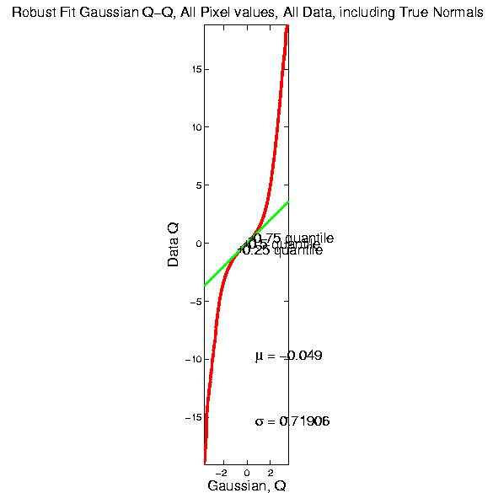
SigClust Estimation of Background Noise

Slide 25
SigClust Estimation of Background Noise
Distribution clearly not Gaussian
Except near the middle
Q-Q curve is very linear there
(closely follows 45º line)
Suggests Gaussian approx. is good there
And that MAD scale estimate is good
(Always a good idea to do such diagnostics)

Slide 26
SigClust Gaussian null distribut’n
Estimation of Biological Covariance :
Keep only “large” eigenvalues
Defined as
So for null distribution, use eigenvalues:

Slide 27
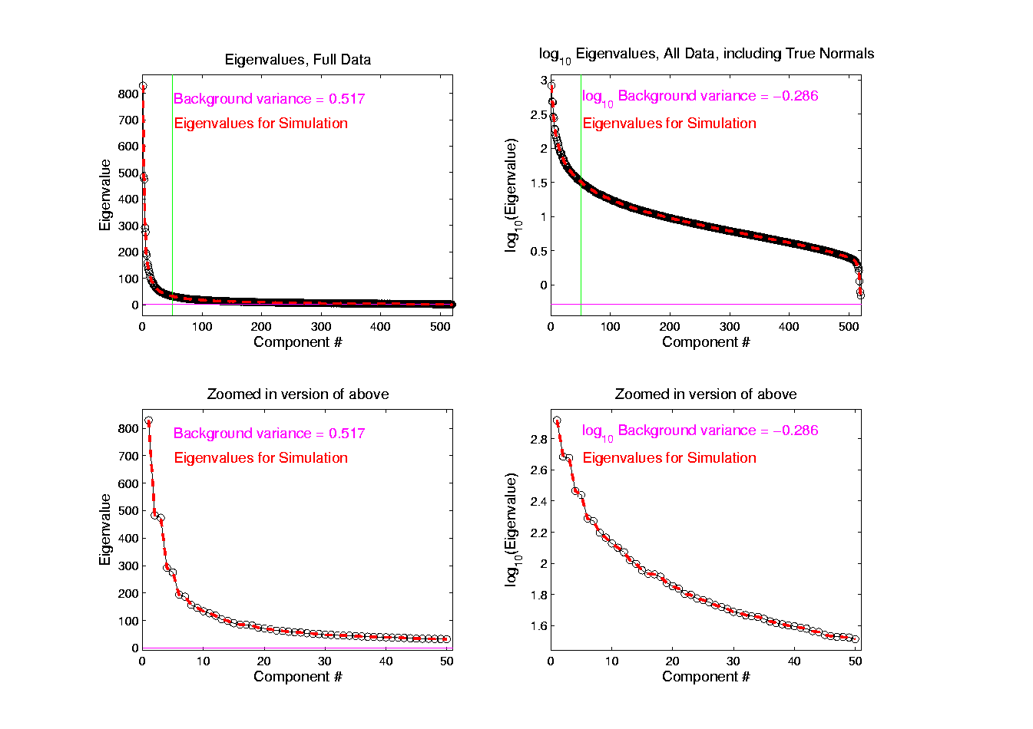
SigClust Estimation of Eigenval’s

Slide 28
SigClust Estimation of Eigenval’s
All eigenvalues > !
Suggests biology is very strong here!
I.e. very strong signal to noise ratio
Have more structure than can analyze
(with only 533 data points)
Data are very far from pure noise
So don’t actually use Factor Anal. Model
Instead end up with estim’d eigenvalues

Slide 29
SigClust Estimation of Eigenval’s
Do we need the factor model?
Explore this with another data set
(with fewer genes)
This time:
  n = 315 cases
  d = 306 genes

Slide 30
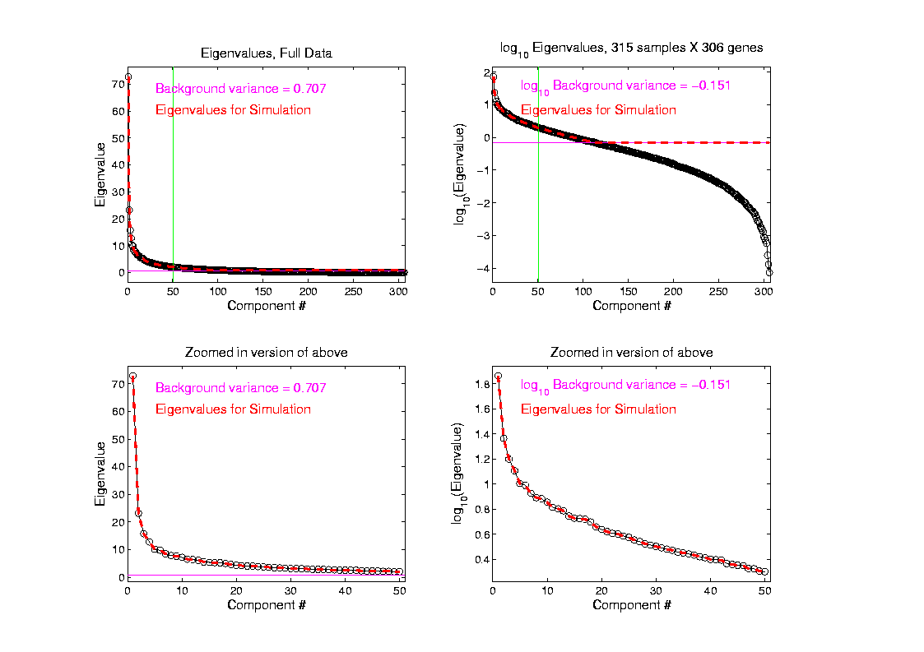
SigClust Estimation of Eigenval’s

Slide 31
SigClust Estimation of Eigenval’s
Try another data set, with fewer genes
This time:
  First ~110 eigenvalues >
  Rest are negligible
  So threshold smaller ones at

Slide 32
SigClust Gaussian null distribution - Simulation
Now simulate from null distribution using:
where (indep.)
Again rotation invariance makes this work
(and location invariance)

Slide 33
SigClust Gaussian null distribution - Simulation
Then compare data CI,
With simulated null population CIs
Spirit similar to DiProPerm
But now significance happens for
smaller values of CI

Slide 34
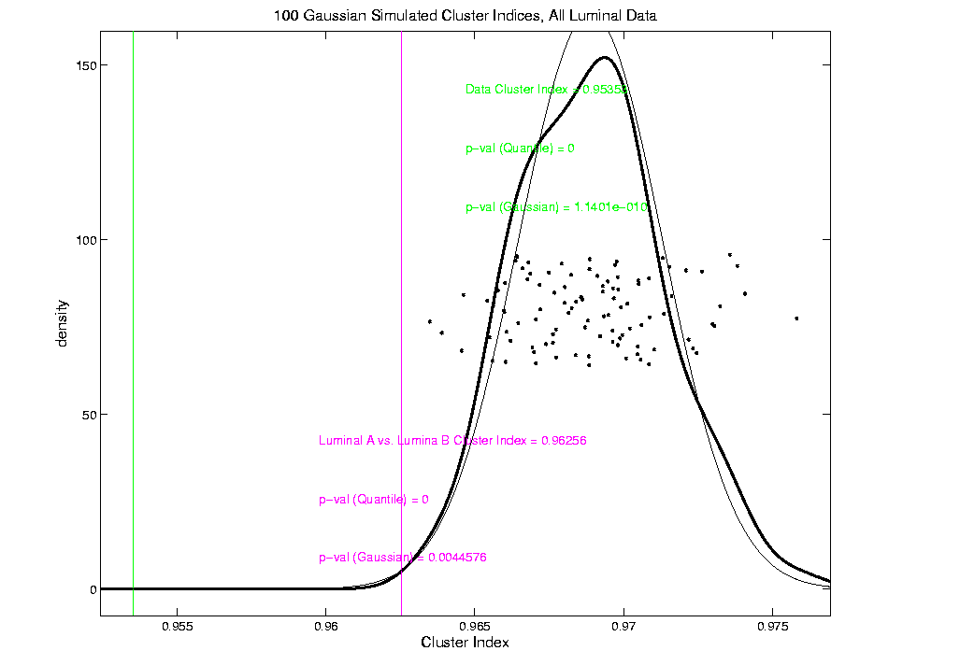
An example (details to follow)
P-val = 0.0045

Slide 35
SigClust Modalities
Two major applications:
Test significance of given clusterings
(e.g. for those found in heat map)
(Use given class labels)

Slide 36
SigClust Modalities
Two major applications:
Test significance of given clusterings
(e.g. for those found in heat map)
(Use given class labels)
Test if known cluster can be further split
(Use 2-means class labels)

Slide 37
SigClust Real Data Results
Analyze Perou 500 breast cancer data
(large cross study combined data set)
Current folklore: 5 classes
Luminal A
Luminal B
Normal
Her 2
Basal

Slide 38
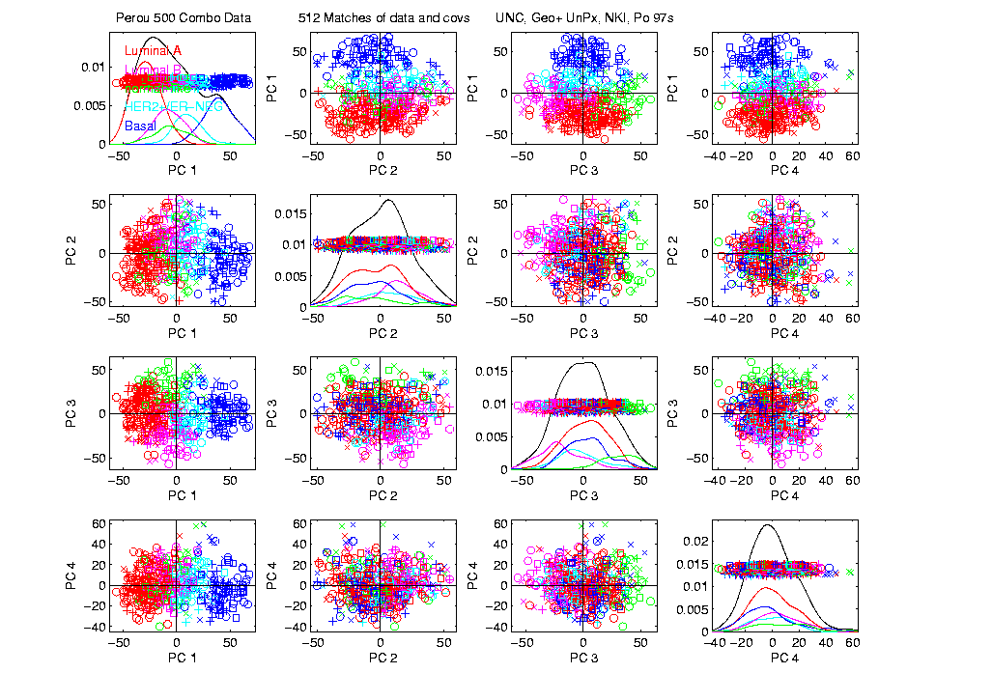
Perou 500 PCA View – real clusters???

Slide 39
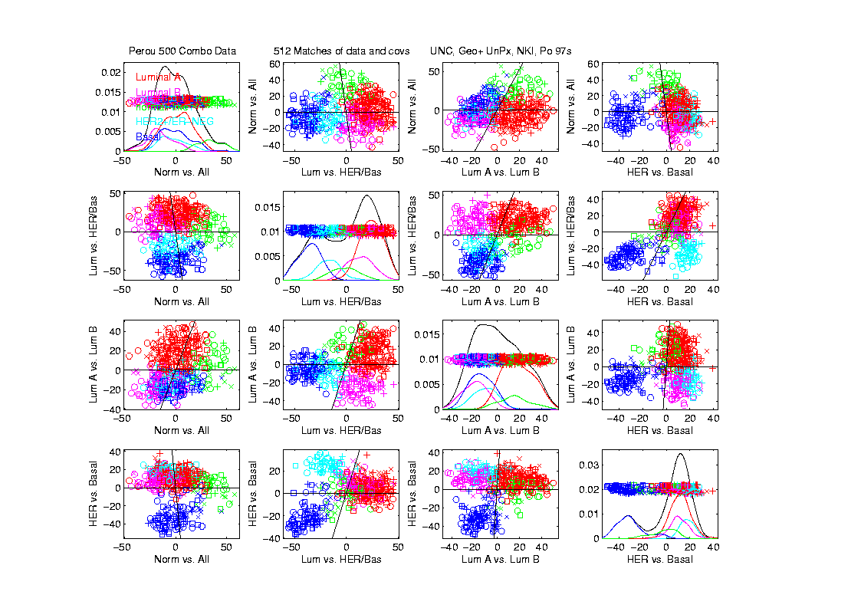
Perou 500 DWD Dir’ns View – real clusters???

Slide 40
Perou 500 – Fundamental Question
Are Luminal A &
Luminal B really
distinct clusters?
Famous for
Far Different
Survivability

Slide 41
SigClust Results for Luminal A vs. Luminal B
P-val = 0.0045

Slide 42
SigClust Results for Luminal A vs. Luminal B
Get p-values from:
Empirical Quantile
  From simulated sample CIs

Slide 43
SigClust Results for Luminal A vs. Luminal B
Get p-values from:
Empirical Quantile
  From simulated sample CIs
Fit Gaussian Quantile
  Don’t “believe these”
  But useful for comparison
  Especially when Empirical Quantile = 0

Slide 44
SigClust Results for Luminal A vs. Luminal B
Test significance of given clusterings
Empirical p-val = 0
  Definitely 2 clusters
Gaussian fit p-val = 0.0045
  same strong evidence
Conclude these really are two clusters

Slide 45
SigClust Results for Luminal A vs. Luminal B
Test if known cluster can be further split
Empirical p-val = 0
  definitely 2 clusters
Gaussian fit p-val = 10⁻¹⁰
  Stronger evidence than above
  Such comparison is value of Gaussian fit
  Makes sense (since CI is min possible)
Conclude these really are two clusters

Slide 46
SigClust Real Data Results
Summary of Perou 500 SigClust Results:
Lum & Norm vs. Her2 & Basal, p-val = 10⁻¹⁹
Luminal A vs. B, p-val = 0.0045
Her 2 vs. Basal, p-val = 10⁻¹⁰
Split Luminal A, p-val = 10⁻⁷
Split Luminal B, p-val = 0.058
Split Her 2, p-val = 0.10
Split Basal, p-val = 0.005

Slide 47
SigClust Real Data Results
Summary of Perou 500 SigClust Results:
All previous splits were real
Most not able to split further
Exception is Basal, already known
Chuck Perou has good intuition!
(insight about signal vs. noise)
How good are others???

Slide 48
SigClust Real Data Results
Experience with Other Data Sets: Similar
Smaller data sets: less power
Gene filtering: more power
Lung Cancer: more distinct clusters

Slide 49
SigClust Real Data Results
Some Personal Observations
Experienced Analysts Impressively Good
SigClust can save them time
SigClust can help them with skeptics
SigClust essential for non-experts

Slide 50
SigClust Overview
Works Well When Factor Part Not Used

Slide 51
SigClust Overview
Works Well When Factor Part Not Used
Sample Eigenvalues Always Valid
But Can be Too Conservative

Slide 52
SigClust Overview
Works Well When Factor Part Not Used
Sample Eigenvalues Always Valid
But Can be Too Conservative
Above Factor Threshold Anti-Conservative

Slide 53
SigClust Overview
Works Well When Factor Part Not Used
Sample Eigenvalues Always Valid
But Can be Too Conservative
Above Factor Threshold Anti-Conservative
Problem Fixed by Soft Thresholding
(Huang et al, 2014)

Slide 54
SigClust Open Problems
Improved Eigenvalue Estimation
More attention to Local Minima in 2-means Clustering
Theoretical Null Distributions
Inference for k > 2 means Clustering
Multiple Comparison Issues

Slide 55

HDLSS Asymptotics
Modern Mathematical Statistics:
Based on asymptotic analysis
Notes:
55

Slide 56
HDLSS Asymptotics
Modern Mathematical Statistics:
Based on asymptotic analysis
I.e. Uses limiting operations
Almost always
Notes:
56

Slide 57
HDLSS Asymptotics
Modern Mathematical Statistics:
Based on asymptotic analysis
I.e. Uses limiting operations
Almost always
Workhorse Method for Much Insight:
Laws of Large Numbers (Consistency)
Central Limit Theorems (Quantify Errors)
Notes:
57

Slide 58
HDLSS Asymptotics
Modern Mathematical Statistics:
Based on asymptotic analysis
I.e. Uses limiting operations
Almost always
Occasional misconceptions
Notes:
58

Slide 59
HDLSS Asymptotics
Modern Mathematical Statistics:
Based on asymptotic analysis
I.e. Uses limiting operations
Almost always
Occasional misconceptions:
  Indicates behavior for large samples
  Thus only makes sense for “large” samples
Notes:
59

Slide 60
HDLSS Asymptotics
Modern Mathematical Statistics:
Based on asymptotic analysis
I.e. Uses limiting operations
Almost always
Occasional misconceptions:
  Indicates behavior for large samples
  Thus only makes sense for “large” samples
  Models phenomenon of “increasing data”
Notes:
60

Slide 61
HDLSS Asymptotics
Modern Mathematical Statistics:
Based on asymptotic analysis
I.e. Uses limiting operations
Almost always
Occasional misconceptions:
  Indicates behavior for large samples
  Thus only makes sense for “large” samples
  Models phenomenon of “increasing data”
  So other flavors are useless???
Notes:
61

Slide 62
HDLSS Asymptotics
Modern Mathematical Statistics:
Based on asymptotic analysis
Notes:
62

Slide 63
HDLSS Asymptotics
Modern Mathematical Statistics:
Based on asymptotic analysis
Real Reasons:
  Approximation provides insights
Notes:
63

Slide 64
HDLSS Asymptotics
Modern Mathematical Statistics:
Based on asymptotic analysis
Real Reasons:
  Approximation provides insights
  Can find simple underlying structure
  In complex situations
Notes:
64

Slide 65
HDLSS Asymptotics
Modern Mathematical Statistics:
Based on asymptotic analysis
Real Reasons:
  Approximation provides insights
  Can find simple underlying structure
  In complex situations
Thus various flavors are fine:
Notes:
65

Slide 66
HDLSS Asymptotics
Modern Mathematical Statistics:
Based on asymptotic analysis
Real Reasons:
  Approximation provides insights
  Can find simple underlying structure
  In complex situations
Thus various flavors are fine:
Even desirable! (find additional insights)
Notes:
66

Slide 67
HDLSS Asymptotics
Personal Observations:
HDLSS world is…

Slide 68
HDLSS Asymptotics
Personal Observations:
HDLSS world is…
Surprising (many times!)
[Think I’ve got it, and then …]

Slide 69
HDLSS Asymptotics
Personal Observations:
HDLSS world is…
Surprising (many times!)
[Think I’ve got it, and then …]
Mathematically Beautiful (?)

Slide 70
HDLSS Asymptotics
Personal Observations:
HDLSS world is…
Surprising (many times!)
[Think I’ve got it, and then …]
Mathematically Beautiful (?)
Practically Relevant

Slide 71
HDLSS Asymptotics: Simple Paradoxes
Study Ideas From:
Hall, Marron and Neeman (2005)

Slide 72
HDLSS Asymptotics: Simple Paradoxes
For dim’al Standard Normal dist’n:

Slide 73
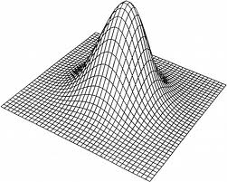
HDLSS Asymptotics: Simple Paradoxes
For dim’al Standard Normal dist’n:
Where are Data?
Near Peak of Density?
Thanks to: psycnet.apa.org

Slide 74
HDLSS Asymptotics: Simple Paradoxes
For dim’al Standard Normal dist’n:
Euclidean Distance to Origin (as )
(measure how close to peak)

Slide 75
HDLSS Asymptotics: Simple Paradoxes
For dim’al Standard Normal dist’n:
Euclidean Distance to Origin (as ):

Slide 76
HDLSS Asymptotics: Simple Paradoxes
For dim’al Standard Normal dist’n:
Euclidean Distance to Origin (as ):

Slide 77
HDLSS Asymptotics: Simple Paradoxes
As ,
Data lie roughly on surface of sphere,
with radius
Notes:
77

Slide 78
HDLSS Asymptotics: Simple Paradoxes
As ,
Data lie roughly on surface of sphere,
with radius
- Yet origin is point of highest density???
Notes:
78

Slide 79
HDLSS Asymptotics: Simple Paradoxes
As ,
Data lie roughly on surface of sphere,
with radius
- Yet origin is point of highest density???
- Paradox resolved by:
density w. r. t. Lebesgue Measure
Notes:
79

Slide 80
HDLSS Asymptotics: Simple Paradoxes
- Paradox resolved by:
density w. r. t. Lebesgue Measure
Notes:
80

Slide 81
HDLSS Asymptotics: Simple Paradoxes
- Paradox resolved by:
density w. r. t. Lebesgue Measure
Consider Volume of Unit Sphere in $ℝ^{d}$
Notes:
81

Slide 82
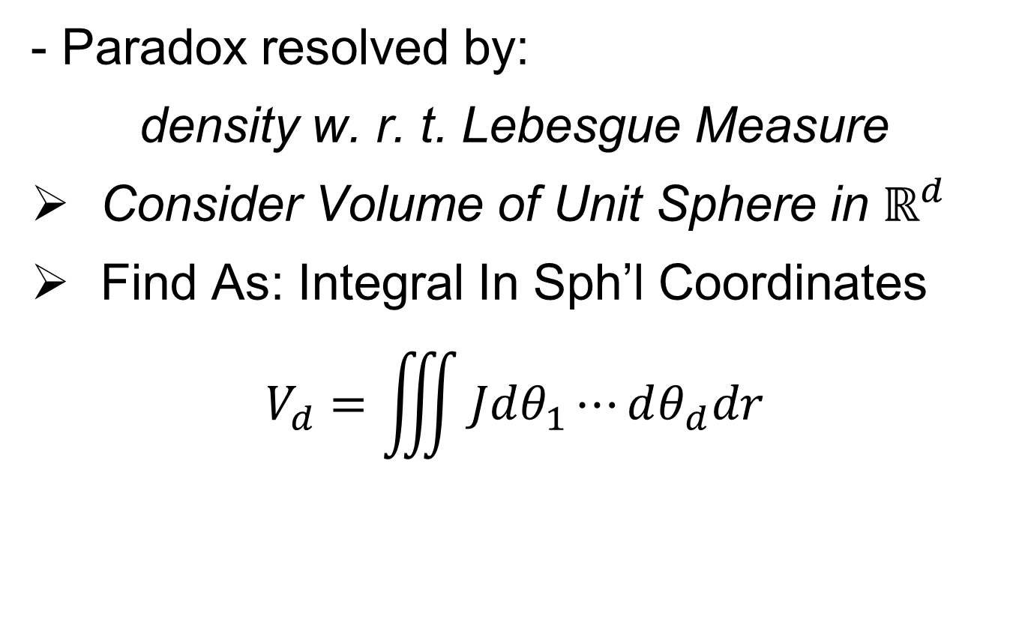
HDLSS Asymptotics: Simple Paradoxes
- Paradox resolved by:
density w. r. t. Lebesgue Measure
Consider Volume of Unit Sphere in $ℝ^{d}$
Find As: Integral In Sph’l Coordinates
$$V_{d}=\iiint{Jdθ_{1}⋯dθ_{d}dr}$$
Notes:
82

Slide 83
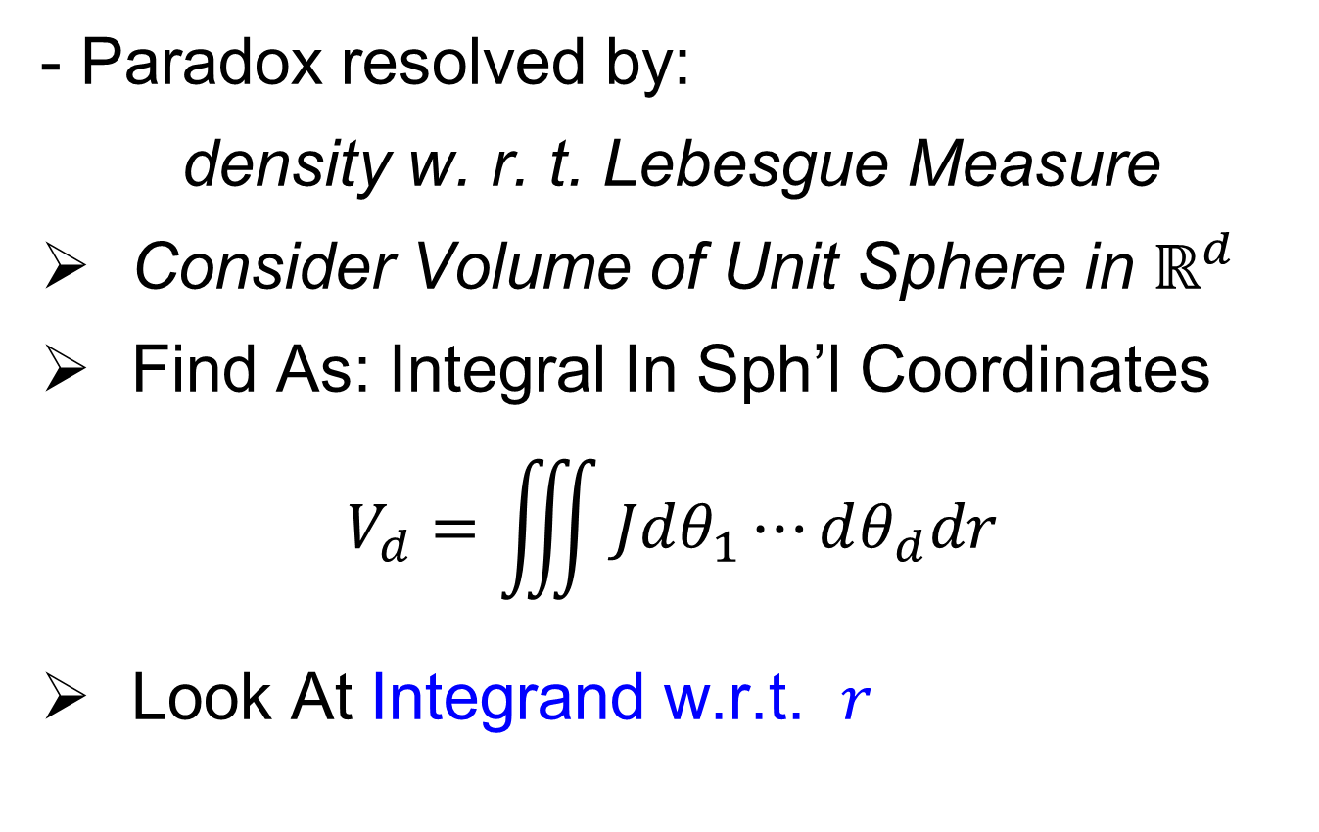
HDLSS Asymptotics: Simple Paradoxes
- Paradox resolved by:
density w. r. t. Lebesgue Measure
Consider Volume of Unit Sphere in $ℝ^{d}$
Find As: Integral In Sph’l Coordinates
$$V_{d}=\iiint{Jdθ_{1}⋯dθ_{d}dr}$$
Look At Integrand w.r.t. $r$
Notes:
83

Slide 84
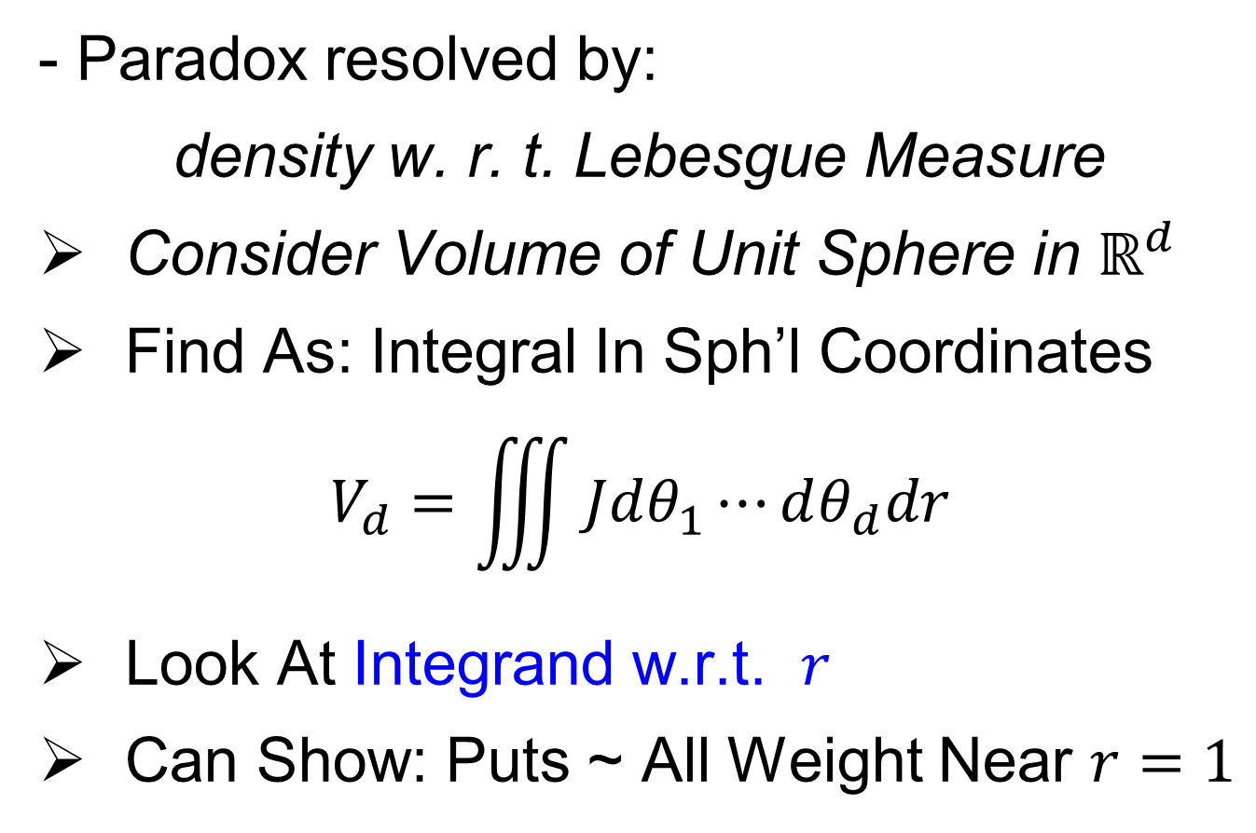
HDLSS Asymptotics: Simple Paradoxes
- Paradox resolved by:
density w. r. t. Lebesgue Measure
Consider Volume of Unit Sphere in $ℝ^{d}$
Find As: Integral In Sph’l Coordinates
$$V_{d}=\iiint{Jdθ_{1}⋯dθ_{d}dr}$$
Look At Integrand w.r.t. $r$
Can Show: Puts ~ All Weight Near $r=1$
Notes:
84

Slide 85
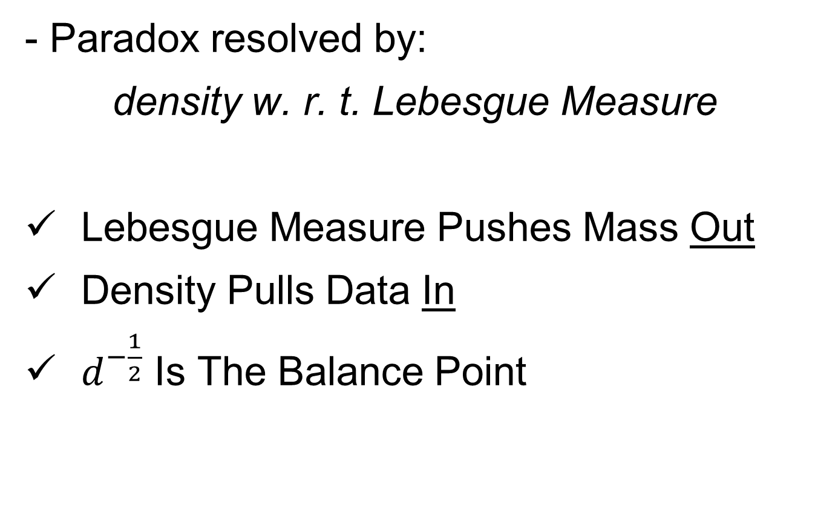
HDLSS Asymptotics: Simple Paradoxes
- Paradox resolved by:
density w. r. t. Lebesgue Measure
Lebesgue Measure Pushes Mass Out
Density Pulls Data In
$d^{−\frac{1}{2}}$ Is The Balance Point
Notes:
85

Slide 86
HDLSS Asymptotics: Simple Paradoxes
As ,
Important Philosophical Consequence
Notes:
86

Slide 87

HDLSS Asymptotics: Simple Paradoxes
As ,
Important Philosophical Consequence:
$∄$“Average People”
Notes:
87

Slide 88
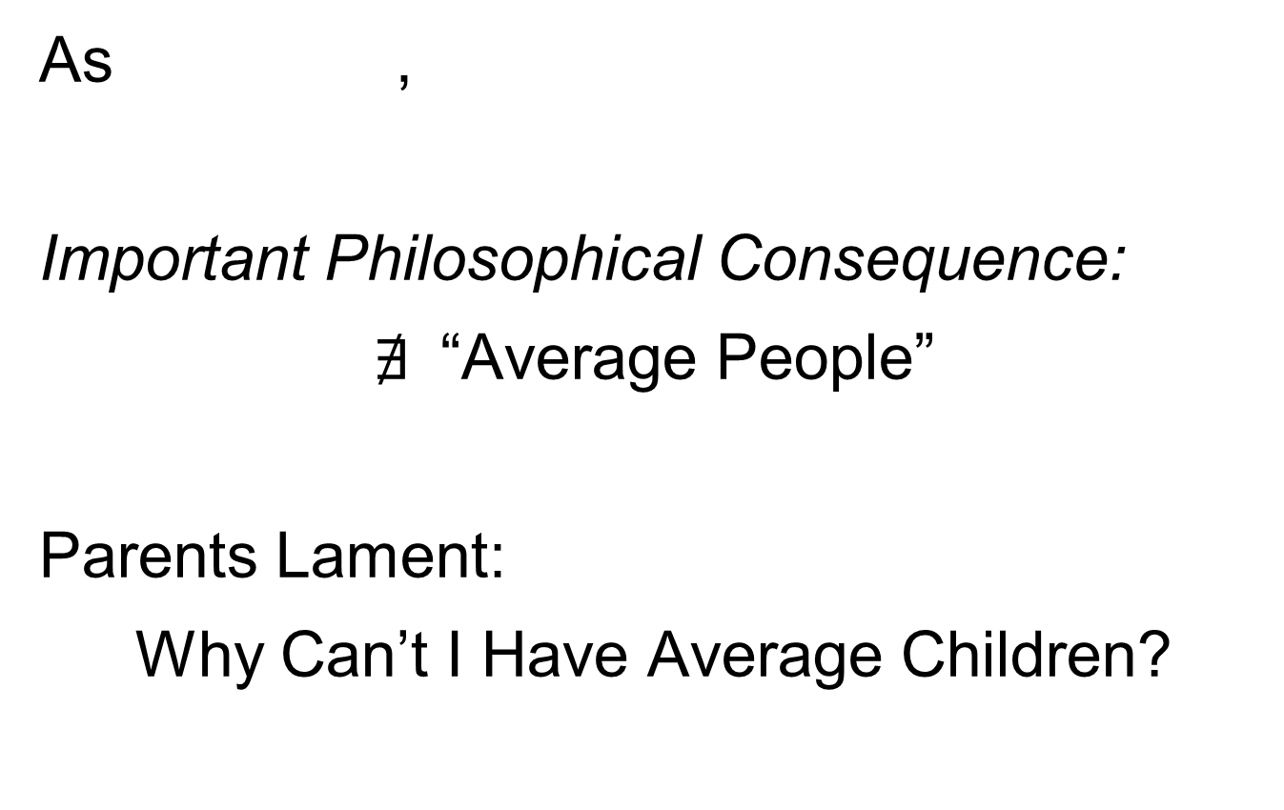
HDLSS Asymptotics: Simple Paradoxes
As ,
Important Philosophical Consequence:
$∄$“Average People”
Parents Lament:
Why Can’t I Have Average Children?
Notes:
88

Slide 89
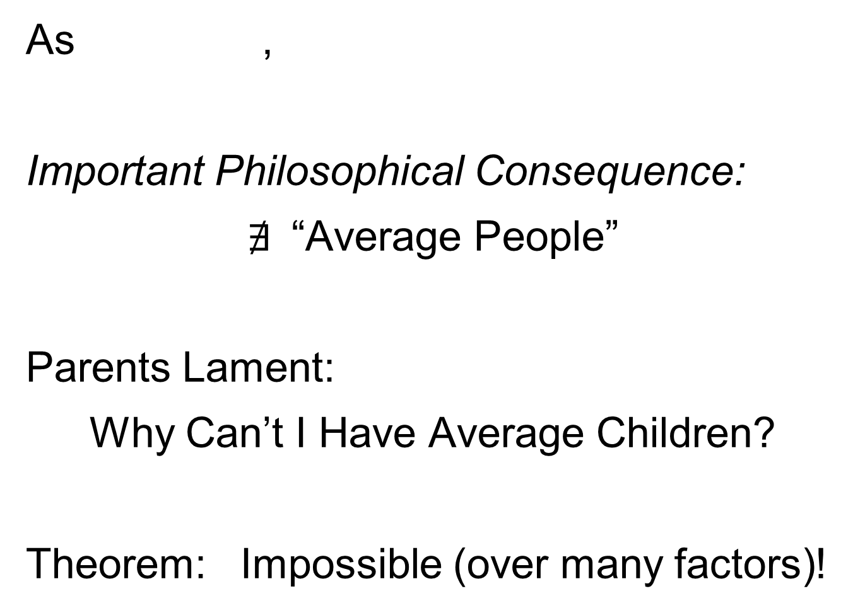
HDLSS Asymptotics: Simple Paradoxes
As ,
Important Philosophical Consequence:
$∄$“Average People”
Parents Lament:
Why Can’t I Have Average Children?
Theorem: Impossible (over many factors)!
Notes:
89

Slide 90
HDLSS Asymptotics: Simple Paradoxes
For dim’al Standard Normal dist’n:
indep. of
Euclidean Dist. Between and

Slide 91
HDLSS Asymptotics: Simple Paradoxes
For dim’al Standard Normal dist’n:
indep. of
Euclidean Dist. Between and
(as ):
Distance tends to non-random constant:

Slide 92
HDLSS Asymptotics: Simple Paradoxes
Distance tends to non-random constant:
Factor , since
Notes:
92

Slide 93
HDLSS Asymptotics: Simple Paradoxes
Distance tends to non-random constant:
Factor , since
Can extend to
Notes:
93

Slide 94
HDLSS Asymptotics: Simple Paradoxes
Distance tends to non-random constant:
Factor , since
Can extend to
Where do they all go???
(we can only perceive 3 dim’ns)
Notes:
94

Slide 95
HDLSS Asymptotics: Simple Paradoxes
Ever Wonder Why?
(we can only perceive 3 dim’ns)
Notes:
95

Slide 96
HDLSS Asymptotics: Simple Paradoxes
Ever Wonder Why?
Perceptual System from Ancestors
They Needed to Find Food
Food Exists in 3-d World
(we can only perceive 3 dim’ns)
Notes:
96

Slide 97
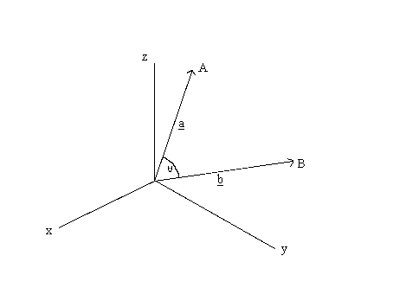


HDLSS Asymptotics: Simple Paradoxes
For dim’al Standard Normal dist’n:
indep. of
High dim’al Angles (as )
As Vectors From Origin
Thanks to: members.tripod.com
$$Z_{1}$$
$$Z_{2}$$

Slide 98
HDLSS Asymptotics: Simple Paradoxes
For dim’al Standard Normal dist’n:
indep. of
High dim’al Angles (as ):

Slide 99
HDLSS Asymptotics: Simple Paradoxes
For dim’al Standard Normal dist’n:
indep. of
High dim’al Angles (as ):
- Everything is orthogonal???

Slide 100
HDLSS Asymptotics: Simple Paradoxes
For dim’al Standard Normal dist’n:
indep. of
High dim’al Angles (as ):
- Everything is orthogonal???
- Where do they all go???
(again our perceptual limitations)

Slide 101
HDLSS Asymptotics: Simple Paradoxes
For dim’al Standard Normal dist’n:
indep. of
High dim’al Angles (as ):
- Everything is orthogonal???
- Where do they all go???
(again our perceptual limitations)
- Again 1st order structure is non-random

Slide 102
HDLSS Asy’s: Geometrical Represent’n
Assume , let
Study Subspace Generated by Data
Hall, Marron & Neeman (2005)

Slide 103
HDLSS Asy’s: Geometrical Represent’n
Assume , let
Study Subspace Generated by Data
Hyperplane through 0,
of dimension
Hall, Marron & Neeman (2005)

Slide 104
HDLSS Asy’s: Geometrical Represent’n
Assume , let
Study Subspace Generated by Data
Hyperplane through 0,
of dimension
Points are “nearly equidistant to 0”,
& dist
Hall, Marron & Neeman (2005)

Slide 105
HDLSS Asy’s: Geometrical Represent’n
Assume , let
Study Subspace Generated by Data
Hyperplane through 0,
of dimension
Points are “nearly equidistant to 0”,
& dist
Within plane, can
“rotate towards Unit Simplex”
Hall, Marron & Neeman (2005)

Slide 106
HDLSS Asy’s: Geometrical Represent’n
Assume , let
Study Subspace Generated by Data
Hyperplane through 0,
of dimension
Points are “nearly equidistant to 0”,
& dist
Within plane, can
“rotate towards Unit Simplex”
All Gaussian data sets are:
“near Unit Simplex Vertices”!!!
(Modulo Rotation)
Hall, Marron & Neeman (2005)

Slide 107
HDLSS Asy’s: Geometrical Represent’n
Assume , let
Study Subspace Generated by Data
Hyperplane through 0,
of dimension
Points are “nearly equidistant to 0”,
& dist
Within plane, can
“rotate towards Unit Simplex”
All Gaussian data sets are:
“near Unit Simplex Vertices”!!!
“Randomness” appears
only in rotation of simplex
Hall, Marron & Neeman (2005)

Slide 108
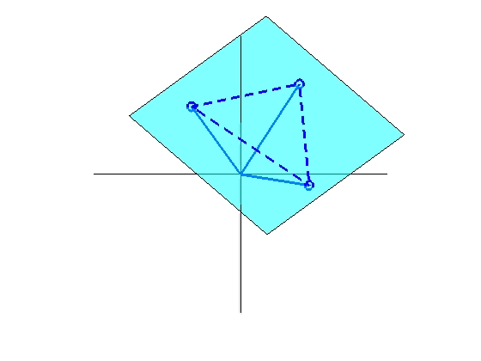
HDLSS Asy’s: Geometrical Represent’n
Assume , let
Study Hyperplane Generated by Data
dimensional hyperplane

Slide 109
HDLSS Asy’s: Geometrical Represent’n
Assume , let
Study Hyperplane Generated by Data
dimensional hyperplane
Points are pairwise equidistant, dist

Slide 110
HDLSS Asy’s: Geometrical Represent’n
Assume , let
Study Hyperplane Generated by Data
dimensional hyperplane
Points are pairwise equidistant, dist
Points lie at vertices of:
“regular hedron”

Slide 111
HDLSS Asy’s: Geometrical Represent’n
Assume , let
Study Hyperplane Generated by Data
dimensional hyperplane
Points are pairwise equidistant, dist
Points lie at vertices of:
“regular hedron”
Again “randomness in data” is only in rotation

Slide 112
HDLSS Asy’s: Geometrical Represent’n
Assume , let
Study Hyperplane Generated by Data
dimensional hyperplane
Points are pairwise equidistant, dist
Points lie at vertices of:
“regular hedron”
Again “randomness in data” is only in rotation
Surprisingly rigid structure in random data?

Slide 113
HDLSS Asy’s: Geometrical Represen’tion
Simulation View: study “rigidity after rotation”
Simple 3 point data sets
In dimensions d = 2, 20, 200, 20000

Slide 114
HDLSS Asy’s: Geometrical Represen’tion
Simulation View: study “rigidity after rotation”
Simple 3 point data sets
In dimensions d = 2, 20, 200, 20000
Generate hyperplane of dimension 2

Slide 115
HDLSS Asy’s: Geometrical Represen’tion
Simulation View: study “rigidity after rotation”
Simple 3 point data sets
In dimensions d = 2, 20, 200, 20000
Generate hyperplane of dimension 2
Rotate that to plane of screen

Slide 116
HDLSS Asy’s: Geometrical Represen’tion
Simulation View: study “rigidity after rotation”
Simple 3 point data sets
In dimensions d = 2, 20, 200, 20000
Generate hyperplane of dimension 2
Rotate that to plane of screen
Rotate within plane, to make “comparable”

Slide 117
HDLSS Asy’s: Geometrical Represen’tion
Simulation View: study “rigidity after rotation”
Simple 3 point data sets
In dimensions d = 2, 20, 200, 20000
Generate hyperplane of dimension 2
Rotate that to plane of screen
Rotate within plane, to make “comparable”
Repeat 10 times, use different colors

Slide 118
HDLSS Asy’s: Geometrical Represen’tion
Simulation View: Shows “Rigidity after Rotation”

