Slide 1
SWISS Score
Nice Graphical Introduction:

Slide 2
SWISS Score
Toy Examples (2-d):
Which are “More Clustered?”

Slide 3
SWISS Score
Toy Examples (2-d):
Which are “More Clustered?”

Slide 4
SWISS Score
Avg. Pairwise SWISS – Toy Examples

Slide 5
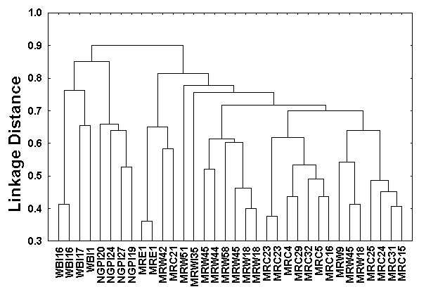
Hiearchical Clustering
Aggregate or Split, to get Dendogram
Thanks to US EPA: water.epa.gov

Slide 6
SigClust
Statistical Significance of Clusters
in HDLSS Data
When is a cluster “really there”?
Liu et al (2007), Huang et al (2014)

Slide 7
DiProPerm Hypothesis Test
Suggested Approach:
Find a DIrection
(separating classes)
PROject the data
(reduces to 1 dim)
PERMute
(class labels, to assess significance,
with recomputed direction)

Slide 8
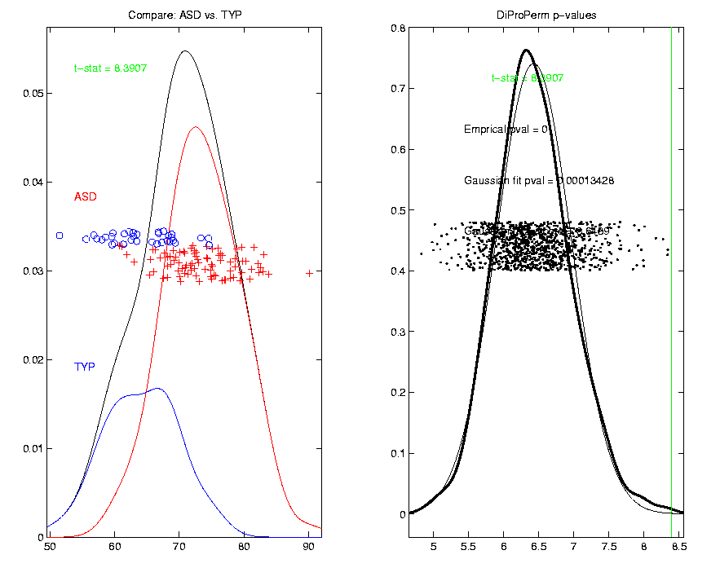
DiProPerm Hypothesis Test
Finds
Significant
Difference
Despite Weak
Visual
Impression
Thanks to Josh Cates

Slide 9
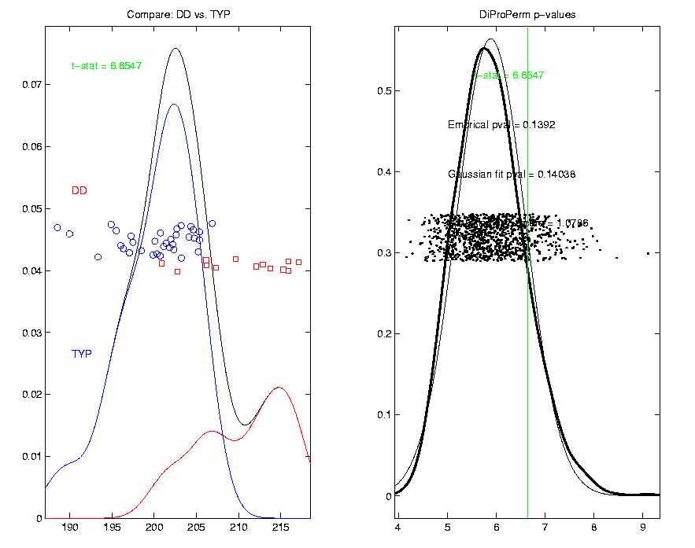
DiProPerm Hypothesis Test
Also Compare: Developmentally Delayed
No
Significant
Difference
But Strong
Visual
Impression
Thanks to Josh Cates

Slide 10
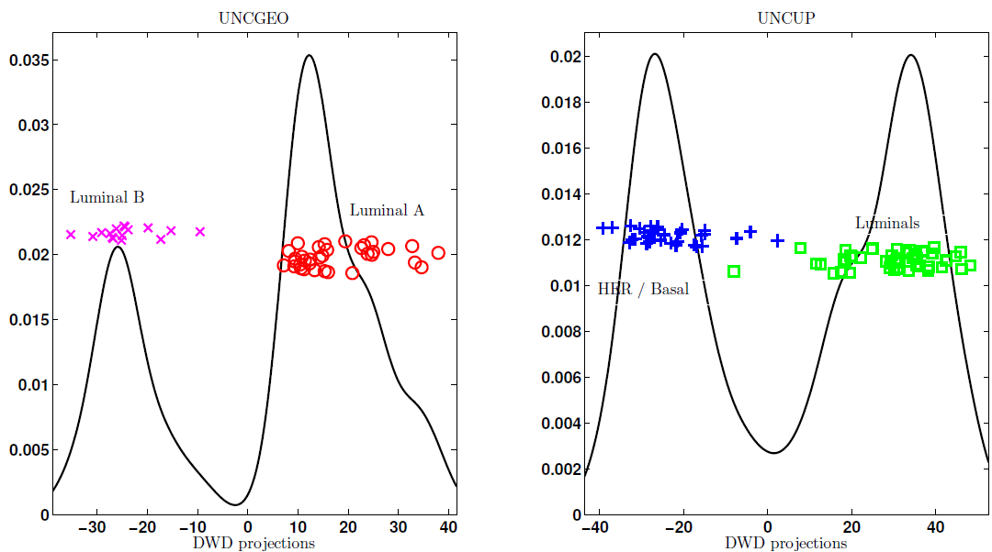
DiProPerm Hypothesis Test
Two
Examples
Which Is
“More
Distinct”?
Visually Better Separation?
Thanks to Katie Hoadley

Slide 11
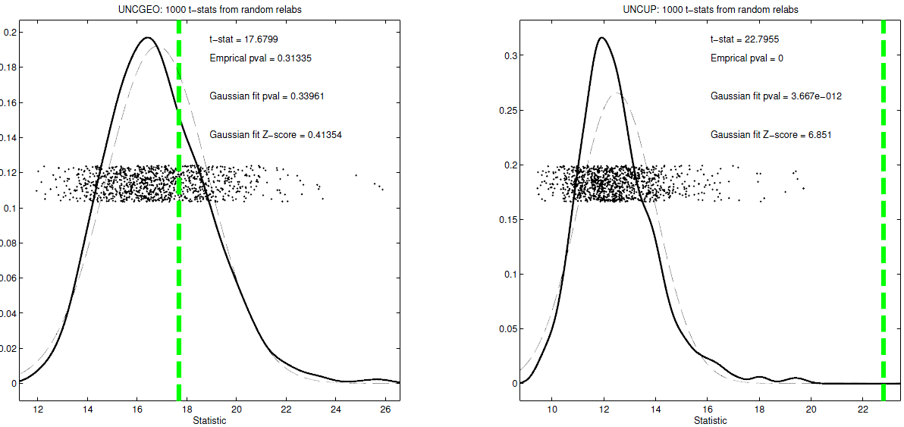
DiProPerm Hypothesis Test
Two
Examples
Which Is
“More
Distinct”?
Stronger Statistical Significance!
Thanks to Katie Hoadley

Slide 12
DiProPerm Hypothesis Test
Value of DiProPerm:
Visual Impression is Easily Misleading
(onto HDLSS projections,
e.g. Maximal Data Piling)
Really Need to Assess Significance
DiProPerm used routinely
(even for variable selection)

Slide 13
Interesting Statistical Problem
For HDLSS data:
When clusters seem to appear
E.g. found by clustering method
How do we know they are really there?
Question asked by Neil Hayes
Define appropriate statistical significance?
Can we calculate it?

Slide 14
Simple Gaussian Example
Results:
Random relabelling T-stat is not significant
But extreme T-stat is strongly significant
This comes from clustering operation
Conclude sub-populations are different
Now see that:
Not the same as clusters really there
Need a new approach to study clusters

Slide 15
Statistical Significance of Clusters
Basis of SigClust Approach:
What defines: A Single Cluster?
A Gaussian distribution (Sarle & Kou 1993)
So define SigClust test based on:
2-means cluster index (measure) as statistic
Gaussian null distribution
Currently compute by simulation
Possible to do this analytically???

Slide 16
SigClust Statistic – 2-Means Cluster Index
Measure of non-Gaussianity:
2-means Cluster Index
Familiar Criterion from k-means Clustering
Within Class Sum of Squared Distances to Class Means
Prefer to divide (normalize) by Overall Sum of Squared Distances to Mean
Puts on scale of proportions

Slide 17
SigClust Gaussian null distribut’n
Which Gaussian (for null)?
Standard (sphered) normal?
No, not realistic
Rejection not strong evidence for clustering
Could also get that from a-spherical Gaussian
Need Gaussian more like data:
Need Full $N_{d}\left(μ,Σ\right)$ model
Challenge: Parameter Estimation
Recall HDLSS Context

Slide 18
SigClust Gaussian null distribut’n
Estimated Mean, $μ$ (of Gaussian dist’n)?
1st Key Idea: Can ignore this
By appealing to shift invariance of CI
When Data are (rigidly) shifted
CI remains the same
So enough to simulate with mean 0
Other uses of invariance ideas?

Slide 19
SigClust Gaussian null distribut’n
2nd Key Idea: Mod Out Rotations
Replace full Cov. by diagonal matrix
As done in PCA eigen-analysis
But then “not like data”???
OK, since k-means clustering (i.e. CI) is
rotation invariant
(assuming e.g. Euclidean Distance)

Slide 20
SigClust Gaussian null distribut’n
2nd Key Idea: Mod Out Rotations
Only need to estimate diagonal matrix
But still have HDLSS problems?
E.g. Perou 500 data:
Dimension
Sample Size
Still need to estimate param’s

Slide 21
SigClust Gaussian null distribut’n
3rd Key Idea: Factor Analysis Model

Slide 22
SigClust Gaussian null distribut’n
3rd Key Idea: Factor Analysis Model
Model Covariance as: Biology + Noise
Where
is “fairly low dimensional”
is estimated from background noise

Slide 23
SigClust Gaussian null distribut’n
Estimation of Background Noise :

Slide 24
SigClust Gaussian null distribut’n
Estimation of Background Noise :
Reasonable model (for each gene):
Expression = Signal + Noise

Slide 25
SigClust Gaussian null distribut’n
Estimation of Background Noise :
Reasonable model (for each gene):
Expression = Signal + Noise
“noise” is roughly Gaussian
“noise” terms essentially independent
(across genes)

Slide 26
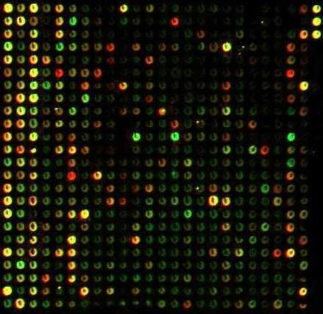
SigClust Gaussian null distribut’n
Estimation of Background Noise :
Model OK, since
data come from
light intensities
at colored spots

Slide 27
SigClust Gaussian null distribut’n
Estimation of Background Noise :
For all expression values (as numbers)
(Each Entry of dxn Data matrix)

Slide 28
SigClust Gaussian null distribut’n
Estimation of Background Noise :
For all expression values (as numbers)
Use robust estimate of scale
Median Absolute Deviation (MAD)
(from the median)

Slide 29
SigClust Gaussian null distribut’n
Estimation of Background Noise :
For all expression values (as numbers)
Use robust estimate of scale
Median Absolute Deviation (MAD)
(from the median)
$${median}_{i}\left|X_{i}−{median}_{i}\left(X_{i}\right)\right|$$

Slide 30
SigClust Gaussian null distribut’n
Estimation of Background Noise :
For all expression values (as numbers)
Use robust estimate of scale
Median Absolute Deviation (MAD)
(from the median)
Rescale to put on same scale as s. d.:

Slide 31
SigClust Estimation of Background Noise
n = 533, d = 9456

Slide 32
SigClust Estimation of Background Noise
Hope: Most
Entries are
“Pure Noise,
(Gaussian)”

Slide 33
SigClust Estimation of Background Noise
Hope: Most
Entries are
“Pure Noise,
(Gaussian)”
A Few (<< ¼)
Are Biological
Signal –
Outliers

Slide 34
SigClust Estimation of Background Noise
Hope: Most
Entries are
“Pure Noise,
(Gaussian)”
A Few (<< ¼)
Are Biological
Signal –
Outliers
How to Check?

Slide 35
Q-Q plots
An aside:
Fitting probability distributions to data

Slide 36
Q-Q plots
An aside:
Fitting probability distributions to data
Does Gaussian distribution “fit”???
If not, why not?

Slide 37
Q-Q plots
An aside:
Fitting probability distributions to data
Does Gaussian distribution “fit”???
If not, why not?
Fit in some part of the distribution?
(e.g. in the middle only?)

Slide 38
Q-Q plots
Approaches to:
Fitting probability distributions to data
Histograms
Kernel Density Estimates

Slide 39
Q-Q plots
Approaches to:
Fitting probability distributions to data
Histograms
Kernel Density Estimates
Drawbacks: often not best view
(for determining goodness of fit)

Slide 40
Q-Q plots
Consider Testbed of 4 Toy Examples:
non-Gaussian!
non-Gaussian(?)
Gaussian
Gaussian?
(Will use these names several times)

Slide 41
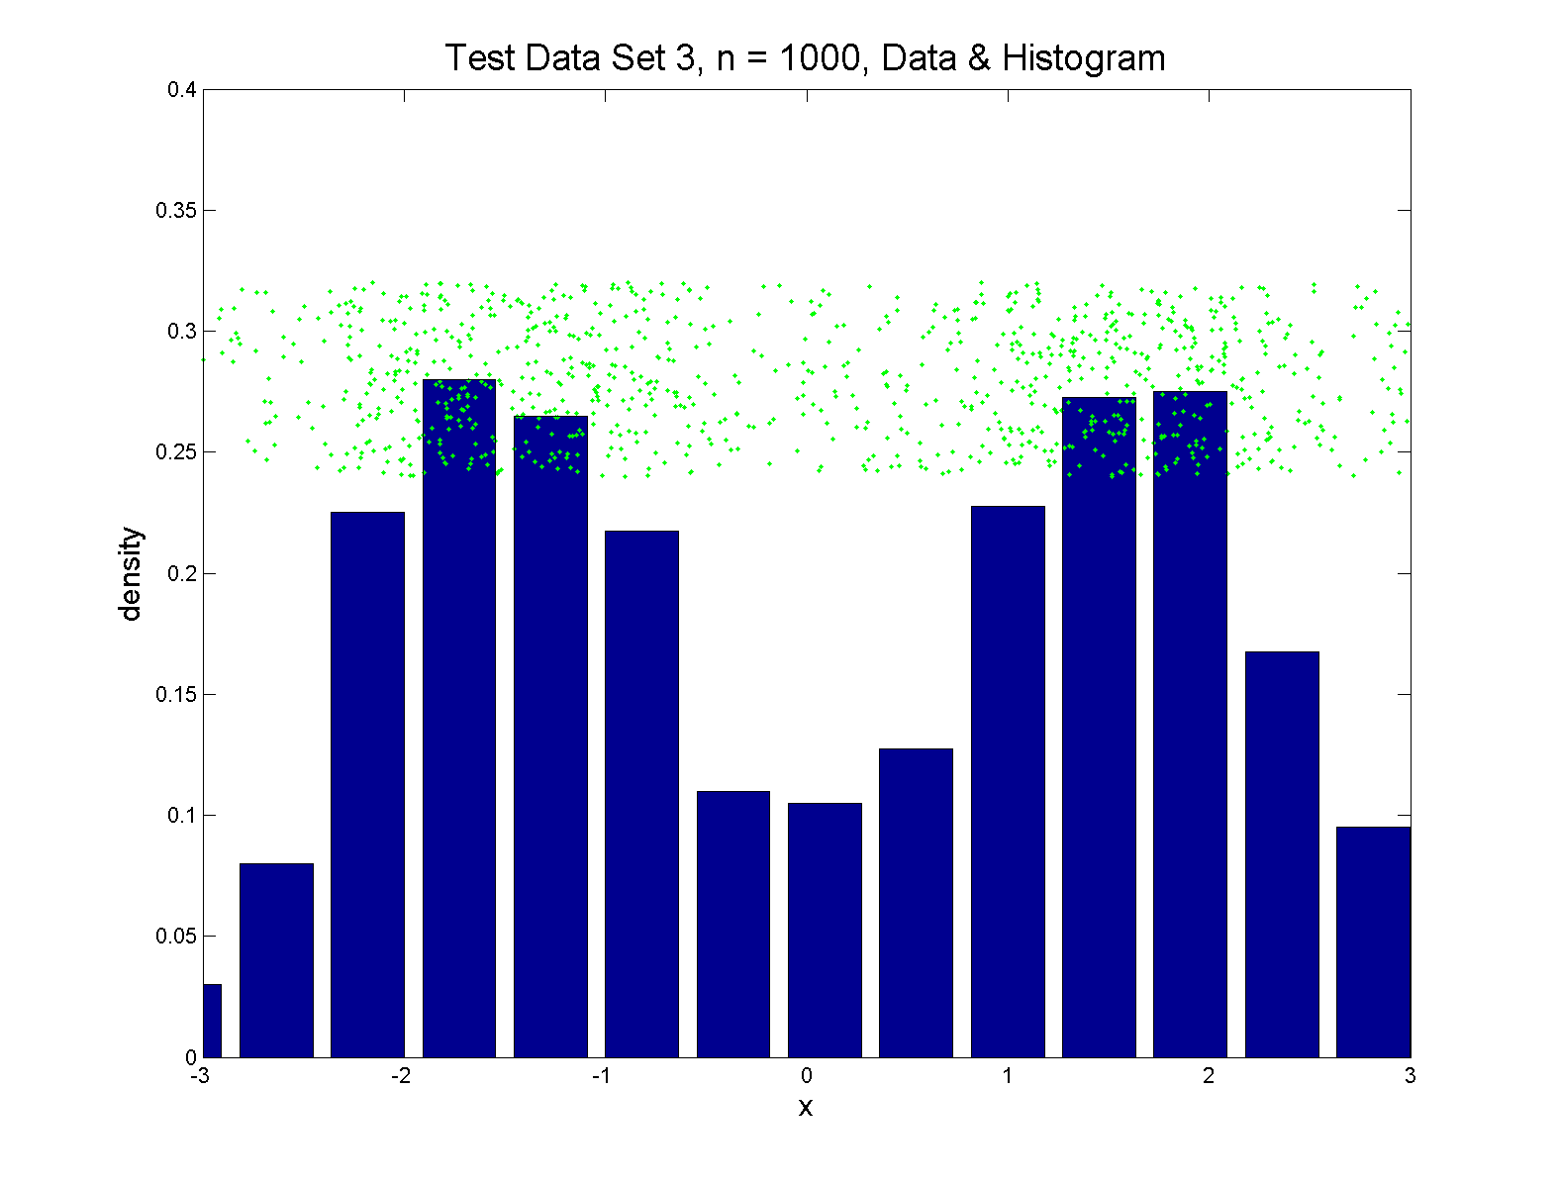
Q-Q plots
Simple Toy Example, non-Gaussian!

Slide 42
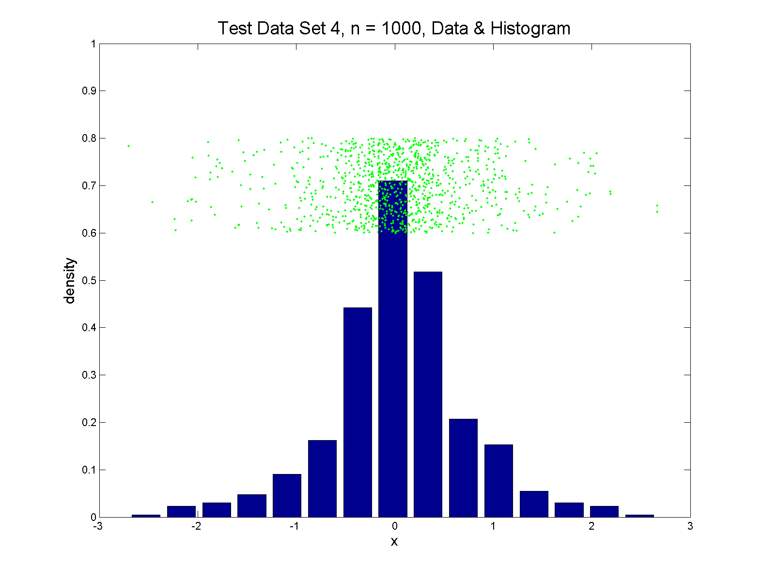
Q-Q plots
Simple Toy Example, non-Gaussian(?)

Slide 43
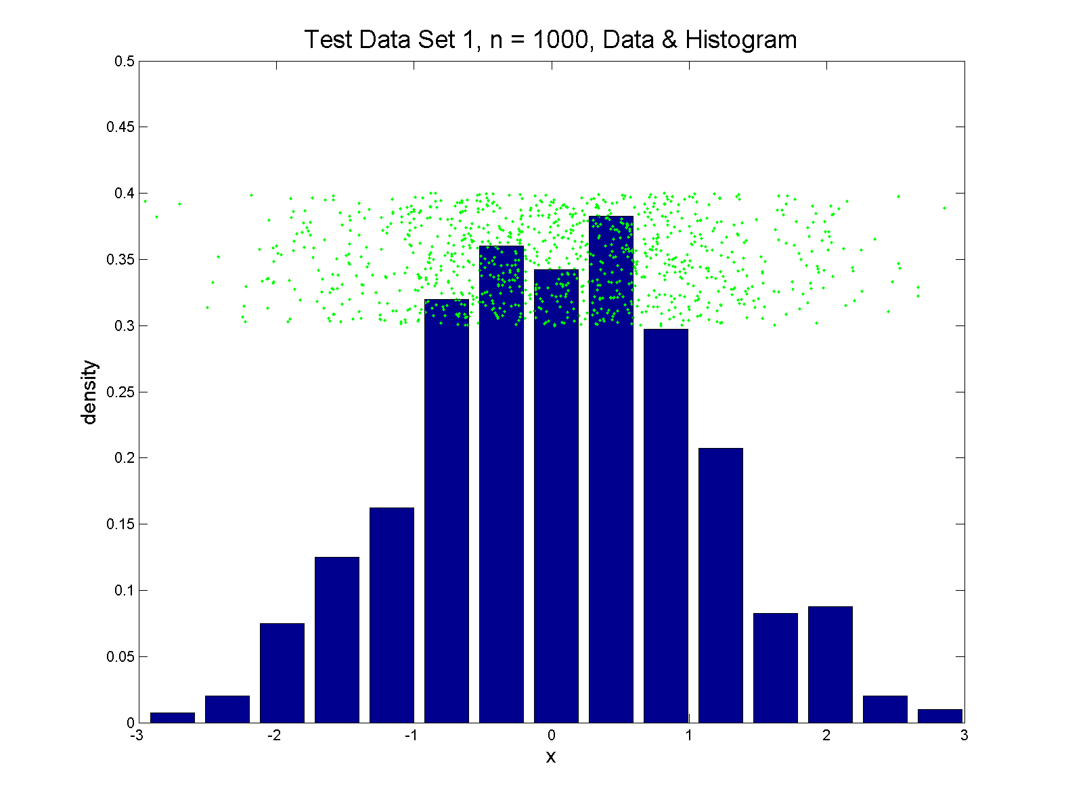
Q-Q plots
Simple Toy Example, Gaussian

Slide 44
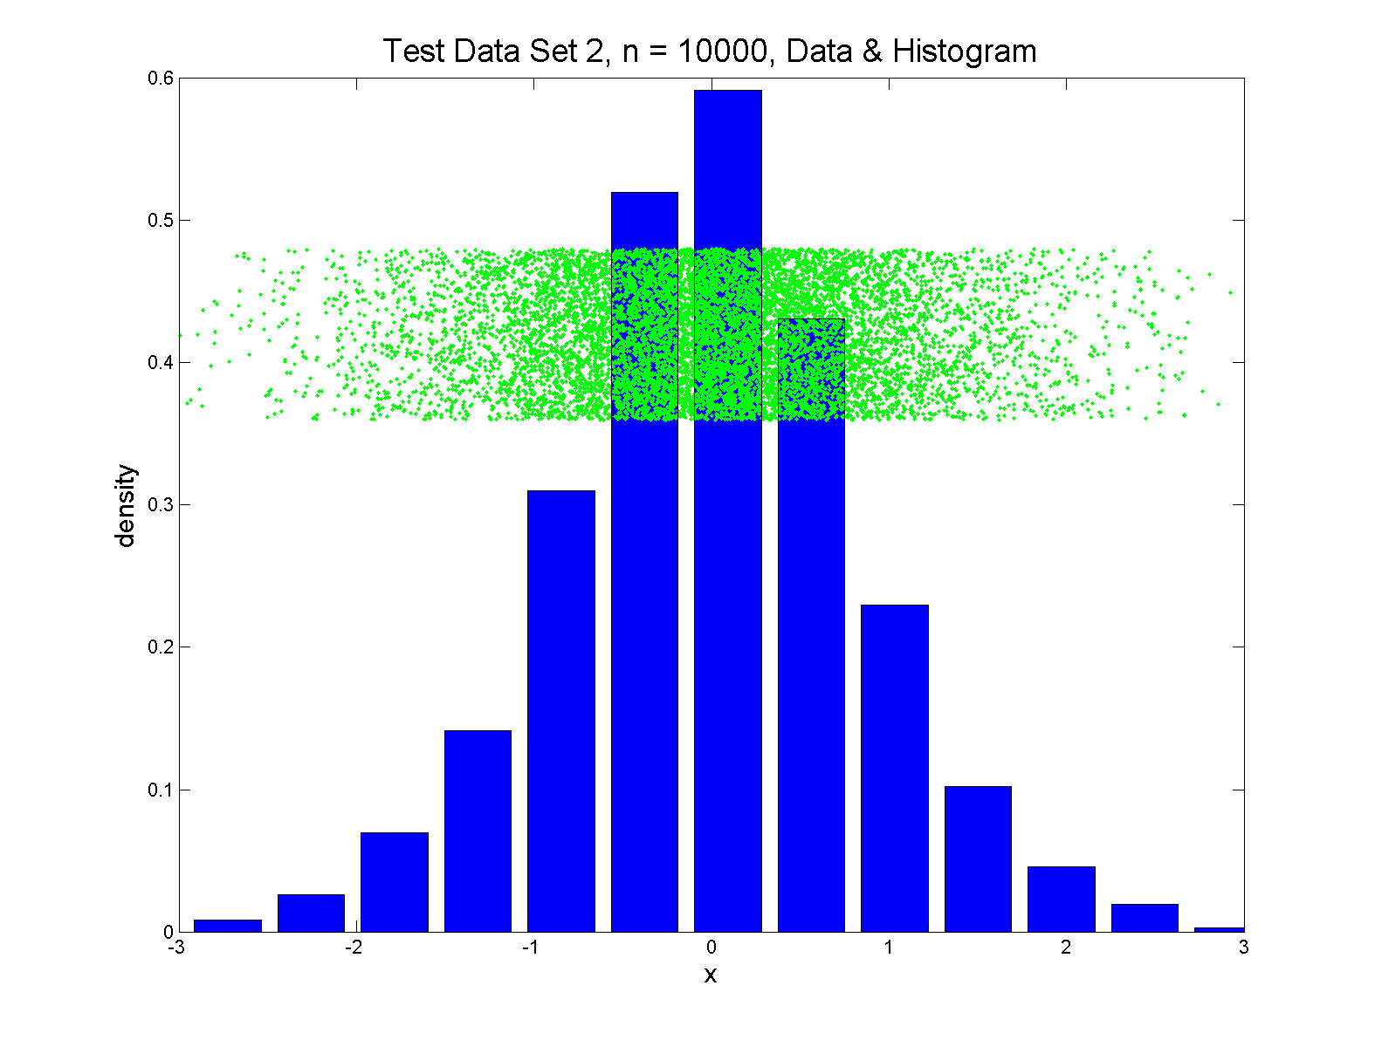
Q-Q plots
Simple Toy Example, Gaussian?

Slide 45
Q-Q plots
Notes:
Bimodal → see non-Gaussian with histo
Other cases: hard to see
Conclude:
Histogram poor at assessing Gauss’ity

Slide 46
Q-Q plots
Standard approach to checking Gaussianity
QQ – plots
Background:
Graphical Goodness of Fit
Fisher (1983)

Slide 47
Q-Q plots
Background: Graphical Goodness of Fit
Basis:
Cumulative Distribution Function (CDF)

Slide 48
Q-Q plots
Background: Graphical Goodness of Fit
Basis:
Cumulative Distribution Function (CDF)
Probability quantile notation:
for "probability” and "quantile"

Slide 49
Q-Q plots
Probability quantile notation:
for "probability” and "quantile“
Thus is called the quantile function

Slide 50
Q-Q plots
Two types of CDF:
Theoretical

Slide 51
Q-Q plots
Two types of CDF:
Theoretical
Empirical, based on data

Slide 52
Q-Q plots
Direct Visualizations:
Empirical CDF plot:
plot
vs. grid of (sorted data) values

Slide 53
Q-Q plots
Direct Visualizations:
Empirical CDF plot:
plot
vs. grid of (sorted data) values
Quantile plot (inverse):
plot
vs.

Slide 54
Q-Q plots
Comparison Visualizations:
(compare a theoretical with an empirical)
P-P plot:
plot vs.
for a grid of values

Slide 55
Q-Q plots
Comparison Visualizations:
(compare a theoretical with an empirical)
P-P plot:
plot vs.
for a grid of values
Q-Q plot:
plot vs.
for a grid of values

Slide 56
Q-Q plots
Illustrative graphic (toy data set):

Slide 57
Q-Q plots
Illustrative graphic (toy data set):
From $N\left(0,1\right)$ Distribution

Slide 58
Q-Q plots
Illustrative graphic (toy data set):
Generated $n=5$ data points

Slide 59
Q-Q plots
Illustrative graphic (toy data set):
So Consider
$$p_{5}$$
$$p_{4}$$
$$p_{3}$$
$$p_{2}$$
$$p_{1}$$

Slide 60
Q-Q plots
Empirical Quantiles (sorted data points)

Slide 61
Q-Q plots
Corresponding ( matched) Theoretical Quantiles

Slide 62
Q-Q plots
Illustrative graphic (toy data set):
Main goal of Q-Q Plot:
Display how well quantiles compare
vs.

Slide 63
Q-Q plots
Illustrative graphic (toy data set):

Slide 64
Q-Q plots
Illustrative graphic (toy data set):

Slide 65
Q-Q plots
Illustrative graphic (toy data set):

Slide 66
Q-Q plots
Illustrative graphic (toy data set):

Slide 67
Q-Q plots
Illustrative graphic (toy data set):

Slide 68
Q-Q plots
Illustrative graphic (toy data set):
Empirical Qs near Theoretical Qs
when
Q-Q curve is near 45⁰ line
(general use of Q-Q plots)

Slide 69
Alternate Terminology
Q-Q Plots = ROC Curves
Recall “Receiver Operator Characteristic”
But Different Goals:
Q-Q Plots: Look for “Equality”
ROC curves: Look for “Differences”

Slide 70
Alternate Terminology
Q-Q Plots = ROC Curves
P-P Plots = “Precision-Recall” Curves
Highlights Different Distributional Aspects
Statistical Folklore: Q-Q Highlights Tails,
So Usually More Useful

Slide 71
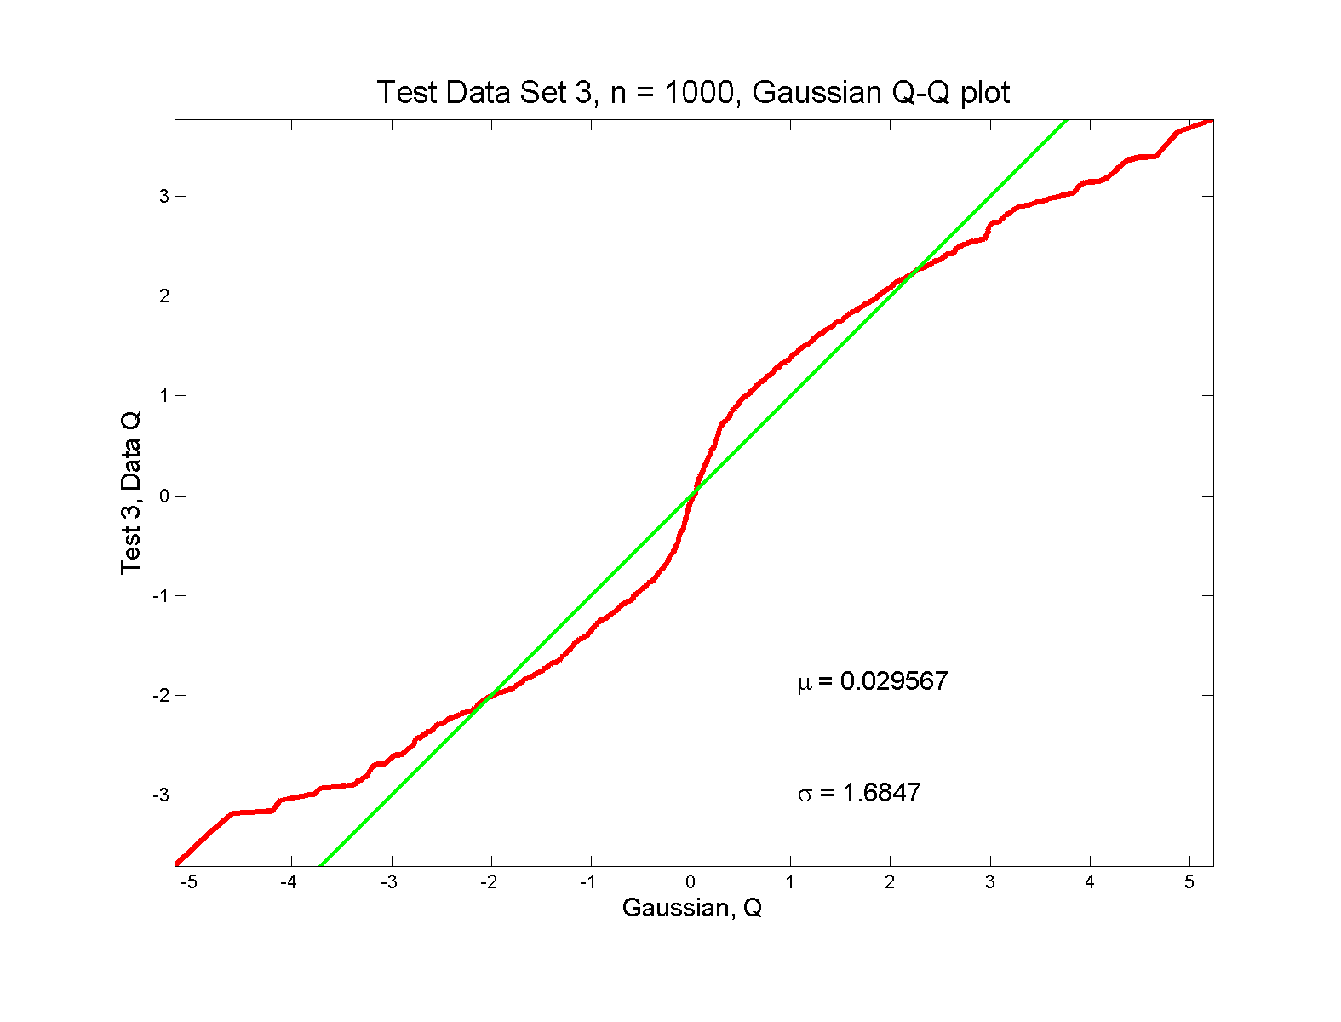
Q-Q plots
non-Gaussian! departures from line?

Slide 72
Q-Q plots
non-Gaussian! departures from line?
Seems different from line?
2 modes turn into wiggles?
Less strong feature
Been proposed to study modality

Slide 73
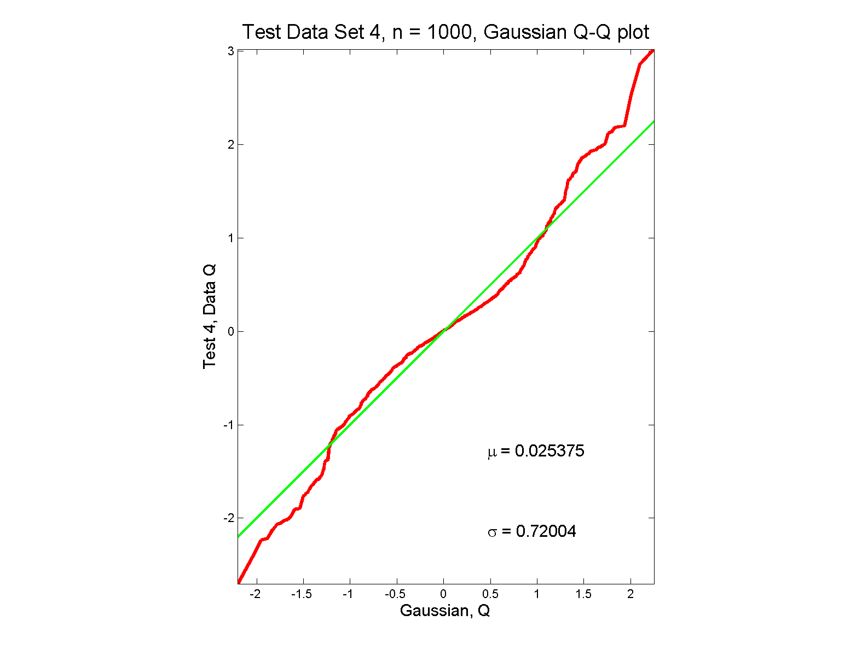
Q-Q plots
non-Gaussian (?) departures from line?

Slide 74
Q-Q plots
non-Gaussian (?) departures from line?
Seems different from line?
Harder to say this time?
What is signal & what is noise?
Need to understand sampling variation

Slide 75
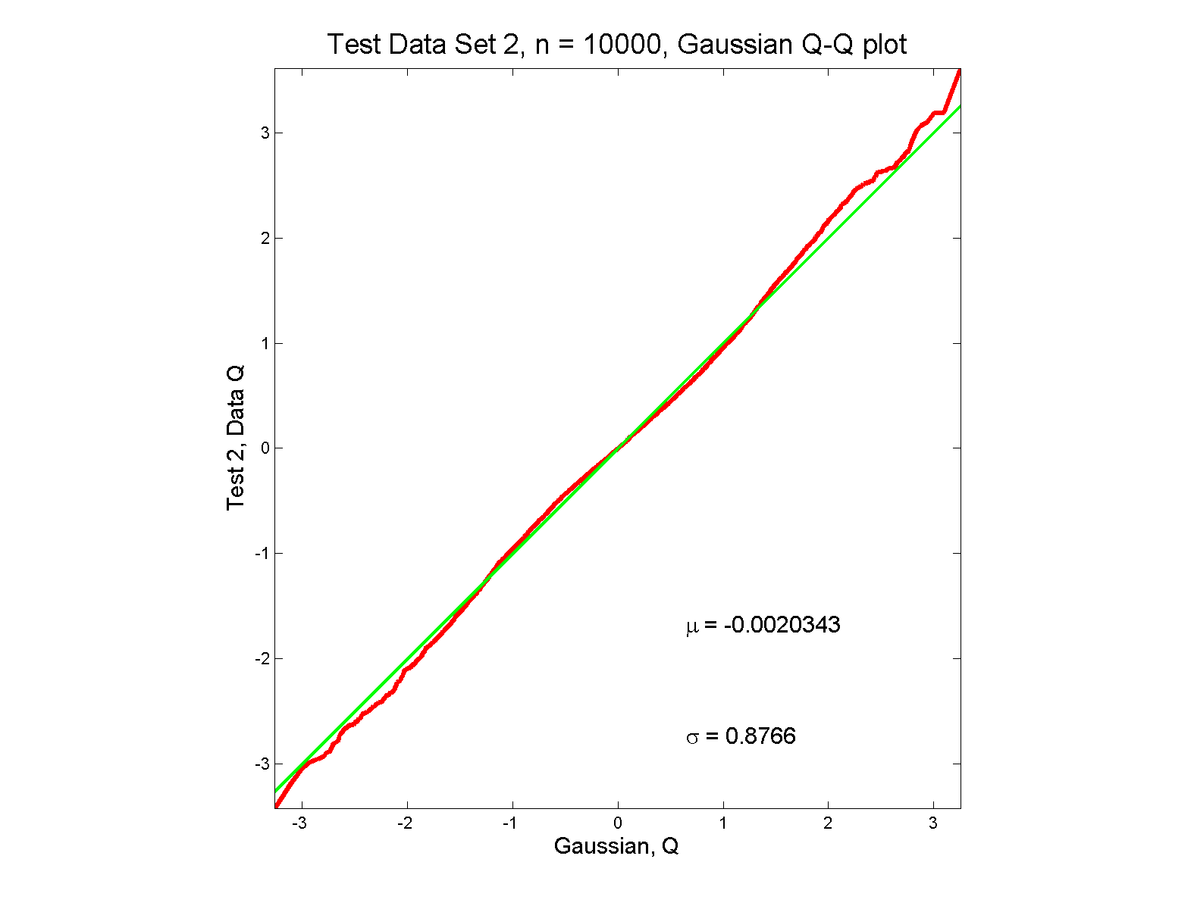
Q-Q plots
Gaussian? departures from line?

Slide 76
Q-Q plots
Gaussian? departures from line?
Looks much like?
Wiggles all random variation?
But there are n = 10,000 data points…
How to assess signal & noise?
Need to understand sampling variation

Slide 77
Q-Q plots
Need to understand sampling variation
Approach: Q-Q envelope plot

Slide 78
Q-Q plots
Need to understand sampling variation
Approach: Q-Q envelope plot
Simulate from Theoretical Dist’n
Samples of same size

Slide 79
Q-Q plots
Need to understand sampling variation
Approach: Q-Q envelope plot
Simulate from Theoretical Dist’n
Samples of same size
About 100 samples gives
“good visual impression”

Slide 80
Q-Q plots
Need to understand sampling variation
Approach: Q-Q envelope plot
Simulate from Theoretical Dist’n
Samples of same size
About 100 samples gives
“good visual impression”
Overlay resulting 100 QQ-curves
To visually convey natural sampling variation

Slide 81
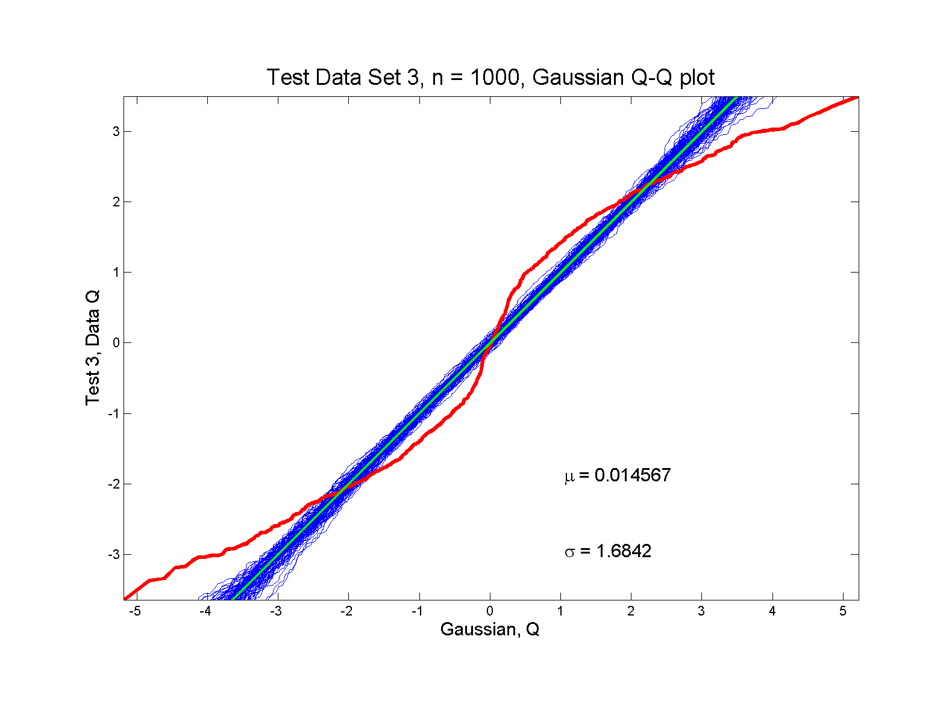
Q-Q plots
non-Gaussian! departures from line?

Slide 82
Q-Q plots
non-Gaussian! departures from line?
Envelope Plot shows:
Departures are significant
Clear these data are not Gaussian
Q-Q plot gives clear indication

Slide 83
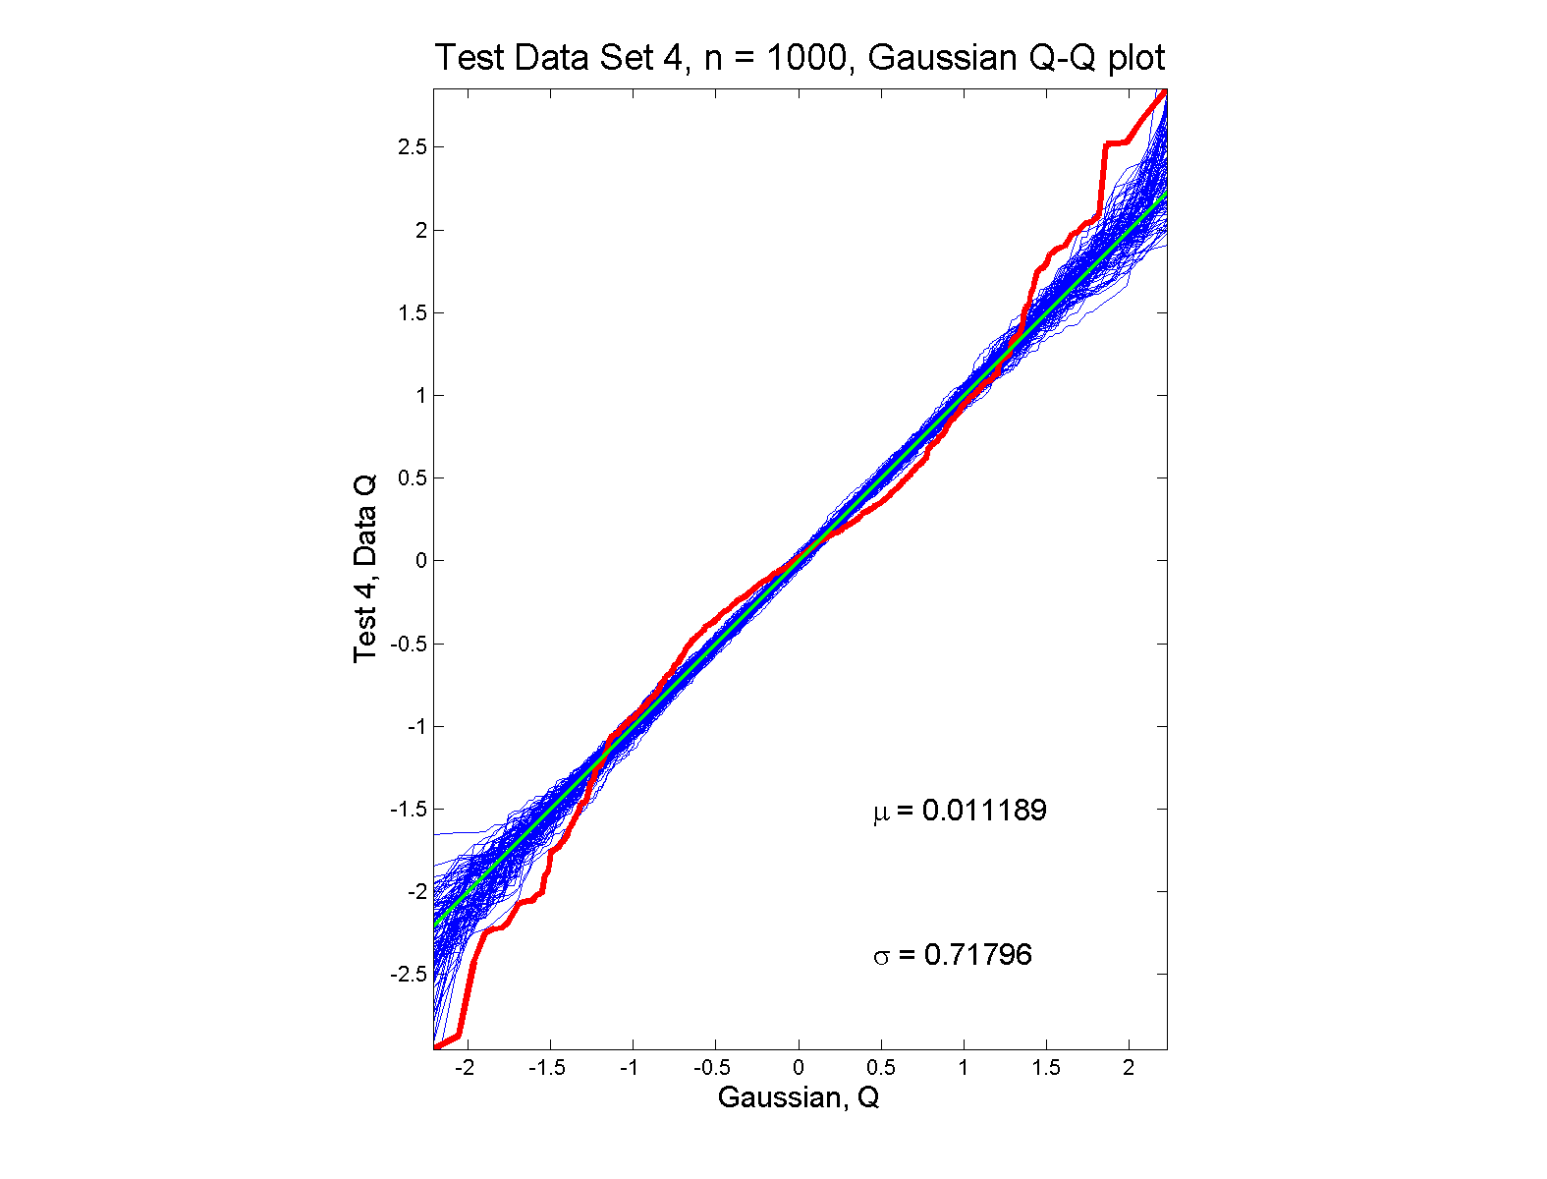
Q-Q plots
non-Gaussian (?) departures from line?

Slide 84
Q-Q plots
non-Gaussian (?) departures from line?
Envelope Plot shows:
Departures are significant
Clear these data are not Gaussian
Recall not so clear from e.g. histogram
Q-Q plot gives clear indication
Envelope plot reflects sampling variation

Slide 85
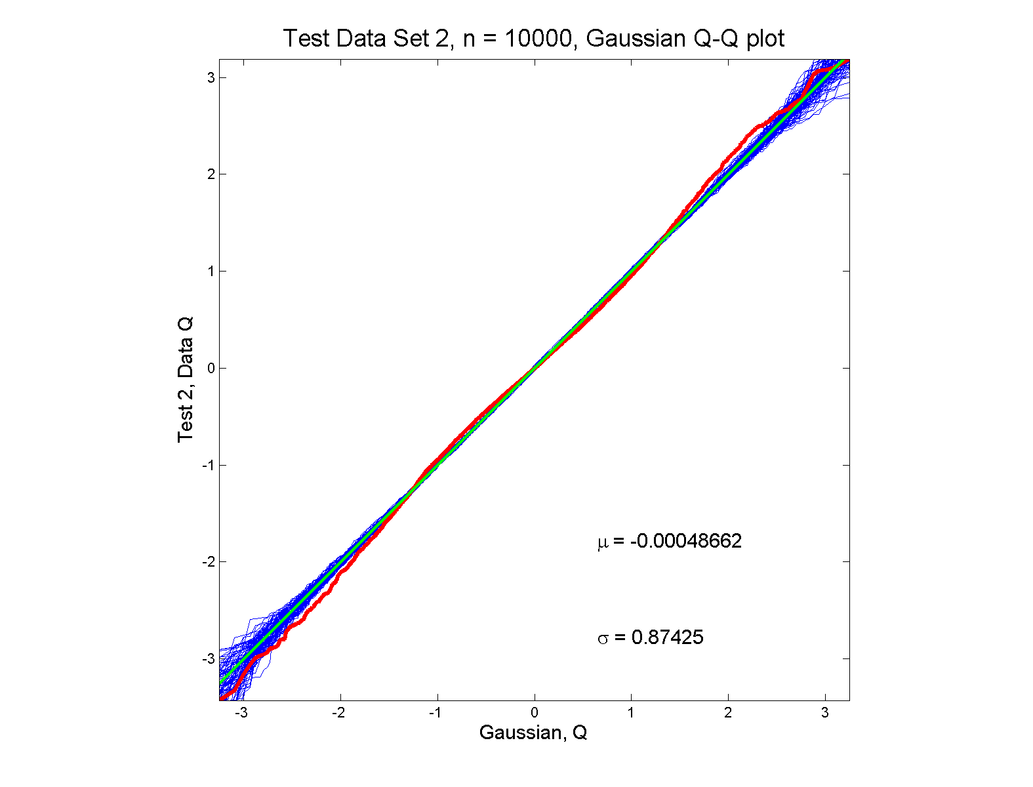
Q-Q plots
Gaussian? departures from line?

Slide 86
Q-Q plots
Gaussian? departures from line?
Harder to see
But clearly there
Conclude non-Gaussian
Really needed n = 10,000 data points…
(why bigger sample size was used)
Envelope plot reflects sampling variation

Slide 87
Q-Q plots
What were these distributions?
Non-Gaussian!
0.5 N(-1.5,0.75²) + 0.5 N(1.5,0.75²)
Non-Gaussian (?)
0.4 N(0,1) + 0.3 N(0,0.5²) + 0.3 N(0,0.25²)
Gaussian
Gaussian?
0.7 N(0,1) + 0.3 N(0,0.5²)

Slide 88
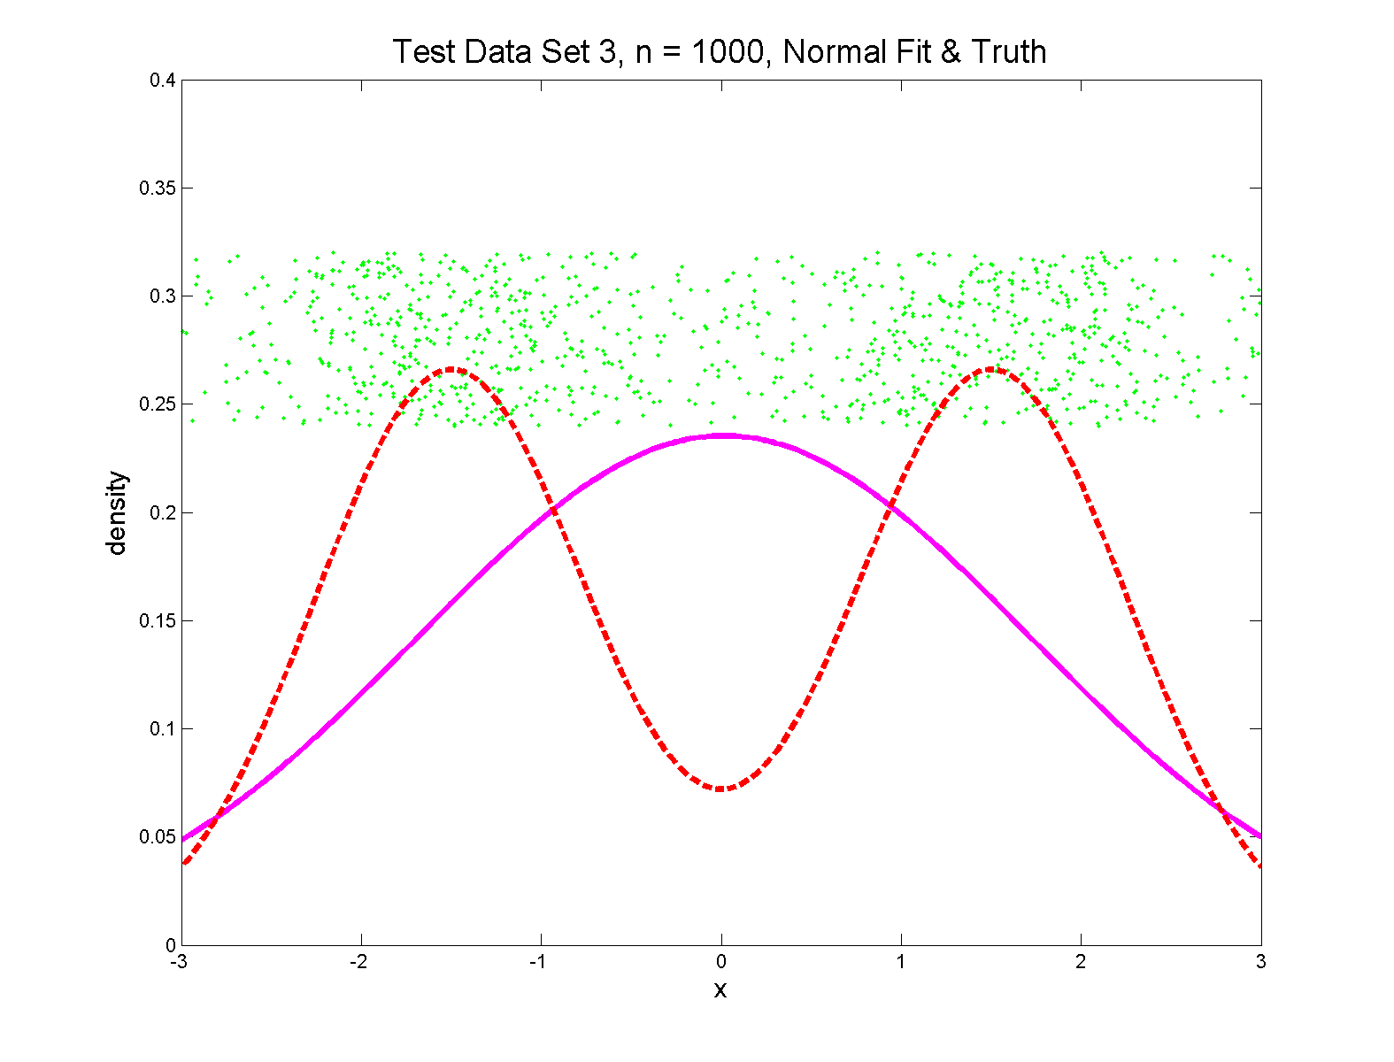
Q-Q plots
Non-Gaussian! .5 N(-1.5,0.75²) + 0.5 N(1.5,0.75²)

Slide 89
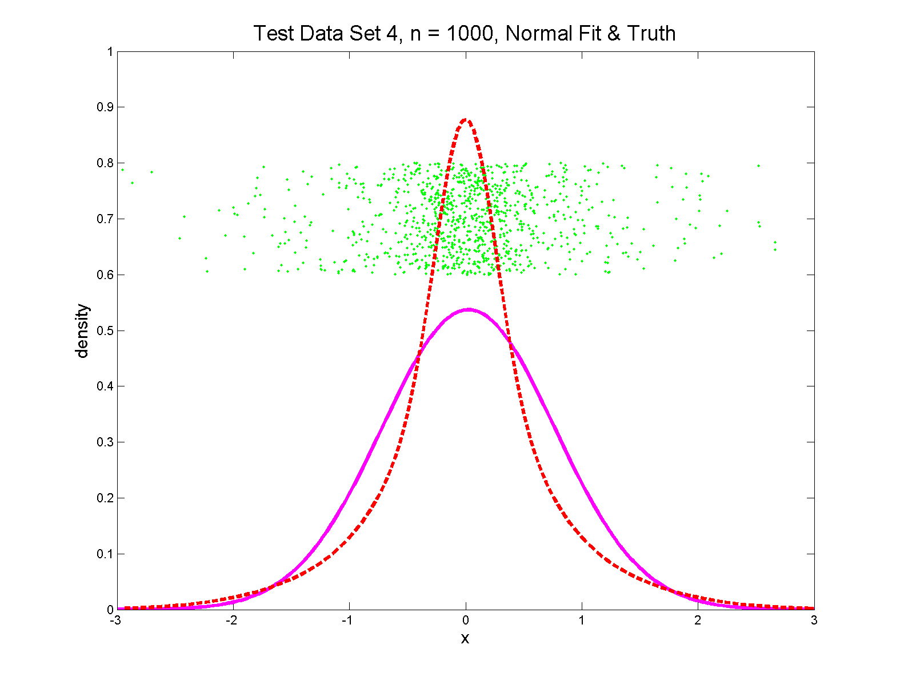
Q-Q plots
Non-Gaussian (?) 0.4 N(0,1) + 0.3 N(0,0.5²) + 0.3 N(0,0.25²)

Slide 90
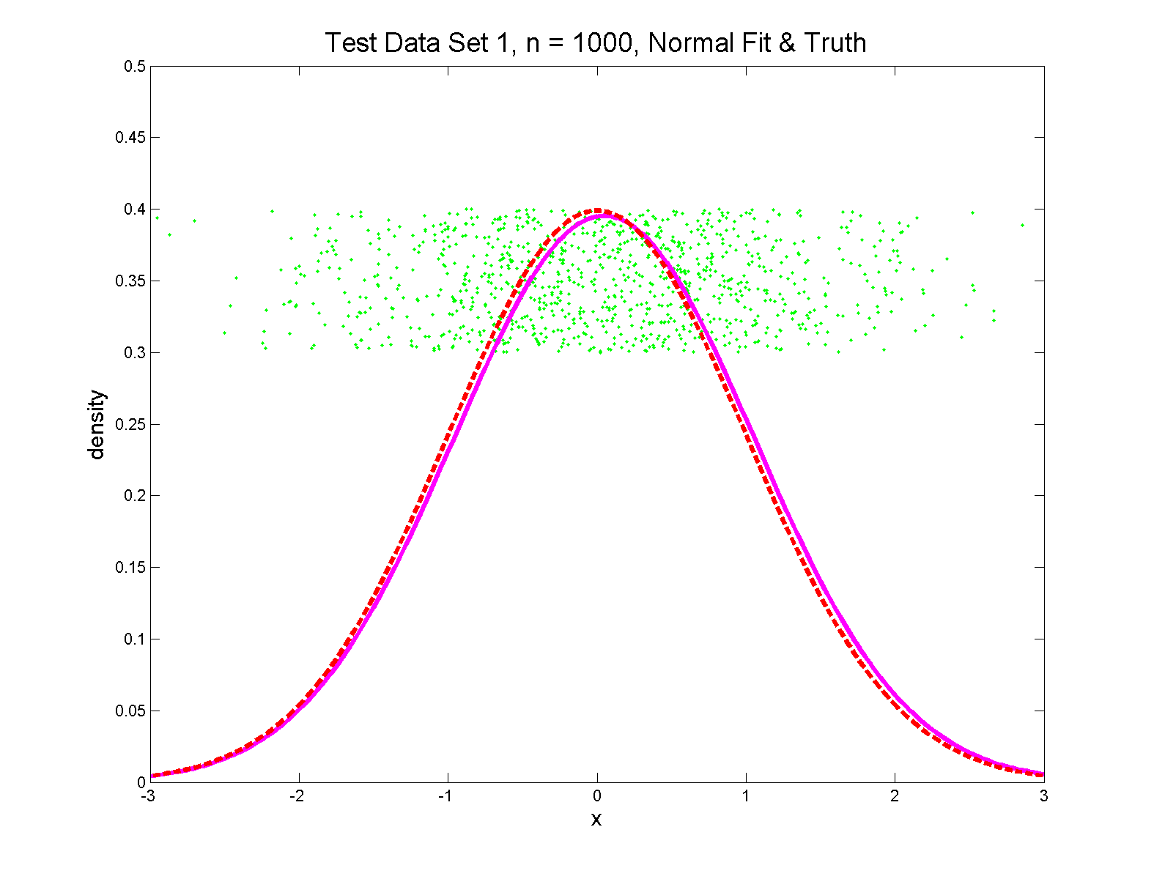
Q-Q plots
Gaussian

Slide 91
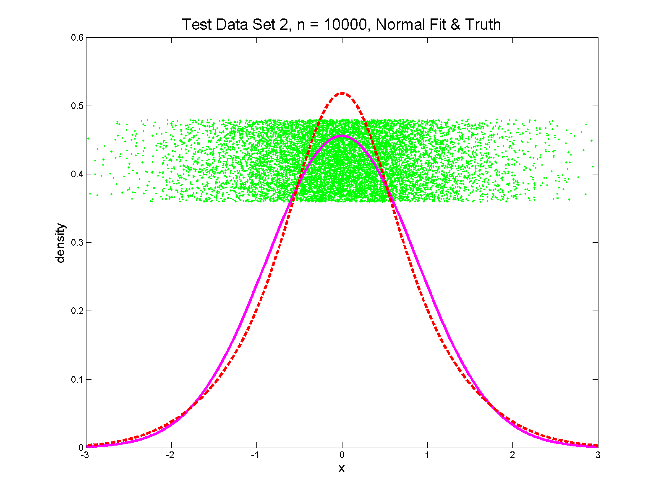
Q-Q plots
Gaussian? 0.7 N(0,1) + 0.3 N(0,0.5²)

Slide 92
Q-Q plots
Variations on Q-Q Plots:
For theoretical distribution:

Slide 93
Q-Q plots
Variations on Q-Q Plots:
For theoretical distribution:
Solving for gives
Where is the Standard Normal Quantile

Slide 94
Q-Q plots
Variations on Q-Q Plots:
Solving for gives
So Q-Q plot against Standard Normal
is linear
With slope and intercept

Slide 95
Q-Q plots
Variations on Q-Q Plots:
Can replace Gaussian with other dist’ns
Can compare 2 theoretical distn’s
Can compare 2 empirical distn’s
(i.e. 2 sample version of Q-Q Plot)
( = ROC curve)

Slide 96
SigClust Estimation of Background Noise
n = 533, d = 9456

Slide 97
SigClust Estimation of Background Noise
Overall distribution has strong kurtosis
Shown by height of kde relative to
MAD based Gaussian fit
Mean and Median both ~ 0
SD ~ 1, driven by few large values
MAD ~ 0.7, driven by bulk of data

Slide 98
SigClust Estimation of Background Noise
Central part of distribution
“seems to look Gaussian”
But recall density does not provide
useful diagnosis of Gaussianity
Better to look at Q-Q plot

Slide 99
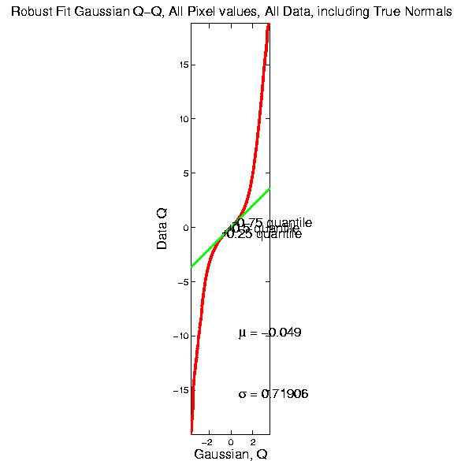
SigClust Estimation of Background Noise

Slide 100
SigClust Estimation of Background Noise
Distribution clearly not Gaussian
Except near the middle
Q-Q curve is very linear there
(closely follows 45º line)
Suggests Gaussian approx. is good there
And that MAD scale estimate is good
(Always a good idea to do such diagnostics)

Slide 101
SigClust Estimation of Background Noise
Now Check Effect of
Using SD, not MAD

Slide 102
SigClust Estimation of Background Noise
Checks that estimation of matters
Show sample s.d. is indeed too large
As expected
Variation assessed by Q-Q envelope plot
Shows variation not negligible
Not surprising with n ~ 5 million

Slide 103
SigClust Gaussian null distribut’n
Estimation of Biological Covariance :
Keep only “large” eigenvalues
Defined as
So for null distribution, use eigenvalues:

Slide 104
SigClust Estimation of Eigenval’s

Slide 105
SigClust Estimation of Eigenval’s
All eigenvalues > !
Suggests biology is very strong here!
I.e. very strong signal to noise ratio
Have more structure than can analyze
(with only 533 data points)
Data are very far from pure noise
So don’t actually use Factor Anal. Model
Instead end up with estim’d eigenvalues

Slide 106
SigClust Estimation of Eigenval’s
Do we need the factor model?
Explore this with another data set
(with fewer genes)
This time:
n = 315 cases
d = 306 genes

