Slide 1
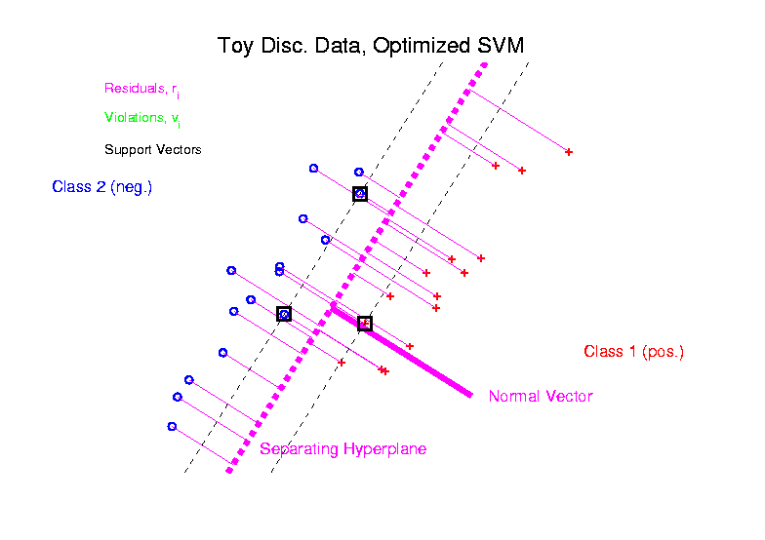
Support Vector Machines
Graphical View, using Toy Example:

Slide 2
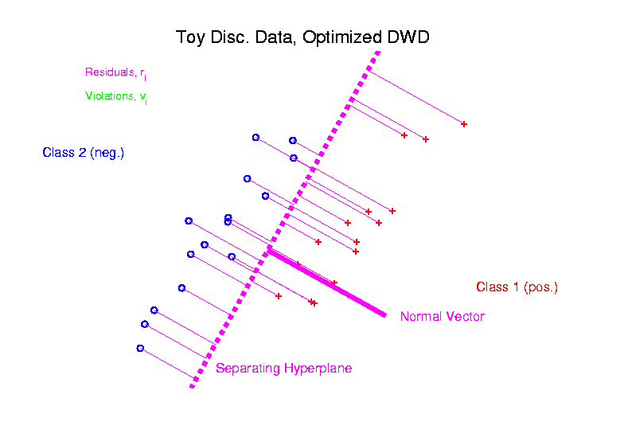
Distance Weighted Discrim’n
Graphical View, using Toy Example:

Slide 3
HDLSS Discrim’n Simulations
Wobble Mixture:
Notes:
DWD1figGBig.ps

Slide 4
HDLSS Discrim’n Simulations
Wobble Mixture:
80% dim. 1 , other dims 0
20% dim. 1 ±0.1, rand dim ±100, others 0
MD still very bad, driven by outliers
SVM & DWD are both very robust
SVM loses (affected by margin push)
DWD slightly better (by w’ted influence)
Methods converge for higher dimension??
Ignore RLR (a mistake)

Slide 5
Melanoma Data
Study Differences Between
(Malignant) Melanoma & (Benign) Nevi
Use Image Features as Before
(Recall from Transformation Discussion)
Paper: Miedema et al (2012)

Slide 6
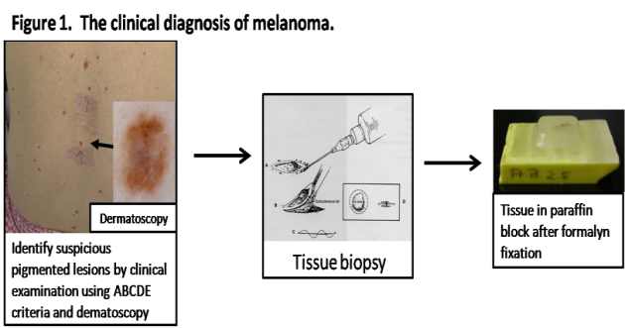
Introduction
Background
Clinical diagnosis

Slide 7
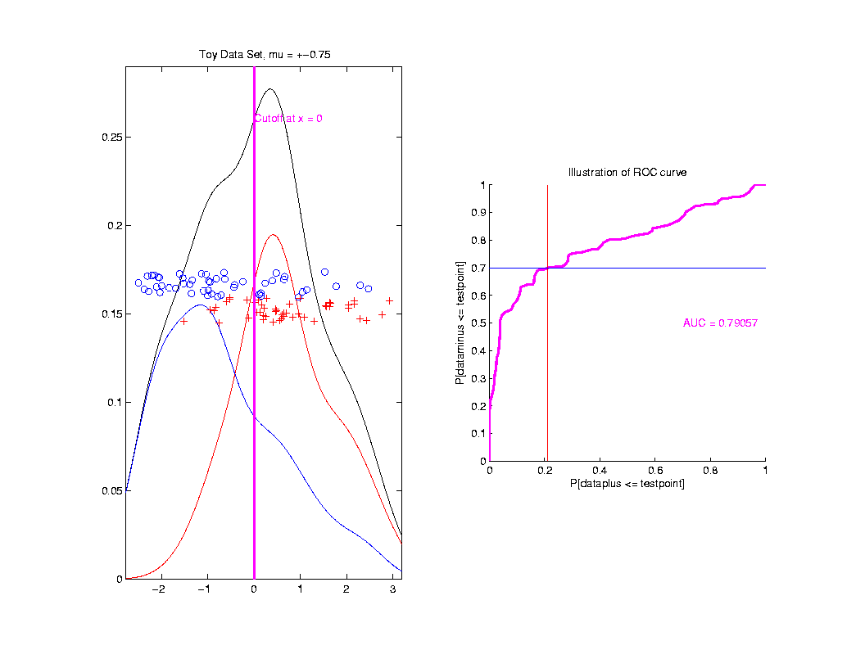
ROC Curve
Slide
Cutoff
To
Trace
Out
Curve

Slide 8
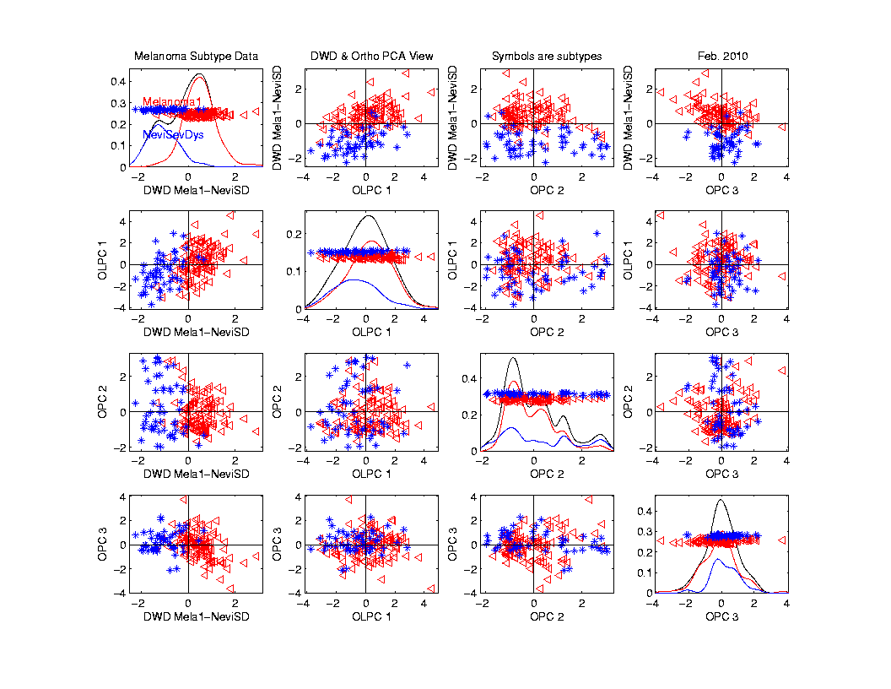
Melanoma Data
Subclass
DWD
Direction

Slide 9
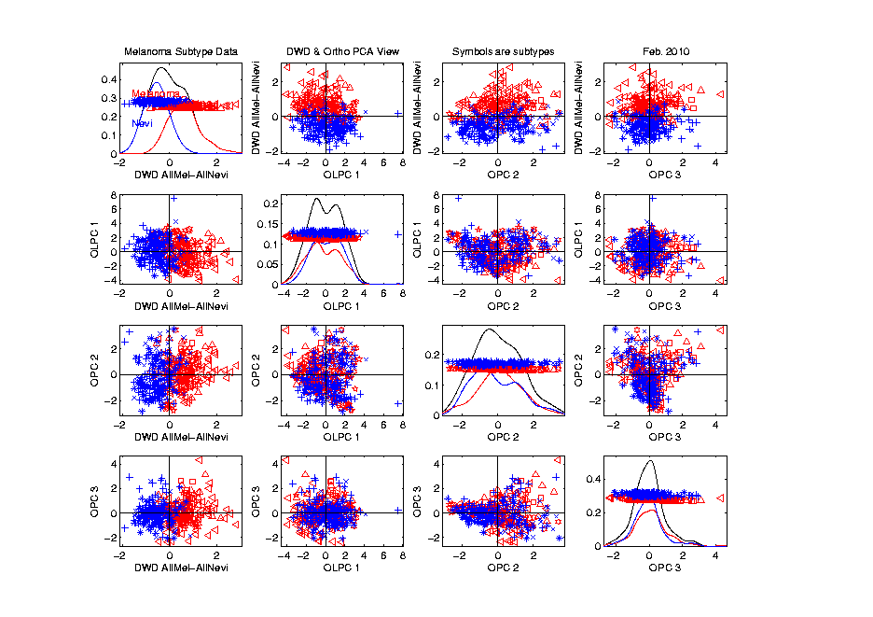
Melanoma Data
Full Data
DWD
Direction

Slide 10
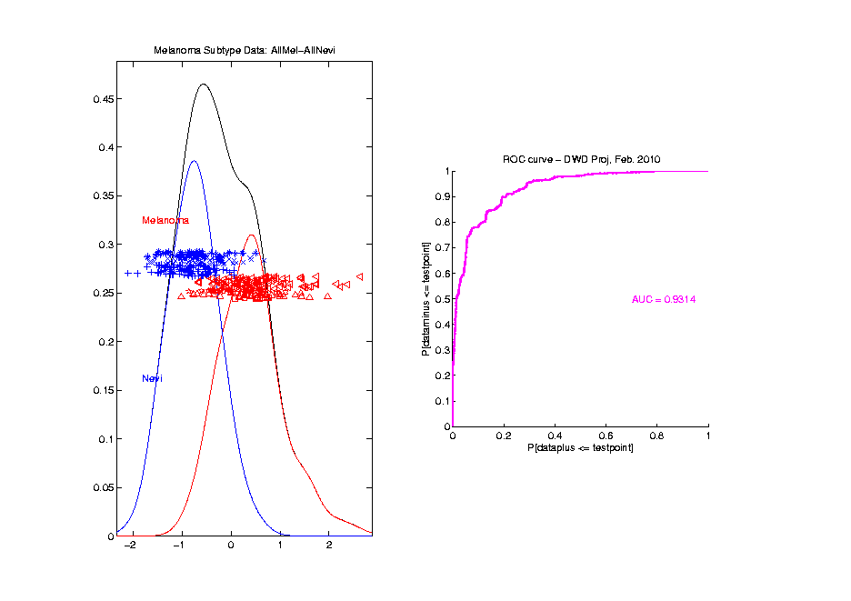
Melanoma Data
Full Data
ROC
Analysis
AUC = 0.93

Slide 11
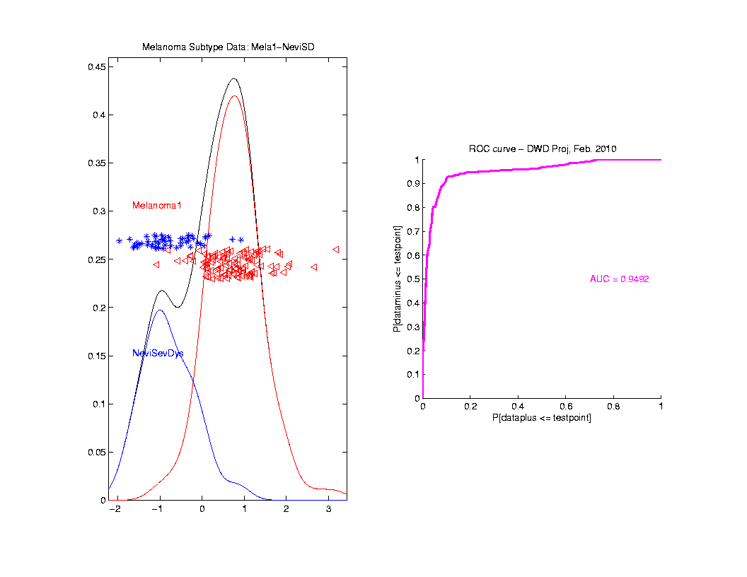
Melanoma Data
SubClass
ROC
Analysis
AUC = 0.95
Better,
Makes
Intuitive
Sense

Slide 12
Clustering
Idea: Given data
Assign each object to a class
Of similar objects
Completely data driven
I.e. assign labels to data
“Unsupervised Learning”
Contrast to Classification (Discrimination)
With predetermined classes
“Supervised Learning”

Slide 13
K-means Clustering
Clustering Goal:
Given data
Choose classes
To miminize

Slide 14
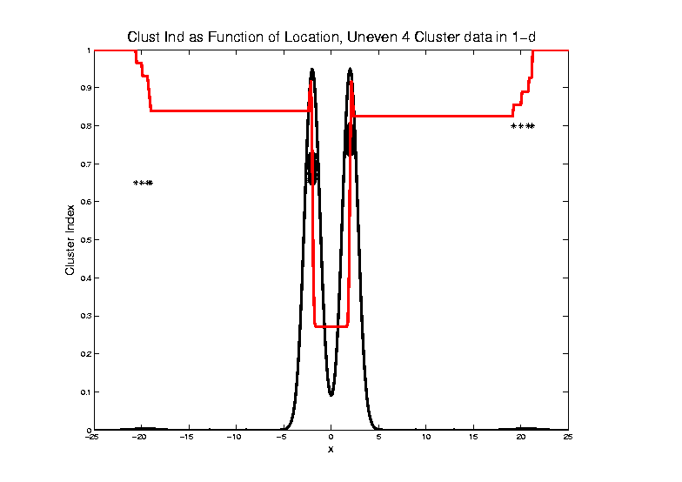
2-means Clustering

Slide 15
2-means Clustering
Study CI, using simple 1-d examples
Over changing Classes (moving b’dry)
Multi-modal data → interesting effects
Local mins can be hard to find
i.e. iterative procedures can “get stuck”
(even in 1 dimension, with K = 2)

Slide 16
SWISS Score
Another Application of CI (Cluster Index)
Cabanski et al (2010)

Slide 17
SWISS Score
Another Application of CI (Cluster Index)
Cabanski et al (2010)
Idea: Use CI in bioinformatics to
“measure quality of data preprocessing”

Slide 18
SWISS Score
Another Application of CI (Cluster Index)
Cabanski et al (2010)
Idea: Use CI in bioinformatics to
“measure quality of data preprocessing”
Philosophy: Clusters Are Scientific Goal
So Want to Accentuate Them

Slide 19
SWISS Score
Toy Examples (2-d):
Which are “More Clustered?”

Slide 20
SWISS Score
Toy Examples (2-d):
Which are “More Clustered?”

Slide 21
SWISS Score
SWISS =
Standardized Within class Sum of Squares

Slide 22
SWISS Score
SWISS =
Standardized Within class Sum of Squares

Slide 23
SWISS Score
SWISS =
Standardized Within class Sum of Squares

Slide 24
SWISS Score
SWISS =
Standardized Within class Sum of Squares

Slide 25
SWISS Score
Nice Graphical Introduction:

Slide 26
SWISS Score
Nice Graphical Introduction:

Slide 27
SWISS Score
Nice Graphical Introduction:

Slide 28
SWISS Score
Revisit Toy Examples (2-d):
Which are “More Clustered?”

Slide 29
SWISS Score
Toy Examples (2-d):
Which are “More Clustered?”

Slide 30
SWISS Score
Toy Examples (2-d):
Which are “More Clustered?”

Slide 31
SWISS Score
Now Consider K > 2:
How well does it work?

Slide 32
SWISS Score
K = 3, Toy Example:

Slide 33
SWISS Score
K = 3, Toy Example:

Slide 34
SWISS Score
K = 3, Toy Example:

Slide 35
SWISS Score
K = 3, Toy Example:
But C
Seems
“Better
Clustered”

Slide 36
SWISS Score
K-Class SWISS:
Instead of using K-Class CI
Use Average of Pairwise SWISS Scores

Slide 37
SWISS Score
K-Class SWISS:
Instead of using K-Class CI
Use Average of Pairwise SWISS Scores
(Preserves [0,1] Range)

Slide 38
SWISS Score
Avg. Pairwise SWISS – Toy Examples

Slide 39
SWISS Score
Additional Feature:
Ǝ Hypothesis Tests:
H₁: SWISS₁ < 1
H₁: SWISS₁ < SWISS₂
Permutation Based
See Cabanski et al (2010)

Slide 40
Clustering
A Very Large Area
K-Means is Only One Approach

Slide 41
Clustering
A Very Large Area
K-Means is Only One Approach
Has its Drawbacks
(Many Toy Examples of This)

Slide 42
Clustering
A Very Large Area
K-Means is Only One Approach
Has its Drawbacks
(Many Toy Examples of This)
Ǝ Many Other Approaches

Slide 43
Clustering
Recall Important References (monographs):
Hartigan (1975)
Gersho and Gray (1992)
Kaufman and Rousseeuw (2005)
See Also Wikipedia

Slide 44
Clustering
A Very Large Area
K-Means is Only One Approach
Has its Drawbacks
(Many Toy Examples of This)
Ǝ Many Other Approaches
Important (And Broad) Class
Hierarchical Clustering

Slide 45
Hiearchical Clustering
Idea: Consider Either:
Bottom Up Aggregation:
One by One Combine Data
Top Down Splitting:
All Data in One Cluster & Split
Through Entire Data Set, to get Dendogram

Slide 46
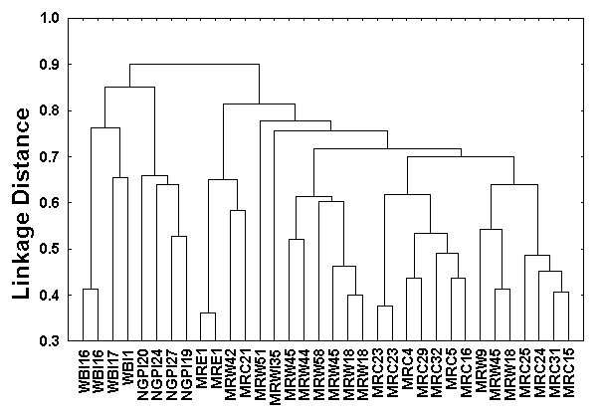
Hiearchical Clustering
Aggregate or Split, to get Dendogram
Thanks to US EPA: water.epa.gov

Slide 47
Hiearchical Clustering
Aggregate or Split, to get Dendogram
Aggregate:
Start With
Individuals,
Move Up

Slide 48
Hiearchical Clustering
Aggregate or Split, to get Dendogram
Aggregate:
Start With
Individuals

Slide 49
Hiearchical Clustering
Aggregate or Split, to get Dendogram
Aggregate:
Start With
Individuals,
Move Up

Slide 50
Hiearchical Clustering
Aggregate or Split, to get Dendogram
Aggregate:
Start With
Individuals,
Move Up

Slide 51
Hiearchical Clustering
Aggregate or Split, to get Dendogram
Aggregate:
Start With
Individuals,
Move Up

Slide 52
Hiearchical Clustering
Aggregate or Split, to get Dendogram
Aggregate:
Start With
Individuals,
Move Up,
End Up With
All in 1 Cluster

Slide 53
Hiearchical Clustering
Aggregate or Split, to get Dendogram
Split:
Start With
All in 1 Cluster

Slide 54
Hiearchical Clustering
Aggregate or Split, to get Dendogram
Split:
Start With
All in 1 Cluster,
Move Down

Slide 55
Hiearchical Clustering
Aggregate or Split, to get Dendogram
Split:
Start With
All in 1 Cluster,
Move Down,
End With
Individuals

Slide 56
Hiearchical Clustering
Vertical Axis in Dendogram:
Based on:
Distance Metric
(Ǝ many, e.g. L², L¹, L∞, …)
Linkage Function
(Reflects Clustering Type)

Slide 57
Hiearchical Clustering
Vertical Axis in Dendogram:
Based on:
Distance Metric
(Ǝ many, e.g. L², L¹, L∞, …)
Linkage Function
(Reflects Clustering Type)
A Lot of “Art” Involved

Slide 58
Hiearchical Clustering
Dendogram Interpretation
Branch
Length
Reflects
Cluster
Strength

Slide 59
SigClust
Statistical Significance of Clusters
in HDLSS Data
When is a cluster “really there”?

Slide 60
SigClust
Statistical Significance of Clusters
in HDLSS Data
When is a cluster “really there”?
Liu et al (2007), Huang et al (2014)

Slide 61
SigClust
Co-authors:
Andrew Nobel – UNC Statistics & OR
C. M. Perou – UNC Genetics
D. N. Hayes – UNC Oncology & Genetics
Yufeng Liu – UNC Statistics & OR
Hanwen Huang – U Georgia Biostatistics

Slide 62
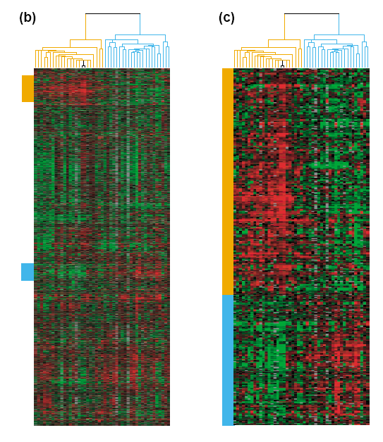
Common Microarray Analytic Approach: Clustering
From: Perou, Brown,
Botstein (2000)
Molecular Medicine
Today
d = 1161 genes
Zoomed to “relevant”
Gene subsets

Slide 63
Interesting Statistical Problem
For HDLSS data:
When clusters seem to appear
E.g. found by clustering method
How do we know they are really there?
Question asked by Neil Hayes
Define appropriate statistical significance?
Can we calculate it?

Slide 64
First Approaches: Hypo Testing
Idea: See if clusters seem to be
Significantly Different Distributions

Slide 65
First Approaches: Hypo Testing
Idea: See if clusters seem to be
Significantly Different Distributions
There Are Several Hypothesis Tests
Most Consistent with Visualization:
Direction, Projection, Permutation

Slide 66
DiProPerm Hypothesis Test
Context: 2 – sample means
H₀: μ₊₁ = μ₋₁ vs. H₁: μ₊₁ ≠ μ₋₁
(in High Dimensions)
Wei et al (2013)

Slide 67
DiProPerm Hypothesis Test
Context: 2 – sample means
H₀: μ₊₁ = μ₋₁ vs. H₁: μ₊₁ ≠ μ₋₁
Challenges:
Distributional Assumptions
Parameter Estimation

Slide 68
DiProPerm Hypothesis Test
Context: 2 – sample means
H₀: μ₊₁ = μ₋₁ vs. H₁: μ₊₁ ≠ μ₋₁
Challenges:
Distributional Assumptions
Parameter Estimation
HDLSS space is slippery

Slide 69
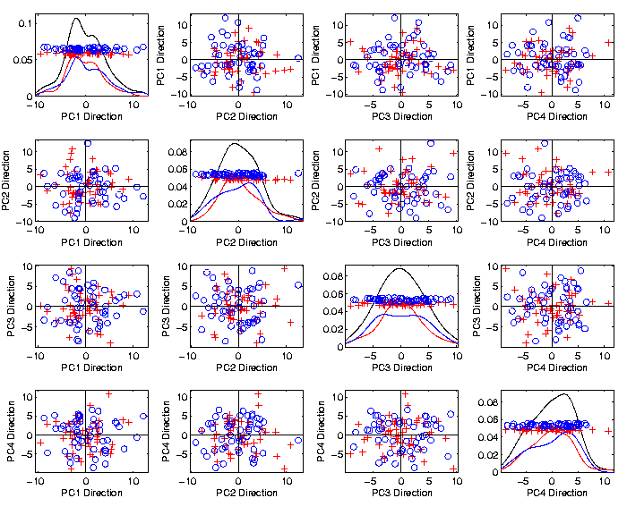
DiProPerm Hypothesis Test
Toy 2-Class
Example
See
Structure?

Slide 70
DiProPerm Hypothesis Test
Toy 2-Class
Example
See
Structure?
Careful,
Only PC1-4

Slide 71
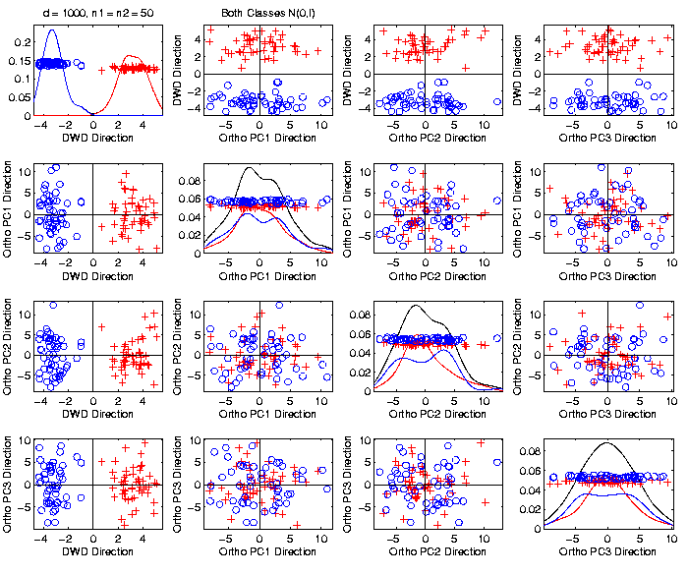
DiProPerm Hypothesis Test
Toy 2-Class
Example
Structure
Looks
Real???

Slide 72
DiProPerm Hypothesis Test
Toy 2-Class
Example
Actually
Both
Classes
Are N(0,I),
d = 1000

Slide 73
DiProPerm Hypothesis Test
Toy 2-Class
Example
Actually
Both
Classes
Are N(0,I),
d = 1000

Slide 74
DiProPerm Hypothesis Test
Toy 2-Class
Example
Separation
Is Natural
Sampling
Variation

Slide 75
DiProPerm Hypothesis Test
Context: 2 – sample means
H₀: μ₊₁ = μ₋₁ vs. H₁: μ₊₁ ≠ μ₋₁
Challenges:
Distributional Assumptions
Parameter Estimation
HDLSS space is slippery

Slide 76
DiProPerm Hypothesis Test
Context: 2 – sample means
H₀: μ₊₁ = μ₋₁ vs. H₁: μ₊₁ ≠ μ₋₁
Challenges:
Distributional Assumptions
Parameter Estimation
Suggested Approach:
Permutation test

Slide 77
DiProPerm Hypothesis Test
Suggested Approach:
Find a DIrection
(separating classes)

Slide 78
DiProPerm Hypothesis Test
Suggested Approach:
Find a DIrection
(separating classes)
PROject the data
(reduces to 1 dim)

Slide 79
DiProPerm Hypothesis Test
Suggested Approach:
Find a DIrection
(separating classes)
PROject the data
(reduces to 1 dim)
PERMute
(class labels, to assess significance,
with recomputed direction)

Slide 80
DiProPerm Hypothesis Test

Slide 81
DiProPerm Hypothesis Test

Slide 82
DiProPerm Hypothesis Test

Slide 83
DiProPerm Hypothesis Test

Slide 84
DiProPerm Hypothesis Test
.
.
.
Repeat this 1,000 times
To get:

Slide 85
DiProPerm Hypothesis Test

Slide 86
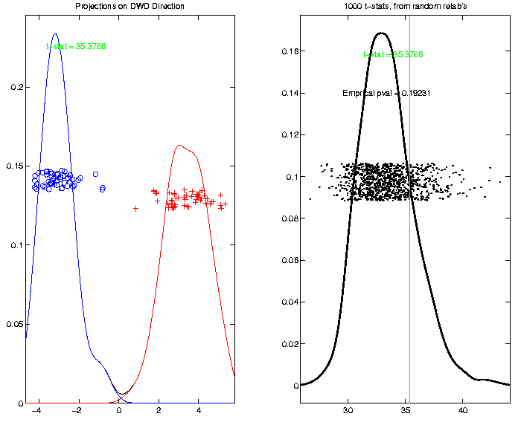
DiProPerm Hypothesis Test
Toy 2-Class
Example
p-value
Not
Significant

Slide 87
DiProPerm Hypothesis Test
Real Data Example: Autism
Caudate Shape
(sub-cortical brain structure)
Shape summarized by 3-d locations of 1032 corresponding points
Autistic vs. Typically Developing

Slide 88
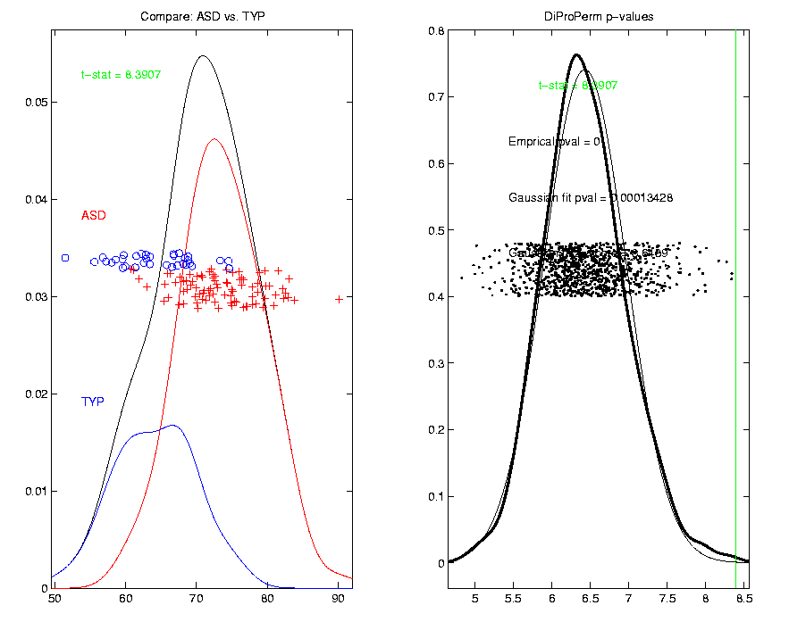
DiProPerm Hypothesis Test
Finds
Significant
Difference
Despite Weak
Visual
Impression
Thanks to Josh Cates

Slide 89
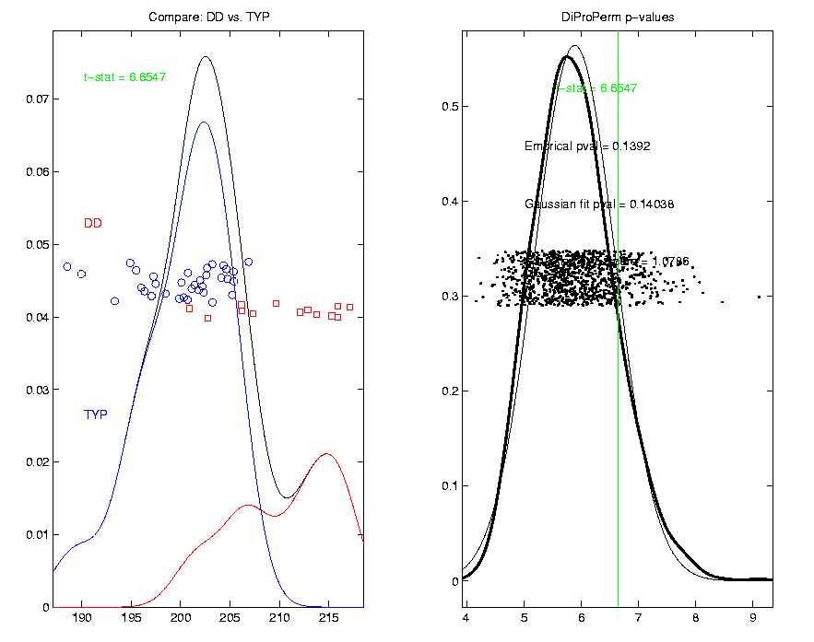
DiProPerm Hypothesis Test
Also Compare: Developmentally Delayed
No
Significant
Difference
But Strong
Visual
Impression
Thanks to Josh Cates

Slide 90
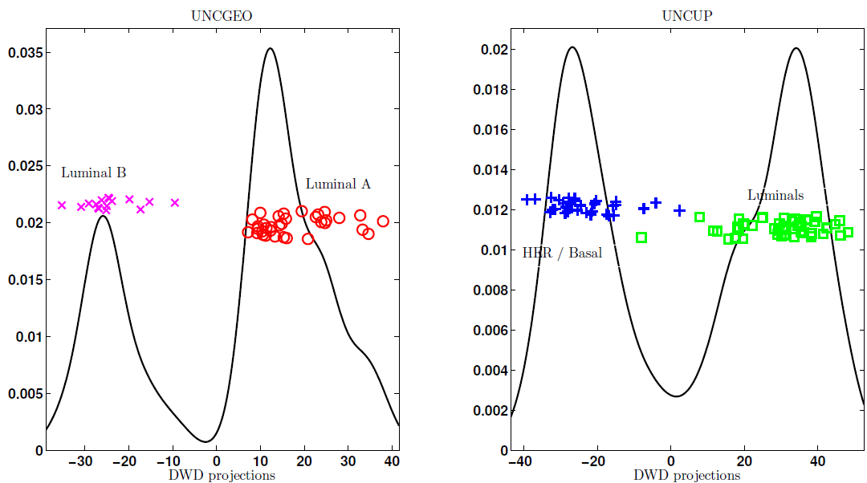
DiProPerm Hypothesis Test
Two
Examples
Which Is
“More
Distinct”?
Visually Better Separation?
Thanks to Katie Hoadley

Slide 91
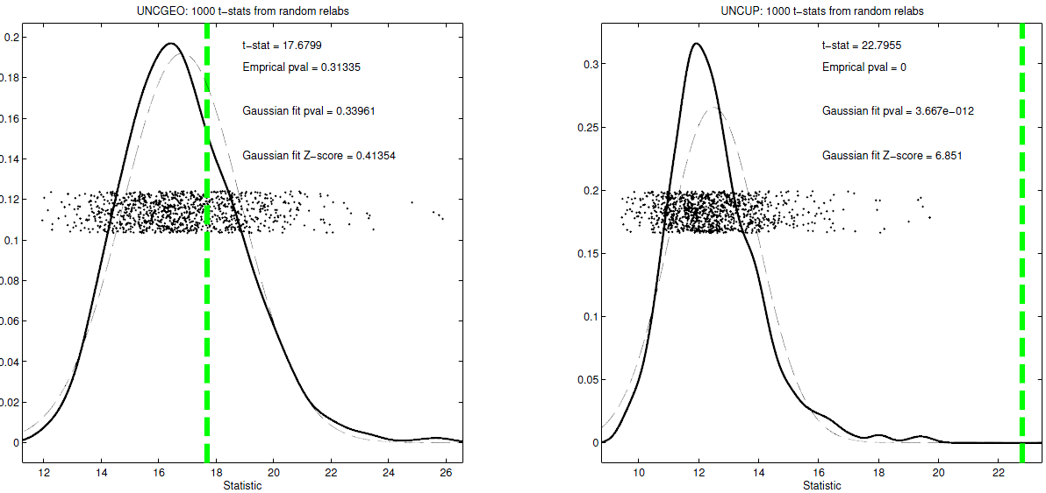
DiProPerm Hypothesis Test
Two
Examples
Which Is
“More
Distinct”?
Stronger Statistical Significance!
Thanks to Katie Hoadley

Slide 92
DiProPerm Hypothesis Test
Value of DiProPerm:
Visual Impression is Easily Misleading
(onto HDLSS projections,
e.g. Maximal Data Piling)
Really Need to Assess Significance
DiProPerm used routinely
(even for variable selection)

Slide 93
DiProPerm Hypothesis Test
Choice of Direction:
Distance Weighted Discrimination (DWD)
Support Vector Machine (SVM)
Mean Difference
Maximal Data Piling

Slide 94
DiProPerm Hypothesis Test
Choice of 1-d Summary Statistic:
2-sample t-stat
Mean difference
Median difference
Area Under ROC Curve

Slide 95
Interesting Statistical Problem
For HDLSS data:
When clusters seem to appear
E.g. found by clustering method
How do we know they are really there?
Question asked by Neil Hayes
Define appropriate statistical significance?
Can we calculate it?

Slide 96
First Approaches: Hypo Testing
e.g. Direction, Projection, Permutation
Hypothesis test of:
Significant difference between sub-populations
Effective and Accurate
I.e. Sensitive and Specific
There exist several such tests
But critical point is:
What result implies about clusters

Slide 97
Clarifying Simple Example
Why Population Difference Tests cannot indicate clustering
Andrew Nobel Observation
For Gaussian Data (Clearly 1 Cluster!)
Assign Extreme Labels
(e.g. by clustering)
Subpopulations are signif’ly different

Slide 98
Simple Gaussian Example
Clearly only 1 Cluster in this Example
But Extreme Relabelling looks different
Extreme T-stat strongly significant
Indicates 2 clusters in data

Slide 99
Simple Gaussian Example
Results:
Random relabelling T-stat is not significant
But extreme T-stat is strongly significant
This comes from clustering operation
Conclude sub-populations are different

Slide 100
Simple Gaussian Example
Results:
Random relabelling T-stat is not significant
But extreme T-stat is strongly significant
This comes from clustering operation
Conclude sub-populations are different
Now see that:
Not the same as clusters really there

Slide 101
Simple Gaussian Example
Results:
Random relabelling T-stat is not significant
But extreme T-stat is strongly significant
This comes from clustering operation
Conclude sub-populations are different
Now see that:
Not the same as clusters really there
Need a new approach to study clusters

Slide 102
Statistical Significance of Clusters
Basis of SigClust Approach:
What defines: A Single Cluster?
A Gaussian distribution (Sarle & Kou 1993)

Slide 103
Statistical Significance of Clusters
Basis of SigClust Approach:
What defines: A Single Cluster?
A Gaussian distribution (Sarle & Kou 1993)
So define SigClust test based on:
2-means cluster index (measure) as statistic
Gaussian null distribution
Currently compute by simulation
Possible to do this analytically???

Slide 104
SigClust Statistic – 2-Means Cluster Index
Measure of non-Gaussianity:
2-means Cluster Index
Familiar Criterion from k-means Clustering

Slide 105
SigClust Statistic – 2-Means Cluster Index
Measure of non-Gaussianity:
2-means Cluster Index
Familiar Criterion from k-means Clustering
Within Class Sum of Squared Distances to Class Means
Prefer to divide (normalize) by Overall Sum of Squared Distances to Mean
Puts on scale of proportions

Slide 106
SigClust Statistic – 2-Means Cluster Index
Measure of non-Gaussianity:
2-means Cluster Index:
Class Index Sets Class Means
“Within Class Var’n” / “Total Var’n”

Slide 107
SigClust Gaussian null distribut’n
Which Gaussian (for null)?

Slide 108
SigClust Gaussian null distribut’n
Which Gaussian (for null)?
Standard (sphered) normal?
No, not realistic
Rejection not strong evidence for clustering
Could also get that from a-spherical Gaussian

Slide 109
SigClust Gaussian null distribut’n
Which Gaussian (for null)?
Standard (sphered) normal?
No, not realistic
Rejection not strong evidence for clustering
Could also get that from a-spherical Gaussian
Need Gaussian more like data:
Need Full $N_{d}\left(μ,Σ\right)$ model
Challenge: Parameter Estimation
Recall HDLSS Context

Slide 110
SigClust Gaussian null distribut’n
Estimated Mean, $μ$ (of Gaussian dist’n)?
1st Key Idea: Can ignore this

Slide 111
SigClust Gaussian null distribut’n
Estimated Mean, $μ$ (of Gaussian dist’n)?
1st Key Idea: Can ignore this
By appealing to shift invariance of CI
When Data are (rigidly) shifted
CI remains the same
So enough to simulate with mean 0

Slide 112
SigClust Gaussian null distribut’n
Estimated Mean, $μ$ (of Gaussian dist’n)?
1st Key Idea: Can ignore this
By appealing to shift invariance of CI
When Data are (rigidly) shifted
CI remains the same
So enough to simulate with mean 0
Other uses of invariance ideas?

Slide 113
SigClust Gaussian null distribut’n
Challenge: how to estimate cov. Matrix $Σ$?

Slide 114
SigClust Gaussian null distribut’n
Challenge: how to estimate cov. Matrix $Σ$?
Number of parameters:
E.g. Perou 500 data:
Dimension
so
But Sample Size

Slide 115
SigClust Gaussian null distribut’n
Challenge: how to estimate cov. Matrix $Σ$?
Number of parameters:
E.g. Perou 500 data:
Dimension
so
But Sample Size
Impossible in HDLSS settings????
Way around this problem?

Slide 116
SigClust Gaussian null distribut’n
2nd Key Idea: Mod Out Rotations

Slide 117
SigClust Gaussian null distribut’n
2nd Key Idea: Mod Out Rotations
Replace full Cov. by diagonal matrix
As done in PCA eigen-analysis
But then “not like data”???

Slide 118
SigClust Gaussian null distribut’n
2nd Key Idea: Mod Out Rotations
Replace full Cov. by diagonal matrix
As done in PCA eigen-analysis
But then “not like data”???
OK, since k-means clustering (i.e. CI) is
rotation invariant
(assuming e.g. Euclidean Distance)

Slide 119
SigClust Gaussian null distribut’n
2nd Key Idea: Mod Out Rotations
Only need to estimate diagonal matrix
But still have HDLSS problems?

Slide 120
SigClust Gaussian null distribut’n
2nd Key Idea: Mod Out Rotations
Only need to estimate diagonal matrix
But still have HDLSS problems?
E.g. Perou 500 data:
Dimension
Sample Size
Still need to estimate param’s

Slide 121
SigClust Gaussian null distribut’n
3rd Key Idea: Factor Analysis Model

