Slide 1
DWD in Face Recognition , (cont.)
Interesting summary:
Jump between means
(in DWD direction)
Clear separation of
Maleness vs. Femaleness

Slide 2
DWD in Face Recognition , (cont.)
Fun Comparison:
Jump between means
(in SVM direction)
Also distinguishes
Maleness vs. Femaleness
But not as well as DWD

Slide 3
DWD in Face Recognition , (cont.)
Analysis of difference: Project onto normals
SVM has “small gap” (feels noise artifacts?)
DWD “more informative” (feels real structure?)

Slide 4
HDLSS Discrim’n Simulations
Main idea:
Comparison of
SVM (Support Vector Machine)
DWD (Distance Weighted Discrimination)
MD (Mean Difference, a.k.a. Centroid)
Linear versions, across dimensions
Notes:
4

Slide 5
HDLSS Discrim’n Simulations
Overall Approach:
Study different known phenomena
Spherical Gaussians
Outliers
Polynomial Embedding
Common Sample Sizes
But wide range of dimensions

Slide 6
HDLSS Discrim’n Simulations
Spherical Gaussians:
Notes:
DWD1figEBig.ps

Slide 7
HDLSS Discrim’n Simulations
Spherical Gaussians:
Same setup as before
Means shifted in dim 1 only,
All methods pretty good
Harder problem for higher dimension
SVM noticeably worse
MD best (Likelihood method)
DWD very close to MD
Methods converge for higher dimension??

Slide 8
HDLSS Discrim’n Simulations
Outlier Mixture:
Notes:
DWD1figFBig.ps

Slide 9
HDLSS Discrim’n Simulations
Outlier Mixture:
80% dim. 1 , other dims 0
20% dim. 1 ±100, dim. 2 ±500, others 0
MD is a disaster, driven by outliers
SVM & DWD are both very robust
SVM is best
DWD very close to SVM (insig’t difference)
Methods converge for higher dimension??
Ignore RLR (a mistake)

Slide 10
HDLSS Discrim’n Simulations
Wobble Mixture:
Notes:
DWD1figGBig.ps

Slide 11
HDLSS Discrim’n Simulations
Wobble Mixture:
80% dim. 1 , other dims 0
20% dim. 1 ±0.1, rand dim ±100, others 0
MD still very bad, driven by outliers
SVM & DWD are both very robust
SVM loses (affected by margin push)
DWD slightly better (by w’ted influence)
Methods converge for higher dimension??
Ignore RLR (a mistake)

Slide 12
HDLSS Discrim’n Simulations
Nested Spheres:
Notes:
DWD1figHBig.ps

Slide 13
HDLSS Discrim’n Simulations
Nested Spheres:
1st d/2 dim’s, Gaussian with var 1 or C
2nd d/2 dim’s, the squares of the 1st dim’s
(as for 2nd degree polynomial embedding)
Each method best somewhere
MD best in highest d (data non-Gaussian)
Methods not comparable (realistic)
Methods converge for higher dimension??
HDLSS space is a strange place
Ignore RLR (a mistake)

Slide 14
HDLSS Discrim’n Simulations
Conclusions:
Everything (sensible) is best sometimes
DWD often very near best
MD weak beyond Gaussian
Caution about simulations (and examples):
Very easy to cherry pick best ones
Good practice in Machine Learning
“Ignore method proposed, but read
paper for useful comparison of others”

Slide 15
HDLSS Discrim’n Simulations
Caution: There are additional players
E.g. Regularized Logistic Regression
looks also very competitive
Interesting Phenomenon:
All methods come together
in very high dimensions???

Slide 16
HDLSS Discrim’n Simulations
Can we say more about:
All methods come together
in very high dimensions???
Mathematical Statistical Question:
Mathematics behind this???
(will answer later)
Notes:
16

Slide 17
SVM & DWD Tuning Parameter
Main Idea:
Handling of Violators (“Slack Variables”),
Controlled by Tuning Parameter, C
Larger C → Try Harder to Avoid Violation
Notes:
17

Slide 18
SVM Tuning Parameter
Recall Movie for SVM:
Notes:
18

Slide 19
SVM & DWD Tuning Parameter
Possible Approaches:
Visually Tuned
(Can be Effective,
But Takes Time,
Requires Expertise)
Notes:
19

Slide 20
SVM & DWD Tuning Parameter
Possible Approaches:
Visually Tuned
Simple Defaults
DWD: 100 / median pairwise distance
(Surprisingly Useful, Simple Answer)
SVM: 1000
(Works Well Sometimes, Not Others)
Notes:
20

Slide 21
SVM & DWD Tuning Parameter
Possible Approaches:
Visually Tuned
Simple Defaults
(Works Well for DWD,
Less Effective for SVM)
Notes:
21

Slide 22
SVM & DWD Tuning Parameter
Possible Approaches:
Visually Tuned
Simple Defaults
Cross Validation
Measure Classification Error Rate
Leaving Some Out (to Avoid Overfitting)
Choose C to Minimize Error Rate
Notes:
22

Slide 23
SVM & DWD Tuning Parameter
Possible Approaches:
Visually Tuned
Simple Defaults
Cross Validation
(Very Popular – Useful for SVD,
But Comes at Computational Cost)
Notes:
23

Slide 24
SVM & DWD Tuning Parameter
Possible Approaches:
Visually Tuned
Simple Defaults
Cross Validation
Scale Space
(Work with Full Range of Choices)
Notes:
24

Slide 25
Melanoma Data
Study Differences Between
(Malignant) Melanoma & (Benign) Nevi
Use Image Features as Before
(Recall from Transformation Discussion)
Paper: Miedema et al (2012)

Slide 26
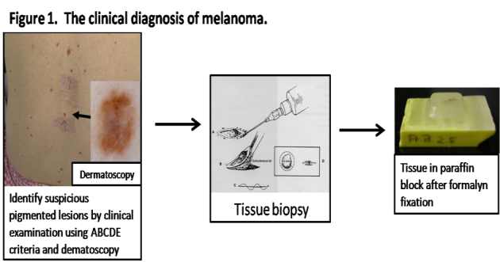
Introduction
Background
Clinical diagnosis

Slide 27
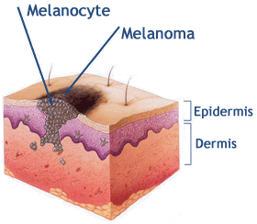
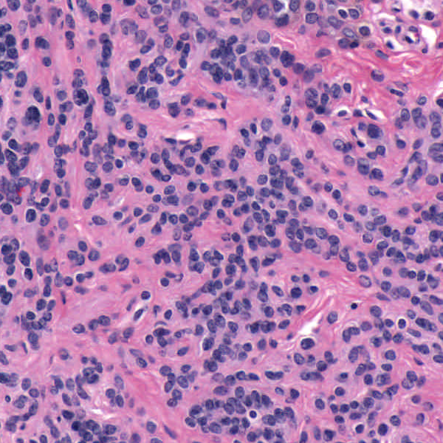
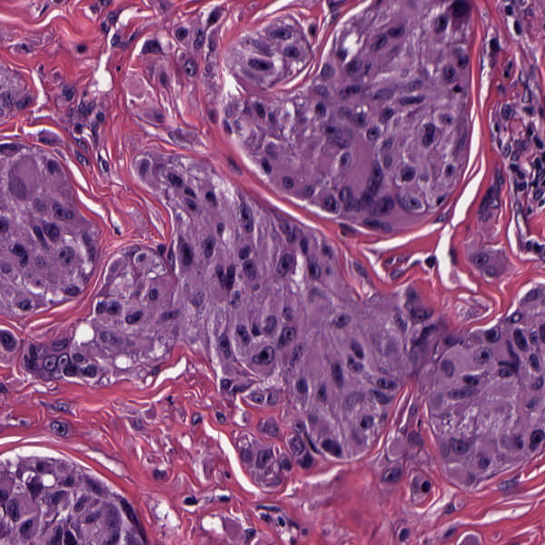
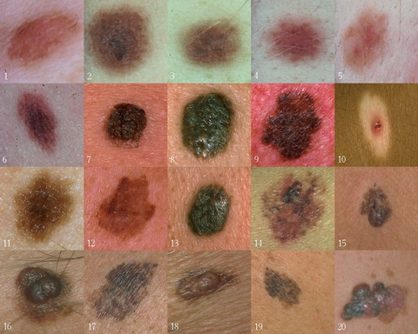
Background
Goal
Image Analysis of Histology Slides
Image: www.melanoma.ca
Benign
Melanoma
1 in 75 North Americans will develop a
malignant melanoma in their lifetime.
Initial goal: Automatically segment nuclei.
Challenge: Dense packing of nuclei.
Ultimately: Cancer grading and patient survival.
Image: melanoma.blogsome.com

Slide 28
Feature Extraction
Features from Cell Nuclei
Feature Extraction
Extract various features based on color and morphology
Example “high-level” concepts:
Stain intensity
Nuclear area
Density of nuclei
Regularity of nuclear shape

Slide 29
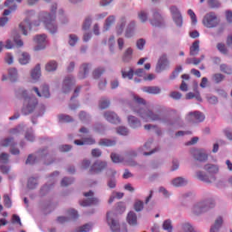
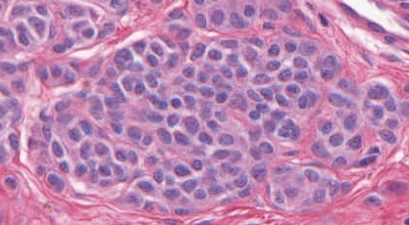
Feature Extraction
Features from Cell Nuclei
Labeled Nuclei
Conventional Nevus
Superficial Spreading Melanoma

Slide 30
Feature Extraction
Features from Cell Nuclei
Nuclear Regions
Conventional Nevus
Superficial Spreading Melanoma
Generated by growing nuclei out from boundary
Used for various color and density features:
Region Stain 2, Region Area Ratio, etc.

Slide 31
Feature Extraction
Features from Cell Nuclei
Delaunay Triangulation
Conventional Nevus
Superficial Spreading Melanoma
Triangulation of nuclear centers
Used for various density features:
Mean Delaunay, Max. Delaunay, etc.

Slide 32
Melanoma Data
Study Differences Between
(Malignant) Melanoma & (Benign) Nevi
Explore with PCA View

Slide 33
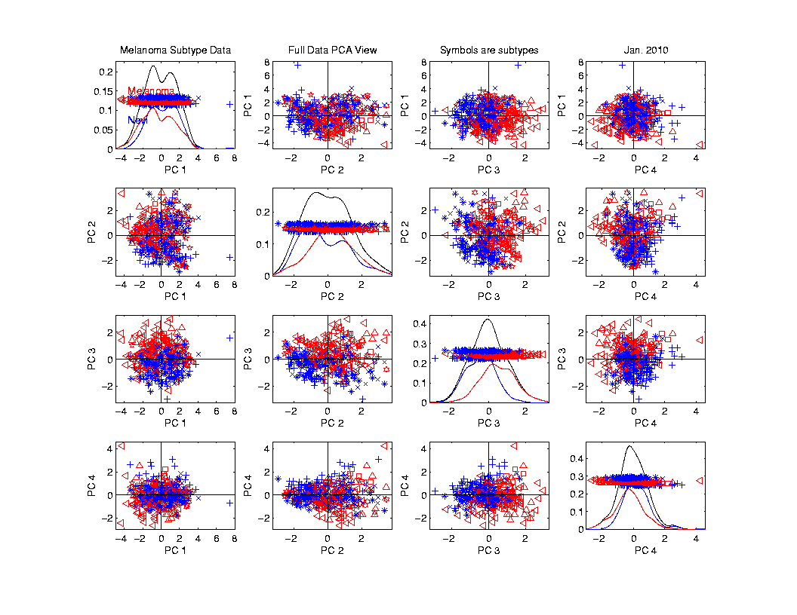
Melanoma Data
PCA
View

Slide 34
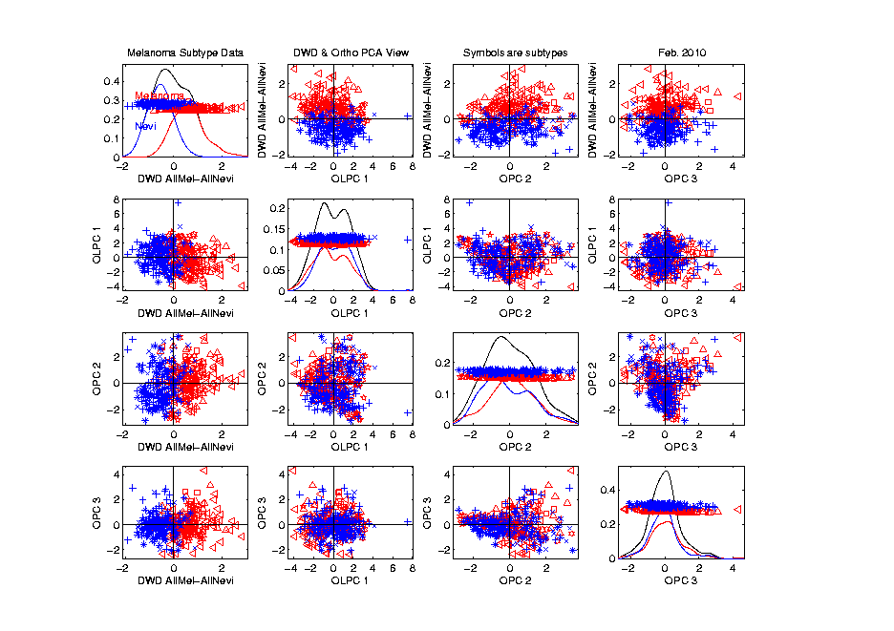
Melanoma Data
Rotate
To DWD
Direction

Slide 35
Melanoma Data
Rotate
To DWD
Direction
“Good”
Separation
???

Slide 36
Melanoma Data
Rotate
To DWD
Direction
Orthogonal
PCs
Avoid
Strange
Projections

Slide 37
Melanoma Data
Return
To
PCA
View
And
Focus
On
Subtypes

Slide 38
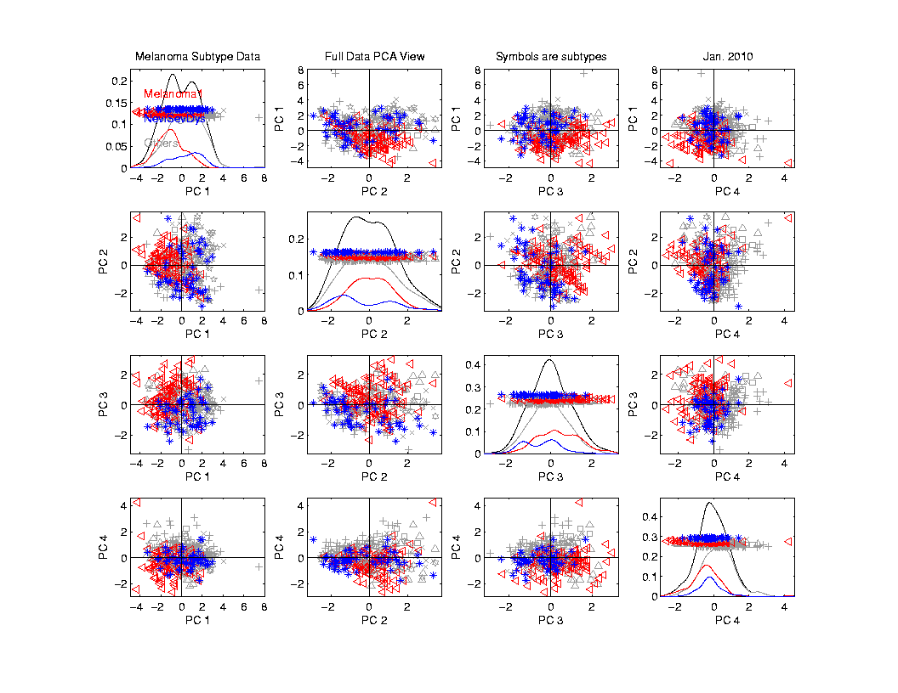
Melanoma Data
Focus
On
Subtypes:
Melanoma 1
Sev. Dys.
Nevi
Gray Out
Others

Slide 39
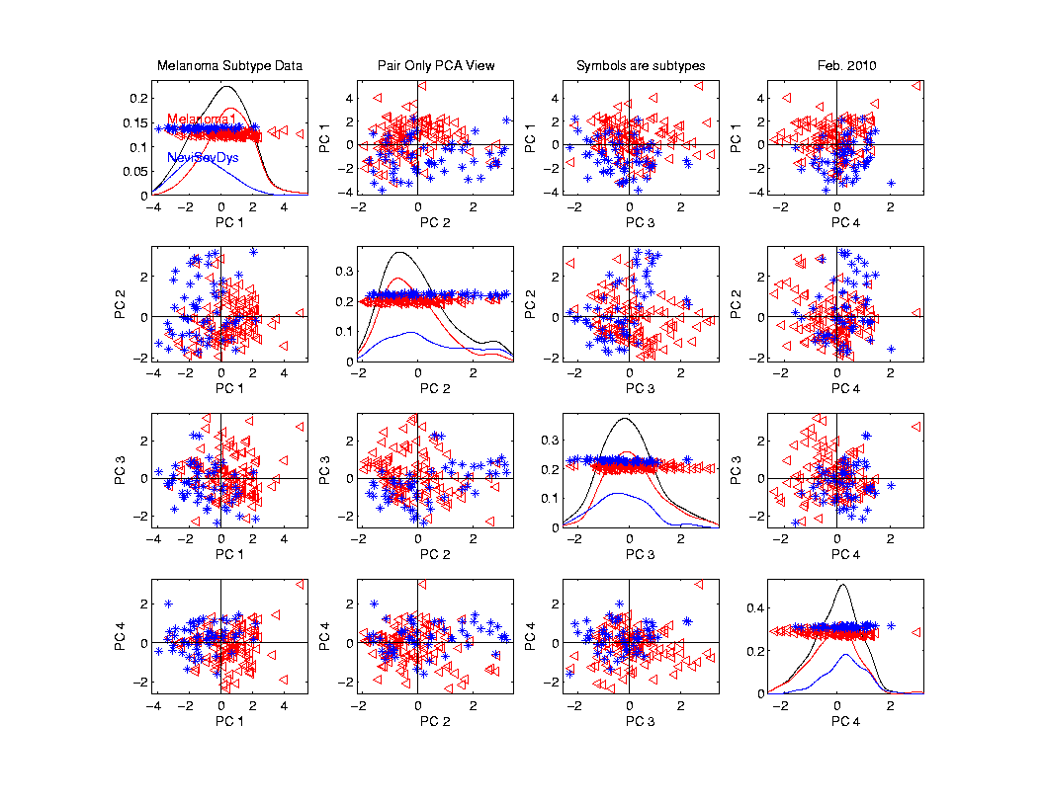
Melanoma Data
Rotate
To
Pairwise
Only
PCA

Slide 40
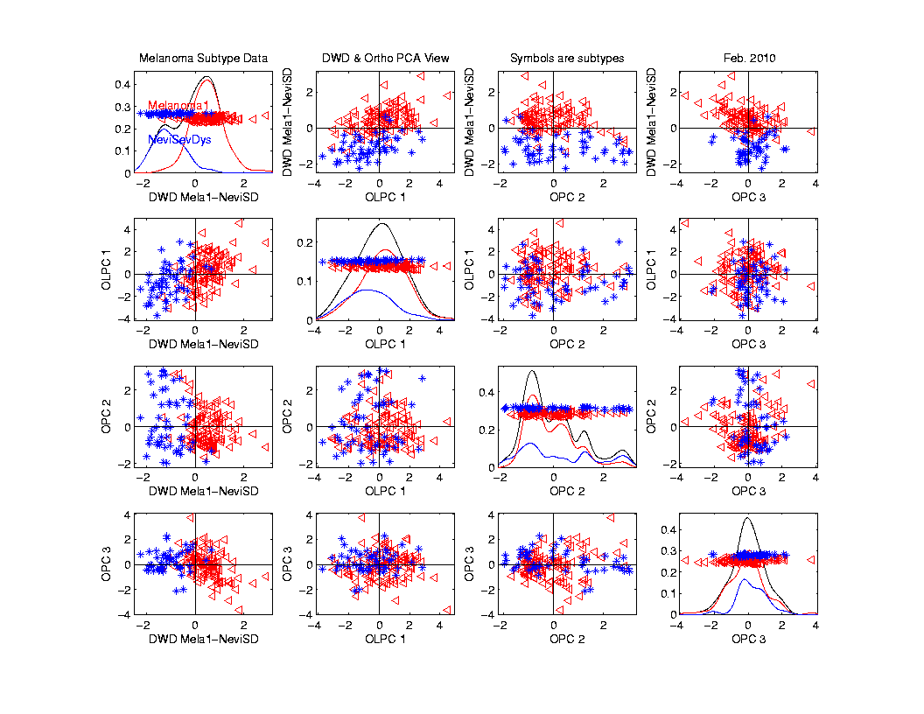
Melanoma Data
Rotate
To DWD
& Ortho PCs

Slide 41
Melanoma Data
Rotate
To DWD
& Ortho PCs
Better
Separation
Than Full
Data???

Slide 42
Melanoma Data
Full Data
DWD
Direction
“Good”
Separation
???

Slide 43
Melanoma Data
Challenge:
Measure “Goodness of Separation”
Approach from Signal Detection:
Receiver Operator Characteristic
(ROC) Curve

Slide 44
ROC Curve
Challenge:
Measure “Goodness of Separation”
Approach from Signal Detection:
Receiver Operator Characteristic
(ROC) Curve
Developed in WWII, History in
Green and Swets (1966)

Slide 45
ROC Curve
Challenge:
Measure “Goodness of Separation”
Approach from Signal Detection:
Receiver Operator Characteristic
(ROC) Curve
Good Modern Treatment:
DeLong, DeLong & Clarke-Pearson (1988)

Slide 46
ROC Curve
Challenge:
Measure “Goodness of Separation”
Idea: For Range of Cutoffs
Plot:
Prop’n +1’s Smaller than Cutoff
Vs.
Prop’n -1s Smaller than Cutoff

Slide 47
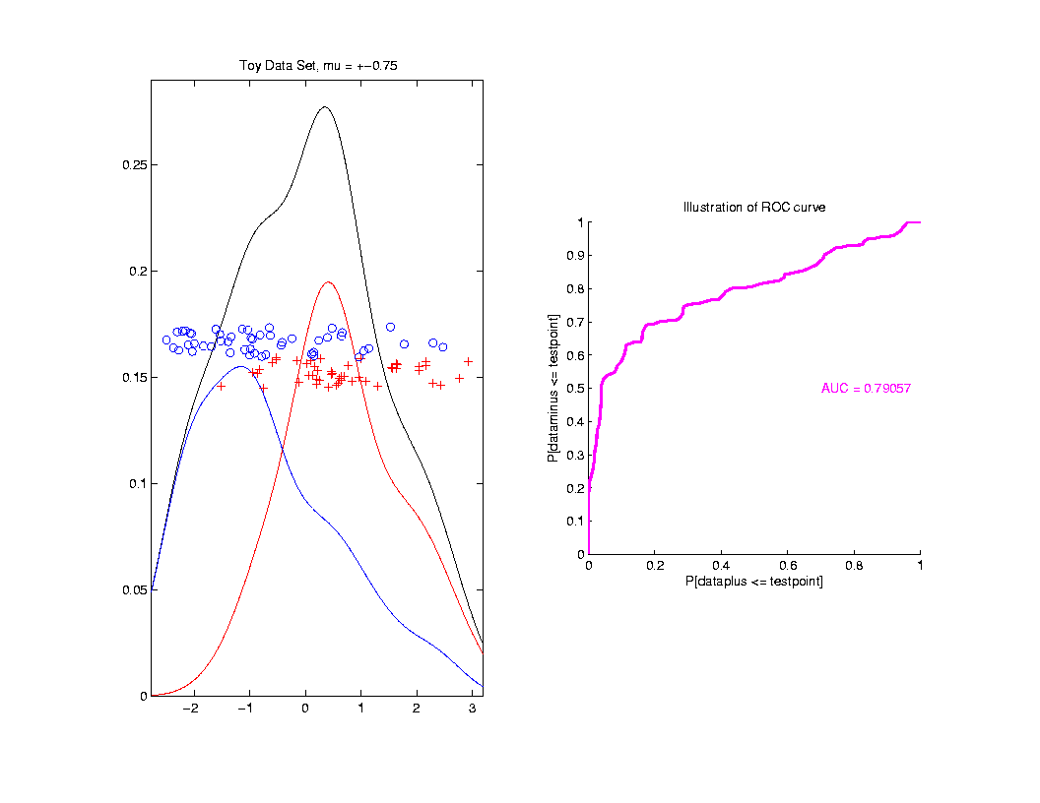
ROC Curve
Aim:
Quantify
“Overlap”

Slide 48
ROC Curve
Aim:
Quantify
“Overlap”
Approach
Consider
Series
Of Cutoffs

Slide 49
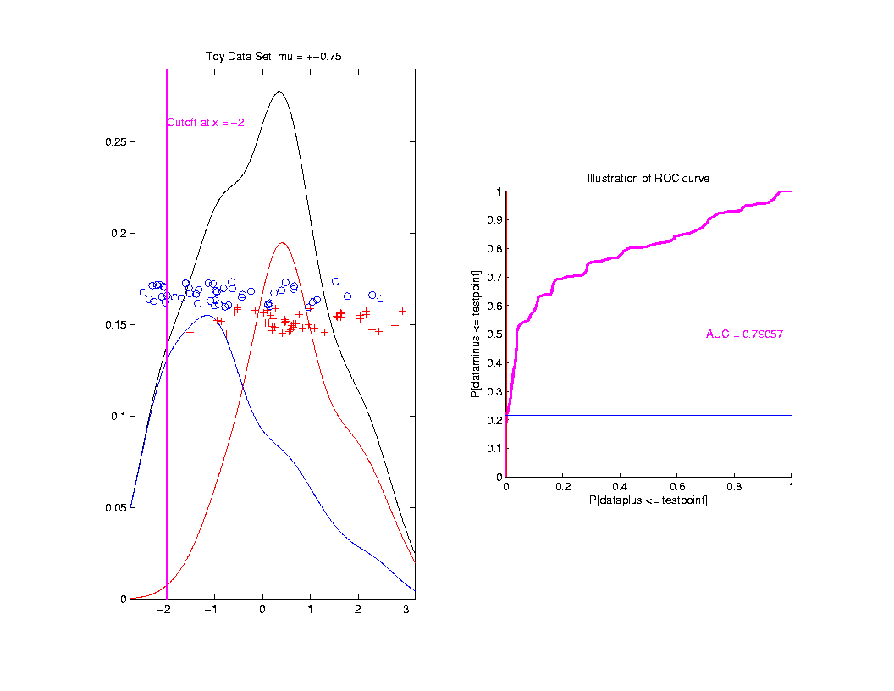
ROC Curve
Approach
Consider
Series
Of Cutoffs

Slide 50
ROC Curve
X-coord
Is Prop’n
Of Reds
Smaller

Slide 51
ROC Curve
X-coord
Is Prop’n
Of Reds
Smaller
Y-coord
Is Prop’n
Of Blues
Smaller

Slide 52
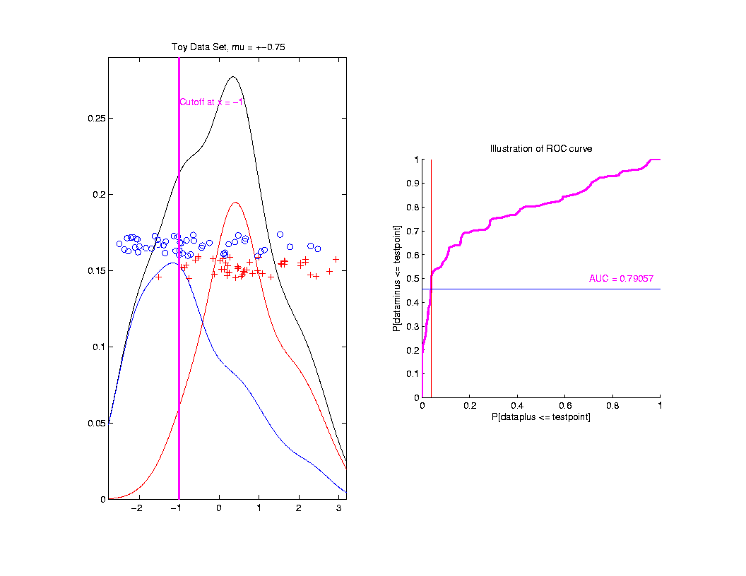
ROC Curve
Slide
Cutoff
To
Trace
Out
Curve

Slide 53
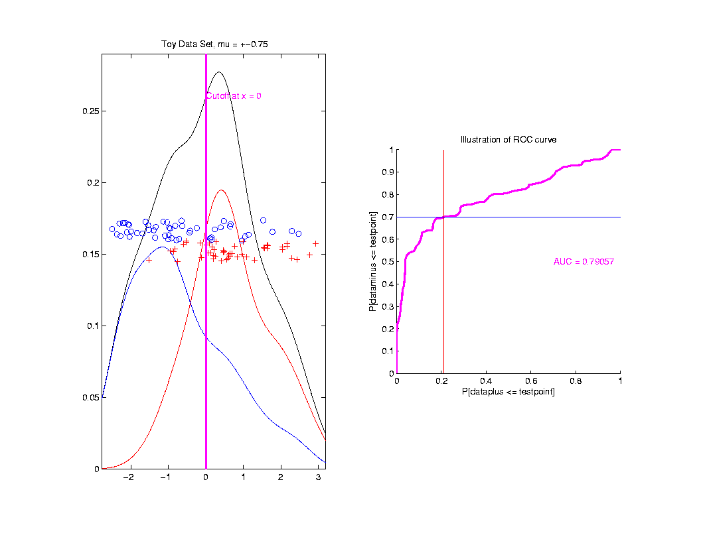
ROC Curve
Slide
Cutoff
To
Trace
Out
Curve

Slide 54
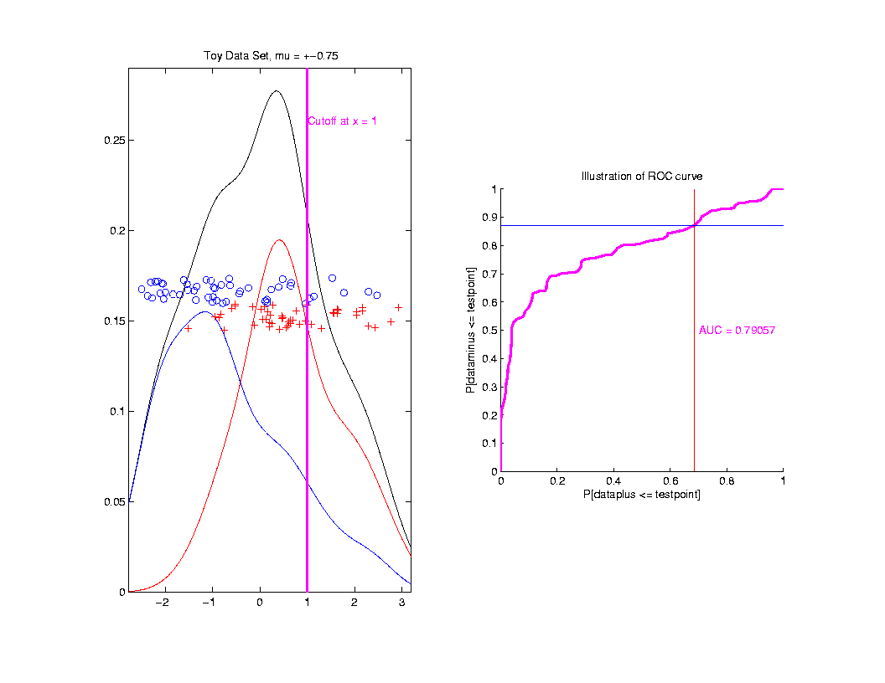
ROC Curve
Slide
Cutoff
To
Trace
Out
Curve

Slide 55
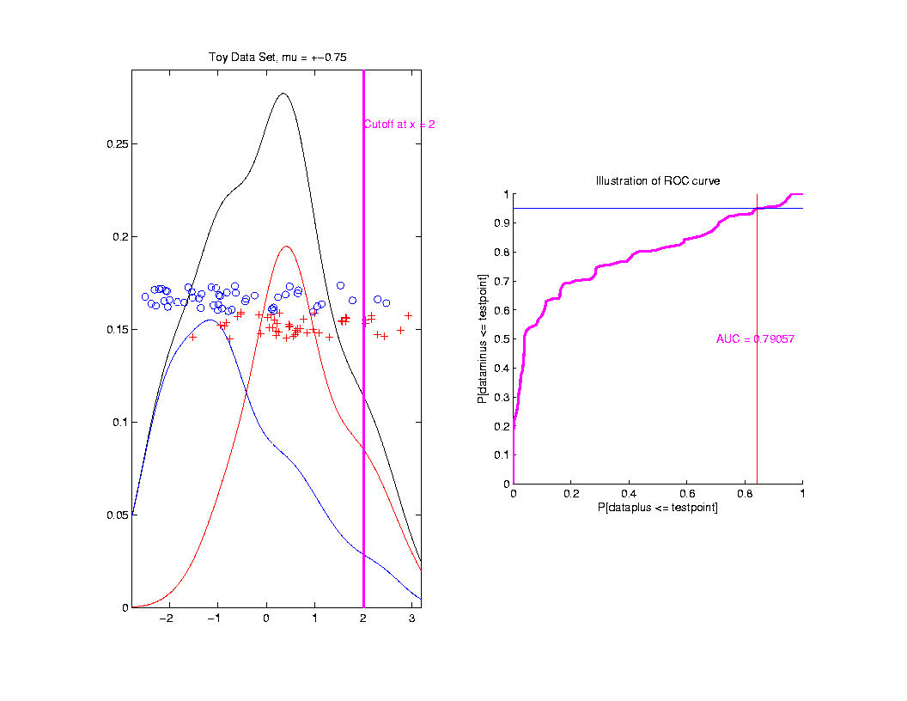
ROC Curve
Slide
Cutoff
To
Trace
Out
Curve

Slide 56
ROC Curve
Better
Separation
Is “More
To Upper
Left”

Slide 57
ROC Curve
Summarize
& Compare
Using
Area
Under
Curve
(AUC)

Slide 58
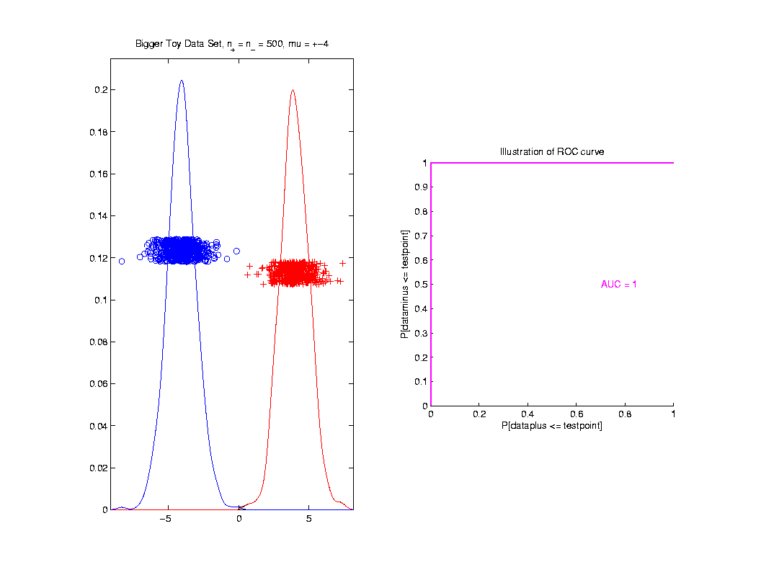
ROC Curve
Toy
Example
Perfect
Separation

Slide 59
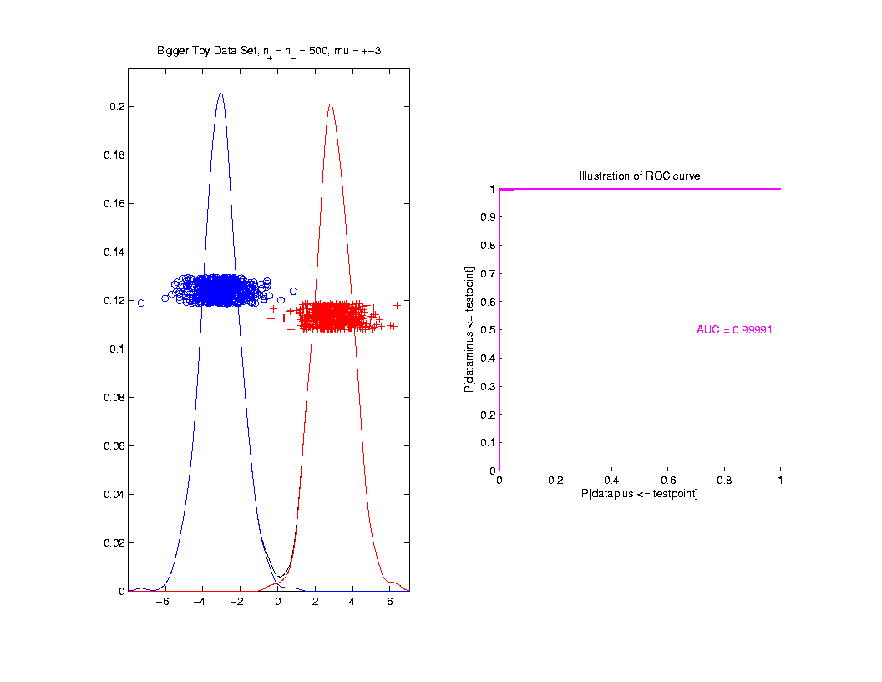
ROC Curve
Toy
Example
Very
Slight
Overlap

Slide 60
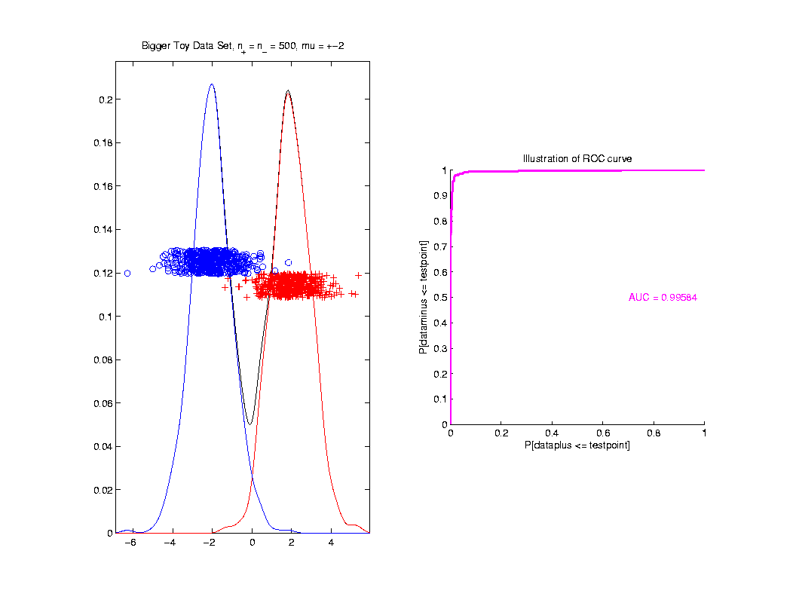
ROC Curve
Toy
Example
Little
More
Overlap

Slide 61
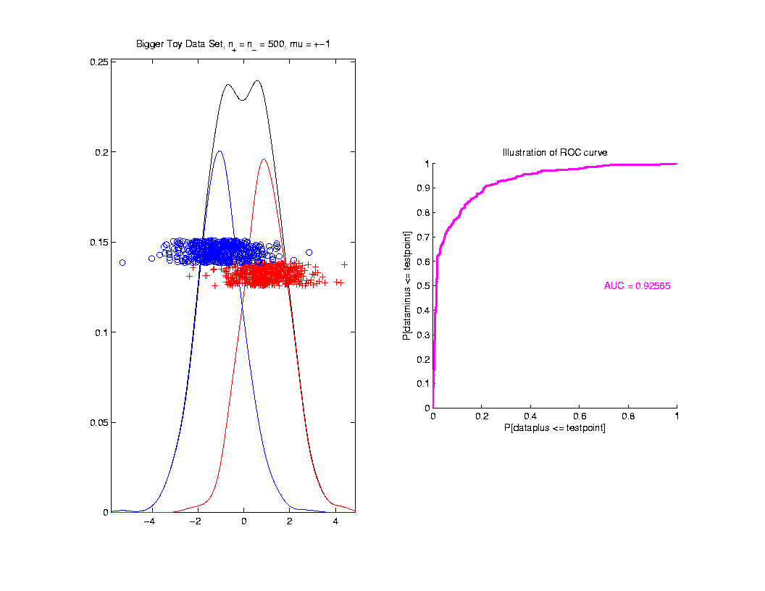
ROC Curve
Toy
Example
More
Overlap

Slide 62
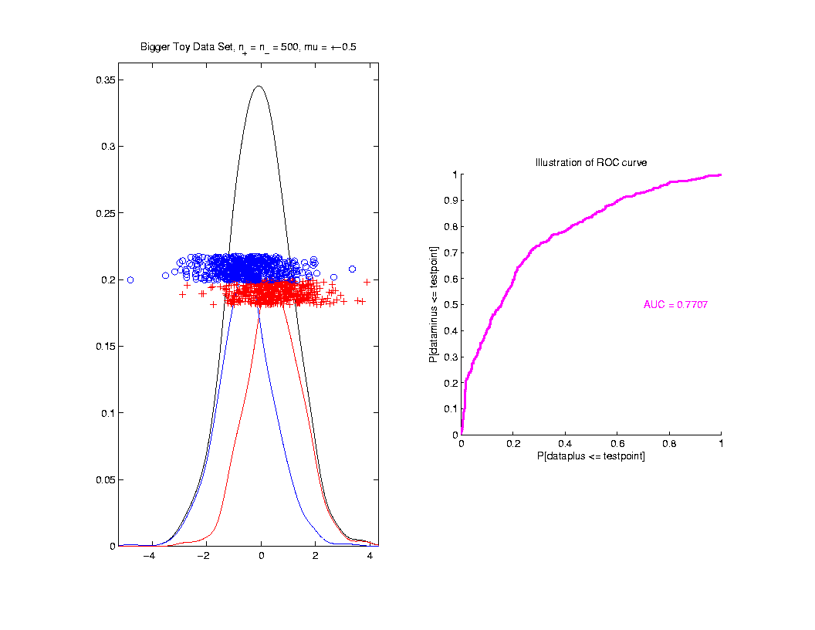
ROC Curve
Toy
Example
Much
More
Overlap

Slide 63
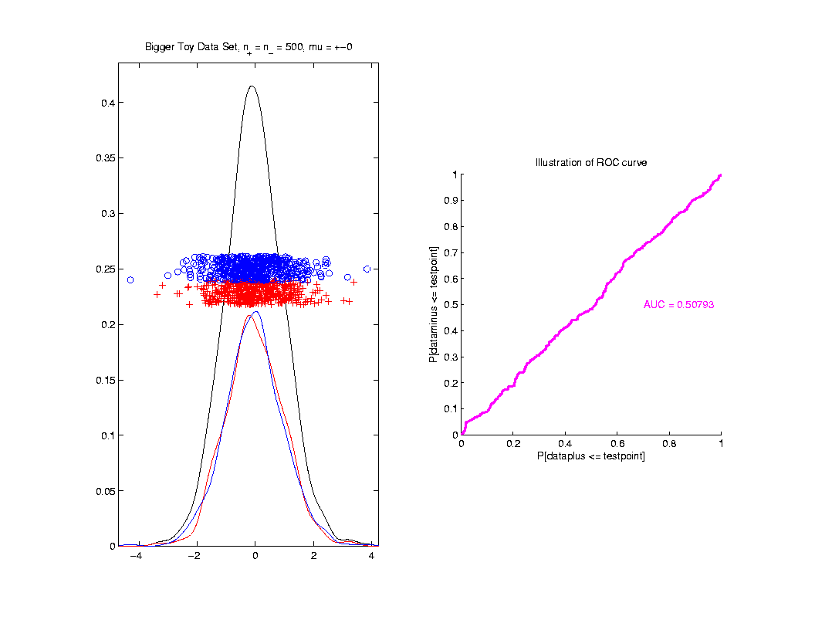
ROC Curve
Toy
Example
Complete
Overlap

Slide 64
ROC Curve
Toy
Example
Complete
Overlap
AUC ≈ 0.5 Reflects “Coin Tossing”

Slide 65
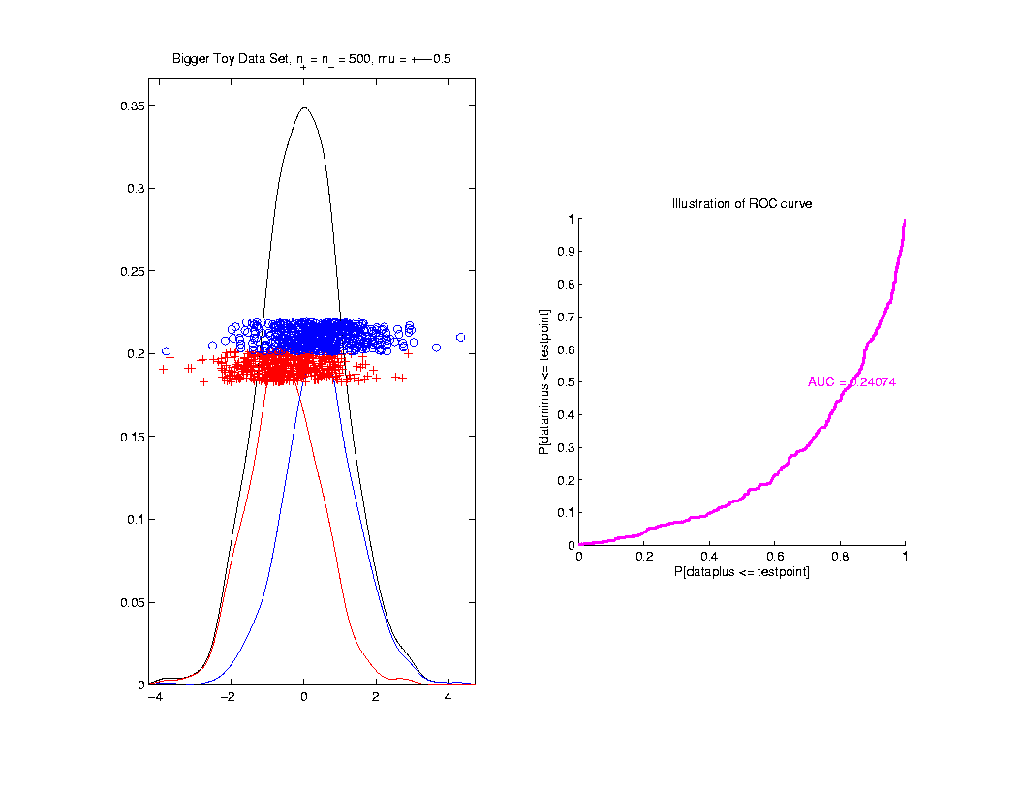
ROC Curve
Toy
Example
Can
Reflect
“Worse
Than Coin
Tossing”

Slide 66
ROC Curve
Interpretation of AUC:
Very Context Dependent
Radiology:
“> 70% has Predictive Usefulness”
Bigger is Better

Slide 67
Melanoma Data
Recall Question:
Which Gives Better Separation of
Melanoma vs. Nevi
DWD on All Melanoma vs. All Nevi
DWD on Melanoma 1 vs. Sev. Dys. Nevi

Slide 68
Melanoma Data
Subclass
DWD
Direction

Slide 69
Melanoma Data
Full Data
DWD
Direction

Slide 70
Melanoma Data
Recall Question:
Which Gives Better Separation of
Melanoma vs. Nevi
DWD on All Melanoma vs. All Nevi
DWD on Melanoma 1 vs. Sev. Dys. Nevi

Slide 71
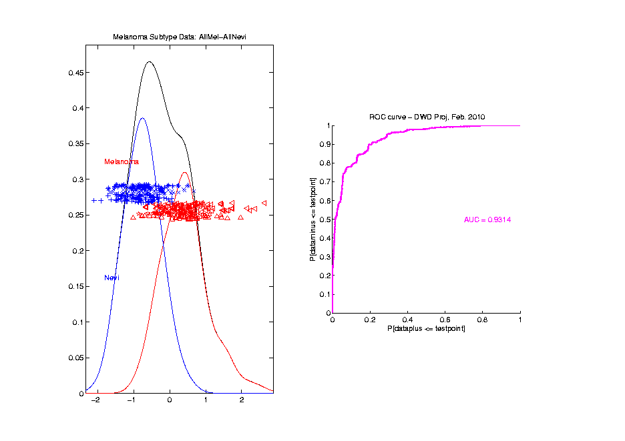
Melanoma Data
Full Data
ROC
Analysis
AUC = 0.93

Slide 72
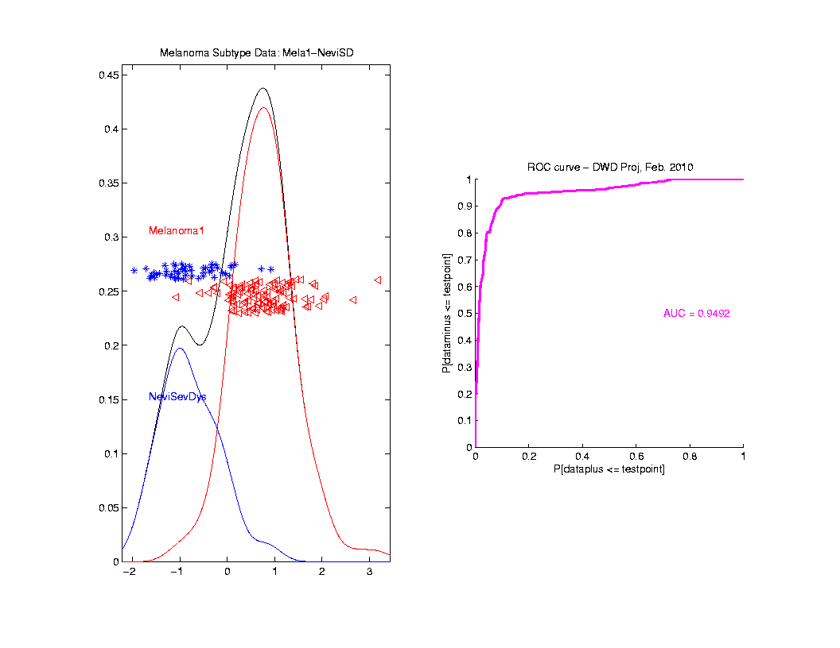
Melanoma Data
SubClass
ROC
Analysis
AUC = 0.95
Better,
Makes
Intuitive
Sense

Slide 73
Melanoma Data
What About Other Subclasses?
Looked at Several
Best Separation Was:
Melanoma 2 vs. Conventional Nevi

Slide 74
Melanoma Data
Full
Data
PCA

Slide 75
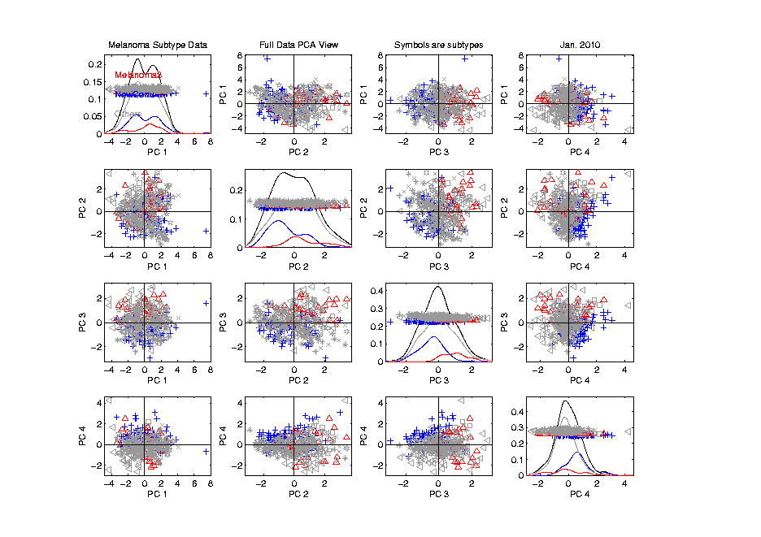
Melanoma Data
Full
Data
PCA
Gray
Out
All
But
Subclasses

Slide 76
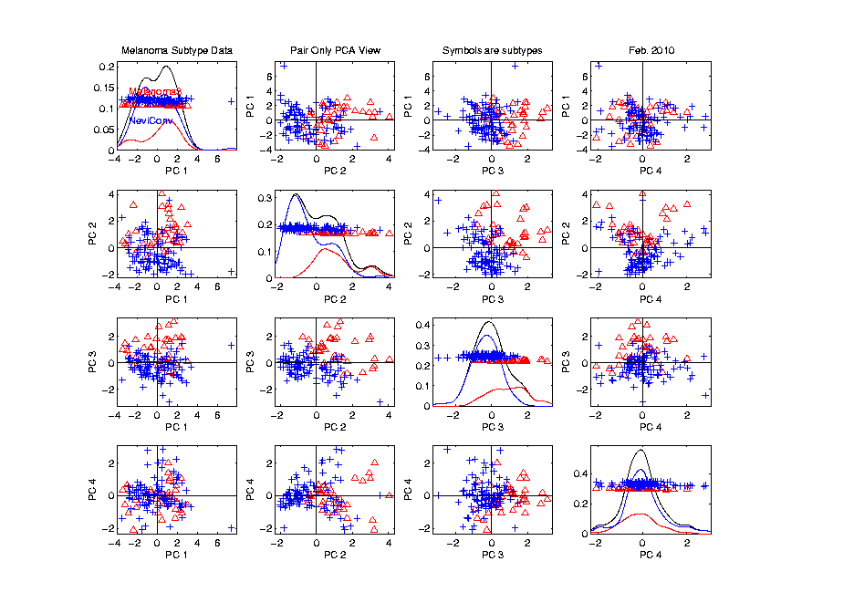
Melanoma Data
Rotate to
SubClass
PCA

Slide 77
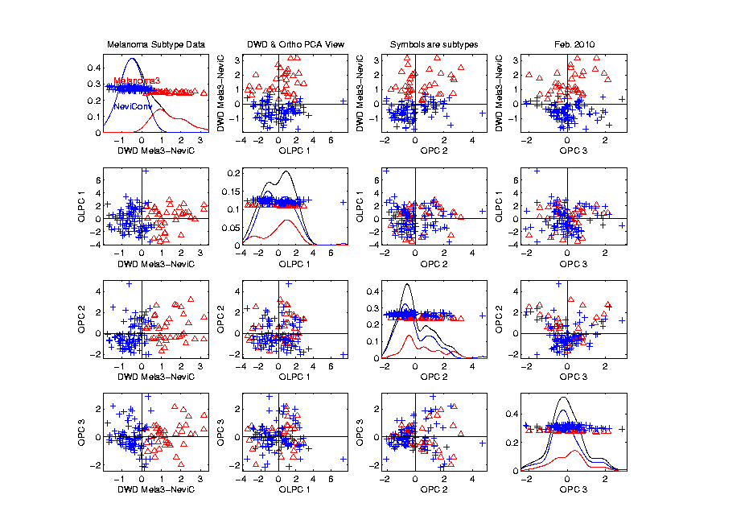
Melanoma Data
Rotate to
SubClass
DWD

Slide 78
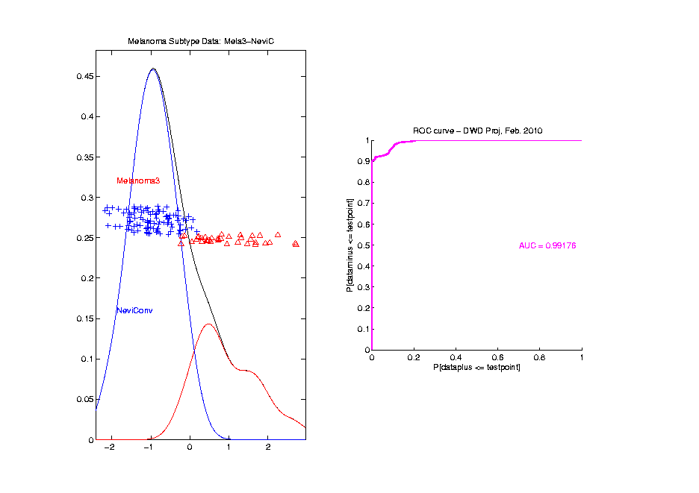
Melanoma Data
ROC
Analysis
AUC = 0.99

Slide 79
Clustering
Idea: Given data
Assign each object to a class

Slide 80
Clustering
Idea: Given data
Assign each object to a class
Of similar objects
Completely data driven

Slide 81
Clustering
Idea: Given data
Assign each object to a class
Of similar objects
Completely data driven
I.e. assign labels to data
“Unsupervised Learning”

Slide 82
Clustering
Idea: Given data
Assign each object to a class
Of similar objects
Completely data driven
I.e. assign labels to data
“Unsupervised Learning”
Contrast to Classification (Discrimination)
With predetermined classes
“Supervised Learning”

Slide 83
Clustering
Important References:
MacQueen (1967)
Hartigan (1975)
Gersho and Gray (1992)
Kaufman and Rousseeuw (2005)

Slide 84
K-means Clustering
Main Idea: for data
Partition indices
among classes

Slide 85
K-means Clustering
Main Idea: for data
Partition indices
among classes
Given index sets
that partition

Slide 86
K-means Clustering
Main Idea: for data
Partition indices
among classes
Given index sets
that partition
represent clusters by “class means”
i.e, (within class means)

Slide 87
K-means Clustering
Given index sets
Measure how well clustered, using
Within Class Sum of Squares

Slide 88
K-means Clustering
Common Variation:
Put on scale of proportions (i.e. in [0,1])

Slide 89
K-means Clustering
Common Variation:
Put on scale of proportions (i.e. in [0,1])
By dividing “within class SS”
by “overall SS”

Slide 90
K-means Clustering
Common Variation:
Put on scale of proportions (i.e. in [0,1])
By dividing “within class SS”
by “overall SS”
Gives Cluster Index:

Slide 91
K-means Clustering
Notes on Cluster Index:
CI = 0 when all data at cluster means

Slide 92
K-means Clustering
Notes on Cluster Index:
CI = 0 when all data at cluster means
CI small when gives tight clustering
(within SS contains little variation)

Slide 93
K-means Clustering
Notes on Cluster Index:
CI = 0 when all data at cluster means
CI small when gives tight clustering
(within SS contains little variation)
CI big when gives poor clustering
(within SS contains most of variation)

Slide 94
K-means Clustering
Notes on Cluster Index:
CI = 0 when all data at cluster means
CI small when gives tight clustering
(within SS contains little variation)
CI big when gives poor clustering
(within SS contains most of variation)
CI = 1 when all cluster means are same

Slide 95
K-means Clustering
Clustering Goal:
Given data
Choose classes
To miminize

Slide 96
2-means Clustering
Study CI, using simple 1-d examples
Varying Standard Deviation

Slide 97
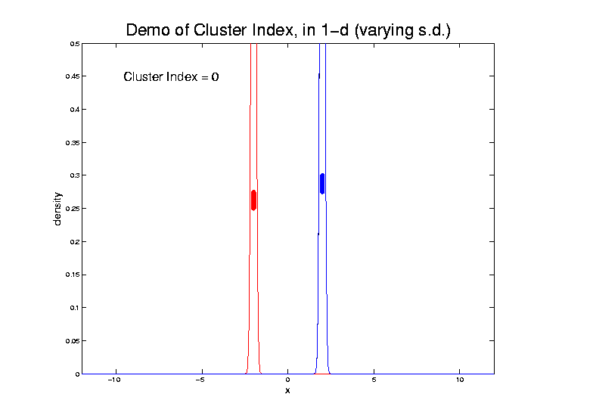
2-means Clustering

Slide 98
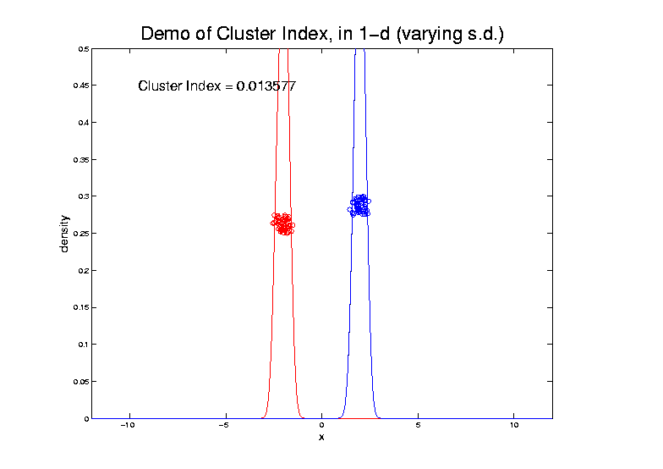
2-means Clustering

Slide 99
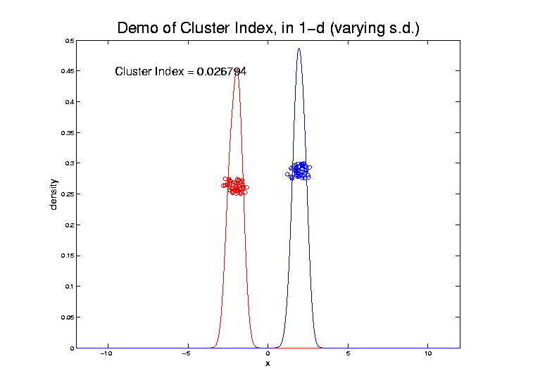
2-means Clustering

Slide 100
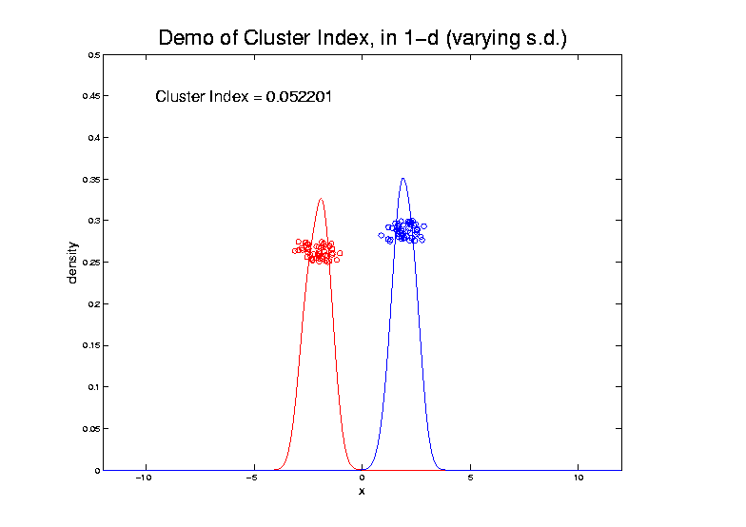
2-means Clustering

Slide 101
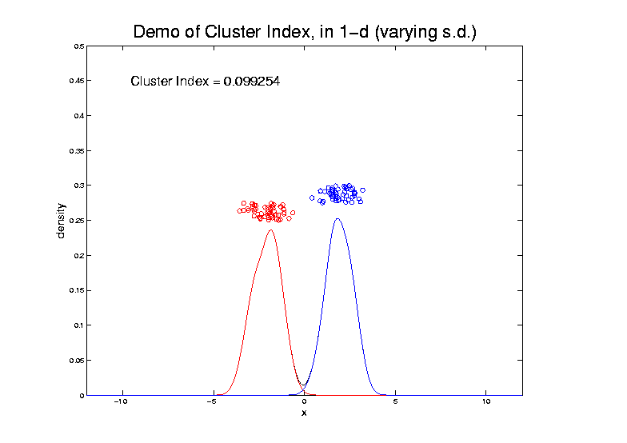
2-means Clustering

Slide 102
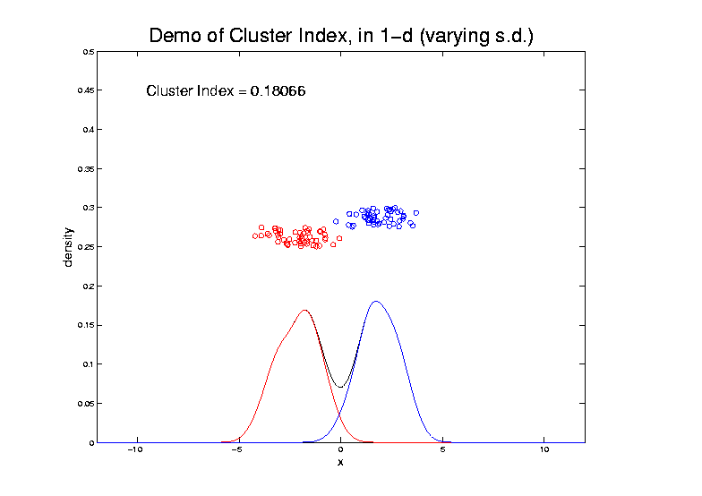
2-means Clustering

Slide 103
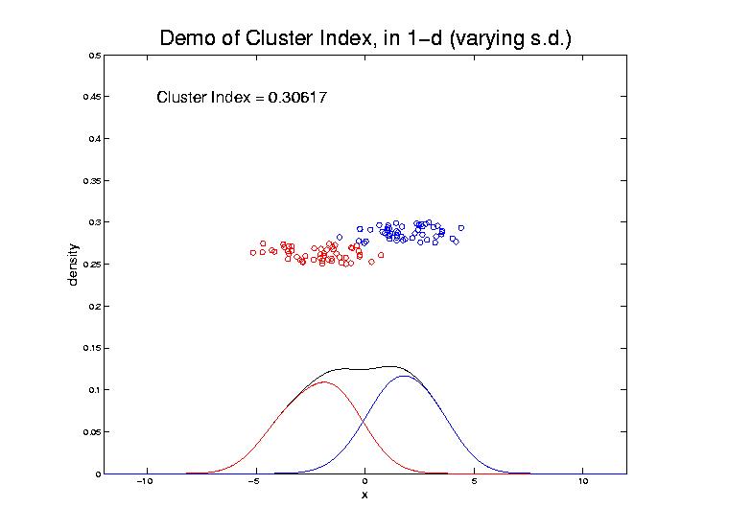
2-means Clustering

Slide 104
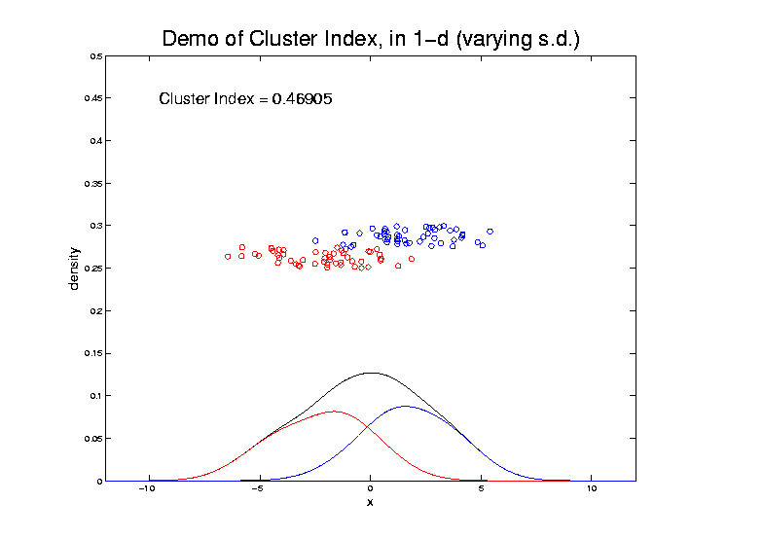
2-means Clustering

Slide 105
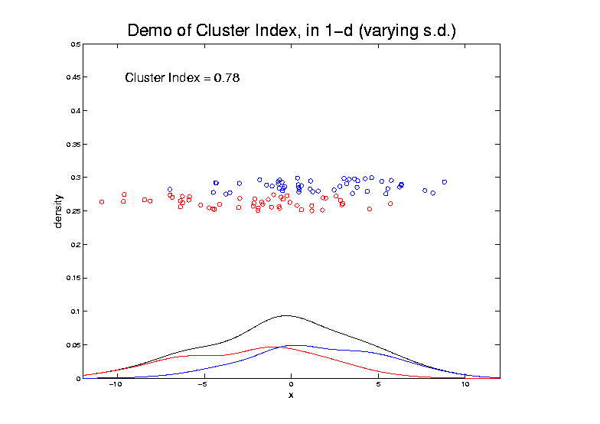
2-means Clustering

Slide 106
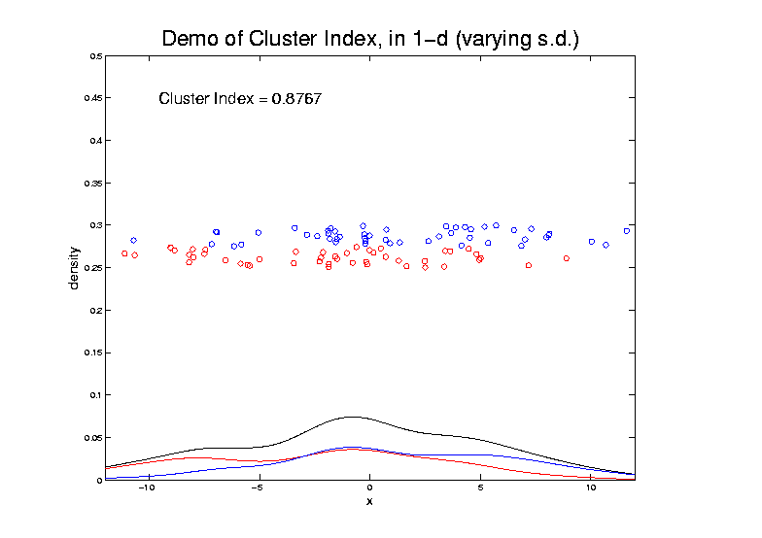
2-means Clustering

Slide 107
2-means Clustering
Study CI, using simple 1-d examples
Varying Standard Deviation
Varying Mean

Slide 108
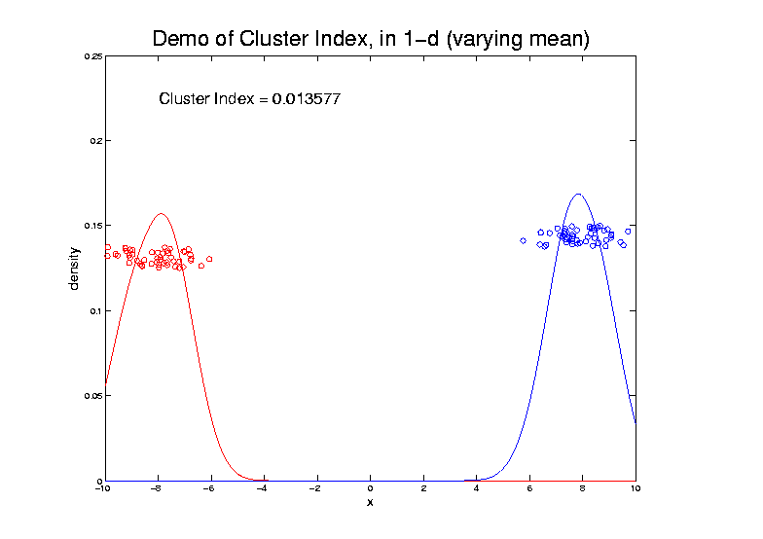
2-means Clustering

Slide 109
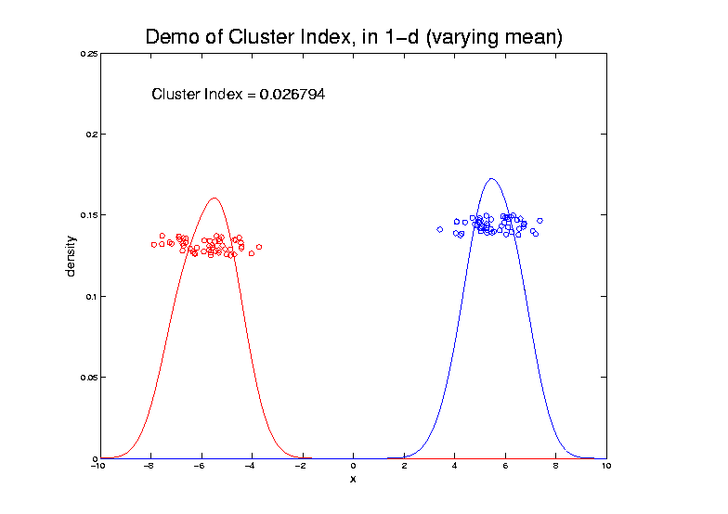
2-means Clustering

Slide 110
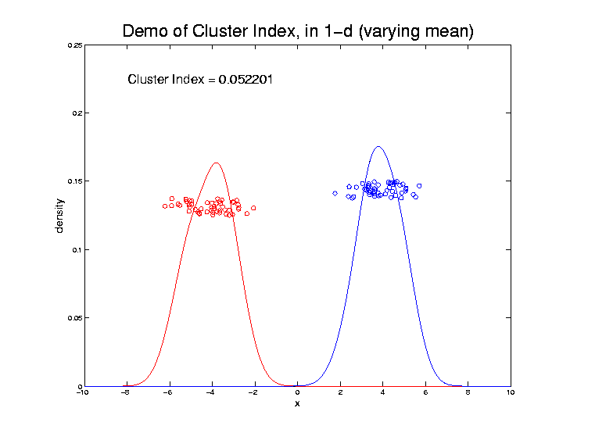
2-means Clustering

Slide 111
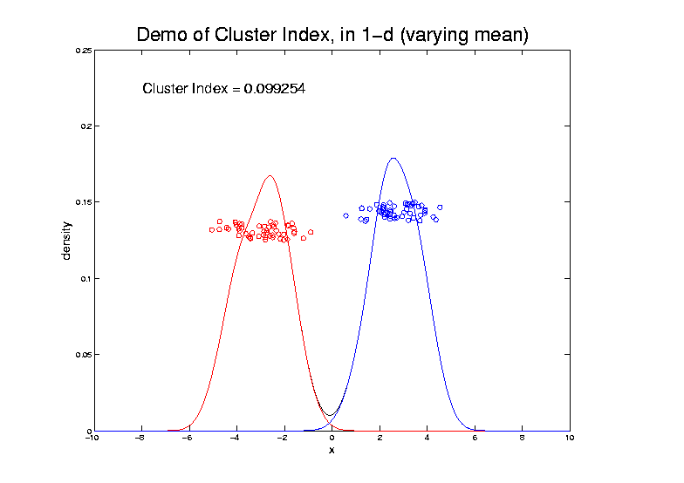
2-means Clustering

Slide 112
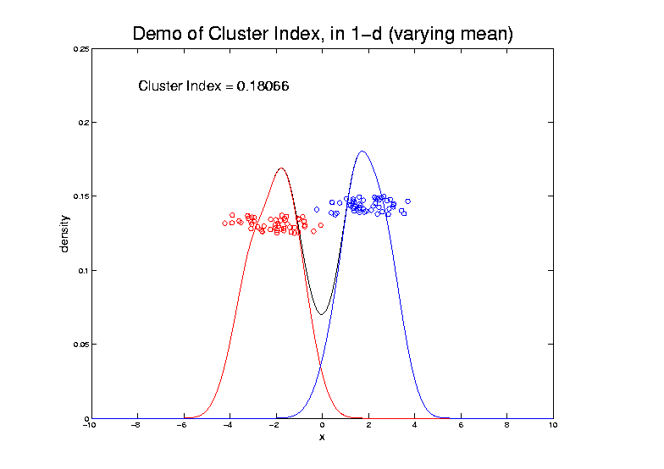
2-means Clustering

Slide 113
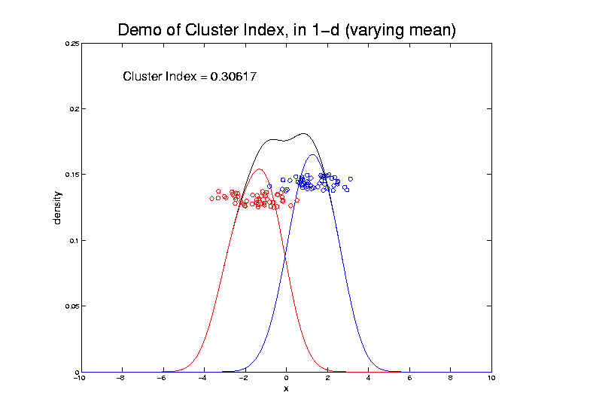
2-means Clustering

Slide 114
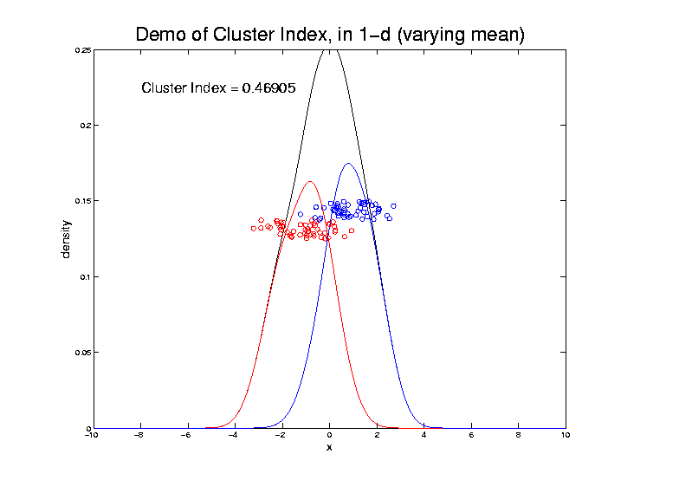
2-means Clustering

Slide 115
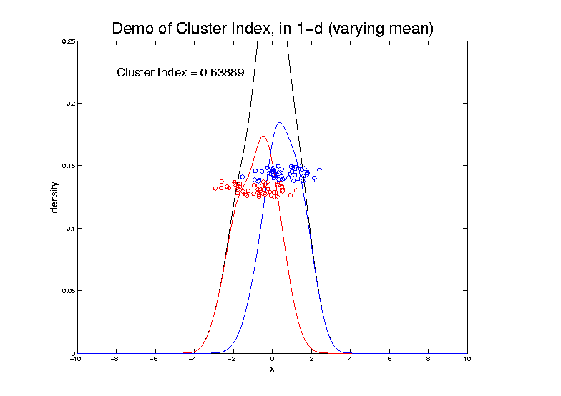
2-means Clustering

Slide 116
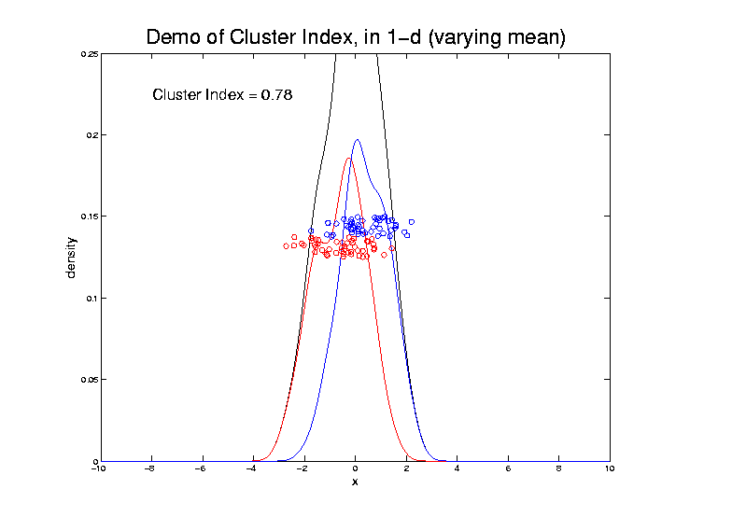
2-means Clustering

Slide 117
2-means Clustering

Slide 118
2-means Clustering

Slide 119
2-means Clustering

Slide 120
2-means Clustering
Study CI, using simple 1-d examples
Varying Standard Deviation
Varying Mean
Varying Proportion

Slide 121
2-means Clustering

Slide 122
2-means Clustering

Slide 123
2-means Clustering

Slide 124
2-means Clustering

Slide 125
2-means Clustering

Slide 126
2-means Clustering

Slide 127
2-means Clustering

Slide 128
2-means Clustering

Slide 129
2-means Clustering

Slide 130
2-means Clustering

Slide 131
2-means Clustering

Slide 132
2-means Clustering

Slide 133
2-means Clustering

Slide 134
2-means Clustering

Slide 135
2-means Clustering
Study CI, using simple 1-d examples
Over changing Classes (moving b’dry)

Slide 136
2-means Clustering

Slide 137
2-means Clustering

Slide 138
2-means Clustering

Slide 139
2-means Clustering

Slide 140
2-means Clustering

Slide 141
2-means Clustering

Slide 142
2-means Clustering

Slide 143
2-means Clustering

Slide 144
2-means Clustering

Slide 145
2-means Clustering

Slide 146
2-means Clustering
Study CI, using simple 1-d examples
Over changing Classes (moving b’dry)
Multi-modal data → interesting effects
Multiple local minima (large number)
Maybe disconnected
Optimization (over ) can be tricky…
(even in 1 dimension, with K = 2)

Slide 147
2-means Clustering

Slide 148
2-means Clustering
Study CI, using simple 1-d examples
Over changing Classes (moving b’dry)
Multi-modal data → interesting effects
Can have 4 (or more) local mins
(even in 1 dimension, with K = 2)

Slide 149
2-means Clustering

Slide 150
2-means Clustering
Study CI, using simple 1-d examples
Over changing Classes (moving b’dry)
Multi-modal data → interesting effects
Local mins can be hard to find
i.e. iterative procedures can “get stuck”
(even in 1 dimension, with K = 2)

Slide 151
2-means Clustering
Study CI, using simple 1-d examples
Effect of a single outlier?

Slide 152
2-means Clustering

Slide 153
2-means Clustering

Slide 154
2-means Clustering

Slide 155
2-means Clustering

Slide 156
2-means Clustering

Slide 157
2-means Clustering

Slide 158
2-means Clustering

Slide 159
2-means Clustering

Slide 160
2-means Clustering

Slide 161
2-means Clustering

Slide 162
2-means Clustering

Slide 163
2-means Clustering
Study CI, using simple 1-d examples
Effect of a single outlier?
Can create local minimum
Can also yield a global minimum
This gives a one point class
Can make CI arbitrarily small
(really a “good clustering”???)

