Slide 1
Return to Big Picture
Main statistical goals of OODA:
Understanding population structure
Low dim’al Projections, PCA …
Classification (i. e. Discrimination)
Understanding 2+ populations
Time Series of Data Objects
Chemical Spectra, Mortality Data
“Vertical Integration” of Data Types

Slide 2
SVMs, Tuning Parameter
Toy Example:
d = 50, Spherical Gaussian data
X=Axis: Opt. Dir’n Other: SVM Dir’n
Small C:
Where is the margin?
Small angle to optimal (generalizable)
Large C:
More data piling
Larger angle (less generalizable)
Bigger gap (but maybe not better???)
Between: Very small range

Slide 3
Distance Weighted Discrim’n
Improvement of SVM for HDLSS Data
Toy e.g.
(similar to
earlier movie)

Slide 4
Distance Weighted Discrim’n
Toy e.g.: Maximal Data Piling Direction
- Perfect
Separation
- Gross
Overfitting
- Large Angle
- Poor
Gen’ability
MDP

Slide 5
Distance Weighted Discrim’n
Toy e.g.: Support Vector Machine Direction
- Bigger Gap
- Smaller Angle
- Better
Gen’ability
- Feels support
vectors too
strongly???
- Ugly subpops?
- Improvement?

Slide 6
Distance Weighted Discrim’n
Toy e.g.: Distance Weighted Discrimination
- Addresses
these issues
- Smaller Angle
- Better
Gen’ability
- Nice subpops
- Replaces
min dist. by
avg. dist.

Slide 7
Distance Weighted Discrim’n
2-d Visualization:
Pushes Plane
Away From
Data
All Points
Have Some
Influence
(not just support vectors)

Slide 8
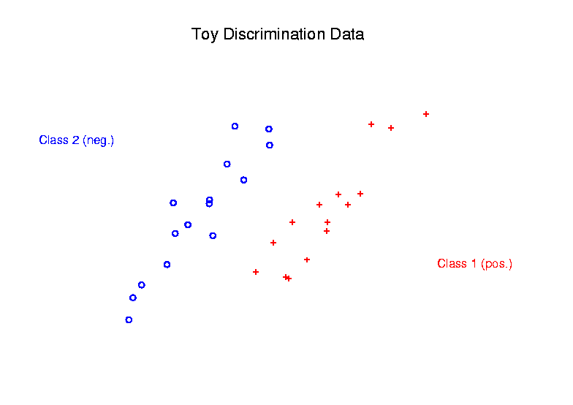
Support Vector Machines
Graphical View, using Toy Example:

Slide 9
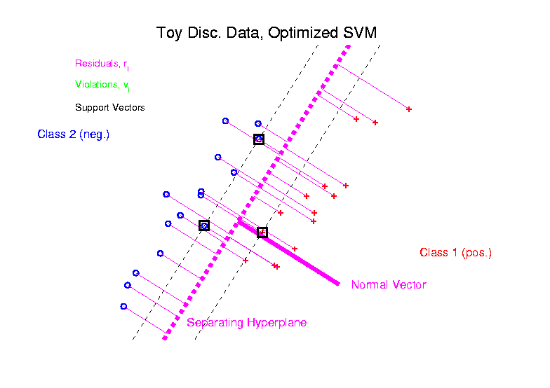
Support Vector Machines
Graphical View, using Toy Example:

Slide 10
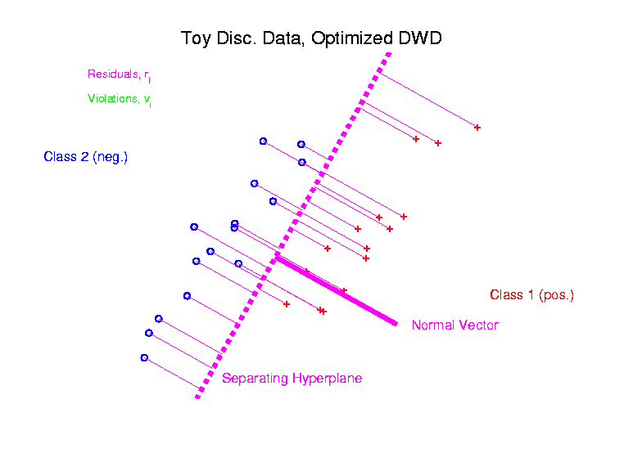
Distance Weighted Discrim’n
Graphical View, using Toy Example:

Slide 11
Source Batch Adj: PC 1-3 & DWD direction

Slide 12
Source Batch Adj: DWD Source Adjustment

Slide 13
Why not adjust by means?
DWD is complicated: value added?
Because it is “cool”
Recall Improves SVM for HDLSS
Good Empirical Success
Routinely Used in Perou Lab
Many Comparisons Done
Similar Lessons from Wistar
Proven Statistical Power

Slide 14
Why not adjust by means?
But Why Not PAM (~Mean Difference)?
Simpler is Better
Why not means, i.e. point cloud centerpoints?
Drawback to PAM:
Poor Handling of Unbalanced Biological Subtypes
DWD more Resistant to Unbalance

Slide 15
DWD in Face Recognition
Face Images as Data
(with M. Benito & D. Peña)
Male – Female Difference?
Discrimination Rule?
Represented as long vector of pixel gray levels
Registration is critical

Slide 16
DWD in Face Recognition, (cont.)
Registered Data
Shifts and scale
Manually chosen
To align eyes and mouth
Still large variation
See males vs. females???

Slide 17
DWD in Face Recognition , (cont.)
DWD Direction
Good separation
Images “make sense”
Garbage at ends?
(extrapolation effects?)

Slide 18
DWD in Face Recognition , (cont.)
Unregistered Version
Much blurrier
Since features don’t properly line up
Nonlinear Variation
But DWD still works
Can see M-F differ’ce?

