Slide 1
Return to Big Picture
Main statistical goals of OODA:
Understanding population structure
  Low dim’al Projections, PCA …
Classification (i. e. Discrimination)
  Understanding 2+ populations
Time Series of Data Objects
  Chemical Spectra, Mortality Data
“Vertical Integration” of Data Types

Slide 2
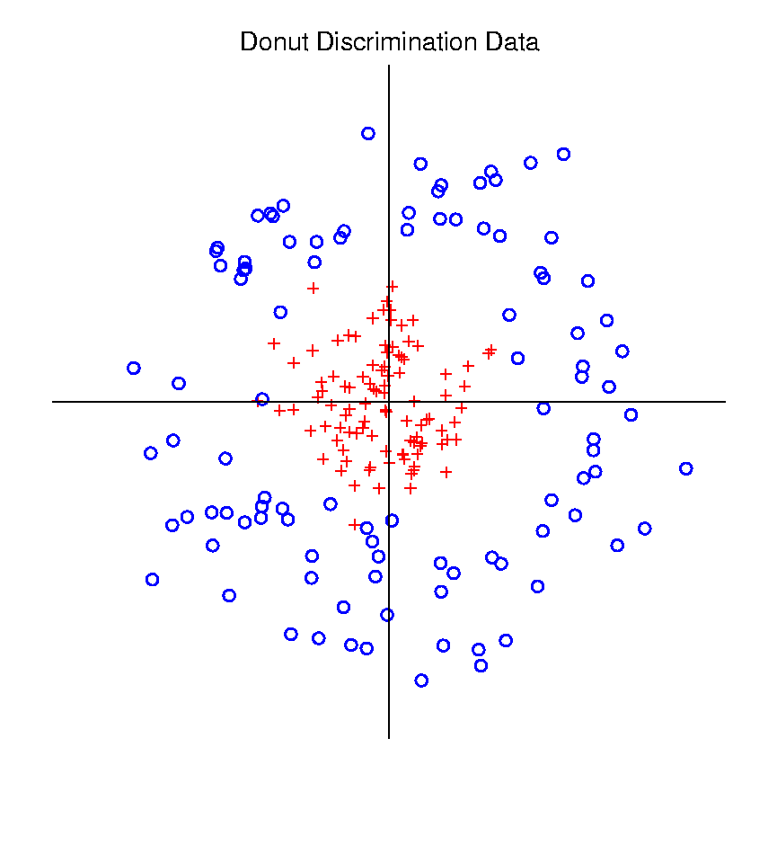
Kernel Embedding
Polynomial Embedding, Toy Example 3:
Donut
Notes:
PEod1Raw.ps

Slide 3
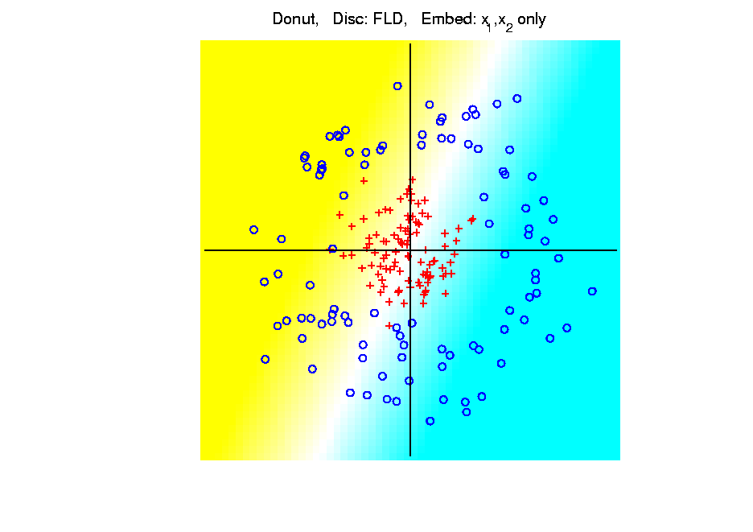
Kernel Embedding
Polynomial Embedding, Toy Example 3:
Donut
FLD
Original
Data
Very
Bad
Notes:
PEod1Raw.ps

Slide 4
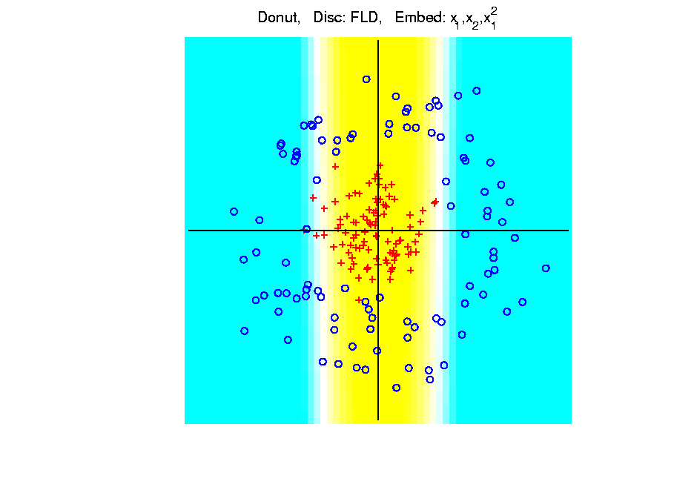
Kernel Embedding
Polynomial Embedding, Toy Example 3:
Donut
FLD
Somewhat
Better
(Parabolic Fold)
Notes:
PEod1Raw.ps

Slide 5
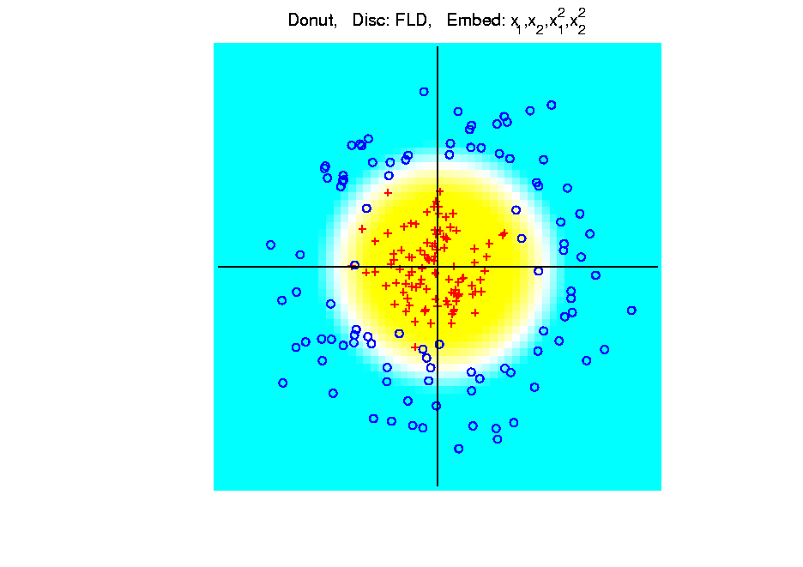
Kernel Embedding
Polynomial Embedding, Toy Example 3:
Donut
FLD
Good
Performance
(Slice of
Paraboloid)
Notes:
PEod1Raw.ps

Slide 6
Kernel Embedding
Hot Topic Variation: “Kernel Machines”
Idea: replace polynomials by
other nonlinear functions
e.g. 1: sigmoid functions from neural nets
e.g. 2: radial basis functions
Gaussian kernels
Related to “kernel density estimation”
(recall: smoothed histogram)

Slide 7
Kernel Embedding
Radial Basis Functions:
Note: there are several ways to embed:
Naïve Embedding (equally spaced grid)
Explicit Embedding (evaluate at data)
Implicit Emdedding (inner prod. based)
(everybody currently does the latter)

Slide 8
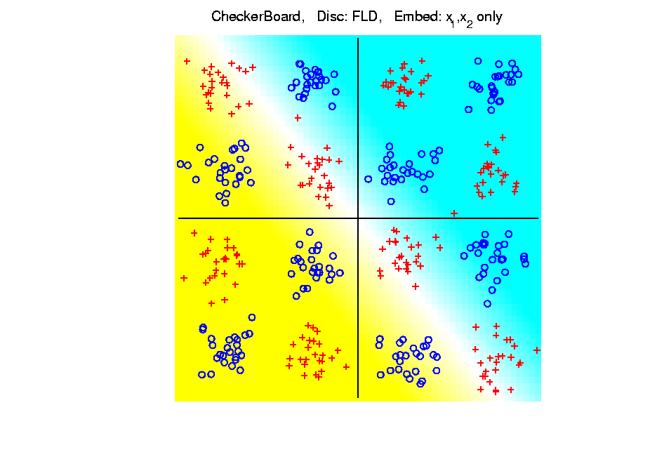
Kernel Embedding
Toy Example 4: Checkerboard
Very
Challenging!
FLD
Linear Is
Hopeless
Notes:
PEod1Raw.ps

Slide 9
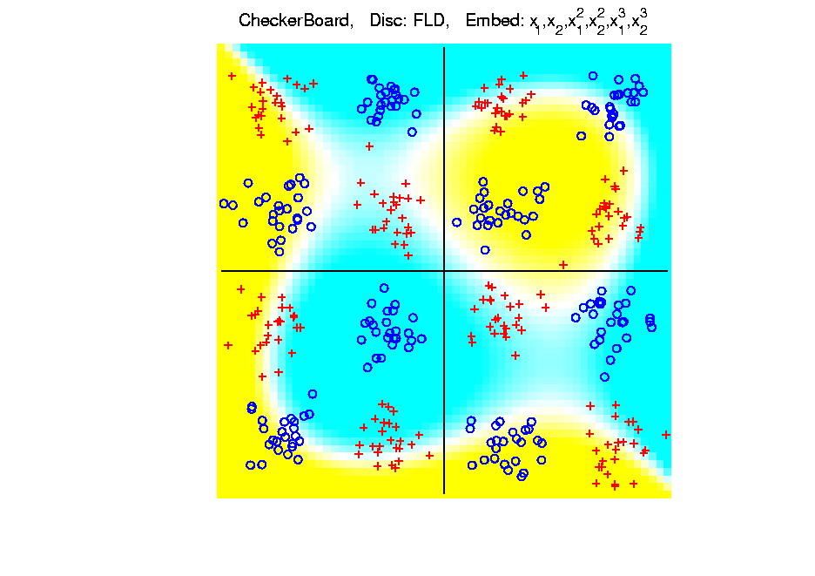
Kernel Embedding
Toy Example 4: Checkerboard
Very
Challenging!
Polynomials
Don’t Have
Needed
Flexiblity
Notes:
PEod1Raw.ps

Slide 10
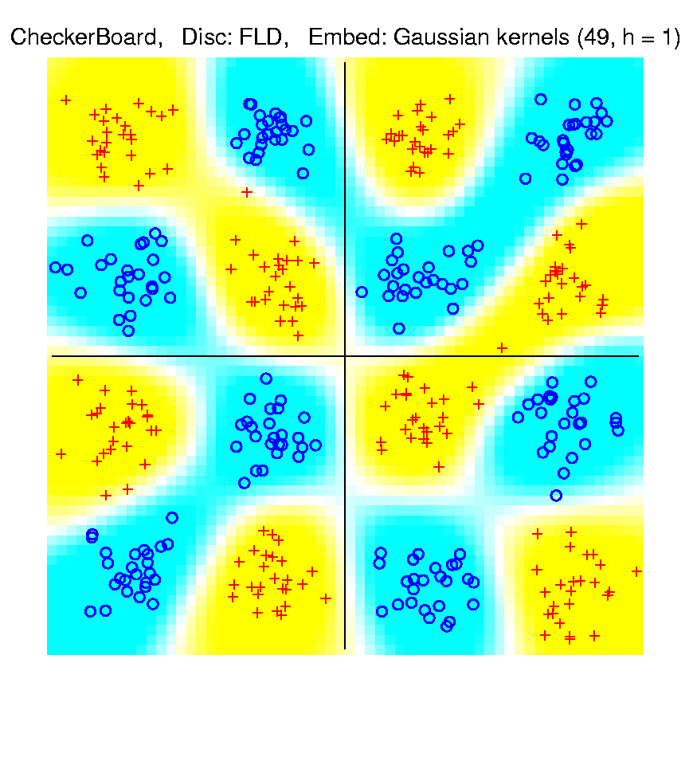
Kernel Embedding
Toy Example 4: Checkerboard
Radial
Basis
Embedding
+ FLD
Is
Excellent!
Notes:
PEod1Raw.ps

Slide 11
Kernel Embedding
Drawbacks to naïve embedding:
Equally spaced grid too big in high d
Not computationally tractable (g^{d})
Approach:
Evaluate only at data points
Not on full grid
But where data live

Slide 12
Support Vector Machines
Motivation:
Find a linear method that “works well”
for embedded data
Note: Embedded data are
very non-Gaussian
Classical Statistics: “Use Prob. Dist’n”
Looks Hopeless

Slide 13
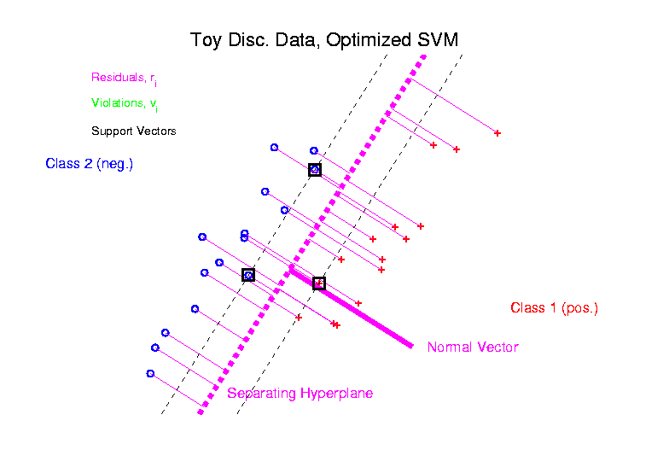
Support Vector Machines
Graphical View, using Toy Example:

Slide 14
SVMs, Optimization Viewpoint
Lagrange Multipliers primal formulation (separable case):
Minimize:
Where are Lagrange multipliers
Dual Lagrangian version:
Maximize:
Get classification function:

Slide 15
SVMs, Computation
Major Computational Point:
Classifier only depends on data through inner products!
Thus enough to only store inner products
Creates big savings in optimization
Especially for HDLSS data
But also creates variations in kernel embedding (interpretation?!?)
This is almost always done in practice

Slide 16
SVMs, Comput’n & Embedding
For an “Embedding Map”,
e.g.
Explicit Embedding:
Maximize:
Get classification function:
Straightforward application of embedding
But loses inner product advantage

Slide 17
SVMs, Comput’n & Embedding
Implicit Embedding:
Maximize:
Get classification function:
Still defined only via inner products
Retains optimization advantage
Thus used very commonly
Comparison to explicit embedding?
Which is “better”???

Slide 18
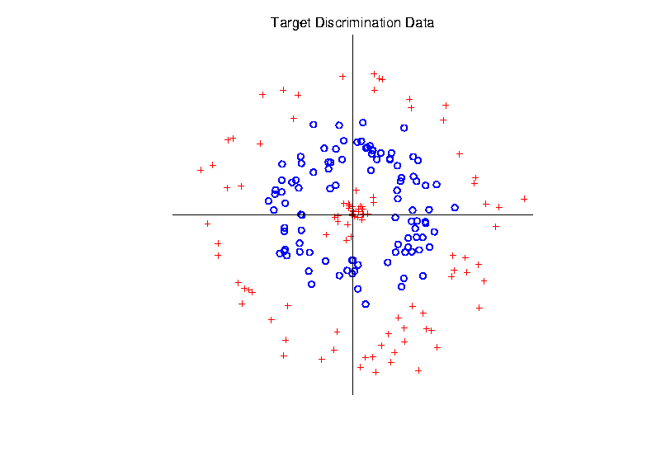
Support Vector Machines
Target Toy Data set:

Slide 19
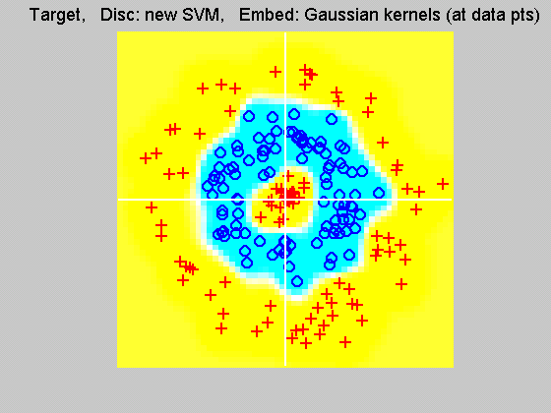
Support Vector Machines
Explicit Embedding, window σ = 0.1:
Gaussian
Kernel,
i.e.
Radial
Basis
Function

Slide 20
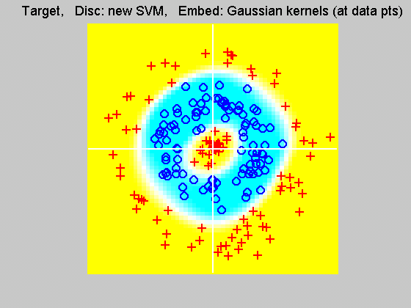
Support Vector Machines
Explicit Embedding, window σ = 1:
Pretty Big
Change
(Factor
of 10)

Slide 21
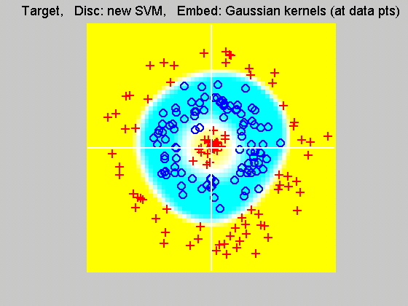
Support Vector Machines
Explicit Embedding, window σ = 10:
Not Quite
As Good
???

Slide 22
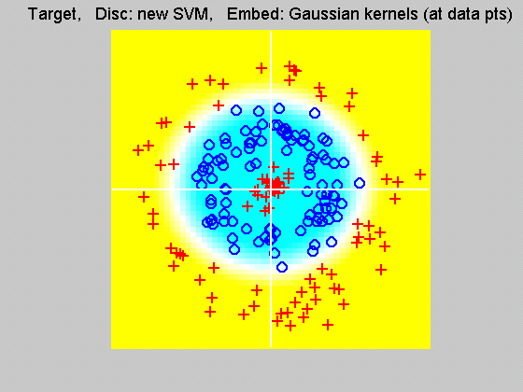
Support Vector Machines
Explicit Embedding, window σ = 100:
Note: Lost Center
(Over- Smoothed)

Slide 23
Support Vector Machines
Interesting Alternative Viewpoint:
Study Projections
In Kernel Space
(Never done in Machine Learning World)

Slide 24
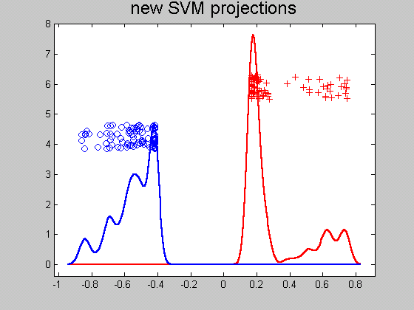
Support Vector Machines
Kernel space projection, window σ = 0.1:
Note:
Data
Piling
At
Margin

Slide 25
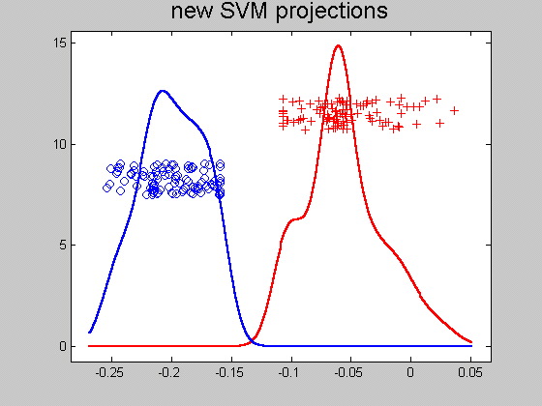
Support Vector Machines
Kernel space projection, window σ = 1:
Excellent
Separation
(but less
than σ = 0.1)

Slide 26
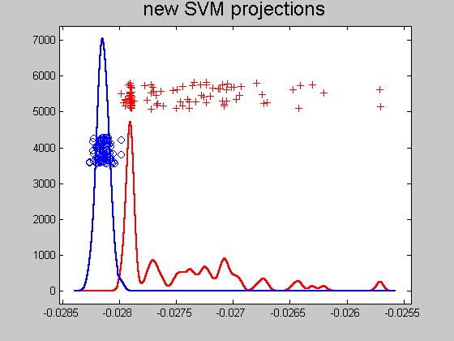
Support Vector Machines
Kernel space projection, window σ = 10:
Still Good
(But Some
Overlap)

Slide 27
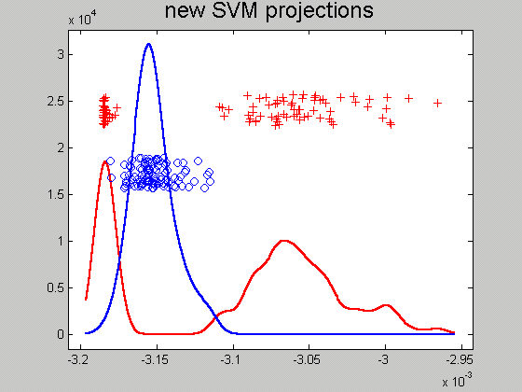
Support Vector Machines
Kernel space projection, window σ = 100:
Some Reds
On Wrong
Side
(Missed
Center)

Slide 28
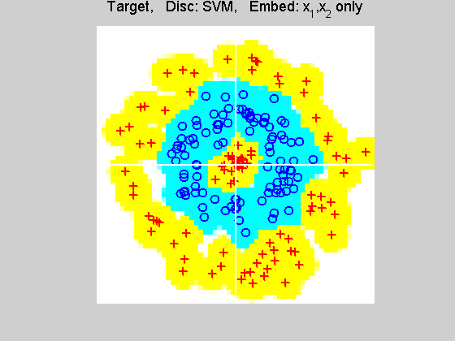
Support Vector Machines
Implicit Embedding, window σ = 0.1:

Slide 29
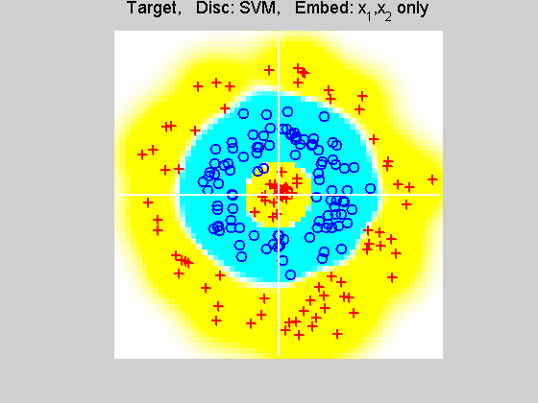
Support Vector Machines
Implicit Embedding, window σ = 0.5:

Slide 30
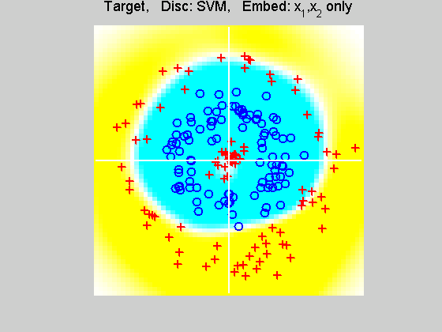
Support Vector Machines
Implicit Embedding, window σ = 1:

Slide 31
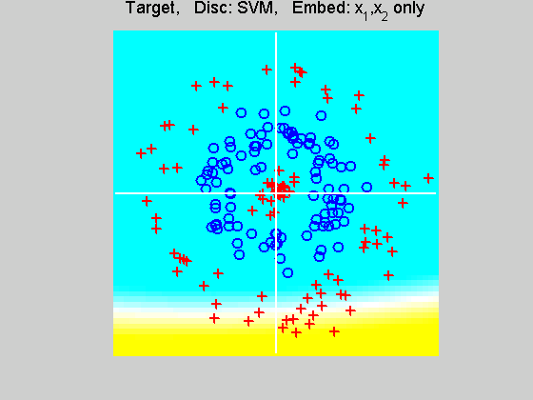
Support Vector Machines
Implicit Embedding, window σ = 10:

Slide 32
Support Vector Machines
Notes on Implicit Embedding:
Similar Large vs. Small lessons
Range of “reasonable results”
Seems to be smaller
(note different range of windows)
Much different “edge” behavior
Interesting topic for future work…

Slide 33
SVMs & Robustness
Usually not severely affected by outliers,
But a possible weakness:
Can have very influential points
Toy E.g., only 2 points drive SVM

Slide 34
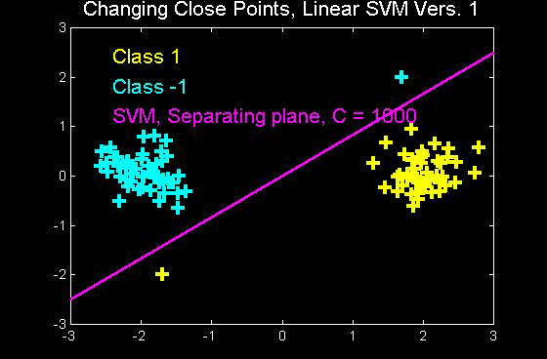
SVMs & Robustness
Can have very influential points

Slide 35
SVMs & Robustness
Usually not severely affected by outliers,
But a possible weakness:
Can have very influential points
Toy E.g., only 2 points drive SVM
Notes:
Huge range of chosen hyperplanes

Slide 36
SVMs & Robustness
Usually not severely affected by outliers,
But a possible weakness:
Can have very influential points
Toy E.g., only 2 points drive SVM
Notes:
Huge range of chosen hyperplanes
But all are “pretty good discriminators”

Slide 37
SVMs & Robustness
Usually not severely affected by outliers,
But a possible weakness:
Can have very influential points
Toy E.g., only 2 points drive SVM
Notes:
Huge range of chosen hyperplanes
But all are “pretty good discriminators”
Only happens when whole range is OK???
Good or bad?

Slide 38
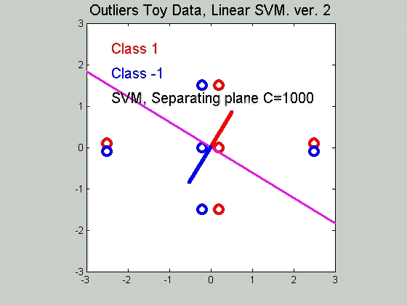
SVMs & Robustness
Effect of violators:

Slide 39
SVMs, Tuning Parameter
Recall Regularization Parameter C:
Controls penalty for violation
I.e. lying on wrong side of plane
Appears in slack variables
Affects performance of SVM
Toy Example:
d = 50, Spherical Gaussian data

Slide 40
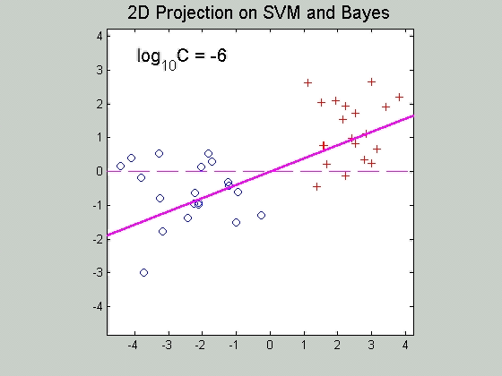
SVMs, Tuning Parameter
Toy Example: d = 50, Sph’l Gaussian data

Slide 41
SVMs, Tuning Parameter
Toy Example:
d = 50, Spherical Gaussian data
X=Axis: Opt. Dir’n Other: SVM Dir’n

Slide 42
SVMs, Tuning Parameter
Toy Example:
d = 50, Spherical Gaussian data
X=Axis: Opt. Dir’n Other: SVM Dir’n
Small C:
  Where is the margin?
  Small angle to optimal (generalizable)

Slide 43
SVMs, Tuning Parameter
Toy Example:
d = 50, Spherical Gaussian data
X=Axis: Opt. Dir’n Other: SVM Dir’n
Small C:
  Where is the margin?
  Small angle to optimal (generalizable)
Large C:
  More data piling
  Larger angle (less generalizable)
  Bigger gap (but maybe not better???)

Slide 44
SVMs, Tuning Parameter
Toy Example:
d = 50, Spherical Gaussian data
X=Axis: Opt. Dir’n Other: SVM Dir’n
Small C:
  Where is the margin?
  Small angle to optimal (generalizable)
Large C:
  More data piling
  Larger angle (less generalizable)
  Bigger gap (but maybe not better???)
Between: Very small range

Slide 45
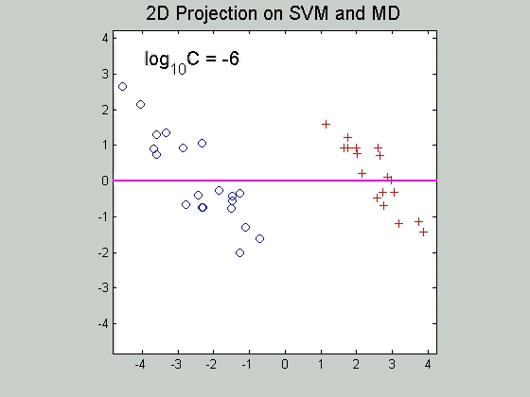
SVMs, Tuning Parameter
Toy Example: d = 50, Sph’l Gaussian data
Put MD on horizontal axis

Slide 46
SVMs, Tuning Parameter
Toy Example:
d = 50, Spherical Gaussian data
Careful look at small C:
Put MD on horizontal axis

Slide 47
SVMs, Tuning Parameter
Toy Example:
d = 50, Spherical Gaussian data
Careful look at small C:
Put MD on horizontal axis
Shows SVM and MD same for C small
  Mathematics behind this?

Slide 48
SVMs, Tuning Parameter
Toy Example:
d = 50, Spherical Gaussian data
Careful look at small C:
Put MD on horizontal axis
Shows SVM and MD same for C small
  Mathematics behind this?
Separates for large C
  No data piling for MD

Slide 49
Support Vector Machines
Important Extension:
Multi-Class SVMs
Hsu & Lin (2002)
Lee, Lin, & Wahba (2002)
Defined for “implicit” version
“Direction Based” variation???

Slide 50
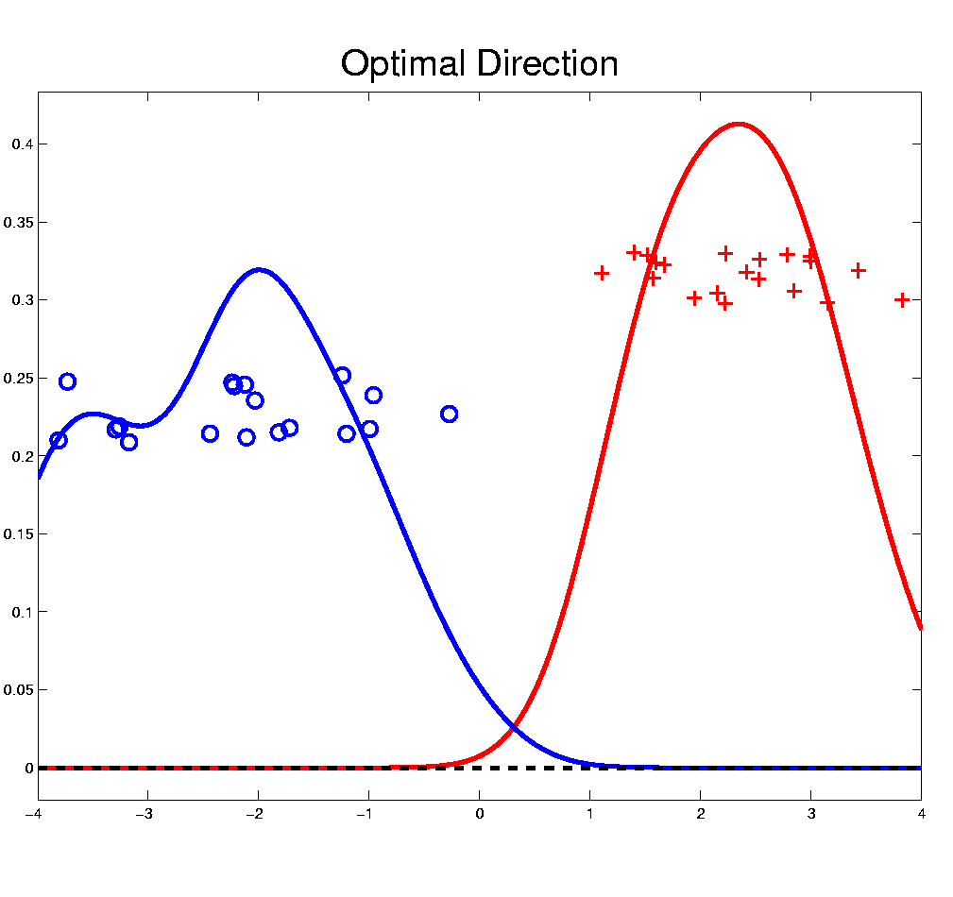
Distance Weighted Discrim’n
Improvement of SVM for HDLSS Data
Toy e.g.
(similar to
earlier movie)

Slide 51
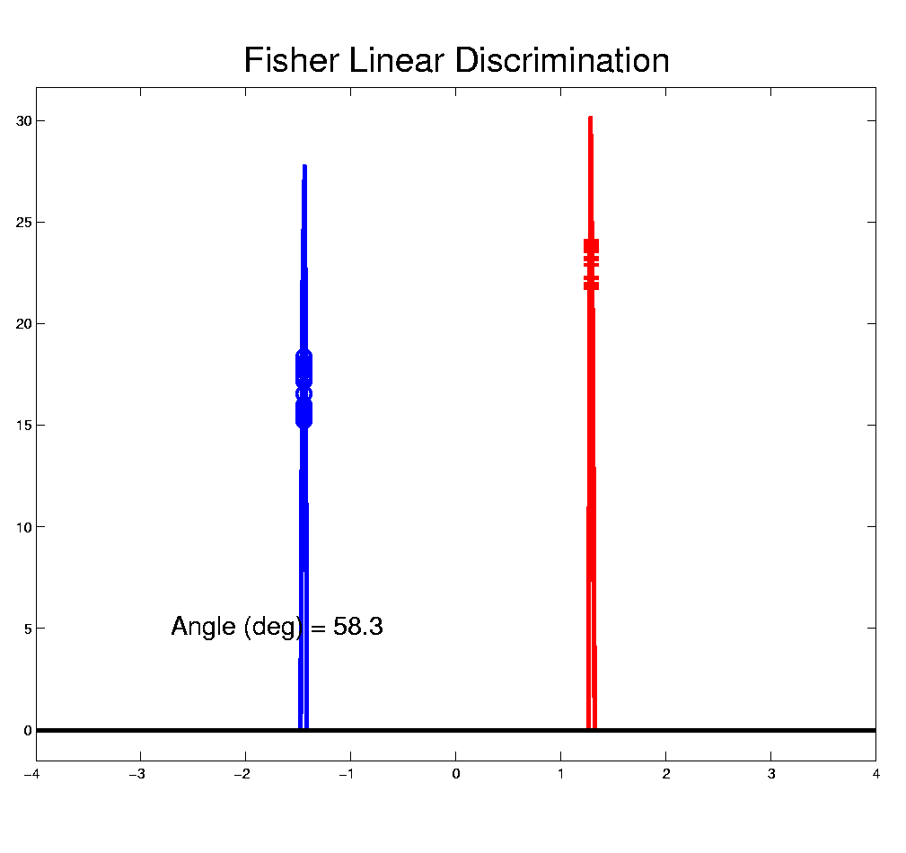
Distance Weighted Discrim’n
Toy e.g.: Maximal Data Piling Direction
- Perfect
Separation
- Gross
Overfitting
- Large Angle
- Poor
Gen’ability
MDP

Slide 52
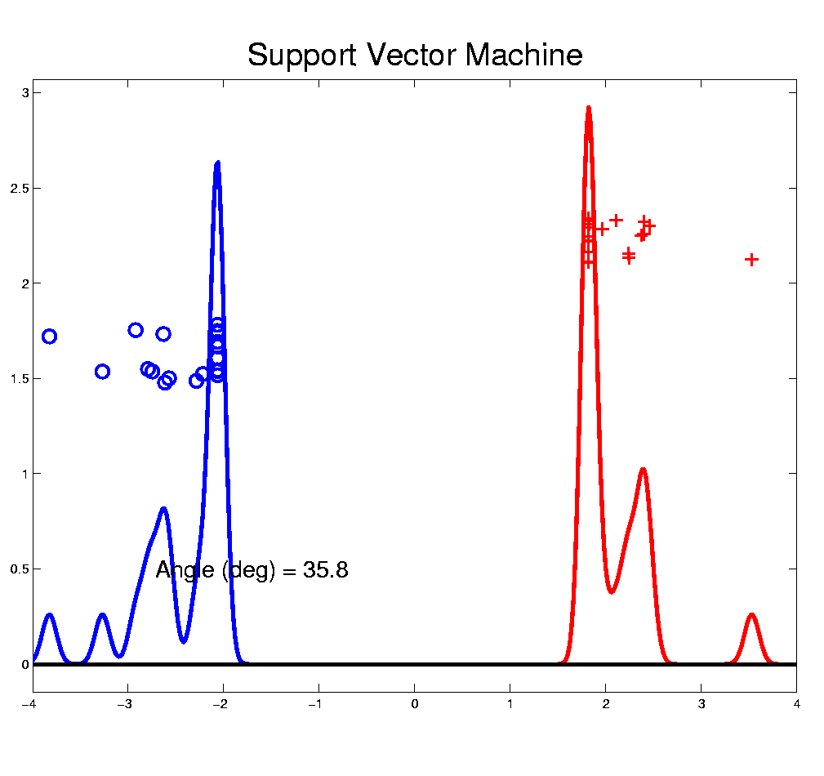
Distance Weighted Discrim’n
Toy e.g.: Support Vector Machine Direction
- Bigger Gap
- Smaller Angle
- Better
Gen’ability
- Feels support
vectors too
strongly???
- Ugly subpops?
- Improvement?

Slide 53
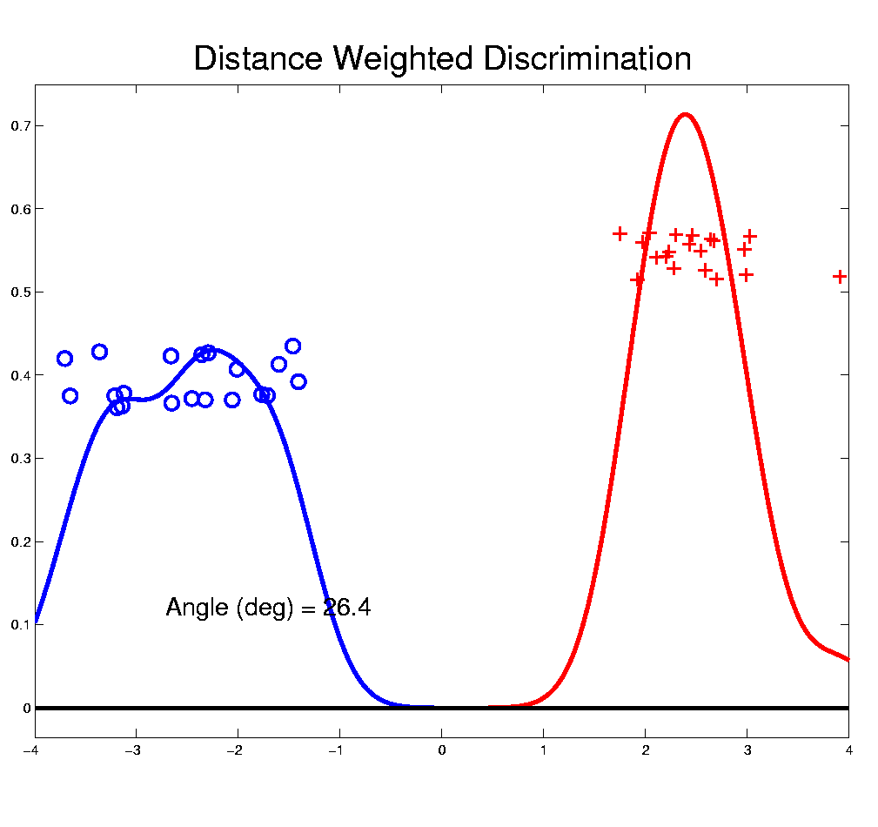
Distance Weighted Discrim’n
Toy e.g.: Distance Weighted Discrimination
- Addresses
these issues
- Smaller Angle
- Better
Gen’ability
- Nice subpops
- Replaces
min dist. by
avg. dist.

Slide 54
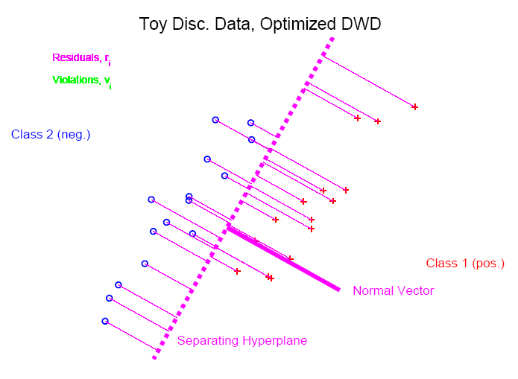
Distance Weighted Discrim’n
Based on Optimization Problem:
For “Residuals”:

Slide 55
Distance Weighted Discrim’n
Based on Optimization Problem:
Uses “poles” to push plane away from data

Slide 56
Distance Weighted Discrim’n
Based on Optimization Problem:
More precisely:
Work in appropriate penalty for violations

Slide 57
Distance Weighted Discrim’n
Based on Optimization Problem:
More precisely:
Work in appropriate penalty for violations
Optimization Method:
Second Order Cone Programming

Slide 58
Distance Weighted Discrim’n
Based on Optimization Problem:
More precisely:
Work in appropriate penalty for violations
Optimization Method:
Second Order Cone Programming
“Still convex” gen’n of quad’c program’g
Allows fast greedy solution
Can use available fast software
(SDP3, Michael Todd, et al)

Slide 59
Distance Weighted Discrim’n
References for more on DWD:
Current paper:
Marron, Todd and Ahn (2007)
Links to more papers:
Ahn (2007)
R Implementation of DWD:
CRAN 2011
SDPT3 Software:
Toh (2007)
Notes:
59

Slide 60
Distance Weighted Discrim’n
2-d Visualization:
Pushes Plane
Away From
Data
All Points
Have Some
Influence
(not just support vectors)

Slide 61
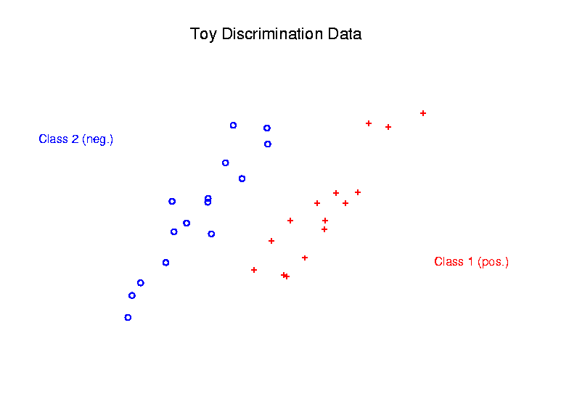
Support Vector Machines
Graphical View, using Toy Example:

Slide 62
Support Vector Machines
Graphical View, using Toy Example:

Slide 63
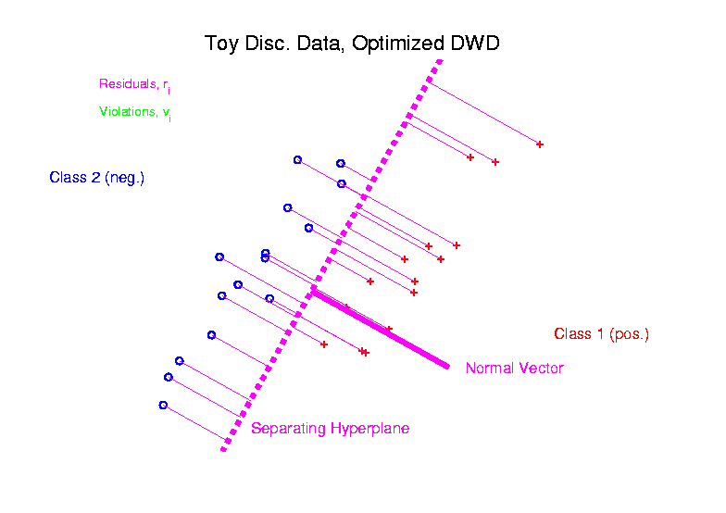
Distance Weighted Discrim’n
Graphical View, using Toy Example:

Slide 64
Batch and Source Adjustment
Recall from Class Notes 8/26/14
For Stanford Breast Cancer Data (C. Perou)
Analysis in Benito, et al (2004)
https://genome.unc.edu/pubsup/dwd/
Adjust for Source Effects
  Different sources of mRNA
Adjust for Batch Effects
  Arrays fabricated at different times

Slide 65
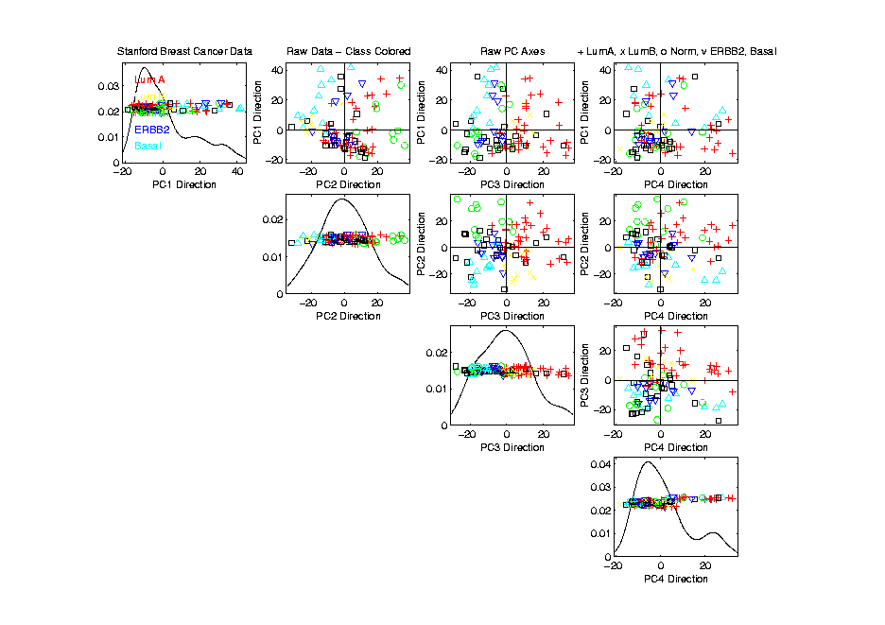
Source Batch Adj: Biological Class Col. & Symbols

Slide 66
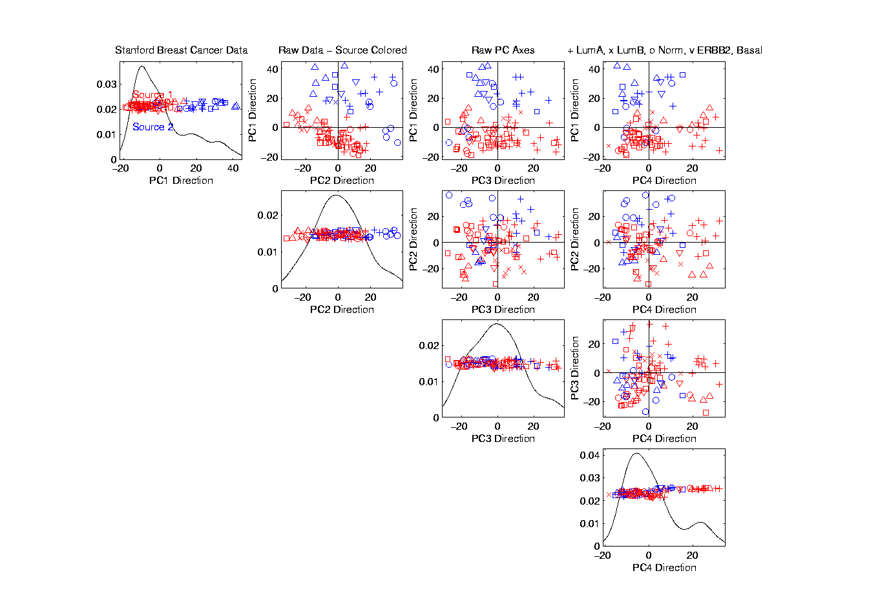
Source Batch Adj: Source Colors

Slide 67
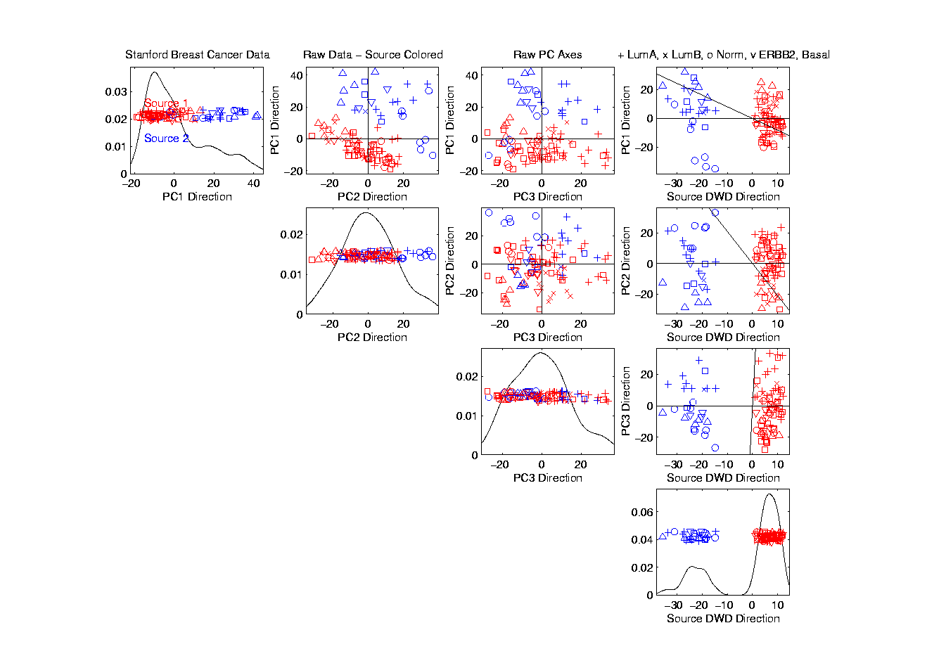
Source Batch Adj: PC 1-3 & DWD direction

Slide 68
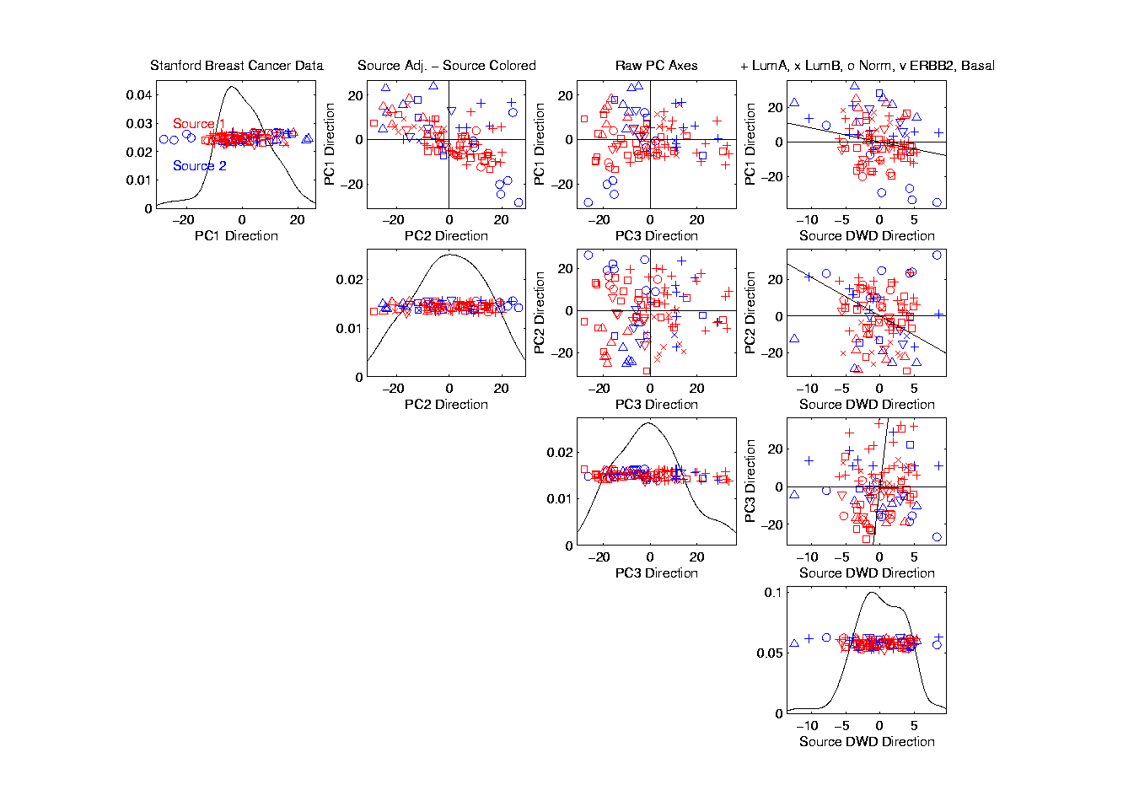
Source Batch Adj: DWD Source Adjustment

Slide 69
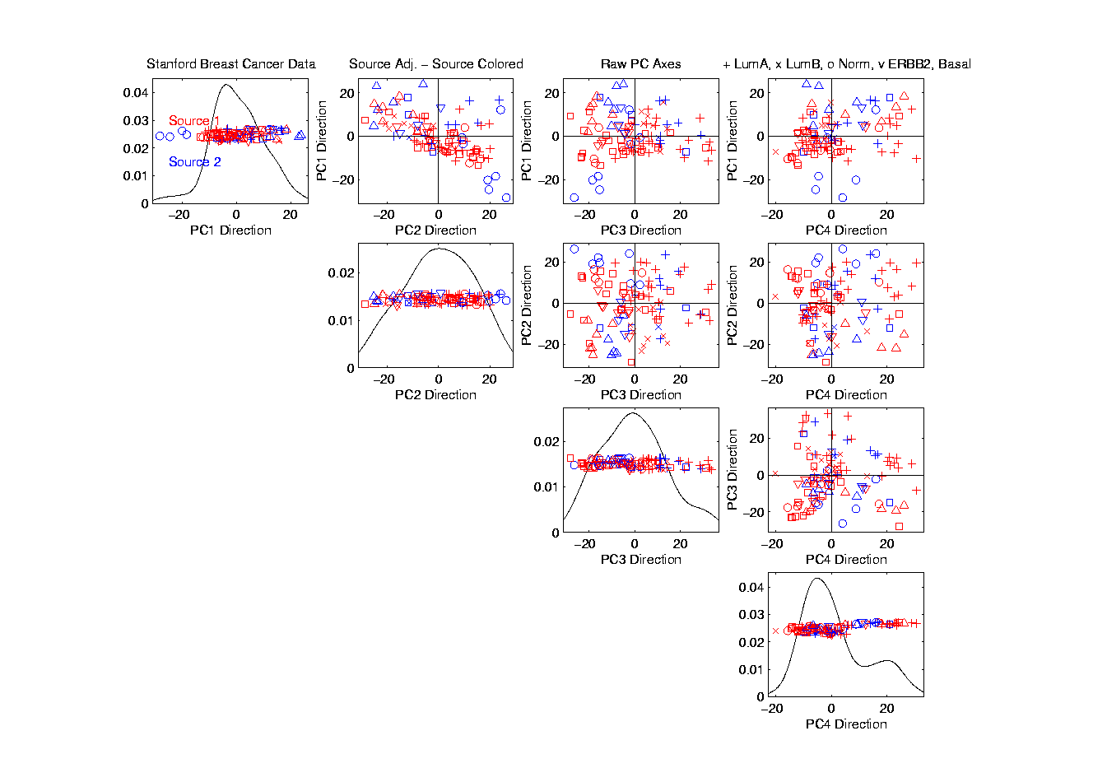
Source Batch Adj: Source Adj’d, PCA view

Slide 70
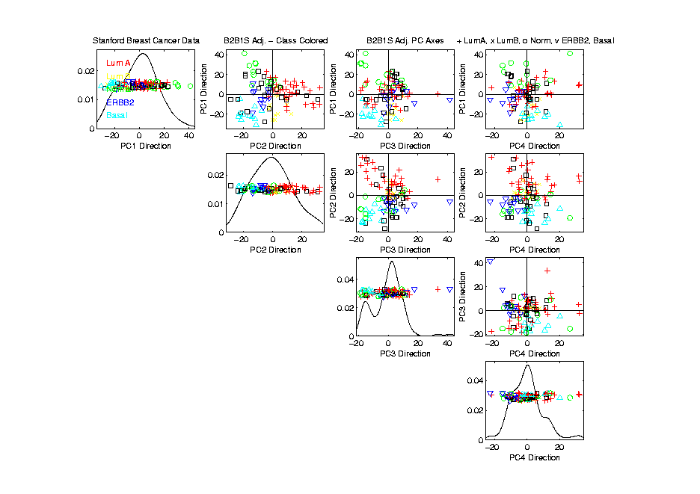
Source Batch Adj: S. & B Adj’d, Adj’d PCA

Slide 71
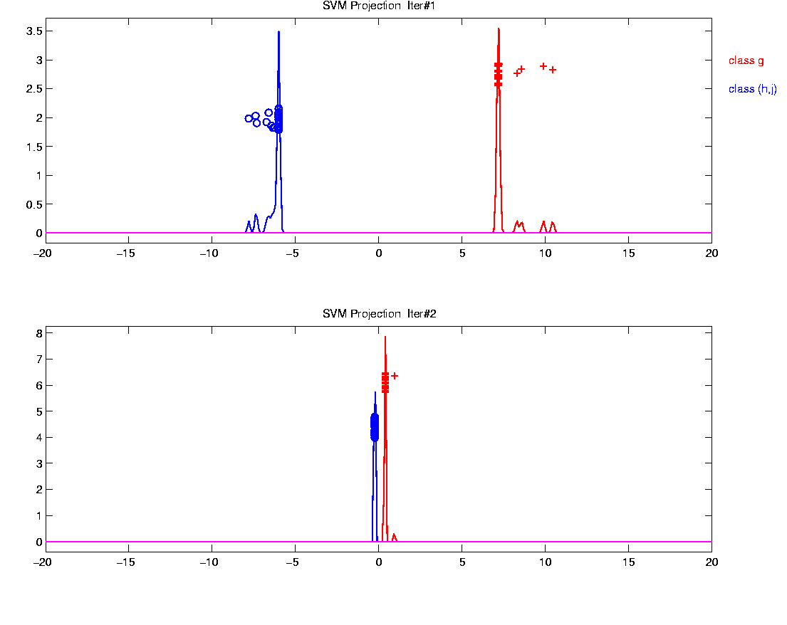
Why not adjust using SVM?
Major Problem: Proj’d Distrib’al Shape
Triangular Dist’ns (opposite skewed)
Does not allow sensible rigid shift

Slide 72
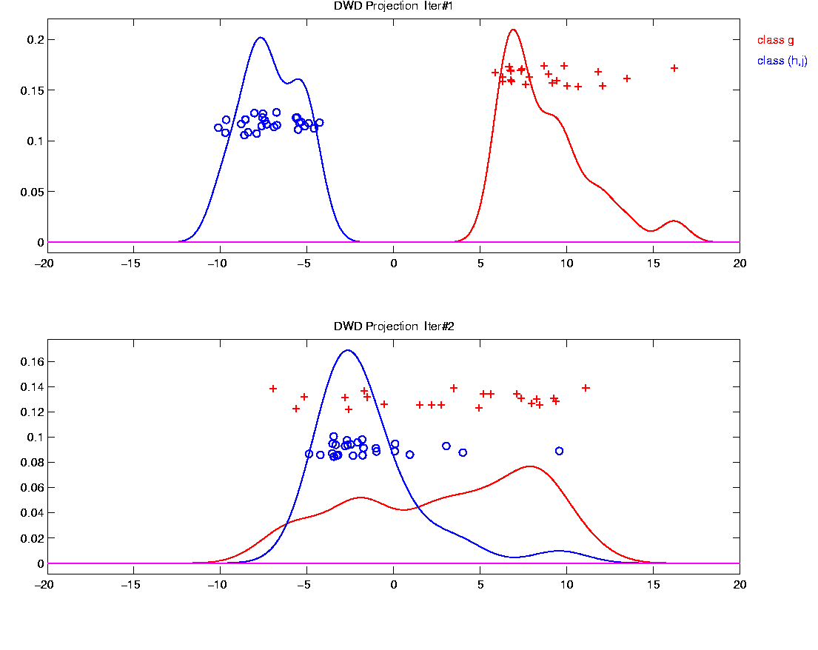
Why not adjust using SVM?
Nicely Fixed by DWD
Projected Dist’ns near Gaussian
Sensible to shift

Slide 73
Why not adjust by means?
DWD is complicated: value added?

Slide 74
Why not adjust by means?
DWD is complicated: value added?
Because it is “cool”
  Recall Improves SVM for HDLSS

Slide 75
Why not adjust by means?
DWD is complicated: value added?
Because it is “cool”
  Recall Improves SVM for HDLSS
Good Empirical Success
  Routinely Used in Perou Lab
  Many Comparisons Done
  Similar Lessons from Wistar

Slide 76
Why not adjust by means?
DWD is complicated: value added?
Because it is “cool”
  Recall Improves SVM for HDLSS
Good Empirical Success
  Routinely Used in Perou Lab
  Many Comparisons Done
  Similar Lessons from Wistar
Proven Statistical Power

Slide 77
Why not adjust by means?
But Why Not PAM (~Mean Difference)?
Simpler is Better
Why not means, i.e. point cloud centerpoints?

Slide 78
Why not adjust by means?
But Why Not PAM (~Mean Difference)?
Simpler is Better
Why not means, i.e. point cloud centerpoints?
Elegant Answer: Xuxin Liu, et al (2009)

Slide 79
Why not adjust by means?
But Why Not PAM (~Mean Difference)?
Simpler is Better
Why not means, i.e. point cloud centerpoints?
Drawback to PAM:
Poor Handling of Unbalanced Biological Subtypes
DWD more Resistant to Unbalance

Slide 80
Why not adjust by means?
Toy Example:
  Gaussian Clusters
  Two batches (denoted: + o)

Slide 81
Why not adjust by means?
Toy Example:
  Gaussian Clusters
  Two batches (denoted: + o)
  Two subtypes (red and blue)

Slide 82
Why not adjust by means?
Toy Example:
  Gaussian Clusters
  Two batches (denoted: + o)
  Two subtypes (red and blue)
  Goal: bring together
  + ←→ o and also + ←→ o

Slide 83
Why not adjust by means?
Toy Example:
  Gaussian Clusters
  Two batches (denoted: + o)
  Two subtypes (red and blue)
  Goal: bring together
  + ←→ o and also + ←→ o
  Challenge: unequal biological ratios within batches

Slide 84
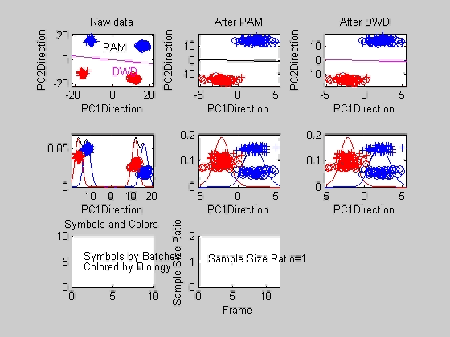
Twiddle ratios of subtypes

Slide 85
Why not adjust by means?
Lessons from DWD vs. PAM Example:
Both very good for ratio ~ 0.7 – 1.0
PAM weakens for ratio < 0.7
DWD robust until ratio < 0.4
PAM has some use, until ratio < 0.2
DWD has some use, until ratio < 0.05
Both methods eventually fail

Slide 86
Why not adjust by means?
DWD robust against non-proportional subtypes…
Mathematical Statistical Question:
Are there mathematics behind this?
(will answer later…)
Notes:
86

Slide 87
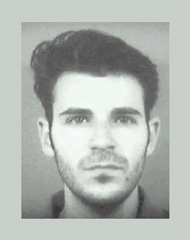
DWD in Face Recognition
Face Images as Data
(with M. Benito & D. Peña)
Male – Female Difference?
Discrimination Rule?
Represented as long vector of pixel gray levels
Registration is critical

