Slide 1
Non-iterative Joint and Individual Variation Explained
Qing Feng
Joint Work with J.S. Marron, Jan Hannig
Date: 2014/09/25

Slide 2
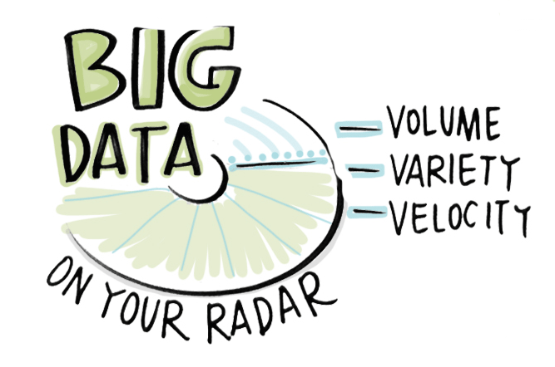
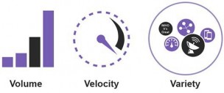
Era Challenge

Slide 3
Data Challenges
Multi-Block data
X
Feature Set 1
Rapid growth of sources to obtain data
High volume of available feature information
A variety of feature sets
$$d_{x}×n$$
Y
Feature Set 2
$$d_{y}×n$$
Subjects

Slide 4
Data Challenges
Multi-Block data challenges
High Dimensionality
Singular value decomposition on concatenated data matrix
?
Variation Explanation
Singular value decomposition on Individual data blocks
?
Heterogeneity
?
Pre-transformation

Slide 5
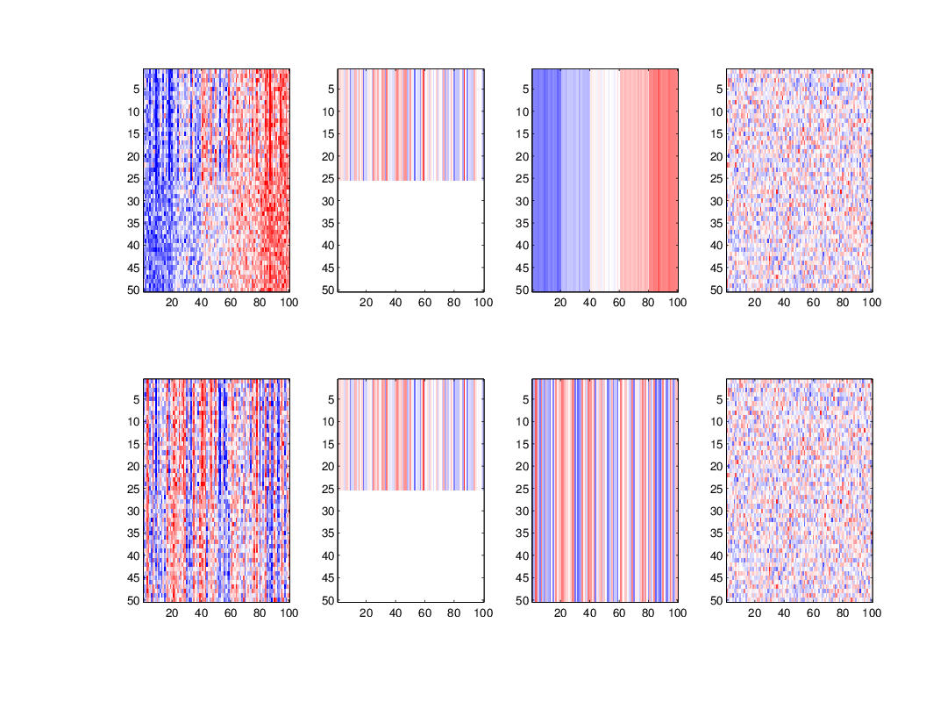
Data Challenges
Toy Example
X
=
+
+
$$(50 ×100)$$
Rank=1
Rank=1
Standard Gaussian Random Matrix
Y
=
+
+

Slide 6
Data Challenges
Simple concatenation
Low-rank SVD Approximation
Merged Data
Residual
=
+

Slide 7
Goal
Insightful Variation Decomposition
X
$$J_{x}$$
$$r_{J}$$
$$I_{x}$$
$$r_{I_{x}}$$
$$E_{x}$$
=
+
+
$$d_{x}×n$$
Y
$$J_{y}$$
$$r_{J}$$
$$I_{y}$$
$$r_{I_{y}}$$
$$E_{y}$$
=
+
+
$$d_{y}×n$$
Joint Structure
Individual Structure
Residual
Notes:
Stress: X and Y are blocks with signal corrupted by noise
Ususally assume noise to be Gaussian but allow different standard deviation

Slide 8
Essential Tool
Singular Value Decomposition (SVD) on $A (d×n)$
$$u_{1}$$
$$u_{r}$$
$$u_{d}$$
$${v_{1}}^{′}$$
$$\begin{matrix}s_{1} & & \\ & ⋱ & \\ & & s_{r}\end{matrix}$$
$$0$$
$$⋮$$
$${v_{r}}^{′}$$
$$row(A)$$
$$\begin{matrix}s_{r+1} & & \\ & ⋱ & \\ & & s_{d⋀n}\end{matrix}$$
$$⋯$$
$$⋯$$
$$0$$
$$⋮$$
$$null(A)$$
$$⋮$$
$${v_{n}}^{′}$$
$$col(A)$$
null$(A^{′})$
Takeaway
Row space can be considered as ‘”Covariate” space
Singular values indicate “importance” of each covariate

Slide 9
Definition
Joint Structure
$${Row(V}_{J_{x}})=Row(V_{J_{y}})$$
$$J_{x}$$
$$r_{J}$$
$$S_{J_{x}}$$
$$V_{J_{x}}$$
$$r_{J}×n$$
=
$$r_{J}×r_{J}$$
$$d_{x}×r_{J}$$
$$J_{y}$$
$$r_{J}$$
$$S_{J_{y}}$$
$$V_{J_{y}}$$
$$r_{J}×n$$
$$r_{J}×r_{J}$$
=
$$d_{y}×r_{J}$$

Slide 10
Definition
$${Row(V}_{I_{x}})∩Row\left(V_{I_{y}}\right)=\{\vec{0}\}$$
Individual structure
$$I_{x}$$
$$r_{I_{x}}$$
$$S_{I_{x}}$$
$$V_{I_{x}}$$
=
$$r_{I_{x}}×n$$
$$r_{I_{x}}×r_{I_{x}}$$
$${Row(V}_{I_{x}})⊥Row\left(V_{J_{x}}\right)$$
$$d_{x}×r_{I_{x}}$$
$$I_{y}$$
$$r_{I_{y}}$$
$$S_{I_{y}}$$
$$V_{I_{y}}$$
$$r_{I_{y}}×n$$
=
$$r_{I_{y}}×r_{I_{y}}$$
$${Row(V}_{I_{y}})⊥Row\left(V_{J_{y}}\right)$$
$$d_{y}×r_{I_{y}}$$

Slide 11
Definition
Residual $Max\left(S_{E_{∗}}\right)<Min(S_{J_{∗}},S_{I_{∗}})$
$$E_{x}$$
$$S_{E_{x}}$$
$$V_{E_{x}}$$
=
$$(r_{o,x}−r_{x})×n$$
$$\left(r_{o,x}−r_{x}\right)×(r_{o,x}−r_{x})$$
$$d_{x}×(r_{o,x}−r_{x})$$
$$E_{y}$$
$$S_{E_{y}}$$
$$V_{E_{y}}$$
=
$$(r_{o,y}−r_{y})×n$$
$$(r_{o,y}−r_{y}) ×(r_{o,y}−r_{y})$$
$$d_{y}×(r_{o,y}−r_{y})$$

Slide 12
Outline of Implementation
Obtain covariate spaces of each structure
Recover structure matrices via projection
Observed Data
Signal
Joint
Individual
Residual
#1 De-Noise
#2 De-Noise

Slide 13
#1 De-noise
Extract signal based on singular values
Perform for each block individually
Data Block X
Data Block Y
# 1 thresholds for each data block

Slide 14
#1 De-noise
#1 threshold selection
[Johnstone 2001] Limiting distribution of largest Eigen-value of covariance of standard Gaussian random matrix
$$\frac{l_{1}−μ_{nd}}{σ_{nd}} \underset{→}{𝒟} W_{1}$$
In which, $W_{1}$ follows Tracy-Widom law of distribution and
$$μ_{nd}={(\sqrt{n−1}+\sqrt{d})}^{2}$$
$$σ_{nd}=(\sqrt{n−1}+\sqrt{d}){(\frac{1}{\sqrt{n−1}}+\frac{1}{\sqrt{d}})}^{\frac{1}{3}}$$
#1 threshold
$$(\sqrt{n−1}+\sqrt{d})σ$$

Slide 15
#2 De-noise
Union of null spaces
From noiseless case
Union $\{Null\left(X\right), Null(Y)\}$ contains everything but row space $Row(V_{J})$
Null space of data X, Null(X) contains
Individual row space of Y, $Row(V_{I^{Y}})$
Grey noise row space
Null space of data Y, Null(Y) contains
Individual row space of X, $Row(V_{I^{X}})$
Grey noise row space
$$ℝ^{n}$$
$$V_{I^{X}}$$
$$V_{J}$$
$$V_{I^{Y}}$$

Slide 16
#2 De-noise
Union of null spaces(UN) under noise
Direction spaces
Leaking joint signal becomes noise
Estimated signal direction deviates from direction in real row space
Signal to ratio influences the angle
Noise in Y
Noise in X
$$θ$$
$$θ$$
Joint in Y
$$θ$$
Direction of noise signal in UN
$$θ$$
Joint in X
Paired in UN
Direction of leaking joint signal in UN

Slide 17
#2 De-noise
Union of null spaces under noise
Identify components via singular value plot
Detect pairs of basis in two estimated row spaces
Angle distinguish joint from individual components
Noisy direction
Individual direction
Paired basis
Calculate angle $θ$
#2 threshold

Slide 18
#2 De-noise
#2 threshold selection $φ$
$$ν_{y}$$
$$\cos\left(φ\right)=\cos\left(θ_{x}\right)\cos\left(θ_{y}\right)$$
$$ν_{x}$$
$\cos\left(θ_{x}\right), \cos\left(θ_{y}\right)$ are estimation from [Shablin 2010]
Suppose $\frac{d_{x}}{n} →c_{x}$ as $n →∞$,
$\cos\left(θ_{x}\right)=\sqrt{(1−\frac{c_{x}{σ_{x}}^{4}}{λ^{2}})/(1+\frac{{σ_{x}}^{2}}{λ})}$
In which,
$$λ=\frac{1}{2}\left({s_{x}}^{2}−\left(1+c_{x}\right){σ_{x}}^{2}+\sqrt{{\left({s_{x}}^{2}−\left(1+c_{x}\right){σ_{x}}^{2}\right)}^{2}−4c_{x}{σ_{x}}^{4}}\right)$$
$$θ_{x}$$
$$θ_{y}$$

Slide 19
#2 De-noise
Connection between #1 and #2 thresholds
What if $σ_{x}, σ_{y}$ are unknown ?
Multi-scale aspect comes!
$${ σ}_{x}, σ_{y}$$
〖 𝜎〗_𝑥, 𝜎_𝑦
#1 Threshold
#2 Threshold

Slide 20
Reconstruction
Project data blocks to each row spaces
Obtain estimations of each structure matrices
Times loading, singular value and basis in row together to recover each component
$$×$$
Row space
Data Block
Get Loading and singular value matrices

Slide 21
Toy Example
Data visualization
X
=
+
+
$$(50 ×100)$$
Rank=1
Rank=1
Standard Gaussian Random Matrix
Y
=
+
+

Slide 22
Toy Example
#1 De-noise
Data Block X
Data Block Y
# 1 thresholds for each data block

Slide 23
Toy Example
#2 De-noise
Noisy direction
Individual direction
Joint direction
#2 threshold

Slide 24
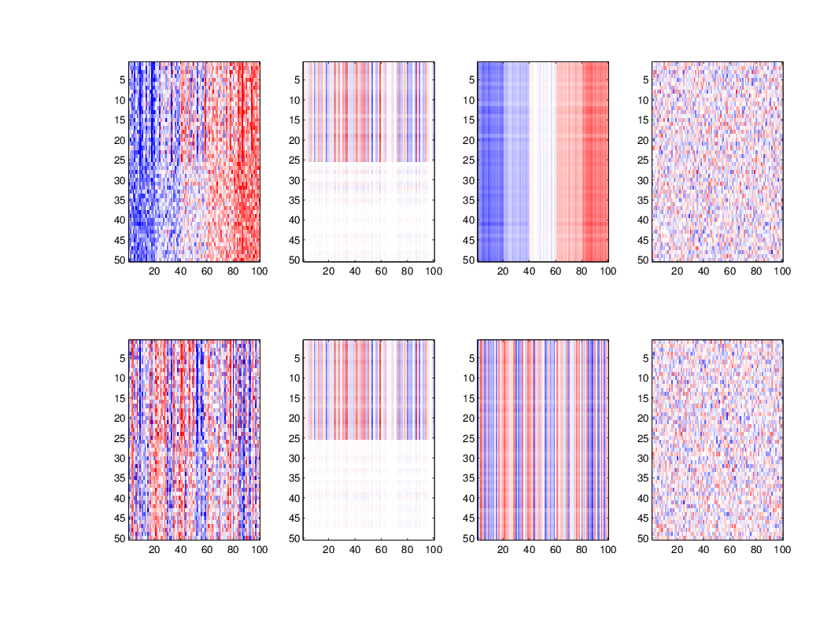
Toy Example
Reconstruction
X
=
+
+
Joint
Individual
Residual
Y
=
+
+

Slide 25
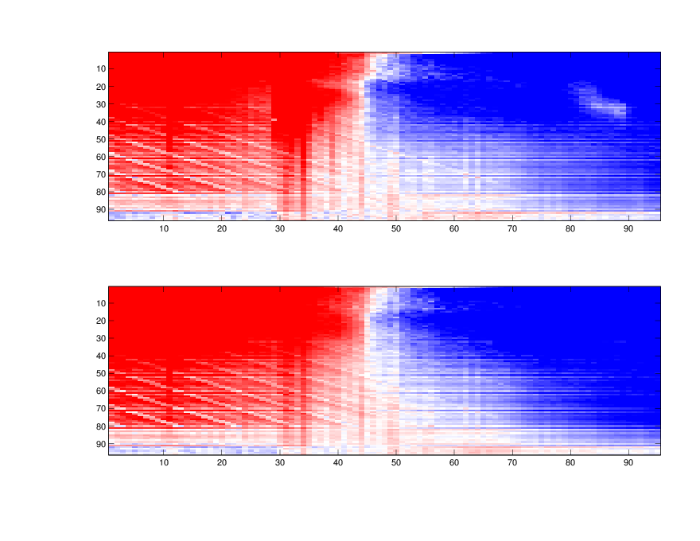
Spanish Mortality
Male block Versus Female block
+
-
Spanish Male
Age as features
Years as Subjects
Spanish Female
Age as features

Slide 26
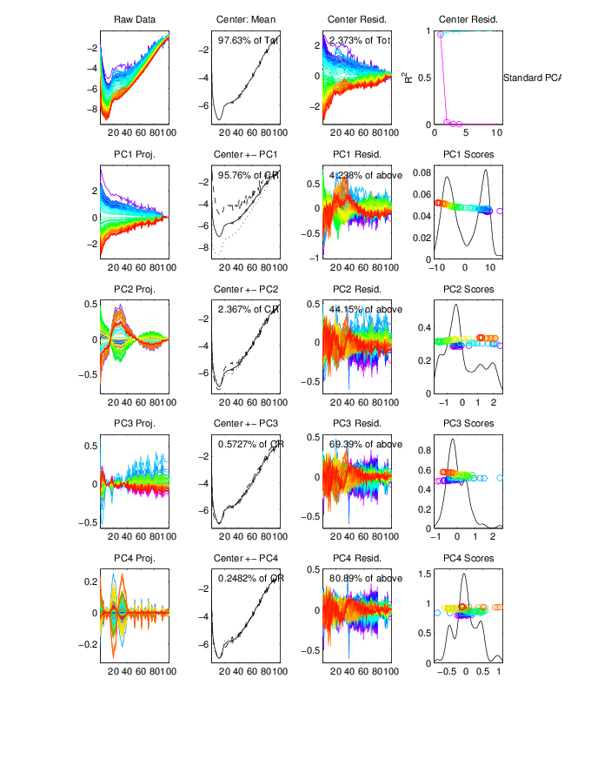
Spanish Male

Slide 27
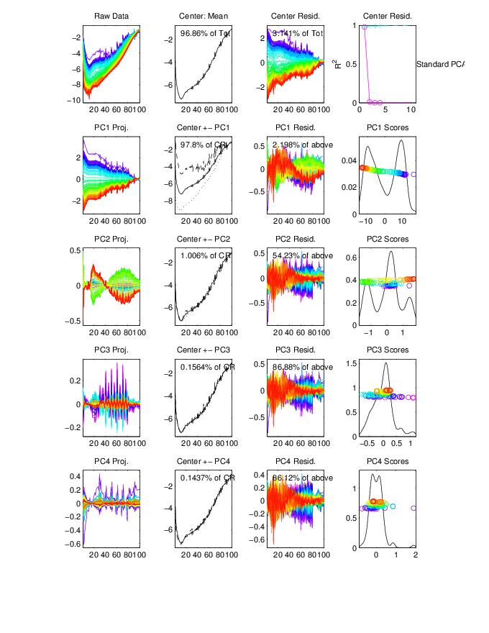
Spanish Female

Slide 28
Spanish Mortality
#1 De-noise
Data Block Male
Rank=7
Data Block Female
Rank=6
Eyeball # 1 thresholds
(Log of singular value)

Slide 29
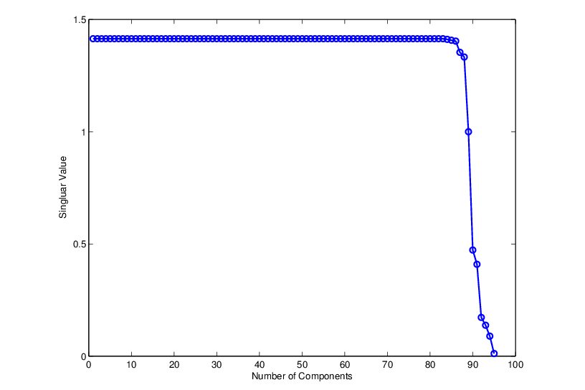
Spanish Mortality
#2 De-noise
Noisy direction
Individual directions
#2 threshold
Rank of Joint structure=4
Joint directions

Slide 30
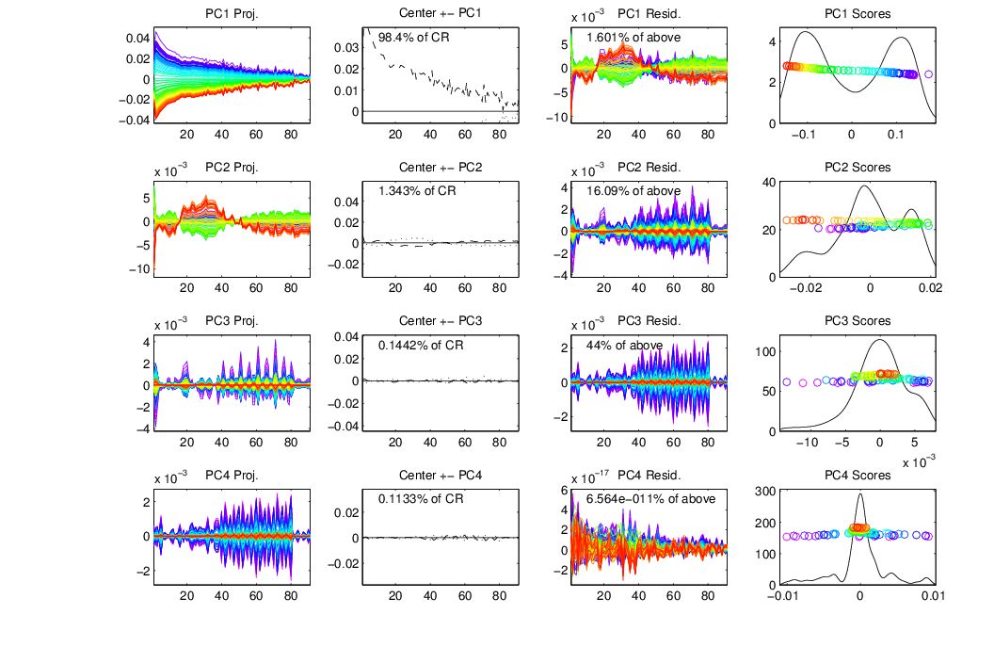
Joint Variation - Male

Slide 31
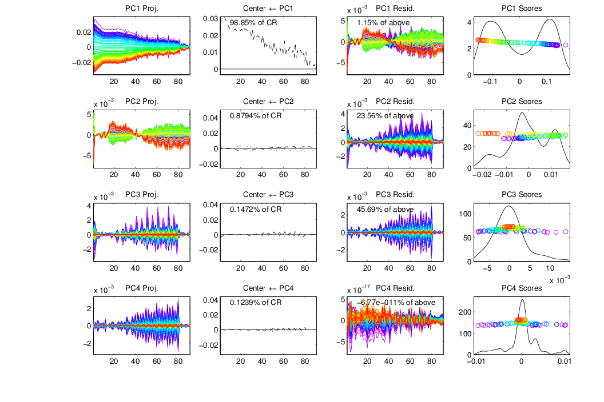
Joint Variation - Female

Slide 32
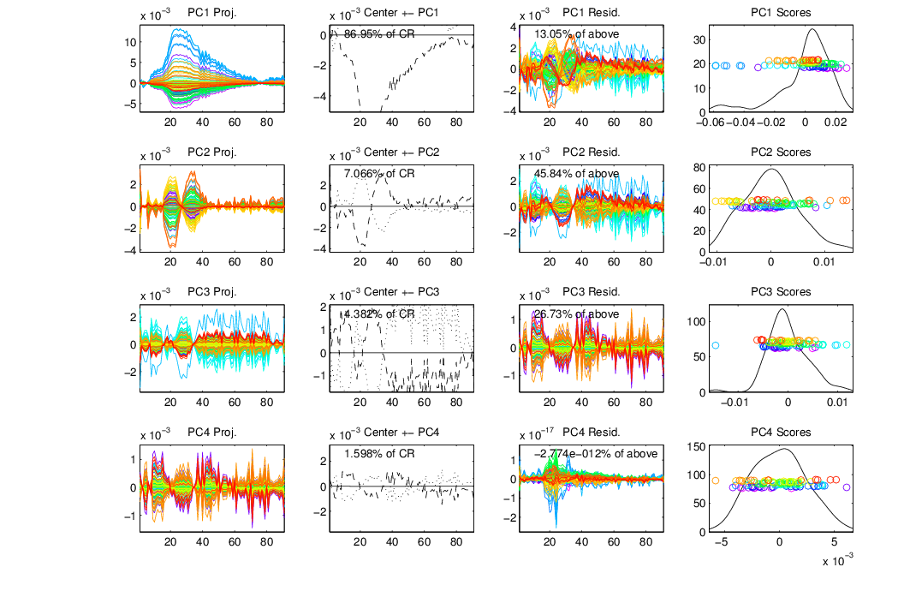
Individual Variation - Male
Spanish Civil War

Slide 33
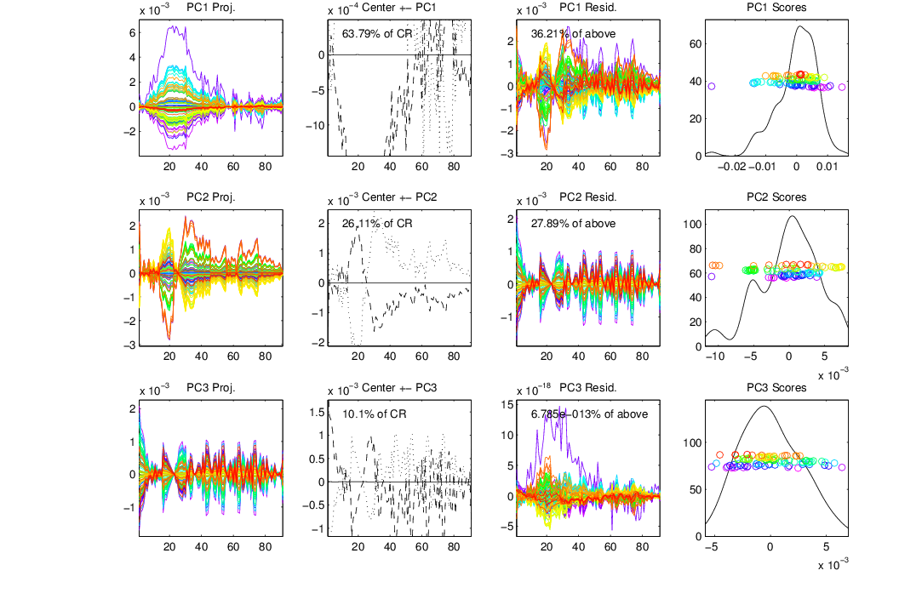
Individual Variation - Female
Flue epidemic

Slide 34
Thank you!

