Slide 1
HDLSS Discrimination
FLD in Increasing Dimensions:
Low dimensions (d = 2-9):
  Visually good separation
  Small angle between FLD and Optimal
  Good generalizability
Medium Dimensions (d = 10-26):
  Visual separation too good?!?
  Larger angle between FLD and Optimal
  Worse generalizability
  Feel effect of sampling noise

Slide 2
HDLSS Discrimination
FLD in Increasing Dimensions:
High Dimensions (d=27-37):
  Much worse angle
  Very poor generalizability
  But very small within class variation
  Poor separation between classes
  Large separation / variation ratio

Slide 3
HDLSS Discrimination
FLD in Increasing Dimensions:
At HDLSS Boundary (d=38):
  38 = degrees of freedom
  (need to estimate 2 class means)
  Within class variation = 0 ?!?
  Data pile up, on just two points
  Perfect separation / variation ratio?
  But only feels microscopic noise aspects
  So likely not generalizable
  Angle to optimal very large

Slide 4
HDLSS Discrimination
FLD in Increasing Dimensions:
Just beyond HDLSS boundary (d=39-70):
  Improves with higher dimension?!?
  Angle gets better
  Improving generalizability?
  More noise helps classification?!?

Slide 5
HDLSS Discrimination
FLD in Increasing Dimensions:
Far beyond HDLSS boun’ry (d=70-1000):
  Quality degrades
  Projections look terrible
  (populations overlap)
  And Generalizability falls apart, as well
  Math’s worked out by Bickel & Levina (2004)
  Problem is estimation of d x d covariance matrix

Slide 6
HDLSS Discrimination
Simple Solution:
Mean Difference (Centroid) Method
Recall not classically recommended
  Usually no better than FLD
  Sometimes worse
But avoids estimation of covariance
Means are very stable
Don’t feel HDLSS problem

Slide 7
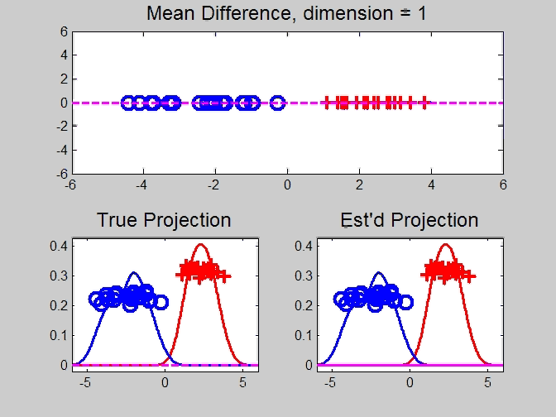
HDLSS Discrimination
Mean Difference (Centroid) Method
Same
Data,
Movie
over
dim’s

Slide 8
HDLSS Discrimination
Mean Difference (Centroid) Method
Far more stable over dimensions
Because is likelihood ratio solution
(for known variance - Gaussians)
Doesn’t feel HDLSS boundary
Eventually becomes too good?!?
Widening gap between clusters?!?
Careful: angle to optimal grows
So lose generalizability (since noise inc’s)
HDLSS data present some odd effects…

