Slide 1
Detailed Look at PCA
Three Important (& Interesting) Viewpoints:
Mathematics
Numerics
Statistics
1st: Review Linear Alg. and Multivar. Prob.

Slide 2
Review of Linear Algebra (Cont.)
Better View of Relationship:
Singular Value Dec. ←→ Eigenvalue Dec.
Start with data matrix:
With SVD:
Create square, symmetric matrix:
Note that:
Gives Eigenanalysis,

Slide 3
Review of Multivariate Probability
Given a Random Vector,
A Center of the Distribution is the Mean Vector,
Note: Component-Wise Calc’n (Euclidean)

Slide 4
Review of Multivariate Probability
Given a Random Vector,
A Measure of Spread is the Covariance Matrix:

Slide 5
Review of Multivar. Prob. (Cont.)
Outer Product Representation:
,
Where:

Slide 6
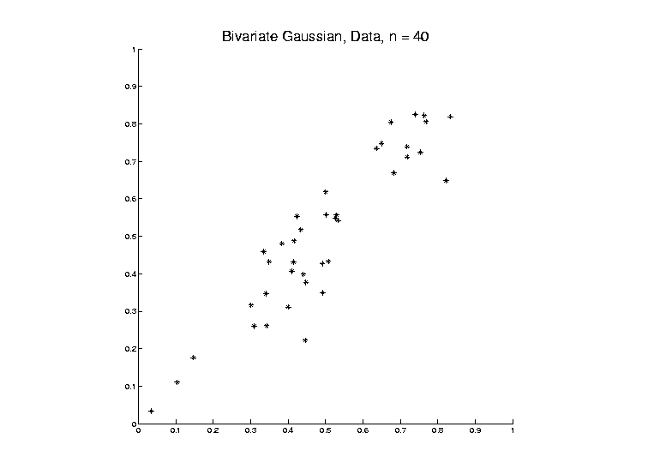
PCA as an Optimization Problem
Find “Direction of Greatest Variability”:

Slide 7
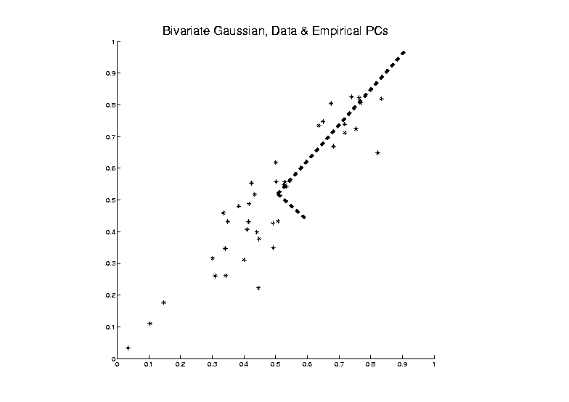
PCA as an Optimization Problem
Find “Direction of Greatest Variability”:

Slide 8
PCA as Optimization (Cont.)
Now since is an Orthonormal Basis Matrix,
and
So the Rotation Gives a Distribution of the Energy of Over the Eigen-Directions
And is Max’d (Over ), by Putting all Energy in the “Largest Direction”, i.e. ,
Where “Eigenvalues are Ordered”,

Slide 9
PCA as Optimization (Cont.)
Notes:
Solution is Unique when
Else have Sol’ns in Subsp. Gen’d by 1st s
Projecting onto Subspace to ,
Gives as Next Direction
Continue Through ,…,
Replace by to get Theoretical PCA
Estimated by the Empirical Version

Slide 10
Connect Math to Graphics
2-d Toy Example
Descriptor Space Object Space
Data Points (Curves) are columns of data matrix, X

Slide 11
Connect Math to Graphics (Cont.)
2-d Toy Example
Descriptor Space Object Space
PC1 Direction = η = Eigenvector (w/ biggest λ)

Slide 12
Connect Math to Graphics (Cont.)
2-d Toy Example
Descriptor Space Object Space
Centered Data PC1 Projection Residual
Best 1-d Approx’s of Data

Slide 13
Connect Math to Graphics (Cont.)
2-d Toy Example
Descriptor Space Object Space
Centered Data PC2 Projection Residual
Worst 1-d Approx’s of Data

Slide 14
PCA Redistribution of Energy
Convenient Summary of Amount of Structure:
Total Sum of Squares
Physical Interpetation:
Total Energy in Data
Insight comes from decomposition
Statistical Terminology:
ANalysis Of VAriance (ANOVA)

Slide 15
PCA Redist’n of Energy (Cont.)
Have already studied this decomposition (recall curve e.g.)
Variation (SS) due to Mean (% of total)
Variation (SS) of Mean Residuals (% of total)
Notes:
15

Slide 16
PCA Redist’n of Energy (Cont.)
Eigenvalues Provide Atoms of SS Decompos’n
Useful Plots are:
Power Spectrum: vs.
log Power Spectrum: vs.
Cumulative Power Spectrum: vs.
Note PCA Gives SS’s for Free (As Eigenval’s),
But Watch Factors of
Notes:
16

Slide 17
PCA Redist’n of Energy (Cont.)
Note, have already considered some of these Useful Plots:
Power Spectrum
Cumulative Power Spectrum
Notes:
17

Slide 18
Connect Math to Graphics (Cont.)
2-d Toy Example
Descriptor Space Object Space
Revisit SS Decomposition for PC1
Notes:
18

Slide 19
Connect Math to Graphics (Cont.)
2-d Toy Example
Descriptor Space Object Space
Revisit SS Decomposition for PC1:
PC1 has “most of var’n” = 93%
Reflected by good approximation in Desc’r Space
Notes:
19

Slide 20
Connect Math to Graphics (Cont.)
2-d Toy Example
Descriptor Space Object Space
Revisit SS Decomposition for PC1:
PC2 has “only a little var’n” = 7%
Reflected by poor approximation in Desc’or Space
Notes:
20

Slide 21
Different Views of PCA
Solves several optimization problems:
Direction to maximize SS of 1-d proj’d data
Notes:
21

Slide 22
Different Views of PCA
2-d Toy Example
Descriptor Space Object Space
Max SS of Projected Data
Min SS of Residuals
Best Fit Line
Notes:
22

Slide 23
Different Views of PCA
Solves several optimization problems:
Direction to maximize SS of 1-d proj’d data
Direction to minimize SS of residuals
Notes:
23

Slide 24
Different Views of PCA
2-d Toy Example
Feature Space Object Space
Max SS of Projected Data
Min SS of Residuals
Best Fit Line
Notes:
24

Slide 25
Different Views of PCA
Solves several optimization problems:
Direction to maximize SS of 1-d proj’d data
Direction to minimize SS of residuals
(same, by Pythagorean Theorem)
Notes:
25

Slide 26
Different Views of PCA
Solves several optimization problems:
Direction to maximize SS of 1-d proj’d data
Direction to minimize SS of residuals
(same, by Pythagorean Theorem)
“Best fit line” to data in “orthogonal sense”
(vs. regression of Y on X = vertical sense
& regression of X on Y = horizontal sense)
Notes:
26

Slide 27
Different Views of PCA
Toy Example Comparison of Fit Lines:
PC1
Regression of Y on X
Regression of X on Y
Notes:
27

Slide 28
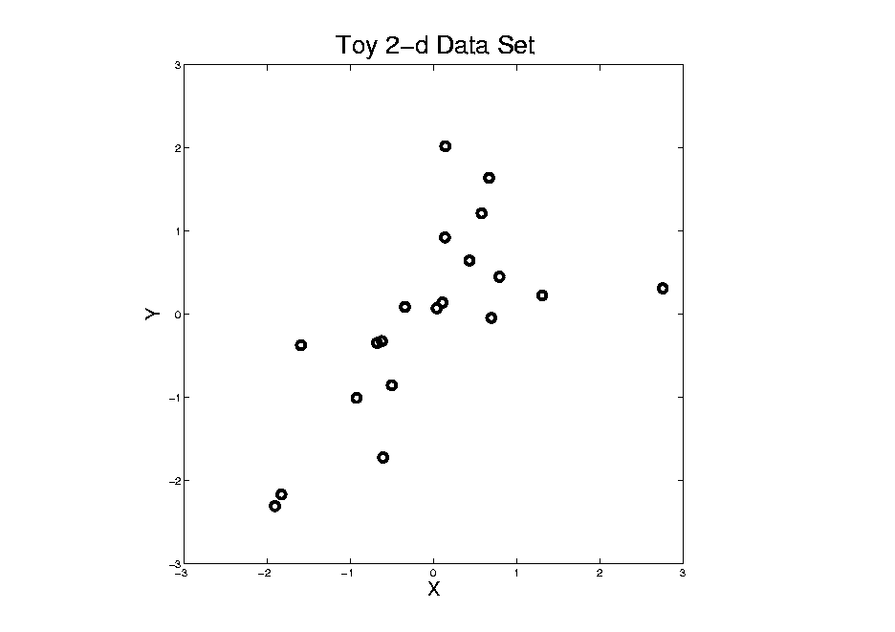
Different Views of PCA
Normal
Data
ρ = 0.3
Notes:
28

Slide 29
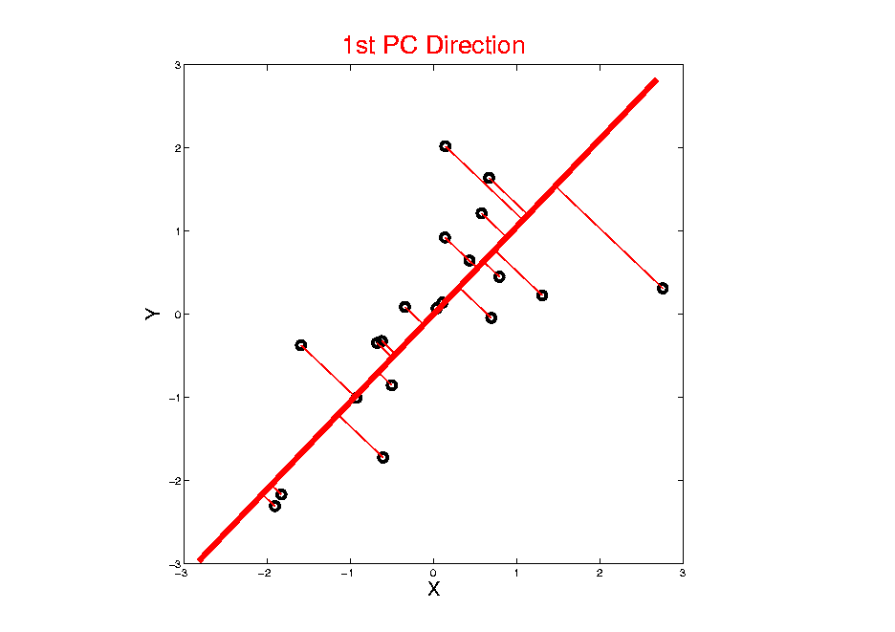
Different Views of PCA
Projected
Residuals
Notes:
29

Slide 30
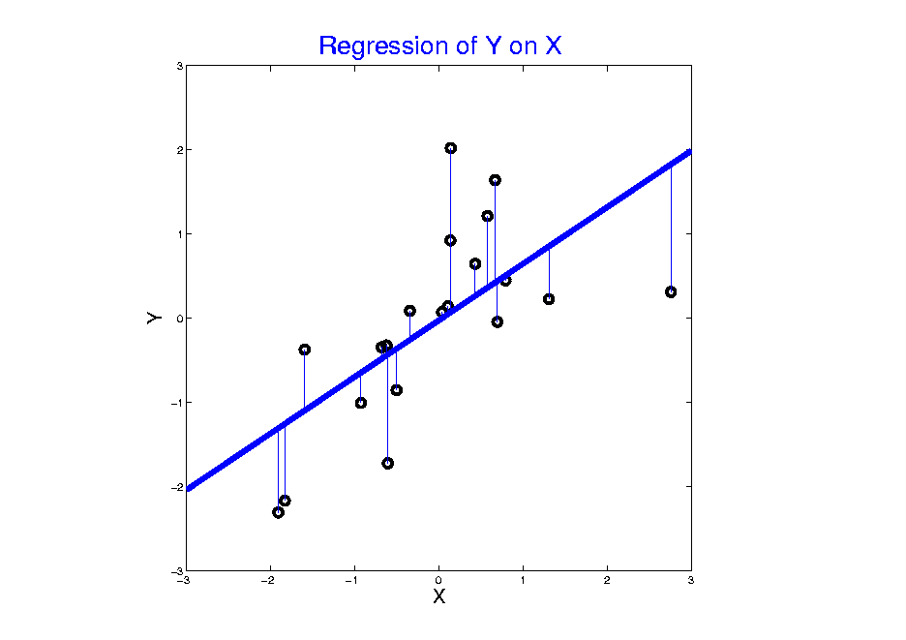
Different Views of PCA
Vertical
Residuals
(X predicts Y)
Notes:
30

Slide 31
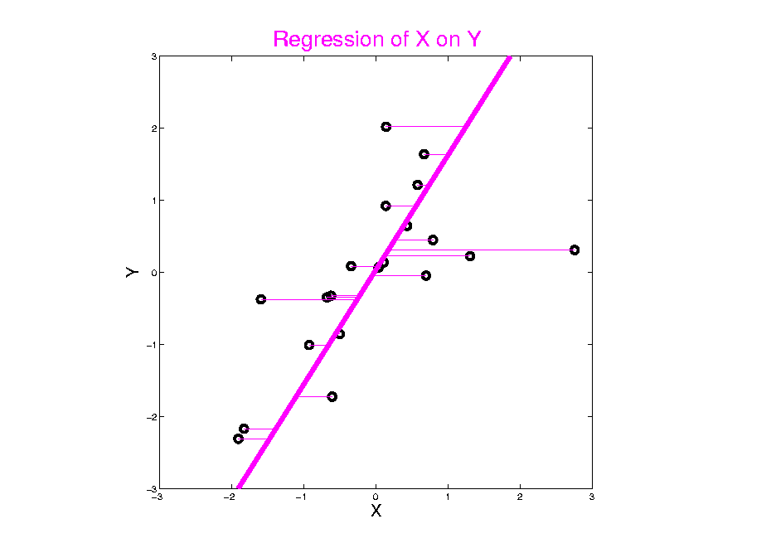
Different Views of PCA
Horizontal
Residuals
(Y predicts X)
Notes:
31

Slide 32
Different Views of PCA
Projected
Residuals
(Balanced
Treatment)
Notes:
32

Slide 33
Different Views of PCA
Toy Example Comparison of Fit Lines:
PC1
Regression of Y on X
Regression of X on Y
Note: Big Difference Prediction Matters
Notes:
33

Slide 34
Different Views of PCA
Solves several optimization problems:
Direction to maximize SS of 1-d proj’d data
Direction to minimize SS of residuals
(same, by Pythagorean Theorem)
“Best fit line” to data in “orthogonal sense”
(vs. regression of Y on X = vertical sense
& regression of X on Y = horizontal sense)
Use one that makes sense…
Notes:
34

Slide 35
PCA Data Representation
Idea: Expand Data Matrix
in Terms of Inner Prod’ts & Eigenvectors

Slide 36
PCA Data Representation
Idea: Expand Data Matrix
in Terms of Inner Prod’ts & Eigenvectors
Recall Notation:
(Mean Centered Data)

Slide 37
PCA Data Representation
Idea: Expand Data Matrix
in Terms of Inner Prod’ts & Eigenvectors
Recall Notation:
Spectral Representation (centered data):

Slide 38
PCA Data Represent’n (Cont.)
Now Using:

Slide 39
PCA Data Represent’n (Cont.)
Now Using:
Spectral Representation (Raw Data):

Slide 40
PCA Data Represent’n (Cont.)
Now Using:
Spectral Representation (Raw Data):
Where:
Entries of are Loadings
Entries of are Scores

Slide 41
PCA Data Represent’n (Cont.)
Can Focus on Individual Data Vectors:
(Part of Above Full Matrix Rep’n)

Slide 42
PCA Data Represent’n (Cont.)
Can Focus on Individual Data Vectors:
(Part of Above Full Matrix Rep’n)
Terminology: are Called “PCs”
and are also Called Scores

Slide 43
PCA Data Represent’n (Cont.)
More Terminology:
Scores, are Coefficients in Spectral Representation:

Slide 44
PCA Data Represent’n (Cont.)
More Terminology:
Scores, are Coefficients in Spectral Representation:
Loadings are Entries of Eigenvectors:

Slide 45
PCA Data Represent’n (Cont.)
Reduced Rank Representation:

Slide 46
PCA Data Represent’n (Cont.)
Reduced Rank Representation:
Reconstruct Using Only Terms
(Assuming Decreasing Eigenvalues)

Slide 47
PCA Data Represent’n (Cont.)
Reduced Rank Representation:
Reconstruct Using Only Terms
(Assuming Decreasing Eigenvalues)
Gives: Rank Approximation of Data

Slide 48
PCA Data Represent’n (Cont.)
Reduced Rank Representation:
Reconstruct Using Only Terms
(Assuming Decreasing Eigenvalues)
Gives: Rank Approximation of Data
Key to PCA Dimension Reduction

Slide 49
PCA Data Represent’n (Cont.)
Reduced Rank Representation:
Reconstruct Using Only Terms
(Assuming Decreasing Eigenvalues)
Gives: Rank Approximation of Data
Key to PCA Dimension Reduction
And PCA for Data Compression (~ .jpeg)

Slide 50
PCA Data Represent’n (Cont.)
Choice of in Reduced Rank Represent’n:

Slide 51
PCA Data Represent’n (Cont.)
Choice of in Reduced Rank Represent’n:
Generally Very Slippery Problem

Slide 52
PCA Data Represent’n (Cont.)
Choice of in Reduced Rank Represent’n:
Generally Very Slippery Problem
Not Recommended:
Arbitrary Choice
E.g. % Variation Explained 90%? 95%?

Slide 53
PCA Data Represent’n (Cont.)
Choice of in Reduced Rank Represent’n:
Generally Very Slippery Problem
SCREE Plot (Kruskal 1964):
Find Knee in Power Spectrum

Slide 54
PCA Data Represent’n (Cont.)
SCREE Plot Drawbacks:
What is a Knee?

Slide 55
PCA Data Represent’n (Cont.)
SCREE Plot Drawbacks:
What is a Knee?
What if There are Several?

Slide 56
PCA Data Represent’n (Cont.)
SCREE Plot Drawbacks:
What is a Knee?
What if There are Several?
Knees Depend on Scaling (Power? log?)

Slide 57
PCA Data Represent’n (Cont.)
SCREE Plot Drawbacks:
What is a Knee?
What if There are Several?
Knees Depend on Scaling (Power? log?)
Personal Suggestions:
Find Auxiliary Cutoffs (Inter-Rater Variation)
Use the Full Range (ala Scale Space)

Slide 58
PCA Simulation
Idea: given
Mean Vector
Eigenvectors
Eigenvalues
Simulate data from Corresponding Normal Distribution

Slide 59
PCA Simulation
Idea: given
Mean Vector
Eigenvectors
Eigenvalues
Simulate data from Corresponding Normal Distribution
Approach: Invert PCA Data Represent’n
where

Slide 60
PCA & Graphical Displays
Small caution on PC directions & plotting:
PCA directions (may) have sign flip
Mathematically no difference
Numerically caused artifact of round off
Can have large graphical impact

Slide 61
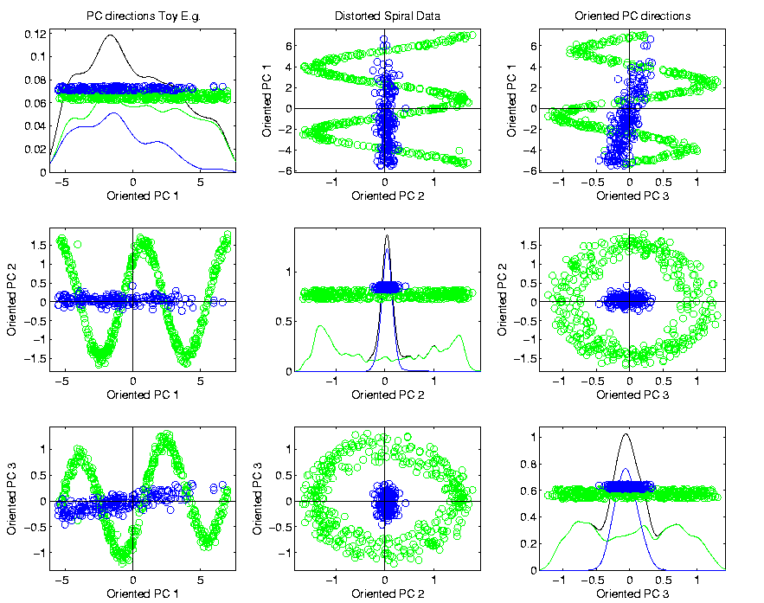
PCA & Graphical Displays
Toy Example (2 colored “clusters” in data)

Slide 62
PCA & Graphical Displays
Toy Example (1 point moved)

Slide 63
PCA & Graphical Displays
Toy Example (1 point moved)
Important
Point:
Constant
Axes

Slide 64
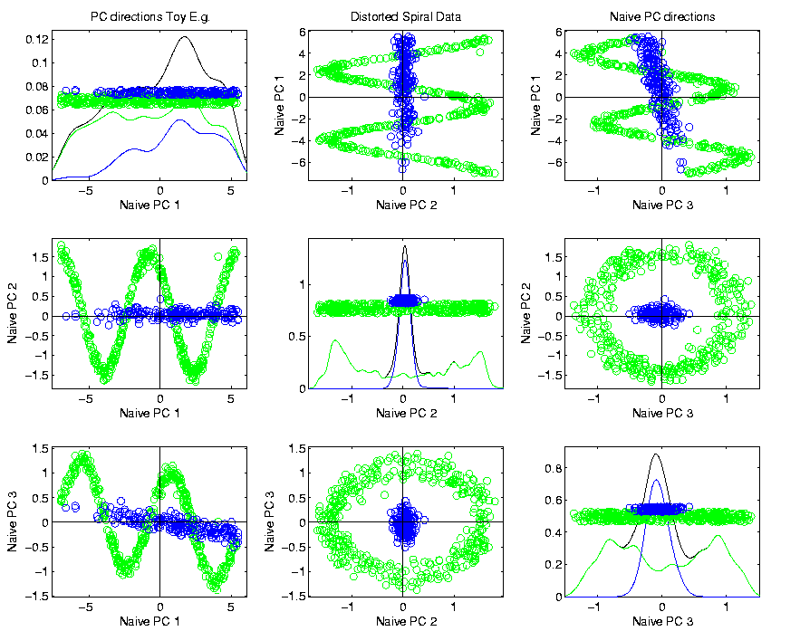
PCA & Graphical Displays
Original Data (arbitrary PC flip)

Slide 65
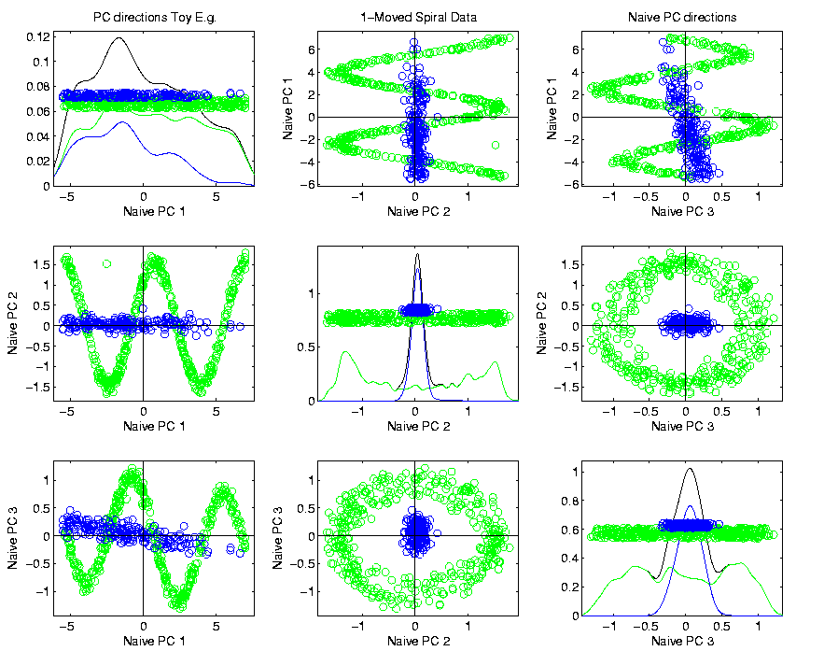
PCA & Graphical Displays
Point Moved Data (arbitrary PC flip)
Much
Harder
To See
Moving
Point

Slide 66
PCA & Graphical Displays
How to “fix directions”?
Personal approach:
Use ± 1 flip that gives:
Max(Proj(X_{i})) > |Min(Proj(X_{i}))|
(assumes 0 centered)

Slide 67
Alternate PCA Computation
Issue: for HDLSS data (recall )
May be Quite Large,

Slide 68
Alternate PCA Computation
Issue: for HDLSS data (recall )
May be Quite Large,
Thus Slow to Work with, and to Compute
What About a Shortcut?

Slide 69
Alternate PCA Computation
Issue: for HDLSS data (recall )
May be Quite Large,
Thus Slow to Work with, and to Compute
What About a Shortcut?
Approach: Singular Value Decomposition
(of (centered, scaled) Data Matrix )

Slide 70
Alternate PCA Computation
Singular Value Decomposition:

Slide 71
Alternate PCA Computation
Singular Value Decomposition:
Where:
is Unitary
is Unitary
is diag’l matrix of singular val’s

Slide 72
Alternate PCA Computation
Singular Value Decomposition:
Where:
is Unitary
is Unitary
is diag’l matrix of singular val’s
Assume: decreasing singular values

Slide 73
Alternate PCA Computation
Singular Value Decomposition:
Recall Relation to Eigen-Analysis of

Slide 74
Alternate PCA Computation
Singular Value Decomposition:
Recall Relation to Eigen-Analysis of
Thus have Same Eigenvector Matrix

Slide 75
Alternate PCA Computation
Singular Value Decomposition:
Recall Relation to Eigen-Analysis of
Thus have Same Eigenvector Matrix
And Eigenval’s are Squares of Singular Val’s

Slide 76
Alternate PCA Computation
Singular Value Decomposition,
Computational Advantage (for Rank ):
Use Compact Form, only need to find
e-vec’s s-val’s scores

Slide 77
Alternate PCA Computation
Singular Value Decomposition,
Computational Advantage (for Rank ):
Use Compact Form, only need to find
e-vec’s s-val’s scores
Other Components not Useful

Slide 78
Alternate PCA Computation
Singular Value Decomposition,
Computational Advantage (for Rank ):
Use Compact Form, only need to find
e-vec’s s-val’s scores
Other Components not Useful
So can be much faster for

Slide 79
Alternate PCA Computation
Another Variation: Dual PCA
Idea: Useful to View Data Matrix

Slide 80
Alternate PCA Computation
Another Variation: Dual PCA
Idea: Useful to View Data Matrix as
Col’ns as Data Objects

Slide 81
Alternate PCA Computation
Another Variation: Dual PCA
Idea: Useful to View Data Matrix as Both
Col’ns as Data Objects
&
Rows as Data Objects

Slide 82
Alternate PCA Computation
Aside on Row-Column Data Object Choice:
Col’ns as Data Objects
&
Rows as Data Objects

Slide 83
Alternate PCA Computation
Aside on Row-Column Data Object Choice:
Personal Choice: (~Matlab,Linear Algebra)
Col’ns as Data Objects
&
Rows as Data Objects

Slide 84
Alternate PCA Computation
Aside on Row-Column Data Object Choice:
Personal Choice: (~Matlab,Linear Algebra)
Another Choice: (~SAS,R, Linear Models)
Variables
Col’ns as Data Objects
&
Rows as Data Objects

Slide 85
Alternate PCA Computation
Aside on Row-Column Data Object Choice:
Personal Choice: (~Matlab,Linear Algebra)
Another Choice: (~SAS,R, Linear Models)
Careful When Discussing!
Col’ns as Data Objects
&
Rows as Data Objects

Slide 86
Alternate PCA Computation
Dual PCA Computation:
Same as above, but replace
with

Slide 87
Alternate PCA Computation
Dual PCA Computation:
Same as above, but replace
with
So can almost replace
with

Slide 88
Alternate PCA Computation
Dual PCA Computation:
Same as above, but replace
with
So can almost replace
with
Then use SVD, , to get:

Slide 89
Alternate PCA Computation
Dual PCA Computation:
Same as above, but replace
with
So can almost replace
with
Then use SVD, , to get:
Note: Same Eigenvalues

Slide 90
Alternate PCA Computation
Appears to be cool symmetry:
Primal ←→ Dual
Loadings ←→ Scores
←→

Slide 91
Alternate PCA Computation
Appears to be cool symmetry:
Primal ←→ Dual
Loadings ←→ Scores
←→
But, there is a problem with the means
and $\sqrt{n−1}$ normalization …

Slide 92
Functional Data Analysis
Recall from 1st Class Meeting:
Spanish Mortality Data

Slide 93
Functional Data Analysis
Interesting Data Set:
Mortality Data
For Spanish Males (thus can relate to history)
Each curve is a single year
x coordinate is age
Note: Choice made of Data Object
(could also study age as curves,
x coordinate = time)

Slide 94
Functional Data Analysis
Important Issue:
What are the Data Objects?
Curves (years) : Mortality vs. Age
Curves (Ages) : Mortality vs. Year
Note: Rows vs. Columns of Data Matrix

Slide 95
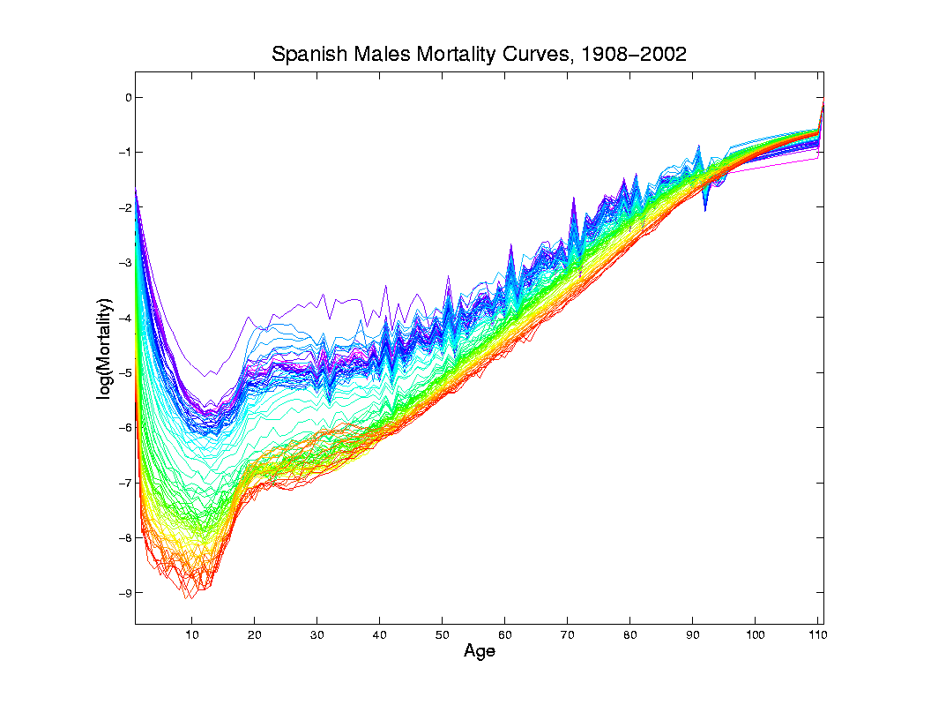
Mortality Time Series
Improved
Coloring:
Rainbow
Representing
Year:
Magenta
= 1908
Red = 2002

Slide 96
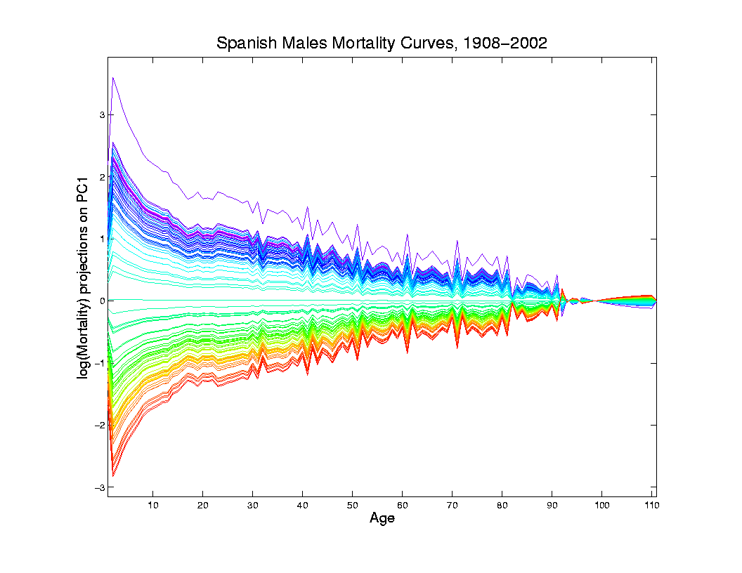
Mortality Time Series
Object Space View of Projections
Onto PC1
Direction
Main Mode
Of Variation:
Constant
Across Ages

Slide 97
Mortality Time Series
Shows Major
Improvement
Over Time
(medical technology,
etc.)
And Change
In Age
Rounding Blips

Slide 98
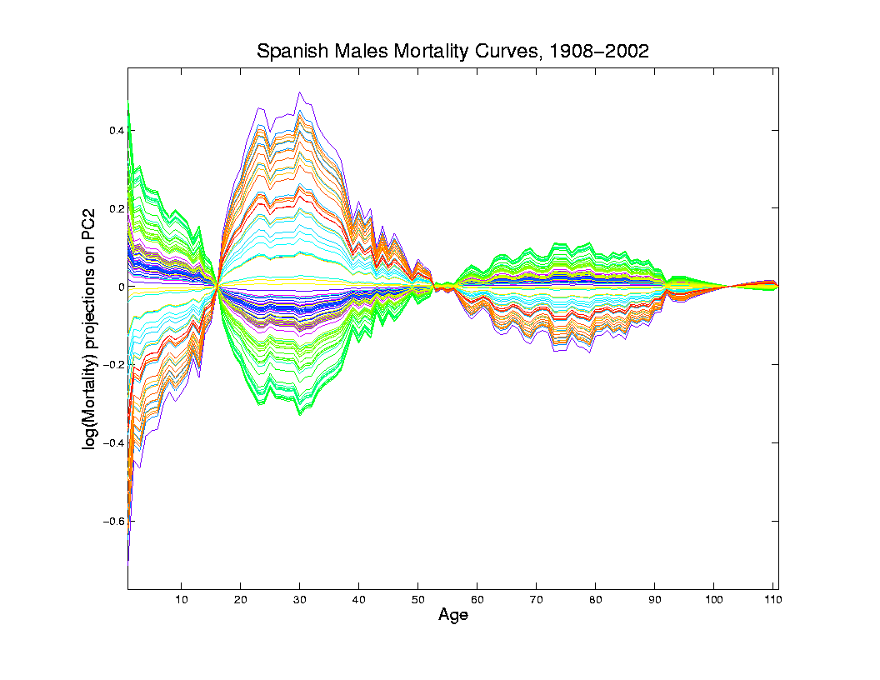
Mortality Time Series
Object Space View of Projections
Onto PC2
Direction
2nd Mode
Of Variation:
Difference
Between
20-45 & Rest

Slide 99
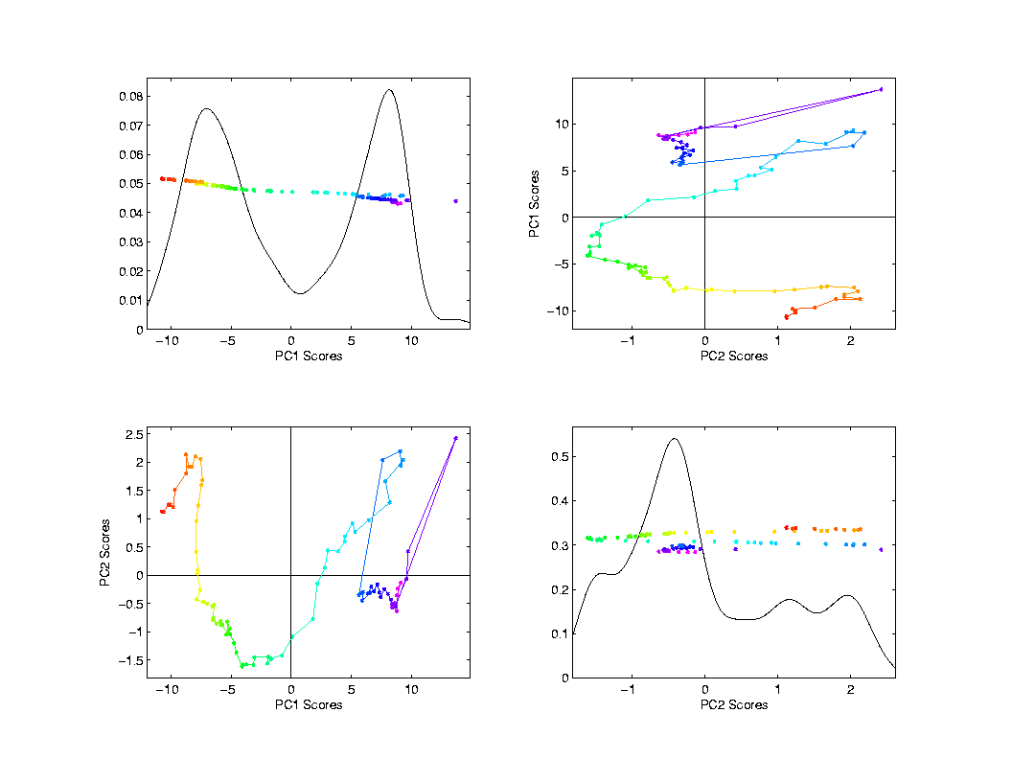
Mortality Time Series
Scores Plot
Feature
(Point Cloud)
Space View
Connecting
Lines
Highlight
Time Order
Good View of
Historical
Effects

Slide 100
Demography Data
Dual PCA
Idea: Rows and Columns trade places
Terminology: from optimization
Insights come from studying “primal” & “dual” problems

Slide 101
Primal / Dual PCA
Consider
“Data Matrix”
Notes:
101

Slide 102
Primal / Dual PCA
Consider
“Data Matrix”
Primal Analysis:
Columns are data vectors
Notes:
102

Slide 103
Primal / Dual PCA
Consider
“Data Matrix”
Dual Analysis:
Rows are data vectors
Notes:
103

Slide 104
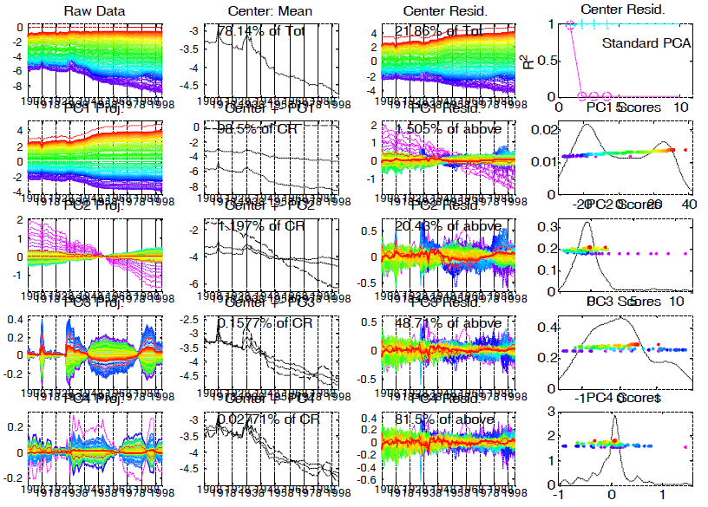
Demography Data
Dual
PCA
Notes:
104

Slide 105
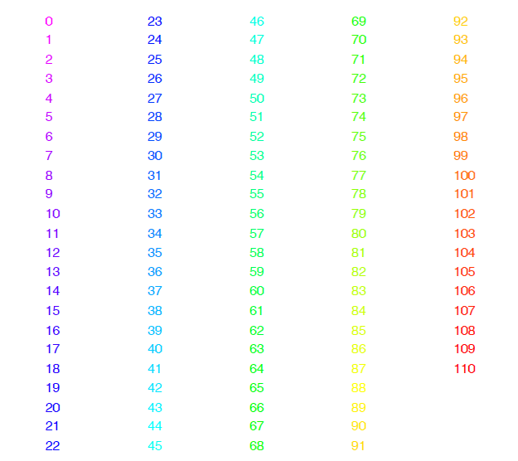
Demography Data
Color Code
(Ages)
Notes:
105

Slide 106
Demography Data
Older People
More At Risk
Of Dying
Notes:
106

Slide 107
Demography Data
Improvement
Over Time
On Average
Notes:
107

Slide 108
Demography Data
Improvement
Over Time
On Average
Except
Flu Pandemic
& Civil War
Notes:
108

Slide 109
Demography Data
PC1: Reflects
Mortality
Higher for
Older People
Notes:
109

Slide 110
Demography Data
PC2: Younger
People
Benefitted
Most From
Improved
Health
Notes:
110

Slide 111
Demography Data
PC3: How
To Interpret?
Notes:
111

Slide 112
Demography Data
Use:
Mean + Max
Mean - Min
Notes:
112

Slide 113
Demography Data
Use:
Mean + Max
Mean – Min
Flu Pandemic
Civil War
Auto Deaths
Notes:
113

Slide 114
Demography Data
PC3 Intepretation:
Mid-Age
Cohort
Notes:
114

Slide 115
Primal / Dual PCA
Which is “Better”?
Same Info,
Displayed
Differently
Here: Prefer
Primal
Notes:
115

Slide 116
Primal / Dual PCA
Which is “Better”?
Same Info,
Displayed
Differently
Here: Prefer
Primal, As Indicated by Graphics Quality
Notes:
116

Slide 117
Primal / Dual PCA
Which is “Better”?
In General:
Either Can Be Best
Try Both and Choose
Or Use “Natural Choice” of
Data Object
Notes:
117

Slide 118
Primal / Dual PCA
Important Early Version:
BiPlot Display
Overlay Primal & Dual PCAs
Not Easy to Interpret
Gabriel, K. R. (1971)
Notes:
118

Slide 119
Return to Big Picture
Main statistical goals of OODA:
Understanding population structure
Low dim’al Projections, PCA …
Classification (i. e. Discrimination)
Understanding 2+ populations
Time Series of Data Objects
Chemical Spectra, Mortality Data
“Vertical Integration” of Data Types

Slide 120
Return to Big Picture
Main statistical goals of OODA:
Understanding population structure
Low dim’al Projections, PCA …
Classification (i. e. Discrimination)
Understanding 2+ populations
Time Series of Data Objects
Chemical Spectra, Mortality Data
“Vertical Integration” of Data Types

Slide 121
Classification - Discrimination
Background: Two Class (Binary) version:
Using “training data” from
Class +1 and Class -1
Develop a “rule” for
assigning new data to a Class
Canonical Example: Disease Diagnosis
New Patients are “Healthy” or “Ill”
Determine based on measurements

Slide 122
Classification - Discrimination
Important Distinction:
Classification vs. Clustering

Slide 123
Classification - Discrimination
Important Distinction:
Classification vs. Clustering
Classification:
Class labels are known,
Goal: understand differences

Slide 124
Classification - Discrimination
Important Distinction:
Classification vs. Clustering
Classification:
Class labels are known,
Goal: understand differences
Clustering:
Goal: Find class labels (to be similar)

Slide 125
Classification - Discrimination
Important Distinction:
Classification vs. Clustering
Classification:
Class labels are known,
Goal: understand differences
Clustering:
Goal: Find class labels (to be similar)
Both are about clumps of similar data,
but much different goals

Slide 126
Classification - Discrimination
Important Distinction:
Classification vs. Clustering
Useful terminology:
Classification: supervised learning
Clustering: unsupervised learning

Slide 127
Classification - Discrimination
Terminology:
For statisticians, these are synonyms

Slide 128
Classification - Discrimination
Terminology:
For statisticians, these are synonyms
For biologists, classification means:
Constructing taxonomies
And sorting organisms into them

Slide 129
Classification - Discrimination
Terminology:
For statisticians, these are synonyms
For biologists, classification means:
Constructing taxonomies
And sorting organisms into them
(maybe this is why discrimination
was used, until politically incorrect…)

Slide 130
Classification (i.e. discrimination)
There are a number of:
Approaches
Philosophies
Schools of Thought
Too often cast as:
Statistics vs. EE - CS

Slide 131
Classification (i.e. discrimination)
EE – CS variations:
Pattern Recognition
Artificial Intelligence
Neural Networks
Data Mining
Machine Learning

Slide 132
Classification (i.e. discrimination)
Differing Viewpoints:
Statistics
Model Classes with Probability Distribut’ns
Use to study class diff’s & find rules

Slide 133
Classification (i.e. discrimination)
Differing Viewpoints:
Statistics
Model Classes with Probability Distribut’ns
Use to study class diff’s & find rules
EE – CS
Data are just Sets of Numbers
Rules distinguish between these

Slide 134
Classification (i.e. discrimination)
Differing Viewpoints:
Statistics
Model Classes with Probability Distribut’ns
Use to study class diff’s & find rules
EE – CS
Data are just Sets of Numbers
Rules distinguish between these
Current thought: combine these

Slide 135
Classification (i.e. discrimination)
Important Overview Reference:
Duda, Hart and Stork (2001)
Too much about neural nets???
Pizer disagrees…
Update of Duda & Hart (1973)

Slide 136
Classification (i.e. discrimination)
For a more classical statistical view:
McLachlan (2004).
Gaussian Likelihood theory, etc.
Not well tuned to HDLSS data
Notes:
136

Slide 137
Classification Basics
Personal Viewpoint: Point Clouds
Notes:
HDLSStmbRaw.ps

Slide 138
Classification Basics
Simple and Natural Approach:
Mean Difference
a.k.a.
Centroid Method
Find “skewer through two meatballs”

Slide 139
Classification Basics
For Simple Toy Example:
Project
On MD
& split
at center
Notes:
HDLSStmbMdif.ps

Slide 140
Classification Basics
Why not use PCA?
Reasonable
Result?
Doesn’t use
class labels…
Good?
Bad?
Notes:
HDLSStmbPCA.ps

Slide 141
Classification Basics
Harder Example (slanted clouds):
Notes:
HDLSSod1Raw.ps

Slide 142
Classification Basics
PCA for slanted clouds:
PC1 terrible
PC2 better?
Still misses
right dir’n
Doesn’t use
Class Labels
Notes:
HDLSSod1PCA.ps

Slide 143
Classification Basics
Mean Difference for slanted clouds:
A little
better?
Still misses
right dir’n
Want to
account for
covariance
Notes:
HDLSSod1Mdif.ps

Slide 144
Classification Basics
Mean Difference & Covariance,
Simplest Approach:
Rescale (standardize) coordinate axes
i. e. replace (full) data matrix:
Then do Mean Difference
Called “Naïve Bayes Approach”

Slide 145
Classification Basics
Naïve Bayes Reference:
Domingos & Pazzani (1997)
Most sensible contexts:
Non-comparable data
E.g. different units

Slide 146
Classification Basics
Problem with Naïve Bayes:
Only adjusts
Variances
Not Covariances
Doesn’t solve
this problem
Notes:
HDLSSod1Raw.ps

Slide 147
Classification Basics
Better Solution: Fisher Linear Discrimination
Gets the
right dir’n
How does
it work?
Notes:
HDLSSod1FLD.ps

