Slide 1
Participant Presentations
Please Sign Up:
Name
Email (Onyen is fine, or …)
Are You ENRolled?
Tentative Title (???? Is OK)
When:
Thurs., Early, Oct., Nov., Late

Slide 2
PCA to find clusters
SiZer analysis of Mass Flux, PC1
Notes:
MassFlux1d1p1s.ps

Slide 3
Detailed Look at PCA
Now Study “Folklore” More Carefully
BackGround
History
Underpinnings
(Mathematical & Computational)
Good Overall Reference: Jolliffe (2002)

Slide 4
Detailed Look at PCA
Three Important (& Interesting) Viewpoints:
Mathematics
Numerics
Statistics
1st: Review Linear Alg. and Multivar. Prob.

Slide 5
Review of Linear Algebra
Vector Space:
set of “vectors”, ,
and “scalars” (coefficients),
“closed” under “linear combination”
( in space)
e.g.
,
“ dim Euclid’n space”

Slide 6
Review of Linear Algebra (Cont.)
Dimension of Subspace (a Notion of “Size”):
Number of Elements in a Basis (Unique)
(Use Basis Above)
e.g. dim of a line is 1
e.g. dim of a plane is 2
Dimension is “Degrees of Freedom”
(in Statistical Uses, e.g. ANOVA)

Slide 7
Review of Linear Algebra (Cont.)
Parseval identity, for
in subsp. gen’d by o. n. basis :
Pythagorean theorem
“Decomposition of Energy”
ANOVA - sums of squares
Transform, , has same length as ,
i.e. “rotation in ”

Slide 8
Review of Linear Algebra (Cont.)
Singular Value Decomposition (SVD):
For a Matrix
Find a Diagonal Matrix ,
with Entries
called Singular Values
And Unitary (Rotation) Matrices ,
(recall )
So That

Slide 9
Review of Linear Algebra (Cont.)
SVD Full Representation:
=
Graphics Display Assumes

Slide 10
Review of Linear Algebra (Cont.)
SVD Full Representation:
=
Full Rank Basis Matrix

Slide 11
Review of Linear Algebra (Cont.)
SVD Full Representation:
=
Full Rank Basis Matrix
All 0s in Bottom

Slide 12
Review of Linear Algebra (Cont.)
SVD Reduced Representation:
=
These Columns Get 0ed Out

Slide 13
Review of Linear Algebra (Cont.)
SVD Reduced Representation:
=

Slide 14
Review of Linear Algebra (Cont.)
SVD Reduced Representation:
=
Also, Some of These May be 0

Slide 15
Review of Linear Algebra (Cont.)
SVD Compact Representation:
=

Slide 16
Review of Linear Algebra (Cont.)
SVD Compact Representation:
=
These Get 0ed Out

Slide 17
Review of Linear Algebra (Cont.)
SVD Compact Representation:
=

Slide 18
Review of Linear Algebra (Cont.)
Eigenvalue Decomposition:
For a (Symmetric) Square Matrix
Find a Diagonal Matrix
And an Orthonormal (Unitary) Matrix
(i.e. )
So that: , i.e.

Slide 19
Review of Linear Algebra (Cont.)
Eigenvalue Decomposition (cont.):
Relation to Singular Value Decomposition
(looks similar?)

Slide 20
Review of Linear Algebra (Cont.)
Eigenvalue Decomposition (cont.):
Relation to Singular Value Decomposition
(looks similar?):
Eigenvalue Decomposition “Looks Harder”
Since Needs

Slide 21
Review of Linear Algebra (Cont.)
Eigenvalue Decomposition (cont.):
Relation to Singular Value Decomposition
(looks similar?):
Eigenvalue Decomposition “Looks Harder”
Since Needs
Price is Eigenvalue Decomp’n is Generally Complex (uses )

Slide 22
Review of Linear Algebra (Cont.)
Eigenvalue Decomposition (cont.):
Relation to Singular Value Decomposition
(looks similar?):
Eigenvalue Decomposition “Looks Harder”
Since Needs
Price is Eigenvalue Decomp’n is Generally Complex (uses )
Except for Square and Symmetric
Then Eigenvalue Decomp. is Real Valued
Thus is the Sing’r Value Decomp. with:

Slide 23
Review of Linear Algebra (Cont.)
Better View of Relationship:
Singular Value Dec. ←→ Eigenvalue Dec.
(better than on previous page)

Slide 24
Review of Linear Algebra (Cont.)
Better View of Relationship:
Singular Value Dec. ←→ Eigenvalue Dec.
Start with data matrix:
With SVD:

Slide 25
Review of Linear Algebra (Cont.)
Better View of Relationship:
Singular Value Dec. ←→ Eigenvalue Dec.
Start with data matrix:
With SVD:
Create square, symmetric matrix:
(Called “Outer Product”)

Slide 26
Review of Linear Algebra (Cont.)
Better View of Relationship:
Singular Value Dec. ←→ Eigenvalue Dec.
Start with data matrix:
With SVD:
Create square, symmetric matrix:
Note that:

Slide 27
Review of Linear Algebra (Cont.)
Better View of Relationship:
Singular Value Dec. ←→ Eigenvalue Dec.
Start with data matrix:
With SVD:
Create square, symmetric matrix:
Note that:
Gives Eigenanalysis,

Slide 28
Review of Linear Algebra (Cont.)
Computation of Singular Value and Eigenvalue Decompositions

Slide 29
Review of Linear Algebra (Cont.)
Computation of Singular Value and Eigenvalue Decompositions:
Details too complex to spend time here
A “primitive” of good software packages

Slide 30
Review of Linear Algebra (Cont.)
Computation of Singular Value and Eigenvalue Decompositions:
Details too complex to spend time here
A “primitive” of good software packages
Eigenvalues are Unique
(Up to )

Slide 31
Review of Linear Algebra (Cont.)
Computation of Singular Value and Eigenvalue Decompositions:
Details too complex to spend time here
A “primitive” of good software packages
Eigenvalues are Unique
Columns of are Called
“Eigenvectors”

Slide 32
Review of Linear Algebra (Cont.)
Computation of Singular Value and Eigenvalue Decompositions:
Details too complex to spend time here
A “primitive” of good software packages
Eigenvalues are Unique
Columns of are Called
“Eigenvectors”
Eigenvectors are “ -Stretched” by :

Slide 33
Review of Linear Algebra (Cont.)
Eigenvalue Decomp. Solves Matrix Problems

Slide 34
Review of Linear Algebra (Cont.)
Eigenvalue Decomp. Solves Matrix Problems:
Inversion:

Slide 35
Review of Linear Algebra (Cont.)
Eigenvalue Decomp. Solves Matrix Problems:
Inversion:
Square Root:

Slide 36
Review of Linear Algebra (Cont.)
Eigenvalue Decomp. Solves Matrix Problems:
Inversion:
Square Root:
is Positive (Nonn’ve, i.e. Semi) Definite all

Slide 37
Recall Linear Algebra (Cont.)
Moore-Penrose Generalized Inverse:
For

Slide 38
Recall Linear Algebra (Cont.)
Easy to see this satisfies the definition of
Generalized (Pseudo) Inverse
symmetric
symmetric

Slide 39
Recall Linear Algebra (Cont.)
Moore-Penrose Generalized Inverse:
Idea: Matrix Inverse on Non-Null Space
of the Corresponding Linear Transformation

Slide 40
Recall Linear Algebra (Cont.)
Moore-Penrose Generalized Inverse:
Idea: Matrix Inverse on Non-Null Space
of the Corresponding Linear Transformation
Reduces to Ordinary Inverse, in Full Rank case,
i.e. for r = d, so could just Always Use This

Slide 41
Recall Linear Algebra (Cont.)
Moore-Penrose Generalized Inverse:
Idea: Matrix Inverse on Non-Null Space
of the Corresponding Linear Transformation
Reduces to Ordinary Inverse, in Full Rank case,
i.e. for r = d, so could just Always Use This
Tricky aspect:
“>0 vs. = 0” & Floating Point Arithmetic

Slide 42
Recall Linear Algebra (Cont.)
Moore-Penrose Generalized Inverse:
Folklore: most multivariate formulas involving matrix inversion “still work” when Generalized Inverse is used instead

Slide 43
Recall Linear Algebra (Cont.)
Moore-Penrose Generalized Inverse:
Folklore: most multivariate formulas involving matrix inversion “still work” when Generalized Inverse is used instead
E.g. Least Squares Projection Formula:
$$X{\left(X^{t}X\right)}^{−1}X^{t}$$

Slide 44
Review of Linear Algebra (Cont.)
Better View of Relationship:
Singular Value Dec. ←→ Eigenvalue Dec.
Start with data matrix:
With SVD:
Create square, symmetric matrix:
Note that:
Gives Eigenanalysis,

Slide 45
Review of Multivariate Probability
Given a Random Vector,

Slide 46
Review of Multivariate Probability
Given a Random Vector,
A Center of the Distribution is the Mean Vector,

Slide 47
Review of Multivariate Probability
Given a Random Vector,
A Center of the Distribution is the Mean Vector,
Note: Component-Wise Calc’n (Euclidean)

Slide 48
Review of Multivariate Probability
Given a Random Vector,
A Measure of Spread is the Covariance Matrix:

Slide 49
Review of Multivar. Prob. (Cont.)
Covariance Matrix:
Noneg’ve Definite (Since all varia’s are ≥ 0)
(i.e. var of any linear combo)

Slide 50
Review of Multivar. Prob. (Cont.)
Covariance Matrix:
Noneg’ve Definite (Since all varia’s are ≥ 0)
Provides “Elliptical Summary of Distribution”
(e.g. Contours of Gaussian Density)

Slide 51
Review of Multivar. Prob. (Cont.)
Covariance Matrix:
Noneg’ve Definite (Since all varia’s are ≥ 0)
Provides “Elliptical Summary of Distribution”
Calculated via “Outer Product”:

Slide 52
Review of Multivar. Prob. (Cont.)
Empirical Versions:
Given a Random Sample

Slide 53
Review of Multivar. Prob. (Cont.)
Empirical Versions:
Given a Random Sample ,
Estimate the Theoretical Mean

Slide 54
Review of Multivar. Prob. (Cont.)
Empirical Versions:
Given a Random Sample ,
Estimate the Theoretical Mean ,
with the Sample Mean:

Slide 55
Review of Multivar. Prob. (Cont.)
Empirical Versions:
Given a Random Sample ,
Estimate the Theoretical Mean ,
with the Sample Mean:
Notation: “hat” for estimate

Slide 56
Review of Multivar. Prob. (Cont.)
Empirical Versions (cont.)
And Estimate the “Theoretical Cov.”

Slide 57
Review of Multivar. Prob. (Cont.)
Empirical Versions (cont.)
And Estimate the “Theoretical Cov.” ,
with the “Sample Cov.”:

Slide 58
Review of Multivar. Prob. (Cont.)
Empirical Versions (cont.)
And Estimate the “Theoretical Cov.” ,
with the “Sample Cov.”:
Normalizations:
Gives Unbiasedness
Gives MLE in Gaussian Case

Slide 59
Review of Multivar. Prob. (Cont.)
Outer Product Representation:

Slide 60
Review of Multivar. Prob. (Cont.)
Outer Product Representation:

Slide 61
Review of Multivar. Prob. (Cont.)
Outer Product Representation:
,
Where:

Slide 62
Review of Multivar. Prob. (Cont.)
Aside on Terminology,
Inner Product:
${\underline{x}}^{t}\underline{y}$

Slide 63
Review of Multivar. Prob. (Cont.)
Aside on Terminology,
Inner Product:
${\underline{x}}^{t}\underline{y}$
=
(scalar)

Slide 64
Review of Multivar. Prob. (Cont.)
Aside on Terminology,
Inner Product: Outer Product:
${\underline{x}}^{t}\underline{y}$ $\underline{x}{\underline{y}}^{t}$
=
(scalar)

Slide 65
Review of Multivar. Prob. (Cont.)
Aside on Terminology,
Inner Product: Outer Product:
${\underline{x}}^{t}\underline{y}$ $\underline{x}{\underline{y}}^{t}$
= =
(scalar) (matrix)

Slide 66
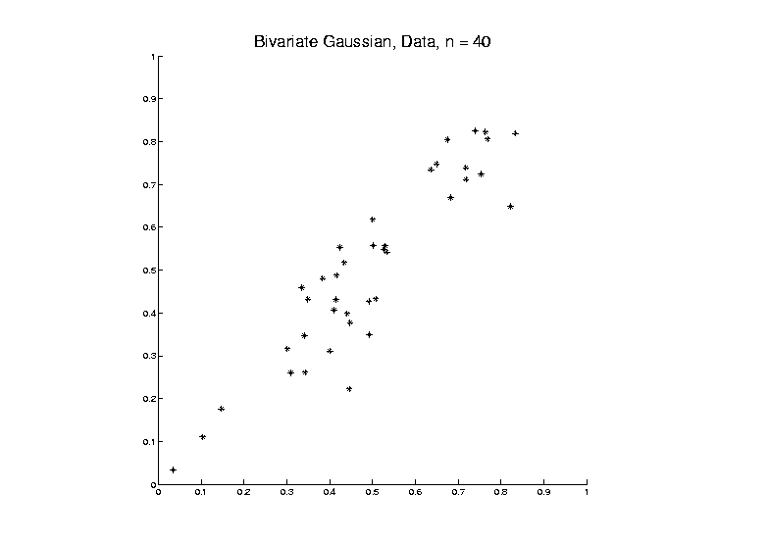
PCA as an Optimization Problem
Find “Direction of Greatest Variability”:

Slide 67
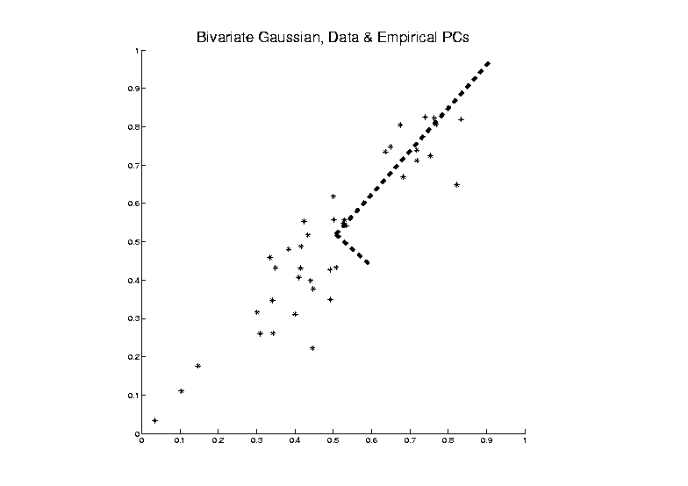
PCA as an Optimization Problem
Find “Direction of Greatest Variability”:

Slide 68
PCA as an Optimization Problem
Find “Direction of Greatest Variability”:
Raw Data

Slide 69
PCA as an Optimization Problem
Find “Direction of Greatest Variability”:
Mean
Residuals
(Shift to
Origin)

Slide 70
PCA as an Optimization Problem
Find “Direction of Greatest Variability”:
Mean
Residuals
(Shift to
Origin)

Slide 71
PCA as an Optimization Problem
Find “Direction of Greatest Variability”:
Centered
Data

Slide 72
PCA as an Optimization Problem
Find “Direction of Greatest Variability”:
Centered
Data
Projections

Slide 73
PCA as an Optimization Problem
Find Direction of Greatest Variability:
Centered
Data
Projections
Direction
Vector

Slide 74
PCA as Optimization (Cont.)
Find Direction of Greatest Variability:
Given a Direction Vector, (i.e. )
(Variable, Over Which Will Optimize)

Slide 75
PCA as Optimization (Cont.)
Find Direction of Greatest Variability:
Given a Direction Vector, (i.e. )
Projection of in the Direction :

Slide 76
PCA as Optimization (Cont.)
Find Direction of Greatest Variability:
Given a Direction Vector, (i.e. )
Projection of in the Direction :
Variability in the Direction :

Slide 77
PCA as Optimization (Cont.)
Find Direction of Greatest Variability:
Given a Direction Vector, (i.e. )
Projection of in the Direction :
Variability in the Direction :

Slide 78
PCA as Optimization (Cont.)
Find Direction of Greatest Variability:
Given a Direction Vector, (i.e. )
Projection of in the Direction :
Variability in the Direction :

Slide 79
PCA as Optimization (Cont.)
Variability in the Direction :

Slide 80
PCA as Optimization (Cont.)
Variability in the Direction :
i.e. (Proportional to) a
Quadratic Form in the Covariance Matrix

Slide 81
PCA as Optimization (Cont.)
Variability in the Direction :
i.e. (Proportional to) a
Quadratic Form in the Covariance Matrix
Simple Solution Comes from the Eigenvalue Representation of :

Slide 82
PCA as Optimization (Cont.)
Variability in the Direction :
i.e. (Proportional to) a
Quadratic Form in the Covariance Matrix
Simple Solution Comes from the Eigenvalue Representation of :
Where is Orthonormal, &

Slide 83
PCA as Optimization (Cont.)
Variability in the Direction :

Slide 84
PCA as Optimization (Cont.)
Variability in the Direction :
But

Slide 85
PCA as Optimization (Cont.)
Variability in the Direction :
But = “ Transform of ”

Slide 86
PCA as Optimization (Cont.)
Variability in the Direction :
But = “ Transform of ”
= “ Rotated into Coordinates”,

Slide 87
PCA as Optimization (Cont.)
Variability in the Direction :
But = “ Transform of ”
= “ Rotated into Coordinates”,
and the Diagonalized Quadratic Form Becomes

Slide 88
PCA as Optimization (Cont.)
Now since is an Orthonormal Basis Matrix,
and

Slide 89
PCA as Optimization (Cont.)
Now since is an Orthonormal Basis Matrix,
and
So the Rotation Gives a Distribution of the Energy of Over the Eigen-Directions

Slide 90
PCA as Optimization (Cont.)
Now since is an Orthonormal Basis Matrix,
and
So the Rotation Gives a Distribution of the Energy of Over the Eigen-Directions
And is Max’d (Over ), by Putting all Energy in the “Largest Direction”, i.e. ,
Where “Eigenvalues are Ordered”,

Slide 91
PCA as Optimization (Cont.)
Notes:
Solution is Unique when

Slide 92
PCA as Optimization (Cont.)
Notes:
Solution is Unique when
Else have Sol’ns in Subsp. Gen’d by 1st s

Slide 93
PCA as Optimization (Cont.)
Notes:
Solution is Unique when
Else have Sol’ns in Subsp. Gen’d by 1st s
Projecting onto Subspace to ,
Gives as Next Direction

Slide 94
PCA as Optimization (Cont.)
Notes:
Solution is Unique when
Else have Sol’ns in Subsp. Gen’d by 1st s
Projecting onto Subspace to ,
Gives as Next Direction
Continue Through ,…,

Slide 95
Iterated PCA Visualization

Slide 96
PCA as Optimization (Cont.)
Notes:
Solution is Unique when
Else have Sol’ns in Subsp. Gen’d by 1st s
Projecting onto Subspace to ,
Gives as Next Direction
Continue Through ,…,
Replace by to get Theoretical PCA
Estimated by the Empirical Version

Slide 97
PCA as Optimization (Cont.)

Slide 98
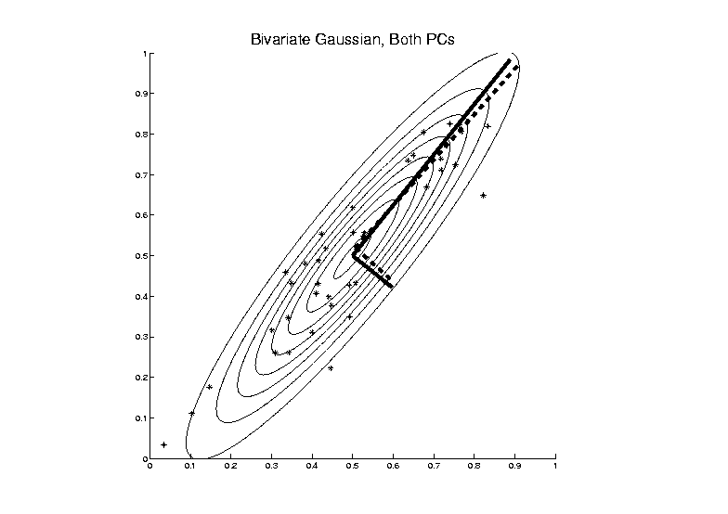
PCA as Optimization (Cont.)

Slide 99
Connect Math to Graphics
2-d Toy Example
Descriptor Space Object Space
Scatterplot View Parallel Coordinate View

Slide 100
Connect Math to Graphics
2-d Toy Example
Descriptor Space Object Space
Data Points (Curves) are columns of data matrix, X

Slide 101
Connect Math to Graphics (Cont.)
2-d Toy Example
Descriptor Space Object Space
Sample Mean, X

Slide 102
Connect Math to Graphics (Cont.)
2-d Toy Example
Descriptor Space Object Space
Residuals from Mean = Data - Mean

Slide 103
Connect Math to Graphics (Cont.)
2-d Toy Example
Descriptor Space Object Space
Recentered Data = Mean Residuals, shifted to 0
= (rescaling of) X

Slide 104
Connect Math to Graphics (Cont.)
2-d Toy Example
Descriptor Space Object Space
PC1 Direction = η = Eigenvector (w/ biggest λ)

Slide 105
Connect Math to Graphics (Cont.)
2-d Toy Example
Descriptor Space Object Space
Centered Data PC1 Projection Residual

Slide 106
Connect Math to Graphics (Cont.)
2-d Toy Example
Descriptor Space Object Space
Centered Data PC1 Projection Residual
Best 1-d Approx’s of Data

Slide 107
Connect Math to Graphics (Cont.)
2-d Toy Example
Descriptor Space Object Space
PC2 Direction = η = Eigenvector (w/ 2nd biggest λ)

Slide 108
Connect Math to Graphics (Cont.)
2-d Toy Example
Descriptor Space Object Space
Centered Data PC2 Projection Residual

Slide 109
Connect Math to Graphics (Cont.)
2-d Toy Example
Descriptor Space Object Space
Centered Data PC2 Projection Residual
Worst 1-d Approx’s of Data

Slide 110
Connect Math to Graphics (Cont.)
Note for this 2-d Example:
PC1 Residuals = PC2 Projections
PC2 Residuals = PC1 Projections
(i.e. colors common across these pics)

Slide 111
PCA Redistribution of Energy
Convenient Summary of Amount of Structure:
Total Sum of Squares

Slide 112
PCA Redistribution of Energy
Convenient Summary of Amount of Structure:
Total Sum of Squares
Physical Interpetation:
Total Energy in Data

Slide 113
PCA Redistribution of Energy
Convenient Summary of Amount of Structure:
Total Sum of Squares
Physical Interpetation:
Total Energy in Data
(Signal Processing Literature)

Slide 114
PCA Redistribution of Energy
Convenient Summary of Amount of Structure:
Total Sum of Squares
Physical Interpetation:
Total Energy in Data
Insight comes from decomposition

Slide 115
PCA Redistribution of Energy
Convenient Summary of Amount of Structure:
Total Sum of Squares
Physical Interpetation:
Total Energy in Data
Insight comes from decomposition
Statistical Terminology:
ANalysis Of VAriance (ANOVA)

Slide 116
PCA Redist’n of Energy (Cont.)
ANOVA Mean Decomposition:
Total Variation

Slide 117
PCA Redist’n of Energy (Cont.)
ANOVA Mean Decomposition:
Total Variation =
= Mean Variation + Mean Residual Variation

Slide 118
PCA Redist’n of Energy (Cont.)
ANOVA Mean Decomposition:
Total Variation =
= Mean Variation + Mean Residual Variation
Mathematics: Pythagorean Theorem

Slide 119
PCA Redist’n of Energy (Cont.)
ANOVA Mean Decomposition:
Total Variation =
= Mean Variation + Mean Residual Variation
Mathematics: Pythagorean Theorem
Intuition Quantified via Sums of Squares

Slide 120
Connect Math to Graphics (Cont.)
2-d Toy Example
Descriptor Space Object Space
Residuals from Mean

Slide 121
Connect Math to Graphics (Cont.)
2-d Toy Example
Descriptor Space Object Space
Residuals from Mean = Data – Mean

Slide 122
Connect Math to Graphics (Cont.)
2-d Toy Example
Descriptor Space Object Space
Residuals from Mean = Data – Mean

Slide 123
Connect Math to Graphics (Cont.)
2-d Toy Example
Descriptor Space Object Space
Residuals from Mean = Data – Mean
Most of Variation

Slide 124
Connect Math to Graphics (Cont.)
2-d Toy Example
Descriptor Space Object Space
Residuals from Mean = Data – Mean
Most of Variation = 92% is Mean Variation SS

Slide 125
Connect Math to Graphics (Cont.)
2-d Toy Example
Descriptor Space Object Space
Residuals from Mean = Data – Mean
Most of Variation = 92% is Mean Variation SS
Remaining Variation = 8% is Resid. Var. SS

Slide 126
PCA Redist’n of Energy (Cont.)
Have already studied this decomposition (recall curve e.g.)
Notes:
126

Slide 127
PCA Redist’n of Energy (Cont.)
Have already studied this decomposition (recall curve e.g.)
Variation (SS) due to Mean (% of total)
Notes:
127

Slide 128
PCA Redist’n of Energy (Cont.)
Have already studied this decomposition (recall curve e.g.)
Variation (SS) due to Mean (% of total)
Variation (SS) of Mean Residuals (% of total)
Notes:
128

Slide 129
PCA Redist’n of Energy (Cont.)
Now Decompose SS About the Mean
where:
Notes:
129

Slide 130
PCA Redist’n of Energy (Cont.)
Now Decompose SS About the Mean
where:
Recall: Can Commute Matrices Inside Trace
Notes:
130

Slide 131
PCA Redist’n of Energy (Cont.)
Now Decompose SS About the Mean
where:
Recall: Cov Matrix is Outer Product
Notes:
131

Slide 132
PCA Redist’n of Energy (Cont.)
Now Decompose SS About the Mean
where:
i.e. Energy is Expressed in Trace of Cov Matrix
Notes:
132

Slide 133
PCA Redist’n of Energy (Cont.)
(Using Eigenvalue Decomp. Of Cov Matrix)
Notes:
133

Slide 134
PCA Redist’n of Energy (Cont.)
(Commute Matrices Within Trace)
Notes:
134

Slide 135
PCA Redist’n of Energy (Cont.)
(Since Basis Matrix is Orthonormal)
Notes:
135

Slide 136
PCA Redist’n of Energy (Cont.)
Eigenvalues Provide Atoms of SS Decompos’n
Notes:
136

Slide 137
PCA Redist’n of Energy (Cont.)
Eigenvalues Provide Atoms of SS Decompos’n
Useful Plots are:
Power Spectrum: vs.
Notes:
137

Slide 138
PCA Redist’n of Energy (Cont.)
Eigenvalues Provide Atoms of SS Decompos’n
Useful Plots are:
Power Spectrum: vs.
log Power Spectrum: vs.
(Very Useful When Are Orders of Mag. Apart)
Notes:
138

Slide 139
PCA Redist’n of Energy (Cont.)
Eigenvalues Provide Atoms of SS Decompos’n
Useful Plots are:
Power Spectrum: vs.
log Power Spectrum: vs.
Cumulative Power Spectrum: vs.
Notes:
139

Slide 140
PCA Redist’n of Energy (Cont.)
Eigenvalues Provide Atoms of SS Decompos’n
Useful Plots are:
Power Spectrum: vs.
log Power Spectrum: vs.
Cumulative Power Spectrum: vs.
Note PCA Gives SS’s for Free (As Eigenval’s),
But Watch Factors of
Notes:
140

Slide 141
PCA Redist’n of Energy (Cont.)
Note, have already considered some of these Useful Plots:
Notes:
141

Slide 142
PCA Redist’n of Energy (Cont.)
Note, have already considered some of these Useful Plots:
Power Spectrum
Notes:
142

Slide 143
PCA Redist’n of Energy (Cont.)
Note, have already considered some of these Useful Plots:
Power Spectrum
Cumulative Power Spectrum
Notes:
143

