Slide 1
Robust PCA
Robust PCA 3:
Spherical
PCA

Slide 2
Robust PCA
Spherical PCA Problem :
Magnification of High Freq. Coeff’s
Solution : Elliptical Analysis
Background (Univariate):
MAD = Median Absolute Deviation
MAD = $median\left|X_{i}−median\left(X_{i}\right)\right|$
Simple, High Breakdown, Outlier Resistant, Measure of “Scale”
Notes:
2

Slide 3
Robust PCA
Rescale
Coords
Spherical PCA
Unscale
Coords

Slide 4
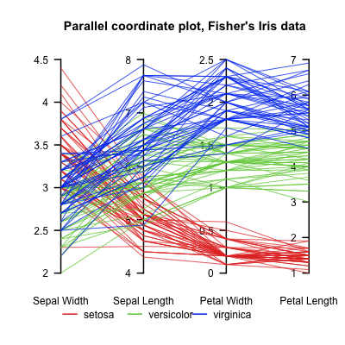
Aside On Visualization
Another Multivariate Data Visualization Tool:
Parallel Coordinates
Forgot to Give Citations:
Inselberg (1985, 2009)
Notes:
4

Slide 5
Big Picture View of PCA
Alternate Viewpoint: Gaussian Likelihood
When data are multivariate Gaussian
PCA finds major axes of ellipt’al contours
of Probability Density
Maximum Likelihood Estimate
Mistaken idea:
PCA only useful for Gaussian data

Slide 6
Big Picture View of PCA
Raw Cornea Data:
Data – Median
(Data – Median)
-------------------
MAD

Slide 7
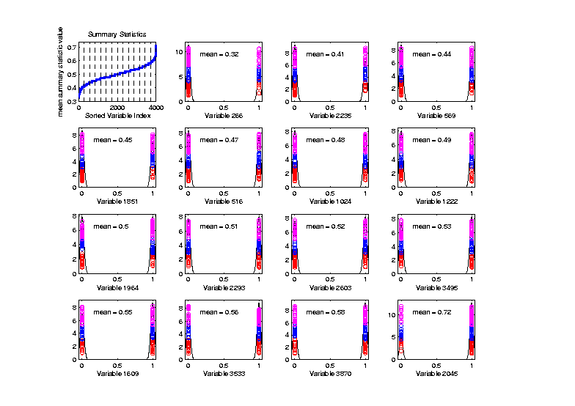
Big Picture View of PCA
Mistaken idea:
PCA only useful for Gaussian data
Toy Example:
Each Marginal
Binary
Clearly NOT
Gaussian
n = 100, d = 4000

Slide 8
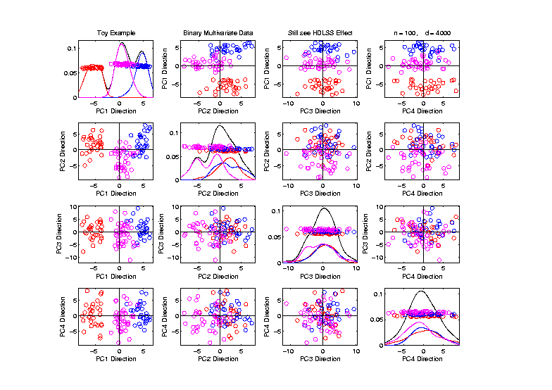
Big Picture View of PCA
Mistaken idea:
PCA only useful for Gaussian data
But PCA
Reveals
Trimodal
Structure

Slide 9
Correlation PCA
A related (& better known) variation of PCA:
Replace cov. matrix with correlation matrix
I.e. do eigen analysis of
Where

Slide 10
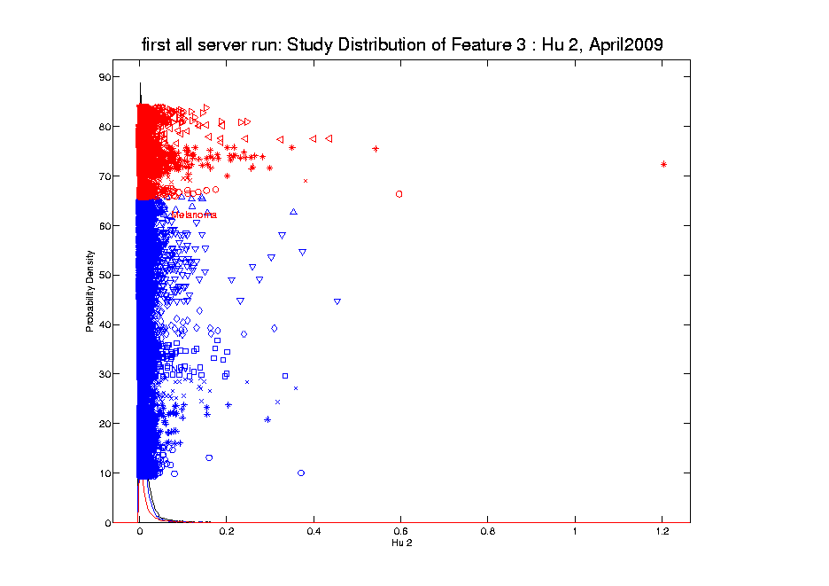
Transformations
Another Feature with Large Values
Approach:
Shifted
Log:
$$log\left(∙+δ\right)$$
Need to
Tune

Slide 11
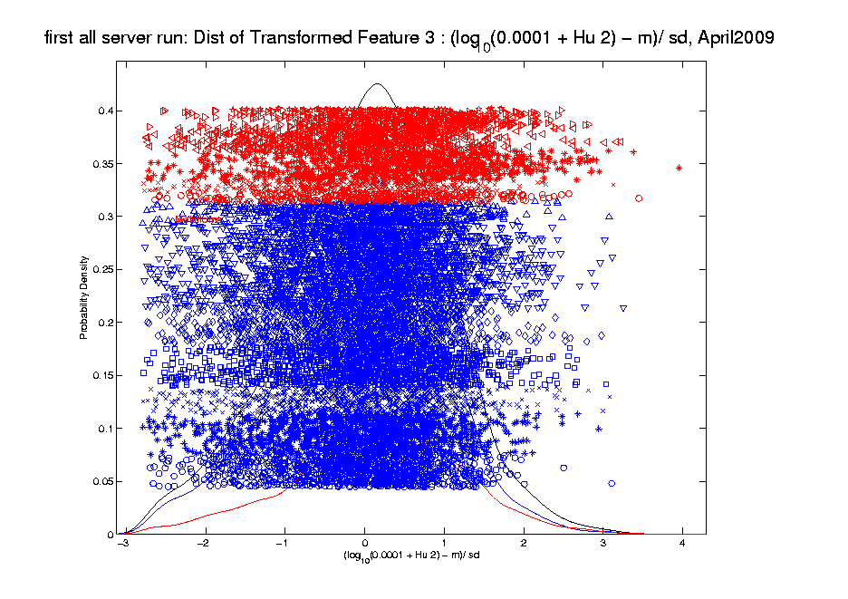
Transformations
Much Nicer Distribution

Slide 12
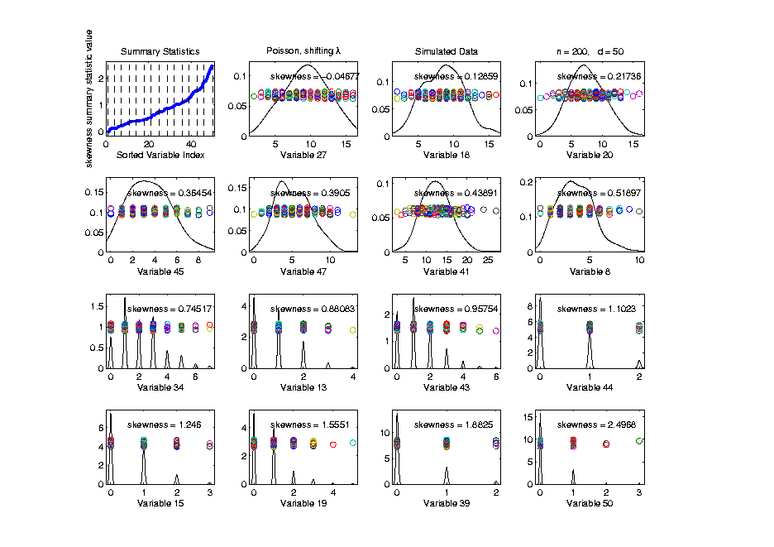
Transformations
Useful Visualization: MargDistPlot
Change
Summary
To
Skewness
Most/Least
Symmetric

Slide 13
Clusters in data
Common Statistical Task:
Find Clusters in Data
Interesting sub-populations?
Important structure in data?
How to do this?
PCA provides very simple approach
There is a large literature of other methods
(will study more later)

Slide 14
PCA to find clusters
Recall Toy Example with more clusters:

Slide 15
PCA to find clusters
Best revealed by 2d scatterplots (4 clusters):

Slide 16
PCA to find clusters
A deeper example:
Mass Flux Data
Data from Enrica Bellone,
National Center for Atmospheric Research
Mass Flux for quantifying cloud types
How does mass change when moving into a cloud

Slide 17
PCA to find clusters
PCA of Mass Flux Data:

Slide 18
PCA to find clusters
Summary of PCA of Mass Flux Data:
Mean:
Captures General Mountain Shape
PC1:
Generally overall height of peak
shows up nicely in mean +- plot (2nd col)
3 apparent clusters in scores plot
Are those “really there”?
If so, could lead to interesting discovery
If not, could waste effort in investigation

Slide 19
PCA to find clusters
Summary of PCA of Mass Flux Data:
PC2:
Location of peak
again mean +- plot very useful here
PC3:
Width adjustment
again see most clearly in mean +- plot
Maybe non-linear modes of variation???

Slide 20
PCA to find clusters
Return to Investigation of PC1 Clusters:
Can see 3 bumps in smooth histogram
Main Question:
Important structure
or
sampling variability?
Approach: SiZer
(SIgnificance of ZERo crossings of deriv.)

Slide 21
Statistical Smoothing
In 1 Dimension
(Numbers as Data Objects)

Slide 22
Statistical Smoothing
In 1 Dimension, 2 Major Settings:
Density Estimation
“Histograms”
Nonparametric Regression
“Scatterplot Smoothing”

Slide 23
Density Estimation
E.g. Hidalgo Stamp Data
Thicknesses of Postage Stamps
Produced in Mexico
Over ~ 70 years
During 1800s
Paper produced in several factories?
How many factories? (Records lost)
Brought to statistical literature by:
Izenman and Sommer (1988)

Slide 24
Density Estimation
E.g. Hidalgo Stamp Data
Thicknesses of Postage Stamps
Produced in Mexico
Over ~ 70 years
During 1800s
Paper produced in several factories?
(Thicknesses vary by up to factor of 2)

Slide 25
Density Estimation
E.g. Hidalgo Stamp Data
A histogram
“Oversmoothed”
Bin Width too
large?
Miss important
structure?

Slide 26
Density Estimation
E.g. Hidalgo Stamp Data
Another histogram
Smaller binwidth
Suggests 2 modes?
2 factories making
the paper?

Slide 27
Density Estimation
E.g. Hidalgo Stamp Data
Another histogram
Smaller binwidth
Suggests 6 modes?
6 factories making
the paper?

Slide 28
Density Estimation
E.g. Hidalgo Stamp Data
Another histogram
Even smaller binwidth
Suggests many modes?
Really believe
modes are “there”?
Or just sampling
variation?

Slide 29
Density Estimation
E.g. Hidalgo Stamp Data
Critical Issue for histograms:
Choice of binwidth (well understood?)

Slide 30
Histograms
Less Well Understood issue:
Choice of bin location
Major impact on number of modes (2-7)
All for same binwidth

Slide 31
Histograms
Choice of bin location:
What is going on?
Compare with Average Histogram

Slide 32
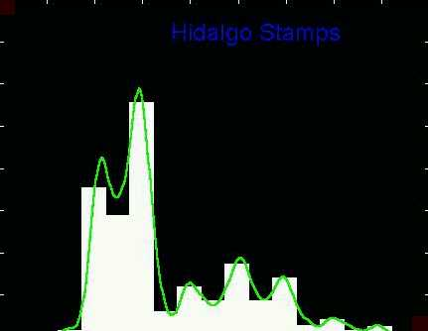
Density Estimation
Compare shifts with Average Histogram
For 7 mode shift
Peaks line up with bin centers
So shifted histo’s
find peaks

Slide 33
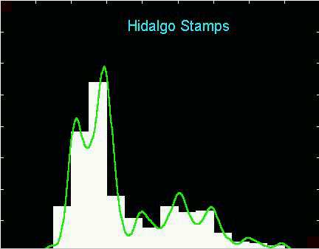
Density Estimation
Compare shifts with Average Histogram
For 2 (3?) mode shift
Peaks split between bins
So shifted histo’s
miss peaks

Slide 34
Density Estimation
Histogram Drawbacks:
Need to choose bin width
Need to choose bin location
But Average Histogram reveals structure
So should use that, instead of histo
Name: Kernel Density Estimate

Slide 35
Kernel Density Estimation
Chondrite Data:
Stony (metal) Meteorites (hit the earth)
So have a chunk of rock
Study “% of silica”
From how many sources?
Only 22 rocks…
Histogram hopeless?
Brought to statistical literature by:
Good and Gaskins (1980)

Slide 36
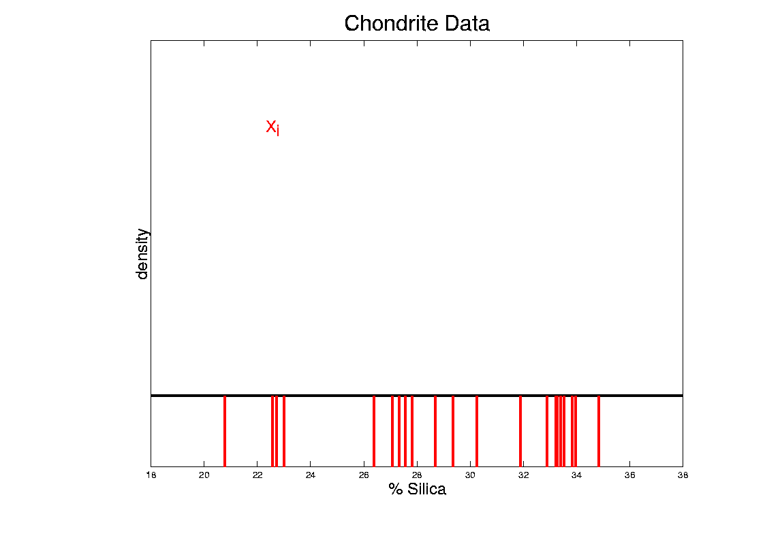
Kernel Density Estimation
Chondrite Data:
Represent points by red bars
Where are data “more dense”?

Slide 37
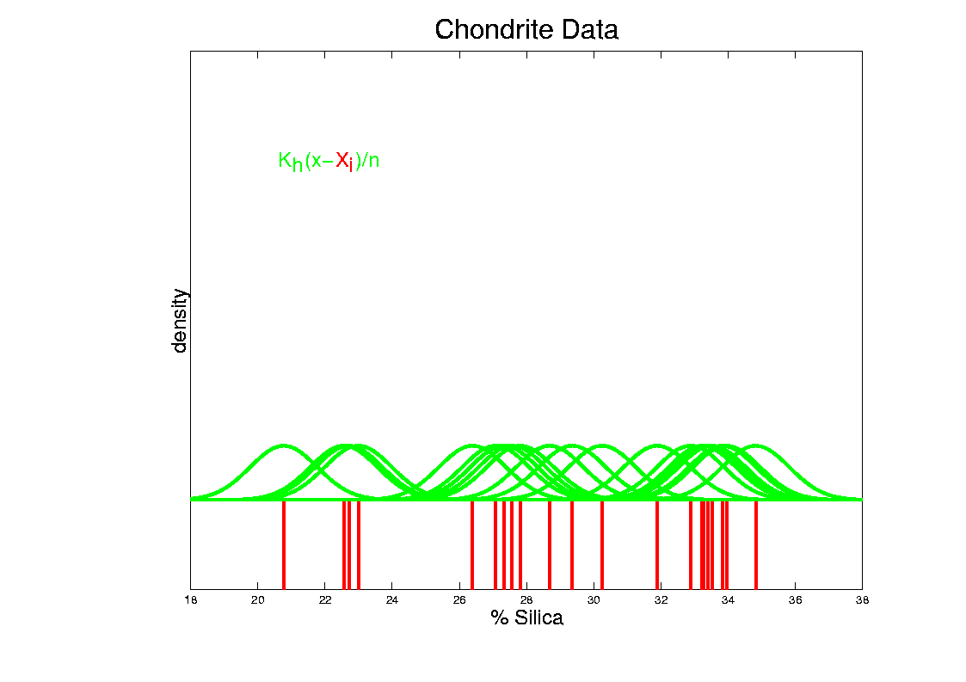
Kernel Density Estimation
Chondrite Data:
Put probability mass 1/n at each point
Smooth piece of “density”

Slide 38
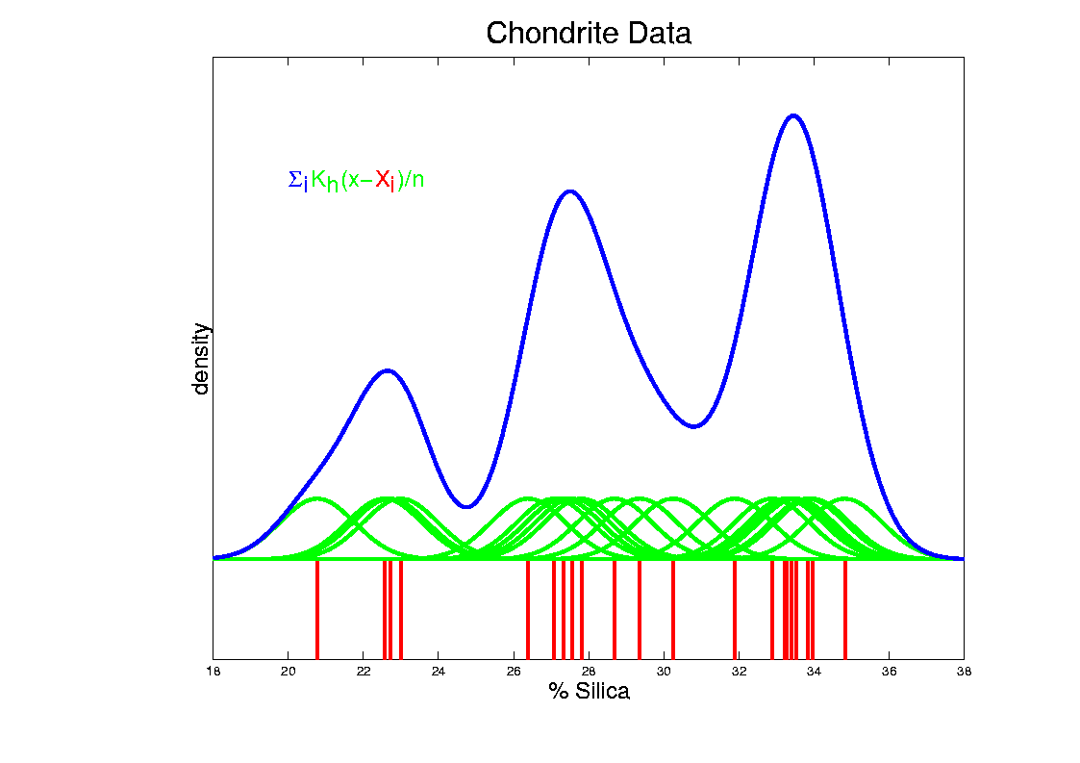
Kernel Density Estimation
Chondrite Data:
Sum pieces to estimate density
Suggests 3 modes (rock sources)

Slide 39
Kernel Density Estimation
Mathematical Notation:
Where
Window shape given by “kernel”,
Window width given by “bandwidth”,

Slide 40
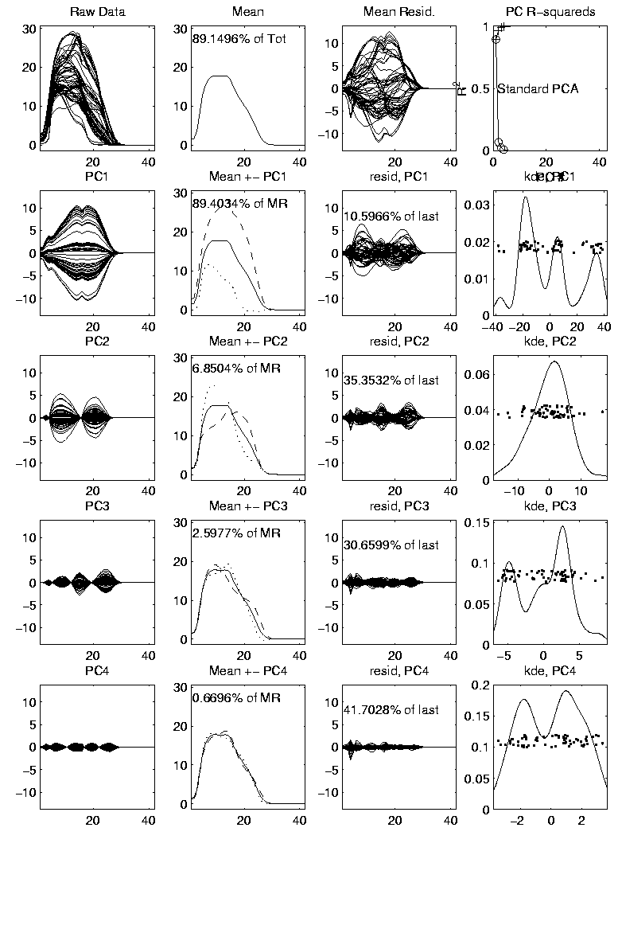
Kernel Density Estimation
Mathematical Notation:
This
Was
Used
In PCA
Graphics

Slide 41
Kernel Density Estimation
Choice of kernel (window shape)?
Controversial issue
Want Computational Speed?
Want Statistical Efficiency?
Want Smooth Estimates?
There is more, but personal choice:
Gaussian
Good Overall Reference:
Wand and Jones (1994)

Slide 42
Kernel Density Estimation
Choice of bandwidth (window width)?
Very important to performance
Fundamental Issue:
Which modes are “really there”?

Slide 43
Density Estimation
How to use histograms if you must:
Undersmooth (minimizes bin edge effect)
Human eye is OK at “post-smoothing”

Slide 44
Statistical Smoothing
2 Major Settings:
Density Estimation
“Histograms”
Nonparametric Regression
“Scatterplot Smoothing”

Slide 45
Scatterplot Smoothing
E.g. Bralower Fossil Data
Prof. of Geosciences
Penn. State Univ.

Slide 46
Scatterplot Smoothing
E.g. Bralower Fossil Data
Study Global Climate
Time scale of millions of years
Data points are fossil shells
Dated by surrounding material
Ratio of Isotopes of Strontium
(differences in 4th decimal point!)
Surrogate for Sea Level (Ice Ages)
Data seem to have structure…

Slide 47
Scatterplot Smoothing
E.g. Bralower Fossil Data

Slide 48
Scatterplot Smoothing
E.g. Bralower Fossil Data
Way to bring out structure:
Smooth the data
Methods of smoothing?
Local Averages
Splines (several types)
Fourier – trim high frequencies
Other bases
…
Also controversial

Slide 49
Scatterplot Smoothing
E.g. Bralower Fossil Data – some smooths

Slide 50
Scatterplot Smoothing
A simple approach: local averages
Given data:
Model in regression form:
How to estimate ?

Slide 51
Scatterplot Smoothing
A simple approach: local averages
Given a kernel window function:
Estimate the curve
by a weighted local average:

Slide 52
Scatterplot Smoothing
Interesting representation of local average:
Given kernel window weights,
Local constant fit to data:

Slide 53
Scatterplot Smoothing
Local Constant Fits (visually):
“Moving Average”
Window width is critical (~ k.d.e.)

Slide 54
Scatterplot Smoothing
Interesting variation:
Local linear fit to data:
Given kernel window weights,

Slide 55
Scatterplot Smoothing
Local Linear Fits (visually):
“Intercept of Moving Fit Line”
Window width is critical (~ k.d.e.)

Slide 56
Scatterplot Smoothing
Another variation:
“Intercept of Moving Polynomial Fit”
Window width is critical (~ k.d.e.)

Slide 57
Scatterplot Smoothing
Local Polynomial Smoothing
What is best polynomial degree?
Once again controversial…
Advocates for all of 0, 1, 2, 3.
Depends on personal weighting of factors involved
Good reference:
Fan & Gijbels (1995)
Personal choice: degree 1, local linear

Slide 58
Scatterplot Smoothing
E.g. Bralower Fossils – local linear smooths

Slide 59
Scatterplot Smoothing
Smooths of Bralower Fossil Data:
Oversmoothed misses structure
Undersmoothed feels sampling noise?
About right shows 2 valleys:
One seems clear
Is other one really there?
Same question as above…

Slide 60
Kernel Density Estimation
Choice of bandwidth (window width)?
Very important to performance
Fundamental Issue:
Which modes are “really there”?

Slide 61
Kernel Density Estimation
Choice of bandwidth (window width)?
Very important to performance
Data Based Choice?
Controversial Issue
Many recommendations
Suggested Reference:
Jones, Marron & Sheather (1996)
Never a consensus…

Slide 62
Kernel Density Estimation
Choice of bandwidth (window width)?
Alternate Choice:
Consider all of them!
I.e. look at whole spectrum of smooths
Can see different structure
At different smoothing levels
Connection to Scale Space
E.g. Stamps data
How many modes?
All answers are there….

Slide 63
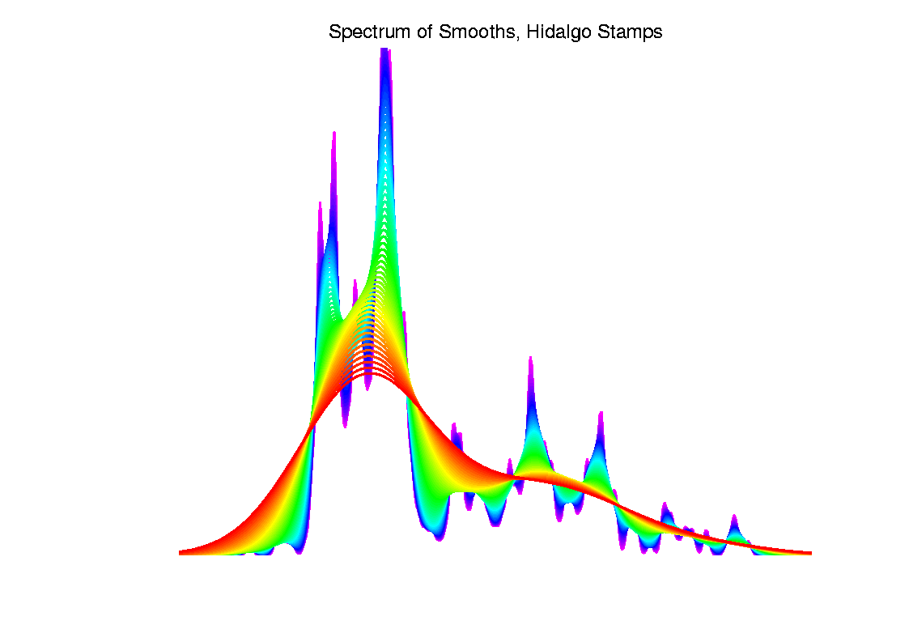
Kernel Density Estimation

Slide 64
Statistical Smoothing
Fundamental Question
For both of
Density Estimation: “Histograms”
Regression: “Scatterplot Smoothing”
Which bumps are “really there”?
vs. “artifacts of sampling noise”?

