Slide 1
Matlab Software
Want to try similar analyses?
Matlab Available from UNC Site License
Download Software:
Google “Marron Software”

Slide 2
Cornea Data
Cornea Data:
Raw Data
Decompose
Into
Modes of
Variation?

Slide 3
PCA of Cornea Data
PC1 Movie:

Slide 4
PCA of Cornea Data
PC1 Summary:
Mean (1st image): mild vert’l astigmatism
known pop’n structure called “with the rule”
Main dir’n: “more curved” & “less curved”
Corresponds to first optometric measure
(89% of variat’n, in Mean Resid. SS sense)
Also: “stronger astig’m” & “no astig’m”
Found corr’n between astig’m and curv’re
Scores (blue): Apparent Gaussian dist’n

Slide 5
PCA of Cornea Data
PC2 Movie:

Slide 6
PCA of Cornea Data
PC2 Movie:
Mean: same as above
Common centerpoint of point cloud
Are studying “directions from mean”
Images along direction vector:
Looks terrible???
Why?

Slide 7
Outliers in PCA
Motivates alternate approach:
Robust Statistical Methods
Recall main idea:
Downweight (instead of delete) outliers
a large literature. Good intro’s
(from different viewpoints) are:
Huber (1981)
Hampel, et al (1986)
Staudte & Sheather (1990)

Slide 8
Robust PCA
What is multivariate median?
There are several!
(“median” generalizes in different ways)
Coordinate-wise median
Often worst
Not rotation invariant
(2-d data uniform on “L”)
Can lie on convex hull of data
(same example)
Thus poor notion of “center”

Slide 9
Robust PCA
What is multivariate median (cont.)?
iii. Huber’s M-estimate:
Given data ,
Estimate “center of population” by
Where is the usual Euclidean norm
Here: use only
(minimal impact by outliers)

Slide 10
Robust PCA
M-estimate (cont.):
“Slide sphere
around until
mean (of
projected data)
is at center”

Slide 11
Robust PCA
M-estimate for Cornea Data:
Sample Mean M-estimate
Definite improvement
But outliers still have some influence
Improvement? (will suggest one soon)

Slide 12
Robust PCA
Approaches to Robust PCA:
Robust Estimation of Covariance Matrix
Projection Pursuit
Spherical PCA

Slide 13
Robust PCA
Robust PCA 3:
Spherical
PCA

Slide 14
Robust PCA
Robust PCA 3: Spherical PCA
Idea: use “projection to sphere” idea from M-estimation
In particular project data to centered sphere
“Hot Dog” of data becomes “Ice Caps”
Easily found by PCA (on proj’d data)
Outliers pulled in to reduce influence
Radius of sphere unimportant
Notes:
14

Slide 15
Robust PCA
Robust PCA 3: Spherical PCA
Independent Derivation & Alternate Name:
PCA of Spatial Signs
(think: multivariate extension of “sign test”)
Idea: test $H_{0}:μ=0$ using #(+) & #(-)
Notes:
15

Slide 16
Robust PCA
Robust PCA 3: Spherical PCA
Independent Derivation & Alternate Name:
PCA of Spatial Signs
(think: multivariate extension of “sign test”)
Complete Description:
Oja, H. (2010) Multivar. Nonpar. Methods …
Notes:
16

Slide 17
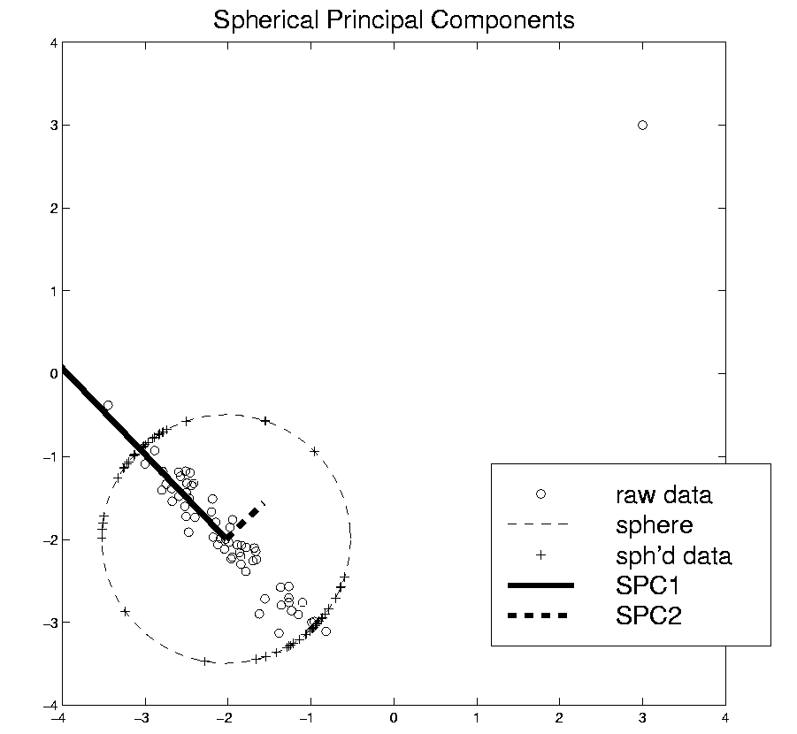
Robust PCA
Spatial Signs
Interesting Variation:
Spatial Ranks
Idea: Keep
Track of “Depth”
Via Ranks of Radii
Notes:
17

Slide 18
Robust PCA
Spherical PCA for Toy Example:
Curve Data
With an
Outlier
First recall
Conventional
PCA
Notes:
18

Slide 19
Robust PCA
Spherical PCA for Toy Example:
Now do
Spherical
PCA
Better result?
Notes:
19

Slide 20
Robust PCA
Spherical PCA for Toy Data:
Mean looks “smoother”
PC1 nearly “flat” (unaffected by outlier)
PC2 is nearly “tilt” (again unaffected by outlier)
PC3 finally strongly driven by outlier
OK, since all other directions “about equal in variation”
Energy Plot, no longer ordered
(outlier drives SS, but not directions)
Notes:
20

Slide 21
Robust PCA
Spherical PCA for Toy Example:
Check out
Later
Components
Notes:
21

Slide 22
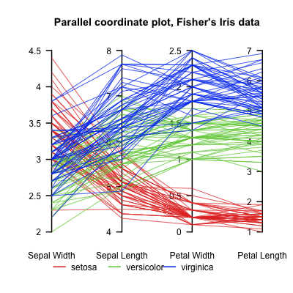
Aside On Visualization
Another Multivariate Data Visualization Tool:
Parallel Coordinates
E.g. Fisher Iris Data
d = 4
Named Variables
(thanks to Wikipedia)
Notes:
22

Slide 23
Aside On Visualization
Another Multivariate Data Visualization Tool:
Parallel Coordinates
E.g. Fisher Iris Data
d = 4
Named Variables
Curves are Data Objects
(4-vectors)
Notes:
23

Slide 24
Robust PCA
Useful View: Parallel Coordinates Plot
X-axis:
Zernike
Coefficient
Number
Y-axis:
Coefficient
Notes:
24

Slide 25
Robust PCA
Cornea Data, Parallel Coordinates Plot:
Top Plot: Zernike
Coefficients
All n = 43 very
Similar
Most Action in few
Low Freq. Coeffs.
Notes:
25

Slide 26
Robust PCA
Cornea Data, Parallel Coordinates Plot
Middle Plot: (Zernike Coefficients – median)
Most Variation in lowest frequencies
E.g. as in Fourier compression of smooth signals
Projecting on sphere will destroy this
By magnifying high frequency behavior
Bottom Plot: discussed later
Notes:
26

Slide 27
Robust PCA
Spherical PCA Problem :
Magnification of High Freq. Coeff’s
Solution : Elliptical Analysis
Main idea: project data onto suitable ellipse, not sphere
Which ellipse? (in general, this is problem that PCA solves!)
Simplification: Consider ellipses parallel to coordinate axes
Notes:
27

Slide 28
Robust PCA
Spherical PCA Problem :
Magnification of High Freq. Coeff’s
Solution : Elliptical Analysis
Background (Univariate):
MAD = Median Absolute Deviation
MAD = $median\left|X_{i}−median\left(X_{i}\right)\right|$
Simple, High Breakdown, Outlier Resistant, Measure of “Scale”
Notes:
28

Slide 29
Robust PCA
Rescale
Coords
Spherical PCA
Unscale
Coords

Slide 30
Robust PCA
Elliptical Analysis (cont.):
Simple Implementation,
via coordinate axis rescaling
Divide each axis by MAD
Project Data to sphere (in transformed space)
Return to original space (mul’ply by orig’l MAD) for analysis
Do PCA on Projections

Slide 31
Robust PCA
Elliptical Estimate of “center”:
Do M-estimation in transformed space
(then transform back)
Results for cornea data:
Sample Mean Spherical Center Elliptical Center
Elliptical clearly best
Nearly no edge effect

Slide 32
Robust PCA
Elliptical PCA for cornea data:
Original PC1, Elliptical PC1

Slide 33
Robust PCA
Elliptical PCA for cornea data:
Original PC1, Elliptical PC1
Still finds overall curvature & correlated astigmatism
Minor edge effects almost completely gone

Slide 34
Robust PCA
Elliptical PCA for cornea data:
Original PC2, Elliptical PC2

Slide 35
Robust PCA
Elliptical PCA for cornea data:
Original PC1, Elliptical PC1
Still finds overall curvature & correlated astigmatism
Minor edge effects almost completely gone
Original PC2, Elliptical PC2
Huge edge effects dramatically reduced
Still finds steeper superior vs. inferior

Slide 36
Robust PCA
Elliptical PCA for cornea data:
Original PC3, Elliptical PC3

Slide 37
Robust PCA
Elliptical PCA for Cornea Data (cont.):
Original PC3, Elliptical PC3
-Edge effects greatly diminished
But some of against the rule astigmatism also lost
Price paid for robustness

Slide 38
Robust PCA
Elliptical PCA for cornea data:
Original PC4, Elliptical PC4

Slide 39
Robust PCA
Elliptical PCA for Cornea Data (cont.):
Original PC3, Elliptical PC3
-Edge effects greatly diminished
But some of against the rule astigmatism also lost
Price paid for robustness
Original PC4, Elliptical PC4
Now looks more like variation on astigmatism???

Slide 40
Robust PCA
Current state of the art:
Spherical & Elliptical PCA are a kludge
Put together by Robustness Amateurs
To solve this HDLSS problem
Good News: Robustness Pros are now in the game:
Maronna, et al (2006), Sec. 6.10.2

Slide 41
Robust PCA
Disclaimer on robust analy’s of Cornea Data:
Critical parameter is “radius of analysis”,
: Shown above, Elliptical PCA very effective
: Stronger edge effects, Elliptical PCA less useful
: Edge effects weaker, don’t need robust PCA

Slide 42
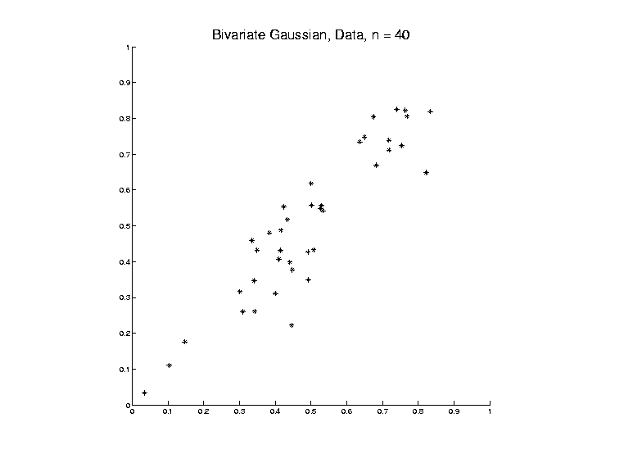
Big Picture View of PCA
Above View:
PCA finds optimal directions in point cloud

Slide 43
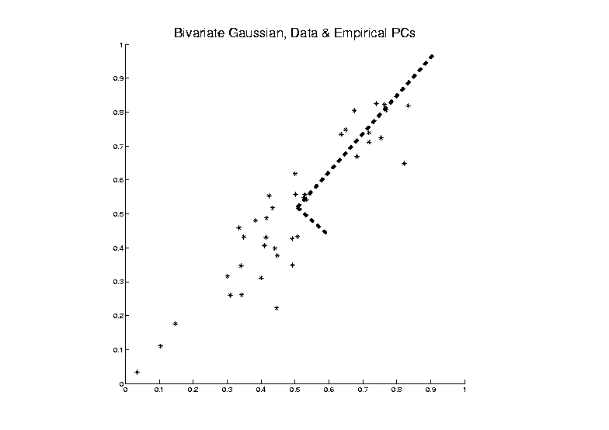
Big Picture View of PCA
Above View:
PCA finds optimal directions in point cloud

Slide 44
Big Picture View of PCA
Above View:
PCA finds optimal directions in point cloud
Maximize projected variation
Minimize residual variation
(same by Pythagorean Theorem)
Notes:
Get useful insights about data
Can compute for any point cloud
But there are other views.

Slide 45
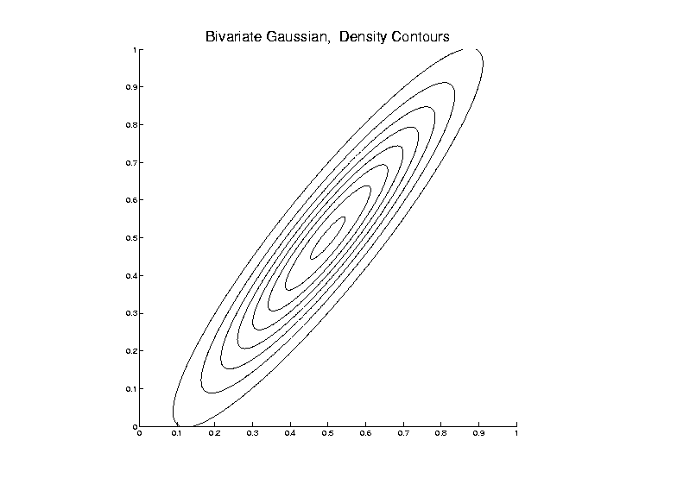
Big Picture View of PCA
Alternate Viewpoint: Gaussian Likelihood

Slide 46
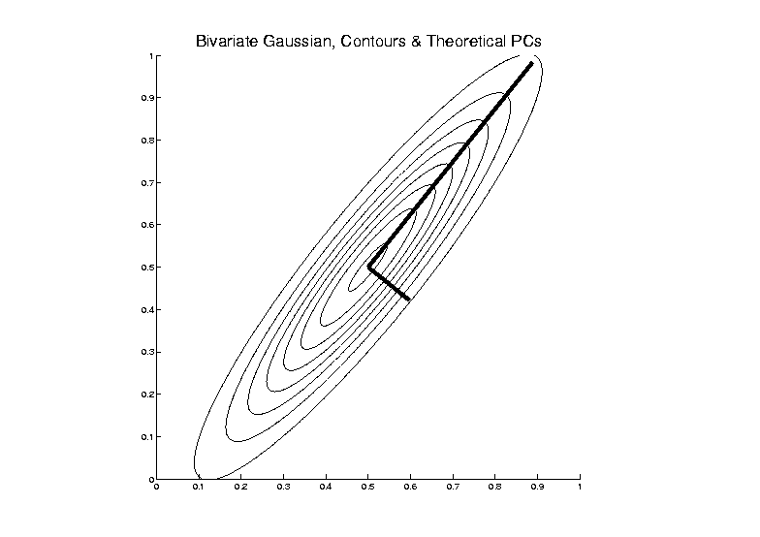
Big Picture View of PCA
Alternate Viewpoint: Gaussian Likelihood

Slide 47
Big Picture View of PCA
Alternate Viewpoint: Gaussian Likelihood
When data are multivariate Gaussian
PCA finds major axes of ellipt’al contours
of Probability Density
Maximum Likelihood Estimate

Slide 48
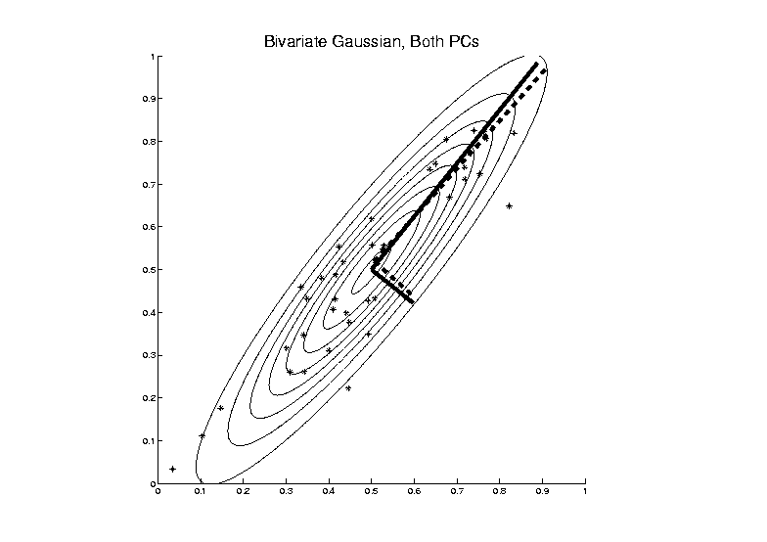
Big Picture View of PCA
Alternate Viewpoint: Gaussian Likelihood
Maximum Likelihood Estimate

Slide 49
Big Picture View of PCA
Alternate Viewpoint: Gaussian Likelihood
When data are multivariate Gaussian
PCA finds major axes of ellipt’al contours
of Probability Density
Maximum Likelihood Estimate
Mistaken idea:
PCA only useful for Gaussian data

Slide 50
Big Picture View of PCA
Simple check for Gaussian distribution:
Standardized parallel coordinate plot
Subtract coordinate wise median
(robust version of mean)
(not good as “point cloud center”,
but now only looking at coordinates)
Divide by MAD / MAD(N(0,1))
(put on same scale as “standard deviation”)
See if data stays in range –3 to +3

Slide 51
Big Picture View of PCA
E.g.
Cornea Data:
Standardized
Parallel
Coordinate
Plot
Shown before

Slide 52
Big Picture View of PCA
Raw Cornea Data:
Data – Median
(Data – Median)
-------------------
MAD

Slide 53
Big Picture View of PCA
Check for Gaussian dist’n:
Stand’zed Parallel Coord. Plot
E.g. Cornea data
(recall image view of data)
Several data points > 20 “s.d.s” from the center
Distribution clearly not Gaussian
Strong kurtosis (“heavy tailed”)
But PCA still gave strong insights

Slide 54
Big Picture View of PCA
Image View of Cornea Data:

Slide 55
Correlation PCA
A related (& better known) variation of PCA:
Replace cov. matrix with correlation matrix
I.e. do eigen analysis of
Where

Slide 56
Correlation PCA
Why use correlation matrix?
Makes features “unit free”
e.g. Height, Weight, Age, $, …
Are “directions in point cloud” meaningful or useful?
Will unimportant directions dominate?

Slide 57
Correlation PCA
Personal Thoughts on Correlation PCA:
Can be very useful
(especially with noncommensurate units)
Not always, can hide important structure
To make choice:
Decide whether whitening is useful
My personal use of correlat’n PCA is rare
Other people use it most of the time

Slide 58
Transformations
Useful Method for Data Analysts
Apply to Marginal Distributions
(i.e. to Individual Variables)
Idea: Put Data on Right Scale
Common Example:
Data Orders of Magnitude Different
Log₁₀ Puts Data on More Analyzable Scale

Slide 59
Transformations
Example: Melanoma Data Analysis
Current Collaborators:
Nancy Thomas
Marc Niethammer
David Eberhard
Qing Feng
Heather Couture

Slide 60
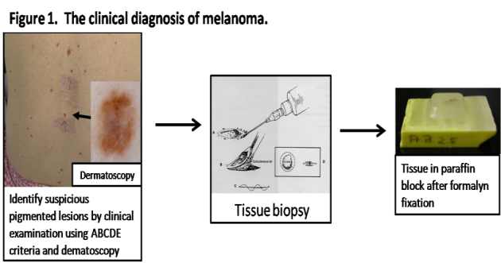
Introduction
Background
Clinical diagnosis

Slide 61
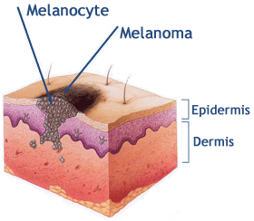
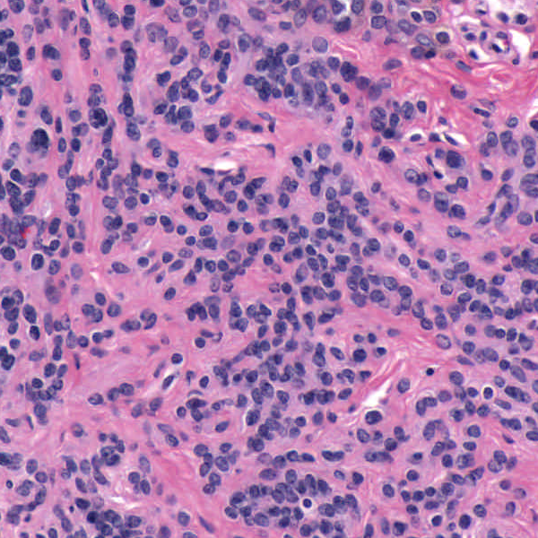
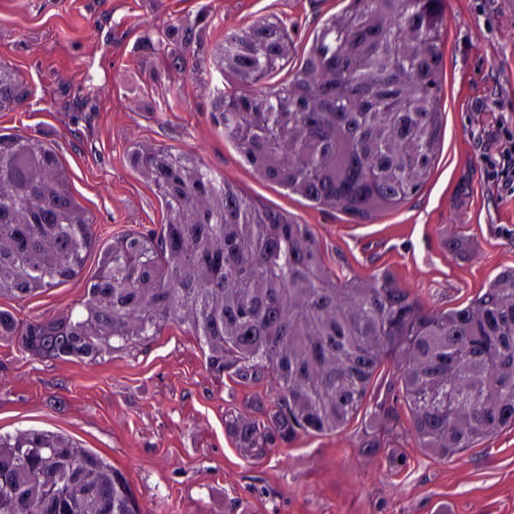
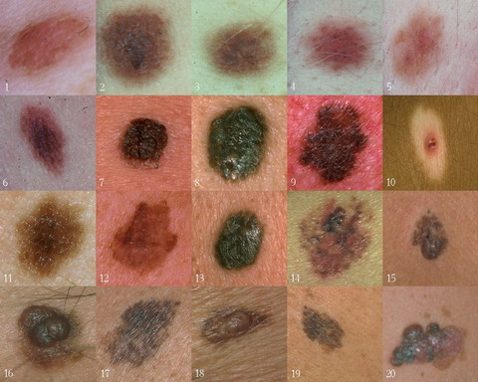
Background
Goal
Image Analysis of Histology Slides
Image: www.melanoma.ca
Benign
Melanoma
1 in 75 North Americans will develop a
malignant melanoma in their lifetime.
Initial goal: Automatically segment nuclei.
Challenge: Dense packing of nuclei.
Ultimately: Cancer grading and patient survival.
Image: melanoma.blogsome.com

Slide 62
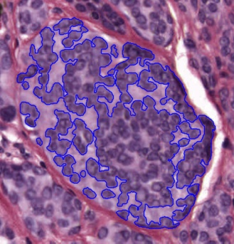
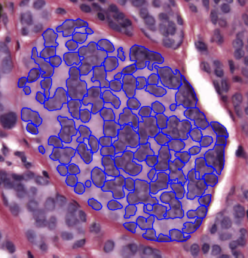
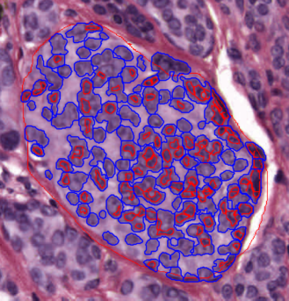
Segmentation
Cell Nuclei from Histology
Cutting Cell Clusters
Without subdivision
With subdivision
Our segmentation
Commercial seg.
Not perfect, but improved over standard algorithm (rq. validation).

Slide 63
Feature Extraction
Features from Cell Nuclei
Feature Extraction
Extract various features based on color and morphology
Example “high-level” concepts:
Stain intensity
Nuclear area
Density of nuclei
Regularity of nuclear shape

Slide 64
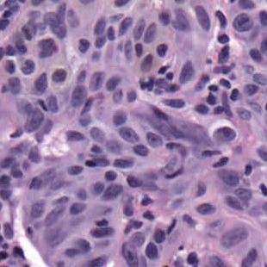
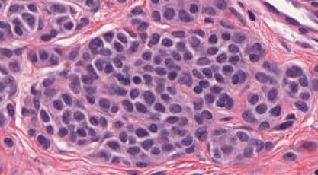
Feature Extraction
Features from Cell Nuclei
Original Image
Conventional Nevus
Superficial Spreading Melanoma

Slide 65
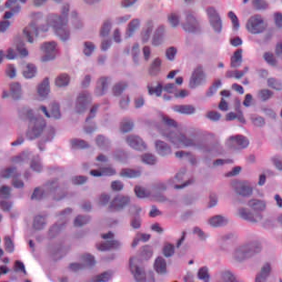
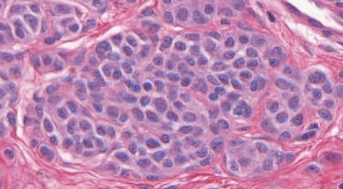
Feature Extraction
Features from Cell Nuclei
Restained Image
Conventional Nevus
Superficial Spreading Melanoma

Slide 66
Feature Extraction
Features from Cell Nuclei
Masked Region
Conventional Nevus
Conventional Nevus
Superficial Spreading Melanoma
Superficial Spreading Melanoma
Masks generated by pathologist

Slide 67
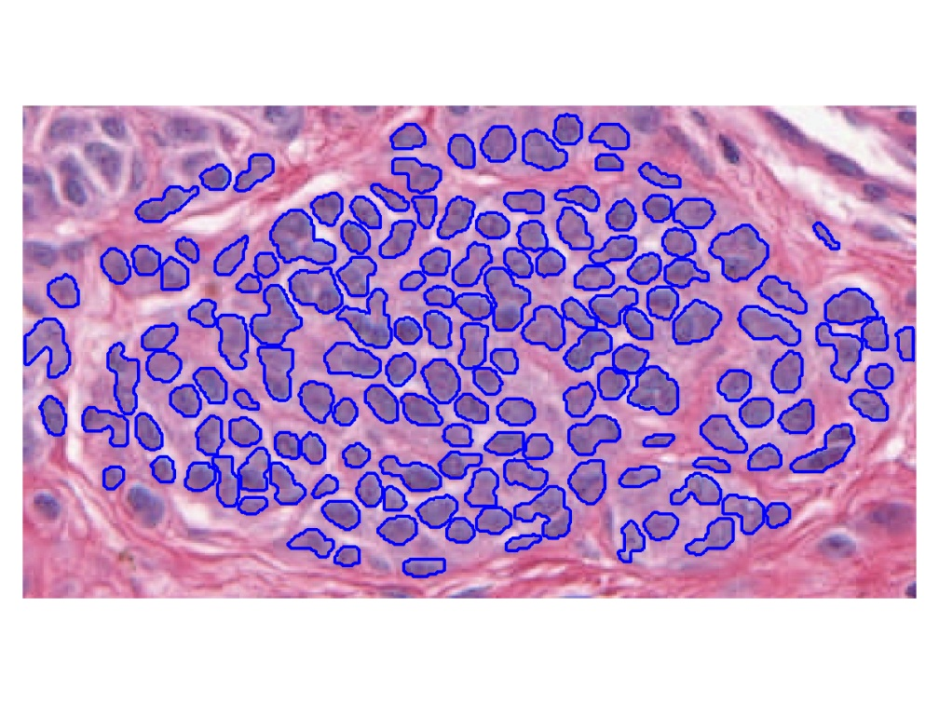
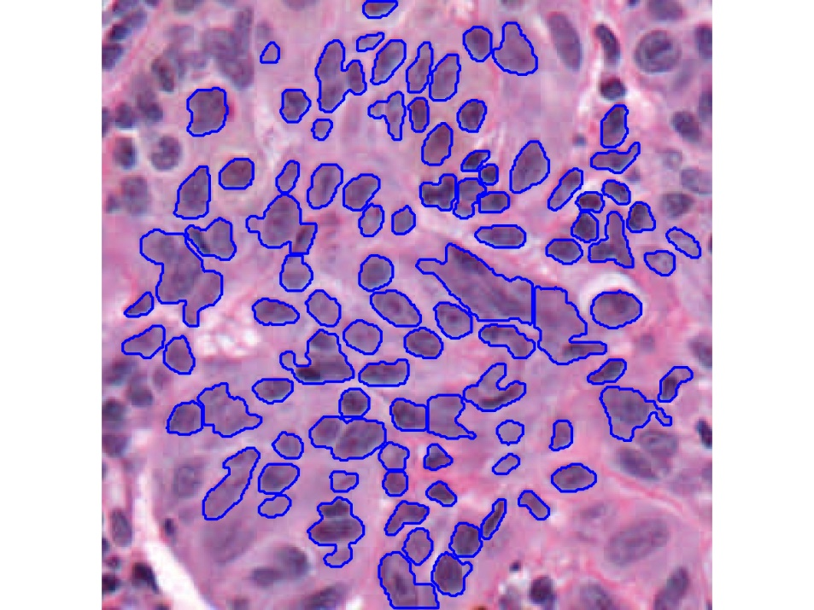
Feature Extraction
Features from Cell Nuclei
Segmented Nuclei
Conventional Nevus
Superficial Spreading Melanoma

Slide 68
Feature Extraction
Features from Cell Nuclei
Labeled Nuclei
Conventional Nevus
Superficial Spreading Melanoma

Slide 69
Feature Extraction
Features from Cell Nuclei
Nuclear Regions
Conventional Nevus
Superficial Spreading Melanoma
Generated by growing nuclei out from boundary
Used for various color and density features:
Region Stain 2, Region Area Ratio, etc.

Slide 70
Feature Extraction
Features from Cell Nuclei
Delaunay Triangulation
Conventional Nevus
Superficial Spreading Melanoma
Triangulation of nuclear centers
Used for various density features:
Mean Delaunay, Max. Delaunay, etc.

Slide 71
Transformations
Statistical Challenge:
Some Features Spread Over Several Orders of Magnitude
Few Big Values Can Dominate Analysis

Slide 72
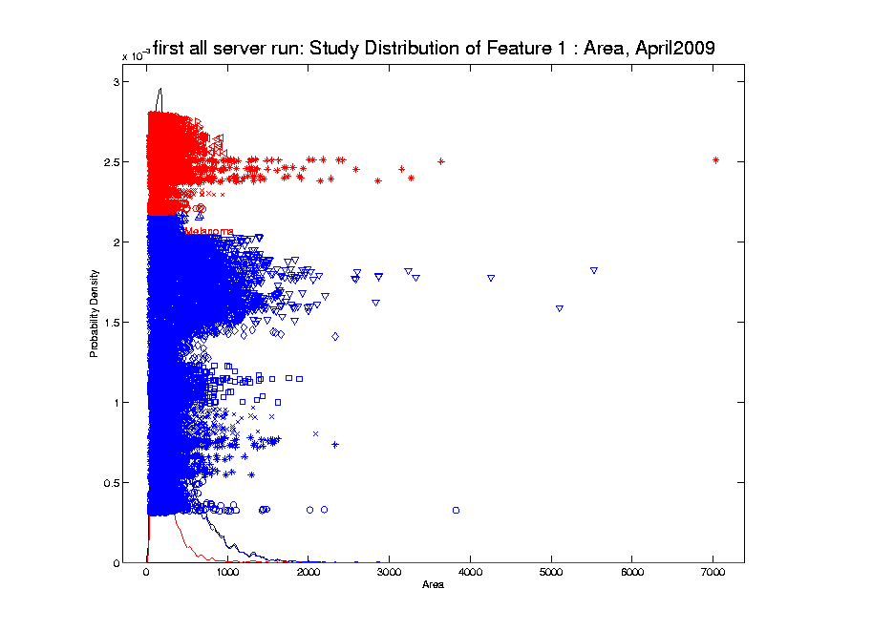
Transformations
Few Large Values Can Dominate Analysis

Slide 73
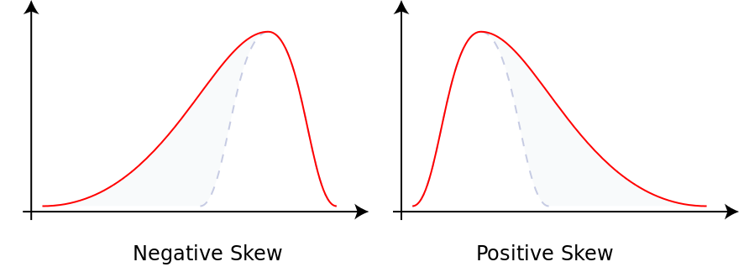
Transformations
Few Large Values Can Dominate Analysis
Terminology: “Skewness”
Largest Positive Values → Positive Skewness
(Thanks to Wikipedia)

Slide 74
Transformations
Few Large Values Can Dominate Analysis
Terminology: “Skewness”
Quantification: Based on “Moments”
$$E\left[{\left(\frac{X−μ}{σ}\right)}^{3}\right]=\frac{E\left[{\left(X−μ\right)}^{3}\right]}{{\left(E\left[{\left(X−μ\right)}^{2}\right]\right)}^{3/2}}$$
Note: 0 at Gaussian

Slide 75
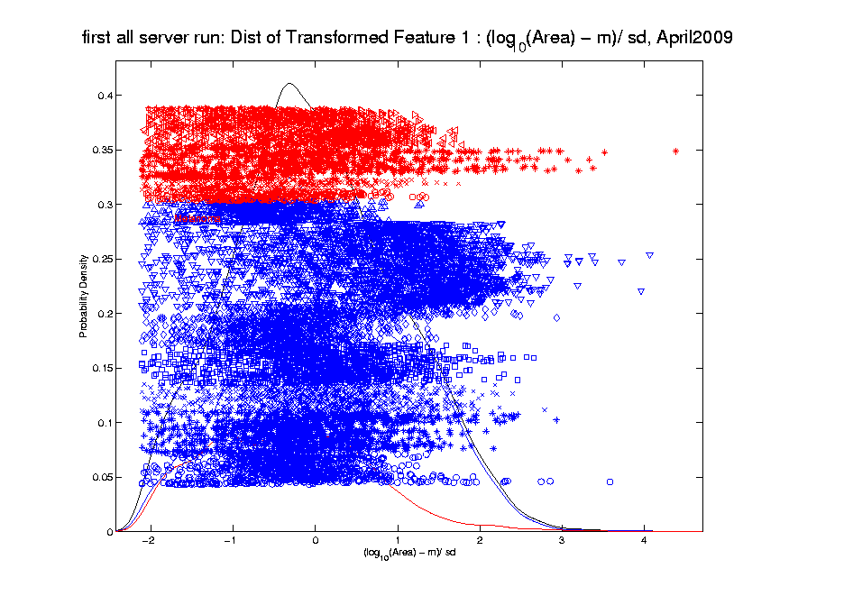
Transformations
Log Scale Gives All More Appropriate Weight
Note:
Orders
Of
Magnitude
Log₁₀ most
Interpretable

Slide 76
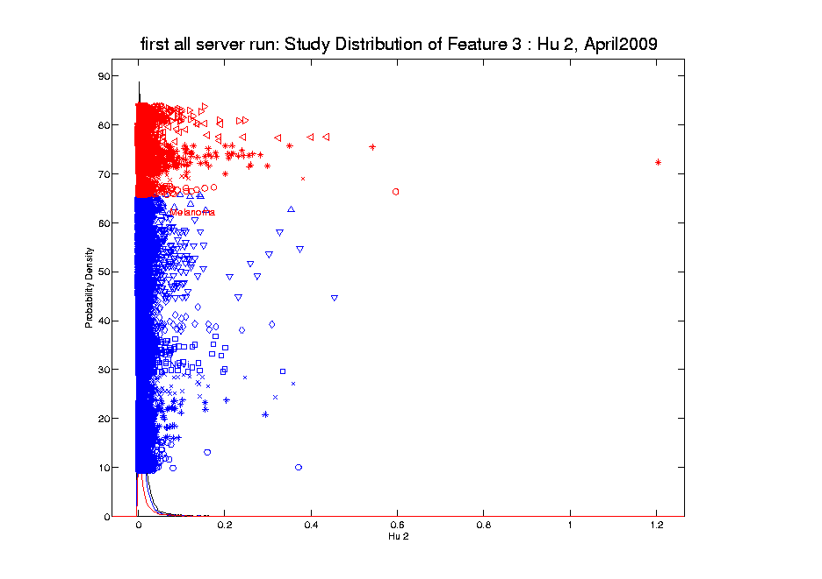
Transformations
Another Feature with Large Values
Problem
For This
Feature:
0 Values
(no log)

Slide 77
Transformations
Another Feature with Large Values
Approach:
Shifted
Log:
$$log\left(∙+δ\right)$$
Need to
Tune

Slide 78
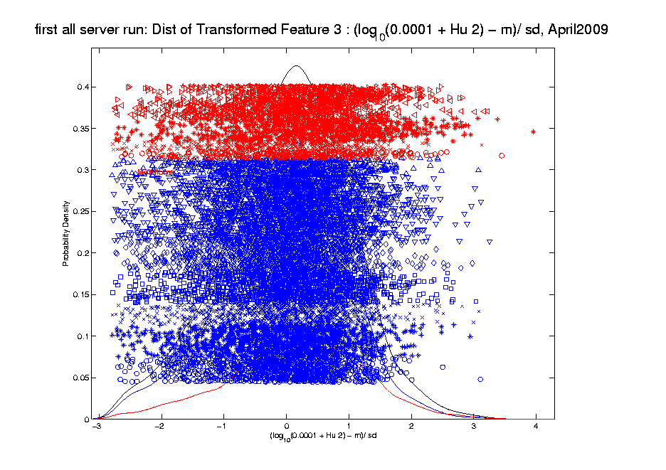
Transformations
Much Nicer Distribution

Slide 79
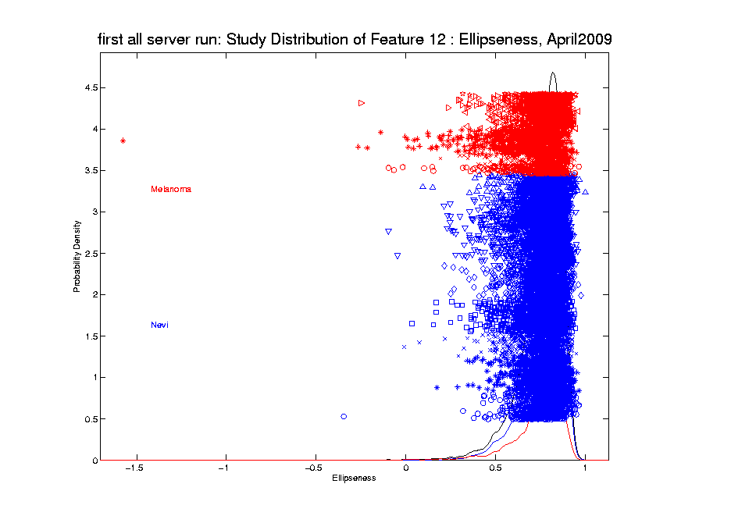
Transformations
Different Direction (Negative) of Skewness

Slide 80
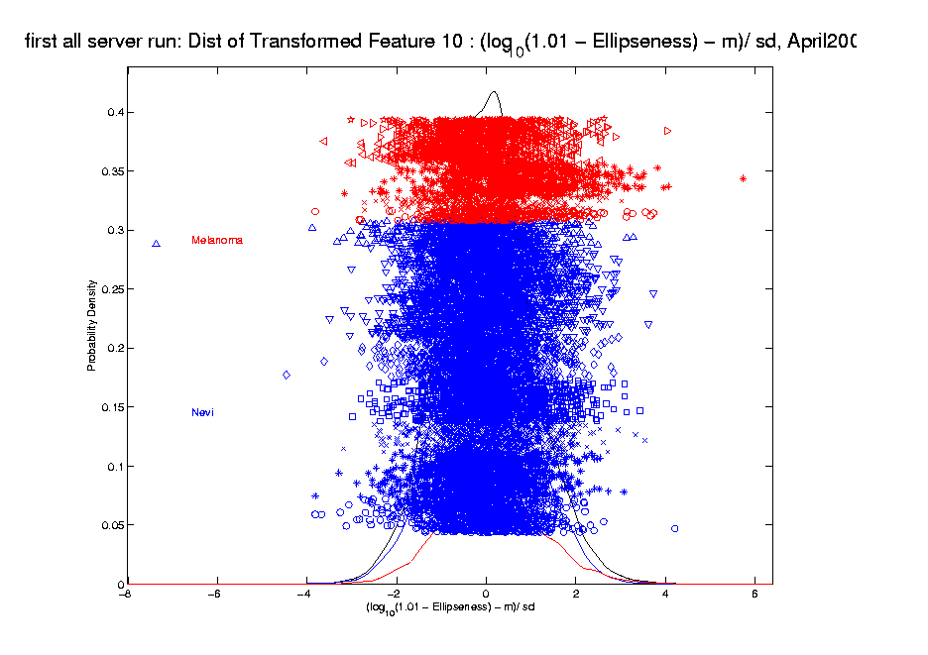
Transformations
Use Log Difference Transformation

Slide 81
Transformations
Useful Visualization: MargDistPlot
Idea: Visually Screen Many Marginal
Distributions, Simultaneously
Approach: Order, Using Some Summary
E.g. Set of Poisson(λ) Distributions
With Wide Range of λ Parameters
(λ = 0.2, …, 20, log spaced)

Slide 82
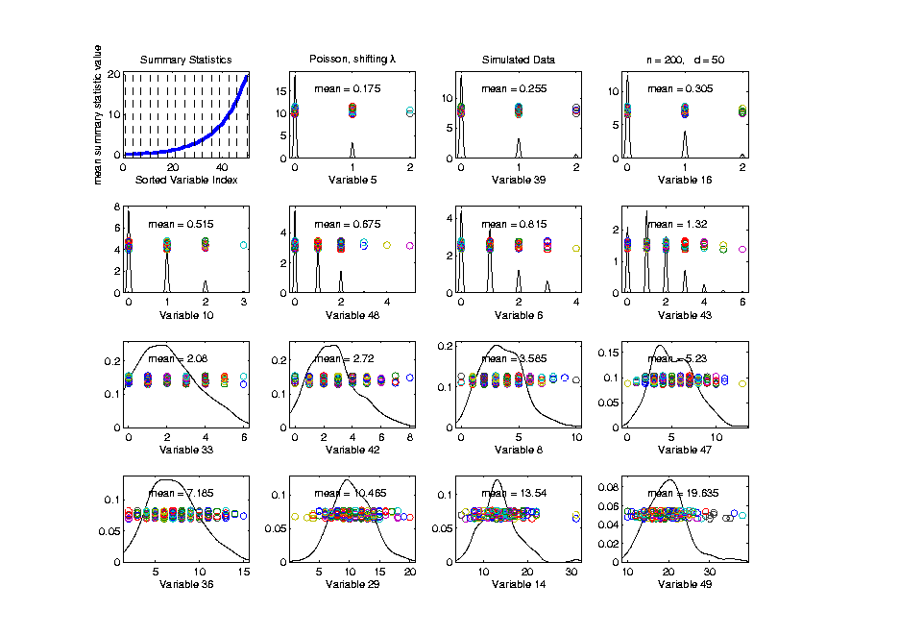
Transformations
Useful Visualization: MargDistPlot
Summary
Plot
Here
Using
Means

Slide 83
Transformations
Useful Visualization: MargDistPlot
Summary
Plot
Show
Repre’tive
Marginal
Dist’ns

Slide 84
Transformations
Useful Visualization: MargDistPlot
Summary
Plot
Note:
Sensible
Ordering

Slide 85
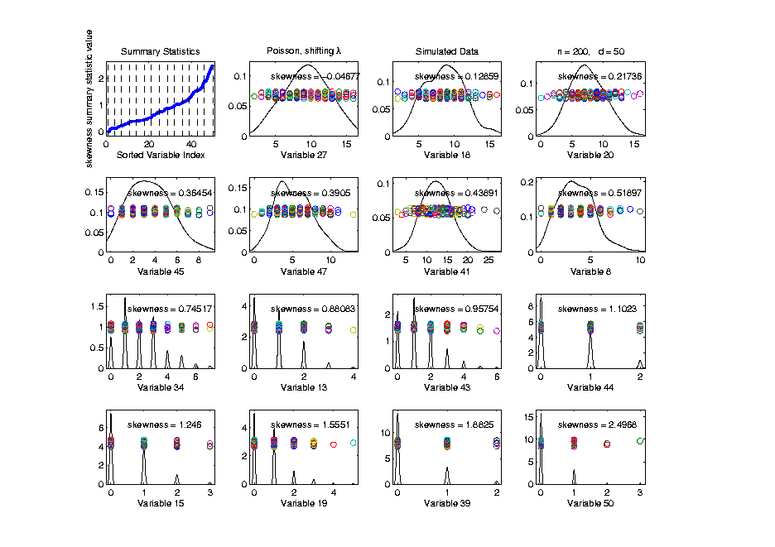
Transformations
Useful Visualization: MargDistPlot
Change
Summary
To
Skewness
Most/Least
Symmetric

Slide 86
Transformations
Useful Visualization: MargDistPlot
Change
Summary
To
Skewness
Most/Least
Symmetric

Slide 87
Transformations
Useful Visualization: MargDistPlot
Some Interesting Summaries:
Mean, SD, Skewness, Kurtosis
# Unique, # Most Frequent, # 0s
Robust Measures
L-statistics
Entropy
Continuity Measure
$⋮$

Slide 88
Transformations
Useful Visualization: MargDistPlot
Some Interesting Summaries:
Mean, SD, Skewness, Kurtosis
# Unique, # Most Frequent, # 0s
Robust Measures
L-statistics
Entropy
Continuity Measure
$⋮$

Slide 89
Transformations
Aside on Kurtosis:
4-th Moment Summary
$$E\left[{\left(\frac{X−μ}{σ}\right)}^{4}\right]−3=\frac{E\left[{\left(X−μ\right)}^{4}\right]}{{\left(E\left[{\left(X−μ\right)}^{2}\right]\right)}^{2}}−3$$
Makes 0 at Gaussian

Slide 90
Transformations
Aside on Kurtosis:
4-th Moment Summary
$$E\left[{\left(\frac{X−μ}{σ}\right)}^{4}\right]−3=\frac{E\left[{\left(X−μ\right)}^{4}\right]}{{\left(E\left[{\left(X−μ\right)}^{2}\right]\right)}^{2}}−3$$
Makes 0 at Gaussian
Think of Departures From Gaussian

Slide 91
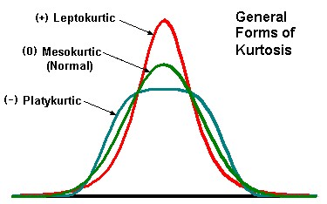
Transformations
Aside on Kurtosis:
4-th Moment Summary
Nice Graphic
(from mvpprograms.com)

Slide 92
Transformations
Aside on Kurtosis:
4-th Moment Summary
Positive Big at Peak
And Tails

Slide 93
Transformations
Aside on Kurtosis:
4-th Moment Summary
Negative Big in Flanks

Slide 94
Clusters in data
Common Statistical Task:
Find Clusters in Data
Interesting sub-populations?
Important structure in data?
How to do this?
PCA provides very simple approach
There is a large literature of other methods
(will study more later)

Slide 95
PCA to find clusters
Toy Example (2 clusters)

Slide 96
PCA to find clusters
Toy Example (2 clusters)
Dominant direction finds very distinct clusters
Skewer through meatballs (in point cloud space)
Shows up clearly in scores plot
An important use of scores plot is finding such structure

Slide 97
PCA to find clusters
Recall Toy Example with more clusters:

Slide 98
PCA to find clusters
Best revealed by 2d scatterplots (4 clusters):

Slide 99
PCA to find clusters
Caution: there are limitations…
Revealed by NCI60 data
Recall Microarray data
With 8 known different cancer types
Could separate out clusters
Using specialized DWD directions
But mostly not found using PCA
Recall only finds dirn’s of max variation
Does not use class label information

Slide 100
PCA to find clusters
Specific DWD directions, for NCI60 Data:
Good
Separation
Of Cancer
Types

Slide 101
PCA to find clusters
PCA directions, for NCI60 Data:
PC2:
Melanoma
PC1-3
Leukemia

Slide 102
PCA to find clusters
Off Diagonal PC1-4 & 5-8, NCI60 Data:
PC1 & 5
Renal
Leukemia
(separated)
PC2:
Melanoma

Slide 103
PCA to find clusters
Main Lesson:
PCA is limited at finding clusters
Revealed by NCI60 data
Recall Microarray data
With 8 known different cancer types
PCA does not find all 8 clusters
Recall only finds dirn’s of max variation
Does not use class label information

Slide 104
PCA to find clusters
A deeper example:
Mass Flux Data
Data from Enrica Bellone,
National Center for Atmospheric Research
Mass Flux for quantifying cloud types
How does mass change when moving into a cloud

Slide 105
PCA to find clusters
PCA of Mass Flux Data:

Slide 106
PCA to find clusters
Summary of PCA of Mass Flux Data:
Mean:
Captures General Mountain Shape
PC1:
Generally overall height of peak
shows up nicely in mean +- plot (2nd col)
3 apparent clusters in scores plot
Are those “really there”?
If so, could lead to interesting discovery
If not, could waste effort in investigation

Slide 107
PCA to find clusters
Summary of PCA of Mass Flux Data:
PC2:
Location of peak
again mean +- plot very useful here
PC3:
Width adjustment
again see most clearly in mean +- plot
Maybe non-linear modes of variation???

Slide 108
PCA to find clusters
Return to Investigation of PC1 Clusters:
Can see 3 bumps in smooth histogram
Main Question:
Important structure
or
sampling variability?
Approach: SiZer
(SIgnificance of ZERo crossings of deriv.)

