Slide 1
Yeast Cell Cycles, Freq. 2 Proj.
PCA on
Freq. 2
Periodic
Component
Of Data

Slide 2
Source Batch Adj: Source Colors

Slide 3
Source Batch Adj: PC 1-3 & DWD direction

Slide 4
Source Batch Adj: DWD Source Adjustment

Slide 5
NCI 60: Raw Data, Platform Colored

Slide 6
NCI 60: Fully Adjusted Data, Platform Colored

Slide 7
Matlab Software
Want to try similar analyses?
Matlab Available from UNC Site License
Download Software:
Google “Marron Software”

Slide 8
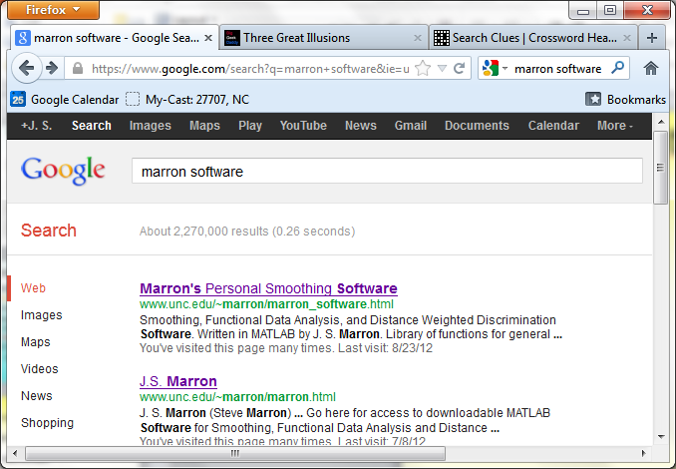
Matlab Software
Choose

Slide 9
Matlab Software
Download .zip File, & Expand to 3 Directories

Slide 10
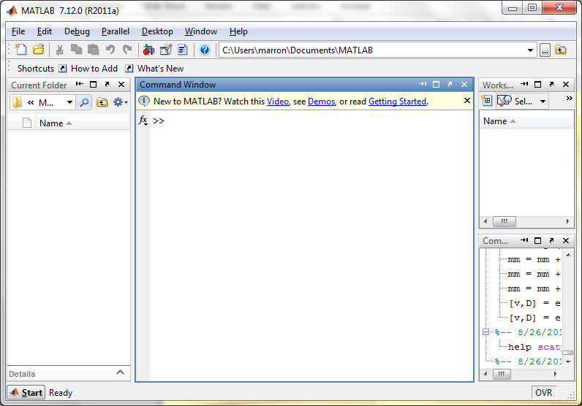
Matlab Software
Put these in Matlab Path

Slide 11
Matlab Software
Put these in Matlab Path

Slide 12
Matlab Basics
Matlab has Modalities:
Interpreted
(Type Commands & Run Individually)
Batch
(Run “Script Files” = Command Sets)

Slide 13
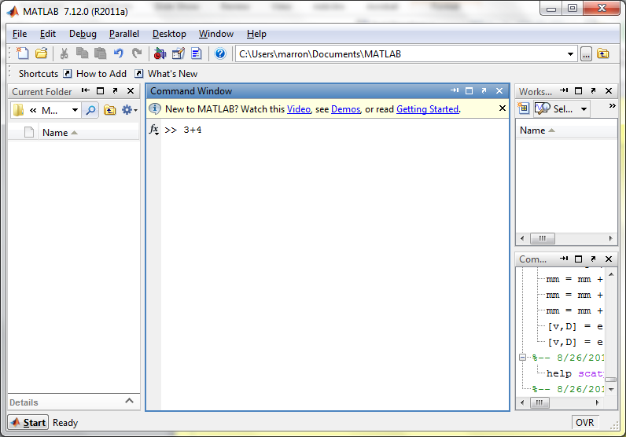
Matlab Basics
Matlab in Interpreted Mode:

Slide 14
Matlab Basics
Matlab in Interpreted Mode:

Slide 15
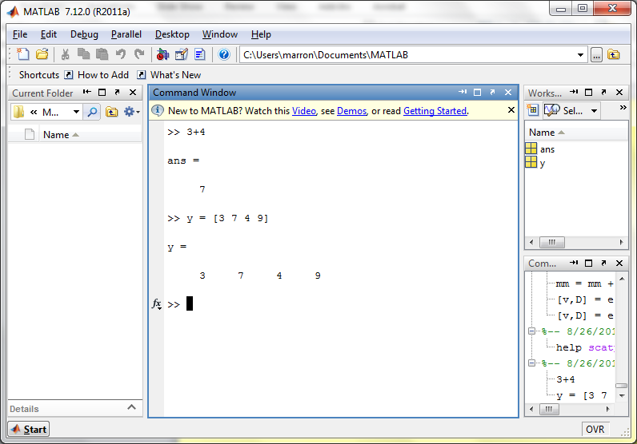
Matlab Basics
Matlab in Interpreted Mode:

Slide 16
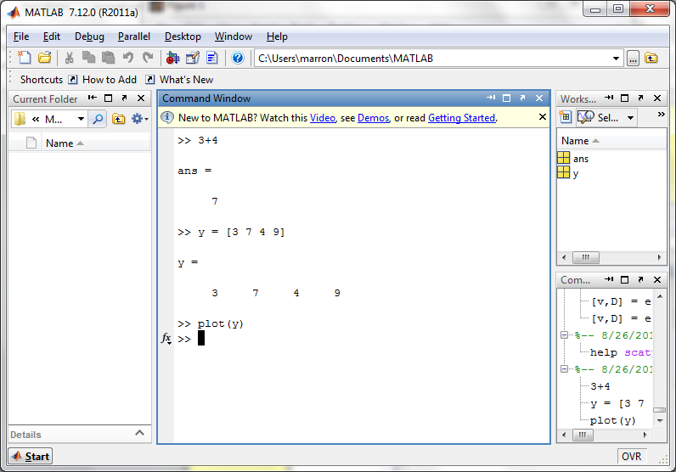
Matlab Basics
Matlab in Interpreted Mode:

Slide 17
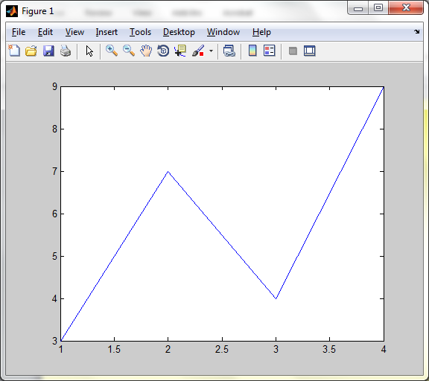
Matlab Basics
Matlab in Interpreted Mode:

Slide 18
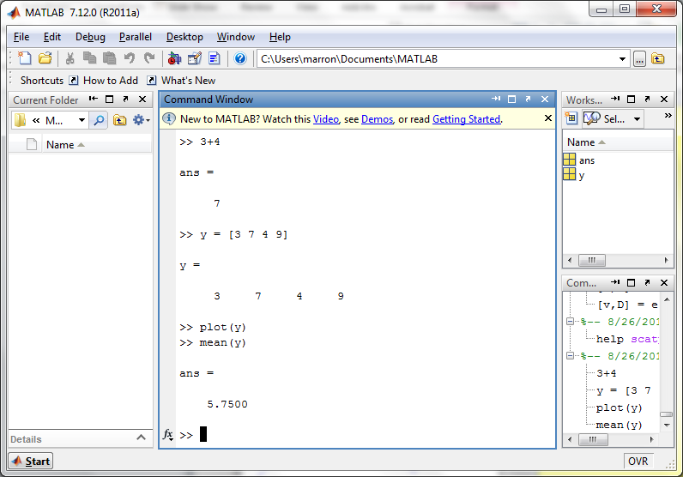
Matlab Basics
Matlab in Interpreted Mode:

Slide 19
Matlab Basics
Matlab in Interpreted Mode:
For description of a function:
>> help [function name]

Slide 20
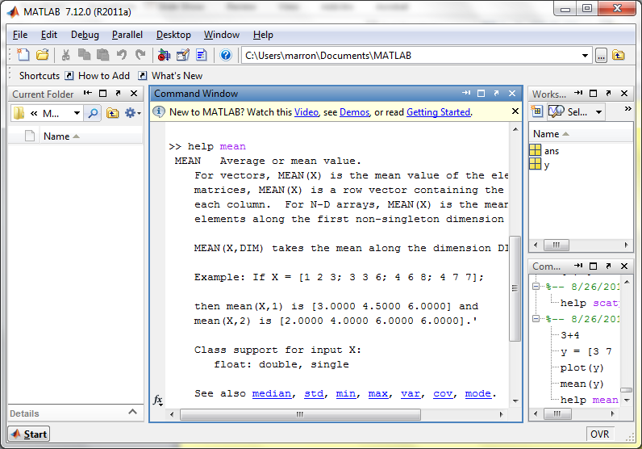
Matlab Basics
Matlab in Interpreted Mode:

Slide 21
Matlab Basics
Matlab in Interpreted Mode:
To Find Functions:
>> help [category name]
e.g.
>> help stats

Slide 22
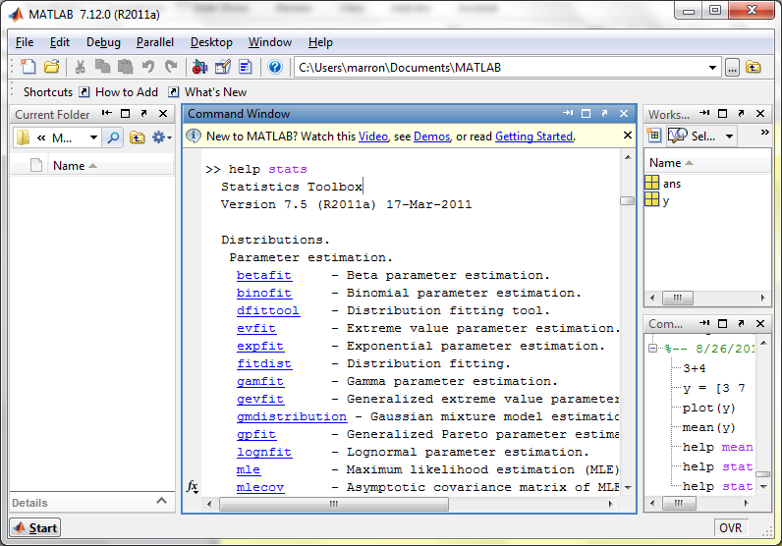
Matlab Basics
Matlab in Interpreted Mode:

Slide 23
Matlab Basics
Matlab has Modalities:
Interpreted (Type Commands)
Batch (Run “Script Files”)
For Serious Scientific Computing:
Always Run Scripts

Slide 24
Matlab Basics
Matlab Script File:
Just a List of Matlab Commands
Matlab Executes Them in Order
Why Bother (Why Not Just Type Commands)?
Reproducibility
(Can Find Mistakes & Use Again Much Later)

Slide 25
Matlab Script Files
An Example:
Recall “Brushing Analysis” of
Next Generation Sequencing Data

Slide 26
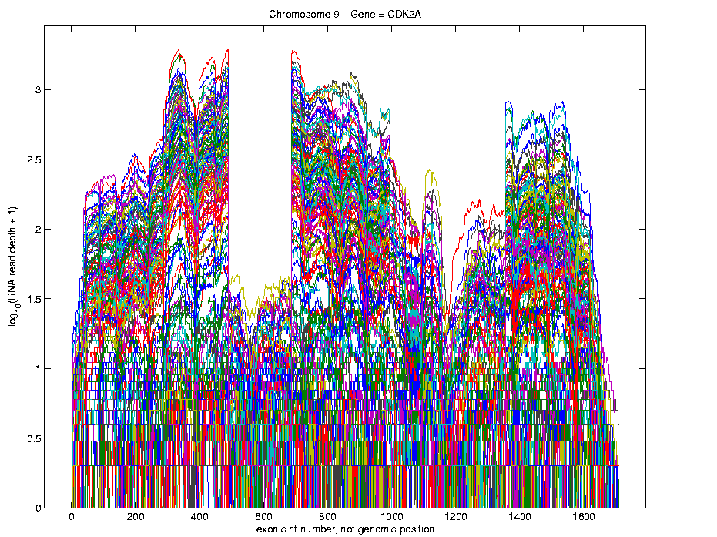
Functional Data Analysis
Simple
1st
View:
Curve
Overlay
(log
scale)

Slide 27
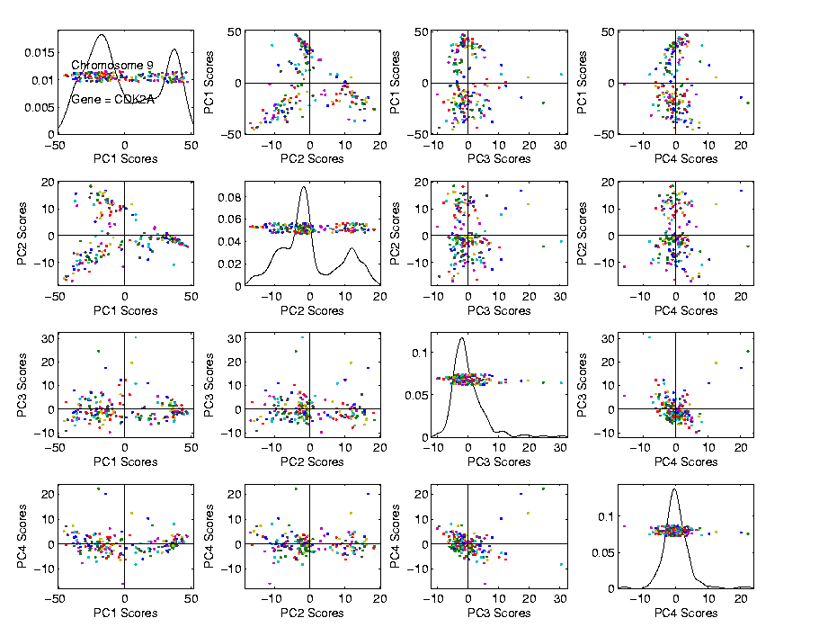
Functional Data Analysis
Often
Useful
Population
View:
PCA
Scores

Slide 28
Functional Data Analysis
Suggestion
Of
Clusters
???

Slide 29
Functional Data Analysis
Suggestion
Of
Clusters
Which
Are
These?

Slide 30
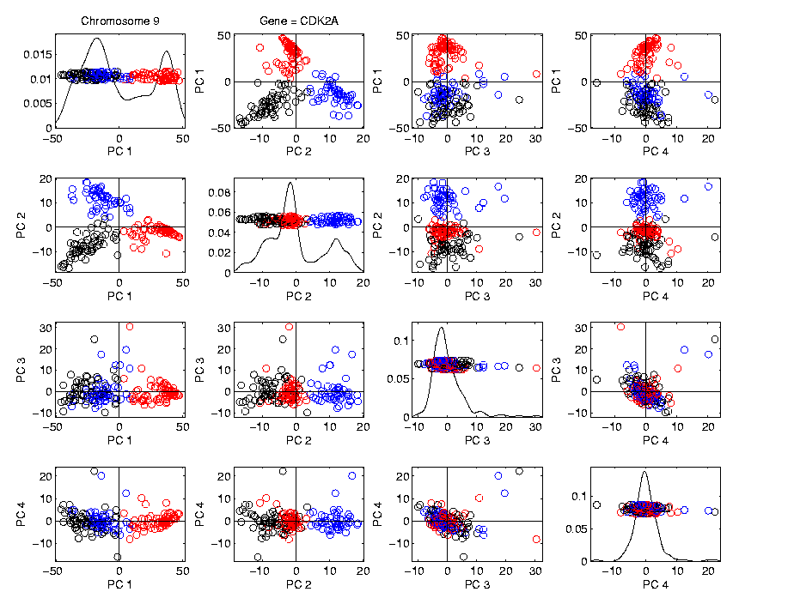
Functional Data Analysis
Manually
“Brush”
Clusters

Slide 31
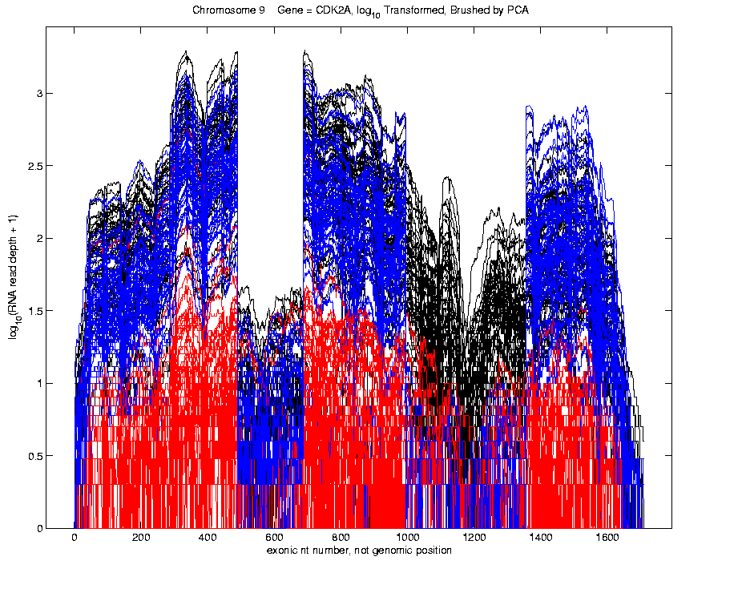
Functional Data Analysis
Manually
Brush
Clusters
Clear
Alternate
Splicing

Slide 32
Matlab Script Files
An Example:
Recall “Brushing Analysis” of
Next Generation Sequencing Data
Analysis In Script File:
VisualizeNextGen2011.m
Matlab Script File Suffix

Slide 33
Matlab Script Files
An Example:
Recall “Brushing Analysis” of
Next Generation Sequencing Data
Analysis In Script File:
VisualizeNextGen2011.m
On Course Web Page
Matlab Script File Suffix

Slide 34
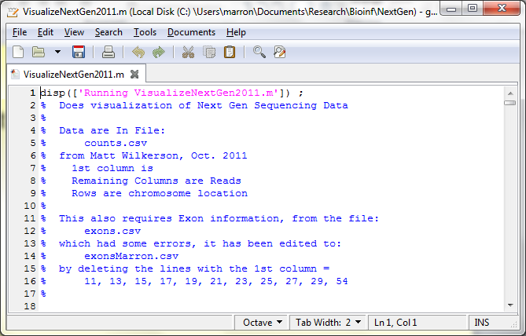
Matlab Script Files
String of Text

Slide 35
Matlab Script Files
Command to Display String to Screen

Slide 36
Matlab Script Files
Notes About Data (Maximizes Reproducibility)

Slide 37
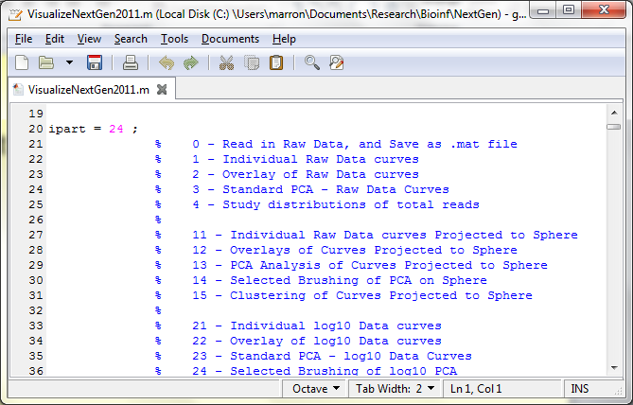
Matlab Script Files
Have Index for Each Part of Analysis

Slide 38
Matlab Script Files
So Keep Everything Done (Max’s Reprod’ity)

Slide 39
Matlab Script Files
Note Some Are Graphics Shown (Can Repeat)

Slide 40
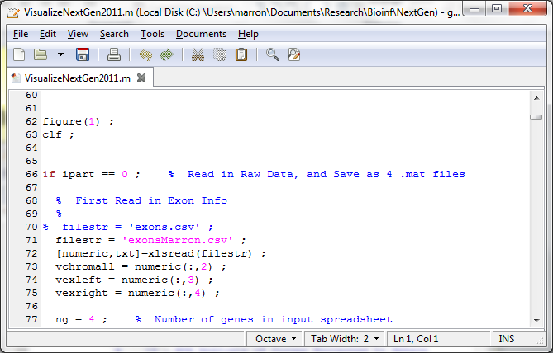
Matlab Script Files
Set Graphics to Default

Slide 41
Matlab Script Files
Put Different Program Parts in IF-Block

Slide 42
Matlab Script Files
Comment Out Currently Unused Commands

Slide 43
Matlab Script Files
Read Data from Excel File

Slide 44
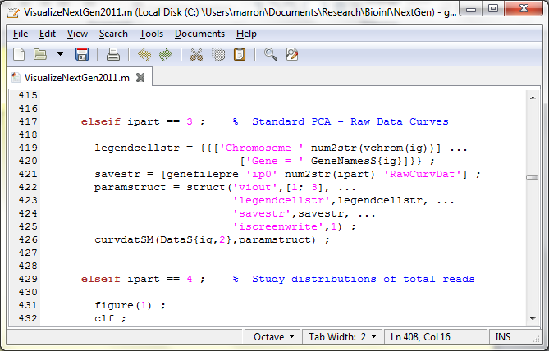
Matlab Script Files
For Generic Functional Data Analysis:

Slide 45
Matlab Script Files
Input Data Matrix

Slide 46
Matlab Script Files
Structure, with Other Settings

Slide 47
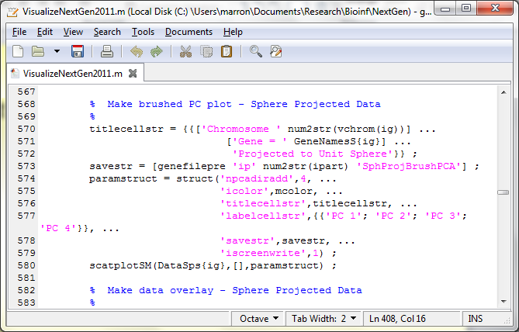
Matlab Script Files
Make Scores Scatterplot

Slide 48
Matlab Script Files
Uses Careful Choice of Color Matrix

Slide 49
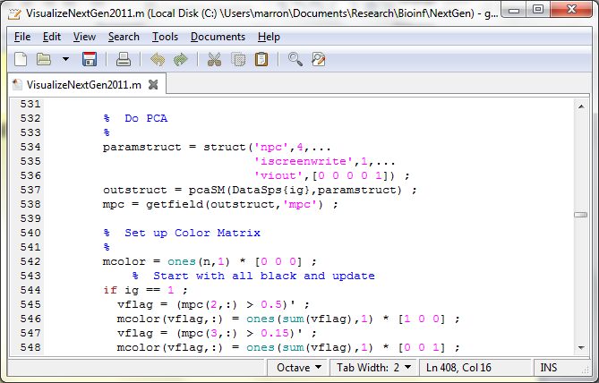
Matlab Script Files
Start with PCA

Slide 50
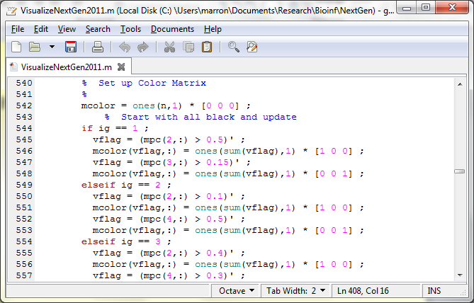
Matlab Script Files
Then Create Color Matrix

Slide 51
Matlab Script Files
Black Red Blue

Slide 52
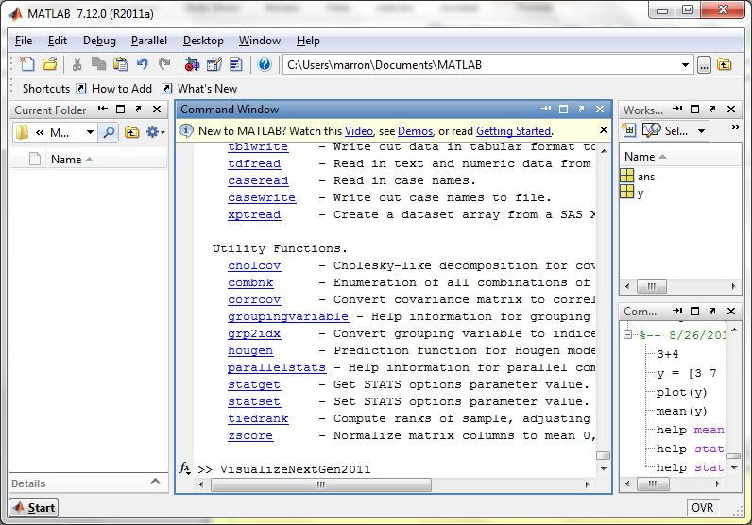
Matlab Script Files
Run Script Using Filename as a Command

Slide 53
Cornea Data
Main Point: OODA Beyond FDA
Recall Interplay:
Object Space ←→ Descriptor Space

Slide 54
Cornea Data
Cornea: Outer surface of the eye
Driver of Vision: Curvature of Cornea
Data Objects: Images on the unit disk
Radial Curvature as “Heat Map”
Special Thanks to K. L. Cohen, N. Tripoli,
UNC Ophthalmology

Slide 55
Cornea Data
Cornea Data:
Raw Data
Decompose
Into
Modes of
Variation?

Slide 56
Cornea Data
Reference: Locantore, et al (1999)
Visualization (generally true for images):
More challenging than for curves
(since can’t overlay)
Instead view sequence of images
Harder to see “population structure”
(than for curves)
So PCA type decomposition of variation is more important

Slide 57
Cornea Data
Nature of images
(on the unit disk, not usual rectangle)
Color is “curvature”
Along radii of circle
(direction with most effect on vision)
Hotter (red, yellow) for “more curvature”
Cooler (blue, green) for “less curvature”
Feature vec. is coeff’s of Zernike expansion
Zernike basis: ~ Fourier basis, on disk
Conveniently represented in polar coord’s

Slide 58
Cornea Data
Data Representation - Zernike Basis
Pixels as features is large and wasteful
Natural to find more efficient represent’n
Polar Coordinate Tensor Product of:
Fourier basis (angular)
Special Jacobi (radial, to avoid singularities)
See:
Schwiegerling, Greivenkamp & Miller (1995)
Born & Wolf (1980)

Slide 59
Cornea Data
Data Representation - Zernike Basis
Descriptor Space is Vector Space of Zernike Coefficients
So Perform PCA There

Slide 60
PCA of Cornea Data
Recall: PCA can find (often insightful)
direction of greatest variability
Main problem: display of result (no overlays for images)
Solution: show movie of “marching along the direction vector”

Slide 61
PCA of Cornea Data
PC1 Movie:

Slide 62
PCA of Cornea Data
PC1 Summary:
Mean (1st image): mild vert’l astigmatism
known pop’n structure called “with the rule”
Main dir’n: “more curved” & “less curved”
Corresponds to first optometric measure
(89% of variat’n, in Mean Resid. SS sense)
Also: “stronger astig’m” & “no astig’m”
Found corr’n between astig’m and curv’re
Scores (blue): Apparent Gaussian dist’n

Slide 63
PCA of Cornea Data
PC2 Movie:

Slide 64
PCA of Cornea Data
PC2 Movie:
Mean: same as above
Common centerpoint of point cloud
Are studying “directions from mean”
Images along direction vector:
Looks terrible???
Why?

Slide 65
PCA of Cornea Data
PC2 Movie:
Reason made clear in Scores Plot (blue):
Single outlying data object drives PC dir’n
A known problem with PCA
Recall finds direction with “max variation”
In sense of variance
Easily dominated by single large observat’n

Slide 66
PCA of Cornea Data
Toy Example: Single Outlier Driving PCA

Slide 67
PCA of Cornea Data
PC2 Affected by Outlier:
How bad is this problem?
View 1: Statistician: Arrggghh!!!!
Outliers are very dangerous
Can give arbitrary and meaningless dir’ns

Slide 68
PCA of Cornea Data
PC2 Affected by Outlier:
How bad is this problem?
View 2: Ophthalmologist: No Problem
Driven by “edge effects” (see raw data)
Artifact of “light reflection” data gathering
(“eyelid blocking”, and drying effects)
Routinely “visually ignore” those anyway
Found interesting (& well known) dir’n:
steeper superior vs steeper inferior

Slide 69
Cornea Data
Cornea Data:
Raw Data
Which one
is the outlier?
Will say more
later …

Slide 70
PCA of Cornea Data
PC3 Movie

Slide 71
PCA of Cornea Data
PC3 Movie (ophthalmologist’s view):
Edge Effect Outlier is present
But focusing on “central region” shows changing dir’n of astig’m (3% of MR SS)
“with the rule” (vertical) vs. “against the rule” (horizontal)
most astigmatism is “with the rule”
most of rest is “against the rule”
(known folklore)

Slide 72
PCA of Cornea Data
PC4 movie

Slide 73
PCA of Cornea Data
Continue with ophthalmologists view…
PC4 movie version:
Other direction of astigmatism???
Location (i.e. “registration”) effect???
Harder to interpret …
OK, since only 1.7% of MR SS
Substantially less than for PC2 & PC3

Slide 74
PCA of Cornea Data
Ophthalmologists View (cont.)
Overall Impressions / Conclusions:
Useful decomposition of population variation
Useful insight into population structure

Slide 75
PCA of Cornea Data
Now return to Statistician’s View:
How can we handle these outliers?
Even though not fatal here, can be for other examples…
Recall Simple
Toy Example
(in 2d):

Slide 76
Outliers in PCA
Deeper Toy Example:

Slide 77
Outliers in PCA
Deeper Toy Example:
Why is that an outlier?
Never leaves range of other data
But Euclidean distance to others very large
relative to other distances
Also major difference in terms of shape
And even smoothness
Important lesson:
many directions in

Slide 78
Outliers in PCA
Much like
earlier
Parabolas
Example
But with
1 “outlier”
thrown in

Slide 79
Outliers in PCA
PCA for
Deeper
Toy E.g.
Data:

Slide 80
Outliers in PCA
Deeper Toy Example:
At first glance, mean and PC1 look similar to no outlier version
PC2 clearly driven completely by outlier
PC2 scores plot (on right) gives clear outlier diagnostic
Outlier does not appear in other directions
Previous PC2, now appears as PC3
Total Power (upper right plot) now “spread farther”

Slide 81
Outliers in PCA
Closer Look at Deeper Toy Example:
Mean “influenced” a little, by the outlier
Appearance of “corners” at every other coordinate
PC1 substantially “influenced” by the outlier
Clear “wiggles”

Slide 82
Outliers in PCA
What can (should?) be done about outliers?
Context 1: Outliers are important aspects of the population
They need to be highlighted in the analysis
Although could separate into subpopulations
Context 2: Outliers are “bad data”, of no interest
recording errors? Other mistakes?
Then should avoid distorted view of PCA

Slide 83
Outliers in PCA
Standard Statistical Approaches to Dealing with Outliers:
Outlier Deletion:
Kick out “bad data”
Robust Statistical methods:
Work with full data set,
but downweight “bad data”
Reduce influence, instead of “deleting”

Slide 84
Outliers in PCA
Example Cornea Data:
Can find PC2 outlier (by looking through data (careful!))
Problem: after removal, another point dominates PC2
Could delete that, but then another appears
After 4th step have eliminated 10% of data (n = 43)

Slide 85
Outliers in PCA
Example
Cornea
Data

Slide 86
Outliers in PCA
Motivates alternate approach:
Robust Statistical Methods
Recall main idea:
Downweight (instead of delete) outliers
a large literature. Good intro’s
(from different viewpoints) are:
Huber (1981)
Hampel, et al (1986)
Staudte & Sheather (1990)

Slide 87
Outliers in PCA
Simple robustness concept: breakdown point
how much of data “moved to ”
will “destroy estimate”?
Usual mean has breakdown 0
Median has breakdown ½ (best possible)
Conclude:
Median much more robust than mean
Median uses all data
Median gets good breakdown from
“equal vote”

Slide 88
Outliers in PCA
Mean has
breakdown 0
Single
Outlier
Pulls Mean
Outside
range
of data

Slide 89
Outliers in PCA
Controversy:
Is median’s “equal vote” scheme good or bad?
Huber:
Outliers contain some information,
So should only control “influence”
(e.g. median)
Hampel, et. al.:
Outliers contain no useful information
Should be assigned weight 0
(not done by median)
Using “proper robust method”
(not simply deleted)

Slide 90
Outliers in PCA
Robustness Controversy (cont.):
Both are “right” (depending on context)
Source of major (unfortunately bitter) debate!
Application to Cornea data:
Huber’s model more sensible
Already know some useful info in each data point
Thus “median type” methods are sensible

Slide 91
Robust PCA
What is multivariate median?
There are several!
(“median” generalizes in different ways)
Coordinate-wise median
Often worst
Not rotation invariant
(2-d data uniform on “L”)
Can lie on convex hull of data
(same example)
Thus poor notion of “center”

Slide 92
Robust PCA
Coordinate-wise median
Not rotation invariant
Thus poor notion of “center”

Slide 93
Robust PCA
Coordinate-wise median
Can lie on convex hull of data
Thus poor notion of “center”

Slide 94
Robust PCA
What is multivariate median (cont.)?
ii. Simplicial depth (a. k. a. “data depth”):
Liu (1990)
“Paint Thickness” of dim “simplices” with corners at data
Nice idea
Good invariance properties
Slow to compute

Slide 95
Robust PCA
What is multivariate median (cont.)?
iii. Huber’s M-estimate:
Given data ,
Estimate “center of population” by
Where is the usual Euclidean norm
Here: use only
(minimal impact by outliers)

Slide 96
Robust PCA
Huber’s M-estimate (cont):
Estimate “center of population” by
Case :
Can show (sample mean)
(also called “Fréchet Mean”)
Here: use only
(minimal impact by outliers)

Slide 97
Robust PCA
M-estimate (cont.):
A view of minimizer: solution of
A useful viewpoint is based on:
= “Proj’n of data onto sphere
cent’d at with radius ”
And representation:

Slide 98
Robust PCA
M-estimate (cont.):
Thus the solution of
is the solution of:
So is location where projected data are centered
“Slide sphere around until mean (of projected data) is at center”

Slide 99
Robust PCA
M-estimate (cont.):
“Slide sphere
around until
mean (of
projected data)
is at center”

Slide 100
Robust PCA
M-estimate (cont.):
Additional literature:
Called “geometric median” (long before Huber) by: Haldane (1948)
Shown unique for by: Milasevic and Ducharme (1987)
Useful iterative algorithm: Gower (1974)
(see also Sec. 3.2 of Huber).
Cornea Data experience:
works well for

Slide 101
Robust PCA
M-estimate for Cornea Data:
Sample Mean M-estimate
Definite improvement
But outliers still have some influence
Improvement? (will suggest one soon)

Slide 102
Robust PCA
Now have robust measure of “center”,
how about
“spread”?
I.e. how
can we
do robust
PCA?

Slide 103
Robust PCA
Now have robust measure of “center”,
how about
“spread”?
I.e. how
can we
do robust
PCA?

Slide 104
Robust PCA
Approaches to Robust PCA:
Robust Estimation of Covariance Matrix
Projection Pursuit
Spherical PCA

Slide 105
Robust PCA
Robust PCA 1: Robust Estimation of Covariance Matrix
A. Component-wise Robust Covariances:
Major problem:
Hard to get non-negative definiteness
Minimum Volume Ellipsoid:
Rousseeuw & Leroy (2005)
Requires (in available software)
Needed for simple definition of affine invariant

Slide 106
Important Aside
Major difference between Fun’al Data Anal’s
& Classical Multivariate Analysis
High Dimension, Low Sample Size Data
(sample size $n$ < dimension $d$)
Classical Multivariate Analysis:
start with “sphering data” (multiply by ${\hat{Σ}}^{−1/2}$)
but ${\hat{Σ}}^{−1/2}$ doesn’t exist for HDLSS data

Slide 107
Important Aside
Classical Approach to HDLSS data: “Don’t have enough data for analysis, get more”
Unworkable (and getting worse) for many modern settings:
Medical Imaging (e.g. Cornea Data)
Micro-arrays & gene expression
Chemometric spectra data

Slide 108
Robust PCA
Robust PCA 2: Projection Pursuit
Idea: focus on
“finding direction of greatest variability”
Reference: Li and Chen (1985)
Problems:
Robust estimates of “spread” are nonlinear
Results in many local optima

Slide 109
Robust PCA
Robust PCA 2: Projection Pursuit (cont.)
Problems:
Results in many local optima
Makes search problem very challenging
Especially in very high dimensions
Most examples have $d=4,5$
Guoying Li:
“I’ve heard of $d=20$,
but 60 seems too big”

Slide 110
Robust PCA
Robust PCA 3:
Spherical
PCA

