Slide 1
Statistics – O. R. 892 Object Oriented Data Analysis
J. S. Marron
Dept. of Statistics and Operations Research
University of North Carolina

Slide 2
Administrative Info
Details on Course Web Page
http://stor892fall2014.web.unc.edu/
Or:
Google: “Marron Courses”
Choose This Course

Slide 3
Object Oriented Data Analysis
What is it?
A Sound-Bite Explanation:
What is the “atom of the statistical analysis”?
1st Course: Numbers
Multivariate Analysis Course : Vectors
Functional Data Analysis: Curves
More generally: Data Objects

Slide 4
Object Oriented Data Analysis
Current Motivation:
In Complicated Data Analyses
Fundamental (Non-Obvious) Question Is:
“What Should We Take as Data Objects?”
Key to Focussing Needed Analyses

Slide 5
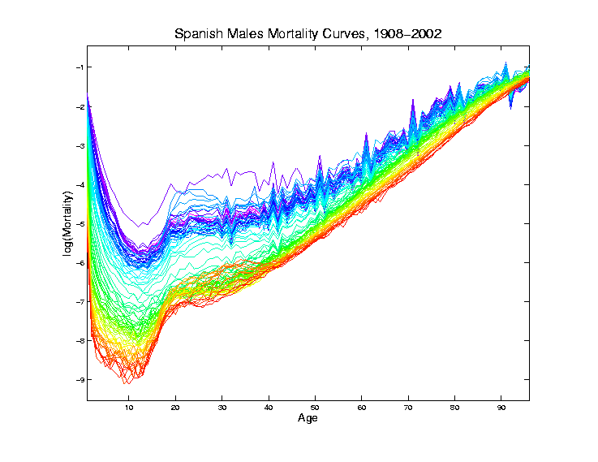
Mortality Time Series
Improved
Coloring:
Rainbow
Representing
Year:
Magenta
= 1908
Red = 2002

Slide 6
Time Series of Curves
Just a “Set of Curves”
But Time Order is Important!
Useful Approach (as above):
Use color to code for time
Start End

Slide 7
T. S. Toy E.g., PCA View
PCA gives “Modes of Variation”
But there are Many…
Intuitively Useful???
Like “harmonics”?
Isn’t there only 1 mode of variation?
Answer comes in scores scatterplots

Slide 8
T. S. Toy E.g., PCA Scatterplot

Slide 9
Chemo-metric Time Series, Control

Slide 10
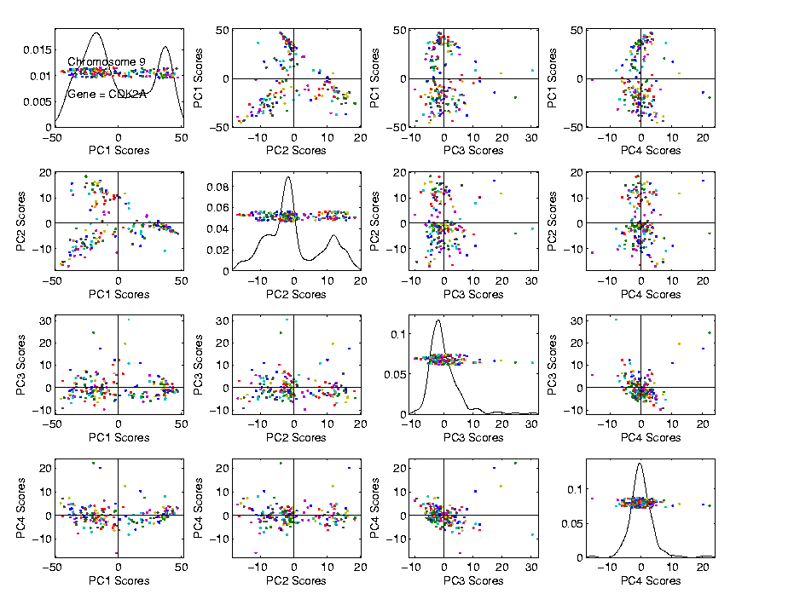
Functional Data Analysis
Suggestion
Of
Clusters
Which
Are
These?

Slide 11
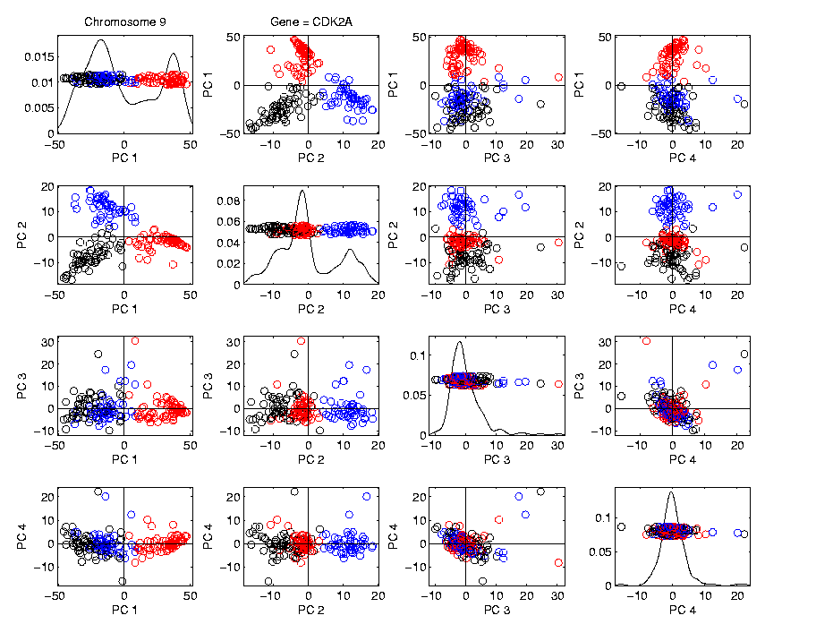
Functional Data Analysis
Manually
“Brush”
Clusters

Slide 12
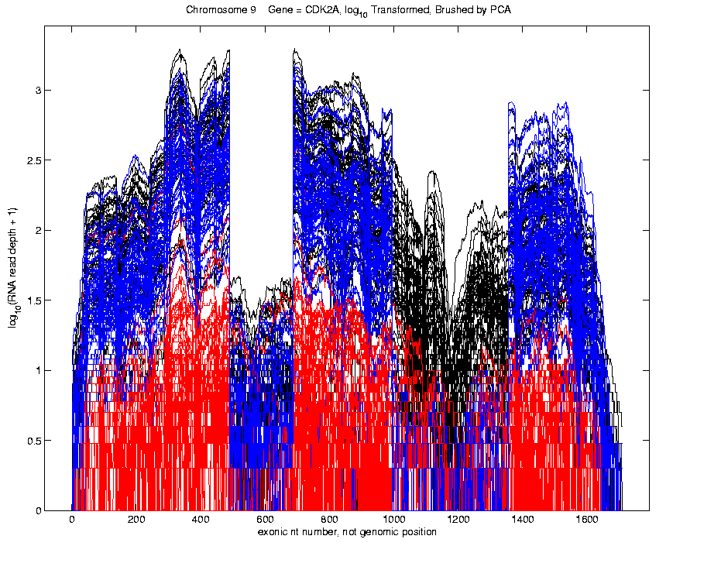
Functional Data Analysis
Manually
Brush
Clusters
Clear
Alternate
Splicing

Slide 13
Limitation of PCA, Toy E.g.

Slide 14
NCI 60: Can we find classes Using PCA view?
Notes:
14

Slide 15
PCA Visualization of NCI 60 Data
Maybe need to look at more PCs?
Study array of such PCA projections:
Notes:
15

Slide 16
NCI 60: Can we find classes Using PCA 9-12?
Notes:
16

Slide 17
PCA Visualization of NCI 60 Data
Can we find classes using PC directions??
Found some, but not others
Nothing after 1st five PCs
Rest seem to be noise driven
Are There Better Directions?
PCA only “feels” maximal variation
Ignores Class Labels
How Can We Use Class Labels?
Notes:
17

Slide 18
Visualization of NCI 60 Data
How Can We Use Class Labels?
Approach:
Find Directions to “Best Separate” Classes
In Disjoint Pairs (thus 4 Directions)
Use DWD:
Distance Weighted Discrimination
Defined (& Motivated) Later
Project All Data on These 4 Directions
Notes:
18

Slide 19
NCI 60: Views using DWD Dir’ns (focus on biology)
Notes:
19

Slide 20
DWD Visualization of NCI 60 Data
Most cancer types clearly distinct
(Renal, CNS, Ovar, Leuk, Colon, Melan)
Using these carefully chosen directions
Others less clear cut
NSCLC (at least 3 subtypes)
Breast (4 published subtypes)

Slide 21
DWD Visualization
Recall PCA limitations
DWD uses class info
Hence can “better separate known classes”
Do this for pairs of classes
(DWD just on those, ignore others)
Carefully choose pairs in NCI 60 data
Note DWD Directions Not Orthogonal
(PCA orthogonality may be
too strong a constraint)

Slide 22
NCI 60: Views using DWD Dir’ns (focus on biology)

Slide 23
PCA Visualization of NCI 60 Data
Can we find classes using PC directions??
Found some, but not others
Not so distinct as in DWD view
Nothing after 1st five PCs
Rest seem to be noise driven
Orthogonality too strong a constraint???
Interesting dir’ns are nearly orthogonal
Notes:
23

Slide 24
Limitation of PCA
Main Point:
May be Important Data Structure
Not Visible in 1st Few PCs

Slide 25
Yeast Cell Cycle Data
Another Example Showing
Interesting Directions Beyond PCA

Slide 26
Yeast Cell Cycle Data
“Gene Expression” – Microarray data
Data (after major preprocessing): Expression “level” of:
thousands of genes (d ~ 1,000s)
but only dozens of “cases” (n ~ 10s)
Interesting statistical issue:
High Dimension Low Sample Size data
(HDLSS)

Slide 27
Yeast Cell Cycle Data
Data from:
Spellman, et al (1998)
Analysis here is from:
Zhao, Marron & Wells (2004)

Slide 28
Yeast Cell Cycle Data
Lab experiment:
Chemically “synchronize cell cycles”, of yeast cells
Do cDNA micro-arrays over time
Used 18 time points, over “about 2 cell cycles”
Studied 4,489 genes (whole genome)
Time series view of data:
have 4,489 time series of length 18
Functional Data View:
have 18 “curves”, of dimension 4,489

Slide 29
Yeast Cell Cycle Data
Lab experiment:
Chemically “synchronize cell cycles”, of yeast cells
Do cDNA micro-arrays over time
Used 18 time points, over “about 2 cell cycles”
Studied 4,489 genes (whole genome)
Time series view of data:
have 4,489 time series of length 18
Functional Data View:
have 18 “curves”, of dimension 4,489
What are
the data
objects?

Slide 30
Yeast Cell Cycle Data, FDA View
Central question:
Which genes are “periodic” over 2 cell cycles?

Slide 31
Yeast Cell Cycle Data, FDA View
Periodic
genes?
Naïve
approach:
Simple PCA

Slide 32
Yeast Cell Cycle Data, FDA View
Central question: which genes are “periodic” over 2 cell cycles?
Naïve approach: Simple PCA
No apparent (2 cycle) periodic structure?
Eigenvalues suggest large amount of “variation”
PCA finds “directions of maximal variation”
Often, but not always, same as “interesting directions”
Here need better approach to study periodicities

Slide 33
Yeast Cell Cycle Data, FDA View
Approach
Project on Period 2 Components Only
Calculate via Fourier Representation
To understand, study Fourier Basis
Powerful Fact: linear combos of sin and cos capture “phase”, since:

Slide 34
Sin-Cos Phase Shifts are Linear
Powerful Fact: linear combos of sin and cos capture “phase”, since:
Consequence:
Random Phase Shifts Captured in Just 2 PCs

Slide 35
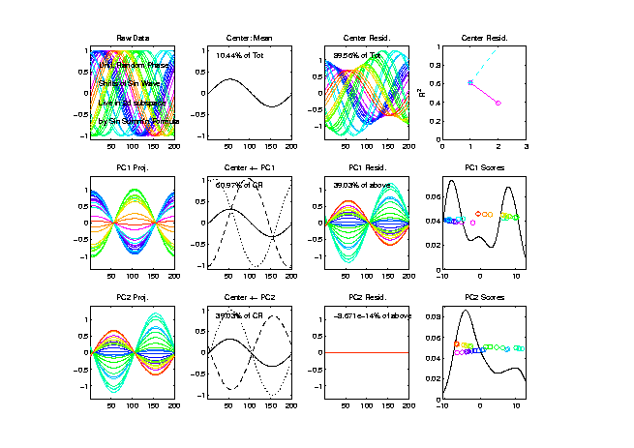
Sin-Cos Phase Shifts are Linear
n = 30
curves

Slide 36
Sin-Cos Phase Shifts are Linear
n = 30
curves
Random Phase Shifts Captured in Just 2 PCs

Slide 37
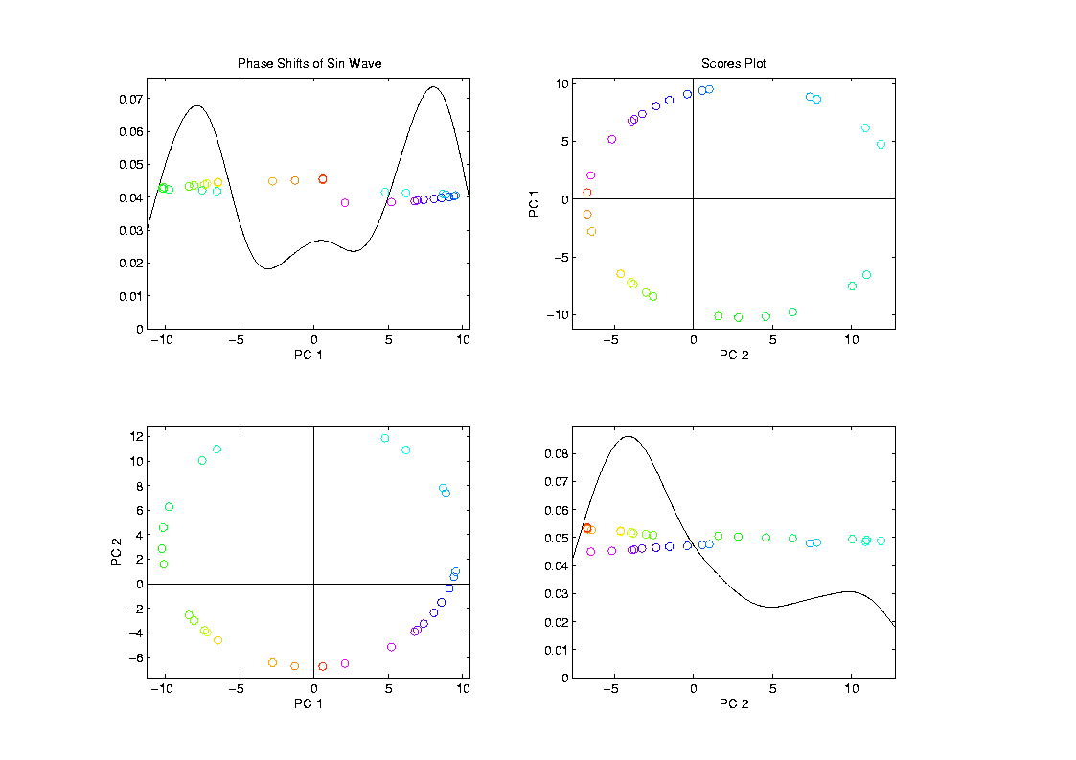
Sin-Cos Phase Shifts are Linear
Coefficents
(Scores)
Show
Circular
Pattern
{Like plot of
$\sin{φ}$ vs.$\cos{φ}$,
see summation
formula}

Slide 38
Fourier Basis

Slide 39
Fourier Basis
Fourier Basis Facts:
Two Versions
Discrete (For Vectors in $ℝ^{d}$)
Continuous (For Curves in $L^{2}$)
Approximately Same (by Riemann Summation)
Thus use same graphics for each
Orthonormal Basis
Exactly true for both versions

Slide 40
Fourier Basis
Fourier Basis Facts:
Complete Basis (spans whole space)
Exactly True for both versions
Basis Elements are “Directions”
Will think about as above
Good References:
Brillinger (2001)
Bloomfield (2004)

Slide 41
Fourier Basis

Slide 42
Yeast Cell Cycle Data, FDA View
Approach
Project on Period 2 Components Only
Calculate via Fourier Representation
Project onto Subspace of Even Frequencies
Keeps only 2-period part of data
(i.e. same over both cycles)
Then do PCA on projected data

Slide 43
Fourier Basis

Slide 44
Yeast Cell Cycles, Freq. 2 Proj.
PCA on
Freq. 2
Periodic
Component
Of Data

Slide 45
Yeast Cell Cycles, Freq. 2 Proj.
PCA on periodic component of data
Hard to see periodicities in raw data
But very clear in PC1 (~sin) and PC2 (~cos)
PC1 and PC2 explain 65% of variation (see residuals)
Recall linear combos of sin and cos capture “phase”, since:

Slide 46
Frequency 2 Analysis
Important features of data appear only at frequency 2,
Hence project data onto 2-dim space of sin and cos (freq. 2)
Useful view: scatterplot
Similar to PCA proj’ns, except “directions” are now chosen, not “var max’ing”

Slide 47
Frequency 2 Analysis
Colors are

Slide 48
Frequency 2 Analysis
Project data onto 2-dim space of sin and cos (freq. 2)
Useful view: scatterplot
Angle (in polar coordinates) shows phase
Colors: Spellman’s cell cycle phase classification
Black was labeled “not periodic”
Within class phases approx’ly same, but notable differences
Later will try to improve “phase classification”

Slide 49
Batch and Source Adjustment
For Stanford Breast Cancer Data (C. Perou)
Analysis in Benito, et al (2004) Bioinformatics, 20, 105-114.
https://genome.unc.edu/pubsup/dwd/
Adjust for Source Effects
Different sources of mRNA
Adjust for Batch Effects
Arrays fabricated at different times

Slide 50
Idea Behind Adjustment
Find “direction” from one to other
Shift data along that direction
Details of DWD Direction developed later

Slide 51
Source Batch Adj: Raw Breast Cancer data

Slide 52
Source Batch Adj: Source Colors

Slide 53
Source Batch Adj: Batch Colors

Slide 54
Source Batch Adj: Biological Class Colors

Slide 55
Source Batch Adj: Biological Class Col. & Symbols

Slide 56
Source Batch Adj: Biological Class Symbols

Slide 57
Source Batch Adj: Source Colors

Slide 58
Source Batch Adj: PC 1-3 & DWD direction

Slide 59
Source Batch Adj: DWD Source Adjustment

Slide 60
Source Batch Adj: Source Adj’d, PCA view

Slide 61
Source Batch Adj: Source Adj’d, Class Colored

Slide 62
Source Batch Adj: Source Adj’d, Batch Colored

Slide 63
Source Batch Adj: Source Adj’d, 5 PCs

Slide 64
Source Batch Adj: S. Adj’d, Batch 1,2 vs. 3 DWD

Slide 65
Source Batch Adj: S. & B1,2 vs. 3 Adjusted

Slide 66
Source Batch Adj: S. & B1,2 vs. 3 Adj’d, 5 PCs

Slide 67
Source Batch Adj: S. & B Adj’d, B1 vs. 2 DWD

Slide 68
Source Batch Adj: S. & B Adj’d, B1 vs. 2 Adj’d

Slide 69
Source Batch Adj: S. & B Adj’d, 5 PC view

Slide 70
Source Batch Adj: S. & B Adj’d, 4 PC view

Slide 71
Source Batch Adj: S. & B Adj’d, Class Colors

Slide 72
Source Batch Adj: S. & B Adj’d, Adj’d PCA

Slide 73
Source Batch Adj: Raw Data, Tree View

Slide 74
Caution on Colors
~10 % of Males are:
Red – Green Color Blind
Can’t distinguish Red vs. Green
Should use better scheme…

Slide 75
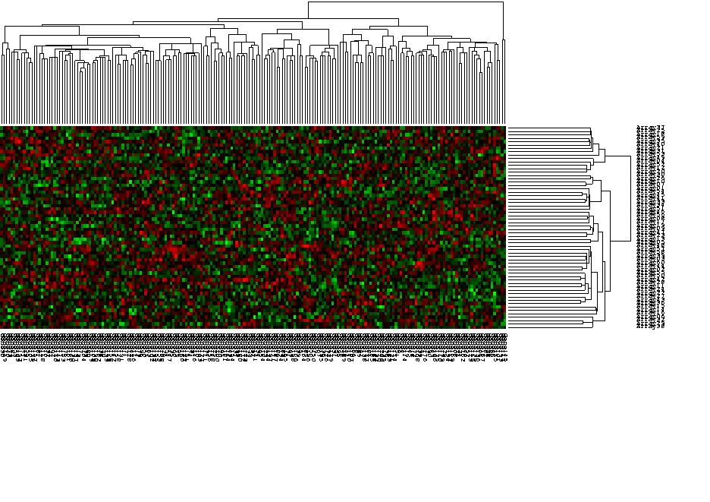
Caution About Tree View
Can Miss Important Features

Slide 76
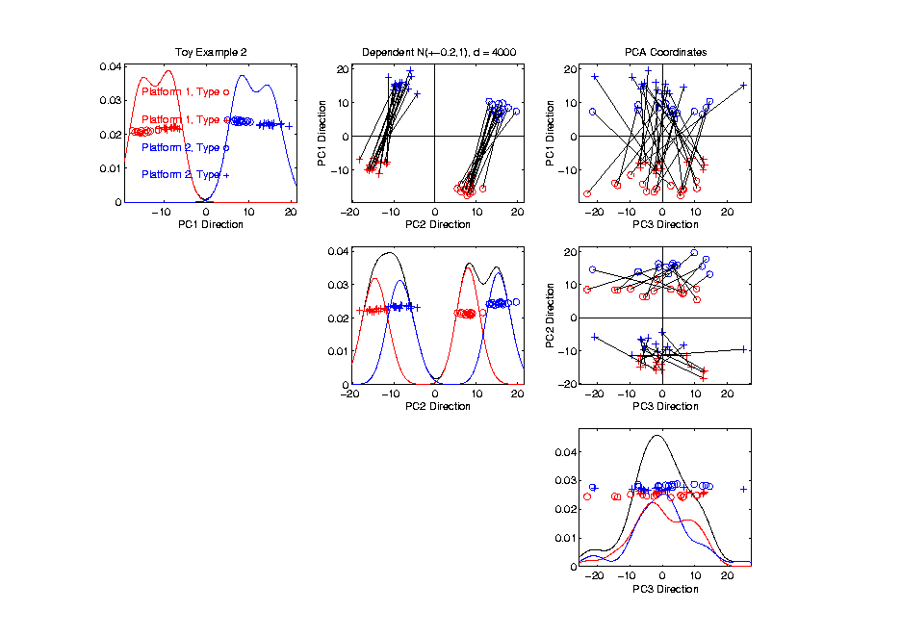
Caution About Tree View
Important Clusters, not in Coord Axis Dir’n

Slide 77
Source Batch Adj: Raw Data, Tree View

Slide 78
Source Batch Adj: Raw Data, Array Tree

Slide 79
Source Batch Adj: Raw Array Tree, Source Colored

Slide 80
Source Batch Adj: Raw Array Tree, Batch Colored

Slide 81
Source Batch Adj: Raw Array Tree, Class Colored

Slide 82
Source Batch Adj: DWD Adjusted Data, Tree View

Slide 83
Source Batch Adj: DWD Adjusted Data, Array Tree

Slide 84
Source Batch Adj: DWD Adjusted Data, Source Colored

Slide 85
Source Batch Adj: DWD Adjusted Data, Batch Colored

Slide 86
Source Batch Adj: DWD Adjusted Data, Class Colored

Slide 87
DWD: A look under the hood
Distance Weighted Discrimination (DWD)
Modification of Support Vector Machine
For HDLSS data
Uses 2nd Order Cone programming
Will study later
Main Goal:
Find direction, that separates data classes
In “best” possible way

Slide 88
DWD: Why not PC1?
PC 1 Direction feels variation, not classes
Also eliminates (important?) within class variation

Slide 89
DWD: Why not PC1?
Direction driven by classes
“Sliding” maintains (important?) within class variation

Slide 90
E. g. even worse for PCA
PC1 direction is worst possible

Slide 91
But easy for DWD
Since DWD uses class label information

Slide 92
DWD does not solve all problems
Only handles means, not differing variation

Slide 93
Interesting Benchmark Data Set
NCI 60 Cell Lines
Interesting benchmark, since same cells
Data Web available:
http://discover.nci.nih.gov/datasetsNature2000.jsp
Both cDNA and Affymetrix Platforms
Different from Breast Cancer Data
Which had no common samples

Slide 94
NCI 60: Raw Data, Platform Colored

Slide 95
NCI 60: Raw Data, Tree View

Slide 96
NCI 60: Raw Data

Slide 97
NCI 60: Raw Data, Before DWD Adjustment

Slide 98
NCI 60: Before & After DWD adjustment

Slide 99
NCI 60: Before & After, new scales

Slide 100
NCI 60: After DWD

Slide 101
NCI 60: DWD adjusted data

Slide 102
NCI 60: Before Column Mean Adjustment

Slide 103
NCI 60: Before & After Column Mean Adjustment

Slide 104
NCI 60: Before & After Col. Mean Adj., Rescaled

Slide 105
NCI 60: After DWD & Column Mean Adj.

Slide 106
NCI 60: DWD & Column Mean Adjusted

Slide 107
NCI 60: Before Column Stand. Dev. Adjustment

Slide 108
NCI 60: Before and After Column S.D. Adjustment

Slide 109
NCI 60: Before and After Col. S.D. Adj., Rescaled

Slide 110
NCI 60: After Column Stand. Dev. adjustment

Slide 111
NCI 60: Fully Adjusted Data

Slide 112
NCI 60: Fully Adjusted Data, Platform Colored

Slide 113
NCI 60: Fully Adjusted Data, Melanoma Cluster
BREAST.MDAMB435
BREAST.MDN
MELAN.MALME3M
MELAN.SKMEL2
MELAN.SKMEL5
MELAN.SKMEL28
MELAN.M14
MELAN.UACC62
MELAN.UACC257

Slide 114
NCI 60: Fully Adjusted Data, Leukemia Cluster
LEUK.CCRFCEM
LEUK.K562
LEUK.MOLT4
LEUK.HL60
LEUK.RPMI8266
LEUK.SR

Slide 115
Another DWD Appl’n: Visualization
Recall PCA limitations
DWD uses class info
Hence can “better separate known classes”
Do this for pairs of classes
(DWD just on those, ignore others)
Carefully choose pairs in NCI 60 data
Shows Effectiveness of Adjustment

Slide 116
NCI 60: Views using DWD Dir’ns (focus on biology)

Slide 117
DWD Visualization of NCI 60 Data
Most cancer types clearly distinct
(Renal, CNS, Ovar, Leuk, Colon, Melan)
Using these carefully chosen directions
Others less clear cut
NSCLC (at least 3 subtypes)
Breast (4 published subtypes)
DWD adjustment was very effective
(very few black connectors visible)

