Slide 1
Statistics – O. R. 892
Object Oriented Data Analysis
J. S. Marron
Dept. of Statistics and Operations Research
University of North Carolina

Slide 2
Administrative Info
Details on Course Web Page
http://stor892fall2014.web.unc.edu/
Or:
  Google: “Marron Courses”
  Choose This Course

Slide 3
Object Oriented Data Analysis
What is it?
A Sound-Bite Explanation:
What is the “atom of the statistical analysis”?
1st Course: Numbers
Multivariate Analysis Course : Vectors
Functional Data Analysis: Curves
More generally: Data Objects

Slide 4
Object Oriented Data Analysis
Current Motivation:
In Complicated Data Analyses
Fundamental (Non-Obvious) Question Is:
“What Should We Take as Data Objects?”
Key to Focussing Needed Analyses

Slide 5
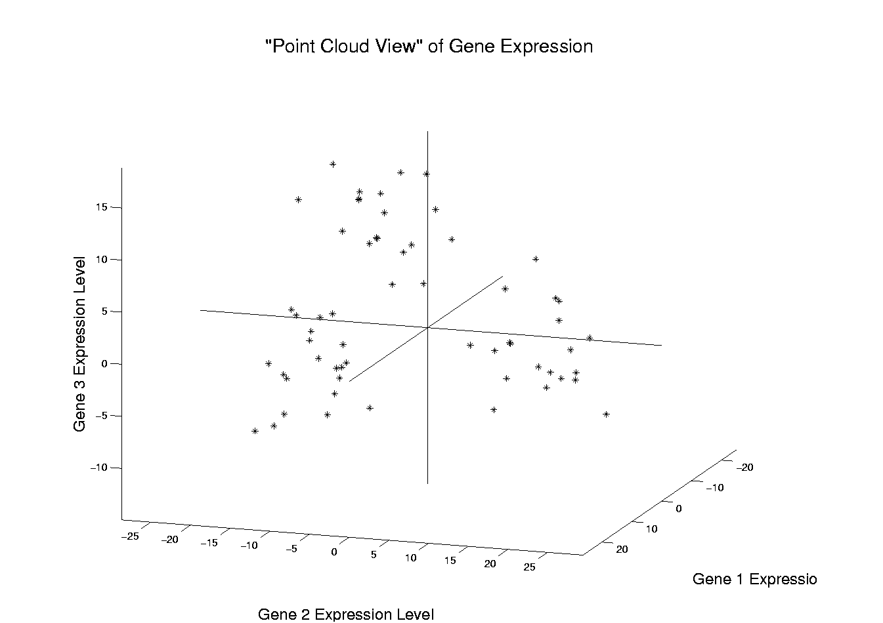
Illustration of Multivariate View: Raw Data
Notes:
EgView1p1RawData.ps

Slide 6
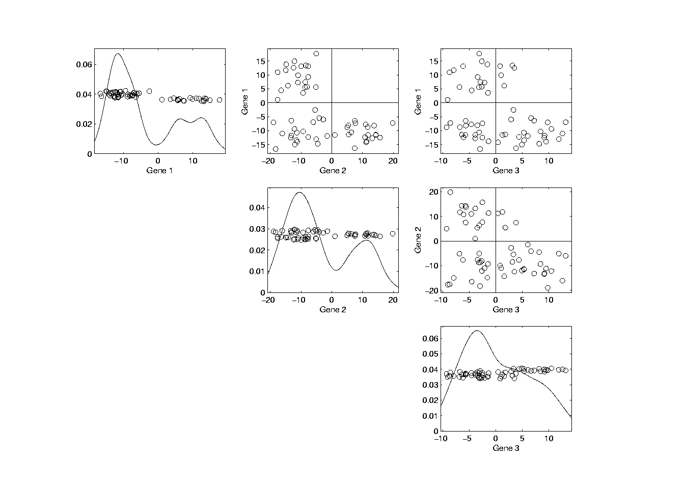
Illust’n of Multivar. View: Typical View
Notes:
EgView1p39ScatPlot.ps

Slide 7
Principal Components
Find Directions of:
“Maximal (projected) Variation”
Compute Sequentially
On Orthogonal Subspaces
Will take careful look at mathematics later

Slide 8
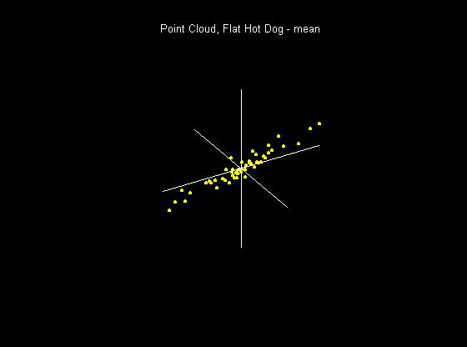
Principal Components
For simple,
3-d toy data,
recall raw
data view:
Notes:
8

Slide 9
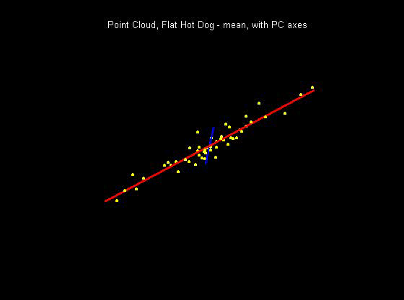
Principal Components
PCA just
gives rotated
coordinate
system:
Notes:
9

Slide 10
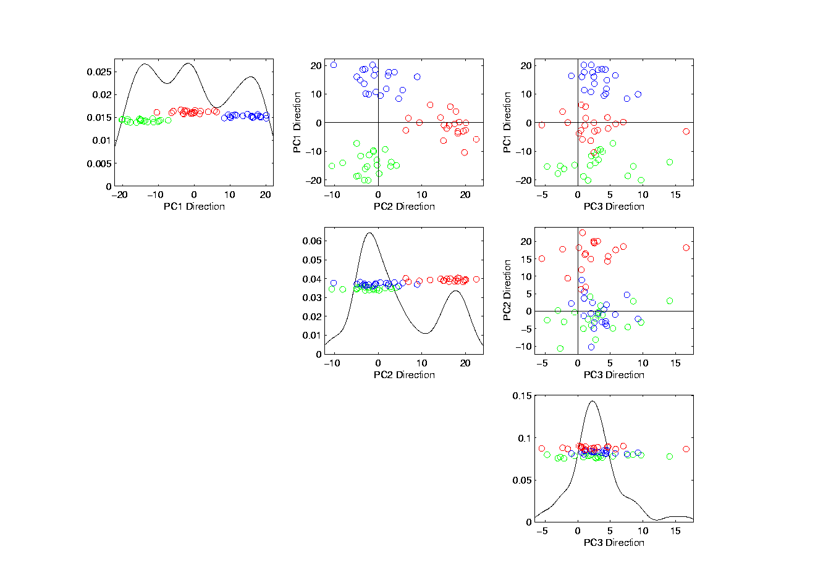
Illust’n of PCA View: PCA View
Clusters are “more distinct”
Since more “air space”
In between
Notes:
EgView1p72PCAViewClustColor.ps

Slide 11
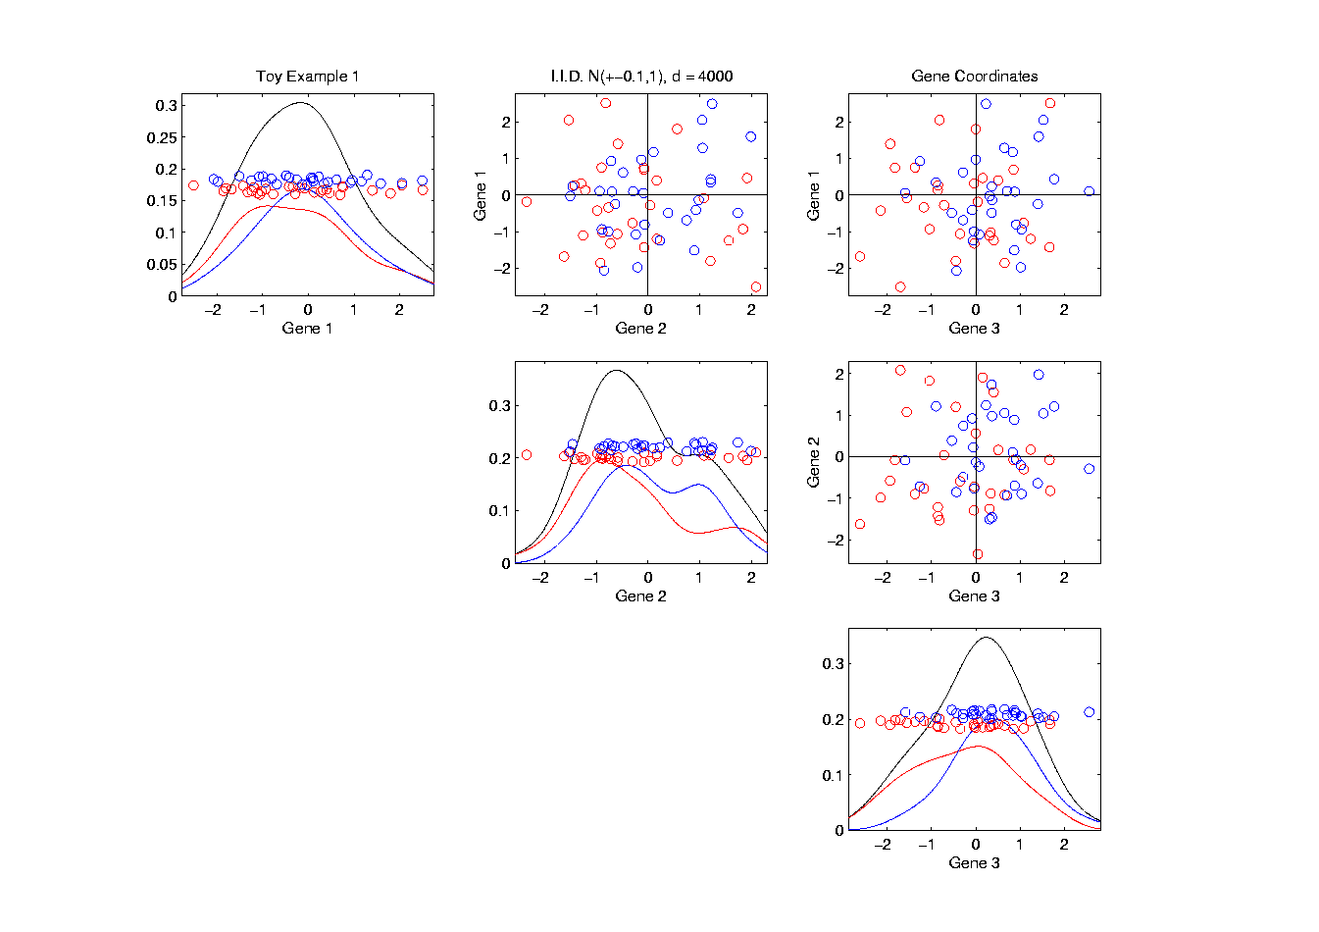
Another Comparison: Gene by Gene View
Very Small Differences
Between Means
Notes:
EgView2p1dat1GeneView.ps

Slide 12
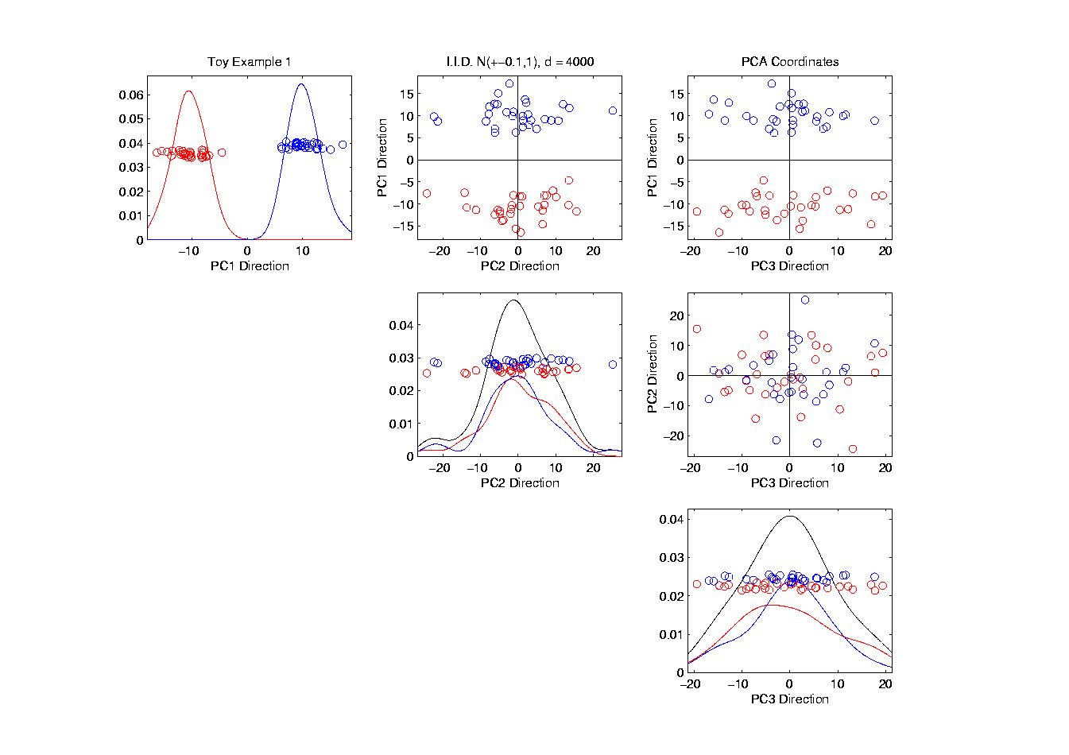
Another Comparison: PCA View
Notes:
EgView2p2dat1PCAView.ps

Slide 13
Data Object Conceptualization
Object Space ←→ Descriptor Space
Curves
Images Manifolds
Shapes Tree Space
Trees

Slide 14
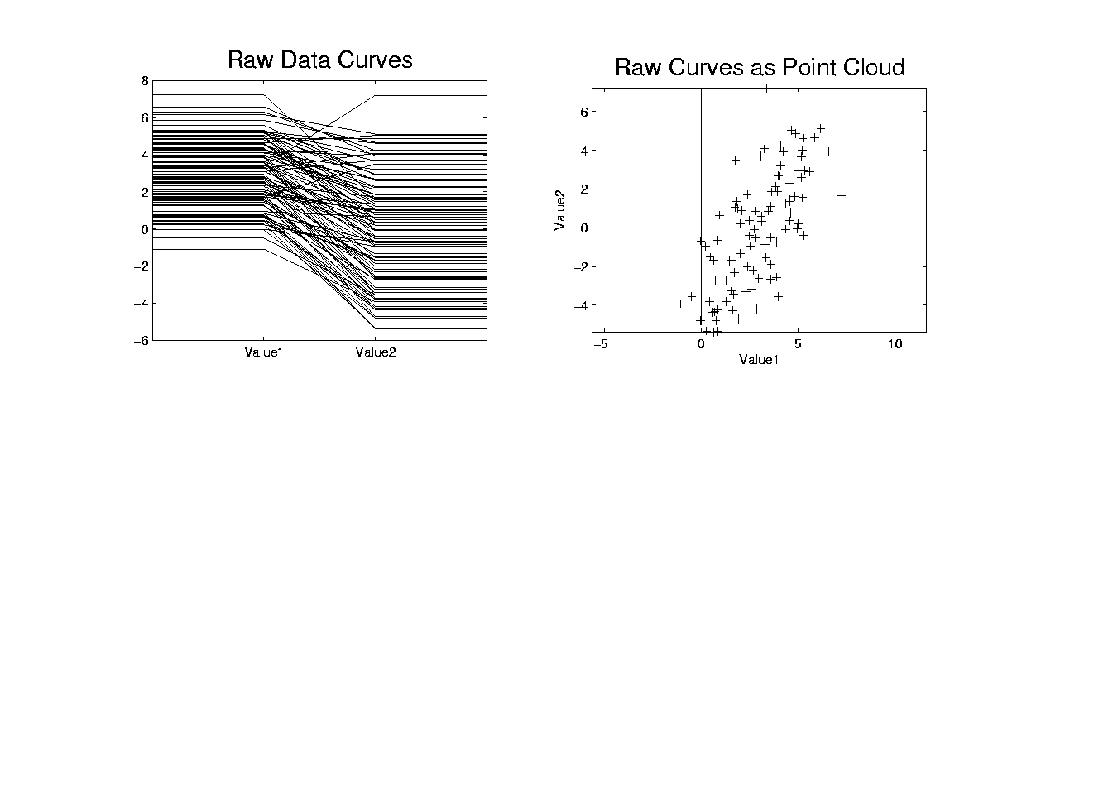
Functional Data Analysis, Toy EG I
Notes:
toyraw.ps

Slide 15
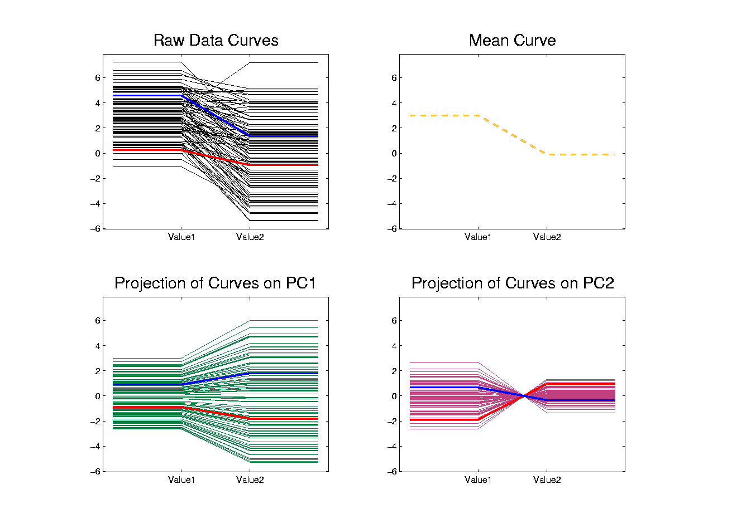
Functional Data Analysis, Toy EG X
Notes:
addupcol.ps

Slide 16
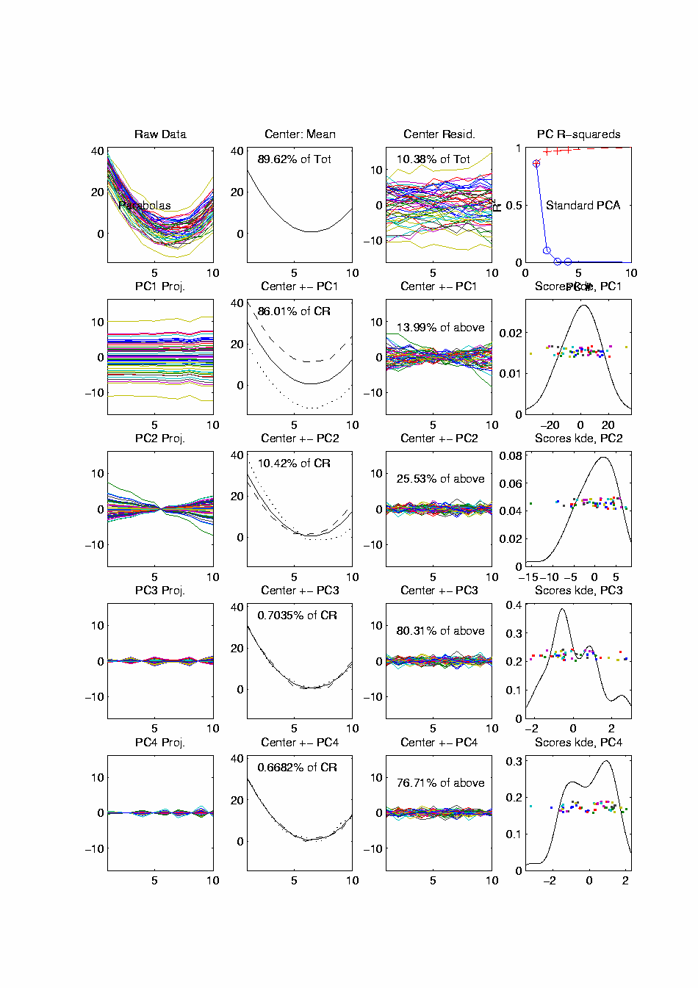
Functional Data Analysis, 10-d Toy EG 1
Terminology:
“Loadings Plots” “Scores Plots”
Notes:
EGCD1Parabs.ps

Slide 17
Functional Data Analysis, 10-d Toy EG 1
Notes:
EGCD1Parabs.ps

Slide 18
E.g. Curves As Data, II
PCA: reveals “population structure”
Mean → Parabolic Structure
PC1 → Vertical Shift
PC2 → Tilt
higher PCs → Gaussian (spherical)
Decomposition into modes of variation

Slide 19
E.g. Curves As Data, III
Two Cluster Example
10-d curves again

Slide 20
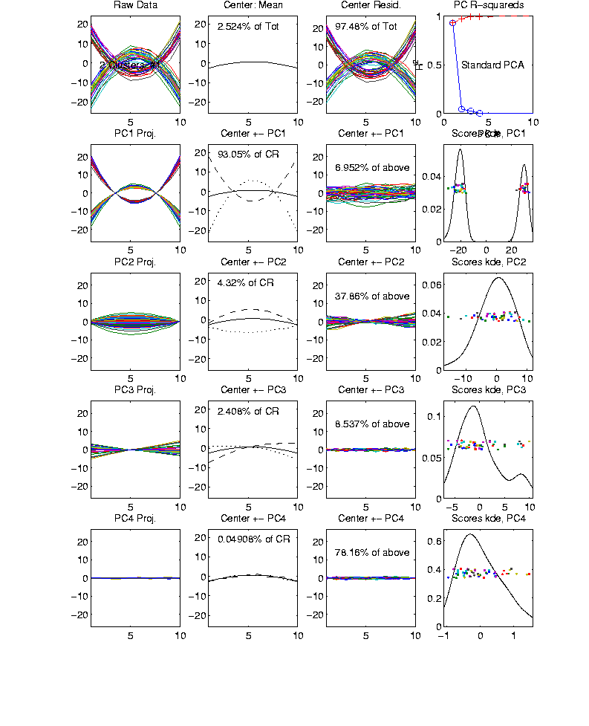
Functional Data Analysis, 10-d Toy EG 2
Notes:
EGCD1Clust2.ps

Slide 21
E.g. Curves As Data, III
Two Cluster Example
10-d curves again
Two big clusters
Revealed by 1-d projection plot (left side)
Note: Cluster Difference is not orthogonal
to Vertical Shift
PCA: reveals “population structure”

Slide 22
E.g. Curves As Data, IV
More Complicated Example
50-d curves

Slide 23
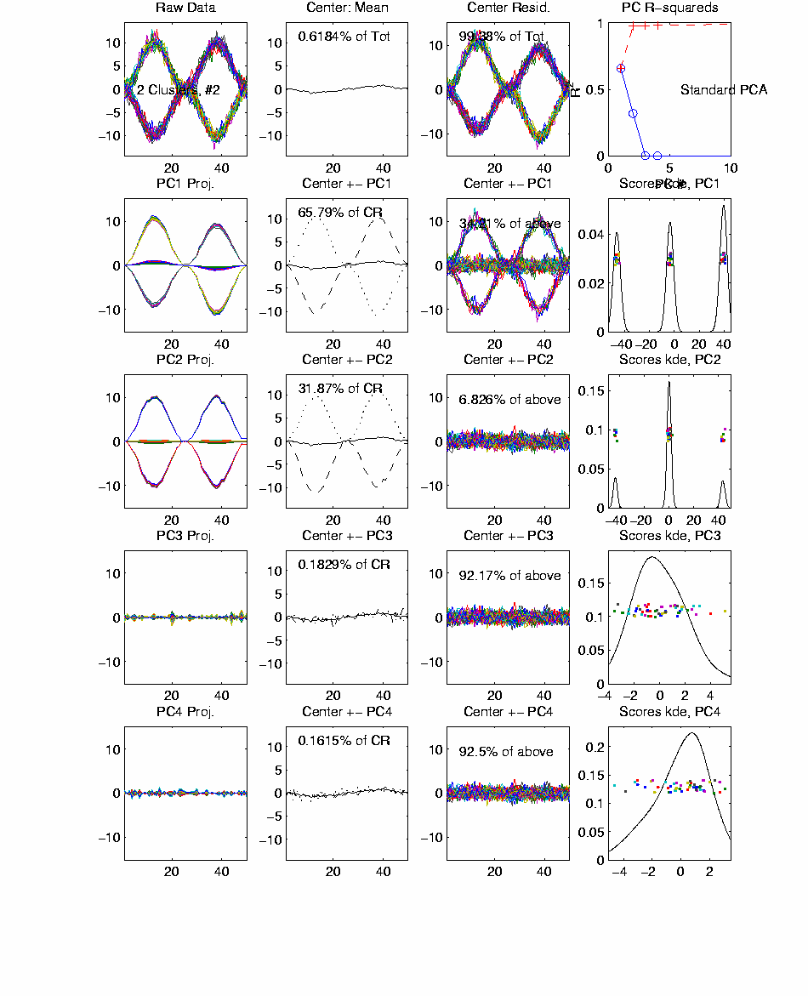
Functional Data Analysis, 50-d Toy EG 3
Notes:
EGCD1Clust4a.ps

Slide 24
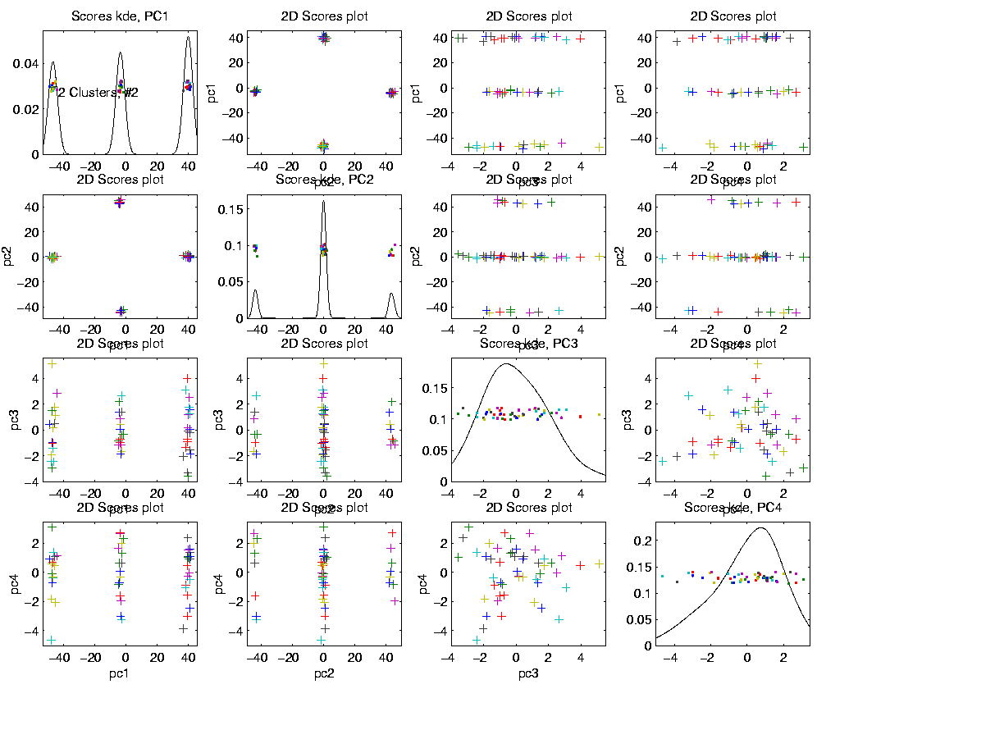
Functional Data Analysis, 50-d Toy EG 3
Notes:
EGCD1Clust4aDP2d.ps

Slide 25
E.g. Curves As Data, IV
More Complicated Example
50-d curves
Pop’n structure hard to see in 1-d
2-d projections make structure clear
PCA: reveals “population structure”

Slide 26
Functional Data Analysis
Interesting Data Set:
Mortality Data
For Spanish Males (thus can relate to history)
Each curve is a single year
x coordinate is age
Mortality = # died / total # (for each age)
Study on log scale
Investigate change over years 1908 – 2002
From Andrés Alonso, U. Carlos III, Madrid
{See Marron & Alonso (2014)}

Slide 27
Functional Data Analysis
Interesting Data Set:
Mortality Data
For Spanish Males (thus can relate to history)
Each curve is a single year
x coordinate is age
Note: Choice made of Data Object
(could also study age as curves,
x coordinate = time)

Slide 28
Functional Data Analysis
Important Issue:
What are the Data Objects?
Mortality vs. Age Curves (over years)
Mortality vs. Year Curves (over ages)
Note: Rows vs. Columns of Data Matrix

Slide 29
Functional Data Analysis
Important Issue:
What are the Data Objects?
Mortality vs. Age Curves (over years)
Mortality vs. Year Curves (over ages)
Note: Rows vs. Columns of Data Matrix

Slide 30
Functional Data Analysis
Interesting Data Set:
Mortality Data
For Spanish Males (thus can relate to history)
Each curve is a single year
x coordinate is age
Mortality = # died / total # (for each age)
Study on log scale
Another Data Object Choice
(not about experimental units)

Slide 31
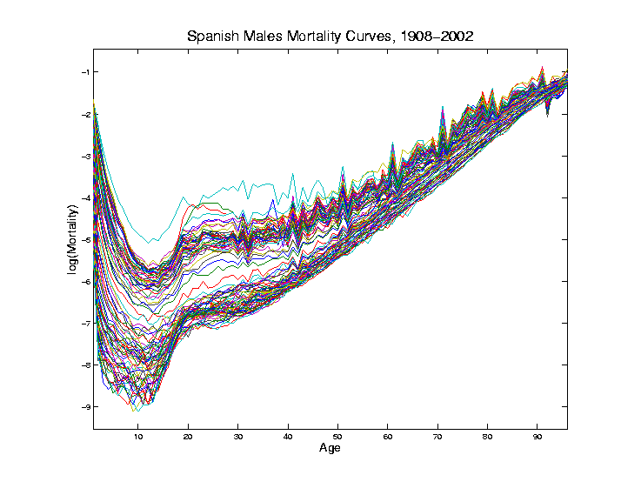
Mortality Time Series
Conventional
Coloring:
Rotate
Through
(7) Colors
Hard to
See Time
Structure

Slide 32
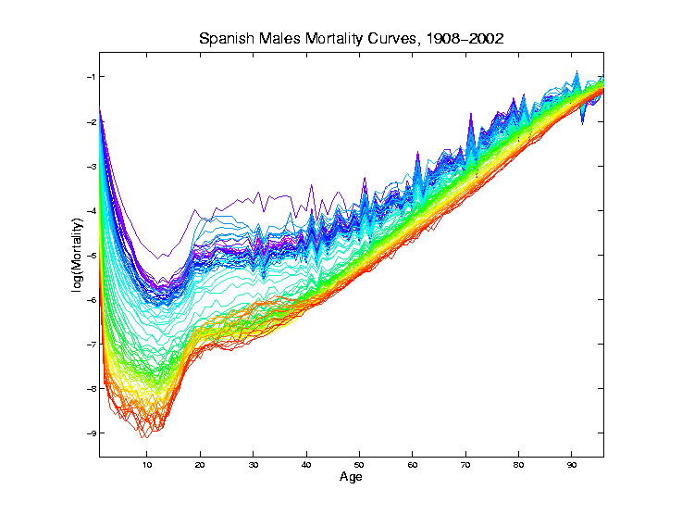
Mortality Time Series
Improved
Coloring:
Rainbow
Representing
Year:
Magenta
= 1908
Red = 2002

Slide 33
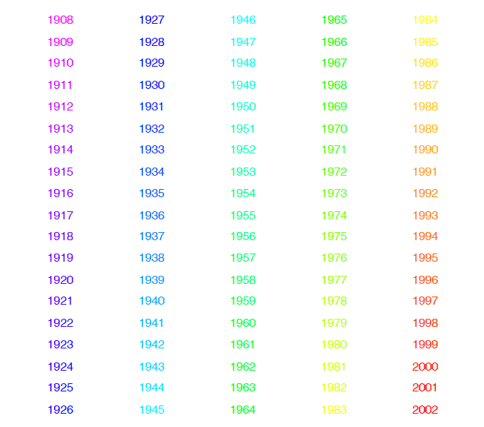
Mortality Time Series
Color Code
(Years)
Notes:
33

Slide 34
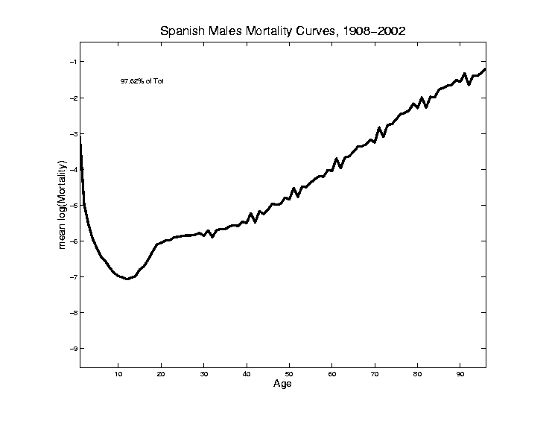
Mortality Time Series
Find
Population Center
(Mean
Vector)
Compute in
Descriptor
Space
Show in
Object Space

Slide 35
Mortality Time Series
Blips Appear
At Decades
Since Ages
Not Precise
(in Spain)
Reported as
“about 50”,
Etc.

Slide 36
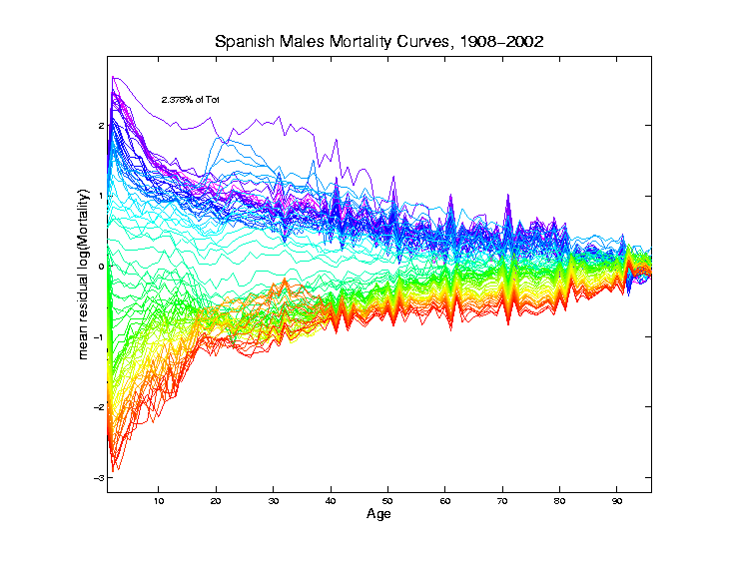
Mortality Time Series
Mean
Residual
Descriptor Space
View of
Shifting Data
To Origin
In Feature Space

Slide 37
Mortality Time Series
Shows:
Main Age
Effects in
Mean, Not
Variation
About Mean

Slide 38
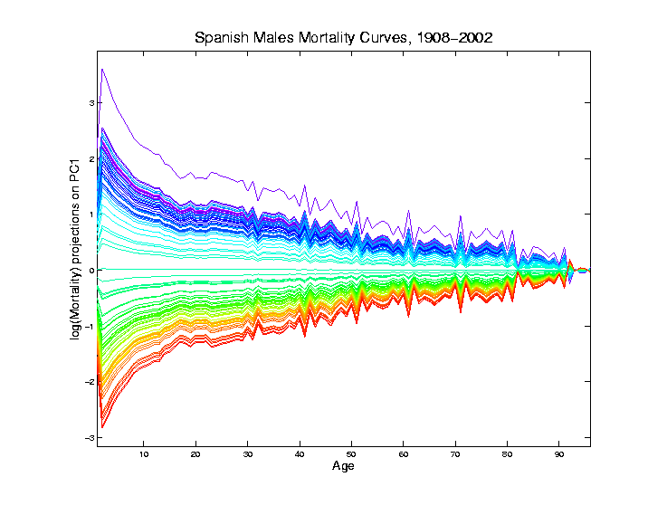
Mortality Time Series
Object Space View of Projections
Onto PC1
Direction
Main Mode
Of Variation:
Constant
Across Ages

Slide 39
Mortality Time Series
Object Space View of Projections
Onto PC1
Direction
Main Mode
Of Variation:
Constant
Across Ages
Loadings Plot

Slide 40
Mortality Time Series
Shows Major
Improvement
Over Time
(medical technology,
etc.)
And Change
In Age
Rounding Blips

Slide 41
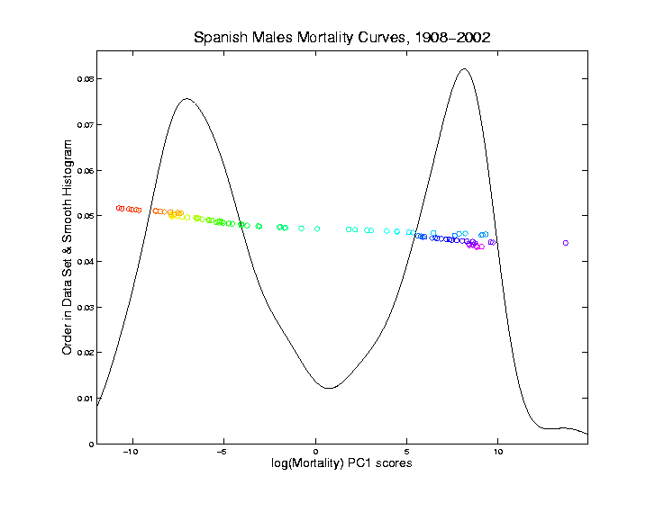
Mortality Time Series
Corresponding
PC 1 Scores
Again Shows
Overall
Improvement
High Mortality
Early

Slide 42
Mortality Time Series
Corresponding
PC 1 Scores
Again Shows
Overall
Improvement
High Mortality
Early
Lower Later

Slide 43
Mortality Time Series
Outliers

Slide 44
Mortality Time Series
Outliers
1918 Global
Flu Pandemic

Slide 45
Mortality Time Series
Outliers
1918 Global
Flu Pandemic

Slide 46
Mortality Time Series
Outliers
1918 Global
Flu Pandemic
1936-1939
Spanish
Civil War

Slide 47
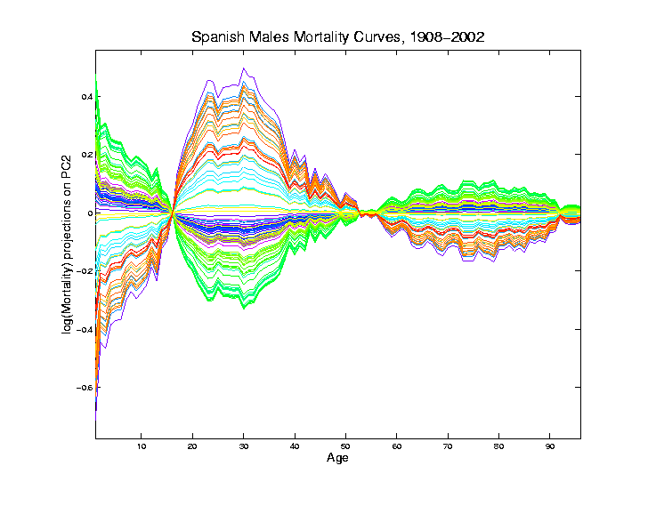
Mortality Time Series
Object Space View of Projections
Onto PC2
Direction

Slide 48
Mortality Time Series
Object Space View of Projections
Onto PC2
Direction
Loadings Plot

Slide 49
Mortality Time Series
Object Space View of Projections
Onto PC2
Direction
2nd Mode
Of Variation:
Difference
Between
20-45 & Rest

Slide 50
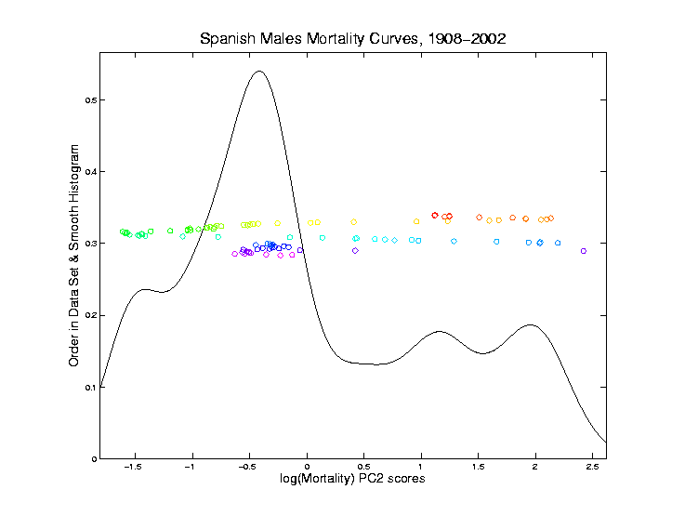
Mortality Time Series
Explain Using
PC 2 Scores
Early
Improvement

Slide 51
Mortality Time Series
Explain Using
PC 2 Scores
Early
Improvement
Pandemic
Hit Hardest

Slide 52
Mortality Time Series
Explain Using
PC 2 Scores
Then better

Slide 53
Mortality Time Series
Explain Using
PC 2 Scores
Then better
Spanish Civil War Hit
Hardest

Slide 54
Mortality Time Series
Explain Using
PC 2 Scores
Steady
Improvement
To mid-50s

Slide 55
Mortality Time Series
Explain Using
PC 2 Scores
Steady
Improvement
To mid-50s
Increasing
Automotive
Death Rate

Slide 56
Mortality Time Series
Explain Using
PC 2 Scores
Corner Finally
Turned by
Safer Cars
& Roads

Slide 57
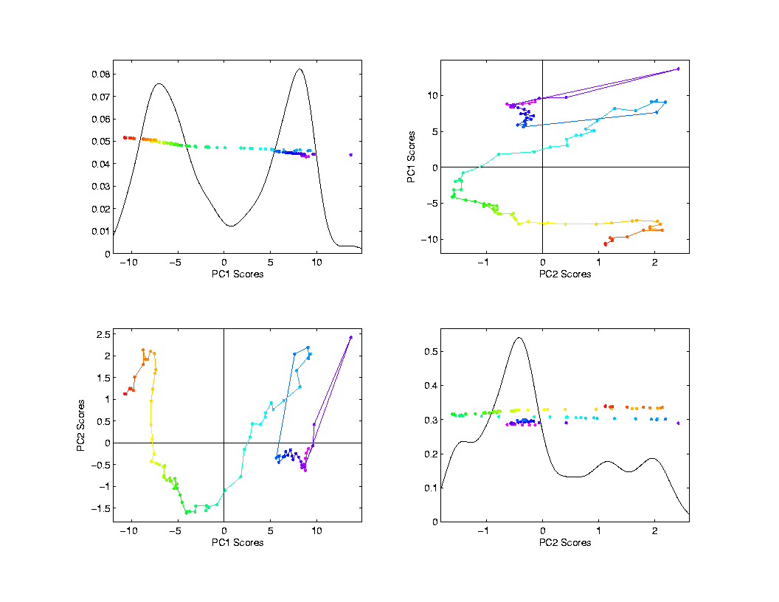
Mortality Time Series
Scores Plot
Descriptor
(Point Cloud)
Space View
Connecting
Lines
Highlight
Time Order
Good View of
Historical
Effects

Slide 58
Mortality Time Series
Try a Related Mortality Data Set:
Switzerland
(In Europe, but different history)

Slide 59
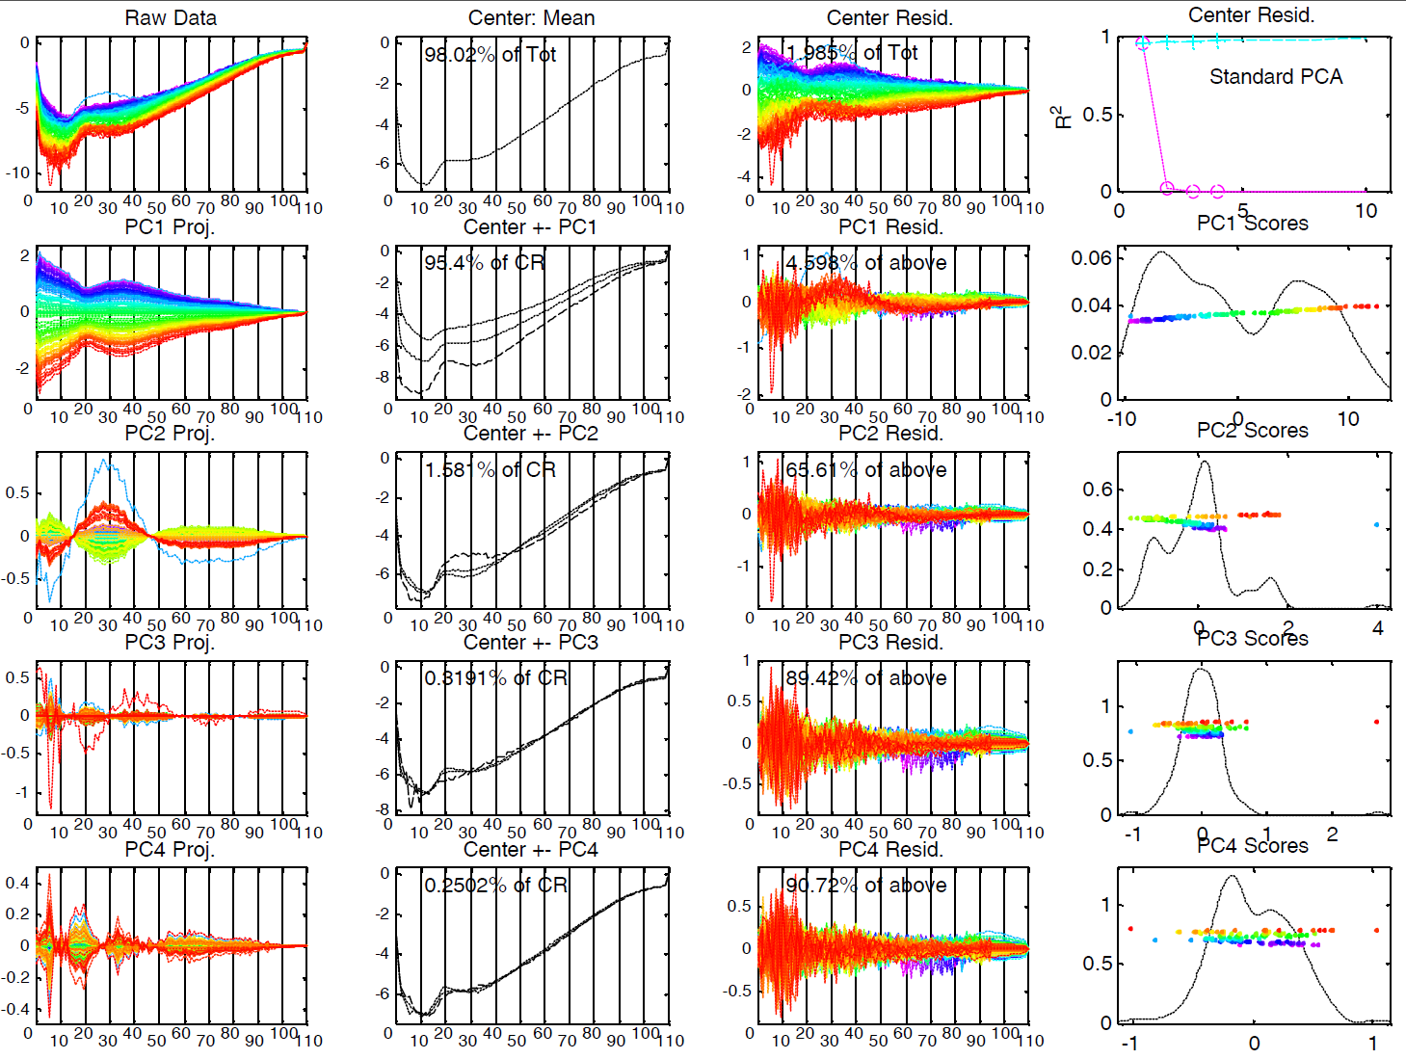
Mortality Time Series – Swiss Males

Slide 60
Mortality Time Series – Swiss Males
Some Points Similar to Spain:
PC1: Overall Improvement
Better for Young
PC2: About 20 – 45 vs. Others
Flu Pandemic
Automobile Effects
Some Quite Different:
No Age Rounding
No Civil War

Slide 61
Time Series of Data Objects
Mortality Data Illustrates an Important Point:
OODA is more than a “framework”
It Provides a Focal Point
Highlights Pivotal Choice:
What should be the Data Objects?

Slide 62
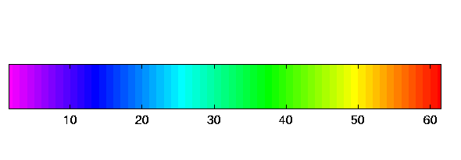
Time Series of Curves
Just a “Set of Curves”
But Time Order is Important!
Useful Approach (as above):
Use color to code for time
Start End

Slide 63
Time Series Toy E.g.
Explore Question:
“Is Horizontal Motion Linear Variation?”
Example: Set of time shifted
Gaussian densities
View: Code time with colors as above

Slide 64
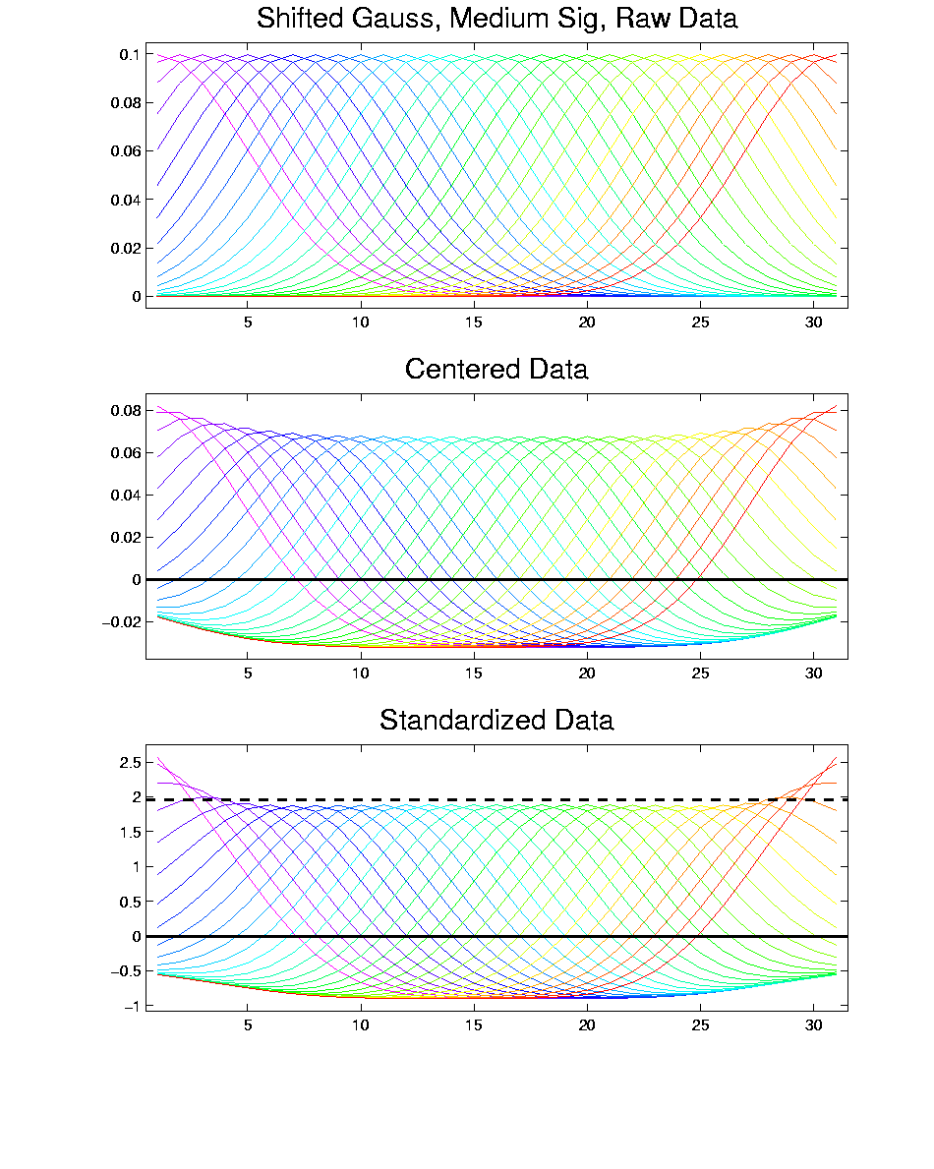
T. S. Toy E.g., Raw Data

Slide 65
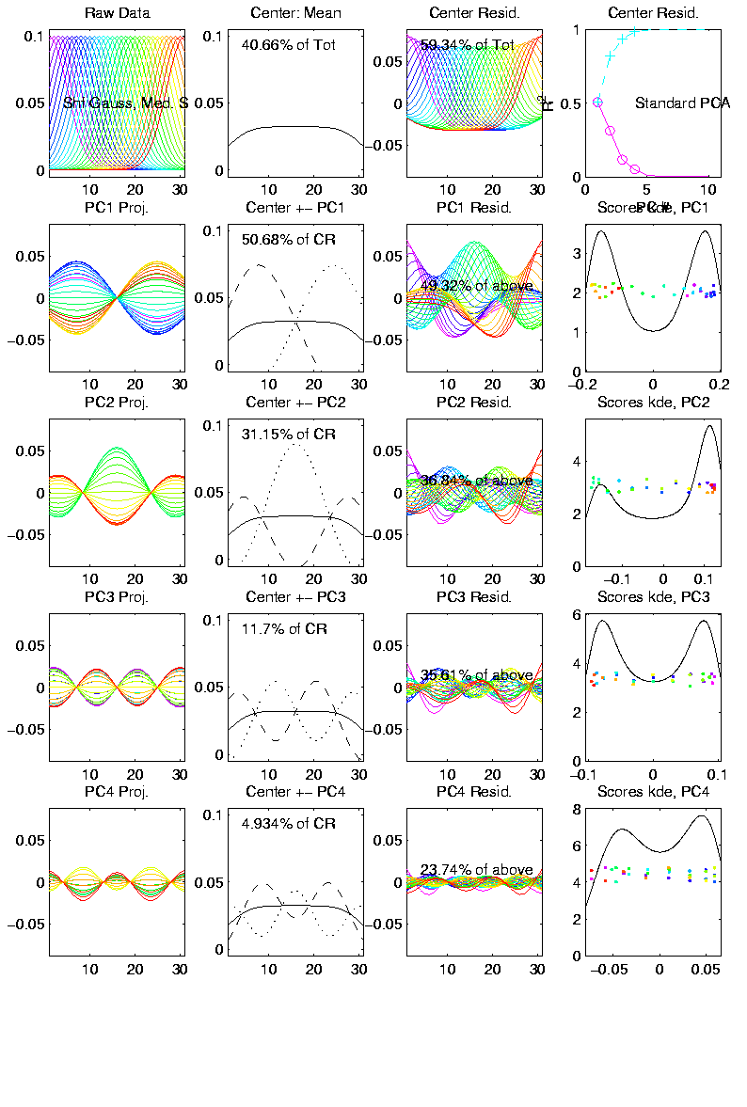
T. S. Toy E.g., PCA View
PCA gives “Modes of Variation”
But there are Many…

Slide 66
T. S. Toy E.g., PCA View
PCA gives “Modes of Variation”
But there are Many…
Intuitively Useful???
Like “harmonics”?

Slide 67
T. S. Toy E.g., PCA View
PCA gives “Modes of Variation”
But there are Many…
Intuitively Useful???
Like “harmonics”?
Isn’t there only 1 mode of variation?

Slide 68
T. S. Toy E.g., PCA View
PCA gives “Modes of Variation”
But there are Many…
Intuitively Useful???
Like “harmonics”?
Isn’t there only 1 mode of variation?
Answer comes in scores scatterplots

Slide 69
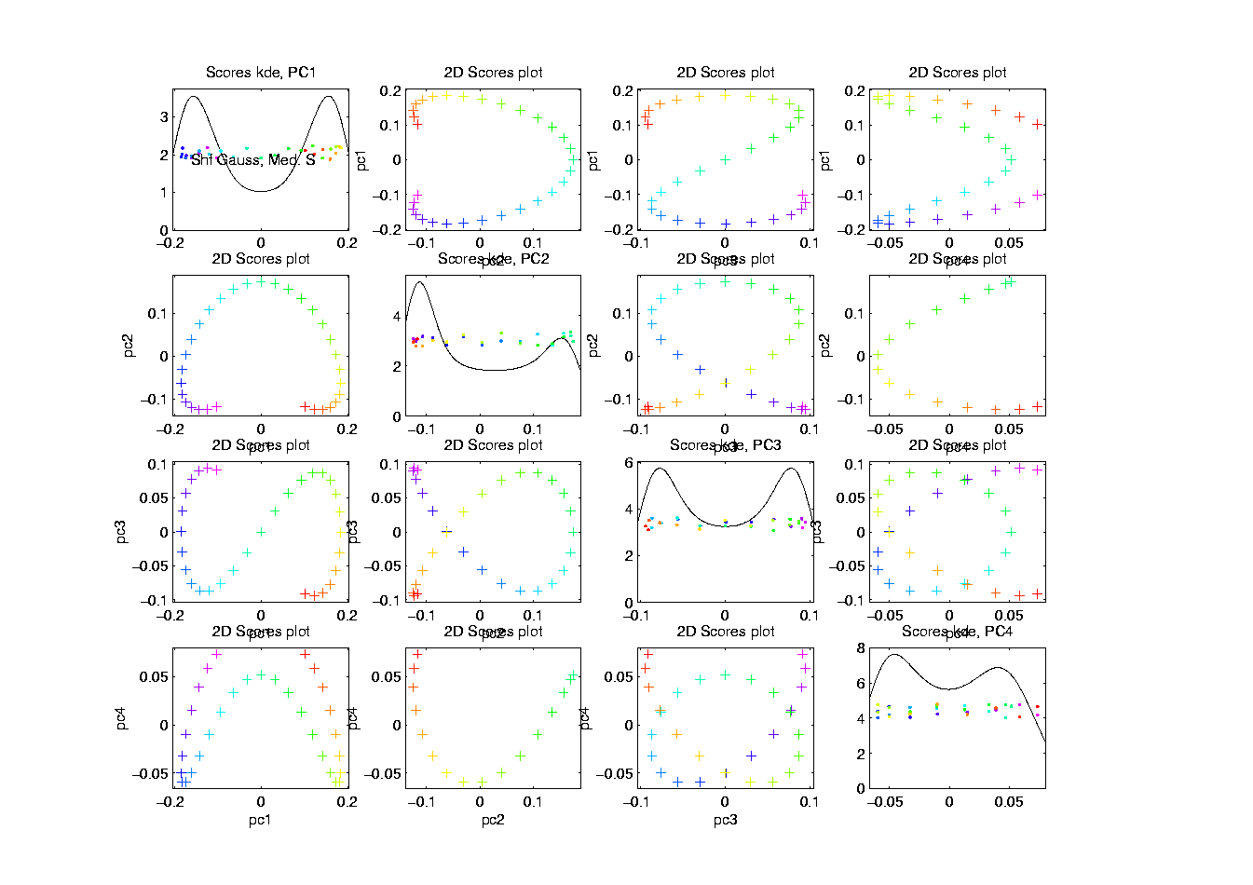
T. S. Toy E.g., PCA Scatterplot

Slide 70
T. S. Toy E.g., PCA Scatterplot
Where is the Point Cloud?
Lies along a 1-d curve in

Slide 71
T. S. Toy E.g., PCA Scatterplot
Where is the Point Cloud?
Lies along a 1-d curve in
So actually have 1-d mode of variation
But a non-linear mode of variation

Slide 72
T. S. Toy E.g., PCA Scatterplot
Where is the Point Cloud?
Lies along a 1-d curve in
So actually have 1-d mode of variation
But a non-linear mode of variation
Poorly captured by PCA (linear method)
Will study more later

Slide 73
Interesting Question
Can we find a 1-d Representation?
Perhaps by:
Different Analysis?
Other Choice of Data Objects?

Slide 74
Chemo-metric Time Series
Mass Spectrometry Measurements
On an Aging Substance, called “Estane”
Made over Logarithmic Time Grid, n = 60
Each Data Object is a Spectrum
What about Time Evolution?
Approach: PCA & Time Coloring

Slide 75
Chemo-metric Time Series
Joint Work w/ E. Kober & J. Wendelberger
Los Alamos National Lab
Four Experimental Conditions:
Control
Aged 59 days in Dry Air
Aged 27 days in Humid Air
Aged 59 days in Humid Air

Slide 76
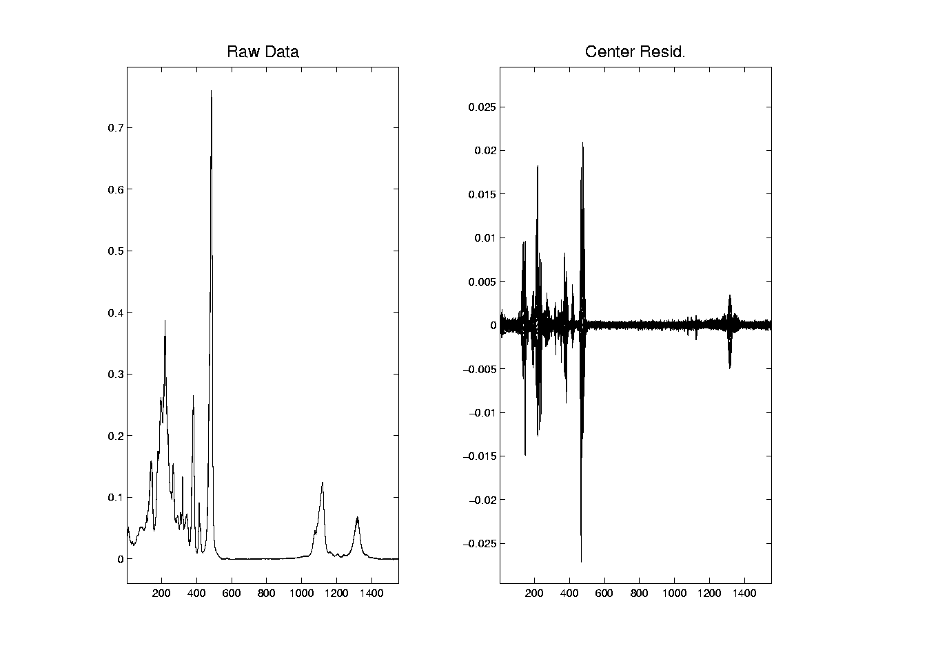
Chemo-metric Time Series, HA 27

Slide 77
Chemo-metric Time Series, HA 27
Raw Data:
All 60 spectra essentially the same
“Scale” of mean is much bigger than variation about mean
Hard to see structure of all 1600 freq’s
Centered Data:
Now can see different spectra
Since mean subtracted off
Note much smaller vertical axis

Slide 78
Chemo-metric Time Series, HA 27
Next Zoom in on “Region of Interest”

Slide 79
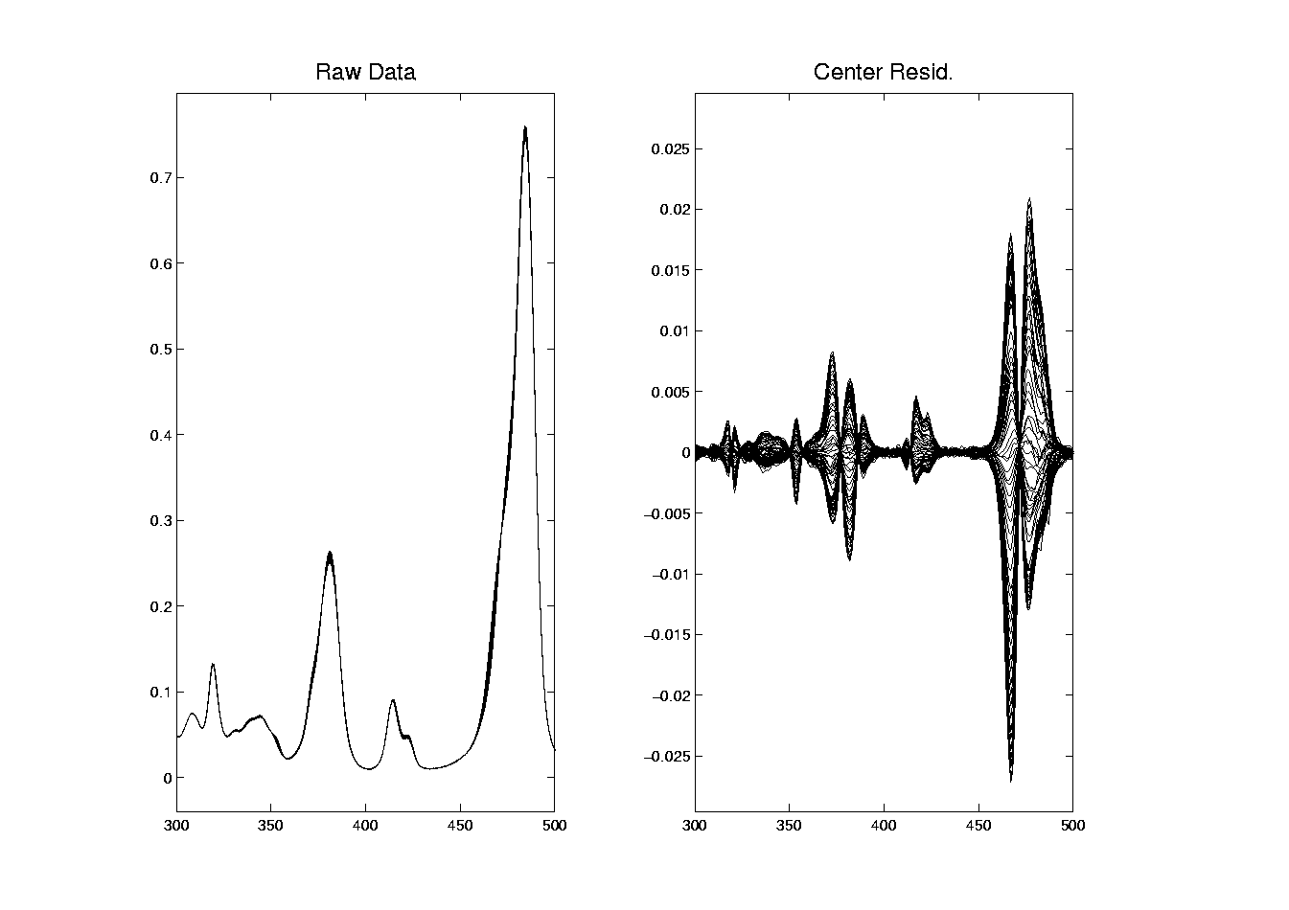
Chemo-metric Time Series, HA 27

Slide 80
Chemo-metric Time Series, HA 27
Data zoomed to “important” freq’s:
Raw Data:
Now see slight differences
Smoother “natural looking” spectra
Centered Data:
Differences in spectra more clear
Maybe now have “real structure”
Scale is important

Slide 81
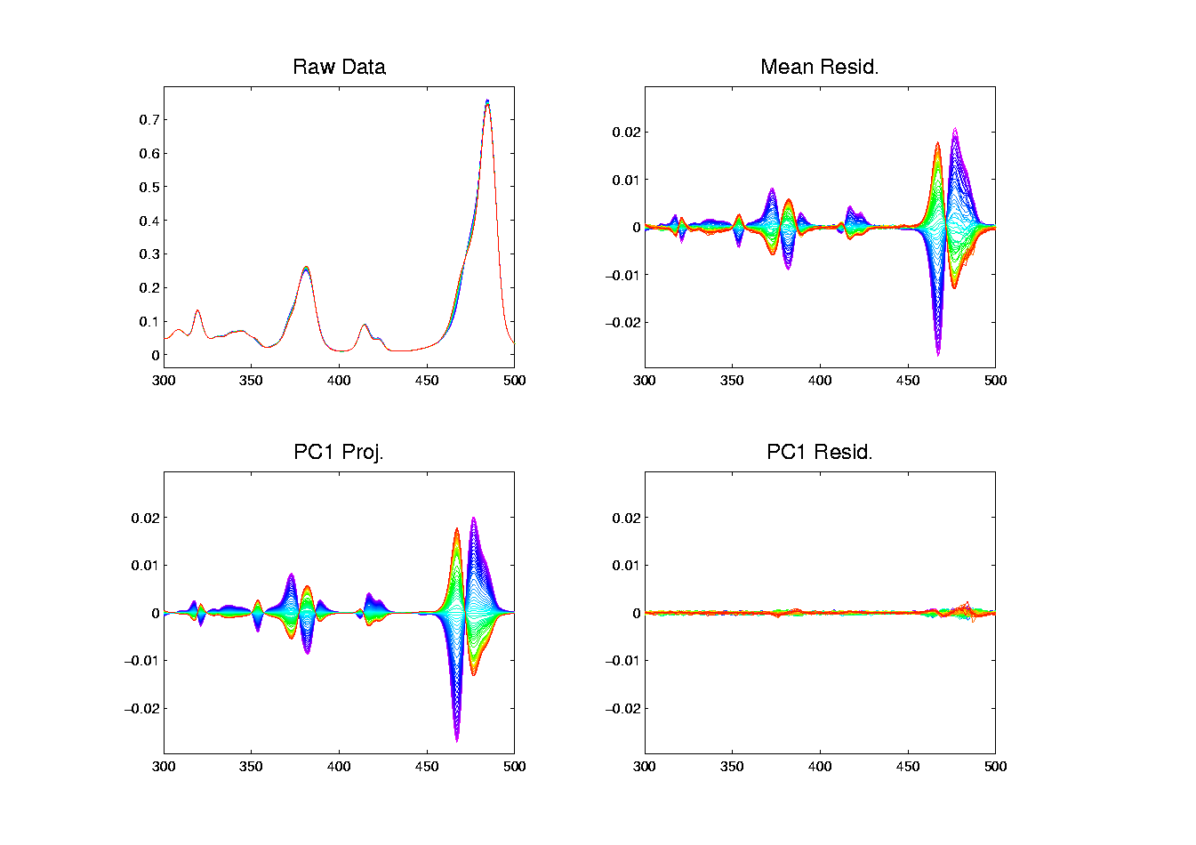
Chemo-metric Time Series, HA 27

Slide 82
Chemo-metric Time Series, HA 27
Use of Time Order Coloring:
Raw Data:
Can see a little ordering, not much
Centered Data:
Clear time ordering
Shifting peaks? (compare to Raw)
PC1:
Almost everything?
PC1 Residuals:
Data nearly linear (same scale import’nt)

Slide 83
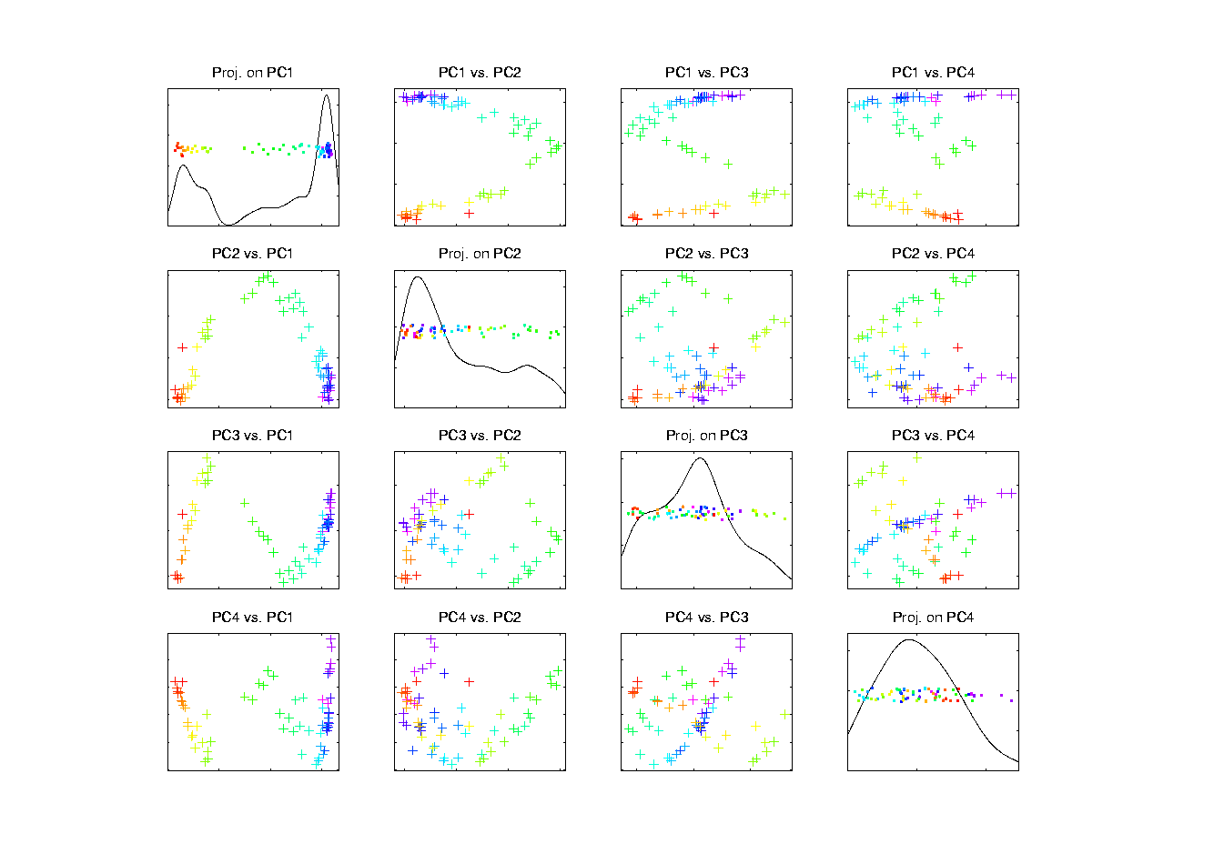
Chemo-metric Time Series, Control

Slide 84
Chemo-metric Time Series, Control
PCA View
Clear systematic structure
Time ordering very important
Reminiscent of Toy Example
(Shifting Gaussian Peak)
Roughly 1-d curve in Feature Space
Physical Explanation?

Slide 85
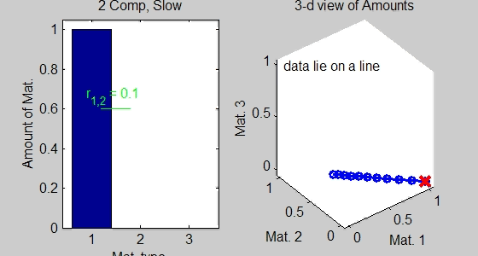
Toy Data Explanations
Simple Chemical Reaction Model:
Subst. 1 transforms into Subst. 2
Note: linear path in Feature Space

Slide 86
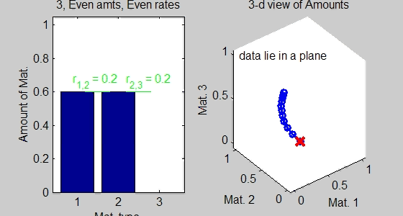
Toy Data Explanations
Richer Chemical Reaction Model:
Subst. 1 → Subst. 2 → Subst. 3
Curved path in Feat. Sp.
2 Reactions → Curve lies in 2-dim’al subsp.

Slide 87
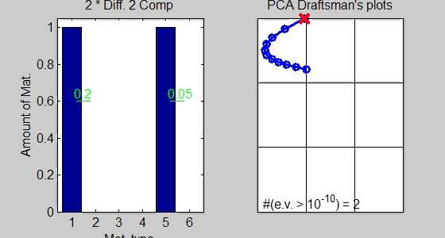
Toy Data Explanations
Another Chemical Reaction Model:
Subst. 1 → Subst. 2 & Subst. 5 → Subst. 6
Curved path in Feat. Sp.
2 Reactions → Curve lies in 2-dim’al subsp.

Slide 88
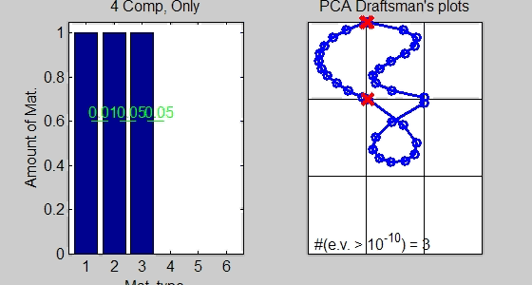
Toy Data Explanations
More Complex Chemical Reaction Model:
1 → 2 → 3 → 4
Curved path in Feat. Sp. (lives in 3-d)
3 Reactions → Curve lies in 3-dim’al subsp.

Slide 89
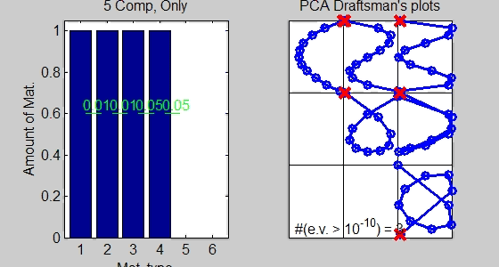
Toy Data Explanations
Even More Complex Chemical Reaction Model:
1 → 2 → 3 → 4 → 5
Curved path in Feat. Sp. (lives in 4-d)
4 Reactions → Curve lies in 4-dim’al subsp.

Slide 90
Chemo-metric Time Series, Control

Slide 91
Chemo-metric Time Series, Control
Suggestions from Toy Examples:
Clearly 3 reactions under way
Maybe a 4th???
Hard to distinguish from noise?
Interesting statistical open problem!

Slide 92
Chemo-metric Time Series
What about the other experiments? Recall:
  Control
  Aged 59 days in Dry Air
  Aged 27 days in Humid Air
  Aged 59 days in Humid Air
Above results were “cherry picked”,
to best makes points
What about other cases???

Slide 93
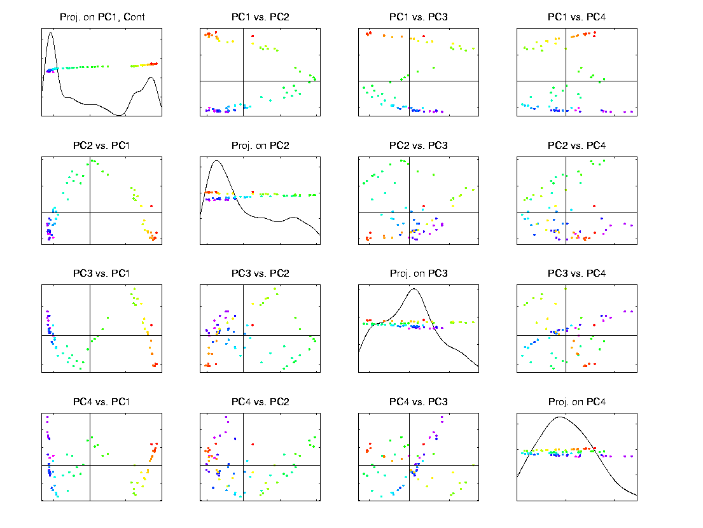
Scatterplot Matrix, Control
Above E.g., maybe ~4d curve → ~4 reactions

Slide 94
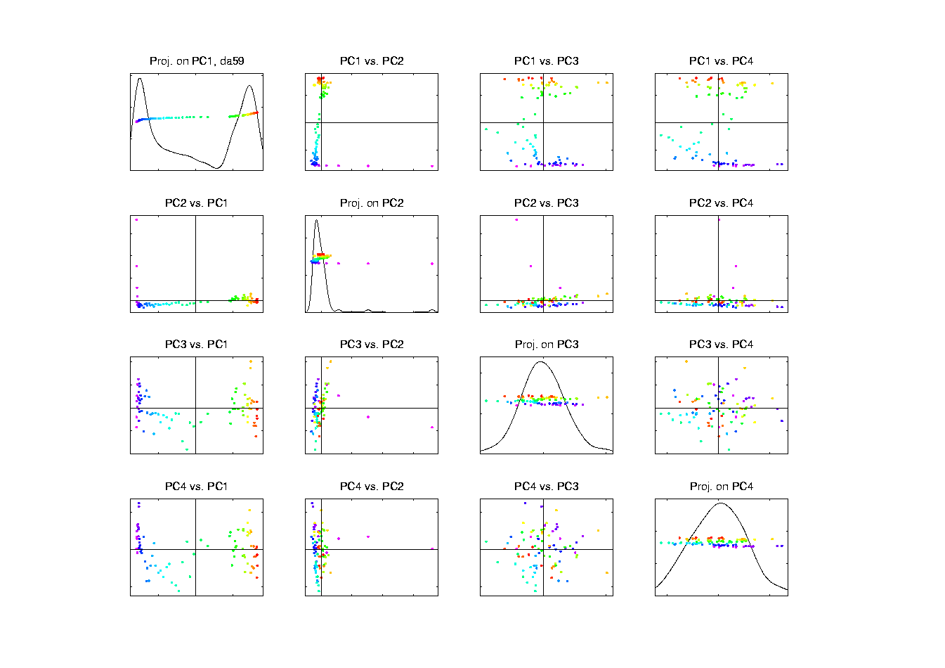
Scatterplot Matrix, Da59
PC2 is “bleeding of CO2”, discussed below

Slide 95
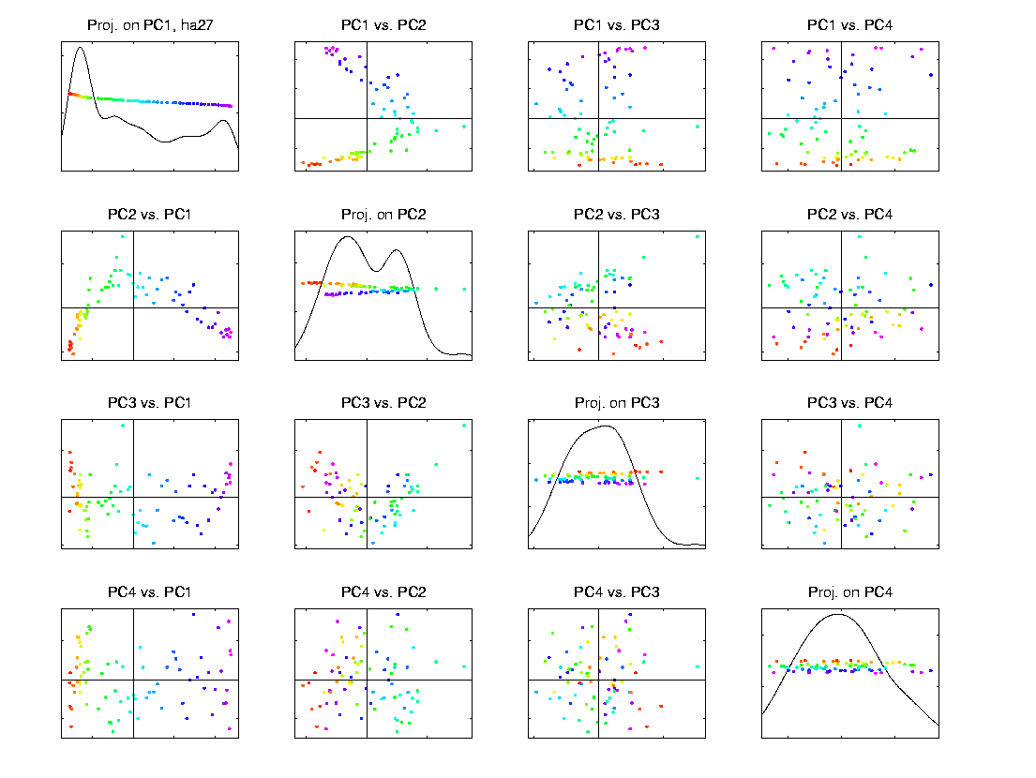
Scatterplot Matrix, Ha27
Only “3-d + noise”? → Only 3 reactions

Slide 96
Scatterplot Matrix, Ha59
Harder to judge???

Slide 97
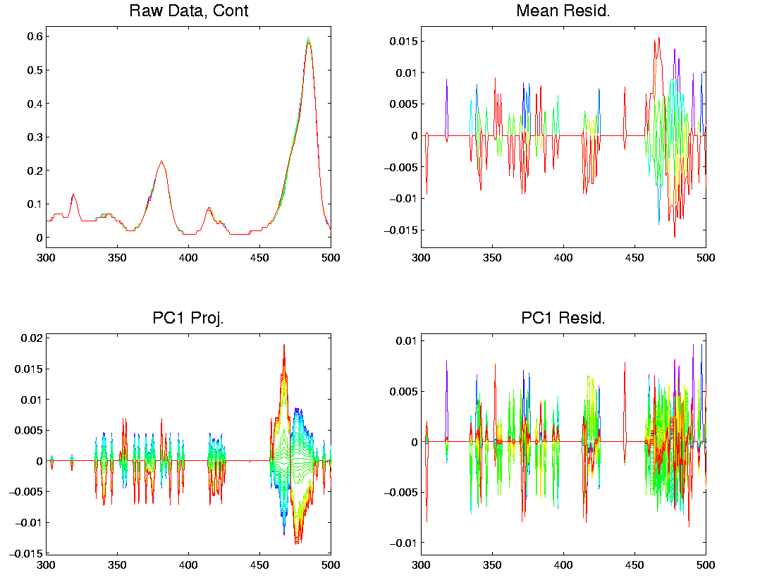
Object Space View, Control
Terrible discretization effect, despite ~4d …

Slide 98
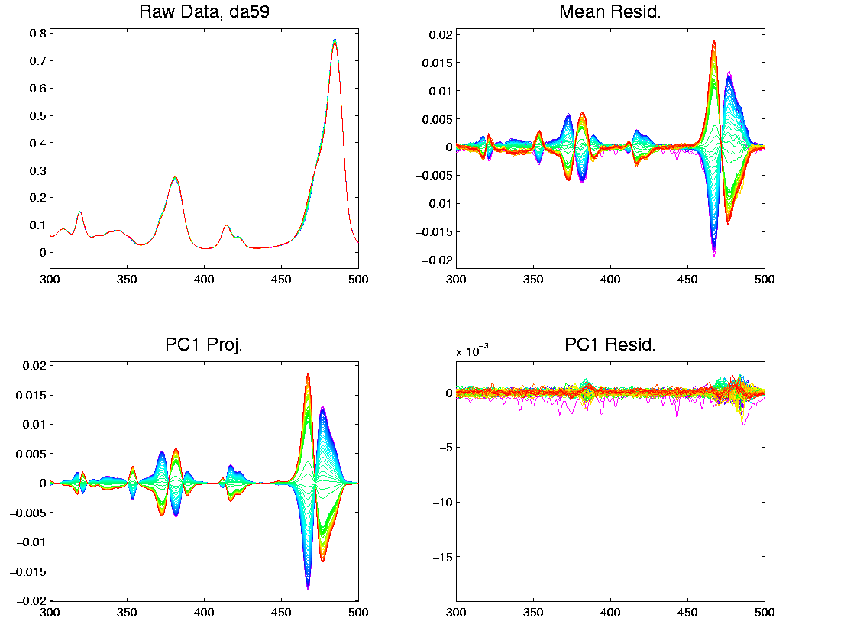
Object Space View, Da59
OK, except strange at beginning (CO2 …)

Slide 99
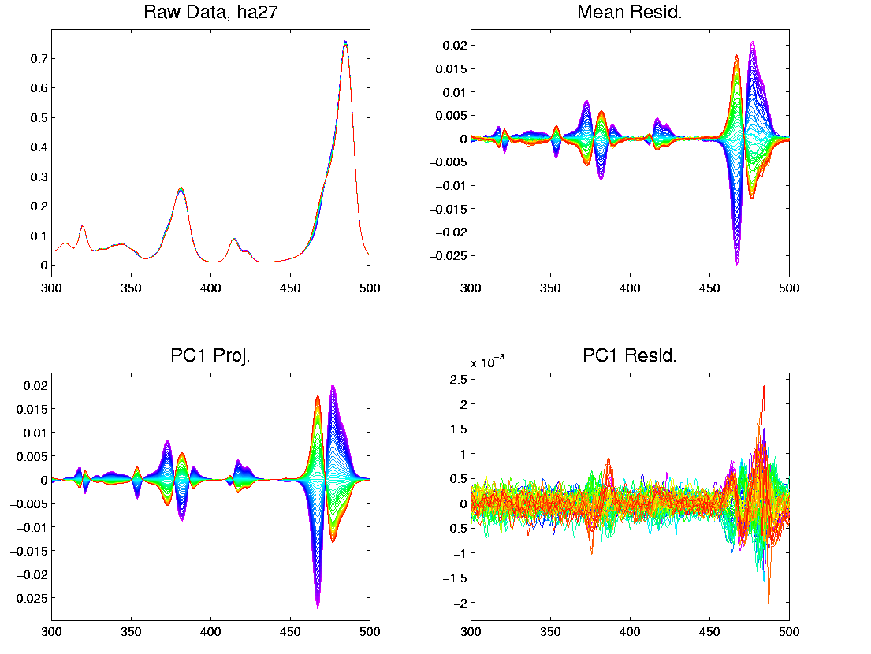
Object Space View, Ha27
Strong structure in PC1 Resid (d < 2)

Slide 100
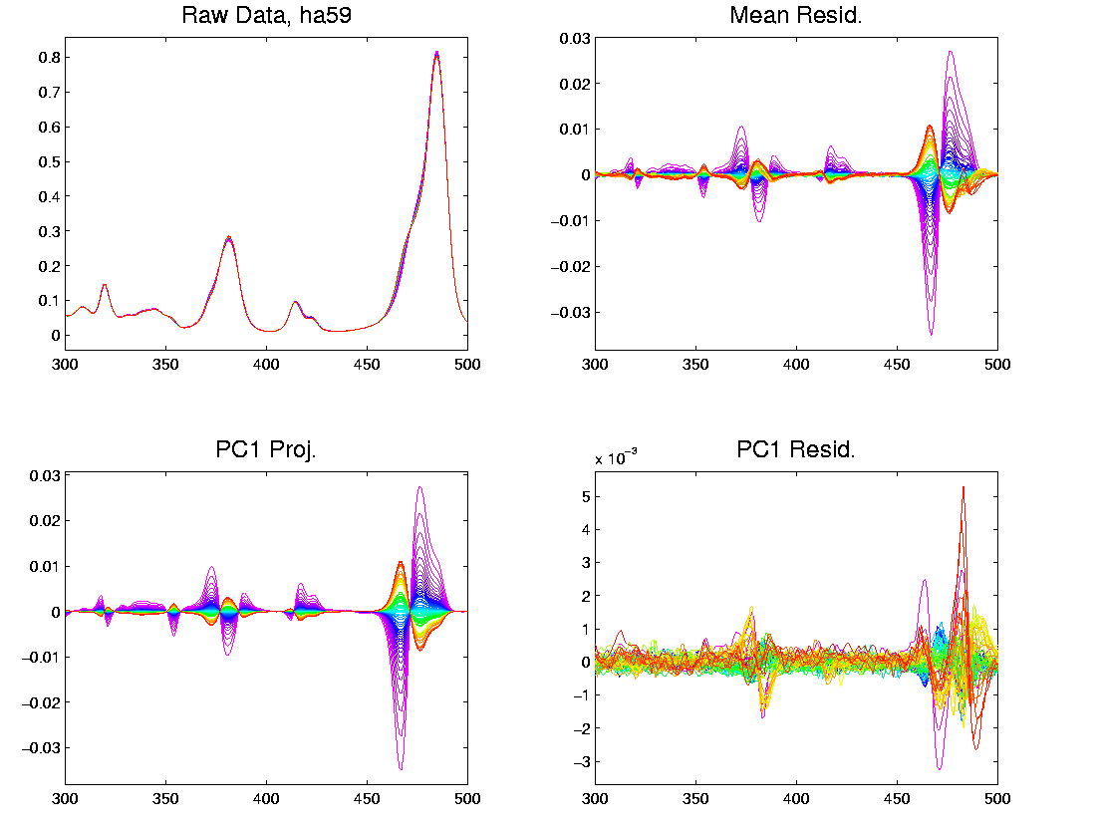
Object Space View, Ha59
Lots at beginning, OK since “oldest”

Slide 101
Problem with Da59
What about strange behavior for DA59?
Recall:
PC2 showed “really different behavior at start”
Chemists comments:
Ignore this, should have started measuring later…

Slide 102
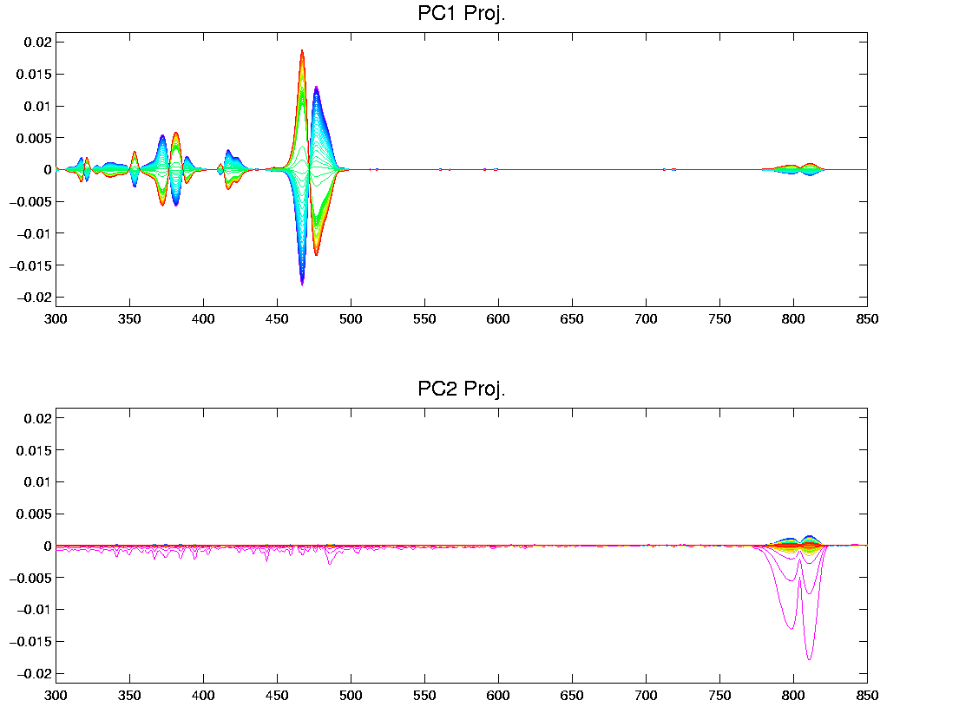
Problem with Da59
But still fun to look at broader spectra

Slide 103
Chemo-metric T. S. Joint View
Throw them all together as big population
Take Point Cloud View

Slide 104
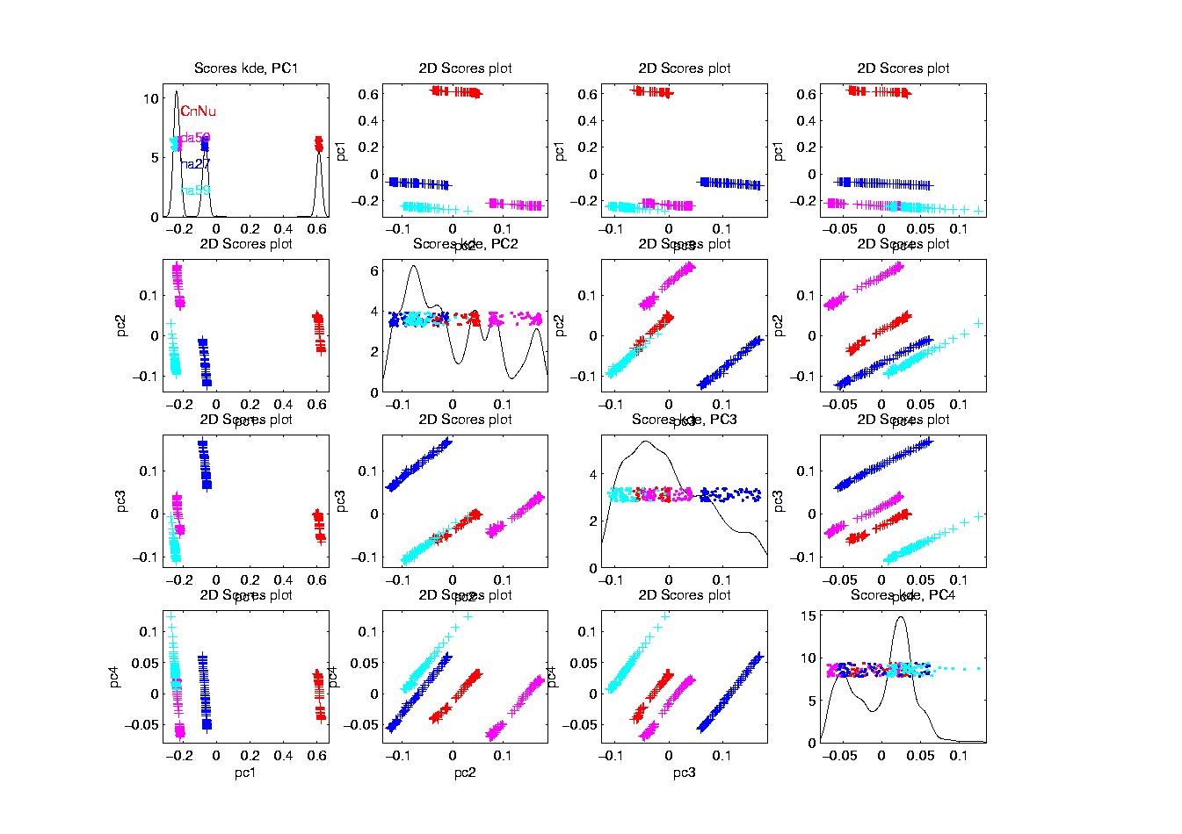
Chemo-metric T. S. Joint View

Slide 105
Chemo-metric T. S. Joint View
Throw them all together as big population
Take Point Cloud View
Note 4d space of interest, driven by:
  4 clusters (3d)
  PC1 of chemical reaction (1-d)
But these don’t appear as the 4 PCs
  Chem. PC1 “spread over PC2,3,4”
Essentially a “rotation of interesting dir’ns”
How to “unrotate”???

Slide 106
Chemo-metric T. S. Joint View
Interesting Variation:
Remove cluster means
Allows clear comparison of within curve variation

Slide 107
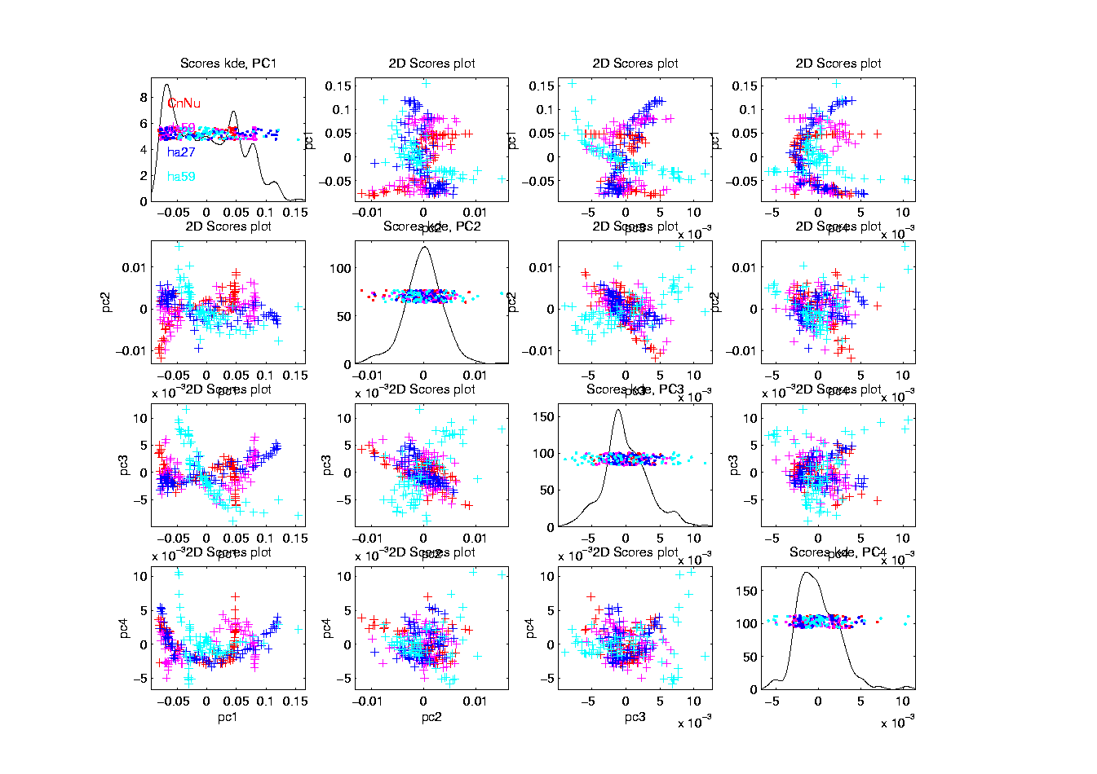
Chemo-metric T. S. Joint View (- mean)

Slide 108
Chemo-metric T. S. Joint View
Interesting Variation:
Remove cluster means
Allows clear comparison of within curve variation:
PC1 versus others are quite revealing
(note different “rotations”)
Others don’t show so much

Slide 109
Functional Data Analysis
Interesting Real Data Example
Genetics (Cancer Research)
RNAseq (Next Gener’n Sequen’g)
Deep look at “gene components”
Microarrays: Single number (per gene)
RNAseq: Thousands of measurements

Slide 110
Functional Data Analysis
Interesting Real Data Example
Genetics (Cancer Research)
RNAseq (Next Gener’n Sequen’g)
Deep look at “gene components”
Gene studied here: CDNK2A
Goal: Study Alternate Splicing
Sample Size, n = 180
Dimension, d = ~1700

Slide 111
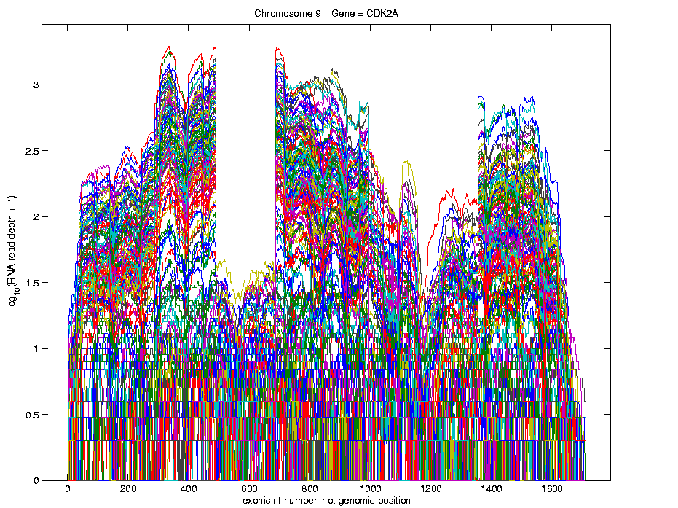
Functional Data Analysis
Simple
1st
View:
Curve
Overlay
(log
scale)

Slide 112
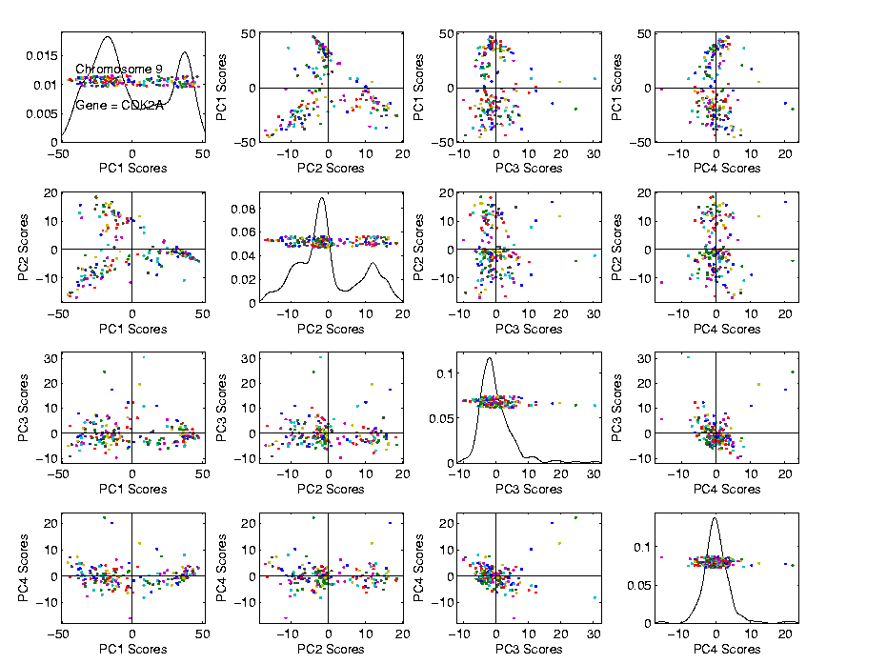
Functional Data Analysis
Often
Useful
Population
View:
PCA
Scores

Slide 113
Functional Data Analysis
Suggestion
Of
Clusters
???

Slide 114
Functional Data Analysis
Suggestion
Of
Clusters
Which
Are
These?

Slide 115
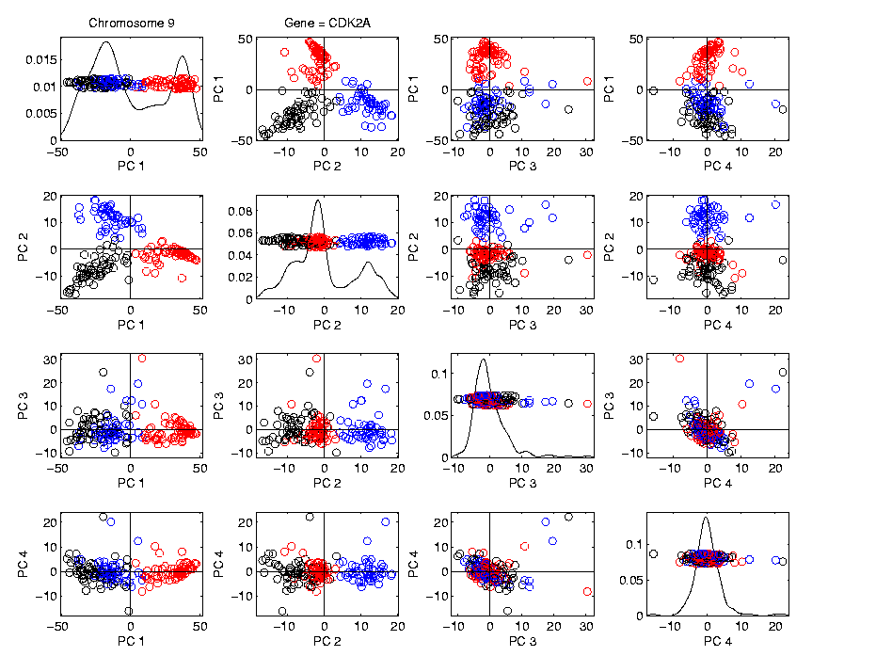
Functional Data Analysis
Manually
“Brush”
Clusters

Slide 116

Functional Data Analysis
Manually
Brush
Clusters
Clear
Alternate
Splicing

Slide 117
Functional Data Analysis
Important Points
PCA found Important Structure
In High Dimensional Data Analysis
d ~ 1700

Slide 118
Functional Data Analysis
Consequences:
Led to Development of SigFuge
Whole Genome Scan Found Interesting Genes
Published in Kimes, et al (2014)

Slide 119
Functional Data Analysis
Interesting Question:
When are clusters really there?
(will study later)

Slide 120
Limitation of PCA
PCA can provide useful projection directions

Slide 121
Limitation of PCA
PCA can provide useful projection directions
But can’t “see everything”…

Slide 122
Limitation of PCA
PCA can provide useful projection directions
But can’t “see everything”…
Reason:
  PCA finds dir’ns of maximal variation
  Which may obscure interesting structure

Slide 123
Limitation of PCA
Toy Example:
Apple – Banana – Pear

Slide 124

Limitation of PCA, Toy E.g.

Slide 125
Limitation of PCA
Toy Example:
Apple – Banana – Pear
Obscured by “noisy dimensions”
1st 3 PC directions only show noise

Slide 126
Limitation of PCA
Toy Example:
Apple – Banana – Pear
Obscured by “noisy dimensions”
1st 3 PC directions only show noise
Study some rotations, to find structure

Slide 127

Limitation of PCA, Toy E.g.

Slide 128
Limitation of PCA
Toy Example:
Rotation shows Apple – Banana – Pear
Example constructed as:
  1st make these in 3-d
  Add 3 dimensions of high s.d. noise
Carefully watch axis labels

Slide 129
Limitation of PCA
Main Point:
May be Important Data Structure
Not Visible in 1st Few PCs

Slide 130
Limitation of PCA, E.g.
Interesting Data Set: NCI-60

Slide 131
Limitation of PCA, E.g.
Interesting Data Set: NCI-60
NCI = National Cancer Institute
60 Cell Lines (cancer treatment targets)
For Different Cancer Types

Slide 132
Limitation of PCA, E.g.
Interesting Data Set: NCI-60
NCI = National Cancer Institute
60 Cell Lines (cancer treatment targets)
For Different Cancer Types
Measured “Gene Expression”
= “Gene Activity”
Several Thousand Genes (Simultaneously)

Slide 133
Limitation of PCA, E.g.
Interesting Data Set: NCI-60
NCI = National Cancer Institute
60 Cell Lines (cancer treatment targets)
For Different Cancer Types
Measured “Gene Expression”
= “Gene Activity”
Several Thousand Genes (Simultaneously)
Data Objects = Vectors of Gene Exp’n
Lots of Preprocessing (study later)

Slide 134
NCI 60 Data
Important Aspect: 8 Cancer Types
Renal Cancer
Non Small Cell Lung Cancer
Central Nervous System Cancer
Ovarian Cancer
Leukemia Cancer
Colon Cancer
Breast Cancer
Melanoma (Skin)
Notes:
134

Slide 135
PCA Visualization of NCI 60 Data
Can we find classes:
(Renal, CNS, Ovar, Leuk, Colon, Melan)
Using PC directions??
First try “unsupervised view”
I.e. switch off class colors
Then turn on colors, to identify clusters
I.e. look at “supervised view”
Notes:
135

Slide 136

NCI 60: Can we find classes
Using PCA view?
Notes:
136

Slide 137

NCI 60: Can we find classes
Using PCA view?
Notes:
137

Slide 138
PCA Visualization of NCI 60 Data
Maybe need to look at more PCs?
Study array of such PCA projections:
Notes:
138

Slide 139

NCI 60: Can we find classes
Using PCA 5-8?
Notes:
139

Slide 140

NCI 60: Can we find classes
Using PCA 5-8?
Notes:
140

Slide 141

NCI 60: Can we find classes
Using PCA 9-12?
Notes:
141

Slide 142

NCI 60: Can we find classes
Using PCA 9-12?
Notes:
142

Slide 143

NCI 60: Can we find classes
Using PCA 1-4 vs. 5-8?
Notes:
143

Slide 144

NCI 60: Can we find classes
Using PCA 1-4 vs. 5-8?
Notes:
144

Slide 145

NCI 60: Can we find classes
Using PCA 1-4 vs. 9-12?
Notes:
145

Slide 146

NCI 60: Can we find classes
Using PCA 5-8 vs. 9-12?
Notes:
146

Slide 147
PCA Visualization of NCI 60 Data
Can we find classes using PC directions??
Found some, but not others
Nothing after 1st five PCs
Rest seem to be noise driven
Notes:
147

Slide 148
PCA Visualization of NCI 60 Data
Can we find classes using PC directions??
Found some, but not others
Nothing after 1st five PCs
Rest seem to be noise driven
Are There Better Directions?
PCA only “feels” maximal variation
Ignores Class Labels
How Can We Use Class Labels?
Notes:
148

