Slide 1
Maximal Data Piling
Visual similarity of & ?
Can show (Ahn & Marron 2009), for d < n:
I.e. directions are the same!
How can this be?
Note lengths are different…
Study from transformation viewpoint

Slide 2
Maximal Data Piling
Recall
Transfo’
view of
FLD:

Slide 3
Maximal Data Piling
Include
Corres-
ponding
MDP
Transfo’:
Both give
Same
Result!

Slide 4
Maximal Data Piling
Details:
FLD,
sep’ing plane
normal vector
Within Class,
PC1
PC2
Global,
PC1
PC2

Slide 5
Maximal Data Piling
Acknowledgement:
This viewpoint
I.e. insight into why FLD = MDP
(for low dim’al data)
Suggested by Daniel Peña

Slide 6
Maximal Data Piling
Fun e.g:
rotate
from PCA
to MDP
dir’ns

Slide 7
Maximal Data Piling
MDP for other class labellings:
Always exists
Separation bigger for natural clusters
Could be used for clustering
Consider all directions
Find one that makes largest gap
Very hard optimization problem
Over 2^{n-2} possible directions

Slide 8
Maximal Data Piling
A point of terminology (Ahn & Marron 2009):
MDP is “maximal” in 2 senses:
# of data piled
Size of gap
(within subspace
gen’d by data)

Slide 9
Maximal Data Piling
Recurring, over-arching, issue:
HDLSS space is a weird place

Slide 10
Maximal Data Piling
Usefulness for Classification?
First Glance: Terrible, not generalizable
HDLSS View: Maybe OK?
Simulation Result:
Good Performance for
Autocorrelated Errors
Reason: not known

Slide 11
Kernel Embedding
Aizerman, Braverman and Rozoner (1964)
Motivating idea:
Extend scope of linear discrimination,
By adding nonlinear components to data
(embedding in a higher dim’al space)
Better use of name:
nonlinear discrimination?

Slide 12
Kernel Embedding
Toy Examples:
In 1d, linear separation splits the domain
into only 2 parts

Slide 13
Kernel Embedding
But in the “quadratic
embedded domain”,
linear separation
can give 3 parts

Slide 14
Kernel Embedding
But in the quadratic embedded domain
Linear separation can give 3 parts
original data space lies in 1d manifold
very sparse region of
curvature of manifold gives:
better linear separation
can have any 2 break points
(2 points line)

Slide 15
Kernel Embedding
Stronger effects for
higher order
polynomial embedding:
E.g. for cubic,
linear separation
can give 4 parts
(or fewer)

Slide 16
Kernel Embedding
Stronger effects - high. ord. poly. embedding:
original space lies in 1-d manifold,
even sparser in
higher d curvature gives:
improved linear separation
can have any 3 break points
(3 points plane)?
Note: relatively few
“interesting separating planes”

Slide 17
Kernel Embedding
General View: for original data matrix:
add rows:
i.e. embed in
Higher
Dimensional
space

Slide 18
Kernel Embedding
Embedded Fisher Linear Discrimination:
Choose Class 1, for any when:
in embedded space.
Image of class boundaries in original space is nonlinear
Allows more complicated class regions
Can also do Gaussian Lik. Rat. (or others)
Compute image by classifying points from original space

Slide 19
Kernel Embedding
Visualization for Toy Examples:
Have Linear Disc. In Embedded Space
Study Effect in Original Data Space
Via Implied Nonlinear Regions
Approach:
Use Test Set in Original Space
(dense equally spaced grid)
Apply embedded discrimination Rule
Color Using the Result

Slide 20
Kernel Embedding
Polynomial Embedding, Toy Example 1:
Parallel Clouds
Notes:
PEod1Raw.ps

Slide 21
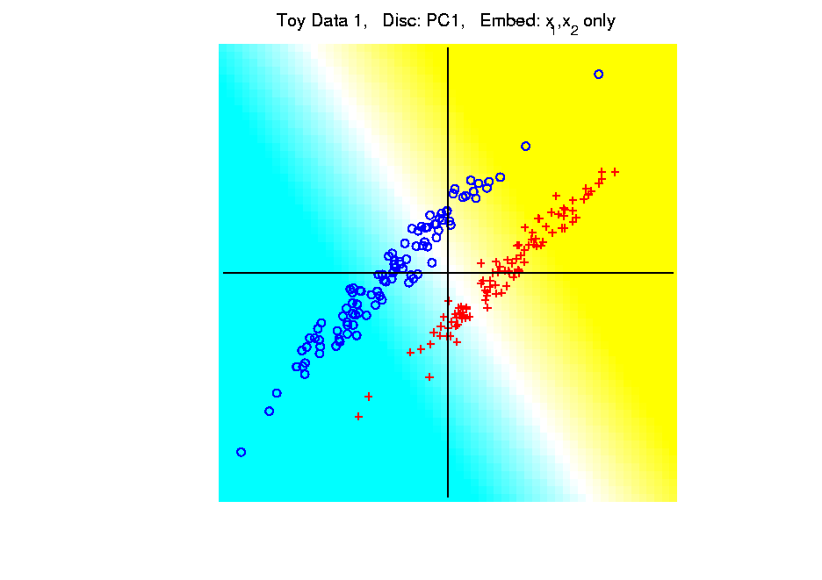
Kernel Embedding
Polynomial Embedding, Toy Example 1:
Parallel Clouds
PC1
Original
Data
Notes:
PEod1Raw.ps

Slide 22
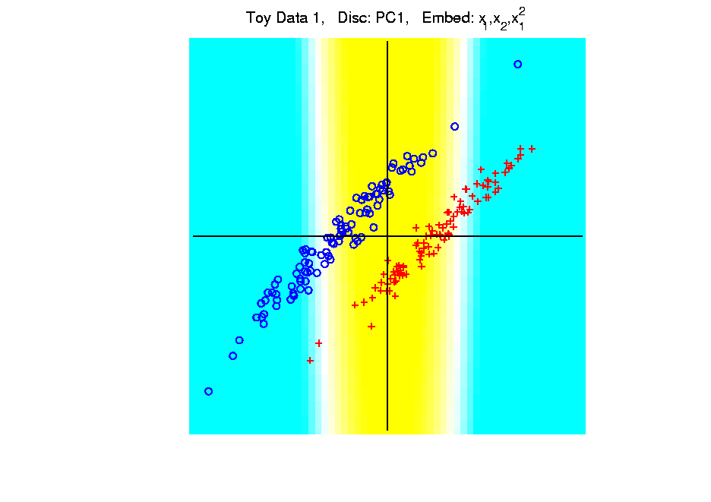
Kernel Embedding
Polynomial Embedding, Toy Example 1:
Parallel Clouds
PC1
Notes:
PEod1Raw.ps

Slide 23
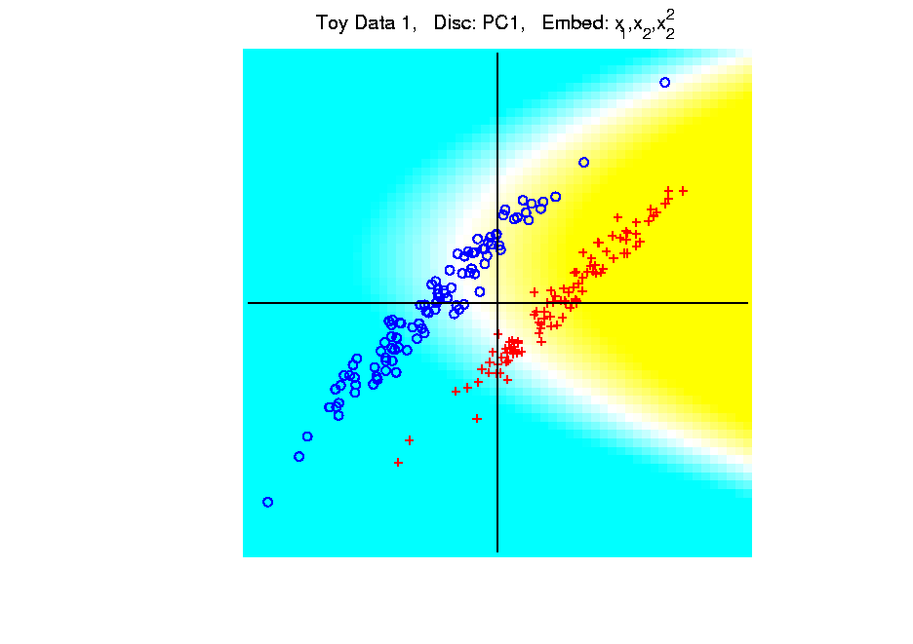
Kernel Embedding
Polynomial Embedding, Toy Example 1:
Parallel Clouds
PC1
Notes:
PEod1Raw.ps

Slide 24
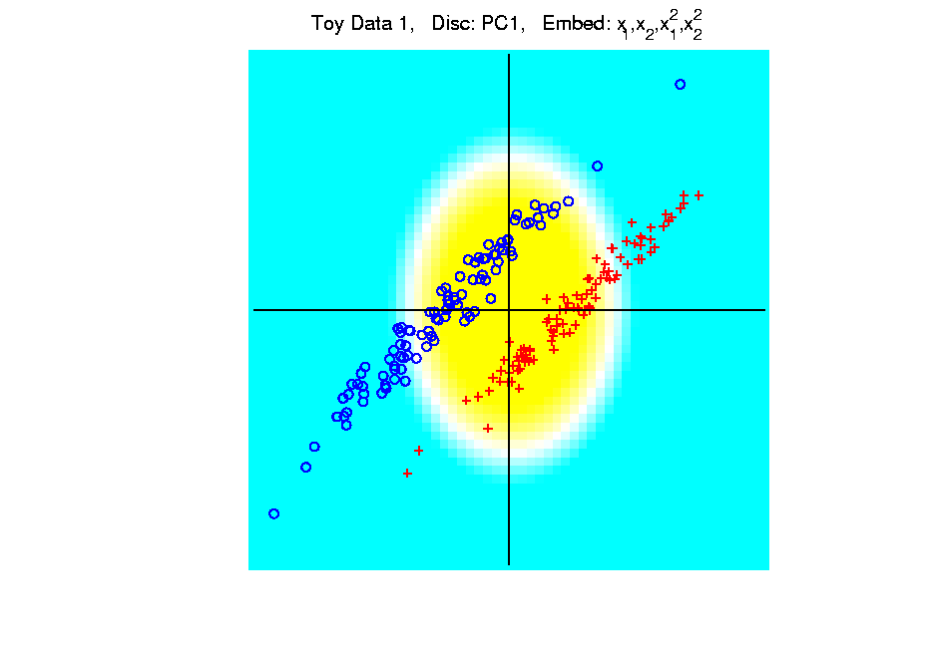
Kernel Embedding
Polynomial Embedding, Toy Example 1:
Parallel Clouds
PC1
Notes:
PEod1Raw.ps

Slide 25
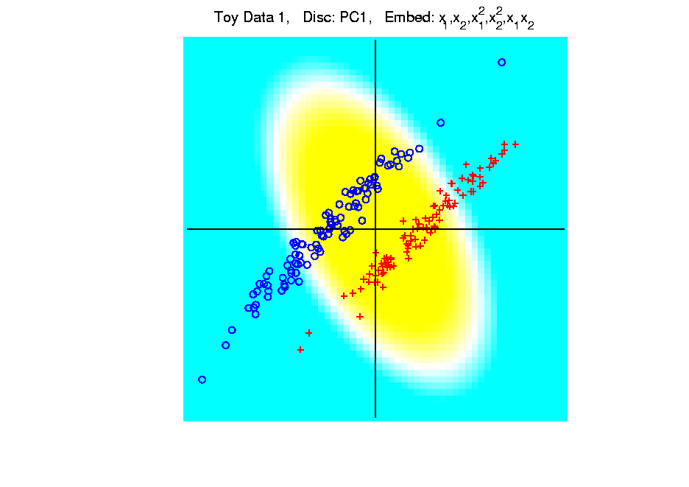
Kernel Embedding
Polynomial Embedding, Toy Example 1:
Parallel Clouds
PC1
Notes:
PEod1Raw.ps

Slide 26
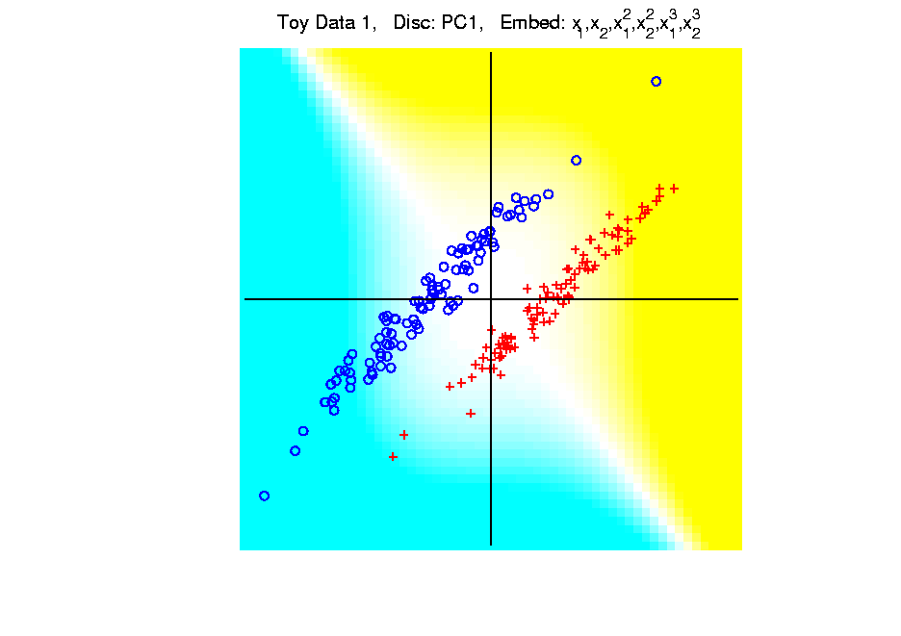
Kernel Embedding
Polynomial Embedding, Toy Example 1:
Parallel Clouds
PC1
Note:
Embedding
Always Bad
Don’t Want
Greatest
Variation
Notes:
PEod1Raw.ps

Slide 27
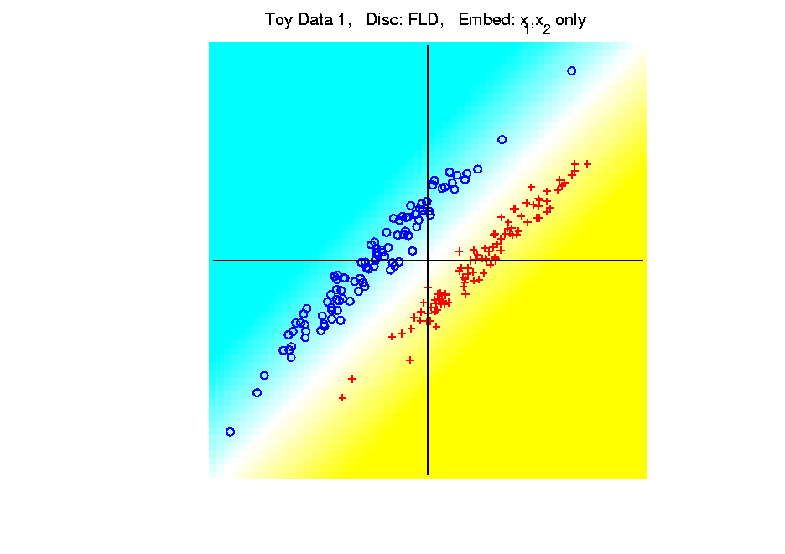
Kernel Embedding
Polynomial Embedding, Toy Example 1:
Parallel Clouds
FLD
Original
Data
Notes:
PEod1Raw.ps

Slide 28
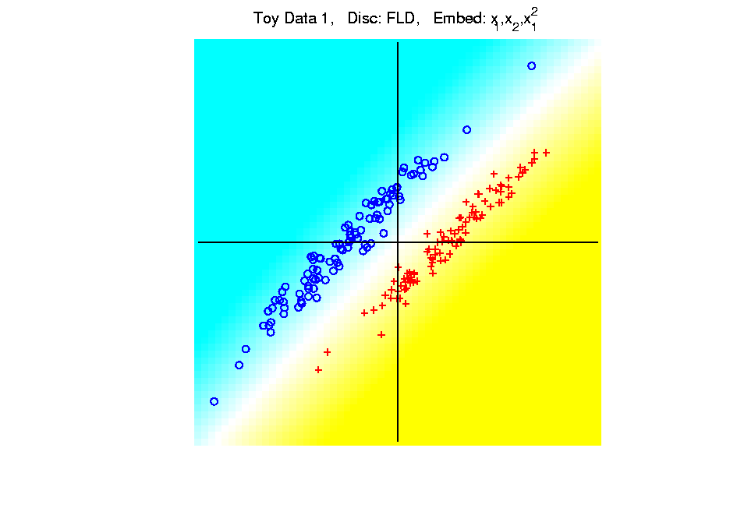
Kernel Embedding
Polynomial Embedding, Toy Example 1:
Parallel Clouds
FLD
Notes:
PEod1Raw.ps

Slide 29
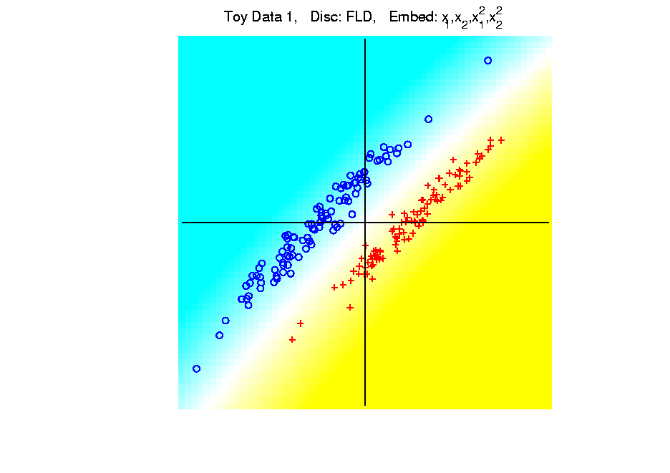
Kernel Embedding
Polynomial Embedding, Toy Example 1:
Parallel Clouds
FLD
Notes:
PEod1Raw.ps

Slide 30
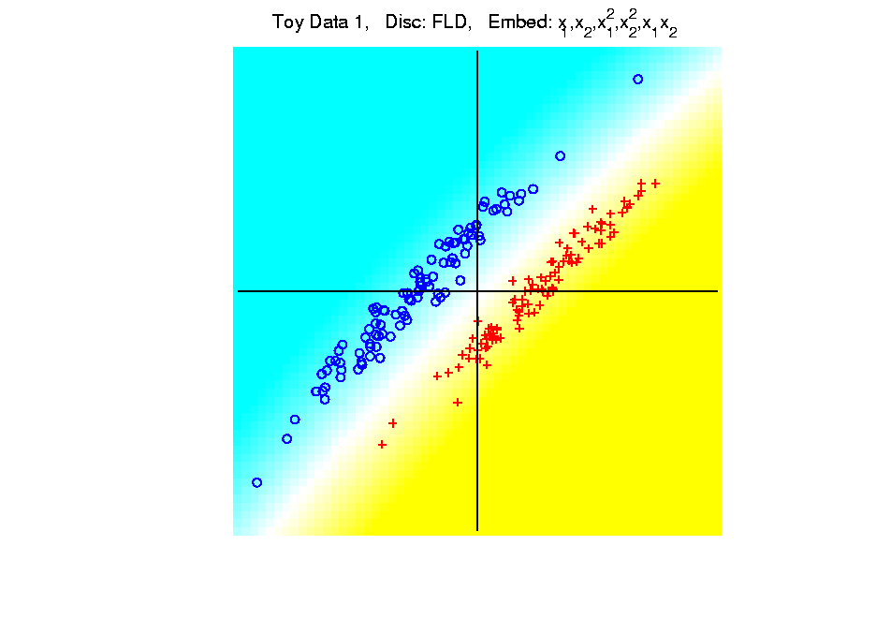
Kernel Embedding
Polynomial Embedding, Toy Example 1:
Parallel Clouds
FLD
Notes:
PEod1Raw.ps

Slide 31
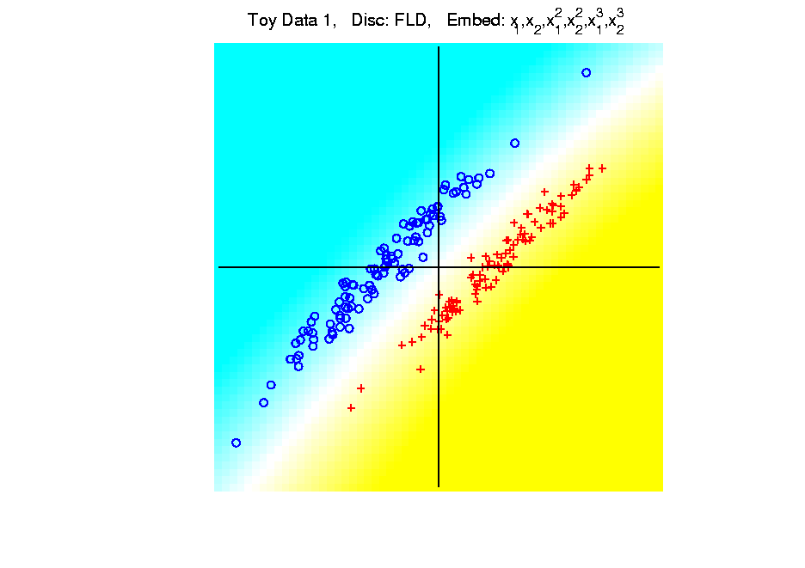
Kernel Embedding
Polynomial Embedding, Toy Example 1:
Parallel Clouds
FLD
All Stable
& Very Good
Notes:
PEod1Raw.ps

Slide 32
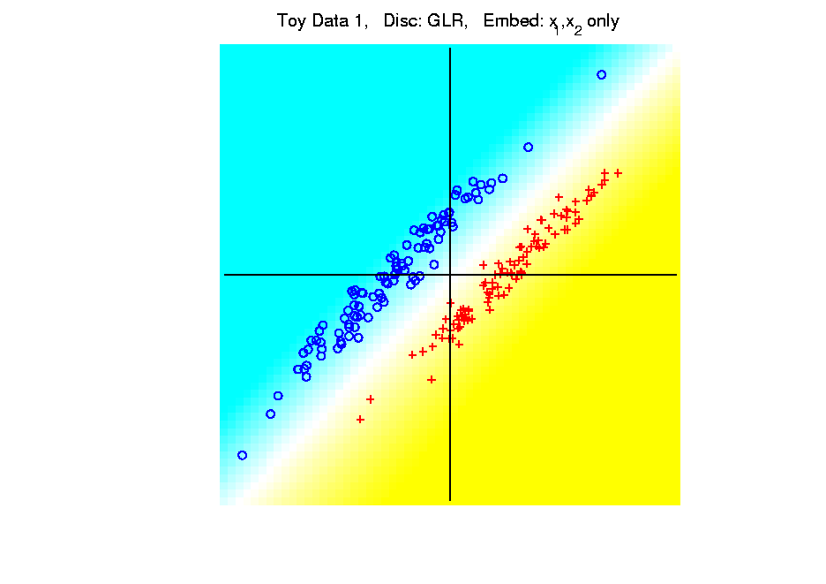
Kernel Embedding
Polynomial Embedding, Toy Example 1:
Parallel Clouds
GLR
Original
Data
Notes:
PEod1Raw.ps

Slide 33
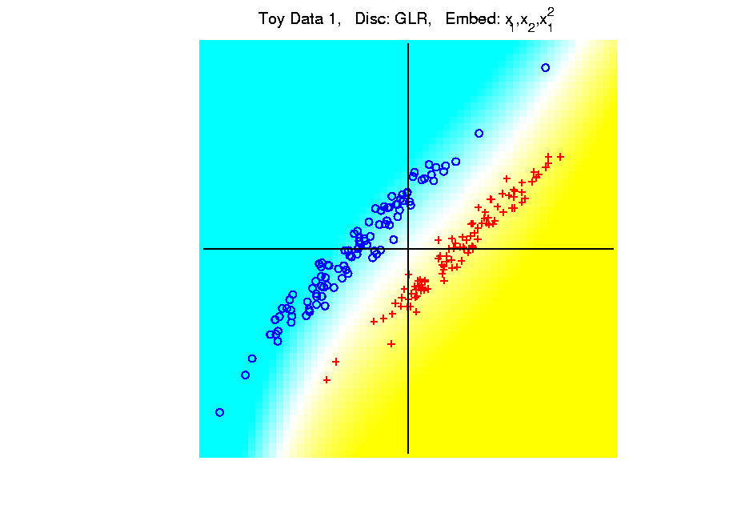
Kernel Embedding
Polynomial Embedding, Toy Example 1:
Parallel Clouds
GLR
Notes:
PEod1Raw.ps

Slide 34
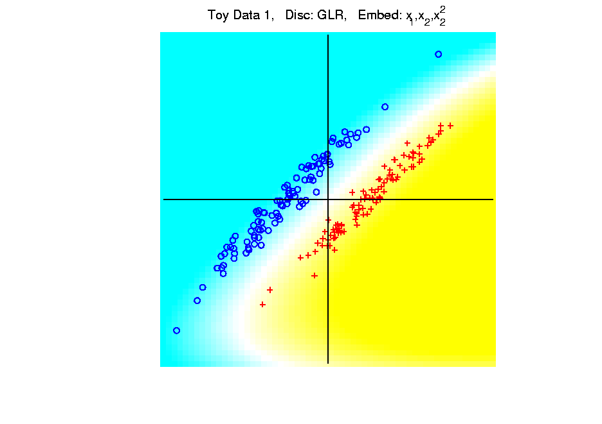
Kernel Embedding
Polynomial Embedding, Toy Example 1:
Parallel Clouds
GLR
Notes:
PEod1Raw.ps

Slide 35
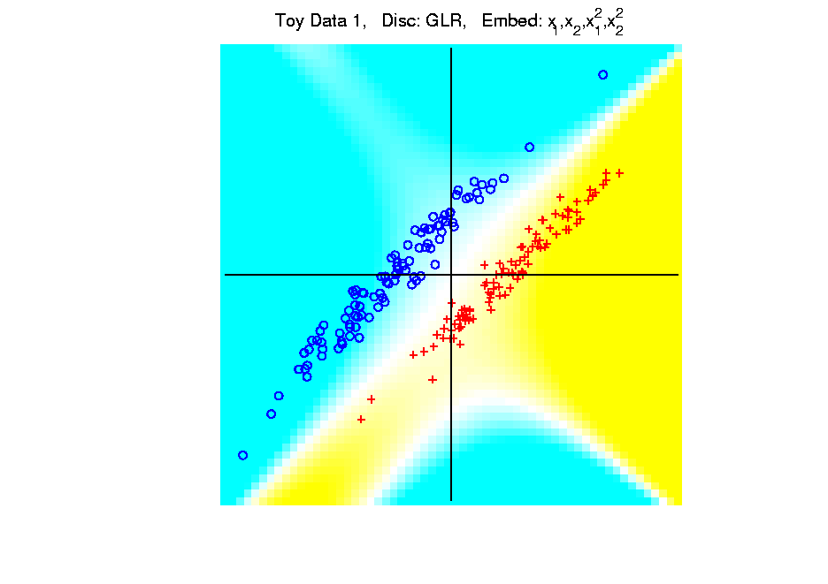
Kernel Embedding
Polynomial Embedding, Toy Example 1:
Parallel Clouds
GLR
Notes:
PEod1Raw.ps

Slide 36
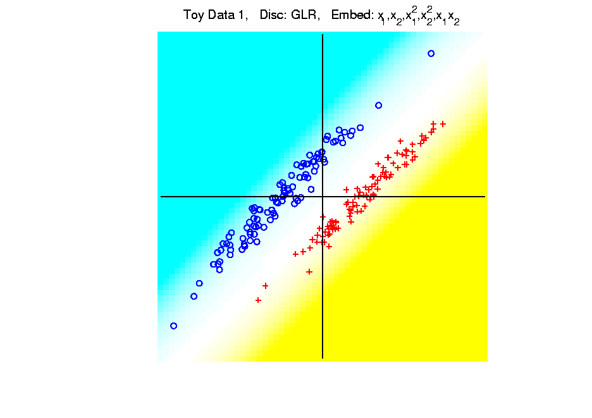
Kernel Embedding
Polynomial Embedding, Toy Example 1:
Parallel Clouds
GLR
Notes:
PEod1Raw.ps

Slide 37
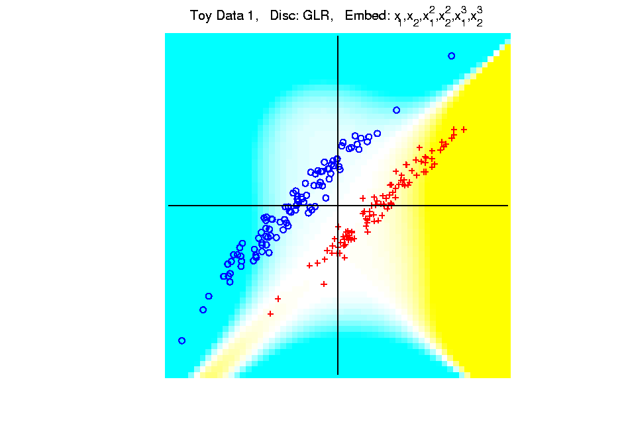
Kernel Embedding
Polynomial Embedding, Toy Example 1:
Parallel Clouds
GLR
Unstable
Subject to
Overfitting
Notes:
PEod1Raw.ps

