Slide 1
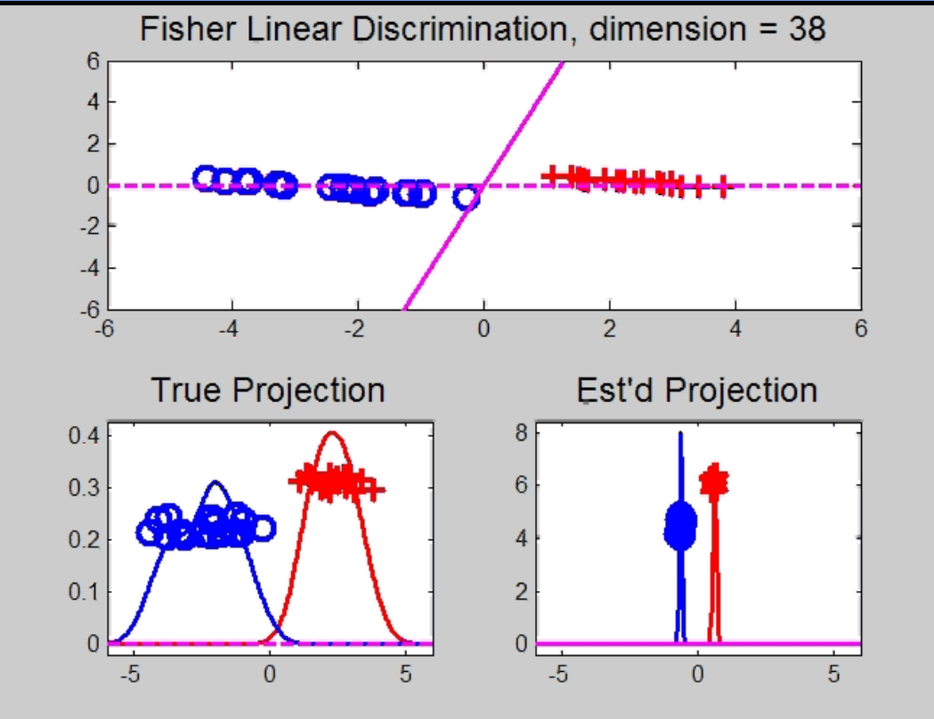
Maximal Data Piling
Strange FLD effect at HDLSS boundary:
Data Piling:
For each class,
all data
project to
single
value

Slide 2
Maximal Data Piling
What is happening?
Hard to imagine
Since our intuition is 3-dim’al
Came from our ancestors…

Slide 3
Maximal Data Piling
What is happening?
Hard to imagine
Since our intuition is 3-dim’al
Came from our ancestors…
Try to understand data piling with
some simple examples

Slide 4

Maximal Data Piling
Simple example (Ahn & Marron 2009):
$n_{+}=n_{−}=2$ in $ℝ^{3}$

Slide 5
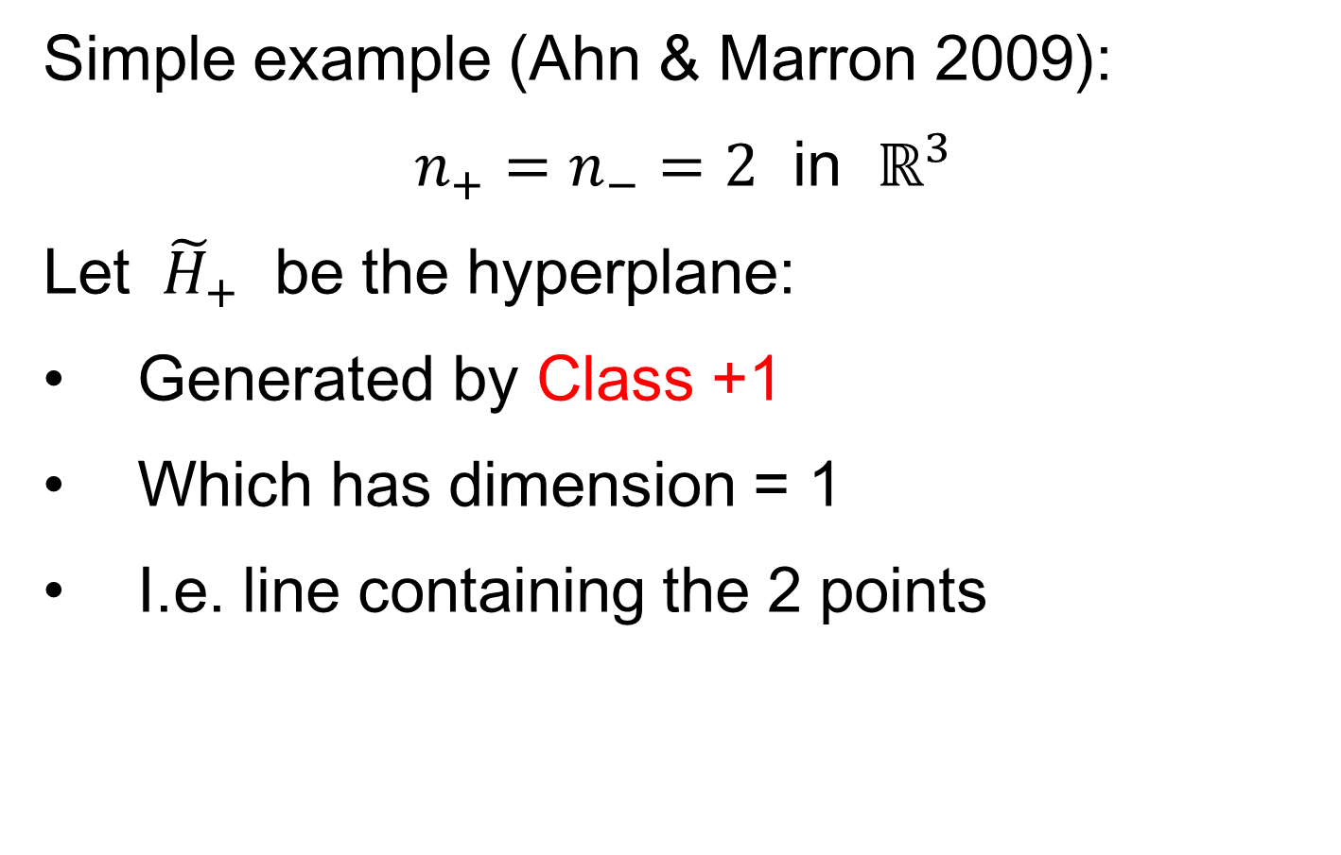
Maximal Data Piling
Simple example (Ahn & Marron 2009):
$n_{+}=n_{−}=2$ in $ℝ^{3}$
Let ${ \tilde{H}}_{+}$ be the hyperplane:
Generated by Class +1
Which has dimension = 1
I.e. line containing the 2 points

Slide 6
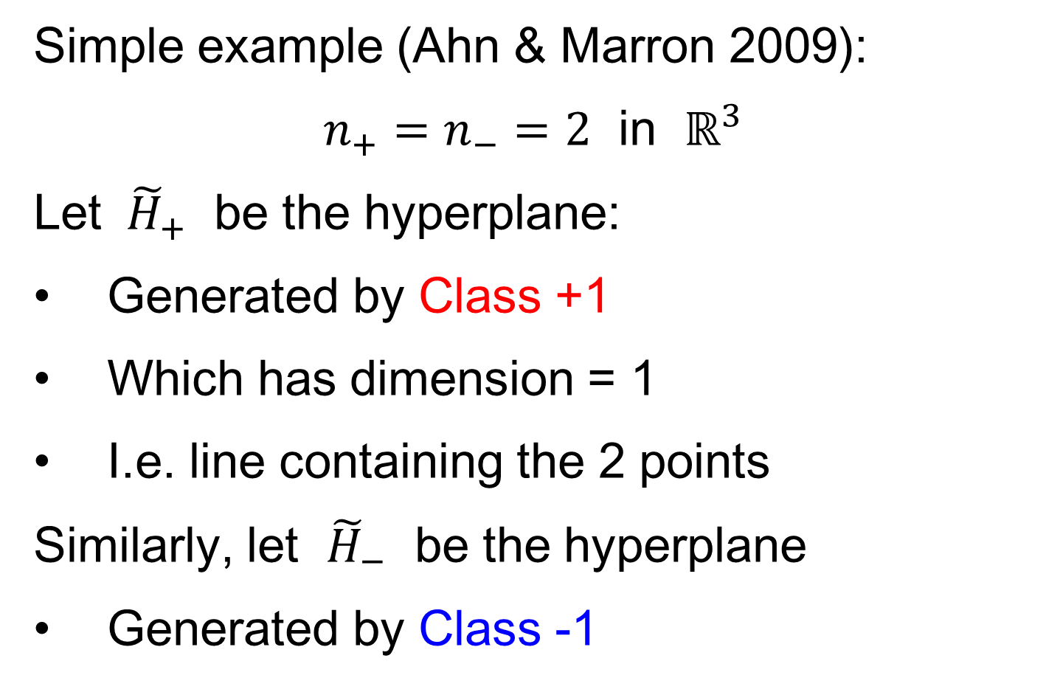
Maximal Data Piling
Simple example (Ahn & Marron 2009):
$n_{+}=n_{−}=2$ in $ℝ^{3}$
Let ${ \tilde{H}}_{+}$ be the hyperplane:
Generated by Class +1
Which has dimension = 1
I.e. line containing the 2 points
Similarly, let ${\tilde{H}}_{−}$ be the hyperplane
Generated by Class -1

Slide 7
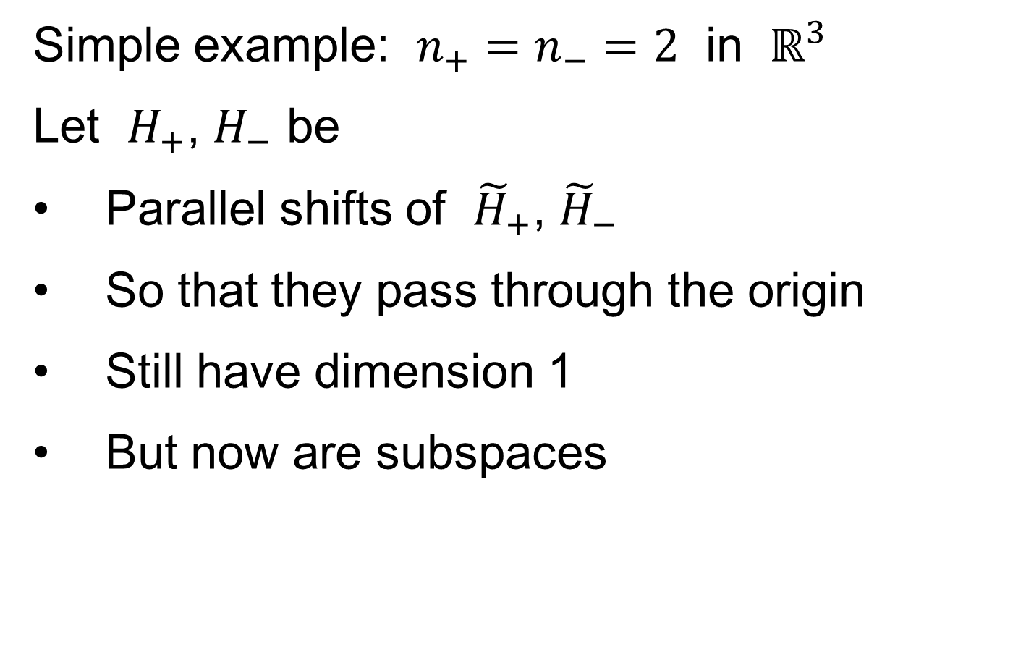
Maximal Data Piling
Simple example: $n_{+}=n_{−}=2$ in $ℝ^{3}$
Let $H_{+}$, $H_{−}$ be
Parallel shifts of ${\tilde{H}}_{+}$, ${\tilde{H}}_{−}$
So that they pass through the origin
Still have dimension 1
But now are subspaces

Slide 8
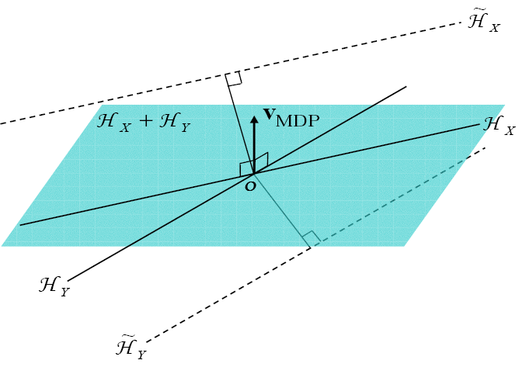

Maximal Data Piling
Simple example: $n_{+}=n_{−}=2$ in $ℝ^{3}$
Notes:
C:\Documents and Settings\J S Marron\My Documents\Research\ComplexPopn\MaxDataPiling\dppic2_2.pdf

Slide 9
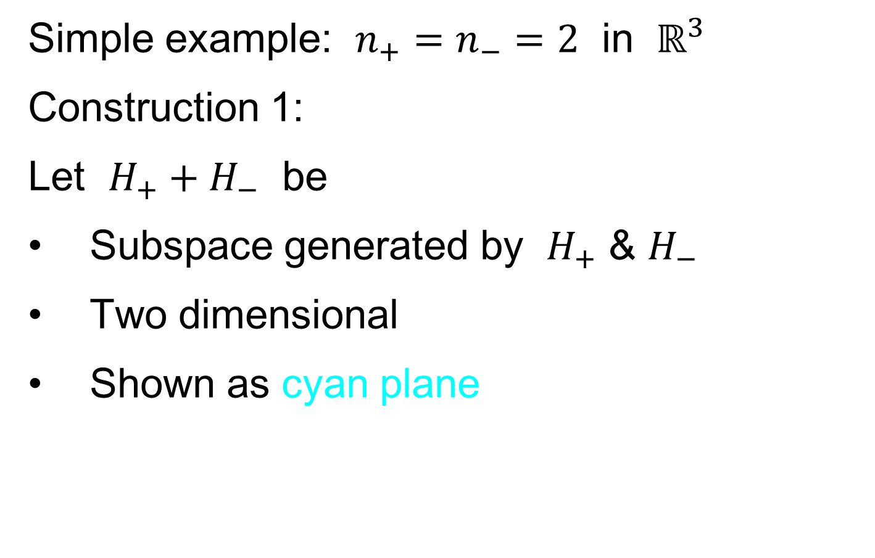
Maximal Data Piling
Simple example: $n_{+}=n_{−}=2$ in $ℝ^{3}$
Construction 1:
Let $H_{+}+H_{−}$ be
Subspace generated by $H_{+}$ & $H_{−}$
Two dimensional
Shown as cyan plane

Slide 10
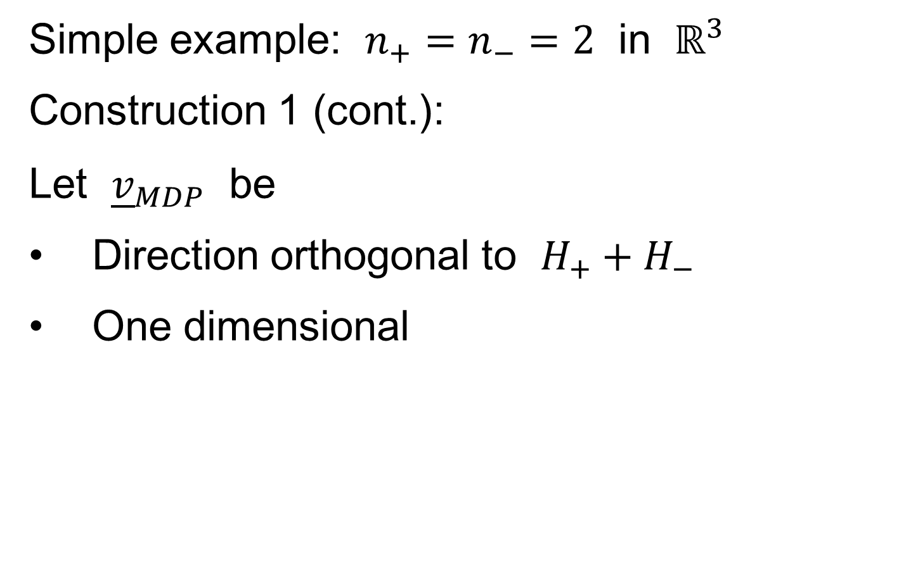
Maximal Data Piling
Simple example: $n_{+}=n_{−}=2$ in $ℝ^{3}$
Construction 1 (cont.):
Let ${\underline{v}}_{MDP}$ be
Direction orthogonal to $H_{+}+H_{−}$
One dimensional

Slide 11
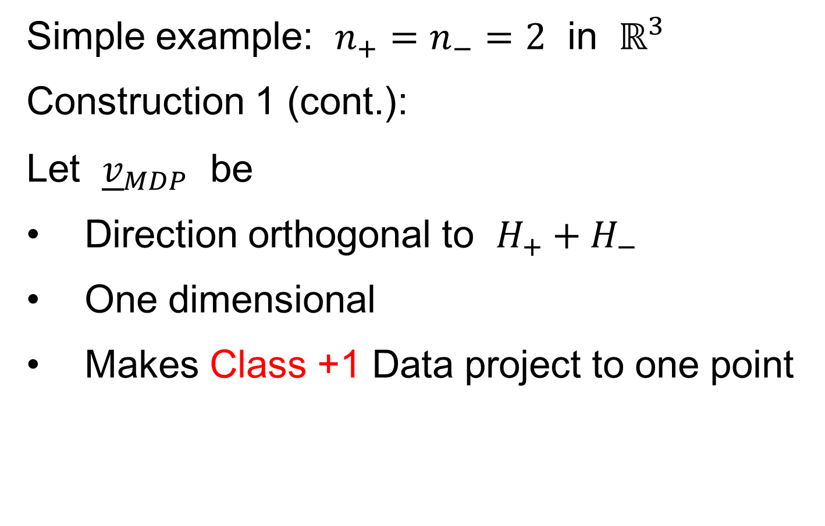
Maximal Data Piling
Simple example: $n_{+}=n_{−}=2$ in $ℝ^{3}$
Construction 1 (cont.):
Let ${\underline{v}}_{MDP}$ be
Direction orthogonal to $H_{+}+H_{−}$
One dimensional
Makes Class +1 Data project to one point

Slide 12
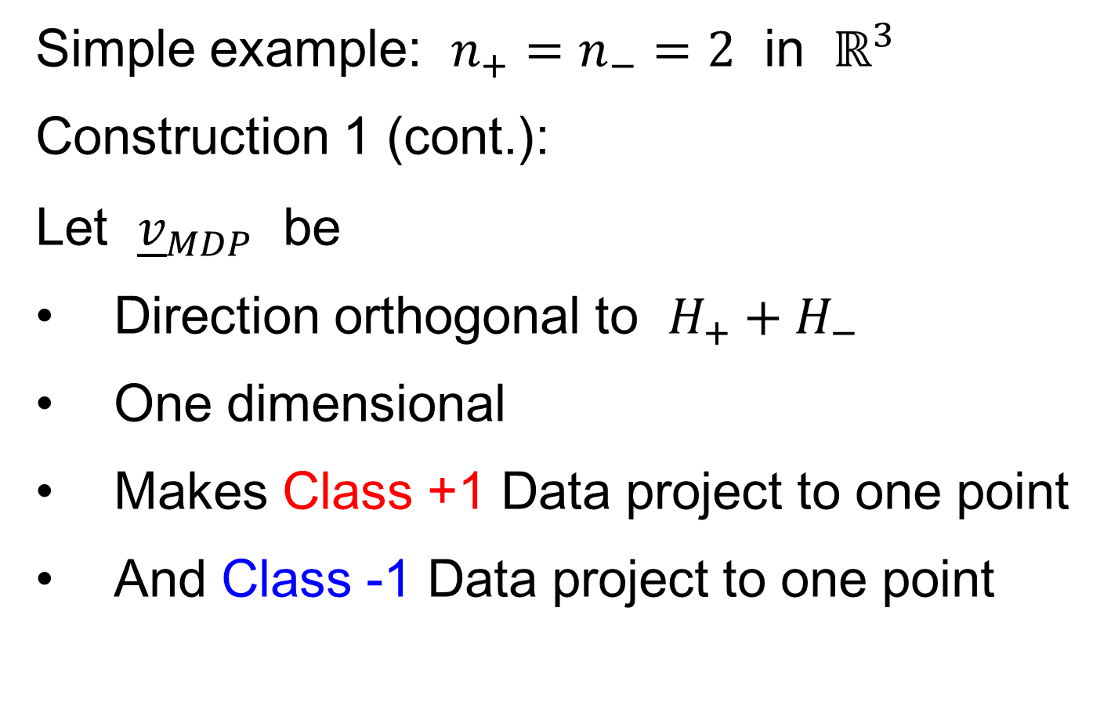
Maximal Data Piling
Simple example: $n_{+}=n_{−}=2$ in $ℝ^{3}$
Construction 1 (cont.):
Let ${\underline{v}}_{MDP}$ be
Direction orthogonal to $H_{+}+H_{−}$
One dimensional
Makes Class +1 Data project to one point
And Class -1 Data project to one point

Slide 13
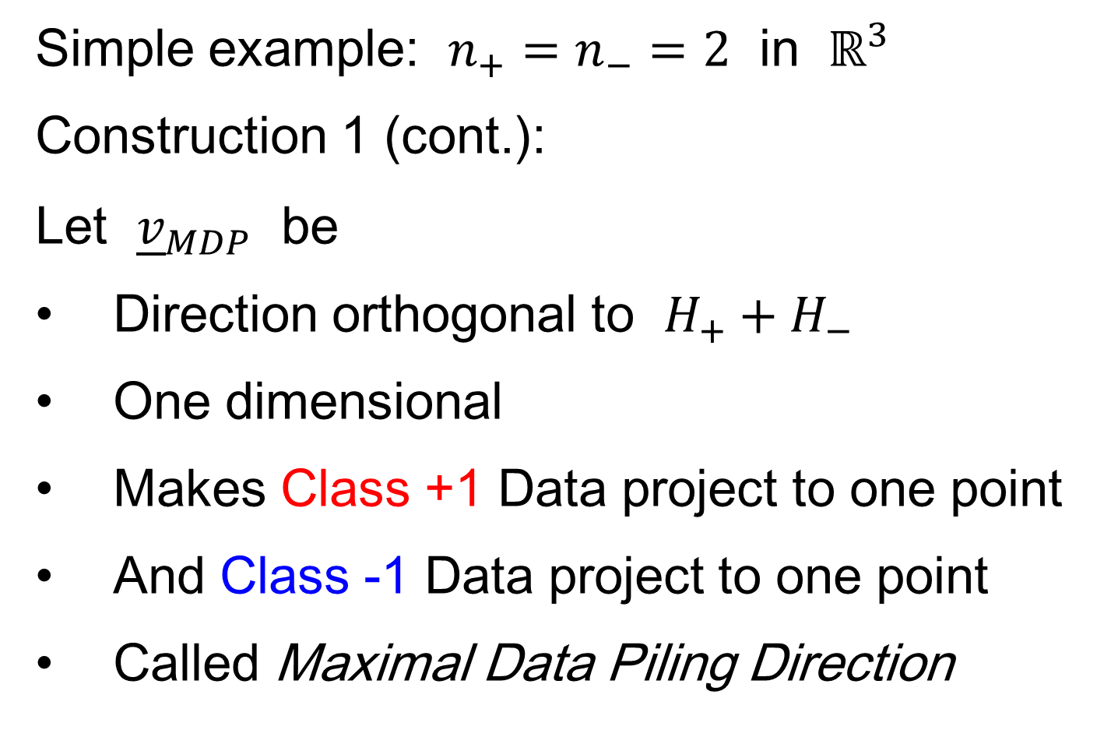
Maximal Data Piling
Simple example: $n_{+}=n_{−}=2$ in $ℝ^{3}$
Construction 1 (cont.):
Let ${\underline{v}}_{MDP}$ be
Direction orthogonal to $H_{+}+H_{−}$
One dimensional
Makes Class +1 Data project to one point
And Class -1 Data project to one point
Called Maximal Data Piling Direction

Slide 14
Maximal Data Piling
Simple example: $n_{+}=n_{−}=2$ in $ℝ^{3}$
Notes:
C:\Documents and Settings\J S Marron\My Documents\Research\ComplexPopn\MaxDataPiling\dppic2_2.pdf

Slide 15
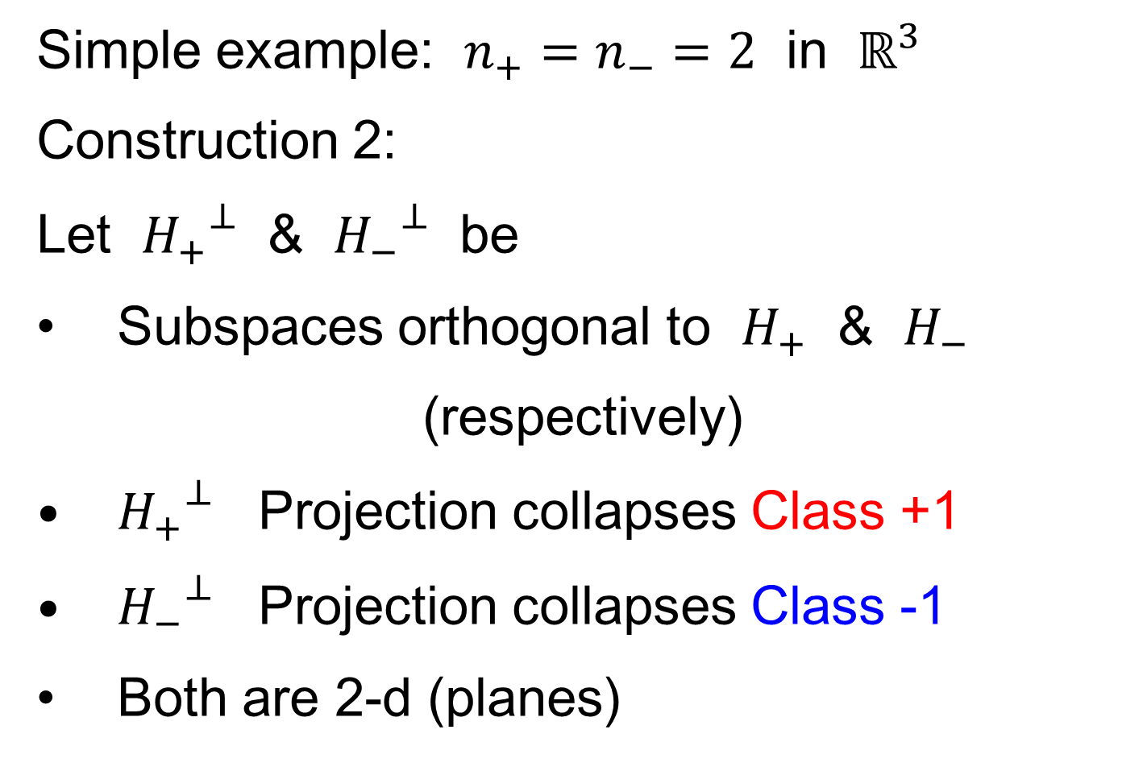
Maximal Data Piling
Simple example: $n_{+}=n_{−}=2$ in $ℝ^{3}$
Construction 2:
Let ${H_{+}}^{⊥}$ & ${H_{−}}^{⊥}$ be
Subspaces orthogonal to $H_{+}$ & $H_{−}$
(respectively)
${H_{+}}^{⊥}$ Projection collapses Class +1
${H_{−}}^{⊥}$ Projection collapses Class -1
Both are 2-d (planes)

Slide 16
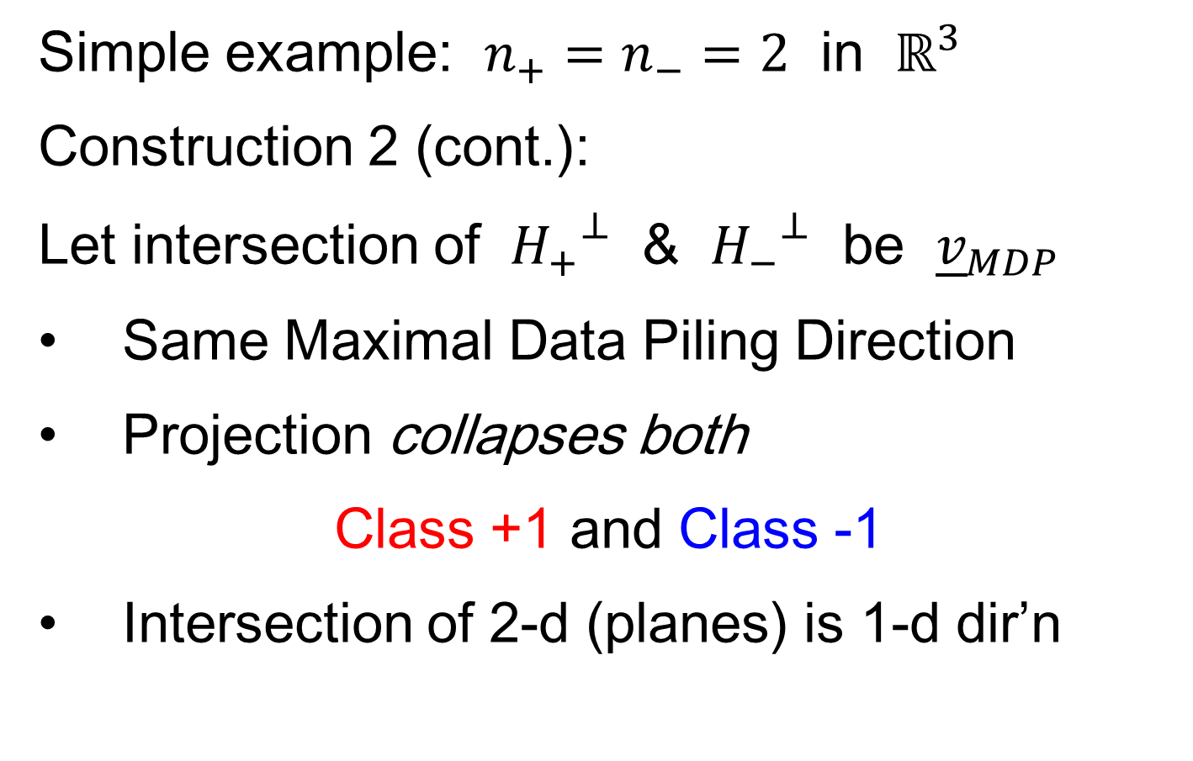
Maximal Data Piling
Simple example: $n_{+}=n_{−}=2$ in $ℝ^{3}$
Construction 2 (cont.):
Let intersection of ${H_{+}}^{⊥}$ & ${H_{−}}^{⊥}$ be ${\underline{v}}_{MDP}$
Same Maximal Data Piling Direction
Projection collapses both
Class +1 and Class -1
Intersection of 2-d (planes) is 1-d dir’n

Slide 17
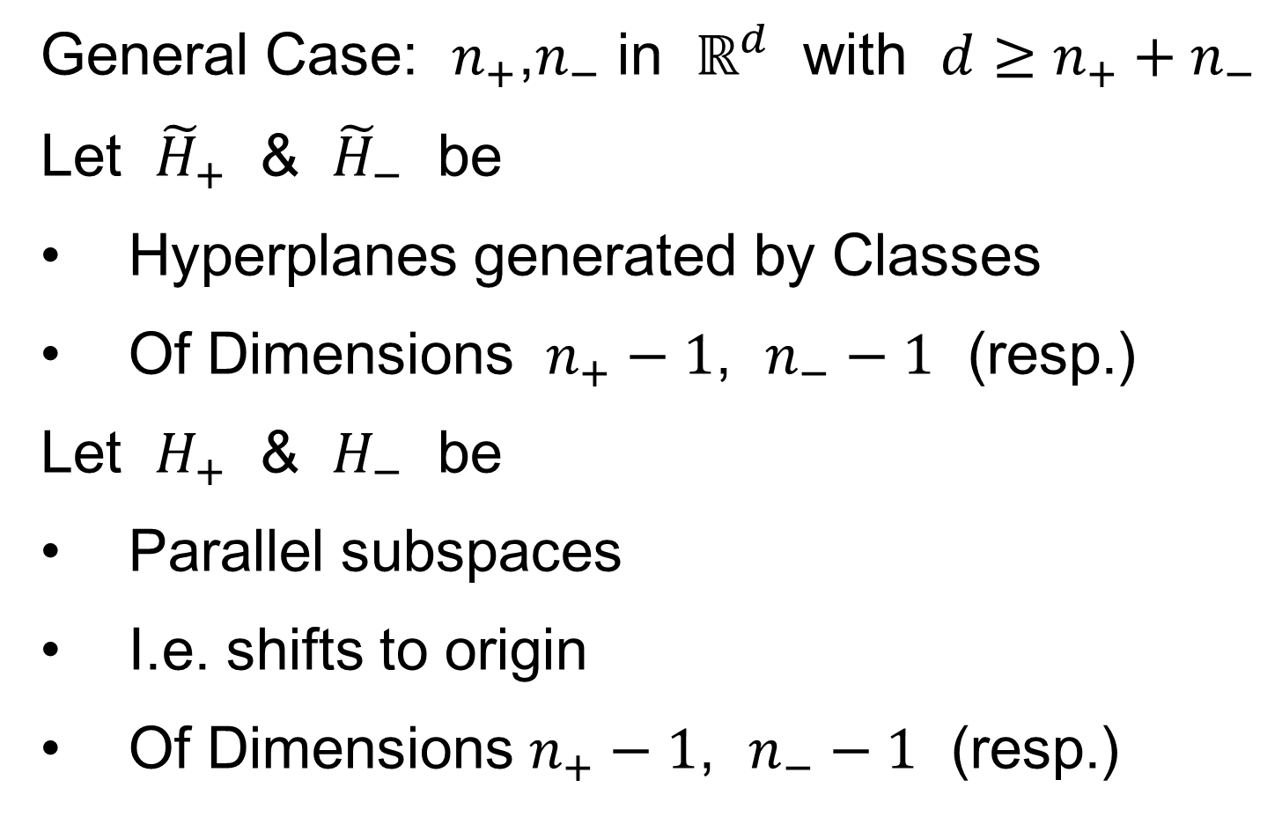
Maximal Data Piling
General Case: $n_{+}$,$n_{−}$ in $ℝ^{d}$ with $d≥n_{+}+n_{−}$
Let ${\tilde{H}}_{+}$ & ${\tilde{H}}_{−}$ be
Hyperplanes generated by Classes
Of Dimensions $n_{+}−1$, $n_{−}−1$ (resp.)
Let $H_{+}$ & $H_{−}$ be
Parallel subspaces
I.e. shifts to origin
Of Dimensions $n_{+}−1$, $n_{−}−1$ (resp.)

Slide 18
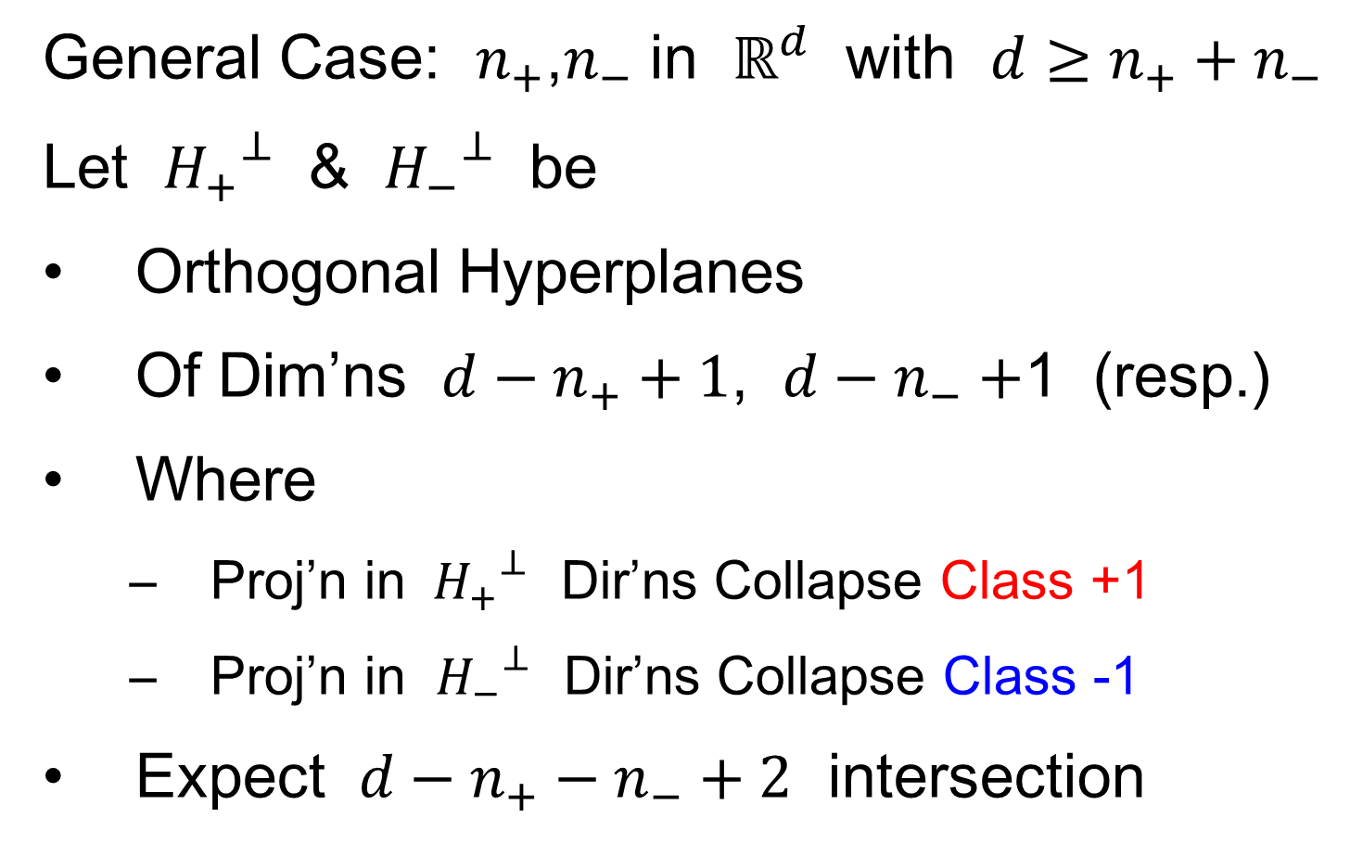
Maximal Data Piling
General Case: $n_{+}$,$n_{−}$ in $ℝ^{d}$ with $d≥n_{+}+n_{−}$
Let ${H_{+}}^{⊥}$ & ${H_{−}}^{⊥}$ be
Orthogonal Hyperplanes
Of Dim’ns $d−n_{+}+1$, $d−n_{−}+$1 (resp.)
Where
  Proj’n in ${H_{+}}^{⊥}$ Dir’ns Collapse Class +1
  Proj’n in ${H_{−}}^{⊥}$ Dir’ns Collapse Class -1
Expect $d−n_{+}−n_{−}+2$ intersection

Slide 19
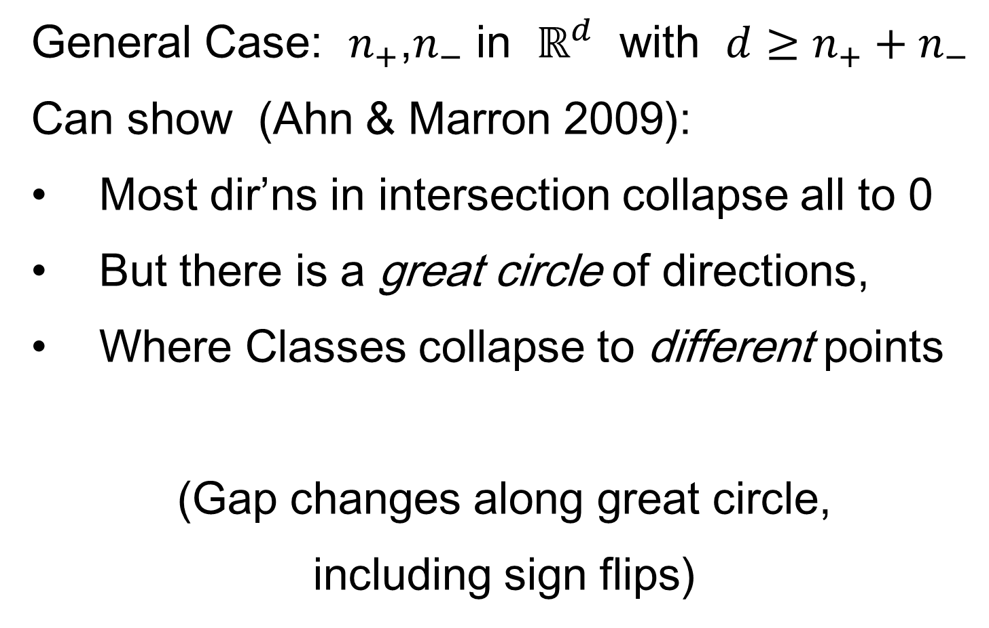
Maximal Data Piling
General Case: $n_{+}$,$n_{−}$ in $ℝ^{d}$ with $d≥n_{+}+n_{−}$
Can show (Ahn & Marron 2009):
Most dir’ns in intersection collapse all to 0
But there is a great circle of directions,
Where Classes collapse to different points
(Gap changes along great circle,
including sign flips)

Slide 20
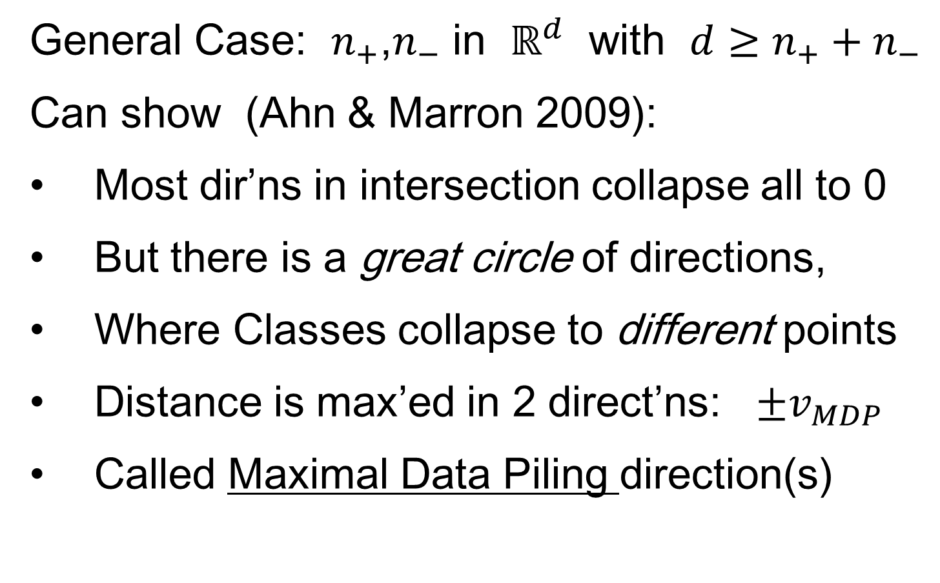
Maximal Data Piling
General Case: $n_{+}$,$n_{−}$ in $ℝ^{d}$ with $d≥n_{+}+n_{−}$
Can show (Ahn & Marron 2009):
Most dir’ns in intersection collapse all to 0
But there is a great circle of directions,
Where Classes collapse to different points
Distance is max’ed in 2 direct’ns: $±v_{MDP}$
Called Maximal Data Piling direction(s)

Slide 21
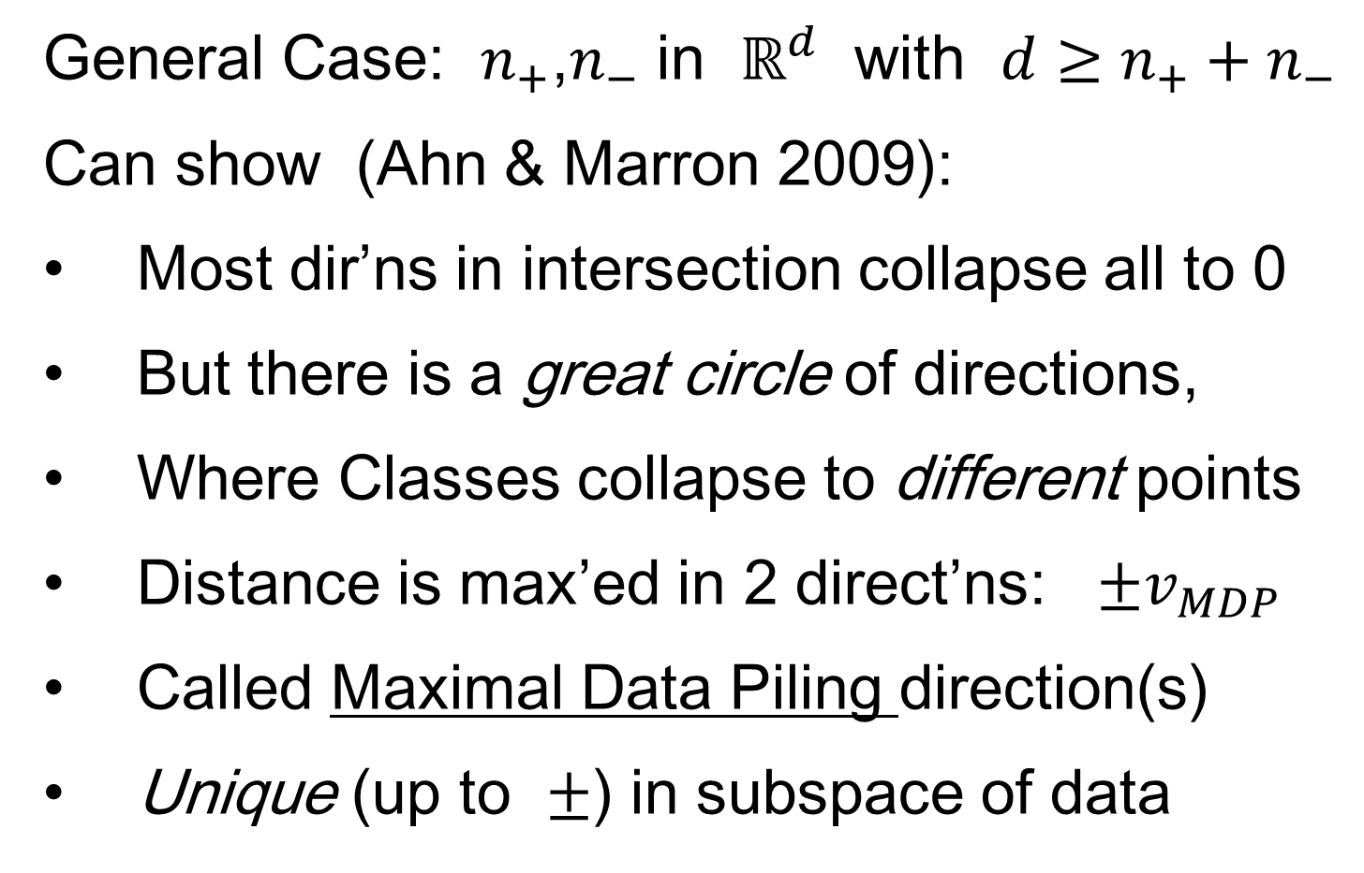
Maximal Data Piling
General Case: $n_{+}$,$n_{−}$ in $ℝ^{d}$ with $d≥n_{+}+n_{−}$
Can show (Ahn & Marron 2009):
Most dir’ns in intersection collapse all to 0
But there is a great circle of directions,
Where Classes collapse to different points
Distance is max’ed in 2 direct’ns: $±v_{MDP}$
Called Maximal Data Piling direction(s)
Unique (up to $±$) in subspace of data

Slide 22
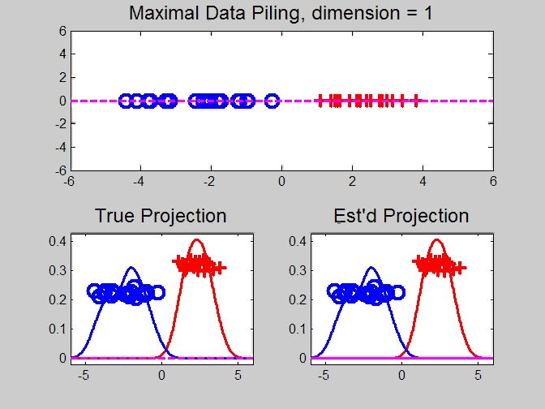
Maximal Data Piling
Movie Through Increasing Dimensions

Slide 23
Maximal Data Piling
MDP in Increasing Dimensions:
Sub HDLSS dimensions (d = 1-37):
  Looks similar to FLD?!?
  Reason for this?
At HDLSS Boundary (d = 38):
  Again similar to FLD…

Slide 24
Maximal Data Piling
FLD in Increasing Dimensions:
For HDLSS dimensions (d = 39-1000):
  Always have data piling
  Gap between grows for larger n
  Even though noise increases?
  Angle (gen’bility) first improves, d = 39–180
  Then worsens, d = 200-1000
  Eventually noise dominates
  Trade-off is where gap near optimal diff’nce

