Slide 1
Return to Big Picture
Main statistical goals of OODA:
Understanding population structure
  Low dim’al Projections, PCA …
Classification (i. e. Discrimination)
  Understanding 2+ populations
Time Series of Data Objects
  Chemical Spectra, Mortality Data
“Vertical Integration” of Data Types

Slide 2
Return to Big Picture
Main statistical goals of OODA:
Understanding population structure
  Low dim’al Projections, PCA …
Classification (i. e. Discrimination)
  Understanding 2+ populations
Time Series of Data Objects
  Chemical Spectra, Mortality Data
“Vertical Integration” of Data Types
Qing Feng: JIVE

Slide 3
Return to Big Picture
Main statistical goals of OODA:
Understanding population structure
  Low dim’al Projections, PCA …
Classification (i. e. Discrimination)
  Understanding 2+ populations
Time Series of Data Objects
  Chemical Spectra, Mortality Data
“Vertical Integration” of Data Types

Slide 4
Classification - Discrimination
Background: Two Class (Binary) version:
Using “training data” from
Class +1 and Class -1
Develop a “rule” for
assigning new data to a Class
Canonical Example: Disease Diagnosis
New Patients are “Healthy” or “Ill”
Determine based on measurements

Slide 5
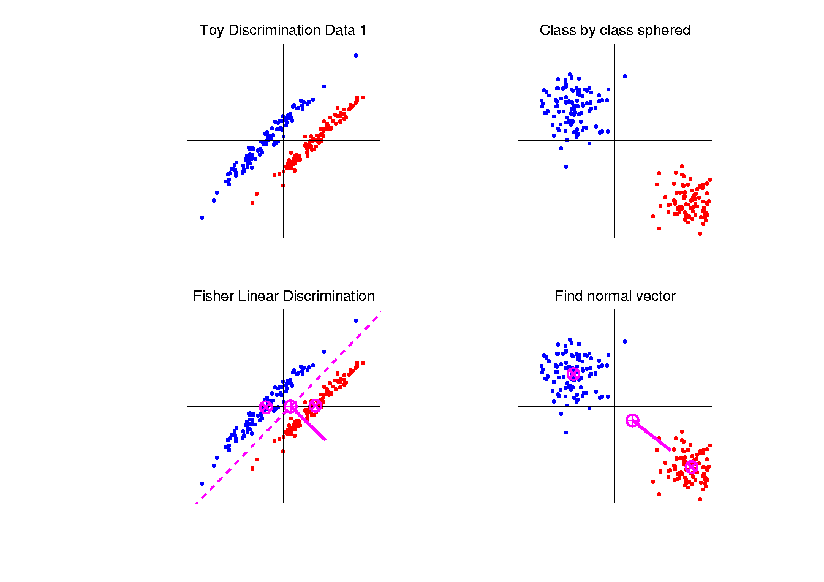
Fisher Linear Discrimination
Simple way to find “correct cov. adjustment”:
Individually transform subpopulations so
“spherical” about their means
For define
Notes:
HDLSSod1egFLD.ps

Slide 6
Fisher Linear Discrimination
So (in orig’l space) have separ’ting hyperplane with:
Normal vector: Intercept:
Notes:
HDLSSod1egFLD.ps

Slide 7
Classical Discrimination
Above derivation of FLD was:
Nonstandard
Not in any textbooks(?)
Nonparametric (don’t need Gaussian data)
I.e. Used no probability distributions
More Machine Learning than Statistics

Slide 8
Classical Discrimination
FLD Likelihood View (cont.)
Replacing , and
by maximum likelihood estimates:
, and
Gives the likelihood ratio discrimination rule:
Choose Class +1, when
Same as above, so: FLD can be viewed as
Likelihood Ratio Rule

Slide 9
Classical Discrimination
Summary of FLD vs. GLR:
Tilted Point Clouds Data
  FLD good
  GLR good
Donut Data
  FLD bad
  GLR good
X Data
  FLD bad
  GLR OK, not great
Classical Conclusion: GLR generally better
(will see a different answer for HDLSS data)

Slide 10
Classical Discrimination
FLD Generalization II (Gen. I was GLR)
Different prior probabilities
Main idea:
Give different weights to 2 classes
I.e. assume not a priori equally likely
Development is “straightforward”
Modified likelihood
Change intercept in FLD
Won’t explore further here

Slide 11
Classical Discrimination
FLD Generalization III
Principal Discriminant Analysis
Idea: FLD-like approach to > 2 classes

Slide 12
Classical Discrimination
FLD Generalization III
Principal Discriminant Analysis
Idea: FLD-like approach to > 2 classes
Assumption: Class covariance matrices are the same (similar)
(but not Gaussian, same situation as for FLD)

Slide 13
Classical Discrimination
Principal Discriminant Analysis (cont.)
But PCA only works like Mean Difference,
Expect can improve by
taking covariance into account.
Blind application of above ideas suggests eigen-analysis of:

Slide 14
Classical Discrimination
Summary of Classical Ideas:
Among “Simple Methods”
  MD and FLD sometimes similar
  Sometimes FLD better
  So FLD is preferred
Among Complicated Methods
  GLR is best
  So always use that?
Caution:
  Story changes for HDLSS settings

Slide 15
HDLSS Discrimination
Main HDLSS issues:
Sample Size, n < Dimension, d
Singular covariance matrix
So can’t use matrix inverse
I.e. can’t standardize (sphere) the data
(requires root inverse covariance)
Can’t do classical multivariate analysis

Slide 16
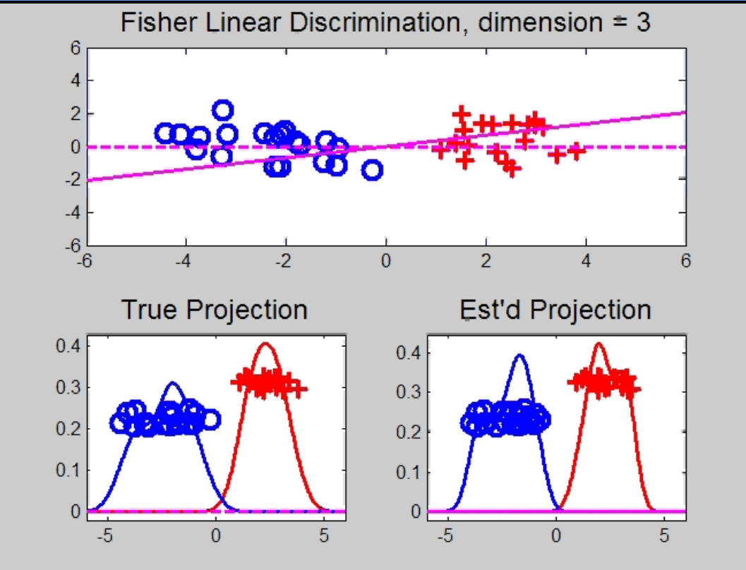
HDLSS Discrimination
Add a 3rd Dimension (noise)
Project on
2-d subspace
generated
by optimal
dir’n & by
FLD dir’n

Slide 17
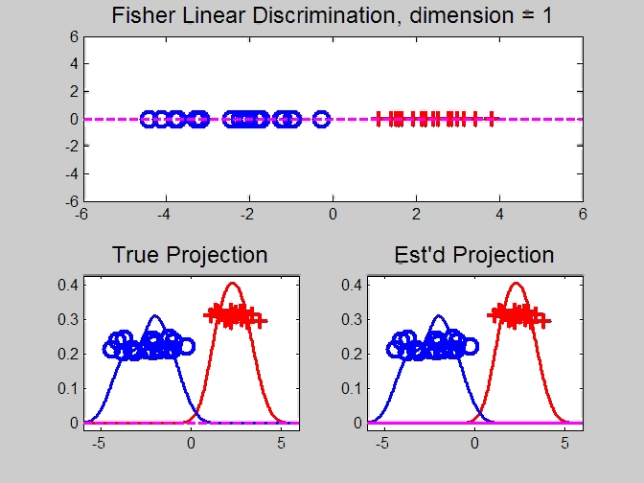
HDLSS Discrimination
Movie Through Increasing Dimensions

Slide 18
HDLSS Discrimination
FLD in Increasing Dimensions:
Low dimensions (d = 2-9):
  Visually good separation
  Small angle between FLD and Optimal
  Good generalizability
Medium Dimensions (d = 10-26):
  Visual separation too good?!?
  Larger angle between FLD and Optimal
  Worse generalizability
  Feel effect of sampling noise

Slide 19
HDLSS Discrimination
FLD in Increasing Dimensions:
High Dimensions (d=27-37):
  Much worse angle
  Very poor generalizability
  But very small within class variation
  Poor separation between classes
  Large separation / variation ratio

Slide 20
HDLSS Discrimination
FLD in Increasing Dimensions:
At HDLSS Boundary (d=38):
  38 = degrees of freedom
  (need to estimate 2 class means)
  Within class variation = 0 ?!?
  Data pile up, on just two points
  Perfect separation / variation ratio?
  But only feels microscopic noise aspects
  So likely not generalizable
  Angle to optimal very large

Slide 21
HDLSS Discrimination
FLD in Increasing Dimensions:
Just beyond HDLSS boundary (d=39-70):
  Improves with higher dimension?!?
  Angle gets better
  Improving generalizability?
  More noise helps classification?!?

Slide 22
HDLSS Discrimination
FLD in Increasing Dimensions:
Far beyond HDLSS boun’ry (d=70-1000):
  Quality degrades
  Projections look terrible
  (populations overlap)
  And Generalizability falls apart, as well
  Math’s worked out by Bickel & Levina (2004)
  Problem is estimation of d x d covariance matrix

Slide 23
HDLSS Discrimination
Simple Solution:
Mean Difference (Centroid) Method
Recall not classically recommended
  Usually no better than FLD
  Sometimes worse
But avoids estimation of covariance
Means are very stable
Don’t feel HDLSS problem

Slide 24
HDLSS Discrimination
Mean Difference (Centroid) Method
Far more stable over dimensions
Because is likelihood ratio solution
(for known variance - Gaussians)
Doesn’t feel HDLSS boundary
Eventually becomes too good?!?
Widening gap between clusters?!?
Careful: angle to optimal grows
So lose generalizability (since noise inc’s)
HDLSS data present some odd effects…

