Slide 1
STOR 892 Object Oriented Data Analysis
Radial Distance Weighted Discrimination
Jie Xiong
Advised by Prof. J.S. Marron
Department of Statistics and Operations Research
UNC-Chapel Hill

Slide 2
Outline
Preliminaries
Support Vector Machine (SVM) and Distance Weighted Discrimination (DWD)
Data Object, which motivates the development of Radial DWD.
An important application: ‘Virus Hunting’
High Dimension Low Sample (HDLSS) characteristics
Radial DWD optimizations
Real data and simulation study

Slide 3
Preliminaries
Binary classification
Using “training data” from Class +1 and Class -1
Develop a “rule” for assigning new data to a Class
Canonical examples include disease diagnosis based on measurements
Think about split the data space for the 2 Classes using a classification boundary
Most simple case: linear hyperplane

Slide 4
Optimization Viewpoint
Formulate Optimization problem, based on:
Data (feature) vectors
Class Labels
Normal Vector
Location (determines intercept)
Residuals (right side)
Residuals (wrong side)

Slide 5
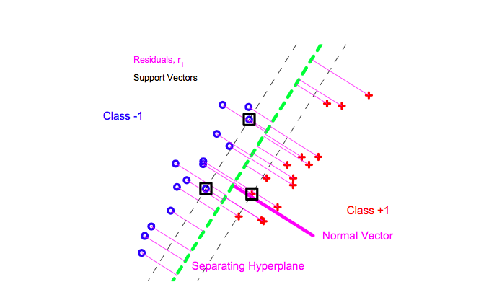

Slide 6
Preliminaries
SVM and DWD
Both are binary classifiers, they separate the 2 classes using a hyperplane
DWD is designed for High Dimension Low Sample Size (HDLSS) data, avoid data piling, larger generalizability

Slide 7
Optimal Direction

Slide 8
Support Vector Machine Direction

Slide 9
Distance Weighted Discrimination

Slide 10
Data Objects
Introduce ‘Virus Hunting’ using DNA sequence-alignment data.
DNA sequence and alignment
Data vector and the normalization used
HDLSS data geometry: data on simplex

Slide 11
Data Objects
Introduce ‘Virus Hunting’ using DNA sequence-alignment data.
DNA sequence and alignment
Data vector and the normalization used
HDLSS data geometry: data on simplex

Slide 12
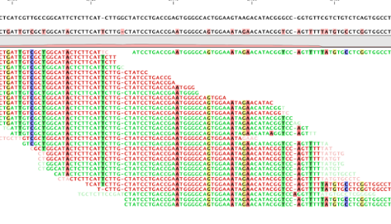
Virus sequence
Reference (HSV-1)
Short reads

Slide 13
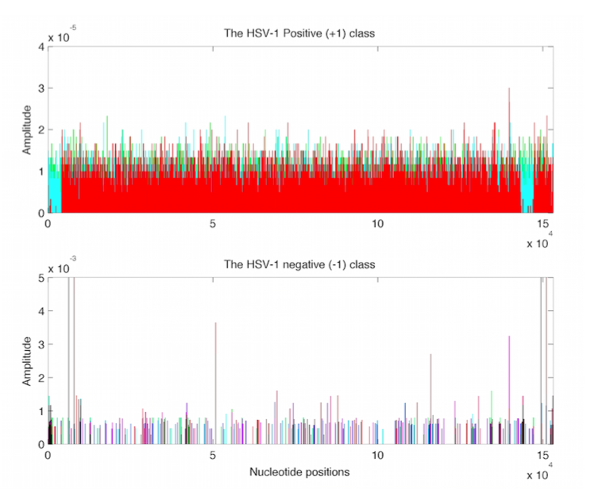

Slide 14
Data Objects
Data on simplex
Let d be the dimension of the data space
(x1,…,xd) with non-negative entries adding up to 1 is on the unit simplex of dimension (d-1)
(1/d,…,1/d) is the center of the unit simplex
(0,…1,…,0) is one of the vertices

Slide 15
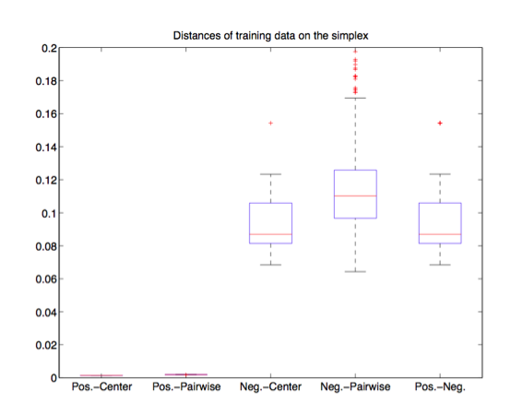

Slide 16
Data Objects
Introduce ‘Virus Hunting’ using DNA sequence-alignment data.
DNA sequence and alignment
Data vector and the normalization use
HDLSS data geometry
Data points on the unit simplex
Position and distances.

Slide 17
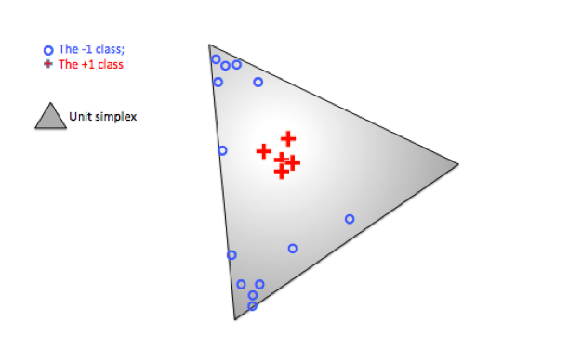

Slide 18
Data Objects
What can we say about the linear classifiers?
When dimension is low, training data may not be linear separable
Under HDLSS, very often the training data is linearly separable (see Ahn and Marron 2010), however, the classification for the new samples could be very bad.

Slide 21
What can we say about this testing sample?

Slide 22
Visualize using the distance to the center of the sphere, in high dimension cases.
Inside or outside the sphere?

Slide 23
Data points: x1…xi…xn
Class labels: y1…yi…yn are +/-1
O: center of the sphere
R: Radius of the sphere
R

Slide 24
Data points: x1…xi…xn
Class labels: y1…yi…yn are +/-1
O: center of the sphere
R: Radius of the sphere
The distance of a data point xi to the center is
R

Slide 25
Data points: x1…xi…xn
Class labels: y1…yi…yn are +/-1
O: center of the sphere
R: Radius of the sphere
The distance of a data point xi to the sphere is
R

Slide 26
Data points: x1…xi…xn
Class labels: y1…yi…yn are +/-1
O: center of the sphere
R: Radius of the sphere
The distance of a data point xi to the sphere is
The objective is to minimize the inverse of the sum of the distances to the sphere
R

Slide 27
Radial DWD
Radial DWD Optimization

Slide 28
Simulation and real data
Real ‘Virus Hunting’ data.
HSV1
Simulated Data using Dirichlet distribution.
Compare Radial DWD with some alternatives: MD, SVM, DWD, LASSO, kernel SVM

Slide 29
Simulation and real data
Real ‘Virus Hunting’ data.
HSV1 positives in training
HSV1 negatives in training
HSV1 related samples in testing (human and other species)
Unrelated samples in testing
Simulated Data using Dirichlet distribution.
Compare Radial DWD with some alternatives: MD, SVM, DWD, LASSO, kernel SVM

Slide 30
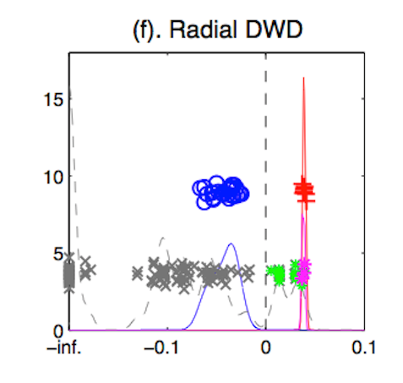
Real ‘Virus Hunting’ data.
HSV1 positives in training
HSV1 negatives in training
HSV1 related samples in testing (human and other species)
Unrelated samples in testing

Slide 31
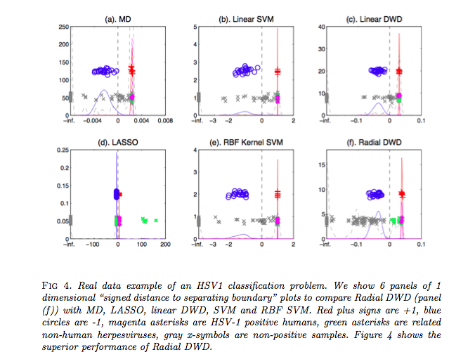

Slide 32
Simulation and real data
Real ‘Virus Hunting’ data.
HSV1
Simulated Data using Dirichlet distribution.
Dirichlet distribution: a 2 dimensional simplex case using Dirichlet (a1,a2,a3), and a1=a2=a3 = a.
Compare Radial DWD with some alternatives: MD, SVM, DWD, LASSO, kernel SVM

Slide 33
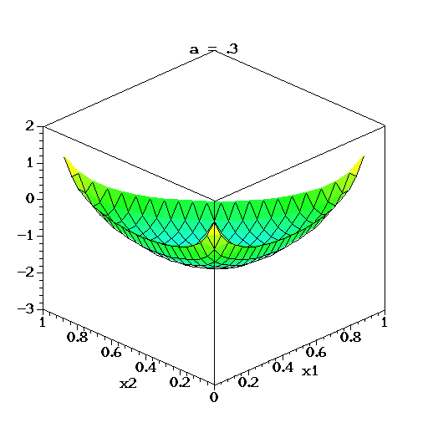
The density of Dirichlet(a,a,a)

Slide 34
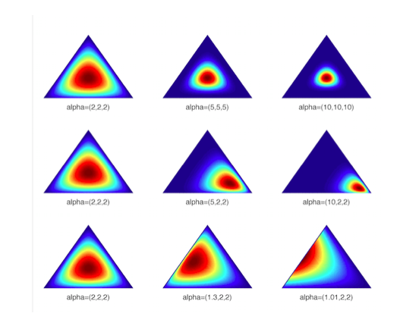

Slide 35
Simulation and real data
Real ‘Virus Hunting’ data.
HSV1
Simulated Data using Dirichlet distribution.
Dirichlet distribution: a 2 dimensional simplex case using Dirichlet (a1,a2,a3), and a1=a2=a3.
Compare Radial DWD with some alternatives: MD, SVM, DWD, LASSO, kernel SVM

Slide 36
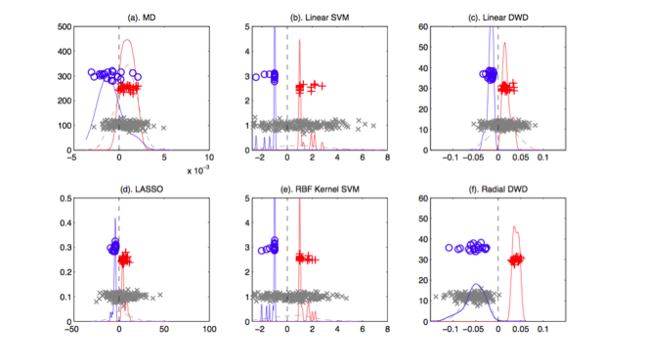

Slide 37
