Slide 1
PCA Extensions for Data on Manifolds
Fletcher (Principal Geodesic Anal.)
Best fit of geodesic to data
Constrained to go through geodesic mean
Huckemann, Hotz & Munk (Geod. PCA)
Best fit of any geodesic to data
Jung, Foskey & Marron (Princ. Arc Anal.)
Best fit of any circle to data
(motivated by conformal maps)

Slide 2
PCA Extensions for Data on Manifolds

Slide 3
Landmark Based Shape Analysis
Key Step: mod out
Translation
Scaling
Rotation
Result:
Data Objects ←→
←→ points on Manifold ( ~ S^{2k-4})

Slide 4
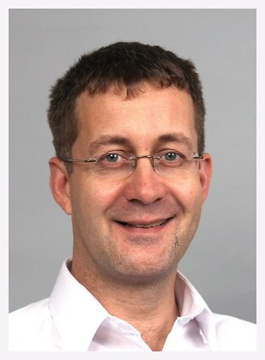
Principal Nested Spheres Analysis
Main Goal:
Extend Principal Arc Analysis (S² to S^{k})
Jung, Dryden & Marron (2012)

Slide 5
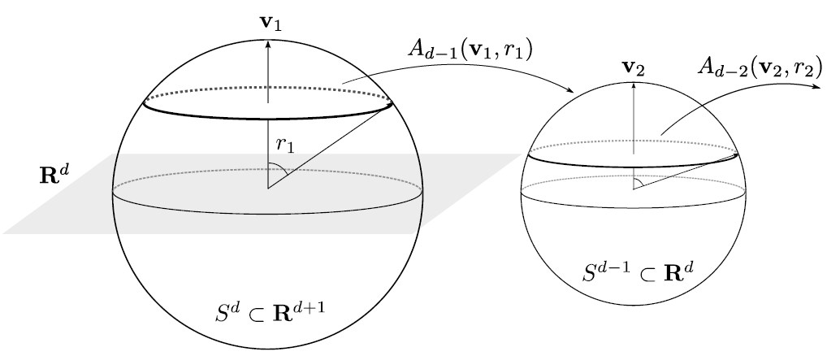
Principal Nested Spheres Analysis
Top Down Nested (small) spheres

Slide 6
Principal Nested Spheres Analysis
Main Goal:
Extend Principal Arc Analysis (S² to S^{k})
Jung, Dryden & Marron (2012)
Important Landmark: This Motivated
Backwards PCA

Slide 7
Principal Nested Spheres Analysis
Replace usual forwards view of PCA
Data → PC1 (1-d approx)
→ PC2 (1-d approx of Data-PC1)
→ PC1 U PC2 (2-d approx)
→ PC1 U … U PCr
(r-d approx)

Slide 8
Principal Nested Spheres Analysis
With a backwards approach to PCA
Data → PC1 U … U PCr (r-d approx)
→ PC1 U … U PC(r-1)
→ PC1 U PC2 (2-d approx)
→ PC1 (1-d approx)

Slide 9
Principal Component Analysis
Euclidean Settings:
Forwards PCA = Backwards PCA
(Pythagorean Theorem,
ANOVA Decomposition)
So Not Interesting
But Very Different in Non-Euclidean Settings
(Backwards is Better !?!)

Slide 10
Principal Component Analysis
Important Property of PCA:
Nested Series of Approximations
$$\left\{{PC}_{1}\right\}⊆\left\{{PC}_{1}{,PC}_{2}\right\}⊆\left\{{PC}_{1}{,PC}_{2},{PC}_{3}\right\}⊆⋯$$
(Often taken for granted)
(Desirable in Non-Euclidean Settings)

Slide 11
An Interesting Question
How generally applicable is
Backwards approach to PCA?
Where is this already being done???

Slide 12
An Interesting Question
How generally applicable is
Backwards approach to PCA?
An Application:
Nonnegative Matrix Factorization
= PCA in Positive Orthant
Think $X ≈LS$
With ≥ 0 Constraints (on both $L$ & $S$)

Slide 13
Nonnegative Matrix Factorization
Standard Approach:
Lee et al (1999):
Formulate & Solve Optimization
Major Challenge:
Not Nested, ($k=3 ≉ k=4$)

Slide 14
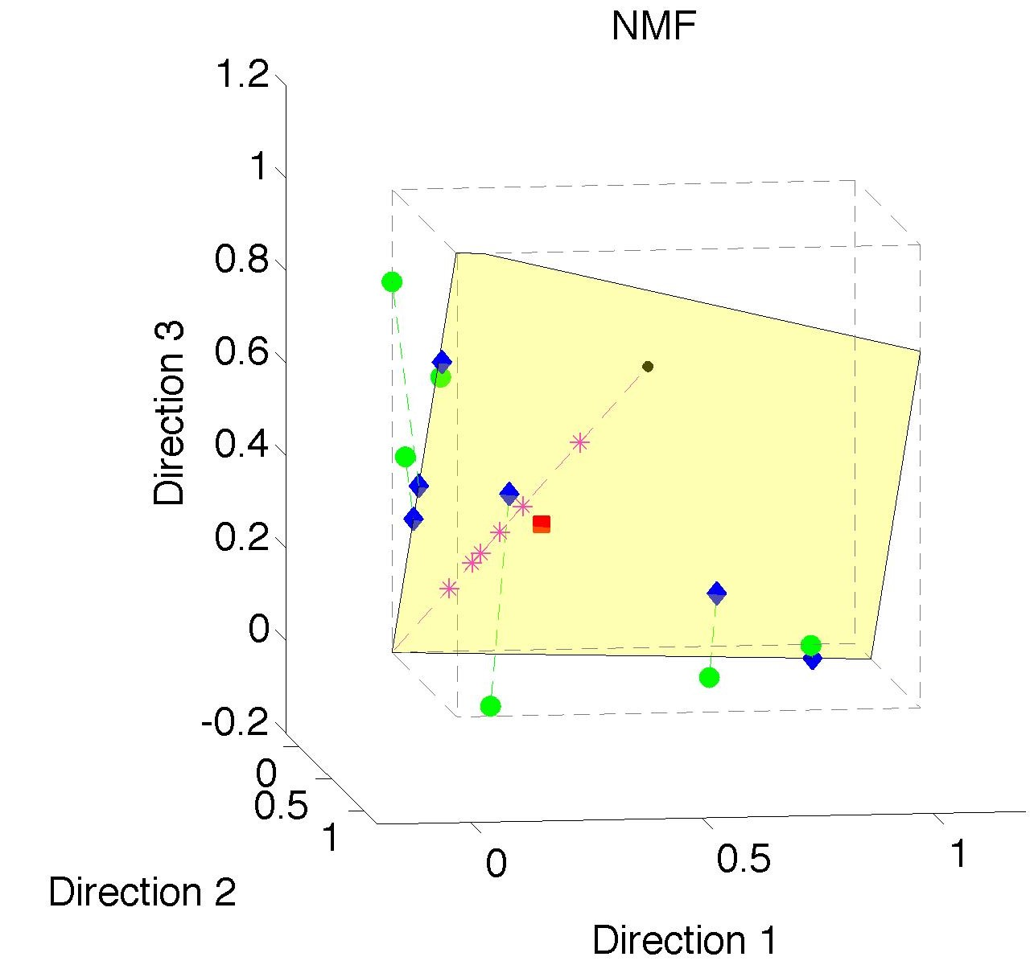
Nonnegative Matrix Factorization
Standard NMF
(Projections
All Inside
Orthant)

Slide 15
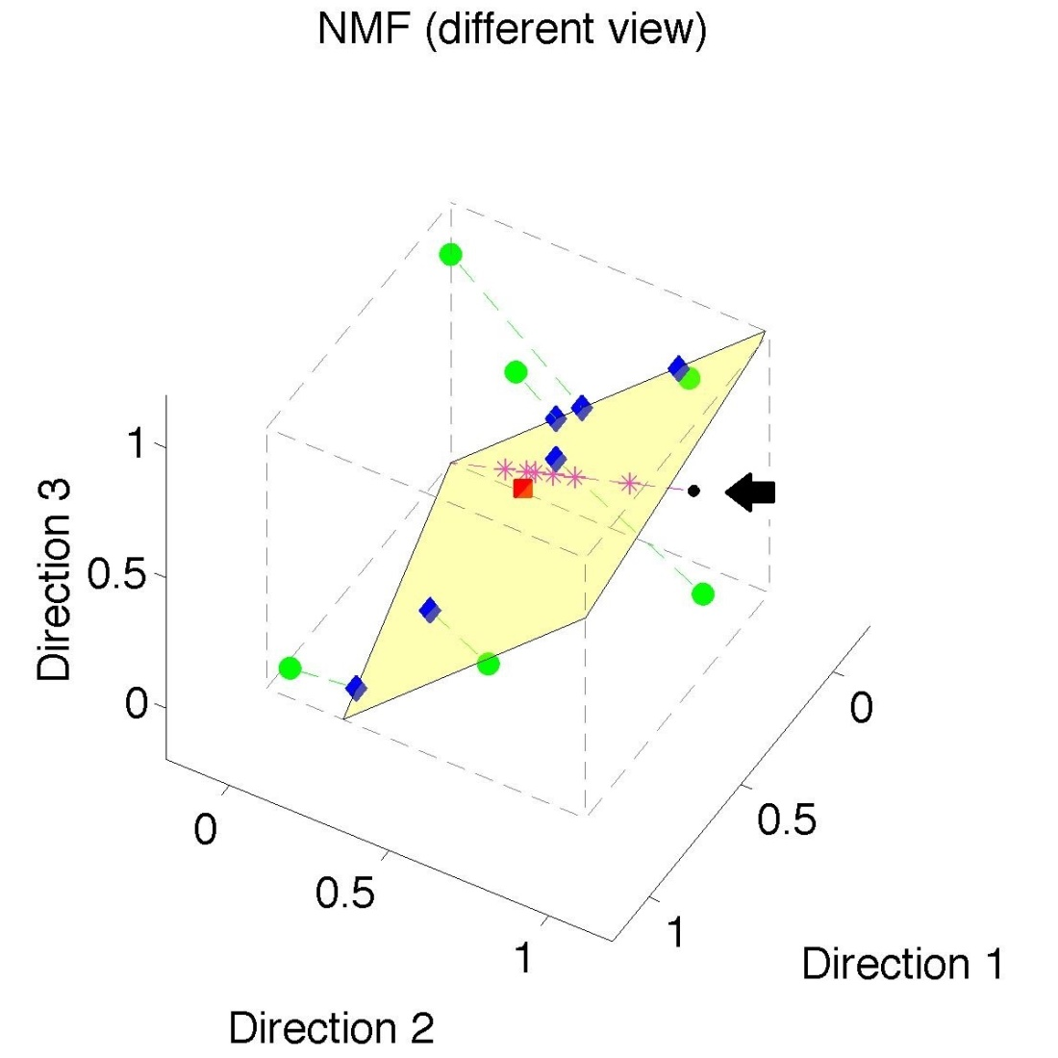
Nonnegative Matrix Factorization
Standard NMF
But Note
Not Nested
No “Multi-scale”
Analysis
Possible (Scores Plot?!?)

Slide 16
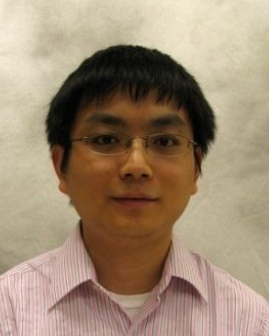
Nonnegative Matrix Factorization
Improved Version:
Use Backwards PCA Idea
“Nonnegative Nested Cone Analysis”
Collaborator:
Lingsong Zhang (Purdue)
Zhang, Marron, Lu (2013)

Slide 17
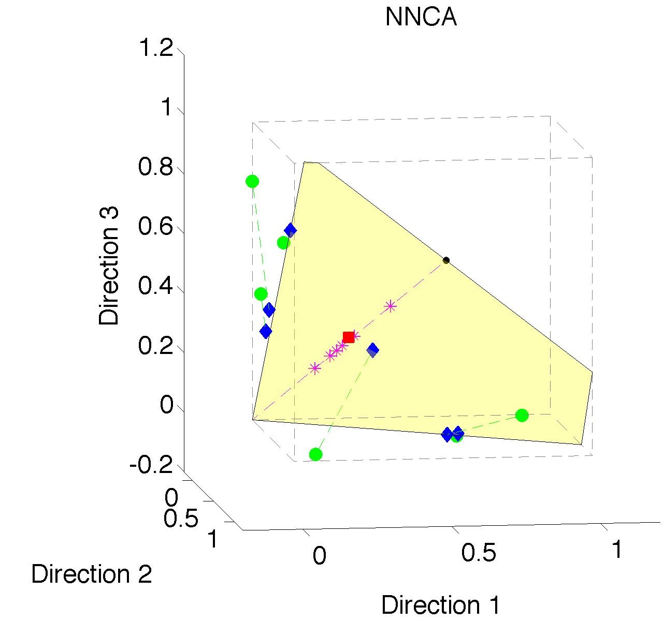
Nonnegative Nested Cone Analysis
Same Toy
Data Set
All
Projections
In Orthant

Slide 18
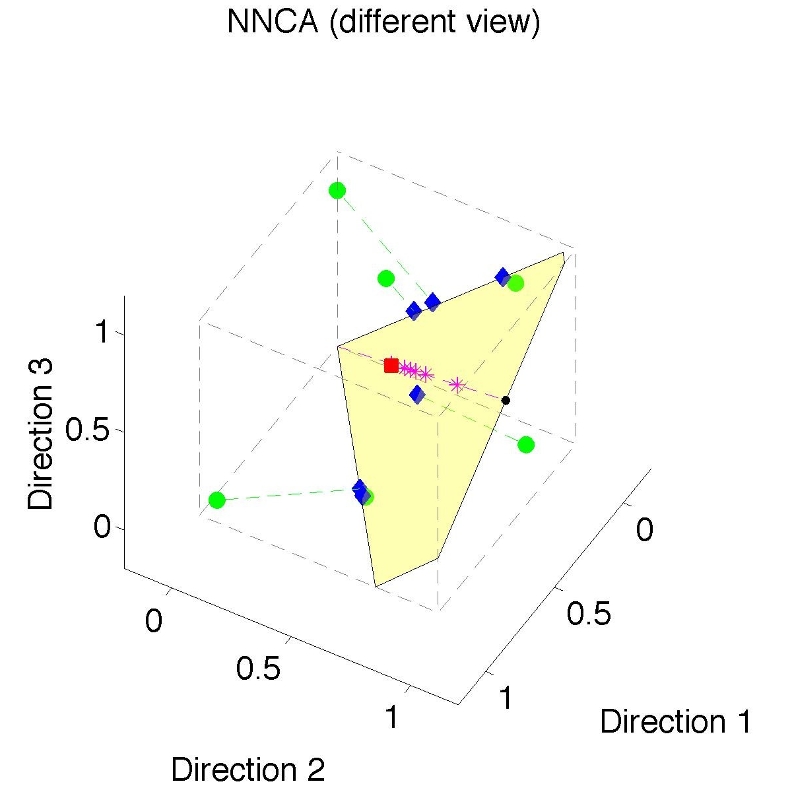
Nonnegative Nested Cone Analysis
Same Toy
Data Set
Rank 1
Approx.
Properly
Nested

Slide 19
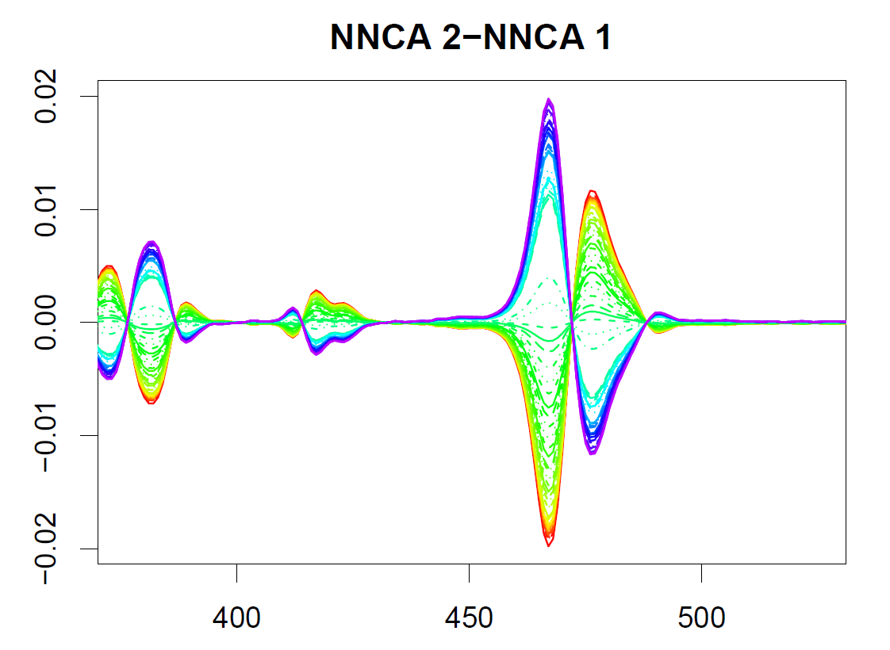
Nonnegative Nested Cone Analysis
Chemical
Spectral
Data
Gives
Clearer
View

Slide 20
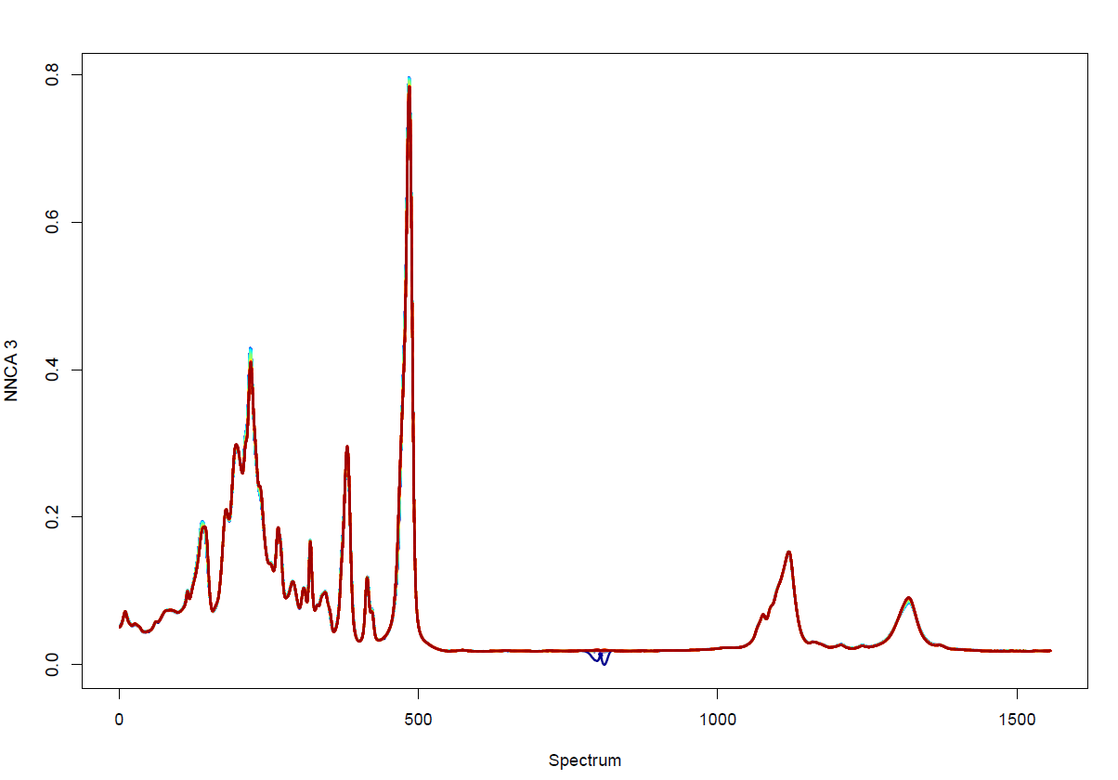
Nonnegative Nested Cone Analysis
Chemical
Spectral
Data
Rank 3
Approximation Highlights Lab Early Error

Slide 21
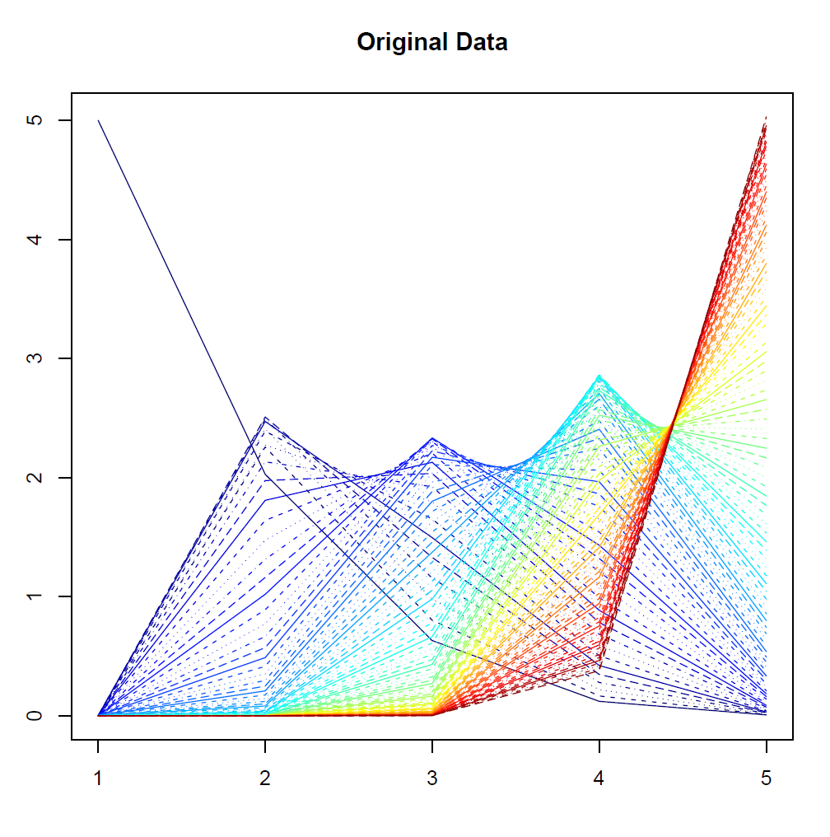
Nonnegative Nested Cone Analysis
5-d Toy
Example
(Rainbow
Colored
by Peak
Order)

Slide 22
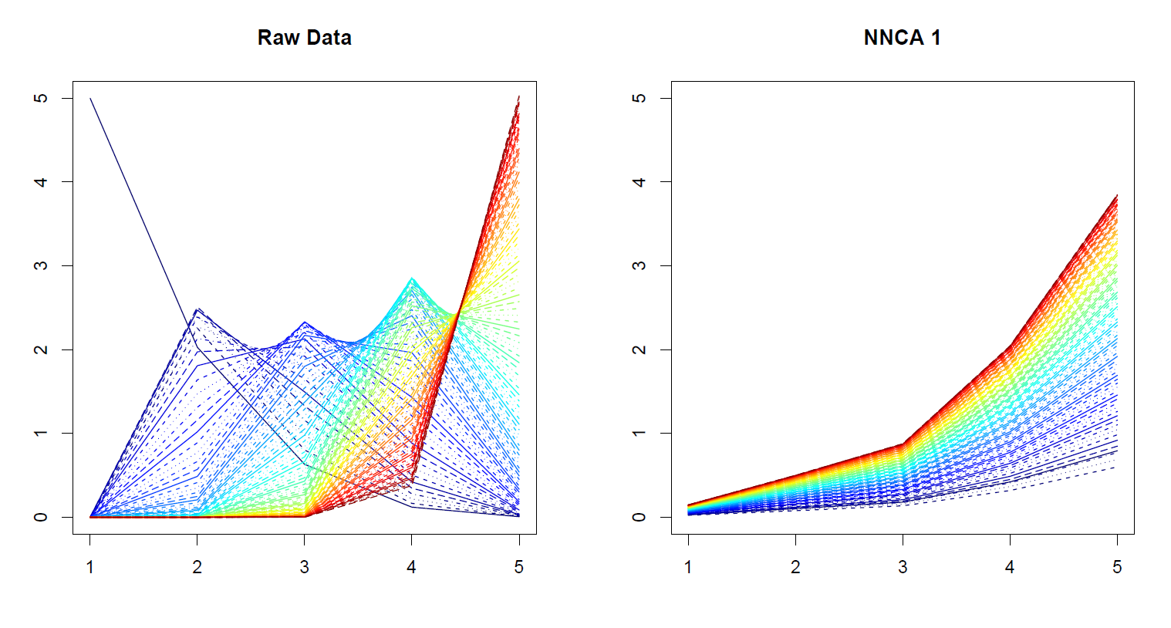
Nonnegative Nested Cone Analysis
5-d Toy Example Rank 1 NNCA Approx.

Slide 23
Nonnegative Nested Cone Analysis
5-d Toy Example Rank 2 NNCA Approx.

Slide 24
Nonnegative Nested Cone Analysis
5-d Toy Example Rank 2 NNCA Approx.
Nonneg.
Basis
Elements
(Not Trivial)

Slide 25
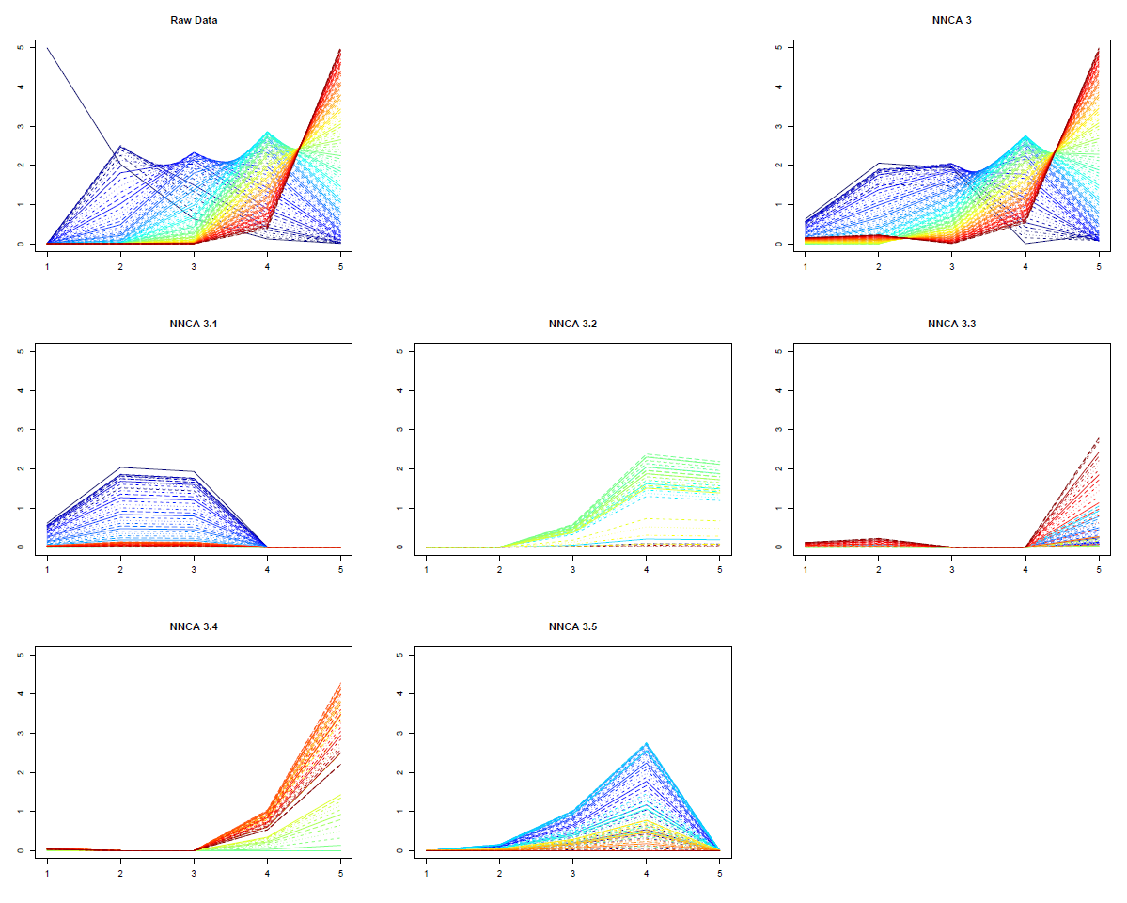
Nonnegative Nested Cone Analysis
5-d Toy Example Rank 3 NNCA Approx.
Current
Research:
How Many
Nonneg.
Basis El’ts
Needed?

Slide 26
An Interesting Question
How generally applicable is
Backwards approach to PCA?
Potential Application: Principal Curves
Hastie & Stuetzle, (1989)
(Foundation of Manifold Learning)

Slide 27
Manifold Learning
Goal: Find lower dimensional manifold that well approximates data
ISOmap
Tennenbaum (2000)
Local Linear Embedding
Roweis & Saul (2000)

Slide 28
1st Principal Curve
Linear Reg’n
Usual Smooth

Slide 29
1st Principal Curve
Linear Reg’n
Proj’s Reg’n
Usual Smooth

Slide 30
1st Principal Curve
Linear Reg’n
Proj’s Reg’n
Usual Smooth
Princ’l Curve

Slide 31
An Interesting Question
How generally applicable is
Backwards approach to PCA?
Potential Application: Principal Curves
Perceived Major Challenge:
How to find 2nd Principal Curve?
Backwards approach???

Slide 32
An Interesting Question
Key Component:
Principal Surfaces
LeBlanc & Tibshirani (1996)

Slide 33
An Interesting Question
Key Component:
Principal Surfaces
LeBlanc & Tibshirani (1996)
Challenge:
Can have any dimensional surface,
But how to nest???

Slide 34
An Interesting Question
How generally applicable is
Backwards approach to PCA?
Another Potential Application:
Trees as Data
(early days)

Slide 35
An Interesting Question
How generally applicable is
Backwards approach to PCA?
An Attractive Answer

Slide 36
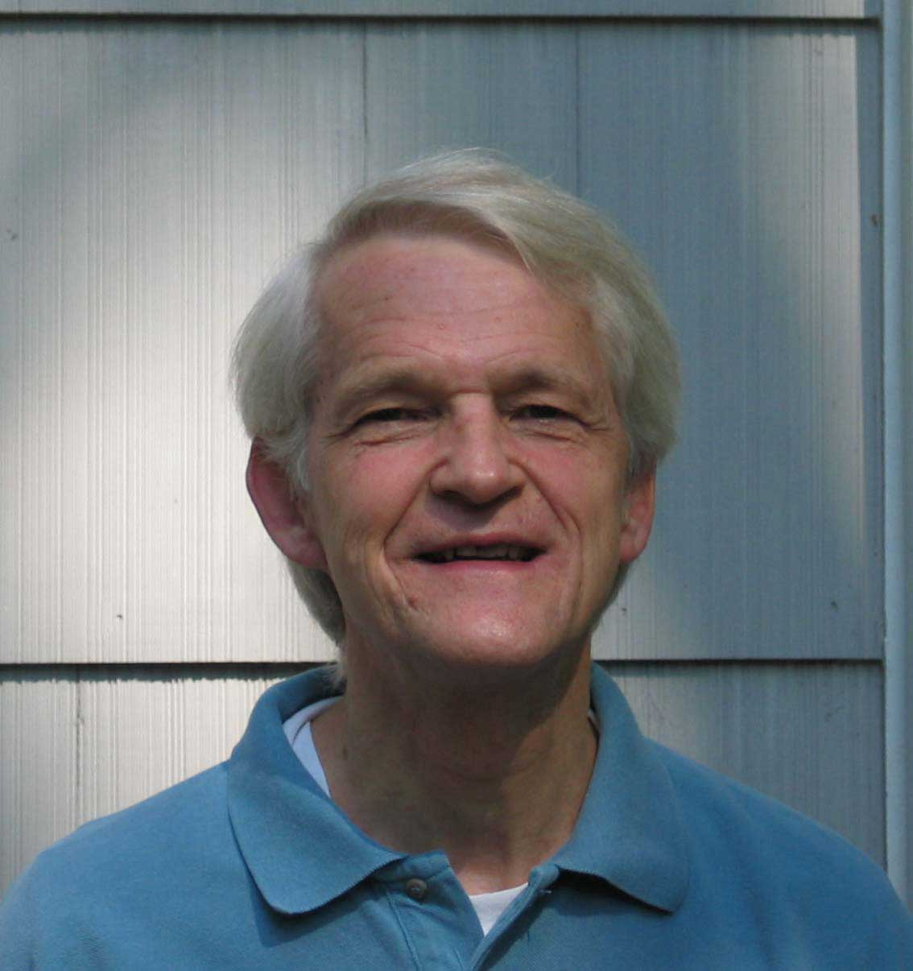
An Interesting Question
How generally applicable is
Backwards approach to PCA?
An Attractive Answer:
James Damon, UNC Mathematics
Geometry
Singularity
Theory

Slide 37
An Interesting Question
How generally applicable is
Backwards approach to PCA?
An Attractive Answer:
James Damon, UNC Mathematics
Damon and Marron (2013)

Slide 38
An Interesting Question
How generally applicable is
Backwards approach to PCA?
An Attractive Answer:
James Damon, UNC Mathematics
Key Idea: Express Backwards PCA as
Nested Series of Constraints

Slide 39
General View of Backwards PCA
Define Nested Spaces via Constraints
Satisfying More Constraints $⇒$
$⇒$ Smaller Subspaces

Slide 40
General View of Backwards PCA
Define Nested Spaces via Constraints
E.g. SVD
(Singular Value Decomposition =
= Not Mean Centered PCA)
(notationally very clean)

Slide 41
General View of Backwards PCA
Define Nested Spaces via Constraints
E.g. SVD
Have $k$ Nested Subspaces:
$$S_{1}⊆S_{2}⊆⋯⊆S_{d}$$

Slide 42
General View of Backwards PCA
Define Nested Spaces via Constraints
E.g. SVD $S_{k}=\left\{x :x=\sum_{j=1}^{k}{c_{j}\vec{u_{j}}}\right\}$
$k$-th SVD Subspace
Scores
Loading Vectors

Slide 43
General View of Backwards PCA
Define Nested Spaces via Constraints
E.g. SVD $S_{k}=\left\{x :x=\sum_{j=1}^{k}{c_{j}\vec{u_{j}}}\right\}$
Now Define:
$$S_{k−1}=\left\{x∈S_{k} :\left\langle x,\vec{u_{k}}\right\rangle =0\right\}$$

Slide 44
General View of Backwards PCA
Define Nested Spaces via Constraints
E.g. SVD $S_{k}=\left\{x :x=\sum_{j=1}^{k}{c_{j}\vec{u_{j}}}\right\}$
Now Define:
$$S_{k−1}=\left\{x∈S_{k} :\left\langle x,\vec{u_{k}}\right\rangle =0\right\}$$
Constraint Gives Nested Reduction of Dim’n

Slide 45
General View of Backwards PCA
Define Nested Spaces via Constraints
Backwards PCA
Reduce Using Affine Constraints

Slide 46
General View of Backwards PCA
Define Nested Spaces via Constraints
Backwards PCA
Principal Nested Spheres
Use Affine Constraints (Planar Slices)
In Ambient Space

Slide 47
General View of Backwards PCA
Define Nested Spaces via Constraints
Backwards PCA
Principal Nested Spheres
Principal Surfaces
Spline Constraint Within Previous?

Slide 48
General View of Backwards PCA
Define Nested Spaces via Constraints
Backwards PCA
Principal Nested Spheres
Principal Surfaces
Spline Constraint Within Previous?
{Been Done Already???}

Slide 49
General View of Backwards PCA
Define Nested Spaces via Constraints
Backwards PCA
Principal Nested Spheres
Principal Surfaces
Other Manifold Data Spaces
Sub-Manifold Constraints??
(Algebraic Geometry)

Slide 50
General View of Backwards PCA
Define Nested Spaces via Constraints
Backwards PCA
Principal Nested Spheres
Principal Surfaces
Other Manifold Data Spaces
Tree Spaces
Suitable Constraints???

Slide 51
New Topic
Curve Registration

Slide 52
Collaborators
Anuj Srivastava (Florida State U.)
Wei Wu (Florida State U.)
Derek Tucker (Florida State U.)
Xiaosun Lu (U. N. C.)
Inge Koch (U. Adelaide)
Peter Hoffmann (U. Adelaide)

Slide 53
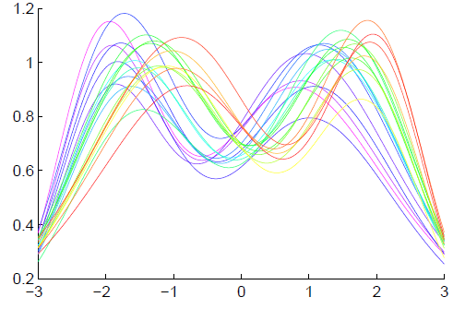
Context
Functional Data Analysis
Curves as Data Objects
Toy Example:

Slide 54
Context
Functional Data Analysis
Curves as Data Objects
Toy Example:
How Can We
Understand
Variation?

Slide 55
Context
Functional Data Analysis
Curves as Data Objects
Toy Example:
How Can We
Understand
Variation?

Slide 56
Context
Functional Data Analysis
Curves as Data Objects
Toy Example:
How Can We
Understand
Variation?

Slide 57
Functional Data Analysis
Insightful
Decomposition

Slide 58
Functional Data Analysis
Insightful
Decomposition
Horiz’l
Var’n

Slide 59
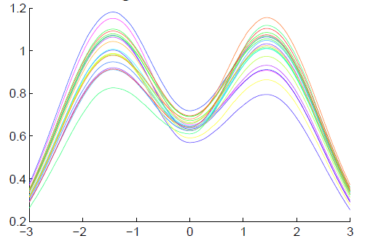
Functional Data Analysis
Insightful
Decomposition
Vertical Variation
Horiz’l
Var’n

Slide 60
Challenge
Fairly Large Literature
Many (Diverse) Past Attempts
Limited Success (in General)
Surprisingly Slippery
(even mathematical formulation)

Slide 61
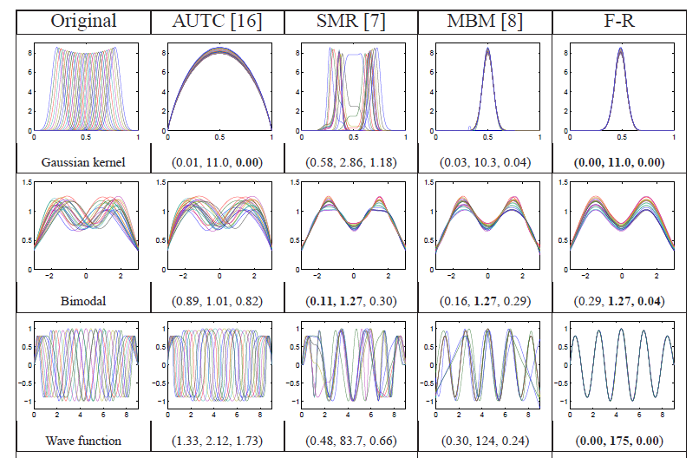
Challenge (Illustrated)
Thanks to Wei Wu

Slide 62
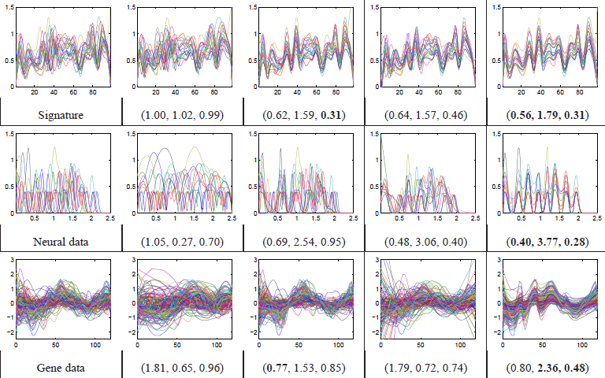
Challenge (Illustrated)
Thanks to Wei Wu

Slide 63
Functional Data Analysis
Appropriate
Mathematical
Framework?
Vertical Variation
Horiz’l
Var’n

Slide 64
Landmark Based Shape Analysis
Approach: Identify objects that are:
Translations
Rotations
Scalings
of each other
Mathematics: Equivalence Relation
Results in: Equivalence Classes
Which become the Data Objects

Slide 65
Landmark Based Shape Analysis
Equivalence Classes become Data Objects
a.k.a. “Orbits”
Mathematics: Called “Quotient Space”
, , , , , ,

Slide 66
Curve Registration
What are the
Data Objects?
Vertical Variation
Horiz’l
Var’n

Slide 67
Curve Registration
What are the Data Objects?
Consider “Time Warpings”
$γ:\left[0,1\right] → [0,1]$ (smooth)
More Precisely: Diffeomorphisms

Slide 68
Curve Registration
Diffeomorphisms
$γ:\left[0,1\right] → [0,1]$
$γ$ is 1 to 1
$γ$ is onto
(thus $γ$ is invertible)
Differentiable
$γ^{−1}$ is Differentiable

Slide 69
Time Warping Intuition
Elastically Stretch & Compress Axis

Slide 70
Time Warping Intuition
Elastically Stretch & Compress Axis
$γ\left(x\right)=x$
(identity)

Slide 71
Time Warping Intuition
Elastically Stretch & Compress Axis
$γ\left(x\right)$

Slide 72
Time Warping Intuition
Elastically Stretch & Compress Axis
$γ\left(x\right)$

Slide 73
Time Warping Intuition
Elastically Stretch & Compress Axis
$γ\left(x\right)$

Slide 74
Curve Registration
Say curves $f_{1}(x)$ and $f_{2}(x)$ are equivalent,
$$f_{1}≈f_{2}$$
When $∃γ$ so that
$$f_{1}\left(γ\left(x\right)\right)=f_{1}∘γ\left(x\right)=f_{2}(x)$$

Slide 75
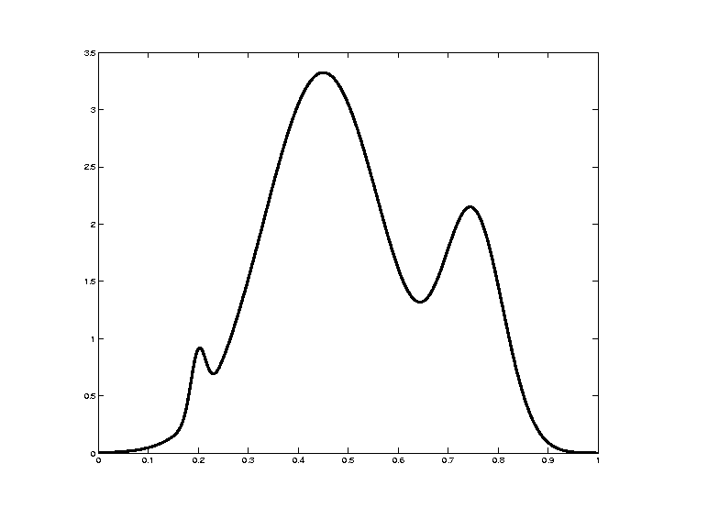
Curve Registration
Toy Example: Starting Curve, $f\left(x\right)$

Slide 76
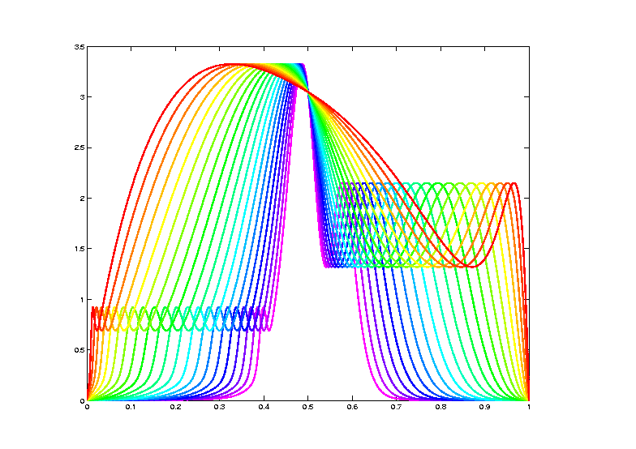
Curve Registration
Toy Example: Equivalent Curves, $\left[f\left(x\right)\right]$

Slide 77
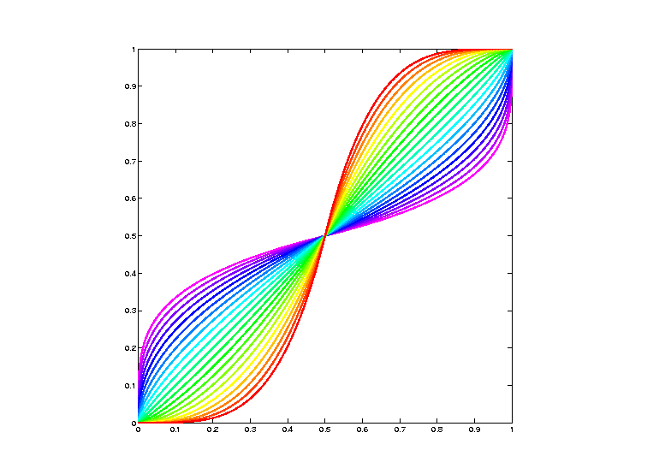
Curve Registration
Toy Example: Warping Functions

Slide 78
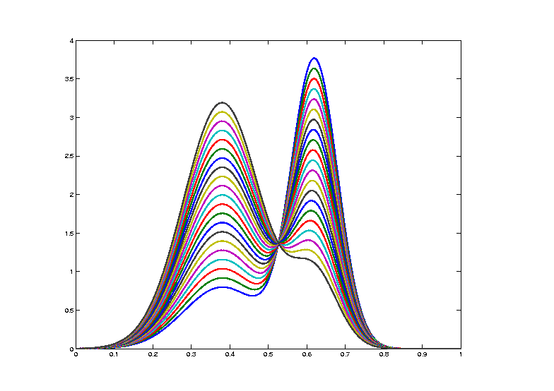
Curve Registration
Toy Example: Non-Equivalent Curves
Cannot
Warp
Into
Each
Other

Slide 79
Data Objects I
Equivalence Classes of Curves
(parallel to Kendall shape analysis)

Slide 80
Data Objects I
Equivalence Classes of Curves
(Set of All
Warps of
Given Curve)
Notation: $\left[f\right]=\left\{f∘γ: γ∈Γ\right\}$
for a “representor” $f\left(x\right)$

Slide 81
Data Objects I
Equivalence Classes of Curves
(Set of All
Warps of
Given Curve)
Next Task:
Find Metric on Equivalence Classes

Slide 82
Metrics in Curve Space
Find Metric on Equivalence Classes
Start with Warp Invariance on Curves
& Extend

Slide 83
Metrics in Curve Space
Traditional Approach to Curve Registration:
Align curves, say $f_{1}$ and $f_{2}$
By finding optimal time warp, $γ$, so:
$$\inf_{γ}\left\|f_{1}−\left(f_{2}∘γ\right)\right\|$$
Vertical var’n: PCA after alignment
Horizontal var’n: PCA on $γ$s

Slide 84
Metrics in Curve Space
Problem:
Don’t have proper metric
Since:
$$d\left(f_{1},f_{2}\right)≠d\left(f_{2},f_{1}\right)$$
Because:
$$\inf_{γ}\left\|f_{1}−\left(f_{2}∘γ\right)\right\|≠\inf_{γ}\left\|f_{2}−\left(f_{1}∘γ\right)\right\|$$

Slide 85
Metrics in Curve Space
$$\inf_{γ}\left\|f_{1}−\left(f_{2}∘γ\right)\right\|≠\inf_{γ}\left\|f_{2}−\left(f_{1}∘γ\right)\right\|$$
Thanks to
Xiaosun Lu

Slide 86
Metrics in Curve Space
$$\inf_{γ}\left\|f_{1}−\left(f_{2}∘γ\right)\right\|≠\inf_{γ}\left\|f_{2}−\left(f_{1}∘γ\right)\right\|$$
Note:
Very
Different
L² norms
Thanks to
Xiaosun Lu

