Slide 1
Shapes As Data Objects
Common Property of Shape Data Objects:
Natural Feature Space is Curved
I.e. a Manifold (from Differential Geometry)

Slide 2
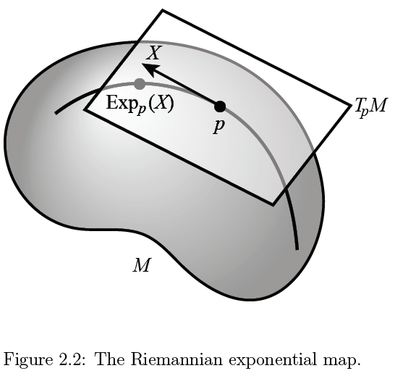
Manifold Feature Spaces
Important Mappings:
Plane → Surface:
$\exp_{p}$
Surface → Plane
$\log_{p}$

Slide 3
Manifold Feature Spaces
Standard Statistical Example:
Directional Data (aka Circular Data)
Idea: Angles as Data Objects
Wind Directions
Magnetic Compass Headings
Cracks in Mines

Slide 4
Manifold Feature Spaces
Standard Statistical Example:
Directional Data (aka Circular Data)
Reasonable View:
Points on Unit Circle

Slide 5
Manifold Feature Spaces
Geodesics:
Idea:
March Along Manifold Without Turning
(Defined in Tangent Plane)

Slide 6
Manifold Feature Spaces
Geodesic Distance:
Given Points $x$ & $y$, define
$$d\left(x,y\right)=\min_{g:geodesic from x to y}{length(g)}$$
Can Show:
$d$ is a metric (distance)

Slide 7
Manifold Feature Spaces
Fréchet Mean of Numbers:
Fréchet Mean in Euclidean Space ($ℝ^{d}$):
Fréchet Mean on a Manifold:
Replace Euclidean by Geodesic

Slide 8
OODA in Image Analysis
First Generation Problems:
Denoising
Segmentation
Registration
(all about single images,
still interesting challenges)

Slide 9
OODA in Image Analysis
Second Generation Problems:
Populations of Images
Understanding Population Variation
Discrimination (a.k.a. Classification)
Complex Data Structures (& Spaces)
HDLSS Statistics

Slide 10
Image Object Representation
Major Approaches for Image Data Objects:
Landmark Representations
Boundary Representations
Medial Representations

Slide 11
Medial Representations
Main Idea:
Represent Objects as:
Discretized skeletons (medial atoms)
Plus spokes from center to edge
Which imply a boundary
Very accessible early reference:
Yushkevich, et al (2001)

Slide 12
Medial Representations
2-d M-Rep Example:
Corpus Callosum
(Yushkevich)
Notes:
CCMsciznormRaw.avi

Slide 13
A Challenging Example
Male Pelvis
Bladder – Prostate – Rectum
How do they move over time (days)?
Critical to Radiation Treatment (cancer)
Work with 3-d CT
Very Challenging to Segment
Find boundary of each object?
Represent each Object?

Slide 14
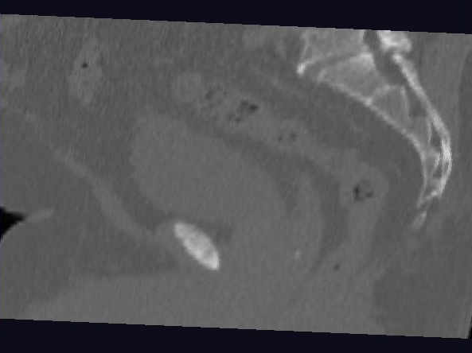
Male Pelvis – Raw Data
One CT Slice
(in 3d image)
Tail Bone
Rectum
Bladder
Prostate

Slide 15
3-d m-reps
Bladder – Prostate – Rectum (multiple objects, J. Y. Jeong)
Medial Atoms provide “skeleton”
Implied Boundary from “spokes” → “surface”

Slide 16
3-d m-reps
M-rep model fitting
Easy, when starting from binary (blue)
But very expensive (30 – 40 minutes technician’s time)
Want automatic approach
Challenging, because of poor contrast, noise, …
Need to borrow information across training sample
Use Bayes approach: prior & likelihood → posterior
~Conjugate Gaussians, but there are issues:
Major HLDSS challenges
Manifold aspect of data

Slide 17
Mildly Non-Euclidean Spaces
Statistical Analysis of M-rep Data
Recall: Many direct products of:
Locations
Radii
Angles
I.e. points on smooth manifold
Data in non-Euclidean Space
But only mildly non-Euclidean

Slide 18
PCA for m-reps, II
PCA on non-Euclidean spaces?
(i.e. on Lie Groups / Symmetric Spaces)
T. Fletcher: Principal Geodesic Analysis
Idea: replace “linear summary of data”
With “geodesic summary of data”…

Slide 19
PCA Extensions for Data on Manifolds
Fletcher (Principal Geodesic Anal.)
Best fit of geodesic to data
Constrained to go through geodesic mean
Happens mean
Naturally contained
in $ℝ^{d}$ in best
fit line

Slide 20
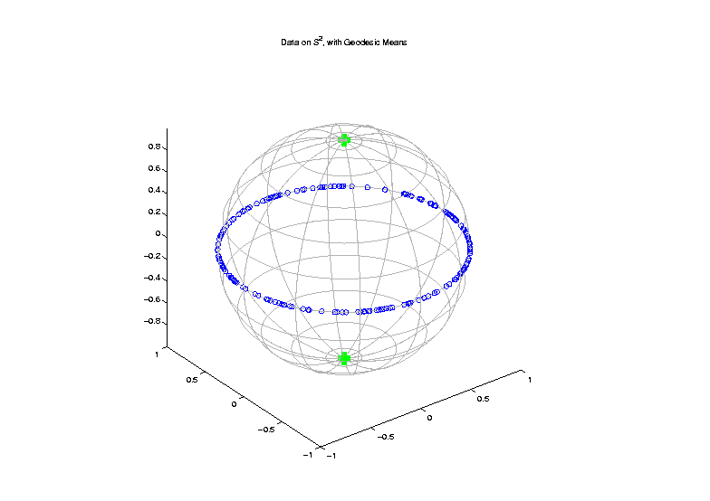
PCA Extensions for Data on Manifolds
Fletcher (Principal Geodesic Anal.)
Best fit of geodesic to data
Constrained to go through geodesic mean
Counterexample:
Data on sphere,
along equator

Slide 21
PCA Extensions for Data on Manifolds
Fletcher (Principal Geodesic Anal.)
Best fit of geodesic to data
Constrained to go through geodesic mean
Huckemann, Hotz & Munk (Geod. PCA)
Best fit of any geodesic to data

Slide 22
PCA Extensions for Data on Manifolds
Fletcher (Principal Geodesic Anal.)
Best fit of geodesic to data
Constrained to go through geodesic mean
Huckemann, Hotz & Munk (Geod. PCA)
Best fit of any geodesic to data
Counterexample:
Data follows Tropic of Capricorn

Slide 23
PCA Extensions for Data on Manifolds
Fletcher (Principal Geodesic Anal.)
Best fit of geodesic to data
Constrained to go through geodesic mean
Huckemann, Hotz & Munk (Geod. PCA)
Best fit of any geodesic to data
Jung, Foskey & Marron (Princ. Arc Anal.)
Best fit of any circle to data
(motivated by conformal maps)

Slide 24
PCA Extensions for Data on Manifolds

Slide 25
Principal Arc Analysis
Jung, Foskey & Marron (2011)
Best fit of any circle to data
Can give better fit than geodesics

Slide 26
Principal Arc Analysis
Jung, Foskey & Marron (2011)
Best fit of any circle to data
Can give better fit than geodesics
Observed for simulated m-rep example

Slide 27
Challenge being addressed

Slide 28
Composite Principal Nested Spheres
Idea: Use Principal Arc Analysis
Over Large Products of $S^{2}$ and $ℝ^{d}$

Slide 29
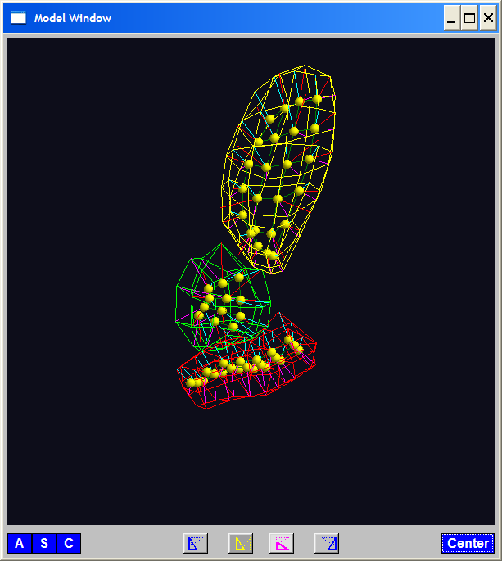
Composite Principal Nested Spheres
Idea: Use Principal Arc Analysis
Over Large Products of $S^{2}$ and $ℝ^{d}$
Motivation:
m-reps
&
s-reps

Slide 30
Composite Principal Nested Spheres
Idea: Use Principal Arc Analysis
Over Large Products of $S^{2}$ and $ℝ^{d}$
Approach: Use Principal Arc Analysis
to Linearize $S^{2}$ Components

Slide 31
Composite Principal Nested Spheres
Idea: Use Principal Arc Analysis
Over Large Products of $S^{2}$ and $ℝ^{d}$
Approach: Use Principal Arc Analysis
to Linearize $S^{2}$ Components
Then Concatenate All & Use PCA

Slide 32
Composite Principal Nested Spheres
Idea: Use Principal Arc Analysis
Over Large Products of $S^{2}$ and $ℝ^{d}$
Approach: Use Principal Arc Analysis
to Linearize $S^{2}$ Components
Then Concatenate All & Use PCA
HDLSS asymptotics?
(When have many s-rep atoms?)

Slide 33
Composite Principal Nested Spheres
HDLSS asymptotics?
Simple Case: $S^{2}×S^{2}×⋯×S^{2}$
$d$

Slide 34
Composite Principal Nested Spheres
HDLSS asymptotics?
Simple Case: $S^{2}×S^{2}×⋯×S^{2}$
Study $\lim_{d→∞}{}$
Get Geometric Representation?

Slide 35
Composite Principal Nested Spheres
HDLSS asymptotics?
Simple Case: $S^{2}×S^{2}×⋯×S^{2}$
Study $\lim_{d→∞}{}$
Get Geometric Representation?
Distances $\sim d^{\frac{1}{2}}$
Random ~ Rotation
Modulo Rotation → Unit Simplex $×d^{\frac{1}{2}}$

Slide 36
Composite Principal Nested Spheres
HDLSS asymptotics?
Simple Case: $S^{2}×S^{2}×⋯×S^{2}$
Study $\lim_{d→∞}{}$
Get Geometric Representation?
Apparent Challenge: $S^{2}$ is Bounded
(So Can’t Have Distances ${\sim d}^{\frac{1}{2}}→∞$???)

Slide 37
Composite Principal Nested Spheres
HDLSS asymptotics?
Simple Case: $S^{2}×S^{2}×⋯×S^{2}$
Study $\lim_{d→∞}{}$
Get Geometric Representation?
Apparent Challenge: $S^{2}$ is Bounded
(So Can’t Have Distances ${\sim d}^{\frac{1}{2}}→∞$???)
Careful, Have Big Product of $S^{2}$s

Slide 38
Composite Principal Nested Spheres
HDLSS asymptotics?
Even Simpler (But Bounded) Case: $\left[0,1\right]×\left[0,1\right]×⋯×\left[0,1\right]$
Unit Cube in $ℝ^{d},$Study $\lim_{d→∞}{}$

Slide 39
Composite Principal Nested Spheres
HDLSS asymptotics?
Even Simpler (But Bounded) Case: $\left[0,1\right]×\left[0,1\right]×⋯×\left[0,1\right]$
Unit Cube in $ℝ^{d},$Study $\lim_{d→∞}{}$
Diagonal Length = $d^{\frac{1}{2}}$

Slide 40
Composite Principal Nested Spheres
HDLSS asymptotics?
Even Simpler (But Bounded) Case: $\left[0,1\right]×\left[0,1\right]×⋯×\left[0,1\right]$
Unit Cube in $ℝ^{d},$Study $\lim_{d→∞}{}$
Diagonal Length = $d^{\frac{1}{2}}$
Length Between Random Points $\sim d^{\frac{1}{2}}$

Slide 41
Composite Principal Nested Spheres
HDLSS asymptotics?
Even Simpler (But Bounded) Case: $\left[0,1\right]×\left[0,1\right]×⋯×\left[0,1\right]$
Unit Cube in $ℝ^{d},$Study $\lim_{d→∞}{}$
Diagonal Length = $d^{\frac{1}{2}}$
Length Between Random Points $\sim d^{\frac{1}{2}}$
Note: # Edges $\sim 2d$, # Diagonals $\sim 2^{d}$

Slide 42
Composite Principal Nested Spheres
HDLSS asymptotics?
Even Simpler (But Bounded) Case: $\left[0,1\right]×\left[0,1\right]×⋯×\left[0,1\right]$
Unit Cube in $ℝ^{d},$Study $\lim_{d→∞}{}$
Diagonal Length = $d^{\frac{1}{2}}$
Length Between Random Points $\sim d^{\frac{1}{2}}$
Note: # Edges $\sim 2d$, # Diagonals $\sim 2^{d}$

Slide 43
Composite Principal Nested Spheres
HDLSS asymptotics?
Even Simpler (But Bounded) Case: $\left[0,1\right]×\left[0,1\right]×⋯×\left[0,1\right]$
Unit Cube in $ℝ^{d},$Study $\lim_{d→∞}{}$
Diagonal Length = $d^{\frac{1}{2}}$
Length Between Random Points $\sim d^{\frac{1}{2}}$
Get Similar Geometric Representation

Slide 44
Composite Principal Nested Spheres
HDLSS asymptotics?
Simple Case: $S^{2}×S^{2}×⋯×S^{2}$
Study $\lim_{d→∞}{}$
Get Geometric Representation?

Slide 45
Composite Principal Nested Spheres
HDLSS asymptotics?
Simple Case: $S^{2}×S^{2}×⋯×S^{2}$
Study $\lim_{d→∞}{}$
Get Geometric Representation?
Yes, Sen et al (2008)

Slide 46
Composite Principal Nested Spheres
HDLSS asymptotics?
Simple Case: $S^{2}×S^{2}×⋯×S^{2}$
Study $\lim_{d→∞}{}$
Get Geometric Representation?
Consistency of CPNS???
(Open Problem)

Slide 47
Landmark Based Shape Analysis
Kendall
Bookstein
Dryden &
Mardia
(recall major monographs)

Slide 48
Landmark Based Shape Analysis
Kendall
Bookstein
Dryden &
Mardia
Digit 3 Data

Slide 49
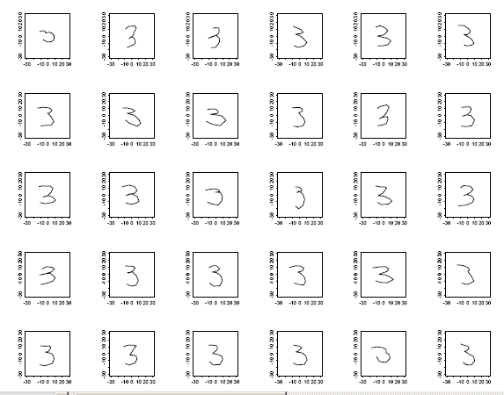
Landmark Based Shape Analysis
Kendall
Bookstein
Dryden &
Mardia
Digit 3 Data

Slide 50
Landmark Based Shape Analysis
Kendall
Bookstein
Dryden &
Mardia
Digit 3 Data
(digitized to 13 landmarks)

Slide 51
Landmark Based Shape Analysis
Key Step: mod out
Translation
Scaling
Rotation

Slide 52
Variation on Landmark Based Shape
Recall Main Idea:
Represent Shapes as Coordinates
“Mod Out” Transl’n, Rotat’n, Scale

Slide 53
Variation on Landmark Based Shape
Typical Viewpoint:
Variation in Shape is Goal
Other Variation+ is Nuisance
Recall Main Idea:
Represent Shapes as Coordinates
“Mod Out” Transl’n, Rotat’n, Scale

Slide 54
Variation on Landmark Based Shape
Typical Viewpoint:
Variation in Shape is Goal
Other Variation+ is Nuisance
Interesting Alternative:
Study Variation in Transformation
Treat Shape as Nuisance

Slide 55
Variation on Landmark Based Shape
Context: Study of Tectonic Plates
Movement of Earth’s Crust (over time)
Take Motions as Data Objects
Interesting Alternative:
Study Variation in Transformation
Treat Shape as Nuisance

Slide 56
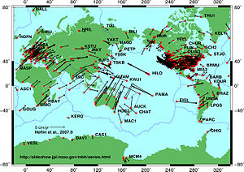
Variation on Landmark Based Shape
Context: Study of Tectonic Plates
Movement of Earth’s Crust (over time)
Take Motions as Data Objects
Royer & Chang (1991)
Thanks to Wikipedia

Slide 57
Landmark Based Shape Analysis
Kendall
Bookstein
Dryden &
Mardia
Digit 3 Data

Slide 58
Landmark Based Shape Analysis
Key Step: mod out
Translation
Scaling
Rotation
Result:
Data Objects ←→
←→ points on Manifold ( ~ S^{2k-4})

Slide 59
Landmark Based Shape Analysis
Currently popular approaches to PCA on S^{k}:
Early: PCA on projections
(Tangent Plane Analysis)

Slide 60
Landmark Based Shape Analysis
Currently popular approaches to PCA on S^{k}:
Early: PCA on projections
Fletcher: Geodesics through mean

Slide 61
Landmark Based Shape Analysis
Currently popular approaches to PCA on S^{k}:
Early: PCA on projections
Fletcher: Geodesics through mean
Huckemann, et al: Any Geodesic

Slide 62
Landmark Based Shape Analysis
Currently popular approaches to PCA on S^{k}:
Early: PCA on projections
Fletcher: Geodesics through mean
Huckemann, et al: Any Geodesic
New Approach:
Principal Nested Sphere Analysis
Jung, Dryden & Marron (2012)

Slide 63
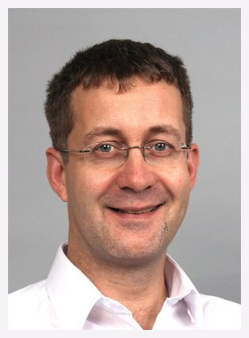
Principal Nested Spheres Analysis
Main Goal:
Extend Principal Arc Analysis (S² to S^{k})
Jung, Dryden & Marron (2012)

Slide 64
Principal Nested Spheres Analysis
Main Goal:
Extend Principal Arc Analysis (S² to S^{k})

Slide 65
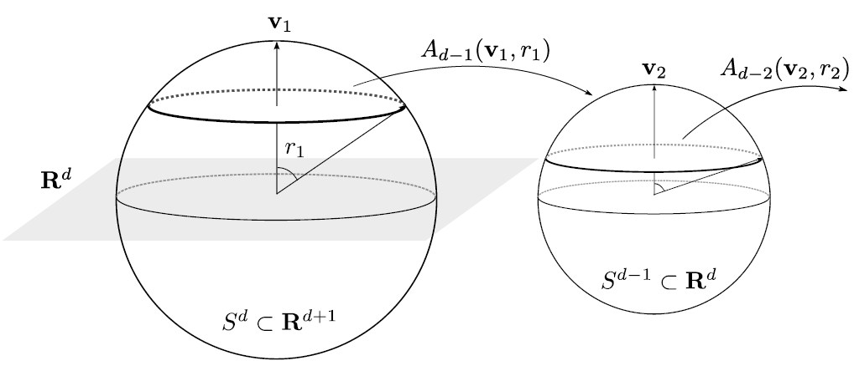
Principal Nested Spheres Analysis
Top Down Nested (small) spheres

Slide 66
Digit 3 data: Principal variations of the shape
Princ. geodesics by PNS
Principal arcs by PNS

