Slide 1
Independent Component Analysis
Personal Viewpoint:
Directions that maximize independence
Motivating Context: Signal Processing
“Blind Source Separation”

Slide 2
More ICA Examples
FDA example – Parabolas Up and Down
ICA Solution 2:
Use Multiple Random Starts
Shows When Have Multiple Minima
Range Should Turn Up Good Directions
More to Look At / Interpret

Slide 3
ICA Overview
Interesting Method, has Potential
Great for Directions of Non-Gaussianity
E.g. Finding Outliers
Common Application Area: FMRI
Has Its Costs
Slippery Optimization
Interpetation Challenges

Slide 4
Aside on Terminology
Personal suggestion:
High Dimension Low Sample Size (HDLSS)
Dimension: d
Sample size n
Versus: “Small n, large p”
Why p? (parameters??? predictors???)
Only because of statistical tradition…

Slide 5
HDMSS, Fan View
Asymptotics: $d,n→∞$ $d≫n$
“Ultra High Dimension” (Fan & Lv 2008):
Driver: $n→∞$
(Classical Viewpoint)
Follower: $d \sim e^{n}$
(Perhaps Impressive?)

Slide 6
HDMSS, Aoshima View
Asymptotics: $d,n→∞$ $d≫n$
Driver: $d→∞$
(New Viewpoint)
Follower: $n \sim log⁡(d)$
(Mathematically Equivalent?)

Slide 7
HDMSS, Personal Choice
Aoshima View:
Driver: $d→∞$
Follower: $n \sim log⁡(d)$
Since this allows easy interface with HDLSS:
$d→∞$, with $n$ fixed

Slide 8
Shapes As Data Objects
Several Different Notions of Shape
Oldest and Best Known (in Statistics):
Landmark Based

Slide 9
Landmark Based Shape Analysis
Start by Representing Shapes by
Landmarks (points in R² or R³)
$$\left(x_{1},y_{1}\right)$$
$$\left(x_{2},y_{2}\right)$$
$$\left(x_{3},y_{3}\right)$$

Slide 10
Landmark Based Shape Analysis
Approach: Identify objects that are:
Translations
Rotations
Scalings
of each other

Slide 11
Landmark Based Shape Analysis
Approach: Identify objects that are:
Translations
Rotations
Scalings
of each other
Mathematics: Equivalence Relation
Results in: Equivalence Classes (orbits)
Which become the Data Objects

Slide 12
Landmark Based Shape Analysis
Equivalence Classes become Data Objects
Mathematics: Called “Quotient Space”
Intuitive Representation: Manifold
(curved surface)
, , , , , ,

Slide 13
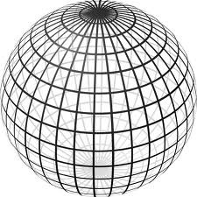
Landmark Based Shape Analysis
Triangle Shape Space: Represent as Sphere:
R⁶ → R⁴ → R³ →
scaling
(thanks to Wikipedia)
, , , , , ,

Slide 14
Shapes As Data Objects
Common Property of Shape Data Objects:
Natural Feature Space is Curved
I.e. a Manifold (from Differential Geometry)

Slide 15
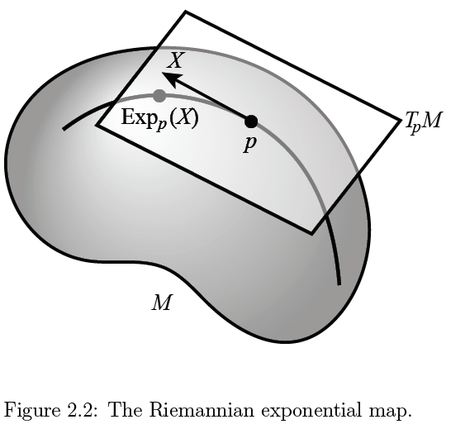
Manifold Feature Spaces
Important Mappings:
Plane → Surface:
$\exp_{p}$

Slide 16
Manifold Feature Spaces
Important Mappings:
Plane → Surface:
$\exp_{p}$
Important Point:
Common Length
(along surface)

Slide 17
Manifold Feature Spaces
Important Mappings:
Plane → Surface:
$\exp_{p}$
Surface → Plane
$\log_{p}$

Slide 18
Manifold Feature Spaces
Log & Exp Memory Device:
Complex Numbers
Exponential:
Tangent Plane → Manifold

Slide 19
Manifold Feature Spaces
Log & Exp Memory Device:
Complex Numbers
Exponential:
Tangent Plane → Manifold
Logarithm:
Manifold → Tangent Plane

Slide 20
Manifold Feature Spaces
Standard Statistical Example:
Directional Data (aka Circular Data)
Idea: Angles as Data Objects
Wind Directions
Magnetic Compass Headings
Cracks in Mines

Slide 21
Manifold Feature Spaces
Standard Statistical Example:
Directional Data (aka Circular Data)
Reasonable View:
Points on Unit Circle

Slide 22
Manifold Feature Spaces
Fréchet Mean of Numbers:
Fréchet Mean in Euclidean Space ($ℝ^{d}$):
Fréchet Mean on a Manifold:
Replace Euclidean by Geodesic

Slide 23
Manifold Feature Spaces
Geodesics:
Idea:
March Along Manifold Without Turning
(Defined in Tangent Plane)

Slide 24
Manifold Feature Spaces
Geodesics:
Idea:
March Along Manifold Without Turning
(Defined in Tangent Plane)
E.g. Surface of the Earth: Great Circle
E.g. Lines of Longitude (Not Latitude…)

Slide 25
Manifold Feature Spaces
Geodesic Distance:
Given Points $x$ & $y$, define
$$d\left(x,y\right)=\min_{g:geodesic from x to y}{length(g)}$$

Slide 26
Manifold Feature Spaces
Geodesic Distance:
Given Points $x$ & $y$, define
$$d\left(x,y\right)=\min_{g:geodesic from x to y}{length(g)}$$
Can Show:
$d$ is a metric (distance)

Slide 27
Manifold Feature Spaces
Fréchet Mean of Numbers:
Fréchet Mean in Euclidean Space ($ℝ^{d}$):
Fréchet Mean on a Manifold:
Replace Euclidean by Geodesic

Slide 28
Manifold Feature Spaces
Fréchet Mean of Numbers:
Well Known in Robust Statistics:
Replace Euclidean Distance
With Robust Distance, e.g. $L^{2}$ with $L^{1}$
Reduces Influence of Outliers
Gives Other Notions of Robust Median

Slide 29
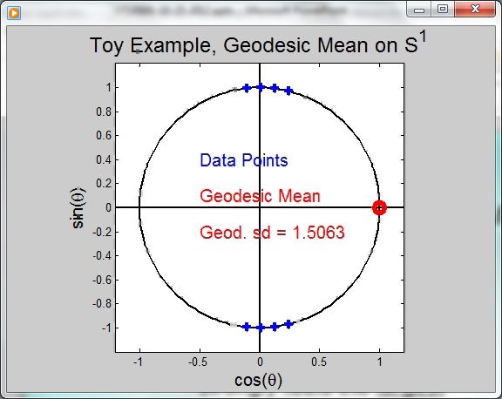
Manifold Feature Spaces
Directional Data Examples of Fréchet Mean:
Not always easily interpretable

Slide 30
Manifold Feature Spaces
Directional Data Examples of Fréchet Mean:
Not always easily interpretable
Think about distances along arc
Not about “points in $ℝ^{2}$”
Sum of squared distances
strongly feels the largest
Not always unique
But unique with probability one
Non-unique requires strong symmetry
But possible to have many means

Slide 31
Manifold Feature Spaces
Directional Data Examples of Fréchet Mean:
Not always sensible notion of center

Slide 32
Manifold Feature Spaces
Directional Data Examples of Fréchet Mean:
Not always sensible notion of center
Sometimes prefer top & bottom?
At end: farthest points from data
Not continuous Function of Data
Jump from 1 – 2
Jump from 2 – 8
All False for Euclidean Mean
But all happen generally for Manifold Data

Slide 33
Manifold Feature Spaces
Directional Data Examples of Fréchet Mean:
Also of interest is Fréchet Variance:
Works like Euclidean sample variance

Slide 34
Manifold Feature Spaces
Directional Data Examples of Fréchet Mean:
Also of interest is Fréchet Variance:
Works like Euclidean sample variance
Note values in movie, reflecting spread in data

Slide 35
Manifold Feature Spaces
Directional Data Examples of Fréchet Mean:
Also of interest is Fréchet Variance:
Works like Euclidean sample variance
Note values in movie, reflecting spread in data
Note theoretical version:
Useful for Laws of Large Numbers, etc.

Slide 36
OODA in Image Analysis
First Generation Problems

Slide 37
OODA in Image Analysis
First Generation Problems:
Denoising
(extract signal from noise)

Slide 38
OODA in Image Analysis
First Generation Problems:
Denoising
Segmentation
(find object boundary)

Slide 39
OODA in Image Analysis
First Generation Problems:
Denoising
Segmentation
Registration
(align same object in 2 images)

Slide 40
OODA in Image Analysis
First Generation Problems:
Denoising
Segmentation
Registration
(all about single images,
still interesting challenges)

Slide 41
OODA in Image Analysis
Second Generation Problems:
Populations of Images

Slide 42
OODA in Image Analysis
Second Generation Problems:
Populations of Images
Understanding Population Variation
Discrimination (a.k.a. Classification)

Slide 43
OODA in Image Analysis
Second Generation Problems:
Populations of Images
Understanding Population Variation
Discrimination (a.k.a. Classification)
Complex Data Structures (& Spaces)

Slide 44
OODA in Image Analysis
Second Generation Problems:
Populations of Images
Understanding Population Variation
Discrimination (a.k.a. Classification)
Complex Data Structures (& Spaces)
HDLSS Statistics

Slide 45
Image Object Representation
Major Approaches for Image Data Objects:
Landmark Representations
Boundary Representations
Medial Representations

Slide 46
Landmark Representations
Landmarks for Fly Wing Data:
Thanks to George Gilchrist

Slide 47
Landmark Representations
Major Drawback of Landmarks:
Need to always find each landmark
Need same relationship

Slide 48
Landmark Representations
Major Drawback of Landmarks:
Need to always find each landmark
Need same relationship
I.e. Landmarks need to correspond

Slide 49
Landmark Representations
Major Drawback of Landmarks:
Need to always find each landmark
Need same relationship
I.e. Landmarks need to correspond
Often fails for medical images
E.g. How many corresponding landmarks on a set of kidneys, livers or brains???

Slide 50
Boundary Representations
Traditional Major Sets of Ideas:
Triangular Meshes
Survey: Owen (1998)

Slide 51
Boundary Representations
Traditional Major Sets of Ideas:
Triangular Meshes
Survey: Owen (1998)
Active Shape Models
Cootes, et al (1993)

Slide 52
Boundary Representations
Traditional Major Sets of Ideas:
Triangular Meshes
Survey: Owen (1998)
Active Shape Models
Cootes, et al (1993)
Fourier Boundary Representations
Keleman, et al (1997 & 1999)

Slide 53
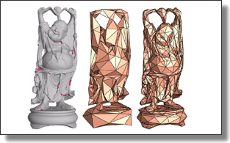
Boundary Representations
Example of triangular mesh rep’n:
From:www.geometry.caltech.edu/pubs.html

Slide 54
Boundary Representations
Main Drawback:
Correspondence
For OODA (on vectors of parameters):
Need to “match up points”
Notes:
54

Slide 55
Boundary Representations
Main Drawback:
Correspondence
For OODA (on vectors of parameters):
Need to “match up points”
Easy to find triangular mesh
Lots of research on this driven by gamers
Notes:
55

Slide 56
Boundary Representations
Main Drawback:
Correspondence
For OODA (on vectors of parameters):
Need to “match up points”
Easy to find triangular mesh
Lots of research on this driven by gamers
Challenge to match mesh across objects
There are some interesting ideas…
Notes:
56

Slide 57
Boundary Representations
Correspondence for Mesh Objects:
Active Shape Models (PCA – like)
Notes:
57

Slide 58
Boundary Representations
Correspondence for Mesh Objects:
Active Shape Models (PCA – like)
Automatic Landmark Choice
Cates, et al (2007)
Based on Optimization Problem:
Good Correspondence & Separation
(Formulate via Entropy)
Notes:
58

Slide 59
Medial Representations
Main Idea

Slide 60
Medial Representations
Main Idea:
Represent Objects as:
Discretized skeletons (medial atoms)

Slide 61
Medial Representations
Main Idea:
Represent Objects as:
Discretized skeletons (medial atoms)
Plus spokes from center to edge
Which imply a boundary

Slide 62
Medial Representations
Main Idea:
Represent Objects as:
Discretized skeletons (medial atoms)
Plus spokes from center to edge
Which imply a boundary
Very accessible early reference:
Yushkevich, et al (2001)

Slide 63
Medial Representations
2-d M-Rep Example:
Corpus Callosum
(Yushkevich)
Notes:
CCMsciznormRaw.avi

Slide 64
Medial Representations
2-d M-Rep Example:
Corpus Callosum
(Yushkevich)
Atoms
Notes:
CCMsciznormRaw.avi

Slide 65
Medial Representations
2-d M-Rep Example:
Corpus Callosum
(Yushkevich)
Atoms
Spokes
Notes:
CCMsciznormRaw.avi

Slide 66
Medial Representations
2-d M-Rep Example:
Corpus Callosum
(Yushkevich)
Atoms
Spokes
Implied
Boundary
Notes:
CCMsciznormRaw.avi

Slide 67
Medial Representations
3-d M-Rep Example: From Ja-Yeon Jeong
Bladder – Prostate - Rectum
Notes:
OODA.ppt

Slide 68
Medial Representations
3-d M-Rep Example: From Ja-Yeon Jeong
Bladder – Prostate - Rectum
In Male Pelvis
Valve on Bladder
Notes:
OODA.ppt

Slide 69
Medial Representations
3-d M-Rep Example: From Ja-Yeon Jeong
Bladder – Prostate - Rectum
In Male Pelvis
Valve on Bladder
Common Area for Cancer in Males
Notes:
OODA.ppt

Slide 70
Medial Representations
3-d M-Rep Example: From Ja-Yeon Jeong
Bladder – Prostate - Rectum
In Male Pelvis
Valve on Bladder
Common Area for Cancer in Males
Goal: Design Radiation Treatment
Hit Prostate
Miss Bladder & Rectum
Notes:
OODA.ppt

Slide 71
Medial Representations
3-d M-Rep Example: From Ja-Yeon Jeong
Bladder – Prostate - Rectum
In Male Pelvis
Valve on Bladder
Common Area for Cancer in Males
Goal: Design Radiation Treatment
Hit Prostate
Miss Bladder & Rectum
Over Course of Many Days
Notes:
OODA.ppt

Slide 72
Medial Representations
3-d M-Rep Example: From Ja-Yeon Jeong
Bladder – Prostate - Rectum
Atoms (yellow dots)
Notes:
OODA.ppt

Slide 73
Medial Representations
3-d M-Rep Example: From Ja-Yeon Jeong
Bladder – Prostate - Rectum
Atoms - Spokes (line segments)
Notes:
OODA.ppt

Slide 74
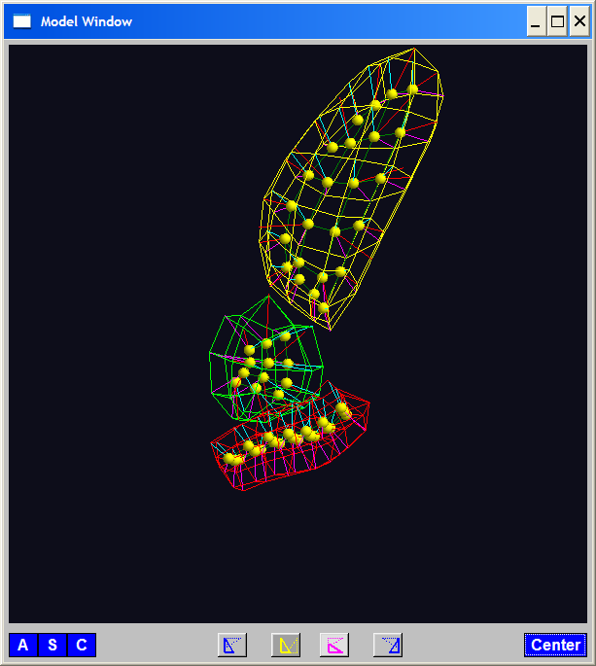
Medial Representations
3-d M-Rep Example: From Ja-Yeon Jeong
Bladder – Prostate - Rectum
Atoms - Spokes - Implied Boundary
Notes:
OODA.ppt

Slide 75
Medial Representations
3-d M-Rep Example: From Ja-Yeon Jeong
Bladder – Prostate - Rectum
Atoms - Spokes - Implied Boundary
Notes:
OODA.ppt

Slide 76
Medial Representations
3-d M-reps: there are several variations
Two choices:
From
Fletcher
(2004)
Notes:
fletcher_thesis.pdf

Slide 77
Medial Representations
Detailed discussion of M-reps:
Siddiqi, K. and Pizer, S. M. (2008)
Notes:
fletcher_thesis.pdf

Slide 78
Medial Representations
Statistical Challenge
M-rep parameters are:
Locations
Radii
Angles (not comparable)

Slide 79
Medial Representations
Statistical Challenge
M-rep parameters are:
Locations
Radii
Angles (not comparable)
Stuffed into a long vector
I.e. many direct products of these

Slide 80
Medial Representations
Statistical Challenge
Many direct products of:
Locations
Radii
Angles (not comparable)
Appropriate View:
Data Lie on Curved Manifold
Embedded in higher dim’al Eucl’n Space

