Slide 1
SigClust Gaussian null distribution - Simulation
Now simulate from null distribution using:
where (indep.)
Again rotation invariance makes this work
(and location invariance)

Slide 2
SigClust Gaussian null distribution - Simulation
Then compare data CI,
With simulated null population CIs
Spirit similar to DiProPerm
But now significance happens for
smaller values of CI

Slide 3
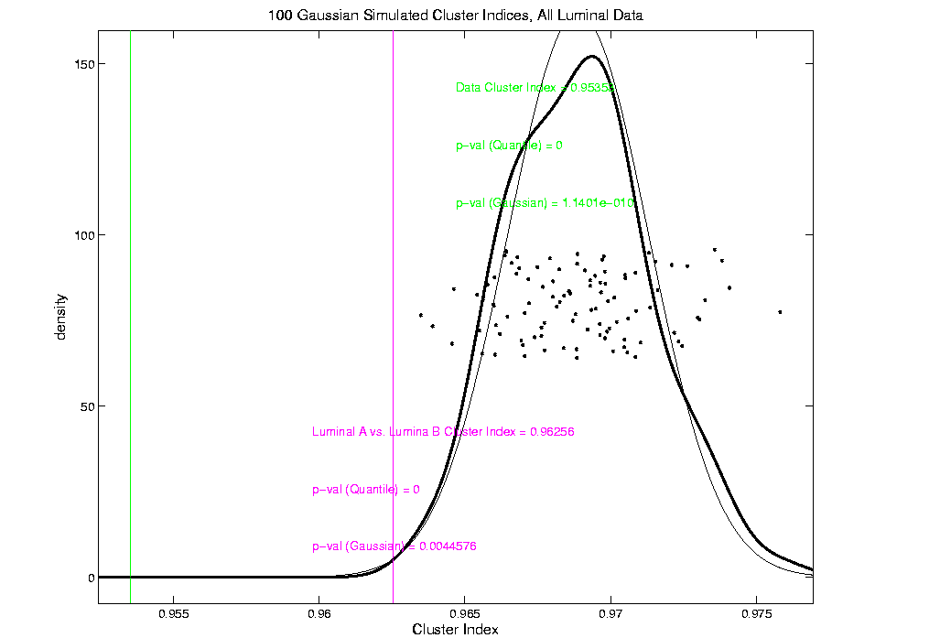
An example (details to follow)
P-val = 0.0045

Slide 4
SigClust Real Data Results
Summary of Perou 500 SigClust Results:
Lum & Norm vs. Her2 & Basal, p-val = 10⁻¹⁹
Luminal A vs. B, p-val = 0.0045
Her 2 vs. Basal, p-val = 10⁻¹⁰
Split Luminal A, p-val = 10⁻⁷
Split Luminal B, p-val = 0.058
Split Her 2, p-val = 0.10
Split Basal, p-val = 0.005

Slide 5
HDLSS Asymptotics
Modern Mathematical Statistics:
Based on asymptotic analysis
I.e. Uses limiting operations
Almost always
Occasional misconceptions:
  Indicates behavior for large samples
  Thus only makes sense for “large” samples
  Models phenomenon of “increasing data”
  So other flavors are useless???
Notes:
5

Slide 6
HDLSS Asymptotics
Modern Mathematical Statistics:
Based on asymptotic analysis
Real Reasons:
  Approximation provides insights
  Can find simple underlying structure
  In complex situations
Thus various flavors are fine:
Even desirable! (find additional insights)
Notes:
6

Slide 7
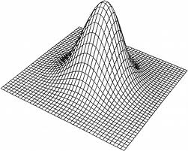
HDLSS Asymptotics: Simple Paradoxes
For dim’al Standard Normal dist’n:
Where are Data?
Near Peak of Density?
Thanks to: psycnet.apa.org

Slide 8
HDLSS Asymptotics: Simple Paradoxes
As ,
Data lie roughly on surface of sphere,
with radius
- Yet origin is point of highest density???
- Paradox resolved by:
density w. r. t. Lebesgue Measure
Notes:
8

Slide 9
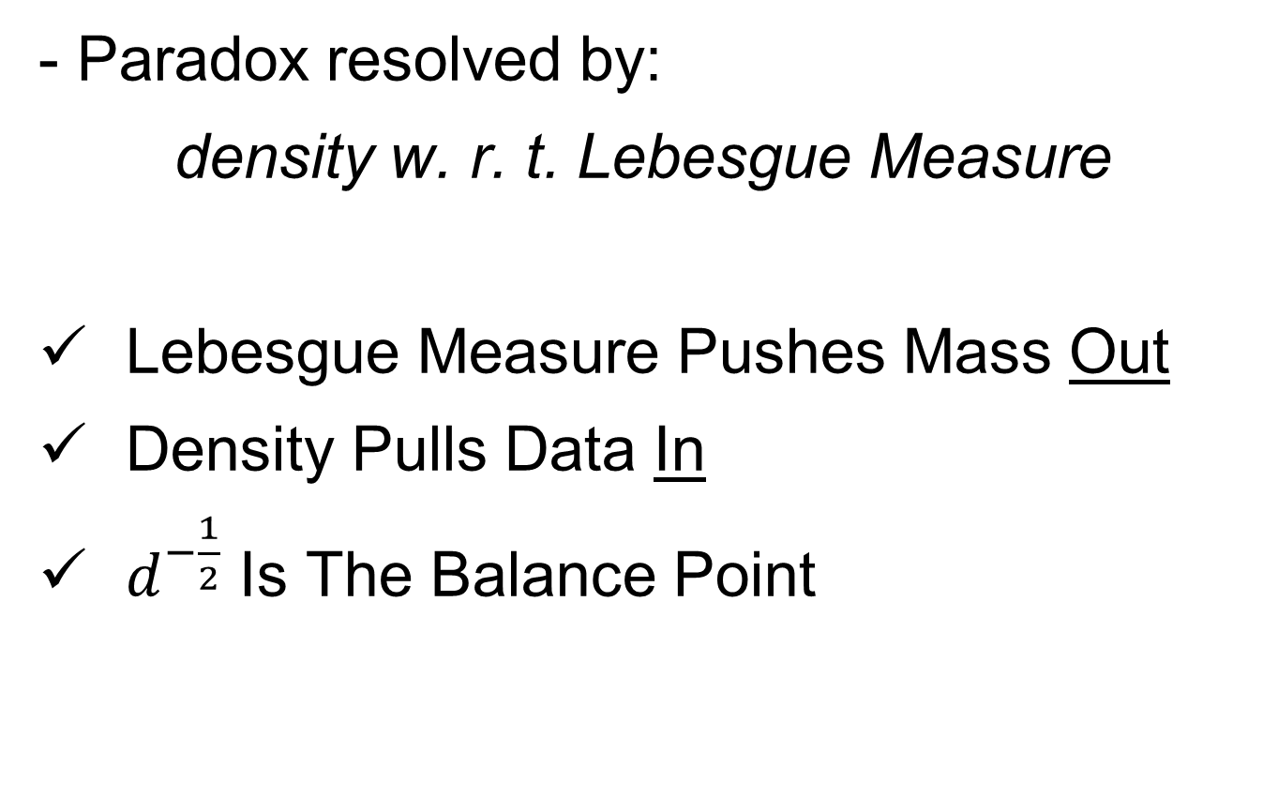
HDLSS Asymptotics: Simple Paradoxes
- Paradox resolved by:
density w. r. t. Lebesgue Measure
Lebesgue Measure Pushes Mass Out
Density Pulls Data In
$d^{−\frac{1}{2}}$ Is The Balance Point
Notes:
9

Slide 10
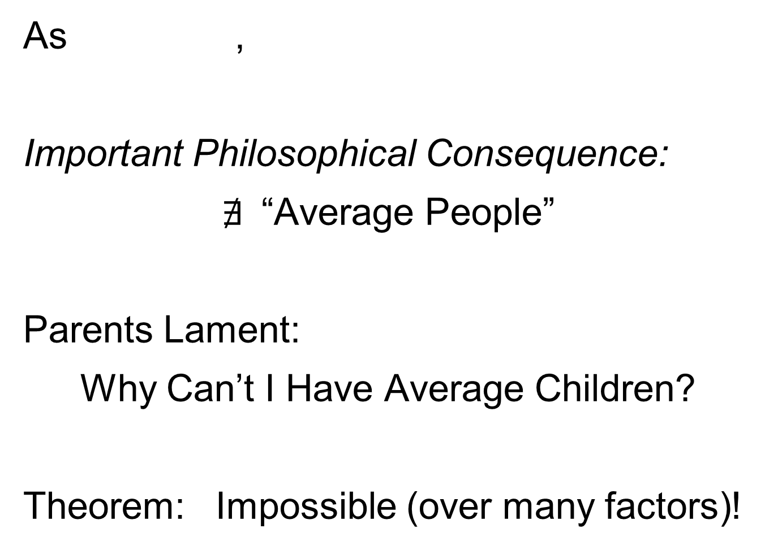
HDLSS Asymptotics: Simple Paradoxes
As ,
Important Philosophical Consequence:
$∄$“Average People”
Parents Lament:
Why Can’t I Have Average Children?
Theorem: Impossible (over many factors)!
Notes:
10

Slide 11
HDLSS Asymptotics: Simple Paradoxes
Distance tends to non-random constant:
Factor , since
Can extend to
Notes:
11

Slide 12
HDLSS Asymptotics: Simple Paradoxes
For dim’al Standard Normal dist’n:
indep. of
High dim’al Angles (as ):
- Everything is orthogonal???

Slide 13
HDLSS Asy’s: Geometrical Represent’n
Assume , let
Study Subspace Generated by Data
Hyperplane through 0,
of dimension
Points are “nearly equidistant to 0”,
& dist
Within plane, can
“rotate towards Unit Simplex”
All Gaussian data sets are:
“near Unit Simplex Vertices”!!!
“Randomness” appears
only in rotation of simplex
Hall, Marron & Neeman (2005)

Slide 14
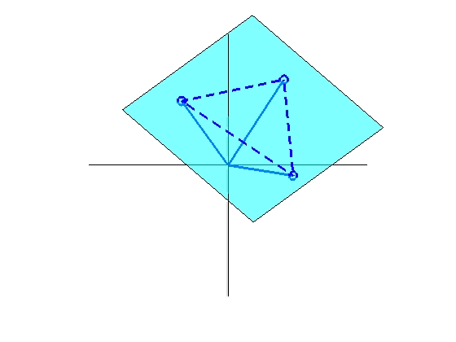
HDLSS Asy’s: Geometrical Represent’n
Assume , let
Study Hyperplane Generated by Data
dimensional hyperplane
Points are pairwise equidistant, dist
Points lie at vertices of:
“regular hedron”
Again “randomness in data” is only in rotation
Surprisingly rigid structure in random data?

Slide 15
HDLSS Asy’s: Geometrical Represen’tion
Simulation View: study “rigidity after rotation”
Simple 3 point data sets
In dimensions d = 2, 20, 200, 20000
Generate hyperplane of dimension 2
Rotate that to plane of screen
Rotate within plane, to make “comparable”
Repeat 10 times, use different colors

Slide 16
HDLSS Asy’s: Geometrical Represen’tion
Simulation View: Shows “Rigidity after Rotation”

Slide 17
HDLSS Asy’s: Geometrical Represen’tion
Now Recall HDLSS Simulation Results,
Comparing DWD, SVM & Others, from 10/21/14

Slide 18
HDLSS Discrim’n Simulations
Main idea:
Comparison of
SVM (Support Vector Machine)
DWD (Distance Weighted Discrimination)
MD (Mean Difference, a.k.a. Centroid)
Linear versions, across dimensions
Notes:
18

Slide 19
HDLSS Discrim’n Simulations
Overall Approach:
Study different known phenomena
  Spherical Gaussians
  Outliers
  Polynomial Embedding
Common Sample Sizes
But wide range of dimensions

Slide 20
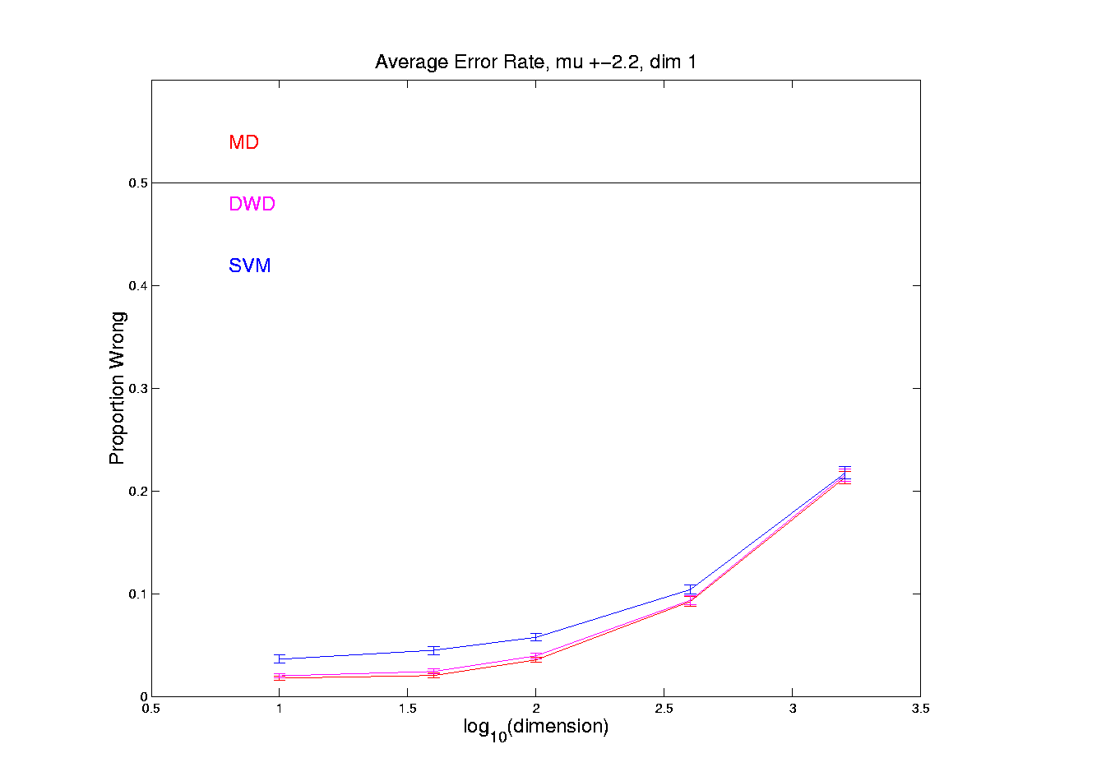
HDLSS Discrim’n Simulations
Spherical Gaussians:
Notes:
DWD1figEBig.ps

Slide 21
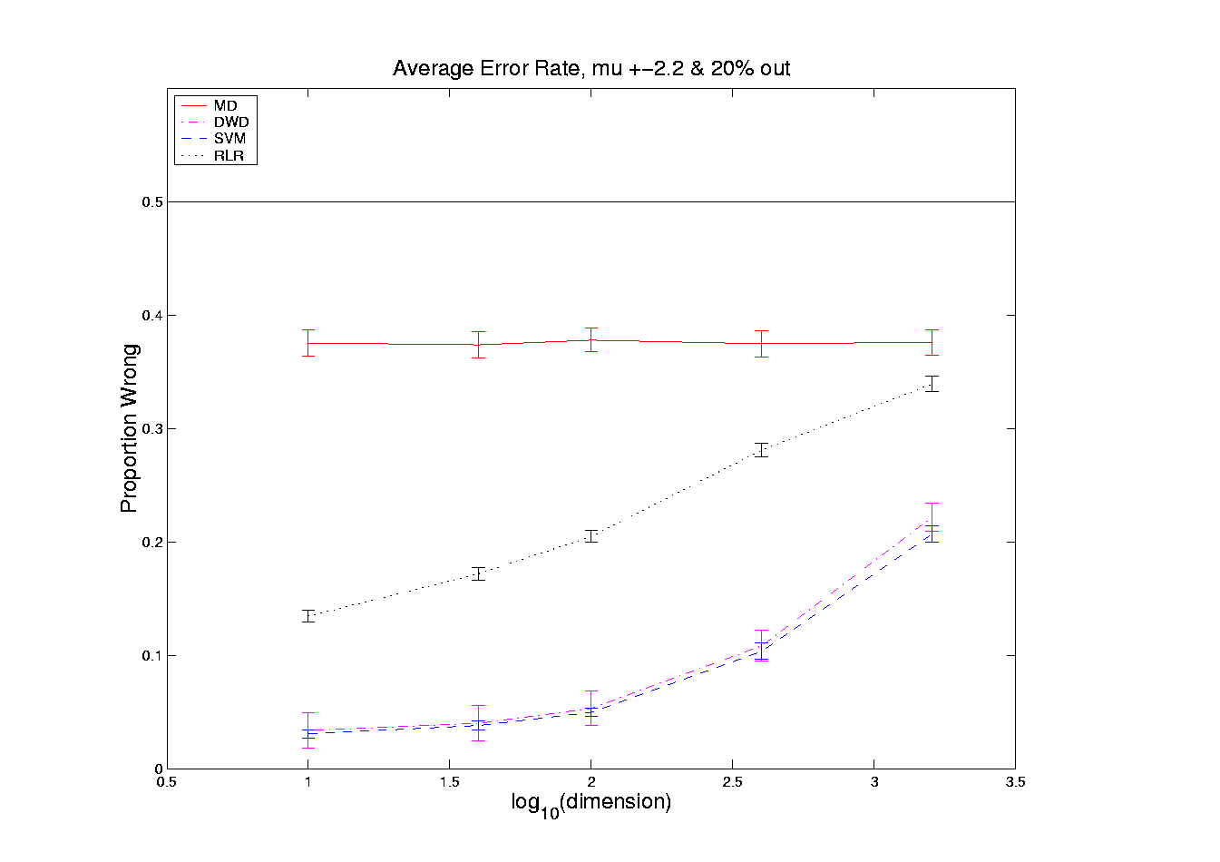
HDLSS Discrim’n Simulations
Outlier Mixture:
Notes:
DWD1figFBig.ps

Slide 22
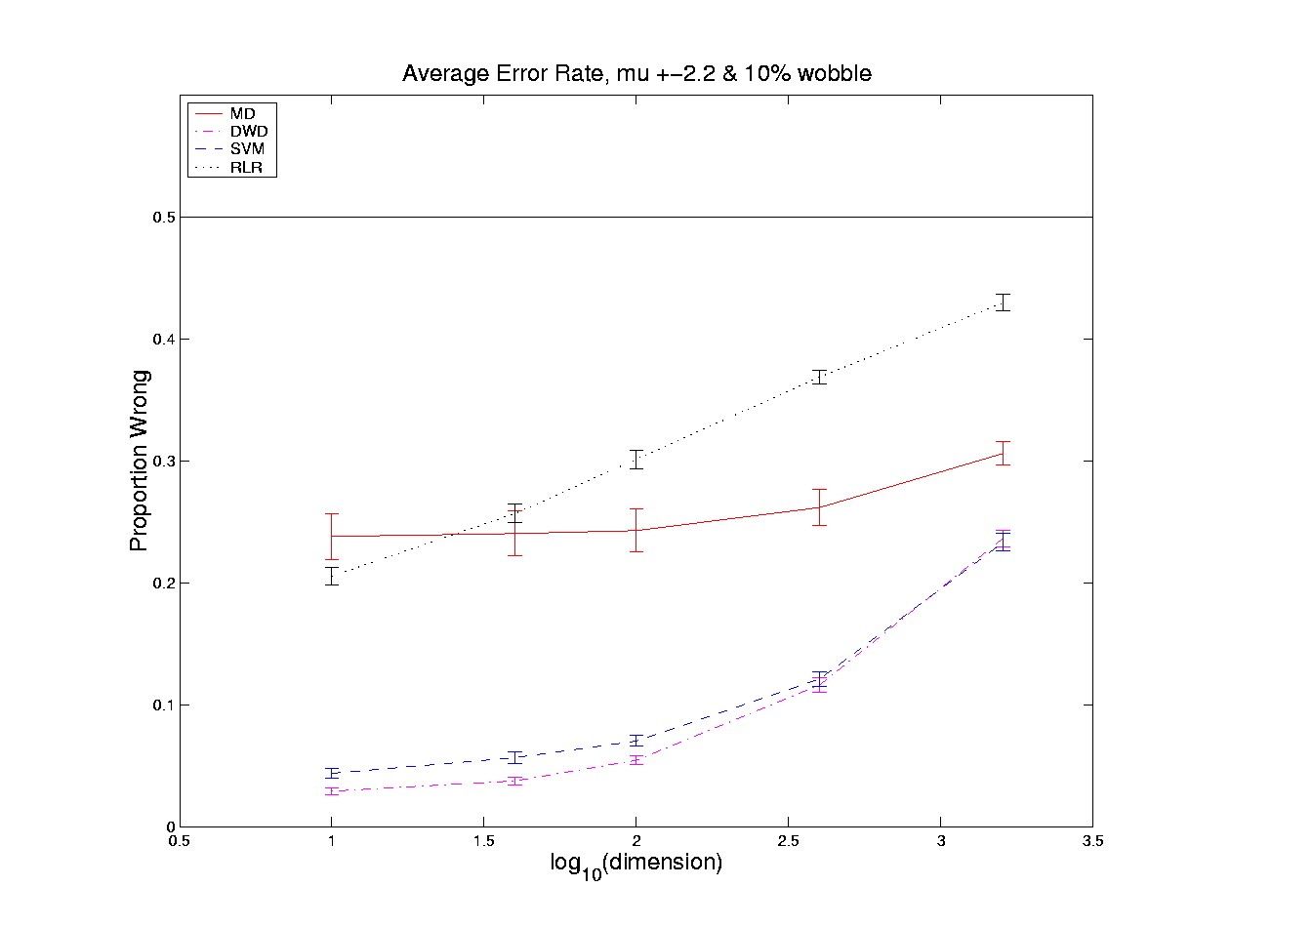
HDLSS Discrim’n Simulations
Wobble Mixture:
Notes:
DWD1figGBig.ps

Slide 23
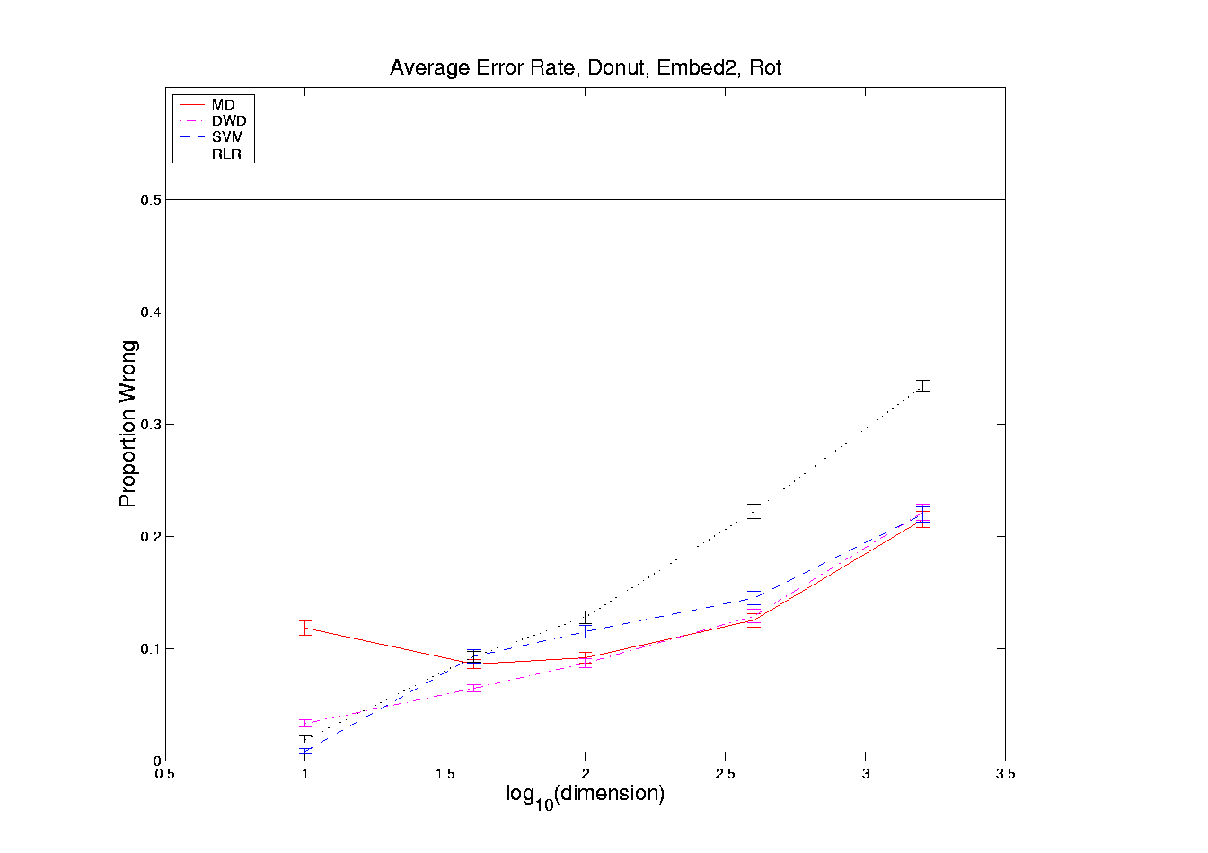
HDLSS Discrim’n Simulations
Nested Spheres:
Notes:
DWD1figHBig.ps

Slide 24
HDLSS Discrim’n Simulations
…
Interesting Phenomenon:
All methods come together
in very high dimensions???

Slide 25
HDLSS Discrim’n Simulations
Can we say more about:
All methods come together
in very high dimensions???
Mathematical Statistical Question:
Mathematics behind this???
(Use Geometric Representation)
Notes:
25

Slide 26
HDLSS Asy’s: Geometrical Represen’tion
Explanation of Observed (Simulation) Behavior:
“everything similar for very high d ”

Slide 27
HDLSS Asy’s: Geometrical Represen’tion
Explanation of Observed (Simulation) Behavior:
“everything similar for very high d ”
2 popn’s are 2 simplices (i.e. regular n-hedrons)

Slide 28
HDLSS Asy’s: Geometrical Represen’tion
Explanation of Observed (Simulation) Behavior:
“everything similar for very high d ”
2 popn’s are 2 simplices (i.e. regular n-hedrons)
All are same distance from the other class

Slide 29
HDLSS Asy’s: Geometrical Represen’tion
Explanation of Observed (Simulation) Behavior:
“everything similar for very high d ”
2 popn’s are 2 simplices (i.e. regular n-hedrons)
All are same distance from the other class
i.e. everything is a support vector
i.e. all sensible directions show “data piling”

Slide 30
HDLSS Asy’s: Geometrical Represen’tion
Explanation of Observed (Simulation) Behavior:
“everything similar for very high d ”
2 popn’s are 2 simplices (i.e. regular n-hedrons)
All are same distance from the other class
i.e. everything is a support vector
i.e. all sensible directions show “data piling”
so “sensible methods are all nearly the same”

Slide 31
HDLSS Asy’s: Geometrical Represen’tion
Straightforward Generalizations:
non-Gaussian data: only need moments?

Slide 32
HDLSS Asy’s: Geometrical Represen’tion
Straightforward Generalizations:
non-Gaussian data: only need moments?
non-independent: use “mixing conditions”

Slide 33
HDLSS Asy’s: Geometrical Represen’tion
Straightforward Generalizations:
non-Gaussian data: only need moments
non-independent: use “mixing conditions”
Mild Eigenvalue condition on Theoretical Cov.
(Ahn, Marron, Muller & Chi, 2007)

Slide 34
HDLSS Asy’s: Geometrical Represen’tion
Straightforward Generalizations:
non-Gaussian data: only need moments
non-independent: use “mixing conditions”
Mild Eigenvalue condition on Theoretical Cov.
(Ahn, Marron, Muller & Chi, 2007)
All based on simple “Laws of Large Numbers”

Slide 35
2nd Paper on HDLSS Asymptotics
Ahn, Marron, Muller & Chi (2007)
  Assume 2nd Moments
  Assume no eigenvalues too large

Slide 36
2nd Paper on HDLSS Asymptotics
Ahn, Marron, Muller & Chi (2007)
  Assume 2nd Moments
  Assume no eigenvalues too large in sense:
For assume i.e.

Slide 37
2nd Paper on HDLSS Asymptotics
Ahn, Marron, Muller & Chi (2007)
  Assume 2nd Moments
  Assume no eigenvalues too large in sense:
For assume i.e.
(min possible)
(much weaker than previous mixing conditions…)

Slide 38
2nd Paper on HDLSS Asymptotics
Background:
In classical multivariate analysis, the statistic
Is called the “epsilon statistic”

Slide 39
2nd Paper on HDLSS Asymptotics
Background:
In classical multivariate analysis, the statistic
Is called the “epsilon statistic”
And is used to test “sphericity” of dist’n,
i.e. “are all cov’nce eigenvalues the same?”

Slide 40
2nd Paper on HDLSS Asymptotics
Can show: epsilon statistic:
Satisfies:

Slide 41
2nd Paper on HDLSS Asymptotics
Can show: epsilon statistic:
Satisfies:
For spherical Normal,

Slide 42
2nd Paper on HDLSS Asymptotics
Can show: epsilon statistic:
Satisfies:
For spherical Normal,
Single extreme eigenvalue gives

Slide 43
2nd Paper on HDLSS Asymptotics
Can show: epsilon statistic:
Satisfies:
For spherical Normal,
Single extreme eigenvalue gives
So assumption is very mild
Much weaker than mixing conditions

Slide 44
2nd Paper on HDLSS Asymptotics
Ahn, Marron, Muller & Chi (2007)
  Assume 2nd Moments
  Assume no eigenvalues too large, :
Then

Slide 45
2nd Paper on HDLSS Asymptotics
Ahn, Marron, Muller & Chi (2007)
  Assume 2nd Moments
  Assume no eigenvalues too large, :
Then
Not so strong as before:

Slide 46
2nd Paper on HDLSS Asymptotics
Can we improve on:
?

Slide 47

2nd Paper on HDLSS Asymptotics
Can we improve on:
?
John Kent example: Normal scale mixture

Slide 48
2nd Paper on HDLSS Asymptotics
Can we improve on:
?
John Kent example: Normal scale mixture
Won’t get:

Slide 49
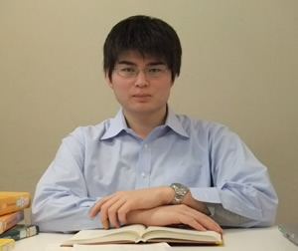
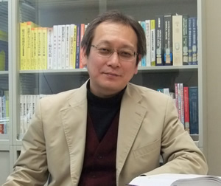
3rd Paper on HDLSS Asymptotics
Get Geometrical Representation using
4th Moment Assumption
Stronger Covariance Matrix (only) Assum’n
Yata & Aoshima (2012)

Slide 50
2nd Paper on HDLSS Asymptotics
Notes on Kent’s Normal Scale Mixture
Data Vectors are indep’dent of each other

Slide 51
2nd Paper on HDLSS Asymptotics
Notes on Kent’s Normal Scale Mixture
Data Vectors are indep’dent of each other
But entries of each have strong depend’ce

Slide 52
2nd Paper on HDLSS Asymptotics
Notes on Kent’s Normal Scale Mixture
Data Vectors are indep’dent of each other
But entries of each have strong depend’ce
However, can show entries have cov = 0!

Slide 53
2nd Paper on HDLSS Asymptotics
Notes on Kent’s Normal Scale Mixture
Data Vectors are indep’dent of each other
But entries of each have strong depend’ce
However, can show entries have cov = 0!
Recall statistical folklore:
Covariance = 0 Independence

Slide 54
0 Covariance is not independence
Simple Example

Slide 55
0 Covariance is not independence
Simple Example:
Random Variables and
Make both Gaussian
(Note: Not Using Multivariate Gaussian)

Slide 56
0 Covariance is not independence
Simple Example:
Random Variables and
Make both Gaussian
With strong dependence
Yet 0 covariance
Given , define

Slide 57
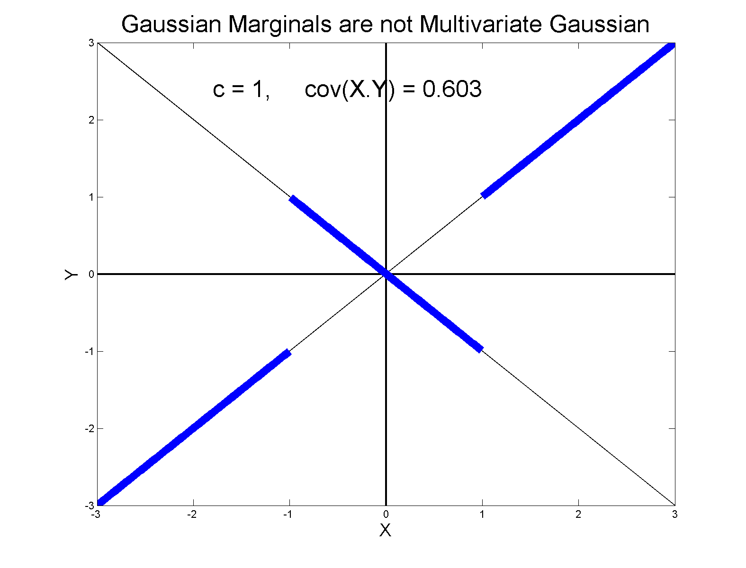
0 Covariance is not independence
Simple Example:

Slide 58
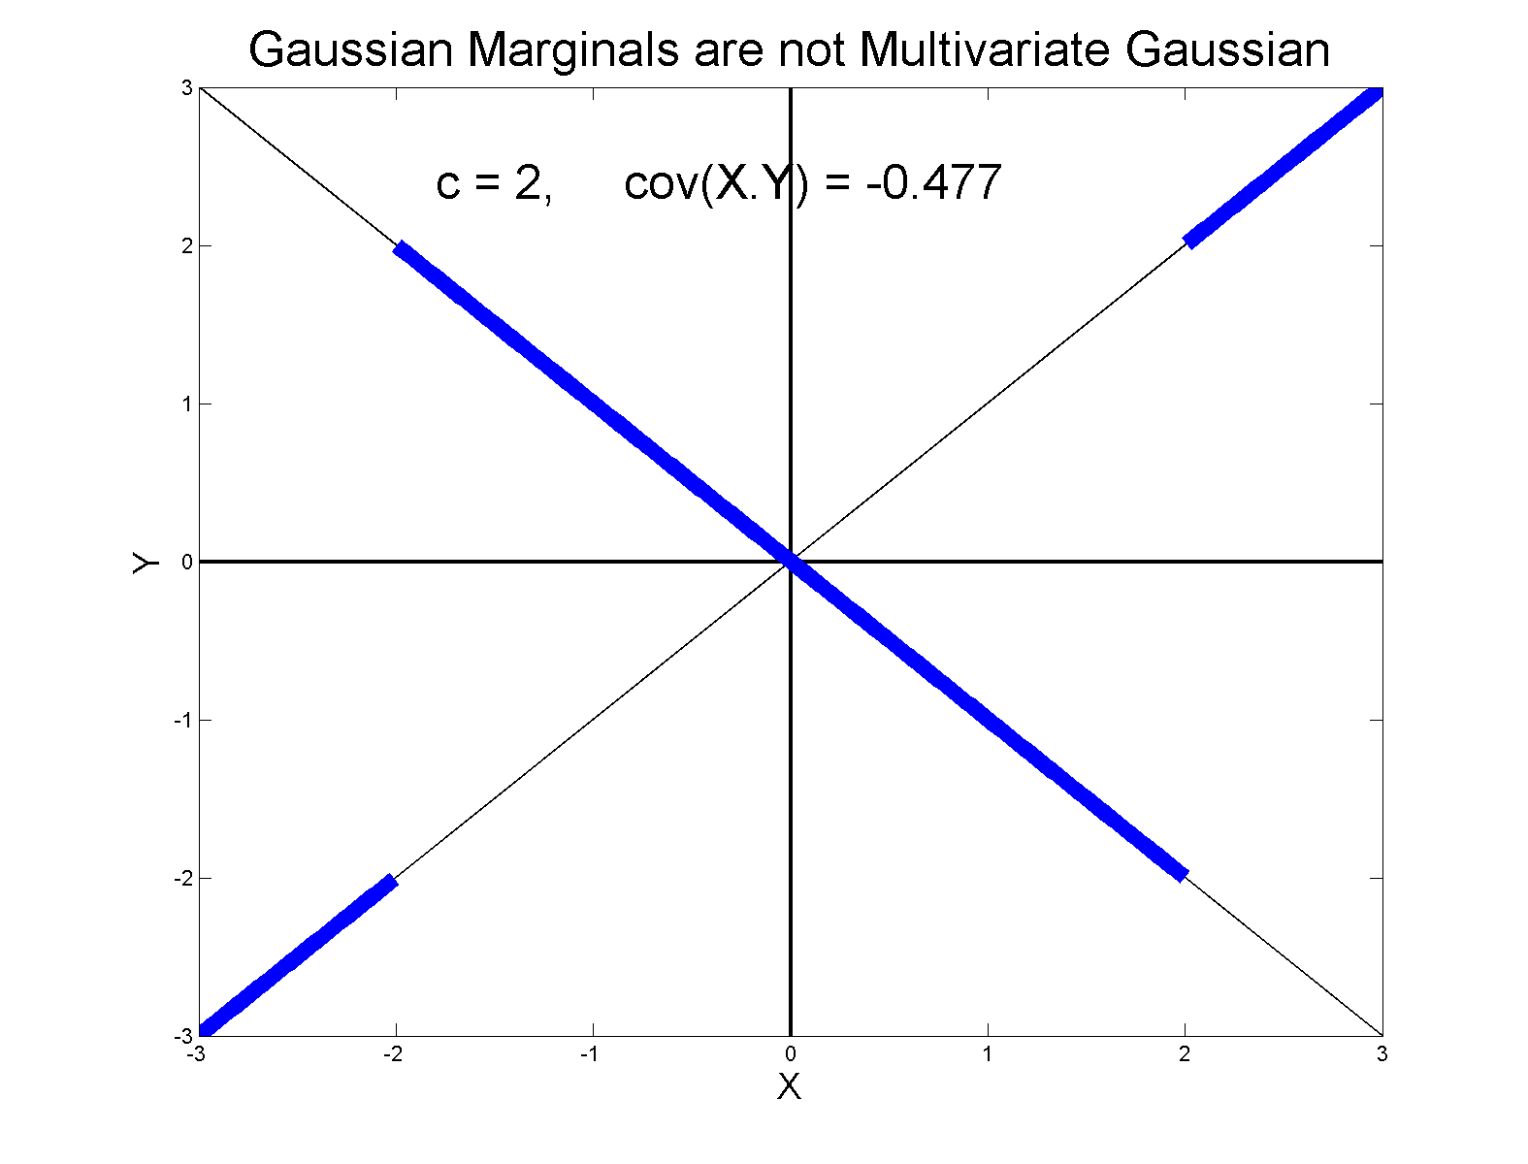
0 Covariance is not independence
Simple Example:

Slide 59
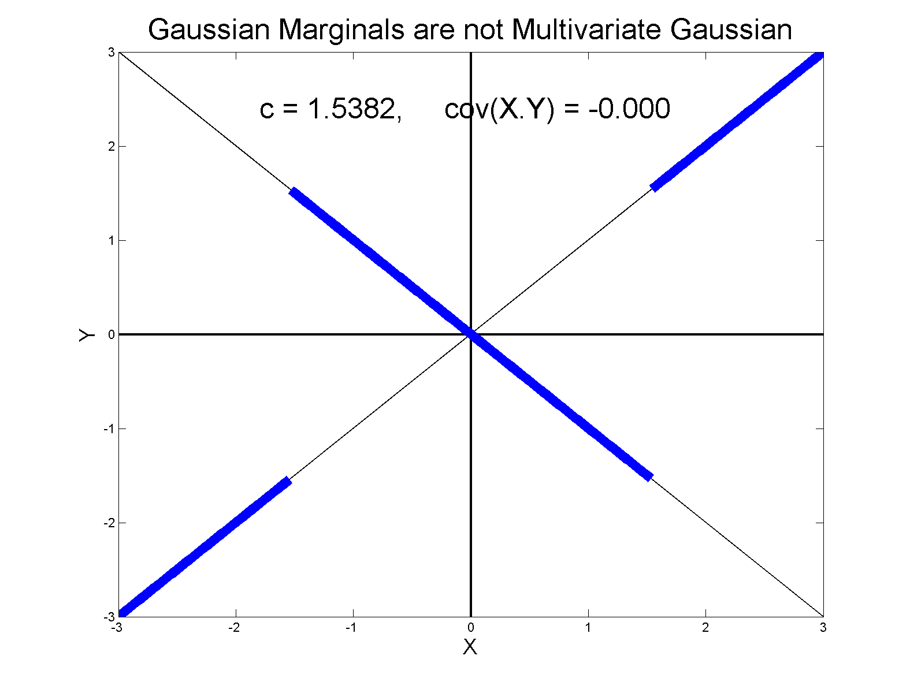
0 Covariance is not independence
Simple Example, c to make cov(X,Y) = 0

Slide 60
0 Covariance is not independence
Simple Example:
Distribution is degenerate
Supported on diagonal lines

Slide 61
0 Covariance is not independence
Simple Example:
Distribution is degenerate
Supported on diagonal lines
Not abs. cont. w.r.t. 2-d Lebesgue meas.

Slide 62
0 Covariance is not independence
Simple Example:
Distribution is degenerate
Supported on diagonal lines
Not abs. cont. w.r.t. 2-d Lebesgue meas.
For small , have
For large , have

Slide 63
0 Covariance is not independence
Simple Example:
Distribution is degenerate
Supported on diagonal lines
Not abs. cont. w.r.t. 2-d Lebesgue meas.
For small , have
For large , have
By continuity, with

Slide 64
0 Covariance is not independence
Result:
Joint distribution of and :
  Has Gaussian marginals
  Has

Slide 65
0 Covariance is not independence
Result:
Joint distribution of and :
  Has Gaussian marginals
  Has
  Yet strong dependence of and
  Thus not multivariate Gaussian

Slide 66
0 Covariance is not independence
Result:
Joint distribution of and :
  Has Gaussian marginals
  Has
  Yet strong dependence of and
  Thus not multivariate Gaussian
Shows Multivariate Gaussian means more
than Gaussian Marginals

Slide 67
HDLSS Asy’s: Geometrical Represen’tion
Further Consequences of Geometric Represen’tion
1. DWD more stable than SVM
(based on deeper limiting distributions)
(reflects intuitive idea feeling sampling variation)
(something like mean vs. median)
Hall, Marron, Neeman (2005)

Slide 68
HDLSS Asy’s: Geometrical Represen’tion
Further Consequences of Geometric Represen’tion
1. DWD more stable than SVM
(based on deeper limiting distributions)
(reflects intuitive idea feeling sampling variation)
(something like mean vs. median)
Hall, Marron, Neeman (2005)
2. 1-NN rule inefficiency is quantified.
Hall, Marron, Neeman (2005)

Slide 69
HDLSS Asy’s: Geometrical Represen’tion
Further Consequences of Geometric Represen’tion
1. DWD more stable than SVM
(based on deeper limiting distributions)
(reflects intuitive idea feeling sampling variation)
(something like mean vs. median)
Hall, Marron, Neeman (2005)
2. 1-NN rule inefficiency is quantified.
Hall, Marron, Neeman (2005)
3. Inefficiency of DWD for uneven sample size
(motivates weighted version)
Qiao, et al (2010)

Slide 70
HDLSS Math. Stat. of PCA
Consistency & Strong Inconsistency
(Study Properties of PCA,
In Estimating Eigen-Directions & -Values)
[Assume Data are Mean Centered]

Slide 71
HDLSS Math. Stat. of PCA
Consistency & Strong Inconsistency:
Spike Covariance Model, Paul (2007)
For Eigenvalues:

Slide 72
HDLSS Math. Stat. of PCA
Consistency & Strong Inconsistency:
Spike Covariance Model, Paul (2007)
For Eigenvalues:
Note: Critical Parameter

Slide 73
HDLSS Math. Stat. of PCA
Consistency & Strong Inconsistency:
Spike Covariance Model, Paul (2007)
For Eigenvalues:
1st Eigenvector:
Turns out: Direction Doesn’t Matter

Slide 74
HDLSS Math. Stat. of PCA
Consistency & Strong Inconsistency:
Spike Covariance Model, Paul (2007)
For Eigenvalues:
1st Eigenvector:
How Good are Empirical Versions,
as Estimates?

Slide 75
HDLSS Math. Stat. of PCA
Consistency (big enough spike):
For ,

Slide 76
HDLSS Math. Stat. of PCA
Consistency (big enough spike):
For ,
Strong Inconsistency (spike not big enough):
For ,

Slide 77
HDLSS Math. Stat. of PCA
Intuition: Random Noise ~ d^{1/2}
For (Recall on Scale of Variance),
Spike Pops Out of Pure Noise Sphere

Slide 78
HDLSS Math. Stat. of PCA
Intuition: Random Noise ~ d^{1/2}
For (Recall on Scale of Variance),
Spike Pops Out of Pure Noise Sphere
For ,
Spike Contained in Pure Noise Sphere

Slide 79
HDLSS Math. Stat. of PCA
Consistency of eigenvalues?

Slide 80
HDLSS Math. Stat. of PCA
Consistency of eigenvalues?
Eigenvalues Inconsistent

Slide 81
HDLSS Math. Stat. of PCA
Consistency of eigenvalues?
Eigenvalues Inconsistent
But Known Distribution

Slide 82
HDLSS Math. Stat. of PCA
Consistency of eigenvalues?
Eigenvalues Inconsistent
But Known Distribution
Consistent when as Well

Slide 83
HDLSS Math. Stat. of PCA
Conditions for Geo. Rep’n & PCA Consist.:
John Kent example:

Slide 84
HDLSS Math. Stat. of PCA
Conditions for Geo. Rep’n & PCA Consist.:
John Kent example:
Can only say:
not deterministic

Slide 85
HDLSS Math. Stat. of PCA
Conditions for Geo. Rep’n & PCA Consist.:
John Kent example:
Can only say:
not deterministic
PCA Conditions Same, since Noise Still

Slide 86
HDLSS Math. Stat. of PCA
Conditions for Geo. Rep’n & PCA Consist.:
John Kent example:
Can only say:
not deterministic
But for Geo. Rep’n: need some Mixing Cond.

Slide 87
HDLSS Math. Stat. of PCA
Conditions for Geo. Rep’n:
Conclude: Need some Mixing Condition

Slide 88
Mixing Conditions
Idea From Probability Theory:

Slide 89

Mixing Conditions
Idea From Probability Theory:
Recall Standard Asymptotic Results, as $n→∞:$

Slide 90
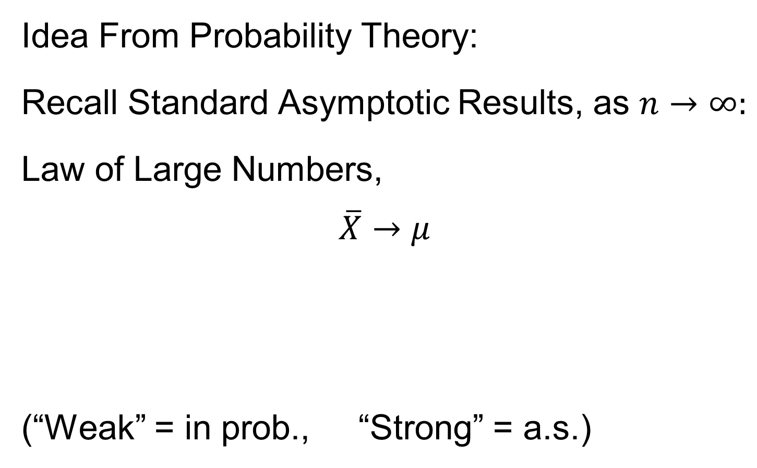
Mixing Conditions
Idea From Probability Theory:
Recall Standard Asymptotic Results, as $n→∞:$
Law of Large Numbers,
$$\overline{X}→μ$$
(“Weak” = in prob., “Strong” = a.s.)

Slide 91
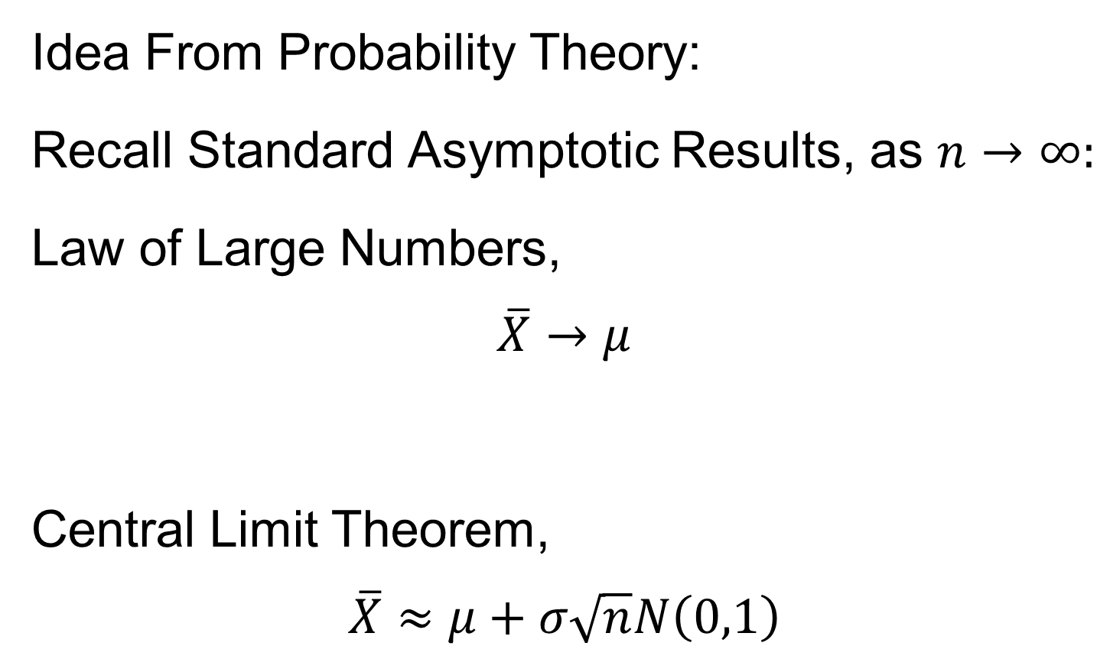
Mixing Conditions
Idea From Probability Theory:
Recall Standard Asymptotic Results, as $n→∞:$
Law of Large Numbers,
$$\overline{X}→μ$$
Central Limit Theorem,
$$\overline{X}≈μ+σ\sqrt{n}N\left(0,1\right)$$

Slide 92
Mixing Conditions
Idea From Probability Theory:
Law of Large Numbers,
Central Limit Theorem,
Both have Technical Assumptions
(Usually Ignore ???)

Slide 93
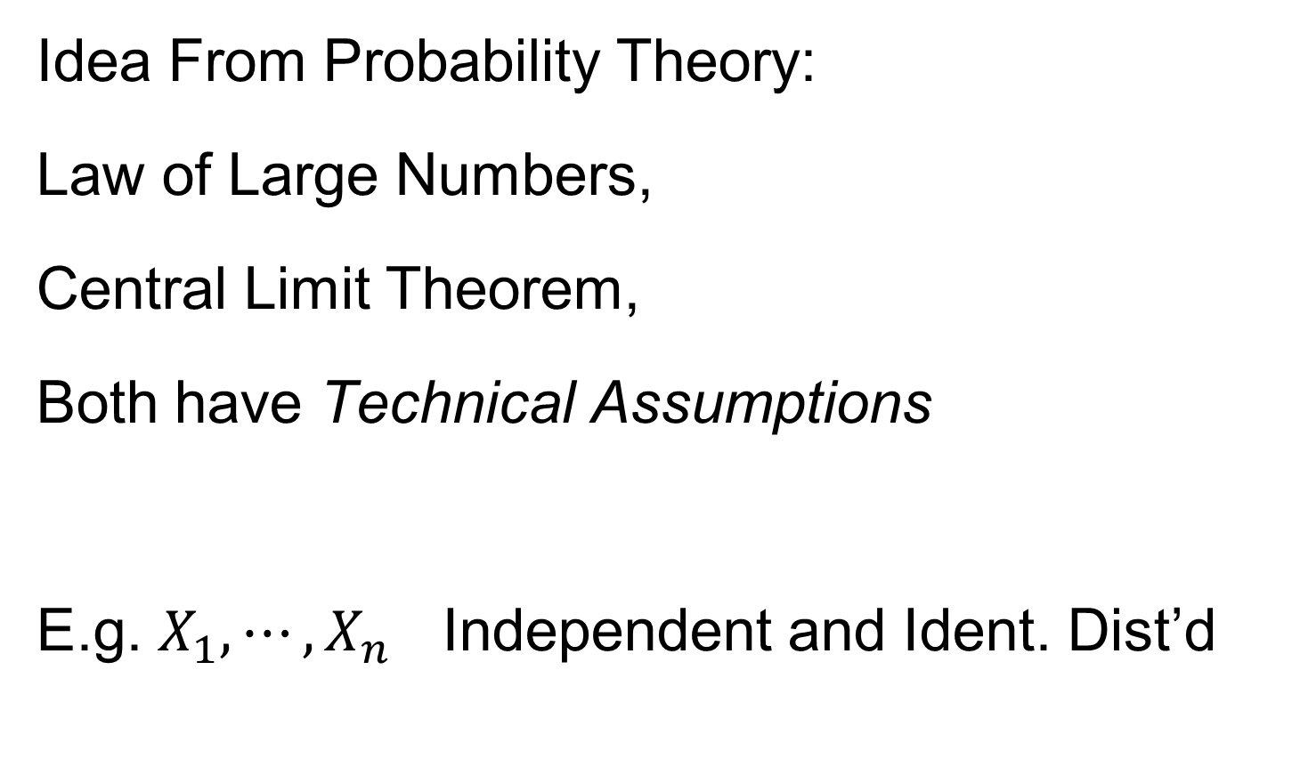
Mixing Conditions
Idea From Probability Theory:
Law of Large Numbers,
Central Limit Theorem,
Both have Technical Assumptions
E.g. $X_{1},⋯,X_{n}$ Independent and Ident. Dist’d

Slide 94
Mixing Conditions
Idea From Probability Theory:
Mixing Conditions:
Explore Weaker Assumptions, to Still Get
Law of Large Numbers,
Central Limit Theorem

Slide 95

Mixing Conditions
Mixing Conditions:
A Whole Area in Probability Theory
$∃$ a Large Literature

Slide 96
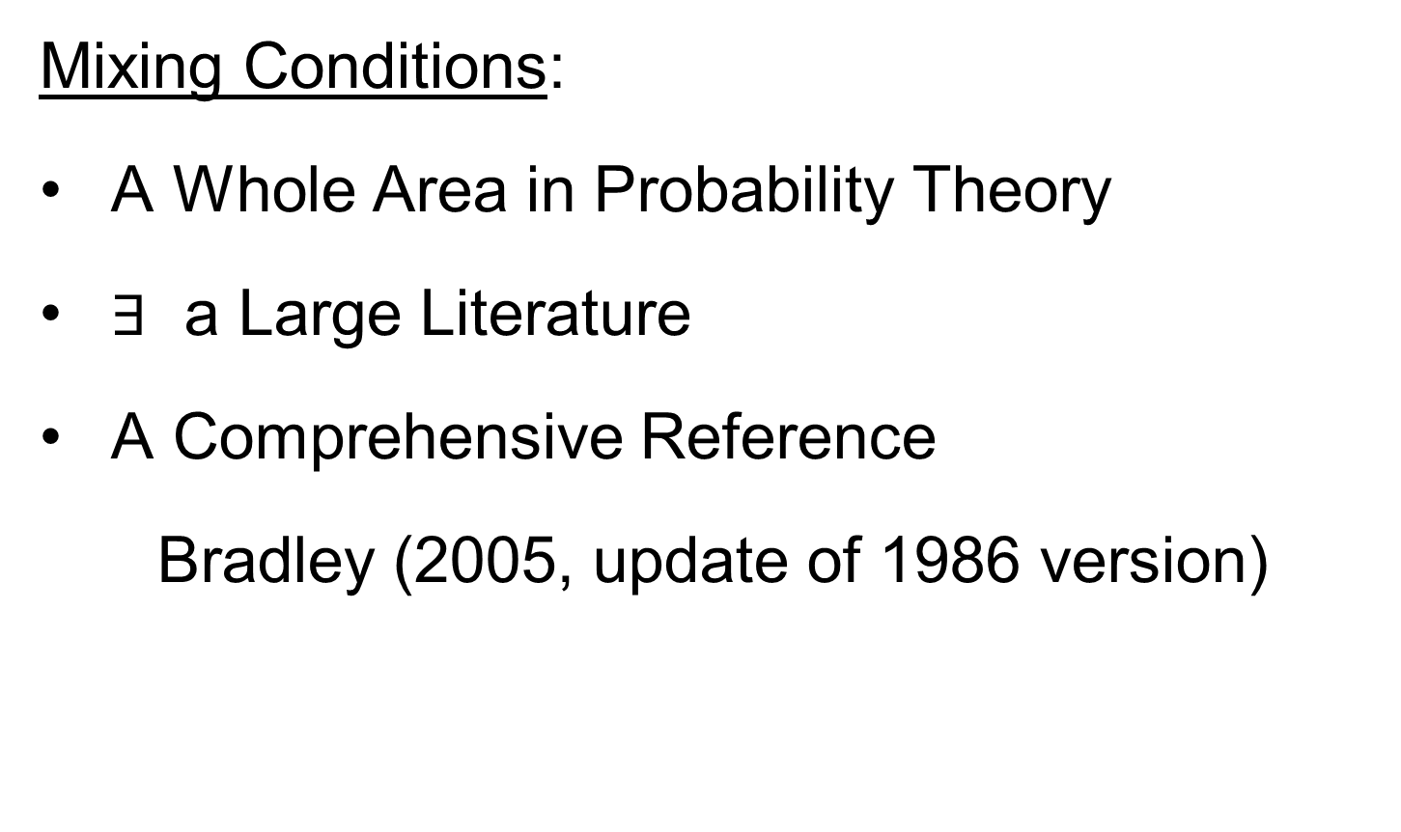
Mixing Conditions
Mixing Conditions:
A Whole Area in Probability Theory
$∃$ a Large Literature
A Comprehensive Reference
Bradley (2005, update of 1986 version)

Slide 97
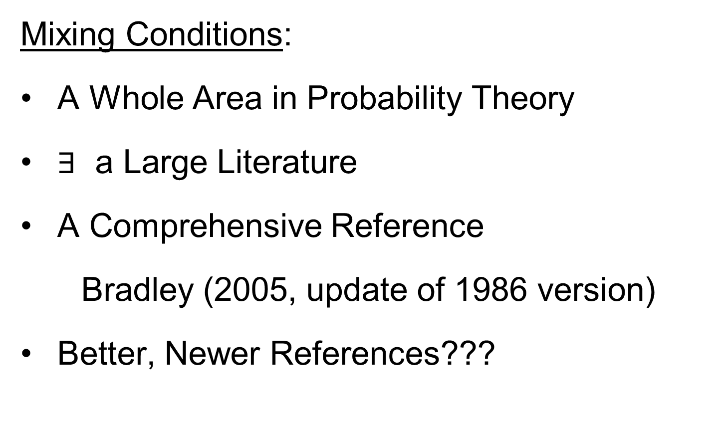
Mixing Conditions
Mixing Conditions:
A Whole Area in Probability Theory
$∃$ a Large Literature
A Comprehensive Reference
Bradley (2005, update of 1986 version)
Better, Newer References???

Slide 98
Mixing Conditions
Mixing Condition Used Here:
Rho – Mixing

Slide 99
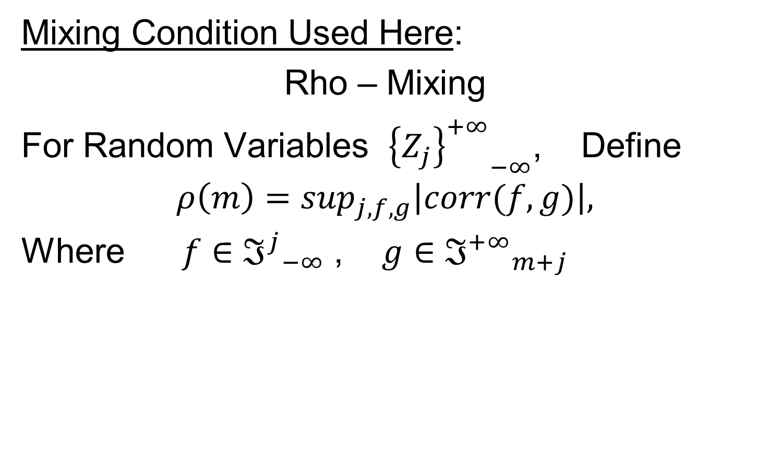
Mixing Conditions
Mixing Condition Used Here:
Rho – Mixing
For Random Variables ${{\left\{Z_{j}\right\}}^{+∞}}_{−∞}^{}$, Define
$$ρ\left(m\right)=\sup_{j,f,g}\left|corr(f,g)\right|,$$
Where $f∈{ℑ^{j}}_{−∞}^{}$ , $g∈{ℑ^{+∞}}_{m+j}^{}$

Slide 100
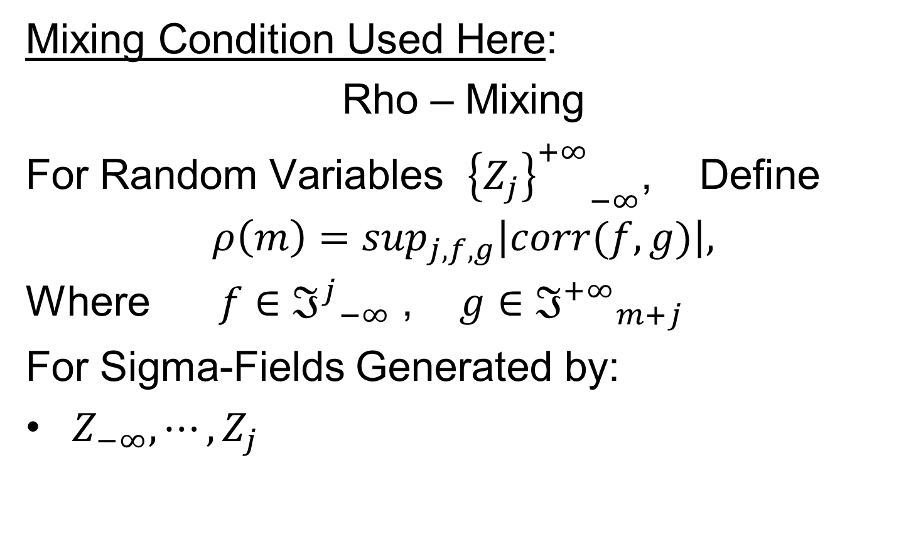
Mixing Conditions
Mixing Condition Used Here:
Rho – Mixing
For Random Variables ${{\left\{Z_{j}\right\}}^{+∞}}_{−∞}^{}$, Define
$$ρ\left(m\right)=\sup_{j,f,g}\left|corr(f,g)\right|,$$
Where $f∈{ℑ^{j}}_{−∞}^{}$ , $g∈{ℑ^{+∞}}_{m+j}^{}$
For Sigma-Fields Generated by:
$Z_{−∞},⋯,Z_{j}$

Slide 101
Mixing Conditions
Mixing Condition Used Here:
Rho – Mixing
For Random Variables ${{\left\{Z_{j}\right\}}^{+∞}}_{−∞}^{}$, Define
$$ρ\left(m\right)=\sup_{j,f,g}\left|corr(f,g)\right|,$$
Where $f∈{ℑ^{j}}_{−∞}^{}$ , $g∈{ℑ^{+∞}}_{m+j}^{}$
For Sigma-Fields Generated by:
$Z_{−∞},⋯,Z_{j}$
$Z_{m+j},⋯,Z_{∞}$

Slide 102
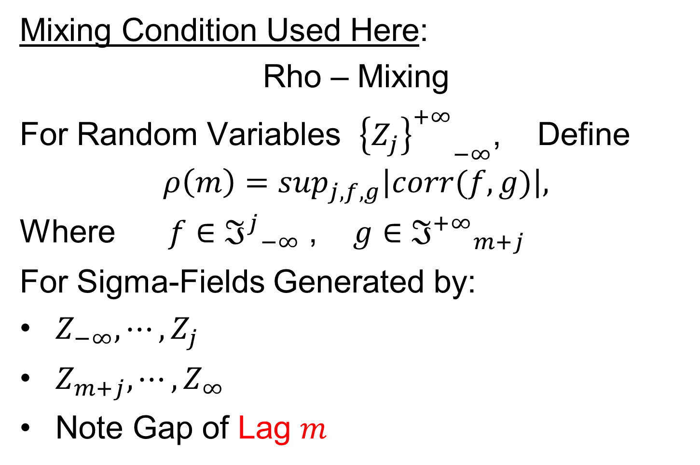
Mixing Conditions
Mixing Condition Used Here:
Rho – Mixing
For Random Variables ${{\left\{Z_{j}\right\}}^{+∞}}_{−∞}^{}$, Define
$$ρ\left(m\right)=\sup_{j,f,g}\left|corr(f,g)\right|,$$
Where $f∈{ℑ^{j}}_{−∞}^{}$ , $g∈{ℑ^{+∞}}_{m+j}^{}$
For Sigma-Fields Generated by:
$Z_{−∞},⋯,Z_{j}$
$Z_{m+j},⋯,Z_{∞}$
Note Gap of Lag $m$

Slide 103
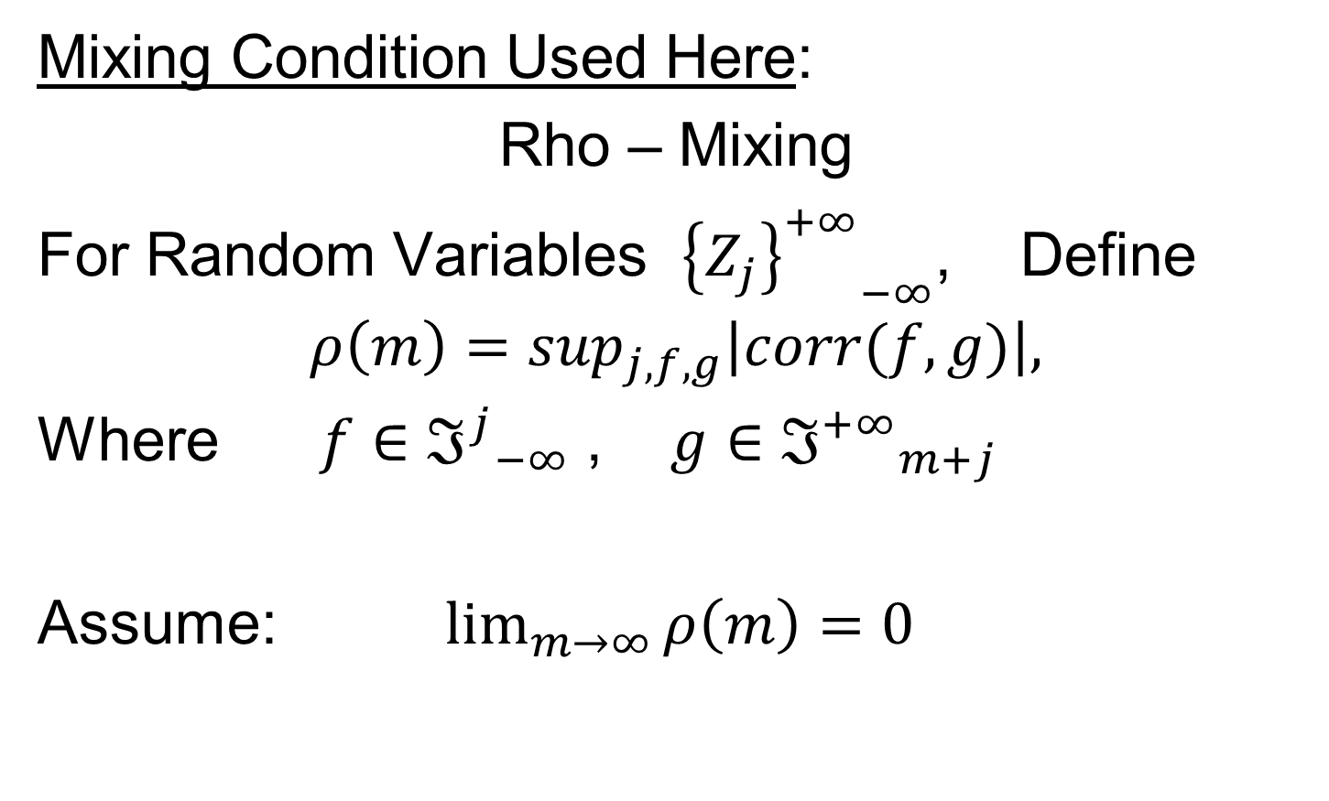
Mixing Conditions
Mixing Condition Used Here:
Rho – Mixing
For Random Variables ${{\left\{Z_{j}\right\}}^{+∞}}_{−∞}^{}$, Define
$$ρ\left(m\right)=\sup_{j,f,g}\left|corr(f,g)\right|,$$
Where $f∈{ℑ^{j}}_{−∞}^{}$ , $g∈{ℑ^{+∞}}_{m+j}^{}$
Assume: $\lim_{m→∞}{ρ\left(m\right)=0}$

Slide 104
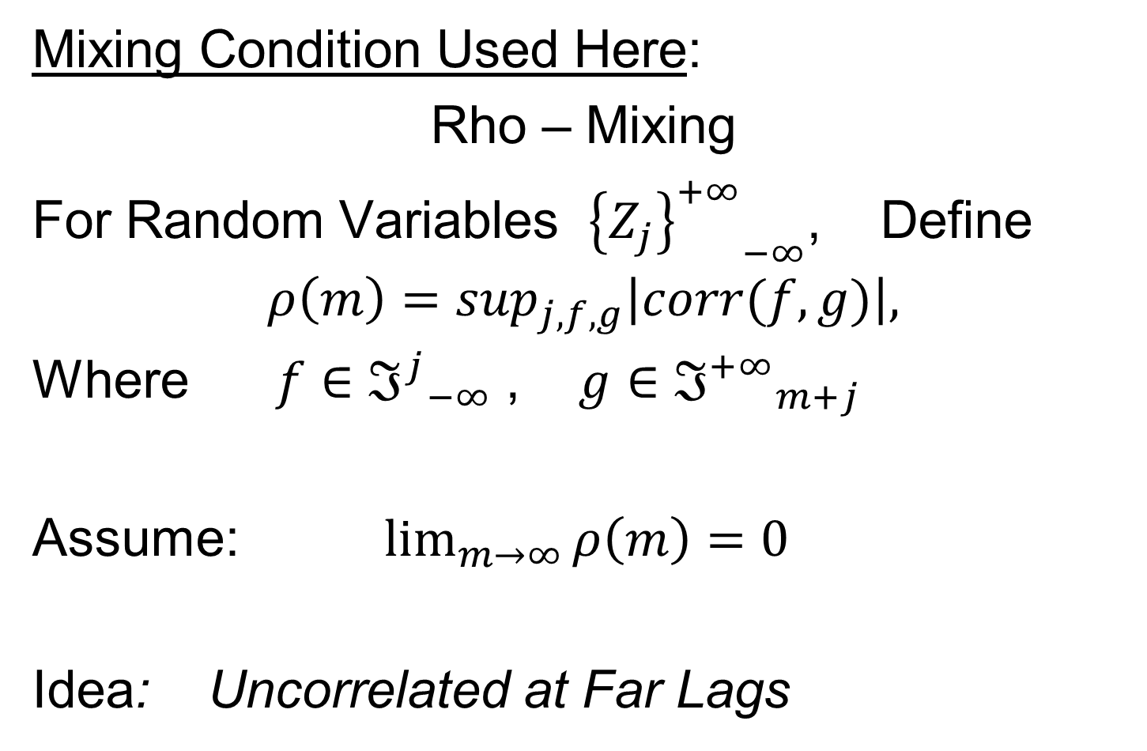
Mixing Conditions
Mixing Condition Used Here:
Rho – Mixing
For Random Variables ${{\left\{Z_{j}\right\}}^{+∞}}_{−∞}^{}$, Define
$$ρ\left(m\right)=\sup_{j,f,g}\left|corr(f,g)\right|,$$
Where $f∈{ℑ^{j}}_{−∞}^{}$ , $g∈{ℑ^{+∞}}_{m+j}^{}$
Assume: $\lim_{m→∞}{ρ\left(m\right)=0}$
Idea: Uncorrelated at Far Lags

Slide 105
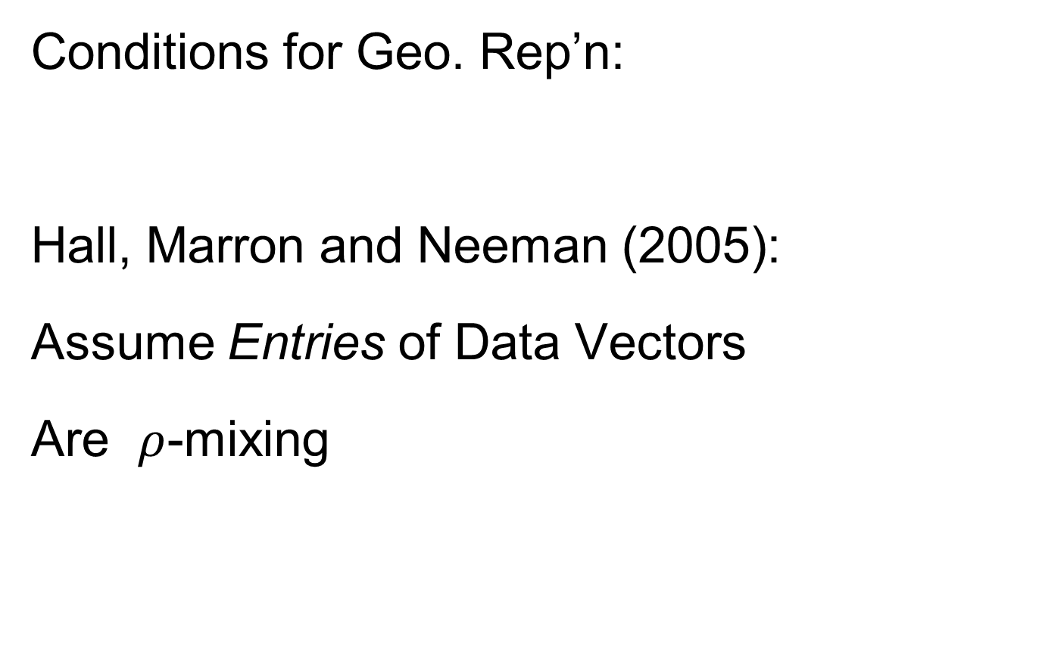
HDLSS Math. Stat. of PCA
Conditions for Geo. Rep’n:
Hall, Marron and Neeman (2005):
Assume Entries of Data Vectors
Are $ρ$-mixing

Slide 106
HDLSS Math. Stat. of PCA
Conditions for Geo. Rep’n:
Hall, Marron and Neeman (2005):
Drawback: Strong Assumption
(In JRSS-B, since
Biometrika Refused)

Slide 107
HDLSS Math. Stat. of PCA
Conditions for Geo. Rep’n:
Series of Technical Improvements:
Ahn, Marron, Muller & Chi (2007)
Aoshima (2010), Yata & Aoshima (2012)
(Fully Covariance Based,
No Mixing)

Slide 108
HDLSS Math. Stat. of PCA
Conditions for Geo. Rep’n:
Tricky Point: Classical Mixing Conditions
Require Notion of Time Ordering
Not Always Clear, e.g. Microarrays

Slide 109
HDLSS Math. Stat. of PCA
Conditions for Geo. Rep’n:
Condition from Jung & Marron (2009):
where
Note: Not Gaussian

Slide 110
HDLSS Math. Stat. of PCA
Conditions for Geo. Rep’n:
Condition from Jung & Marron (2009):
where
Define:
Standardized Version

Slide 111
HDLSS Math. Stat. of PCA
Conditions for Geo. Rep’n:
Condition from Jung & Marron (2009):
where
Define:
Assume: Ǝ a permutation,
So that is ρ-mixing

Slide 112
HDLSS Math. Stat. of PCA
Careful look at:
PCA Consistency - spike
(Reality Check, Suggested by Reviewer)

Slide 113
HDLSS Math. Stat. of PCA
Careful look at:
PCA Consistency - spike
Independent of Sample Size,
So true for n = 1 (!?!)

Slide 114
HDLSS Math. Stat. of PCA
Careful look at:
PCA Consistency - spike
Independent of Sample Size,
So true for n = 1 (!?!)
Reviewers Conclusion: Absurd, shows assumption too strong for practice ???

Slide 115
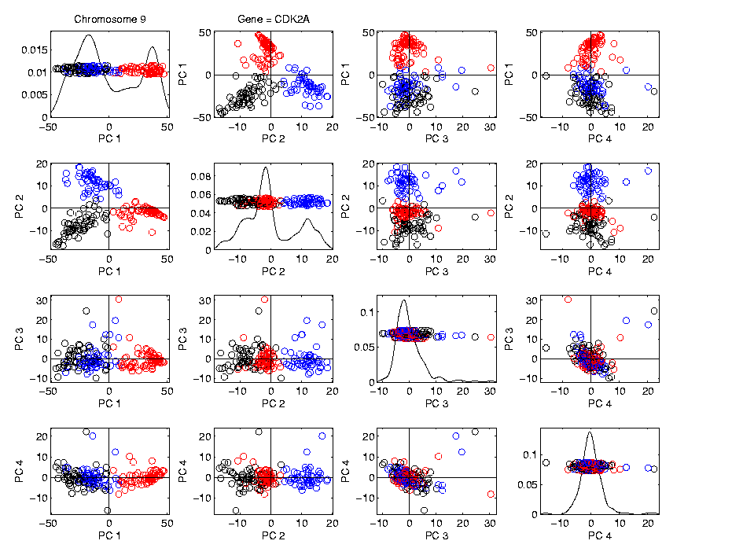
HDLSS Math. Stat. of PCA
HDLSS
PCA
Often
Finds
Signal,
Not Pure
Noise

Slide 116
HDLSS Math. Stat. of PCA
Recall
RNAseq
Data From
8/23/12
d ~ 1700
n = 180

Slide 117
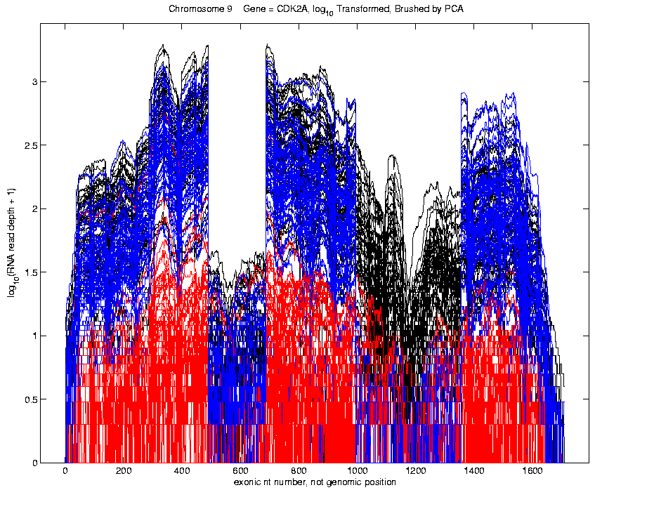
Functional Data Analysis
Manually
Brushed
Clusters
Clear
Alternate
Splicing
Not
Noise!

Slide 118
HDLSS Math. Stat. of PCA
Recall Theoretical Separation:
Strong Inconsistency - spike
Consistency - spike

Slide 119
HDLSS Math. Stat. of PCA
Recall Theoretical Separation:
Strong Inconsistency - spike
Consistency - spike
Mathematically Driven Conclusion:
Real Data Signals Are This Strong

Slide 120
HDLSS Math. Stat. of PCA
An Interesting Objection:
Should not Study Angles in PCA

Slide 121
HDLSS Math. Stat. of PCA
An Interesting Objection:
Should not Study Angles in PCA
Recall, for Consistency:

Slide 122
HDLSS Math. Stat. of PCA
An Interesting Objection:
Should not Study Angles in PCA
Recall, for Consistency:
For Strong Inconsistency:

Slide 123
HDLSS Math. Stat. of PCA
An Interesting Objection:
Should not Study Angles in PCA
Because PC Scores (i.e. projections)
Not Consistent

Slide 124
HDLSS Math. Stat. of PCA
An Interesting Objection:
Should not Study Angles in PCA
Because PC Scores (i.e. projections)
Not Consistent
For Scores
What we study in PCA scatterplots

Slide 125
HDLSS Math. Stat. of PCA
An Interesting Objection:
Should not Study Angles in PCA
Because PC Scores (i.e. projections)
Not Consistent
For Scores and

Slide 126
HDLSS Math. Stat. of PCA
An Interesting Objection:
Should not Study Angles in PCA
Because PC Scores (i.e. projections)
Not Consistent
For Scores and
Can Show (Random!)
Thanks to Dan Shen

Slide 127
HDLSS Math. Stat. of PCA
PC Scores (i.e. projections)
Not Consistent
So how can PCA find Useful Signals in Data?

Slide 128
HDLSS Math. Stat. of PCA
HDLSS
PCA
Often
Finds
Signal,
Not Pure
Noise

Slide 129
HDLSS Math. Stat. of PCA
PC Scores (i.e. projections)
Not Consistent
So how can PCA find Useful Signals in Data?
Key is “Proportional Errors”

Slide 130
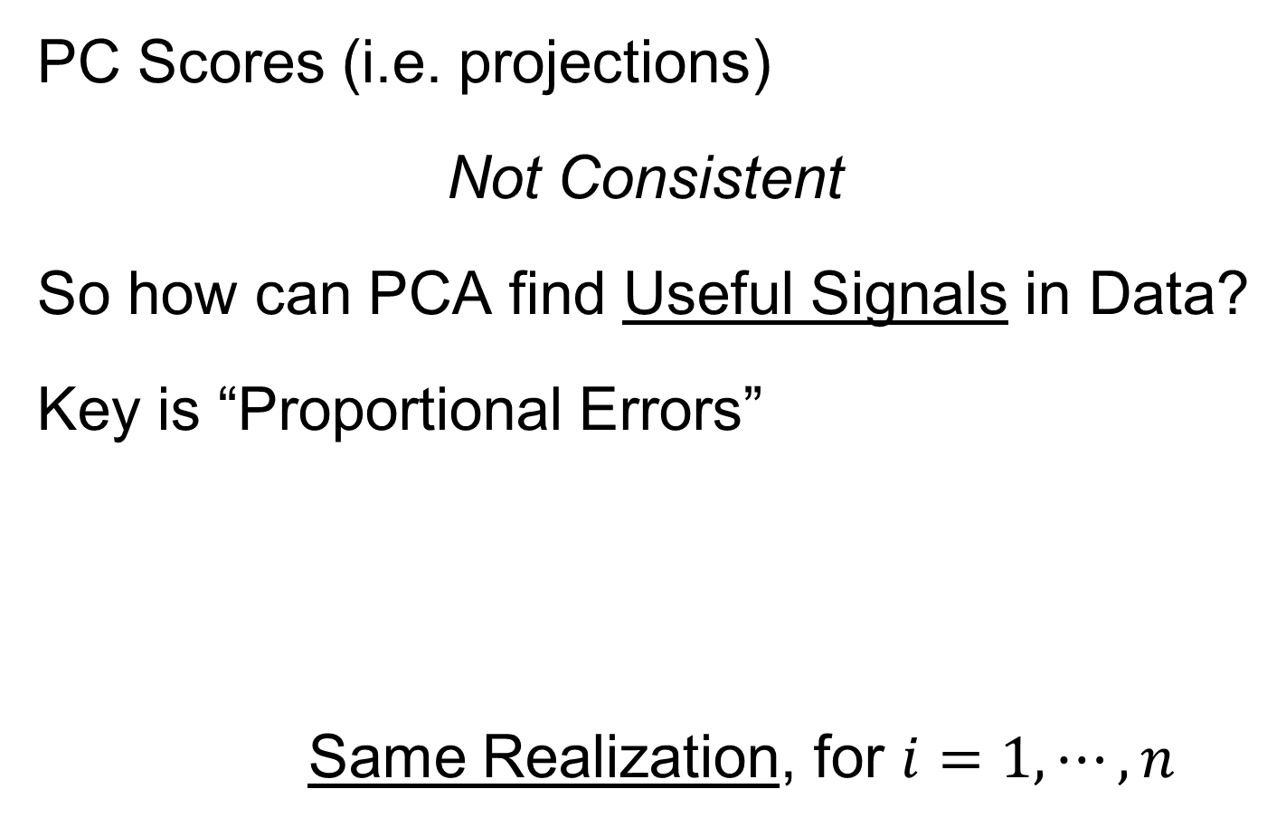
HDLSS Math. Stat. of PCA
PC Scores (i.e. projections)
Not Consistent
So how can PCA find Useful Signals in Data?
Key is “Proportional Errors”
Same Realization, for $i=1,⋯,n$

Slide 131
HDLSS Math. Stat. of PCA
PC Scores (i.e. projections)
Not Consistent
So how can PCA find Useful Signals in Data?
Key is “Proportional Errors”
Axes have Inconsistent Scales,
But Relationships are Still Useful

Slide 132
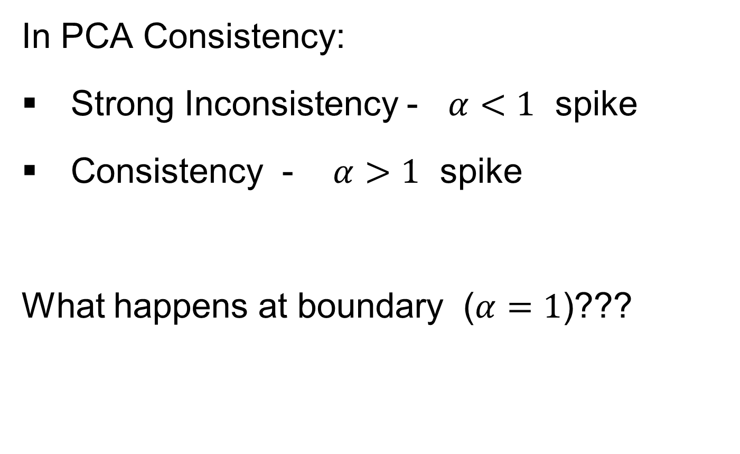
HDLSS Deep Open Problem
In PCA Consistency:
Strong Inconsistency - $α<1$ spike
Consistency - $α>1$ spike
What happens at boundary ($α=1$)???

Slide 133
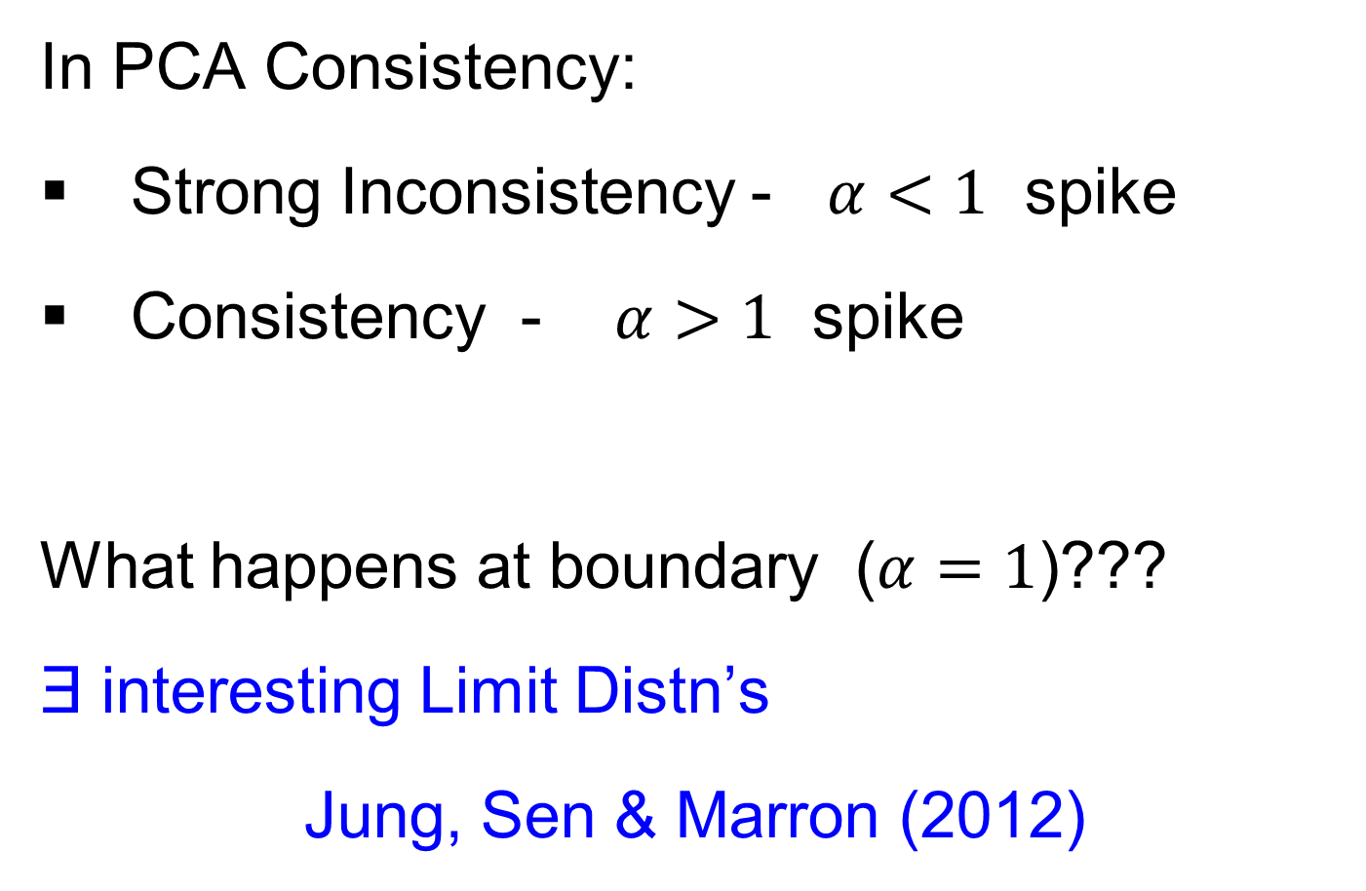
HDLSS Deep Open Problem
Result
In PCA Consistency:
Strong Inconsistency - $α<1$ spike
Consistency - $α>1$ spike
What happens at boundary ($α=1$)???
Ǝ interesting Limit Distn’s
Jung, Sen & Marron (2012)

Slide 134
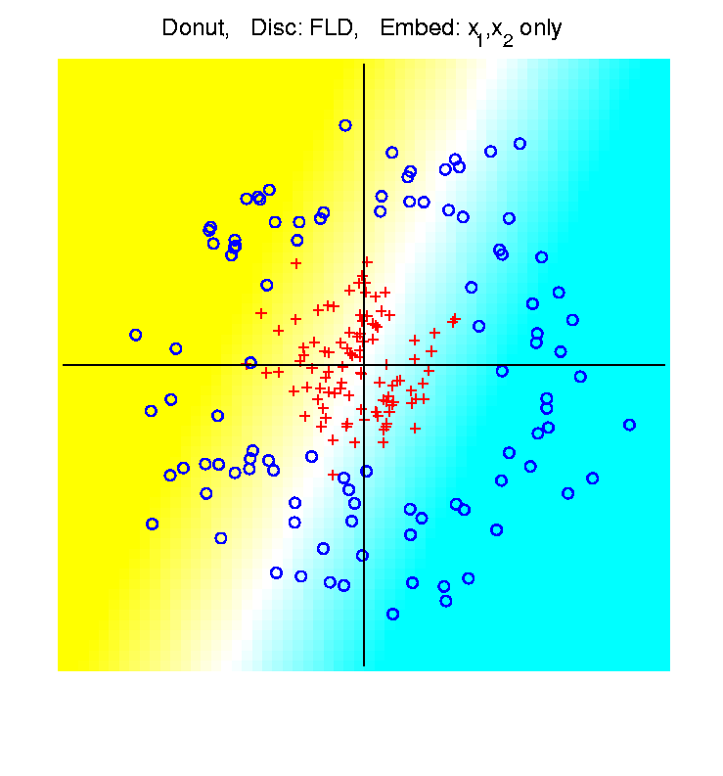
HDLSS Asymptotics & Kernel Methods
Recall
Flexibility
From
Kernel
Embedding
Idea

Slide 135
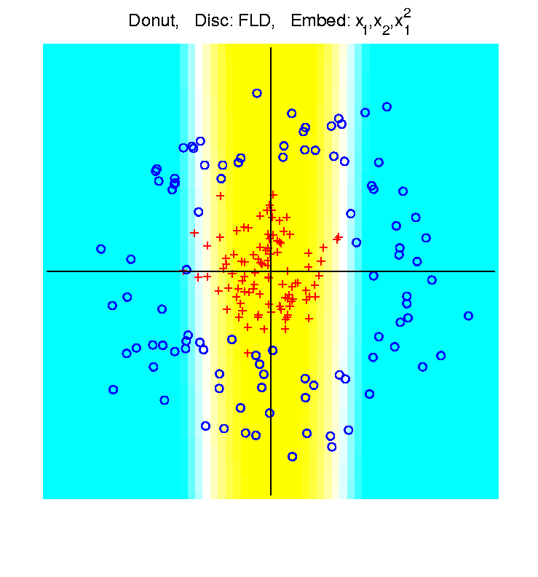
HDLSS Asymptotics & Kernel Methods
Recall
Flexibility
From
Kernel
Embedding
Idea

Slide 136
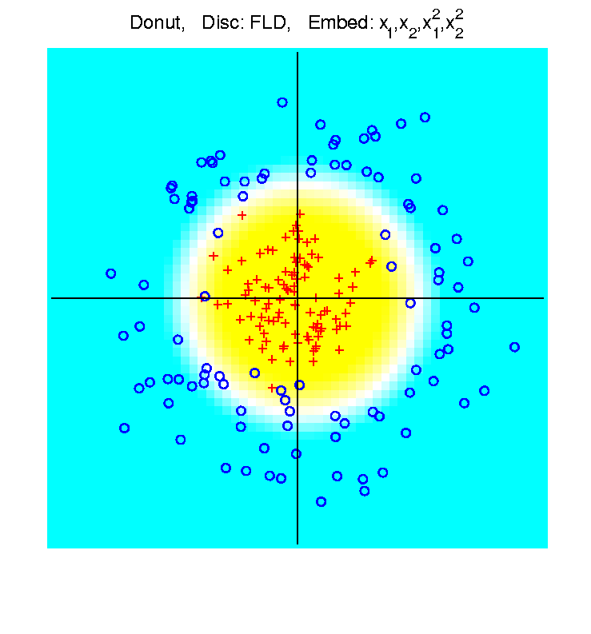
HDLSS Asymptotics & Kernel Methods
Recall
Flexibility
From
Kernel
Embedding
Idea

Slide 137
HDLSS Asymptotics & Kernel Methods
Interesting Question:
Behavior in Very High Dimension?

Slide 138
HDLSS Asymptotics & Kernel Methods
Interesting Question:
Behavior in Very High Dimension?
Answer: El Karoui (2010)

Slide 139
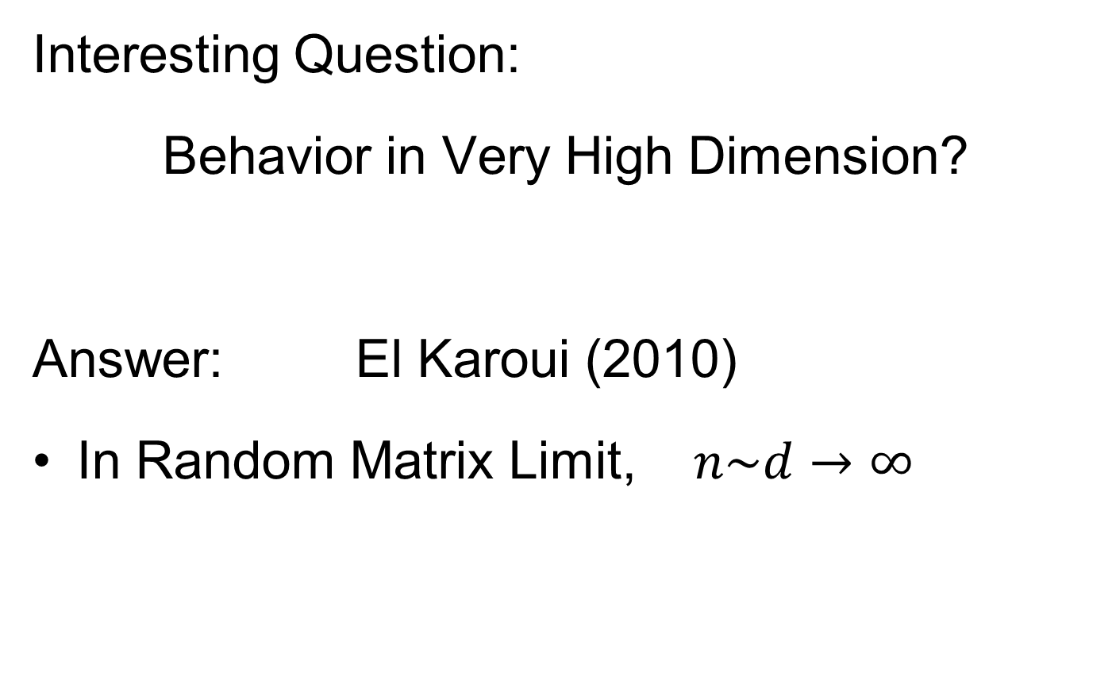

HDLSS Asymptotics & Kernel Methods
Interesting Question:
Behavior in Very High Dimension?
Answer: El Karoui (2010)
In Random Matrix Limit, $n\sim d→∞$

Slide 140
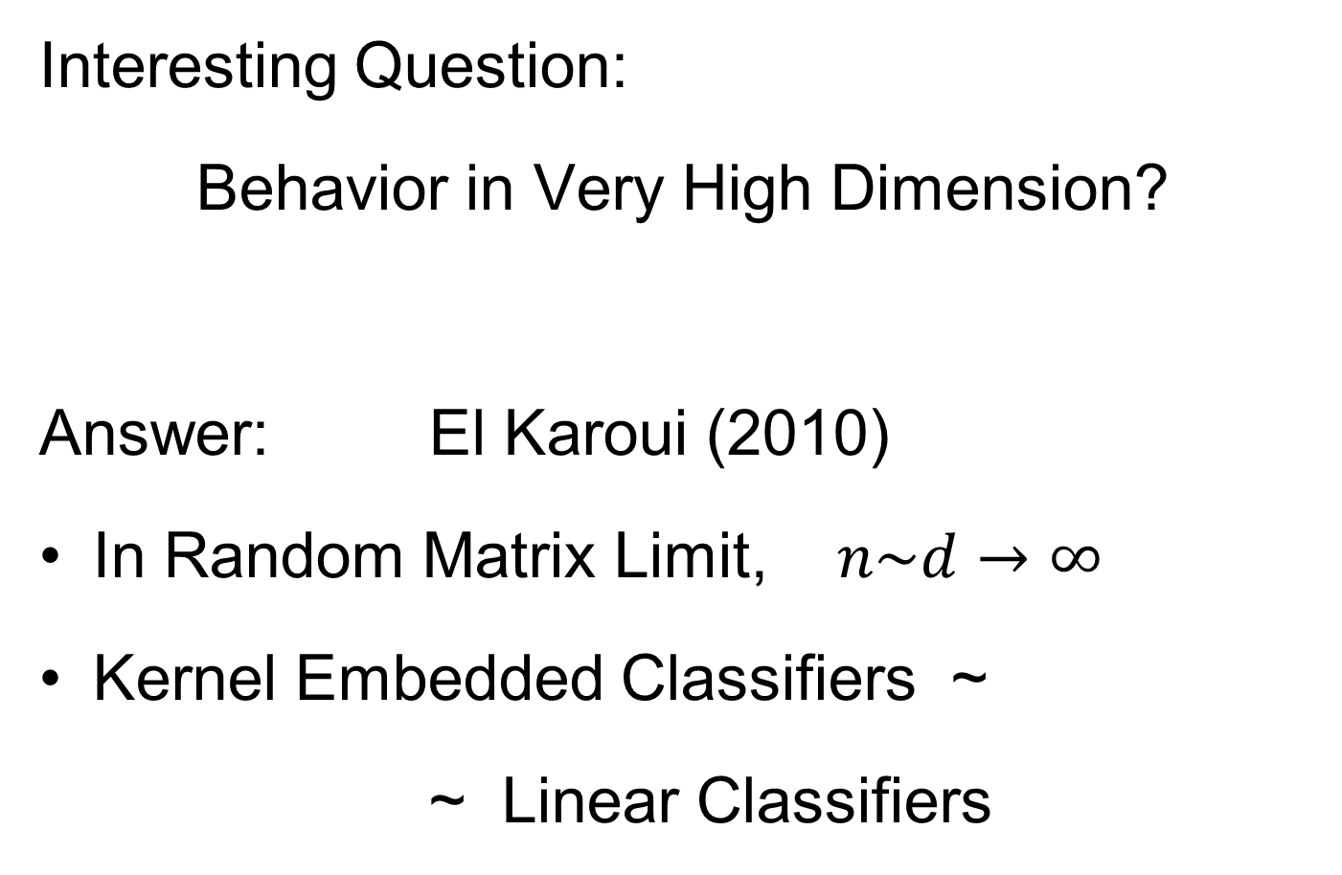
HDLSS Asymptotics & Kernel Methods
Interesting Question:
Behavior in Very High Dimension?
Answer: El Karoui (2010)
In Random Matrix Limit, $n\sim d→∞$
Kernel Embedded Classifiers ~
~ Linear Classifiers

Slide 141
HDLSS Asymptotics & Kernel Methods
Interesting Question:
Behavior in Very High Dimension?
Implications for DWD:
Recall Main Advantage is for High d

Slide 142
HDLSS Asymptotics & Kernel Methods
Interesting Question:
Behavior in Very High Dimension?
Implications for DWD:
Recall Main Advantage is for High d
So not Clear Embedding Helps
Thus not yet Implemented in DWD

Slide 143
HDLSS Additional Results
Batch Adjustment: Xuxin Liu
Recall Intuition from above:
Key is sizes of biological subtypes
Differing ratio trips up mean
But DWD more robust
Mathematics behind this?

