Slide 1
Return to Big Picture
Main statistical goals of OODA:
Understanding population structure
Low dim’al Projections, PCA …
Classification (i. e. Discrimination)
Understanding 2+ populations
Time Series of Data Objects
Chemical Spectra, Mortality Data
“Vertical Integration” of Data Types

Slide 2
Maximal Data Piling
Strange FLD effect at HDLSS boundary:
Data Piling:
For each class,
all data
project to
single
value

Slide 3
Maximal Data Piling
Visual similarity of & ?
Can show (Ahn & Marron 2009), for d < n:
I.e. directions are the same!
How can this be?
Note lengths are different…
Study from transformation viewpoint

Slide 4
Kernel Embedding
Aizerman, Braverman and Rozoner (1964)
Motivating idea:
Extend scope of linear discrimination,
By adding nonlinear components to data
(embedding in a higher dim’al space)
Better use of name:
nonlinear discrimination?

Slide 5
Kernel Embedding
General View: for original data matrix:
add rows:
i.e. embed in
Higher
Dimensional
space

Slide 6
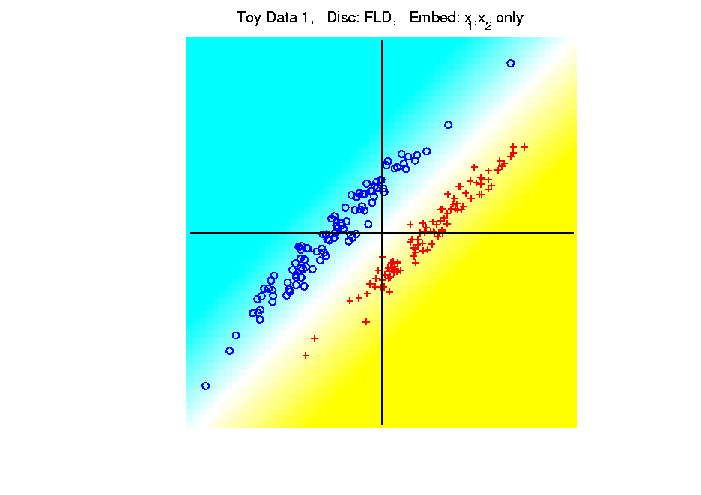
Kernel Embedding
Polynomial Embedding, Toy Example 1:
Parallel Clouds
FLD
Original
Data
Notes:
PEod1Raw.ps

Slide 7
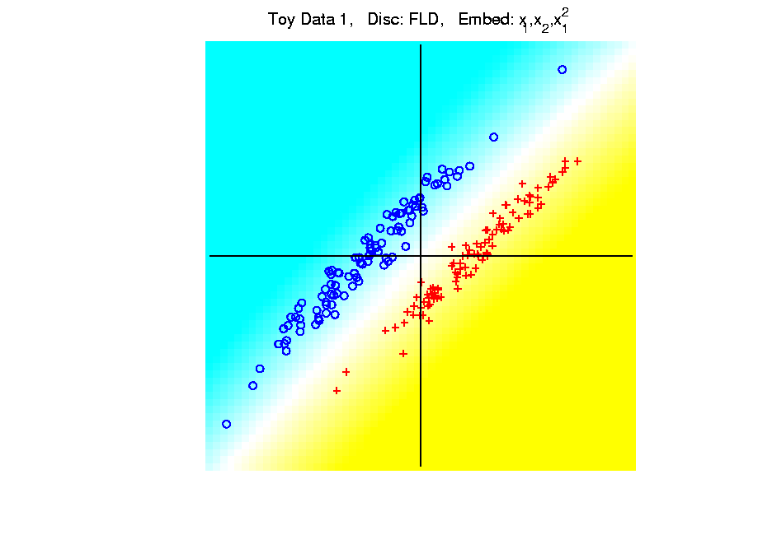
Kernel Embedding
Polynomial Embedding, Toy Example 1:
Parallel Clouds
FLD
Notes:
PEod1Raw.ps

Slide 8
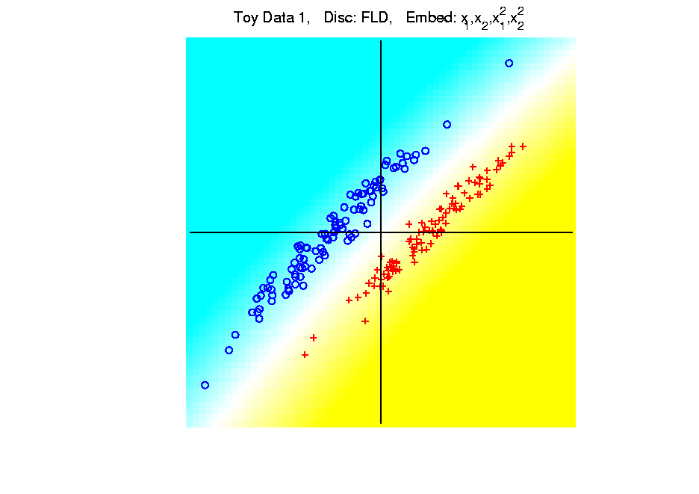
Kernel Embedding
Polynomial Embedding, Toy Example 1:
Parallel Clouds
FLD
Notes:
PEod1Raw.ps

Slide 9
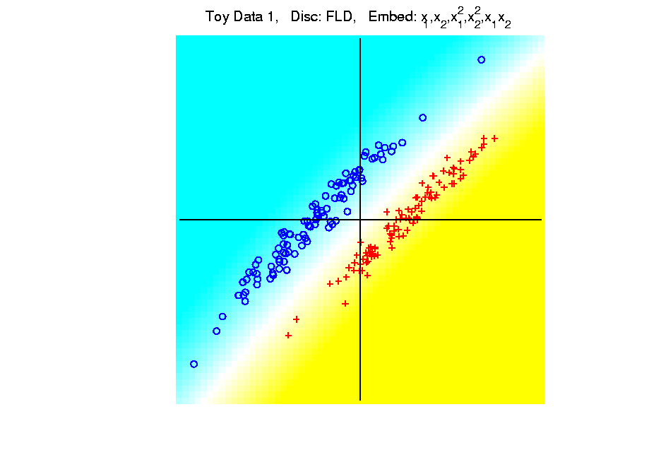
Kernel Embedding
Polynomial Embedding, Toy Example 1:
Parallel Clouds
FLD
Notes:
PEod1Raw.ps

Slide 10
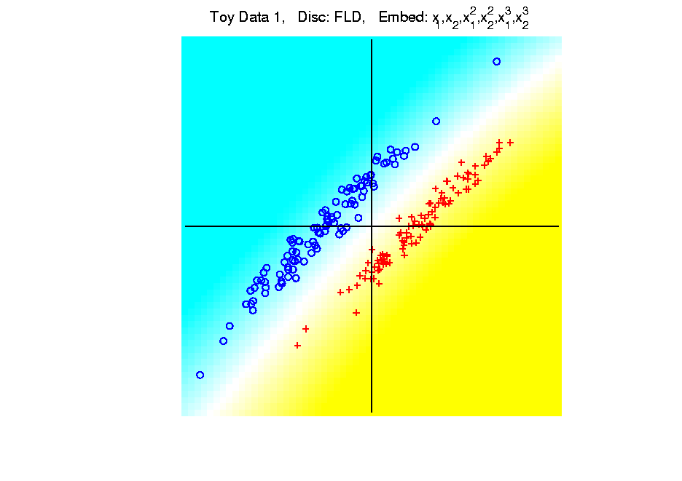
Kernel Embedding
Polynomial Embedding, Toy Example 1:
Parallel Clouds
FLD
All Stable
& Very Good
Notes:
PEod1Raw.ps

Slide 11
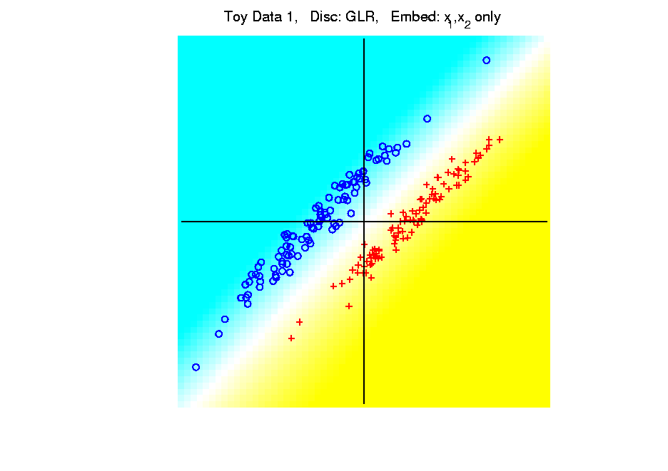
Kernel Embedding
Polynomial Embedding, Toy Example 1:
Parallel Clouds
GLR
Original
Data
Notes:
PEod1Raw.ps

Slide 12
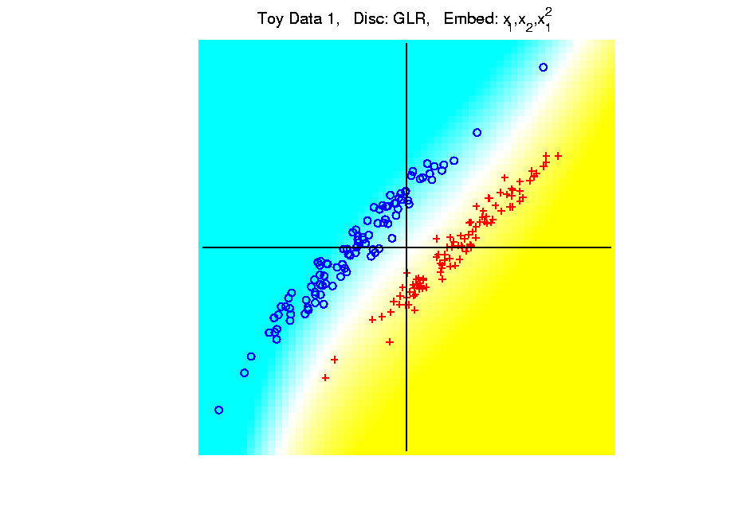
Kernel Embedding
Polynomial Embedding, Toy Example 1:
Parallel Clouds
GLR
Notes:
PEod1Raw.ps

Slide 13
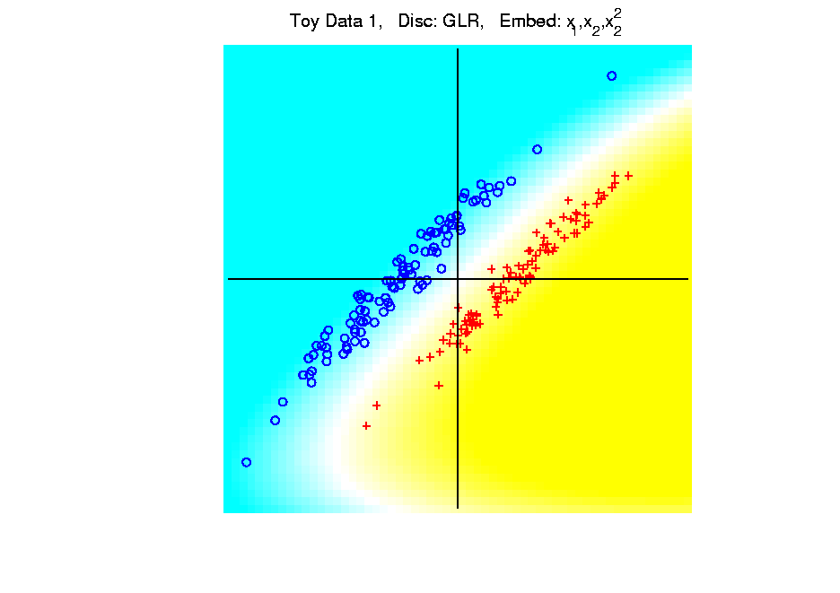
Kernel Embedding
Polynomial Embedding, Toy Example 1:
Parallel Clouds
GLR
Notes:
PEod1Raw.ps

Slide 14
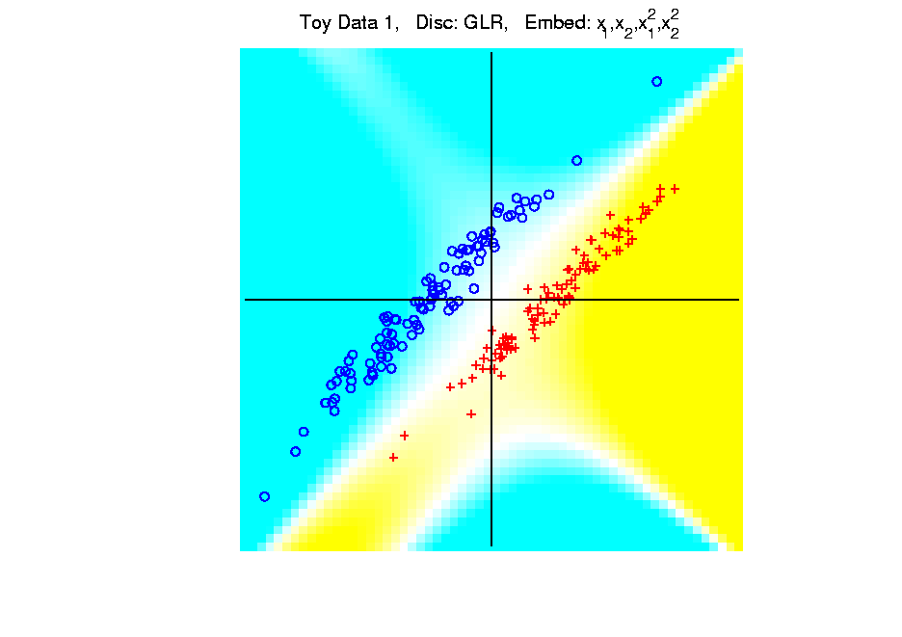
Kernel Embedding
Polynomial Embedding, Toy Example 1:
Parallel Clouds
GLR
Notes:
PEod1Raw.ps

Slide 15
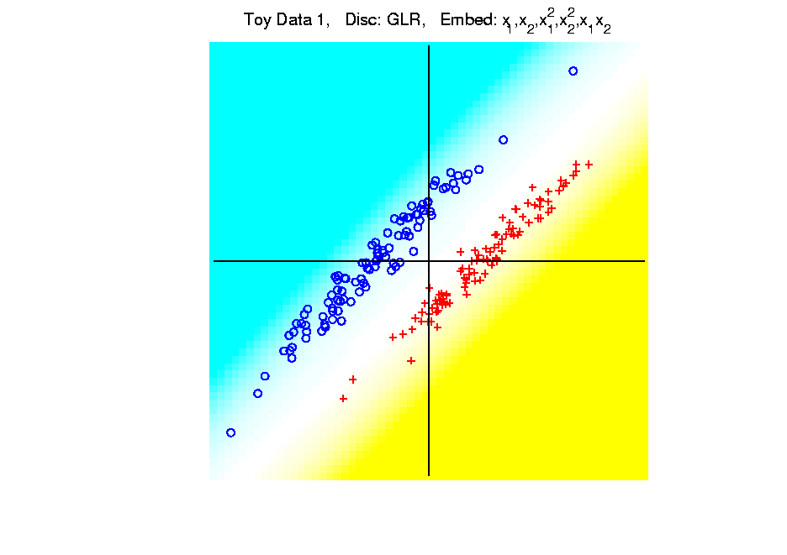
Kernel Embedding
Polynomial Embedding, Toy Example 1:
Parallel Clouds
GLR
Notes:
PEod1Raw.ps

Slide 16
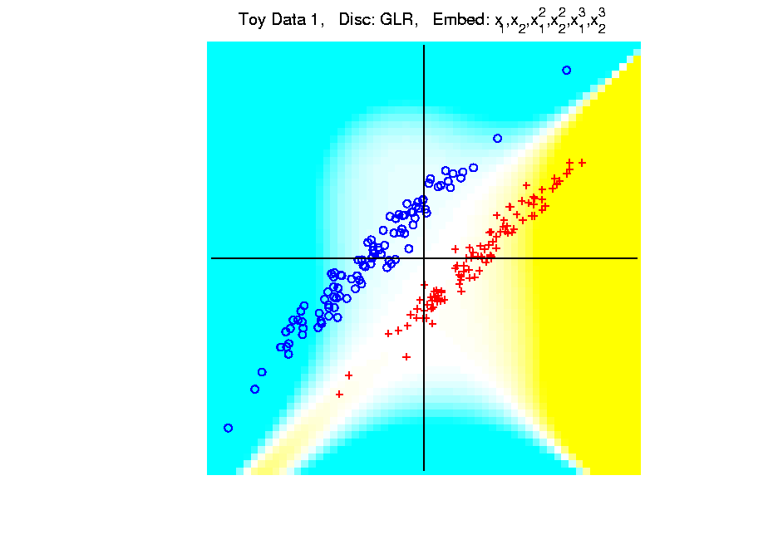
Kernel Embedding
Polynomial Embedding, Toy Example 1:
Parallel Clouds
GLR
Unstable
Subject to
Overfitting
Notes:
PEod1Raw.ps

Slide 17
Kernel Embedding
Polynomial Embedding, Toy Example 2:
Split X
Notes:
PEod1Raw.ps

Slide 18
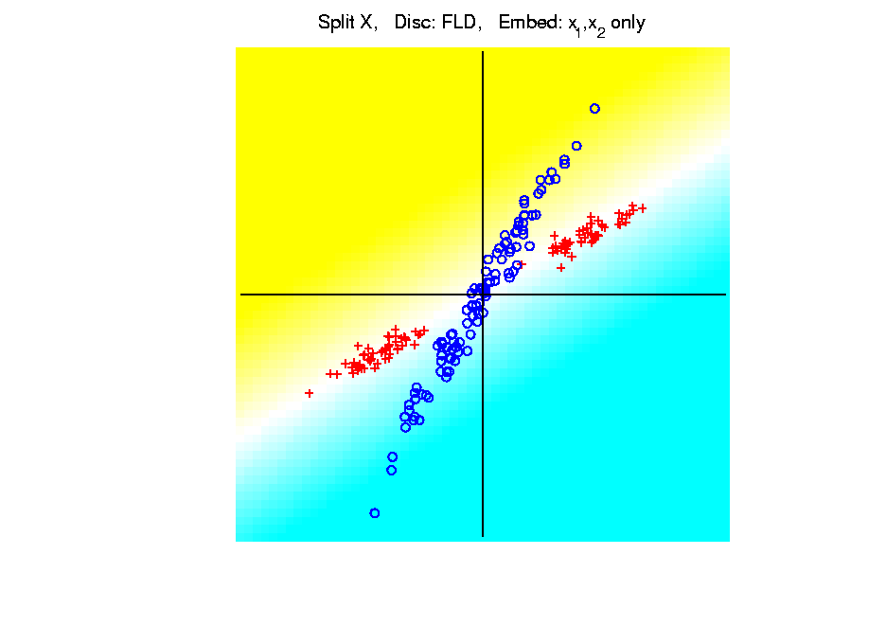
Kernel Embedding
Polynomial Embedding, Toy Example 2:
Split X
FLD
Original
Data
Notes:
PEod1Raw.ps

Slide 19
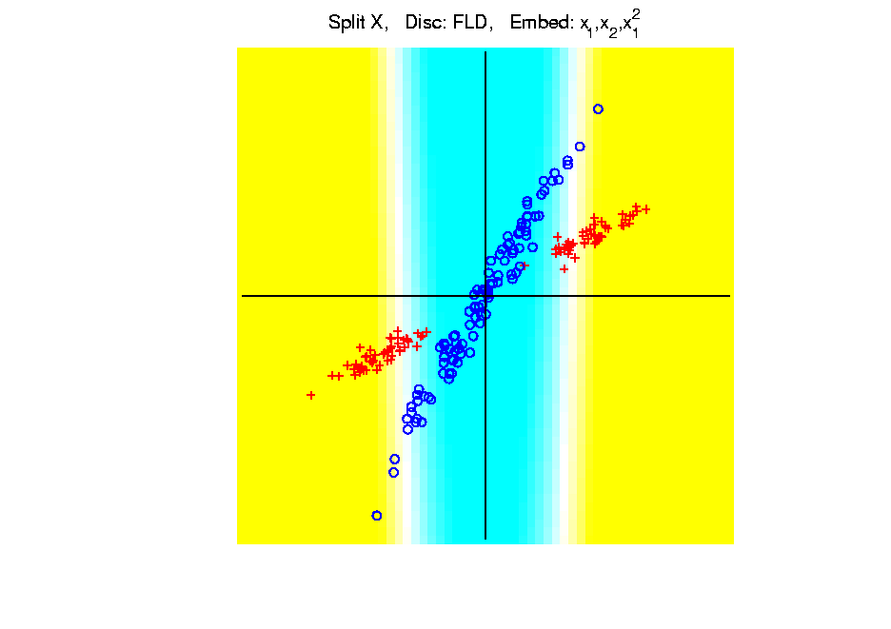
Kernel Embedding
Polynomial Embedding, Toy Example 2:
Split X
FLD
Slightly
Better
Notes:
PEod1Raw.ps

Slide 20
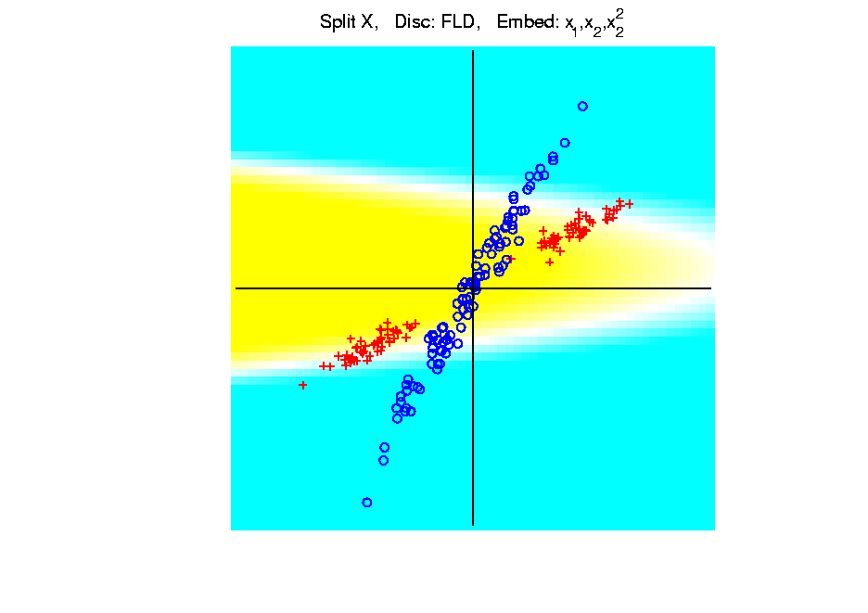
Kernel Embedding
Polynomial Embedding, Toy Example 2:
Split X
FLD
Notes:
PEod1Raw.ps

Slide 21
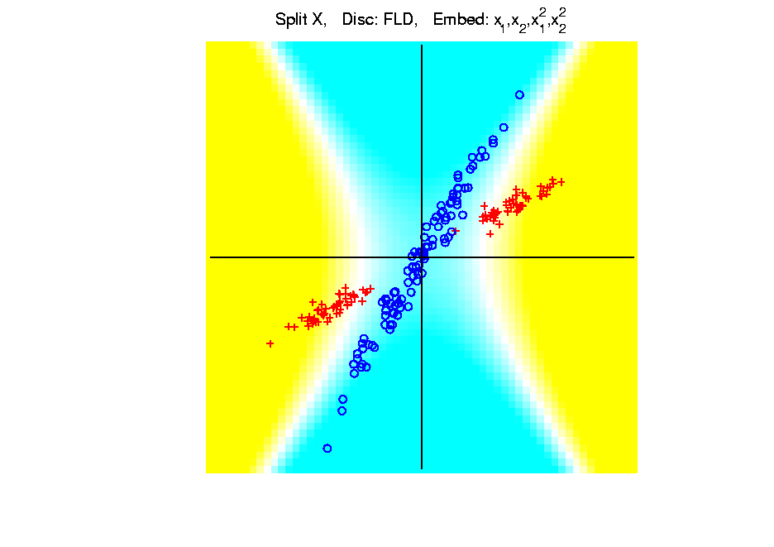
Kernel Embedding
Polynomial Embedding, Toy Example 2:
Split X
FLD
Very Good
Effective
Hyperbola
Notes:
PEod1Raw.ps

Slide 22
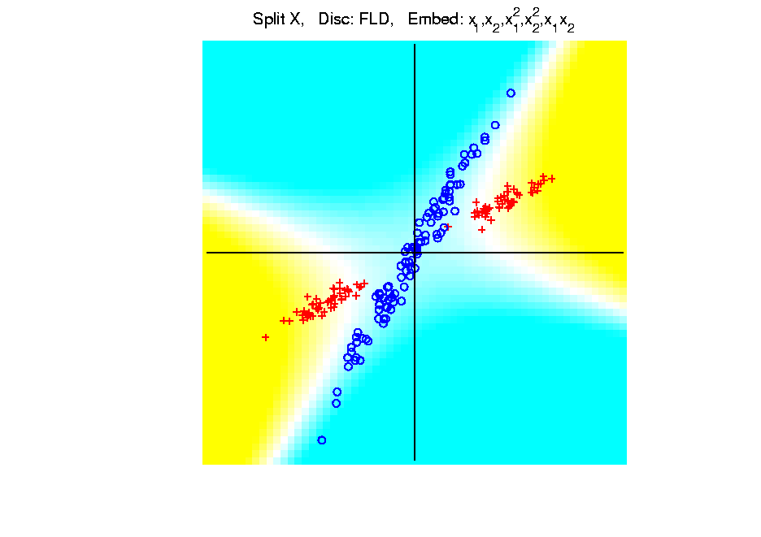
Kernel Embedding
Polynomial Embedding, Toy Example 2:
Split X
FLD
Notes:
PEod1Raw.ps

Slide 23
Kernel Embedding
Polynomial Embedding, Toy Example 2:
Split X
FLD
Robust
Against
Overfitting
Notes:
PEod1Raw.ps

Slide 24
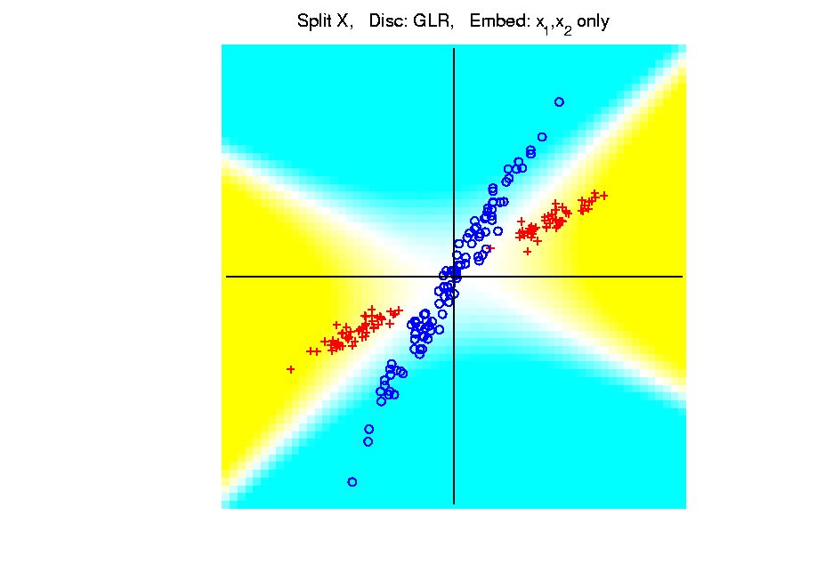
Kernel Embedding
Polynomial Embedding, Toy Example 2:
Split X
GLR
Original
Data
Looks
Very
Good
Notes:
PEod1Raw.ps

Slide 25
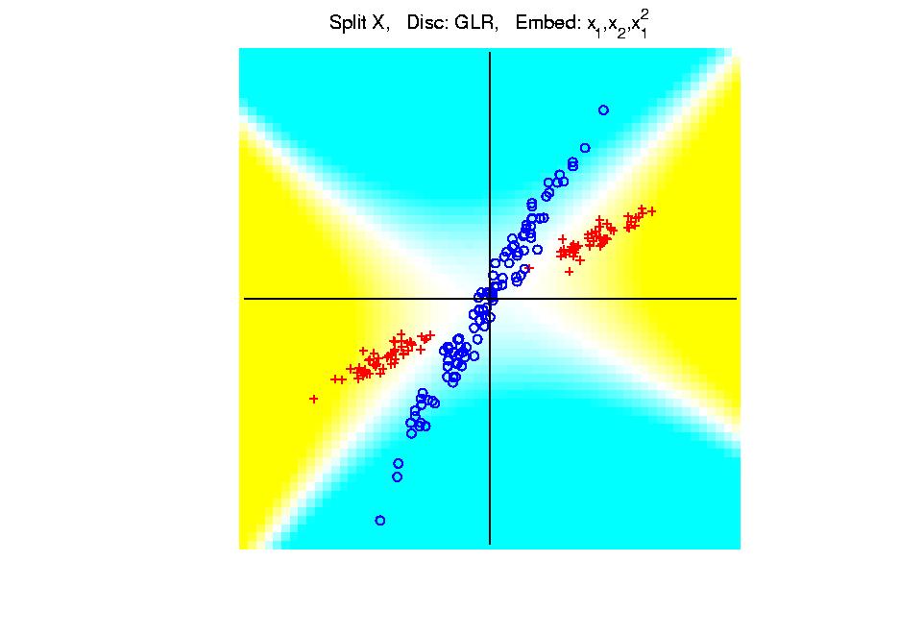
Kernel Embedding
Polynomial Embedding, Toy Example 2:
Split X
GLR
Notes:
PEod1Raw.ps

Slide 26
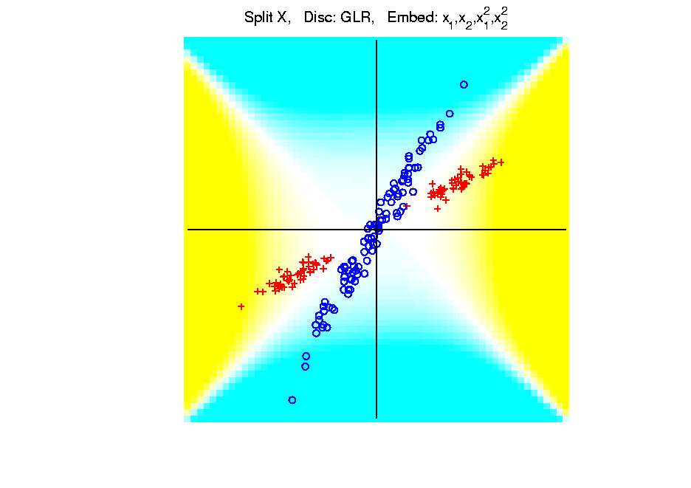
Kernel Embedding
Polynomial Embedding, Toy Example 2:
Split X
GLR
Reasonably
Stable
Never Ellipse
Around Blues
Notes:
PEod1Raw.ps

Slide 27
Kernel Embedding
Polynomial Embedding, Toy Example 3:
Donut
Notes:
PEod1Raw.ps

Slide 28
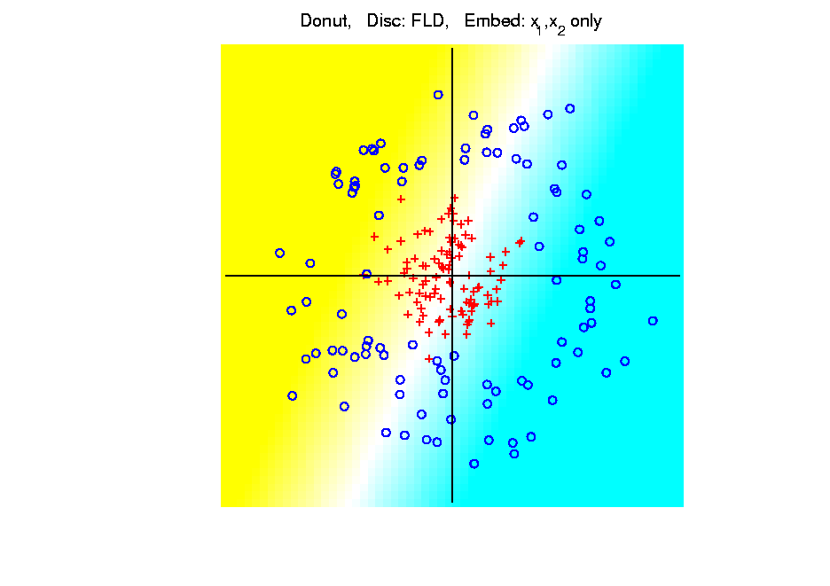
Kernel Embedding
Polynomial Embedding, Toy Example 3:
Donut
FLD
Original
Data
Very
Bad
Notes:
PEod1Raw.ps

Slide 29
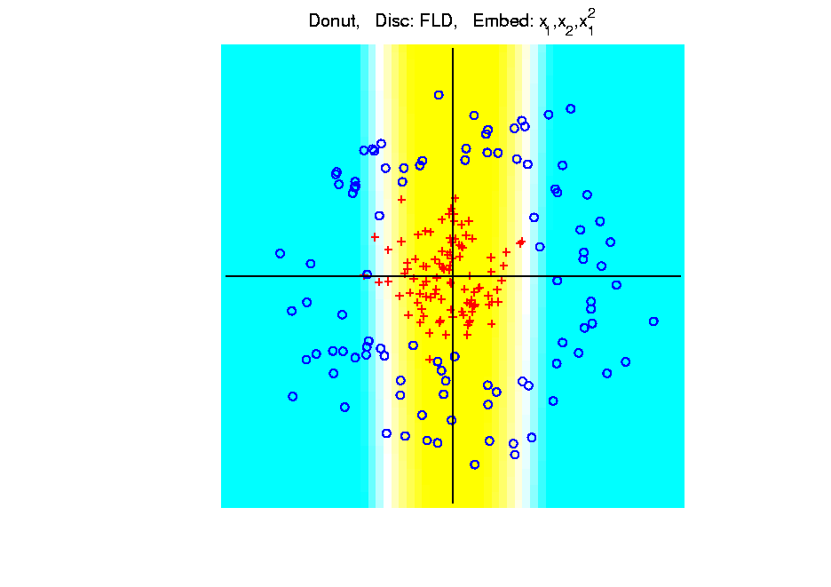
Kernel Embedding
Polynomial Embedding, Toy Example 3:
Donut
FLD
Somewhat
Better
(Parabolic Fold)
Notes:
PEod1Raw.ps

Slide 30
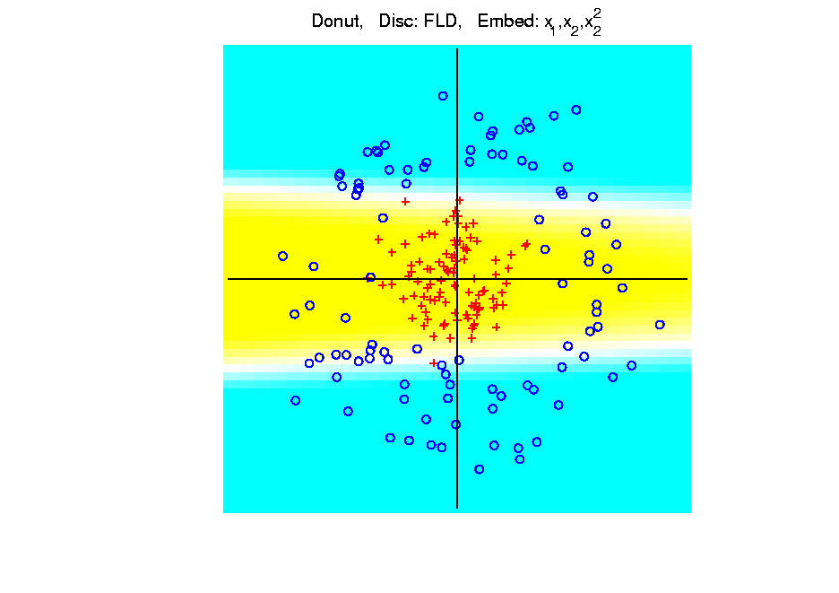
Kernel Embedding
Polynomial Embedding, Toy Example 3:
Donut
FLD
Somewhat
Better
(Other Fold)
Notes:
PEod1Raw.ps

Slide 31
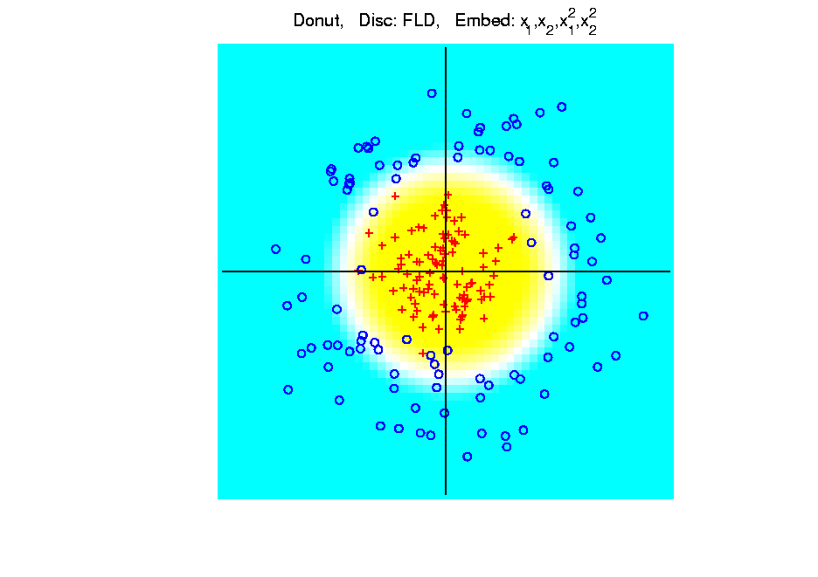
Kernel Embedding
Polynomial Embedding, Toy Example 3:
Donut
FLD
Good
Performance
(Slice of
Paraboloid)
Notes:
PEod1Raw.ps

Slide 32
Kernel Embedding
Polynomial Embedding, Toy Example 3:
Donut
FLD
Notes:
PEod1Raw.ps

Slide 33
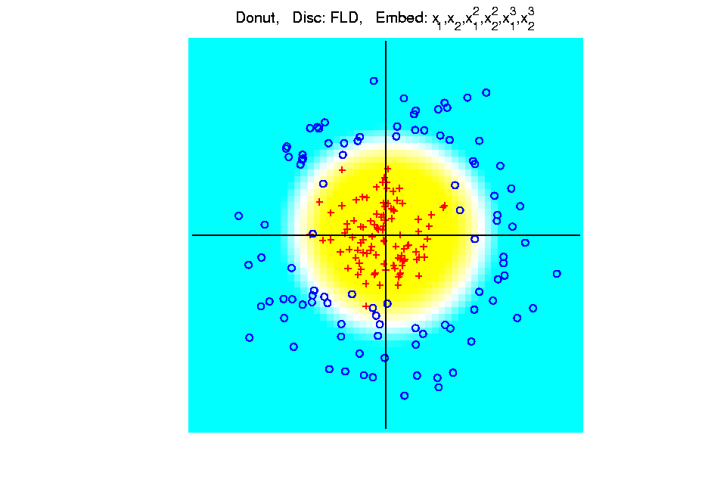
Kernel Embedding
Polynomial Embedding, Toy Example 3:
Donut
FLD
Robust
Against
Overfitting
Notes:
PEod1Raw.ps

Slide 34
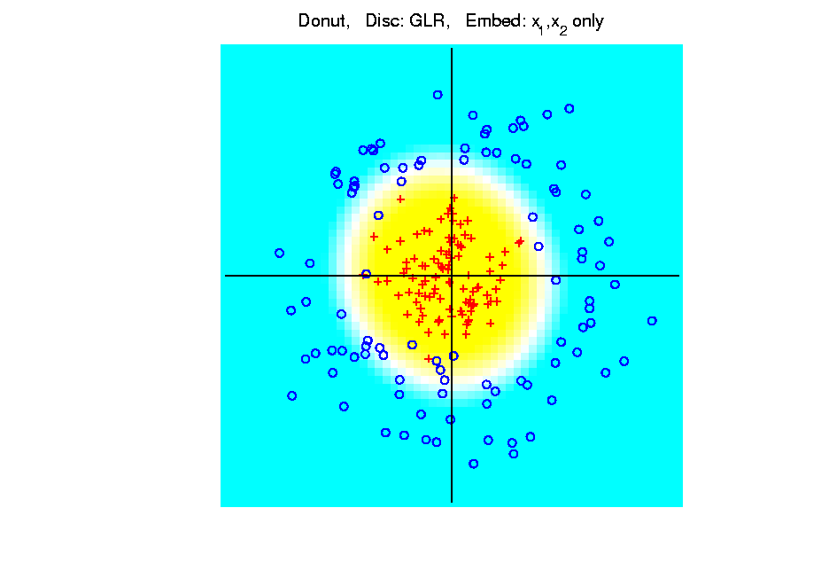
Kernel Embedding
Polynomial Embedding, Toy Example 3:
Donut
GLR
Original
Data
Best With
No Embedding?
Notes:
PEod1Raw.ps

Slide 35
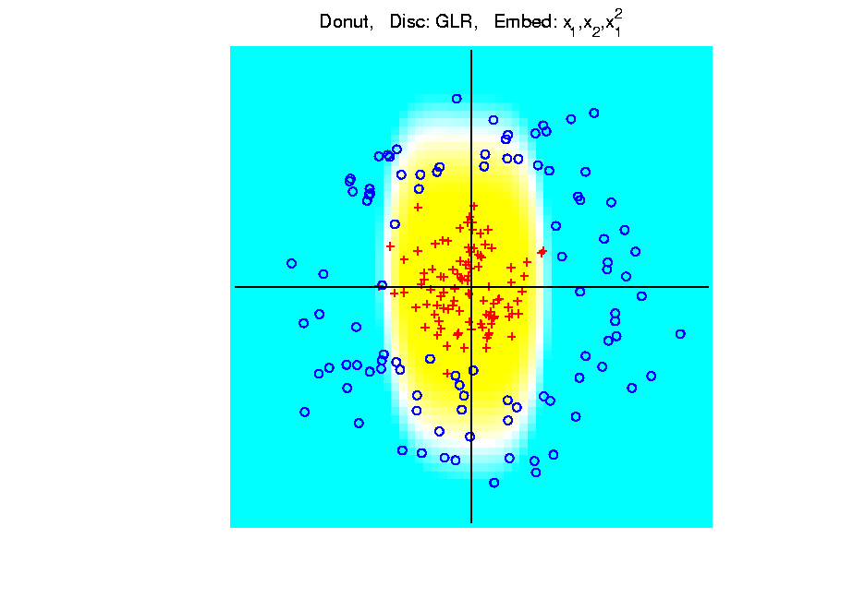
Kernel Embedding
Polynomial Embedding, Toy Example 3:
Donut
GLR
Notes:
PEod1Raw.ps

Slide 36
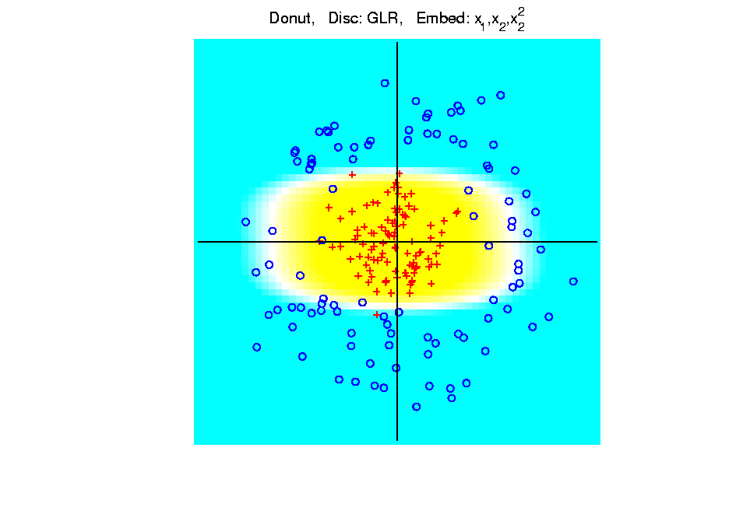
Kernel Embedding
Polynomial Embedding, Toy Example 3:
Donut
GLR
Notes:
PEod1Raw.ps

Slide 37
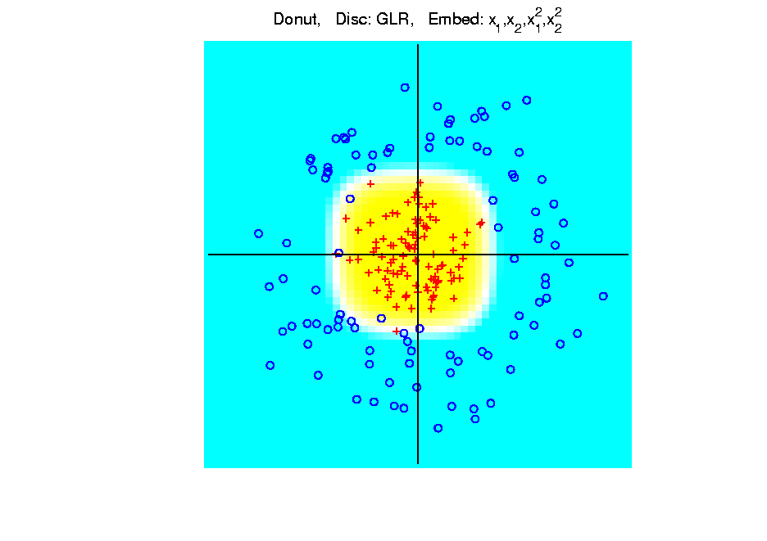
Kernel Embedding
Polynomial Embedding, Toy Example 3:
Donut
GLR
Notes:
PEod1Raw.ps

Slide 38
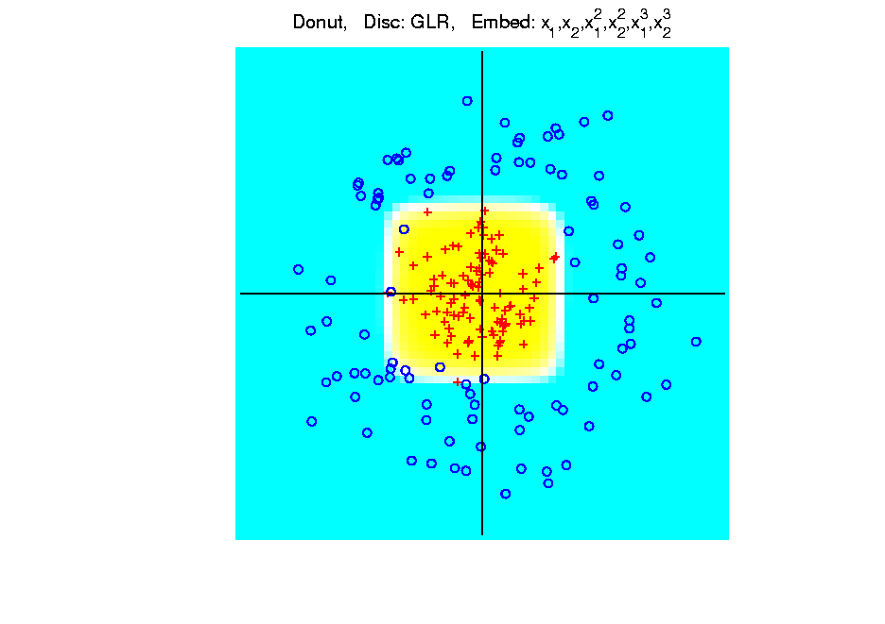
Kernel Embedding
Polynomial Embedding, Toy Example 3:
Donut
GLR
Overfitting
Gives Square
Shape?
Notes:
PEod1Raw.ps

Slide 39
Kernel Embedding
Drawbacks to polynomial embedding:
too many extra terms create spurious structure
i.e. have “overfitting”
HDLSS problems typically get worse

Slide 40
Kernel Embedding
Hot Topic Variation: “Kernel Machines”
Idea: replace polynomials by
other nonlinear functions

Slide 41
Kernel Embedding
Hot Topic Variation: “Kernel Machines”
Idea: replace polynomials by
other nonlinear functions
e.g. 1: sigmoid functions from neural nets

Slide 42
Kernel Embedding
Hot Topic Variation: “Kernel Machines”
Idea: replace polynomials by
other nonlinear functions
e.g. 1: sigmoid functions from neural nets
e.g. 2: radial basis functions
Gaussian kernels
Related to “kernel density estimation”
(recall: smoothed histogram)

Slide 43
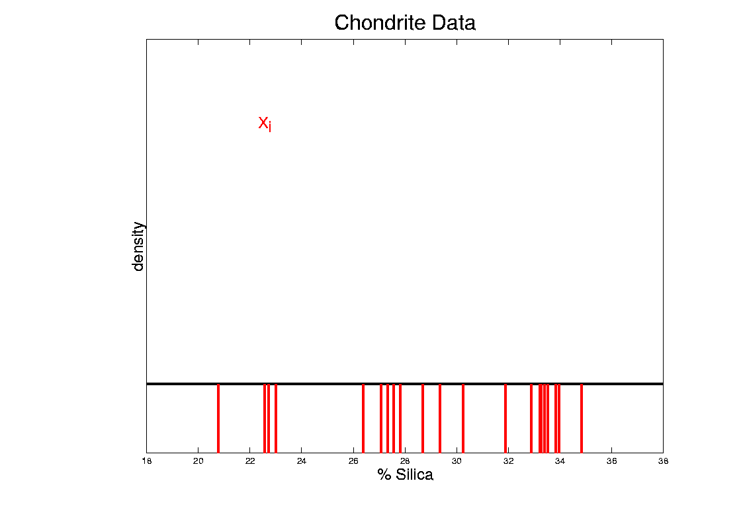
Kernel Density Estimation
Chondrite Data:
Represent points by red bars
Where are data “more dense”?
Notes:
43

Slide 44
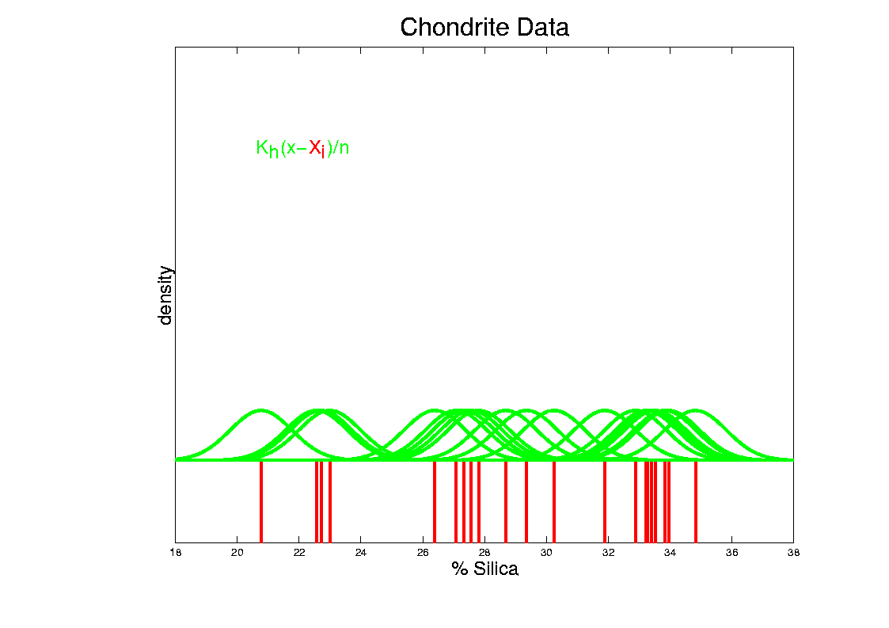
Kernel Density Estimation
Chondrite Data:
Put probability mass 1/n at each point
Smooth piece of “density”
Notes:
44

Slide 45
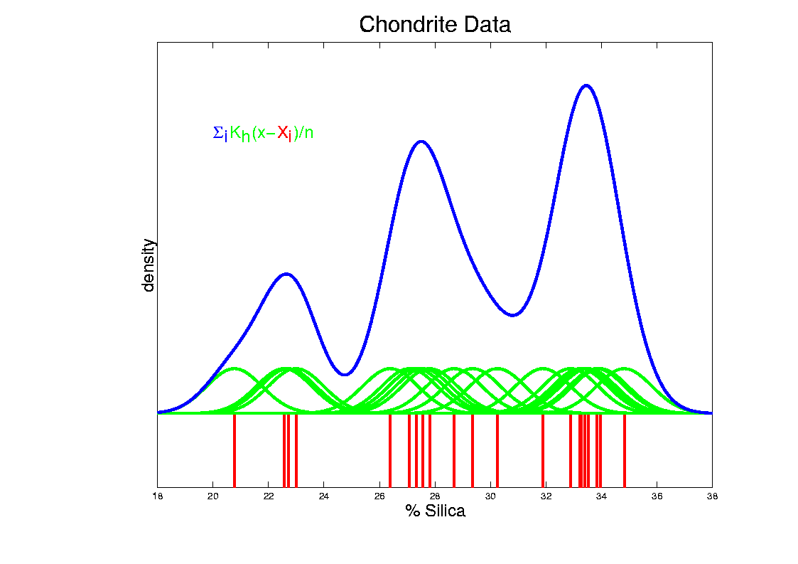
Kernel Density Estimation
Chondrite Data:
Sum pieces to estimate density
Suggests 3 modes (rock sources)
Notes:
45

Slide 46
Kernel Embedding
Radial Basis Functions:
Note: there are several ways to embed

Slide 47
Kernel Embedding
Radial Basis Functions:
Note: there are several ways to embed:
Naïve Embedding (equally spaced grid)
(Will take a look at this,
for illustration purposes)

Slide 48
Kernel Embedding
Radial Basis Functions:
Note: there are several ways to embed:
Naïve Embedding (equally spaced grid)
Explicit Embedding (evaluate at data)

Slide 49
Kernel Embedding
Radial Basis Functions:
Note: there are several ways to embed:
Naïve Embedding (equally spaced grid)
Explicit Embedding (evaluate at data)
Implicit Emdedding (inner prod. based)
(everybody currently does the latter)

Slide 50
Kernel Embedding
Naïve Embedding, Radial basis functions:

Slide 51
Kernel Embedding
Naïve Embedding, Radial basis functions:
At some “grid points” ,
For a “bandwidth” (i.e. standard dev’n) ,

Slide 52
Kernel Embedding
Naïve Embedding, Radial basis functions:
At some “grid points” ,
For a “bandwidth” (i.e. standard dev’n) ,
Consider ( dim’al) functions:

Slide 53
Kernel Embedding
Naïve Embedding, Radial basis functions:
At some “grid points” ,
For a “bandwidth” (i.e. standard dev’n) ,
Consider ( dim’al) functions:
Replace data matrix with:

Slide 54
Kernel Embedding
Naïve Embedding, Radial basis functions:
For discrimination:
Work in radial basis space,
With new data vector ,
represented by:

Slide 55
Kernel Embedding
Naïve Embedd’g, Toy E.g. 1: Parallel Clouds
Good
at data
Poor
outside

Slide 56
Kernel Embedding
Naïve Embedd’g, Toy E.g. 2: Split X
OK at
data
Strange
outside

Slide 57
Kernel Embedding
Naïve Embedd’g, Toy E.g. 3: Donut
Mostly
good

Slide 58
Kernel Embedding
Naïve Embedd’g, Toy E.g. 3: Donut
Mostly
good
Slight
mistake
for one
kernel

Slide 59
Kernel Embedding
Naïve Embedding, Radial basis functions:
Toy Example, Main lessons:
Generally good in regions with data,
Unpredictable where data are sparse

Slide 60
Kernel Embedding
Toy Example 4: Checkerboard
Very
Challenging!
Linear
Method?
Polynomial
Embedding?
Notes:
PEod1Raw.ps

Slide 61
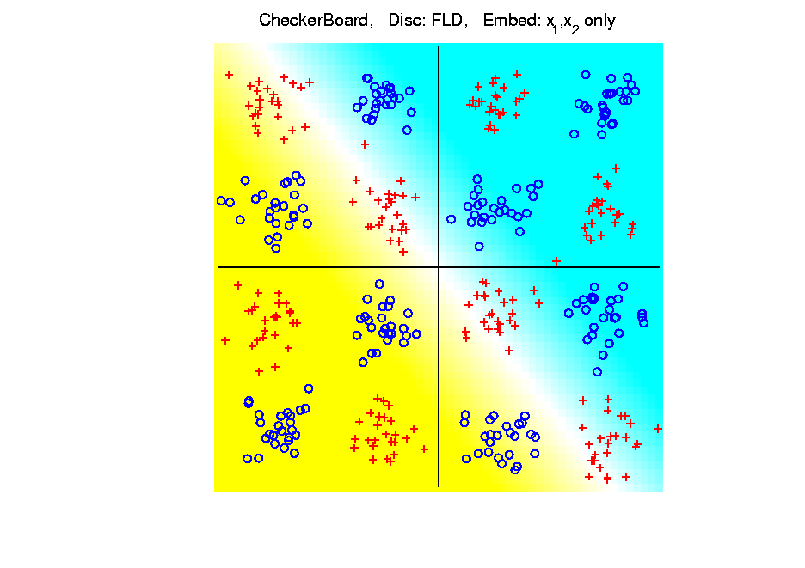
Kernel Embedding
Toy Example 4: Checkerboard
Very
Challenging!
FLD
Linear Is
Hopeless
Notes:
PEod1Raw.ps

Slide 62
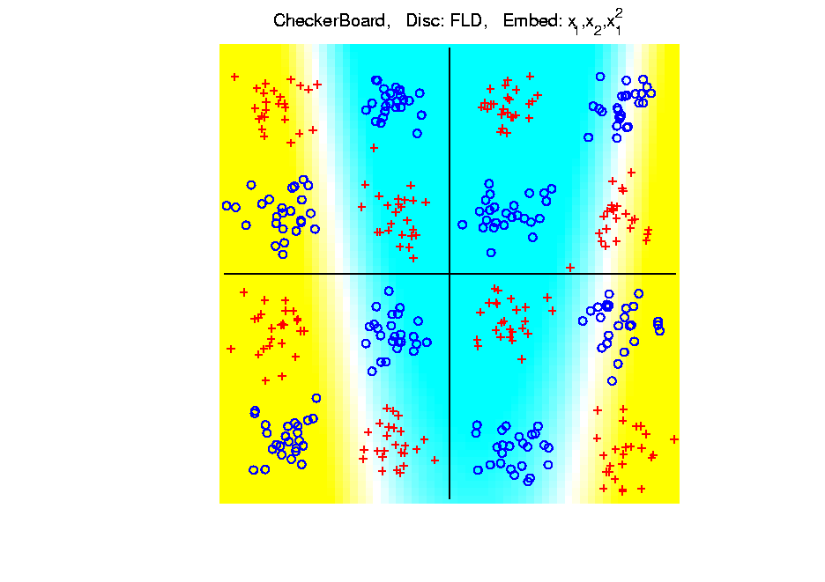
Kernel Embedding
Toy Example 4: Checkerboard
Very
Challenging!
FLD
Notes:
PEod1Raw.ps

Slide 63
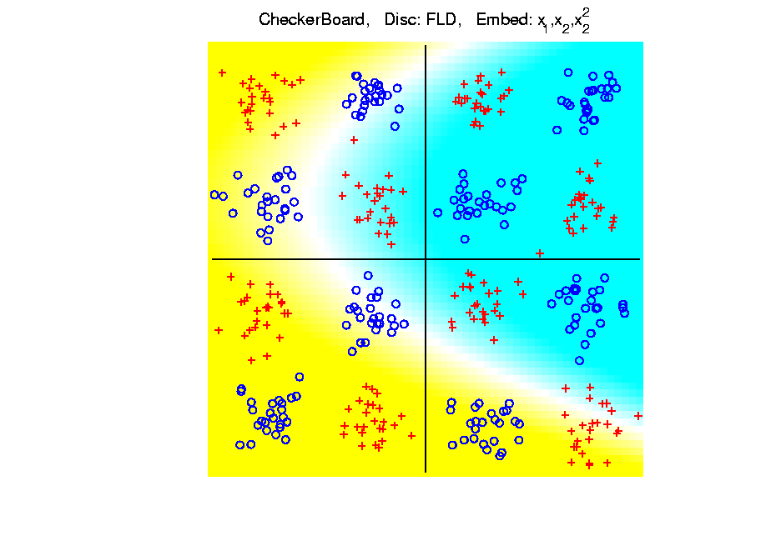
Kernel Embedding
Toy Example 4: Checkerboard
Very
Challenging!
FLD
Notes:
PEod1Raw.ps

Slide 64
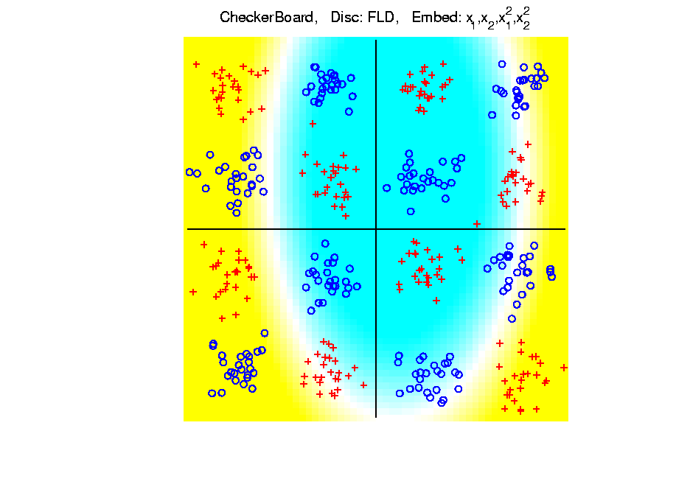
Kernel Embedding
Toy Example 4: Checkerboard
Very
Challenging!
FLD
Notes:
PEod1Raw.ps

Slide 65
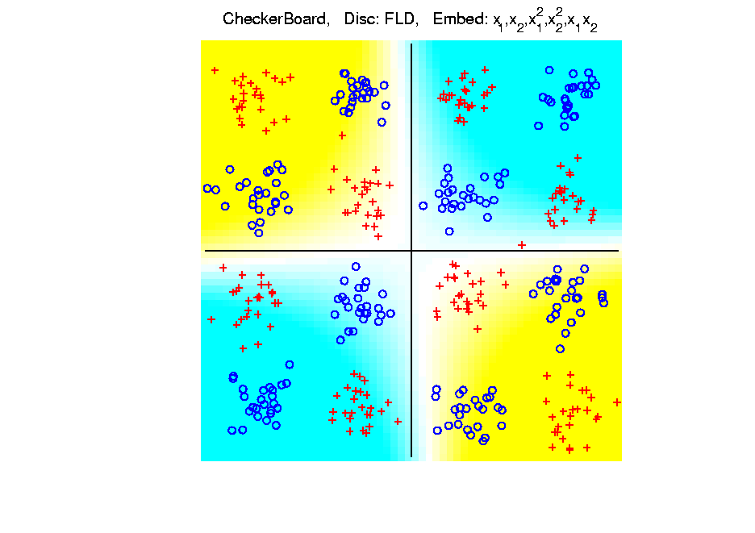
Kernel Embedding
Toy Example 4: Checkerboard
Very
Challenging!
FLD
Notes:
PEod1Raw.ps

Slide 66
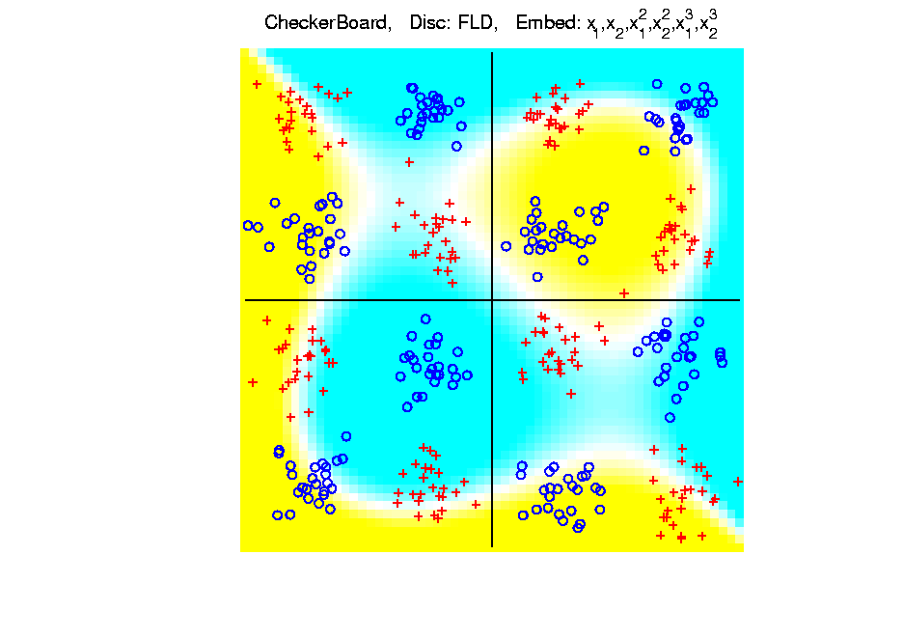
Kernel Embedding
Toy Example 4: Checkerboard
Very
Challenging!
FLD
Embedding
Gets Better
But Still
Not Great
Notes:
PEod1Raw.ps

Slide 67
Kernel Embedding
Toy Example 4: Checkerboard
Very
Challenging!
Polynomials
Don’t Have
Needed
Flexiblity
Notes:
PEod1Raw.ps

Slide 68
Kernel Embedding
Toy Example 4: Checkerboard
Radial
Basis
Embedding
+ FLD
Is
Excellent!
Notes:
PEod1Raw.ps

Slide 69
Kernel Embedding
Drawbacks to naïve embedding:
Equally spaced grid too big in high d
Not computationally tractable (g^{d})
Approach:
Evaluate only at data points
Not on full grid
But where data live

Slide 70
Kernel Embedding
Other types of embedding:
Explicit
Implicit
Will be studied soon, after
introduction to Support Vector Machines…

Slide 71
Kernel Embedding
generalizations of this idea to other types of analysis
& some clever computational ideas.
E.g. “Kernel based, nonlinear Principal Components Analysis”
Ref: Schölkopf, Smola and Müller (1998)

Slide 72
Support Vector Machines
Motivation:
Find a linear method that “works well”
for embedded data
Note: Embedded data are
very non-Gaussian
Classical Statistics: “Use Prob. Dist’n”
Looks Hopeless

Slide 73
Support Vector Machines
Motivation:
Find a linear method that “works well”
for embedded data
Note: Embedded data are
very non-Gaussian
Suggests value of
really new approach

Slide 74
Support Vector Machines
Classical References:
Vapnik (1982)
Boser, Guyon & Vapnik (1992)
Vapnik (1995)

Slide 75
Support Vector Machines
Recommended tutorial:
Burges (1998)

Slide 76
Support Vector Machines
Recommended tutorial:
Burges (1998)
Recommended Monographs:
Cristianini & Shawe-Taylor (2000)
Schölkopf & Smola (2002)

Slide 77
Support Vector Machines
Graphical View, using Toy Example:

Slide 78
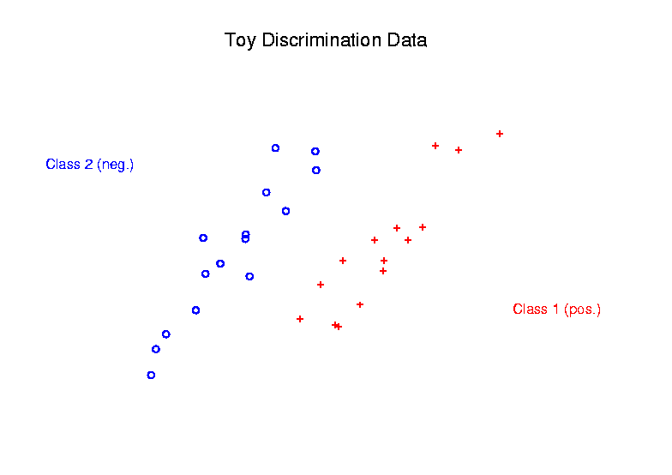
Support Vector Machines
Graphical View, using Toy Example:

Slide 79
Support Vector Machines
Graphical View, using Toy Example:
Find separating plane

Slide 80
Support Vector Machines
Graphical View, using Toy Example:
Find separating plane
To maximize distances from data to plane

Slide 81
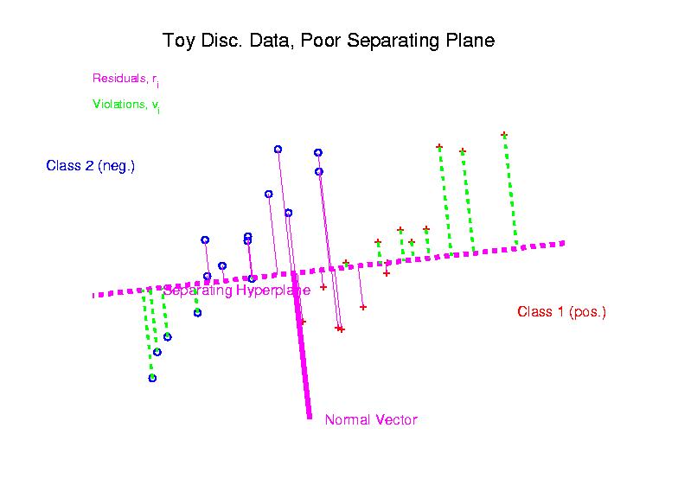
Support Vector Machines
Graphical View, using Toy Example:

Slide 82
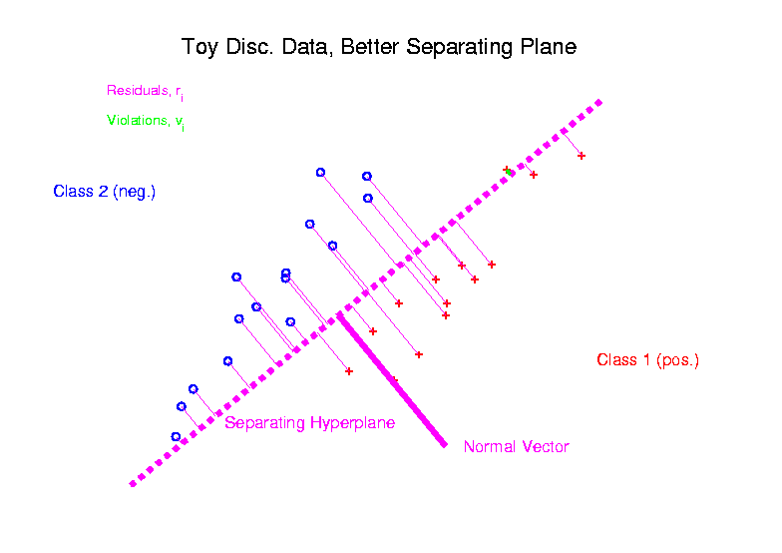
Support Vector Machines
Graphical View, using Toy Example:

Slide 83
Support Vector Machines
Graphical View, using Toy Example:
Find separating plane
To maximize distances from data to plane
In particular smallest distance

Slide 84
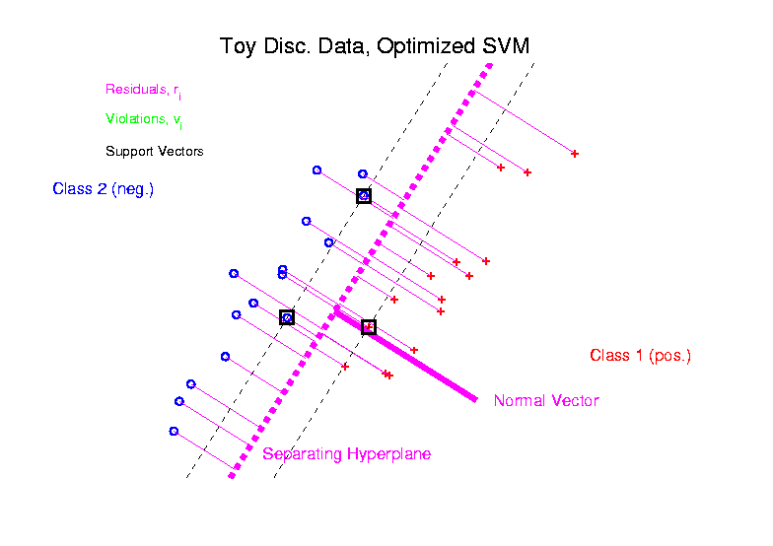
Support Vector Machines
Graphical View, using Toy Example:

Slide 85
Support Vector Machines
Graphical View, using Toy Example:
Find separating plane
To maximize distances from data to plane
In particular smallest distance
Data points closest are called
support vectors
Gap between is called margin

Slide 86
Support Vector Machines
Graphical View, using Toy Example:
Find separating plane
To maximize distances from data to plane
In particular smallest distance
Data points closest are called
support vectors
Gap between is called margin
Caution: For some “margin” is different

Slide 87
SVMs, Optimization Viewpoint
Formulate Optimization problem, based on:
Data (feature) vectors
Class Labels

Slide 88
SVMs, Optimization Viewpoint
Formulate Optimization problem, based on:
Data (feature) vectors
Class Labels
Normal Vector
Location (determines intercept)

Slide 89
SVMs, Optimization Viewpoint
Formulate Optimization problem, based on:
Data (feature) vectors
Class Labels
Normal Vector
Location (determines intercept)
Residuals (right side)
Residuals (wrong side)

Slide 90
SVMs, Optimization Viewpoint
Formulate Optimization problem, based on:
Data (feature) vectors
Class Labels
Normal Vector
Location (determines intercept)
Residuals (right side)
Residuals (wrong side)
Solve (convex problem) by quadratic programming

Slide 91
SVMs, Optimization Viewpoint
Lagrange Multipliers primal formulation (separable case):
Minimize:
Where are Lagrange multipliers

Slide 92
SVMs, Optimization Viewpoint
Lagrange Multipliers primal formulation (separable case):
Minimize:
Where are Lagrange multipliers
Notation: “dot product” = inner product
Elsewhere: $u∙v= \left\langle u,v\right\rangle =u^{t}v$

Slide 93
SVMs, Optimization Viewpoint
Lagrange Multipliers primal formulation (separable case):
Minimize:
Where are Lagrange multipliers
Dual Lagrangian version:
Maximize:

Slide 94
SVMs, Optimization Viewpoint
Lagrange Multipliers primal formulation (separable case):
Minimize:
Where are Lagrange multipliers
Dual Lagrangian version:
Maximize:
Get classification function:

Slide 95
SVMs, Optimization Viewpoint
Get classification function:

Slide 96
SVMs, Optimization Viewpoint
Get classification function:
Choose Class:
+1, when $f\left(x\right)>0$
-1, when $f\left(x\right)<0$

Slide 97
SVMs, Optimization Viewpoint
Get classification function:
Choose Class:
+1, when $f\left(x\right)>0$
-1, when $f\left(x\right)<0$
Note: linear function of $x$
i.e. have found separating hyperplane

Slide 98
SVMs, Computation
Major Computational Point:
Classifier only depends on data through inner products!

Slide 99
SVMs, Computation
Major Computational Point:
Classifier only depends on data through inner products!
Thus enough to only store inner products

Slide 100
SVMs, Computation
Major Computational Point:
Classifier only depends on data through inner products!
Thus enough to only store inner products
Creates big savings in optimization
Especially for HDLSS data

Slide 101
SVMs, Computation
Major Computational Point:
Classifier only depends on data through inner products!
Thus enough to only store inner products
Creates big savings in optimization
Especially for HDLSS data
But also creates variations in kernel embedding (interpretation?!?)

Slide 102
SVMs, Computation
Major Computational Point:
Classifier only depends on data through inner products!
Thus enough to only store inner products
Creates big savings in optimization
Especially for HDLSS data
But also creates variations in kernel embedding (interpretation?!?)
This is almost always done in practice

Slide 103
SVMs, Comput’n & Embedding
For an “Embedding Map”,
e.g.
Explicit Embedding

Slide 104
SVMs, Comput’n & Embedding
For an “Embedding Map”,
e.g.
Explicit Embedding:
Maximize:

Slide 105
SVMs, Comput’n & Embedding
For an “Embedding Map”,
e.g.
Explicit Embedding:
Maximize:
Get classification function:

Slide 106
SVMs, Comput’n & Embedding
For an “Embedding Map”,
e.g.
Explicit Embedding:
Maximize:
Get classification function:
Straightforward application of embedding
But loses inner product advantage

Slide 107
SVMs, Comput’n & Embedding
Implicit Embedding:
Maximize:

Slide 108
SVMs, Comput’n & Embedding
Implicit Embedding:
Maximize:
Note Difference from Explicit Embedding:

Slide 109
SVMs, Comput’n & Embedding
Implicit Embedding:
Maximize:
Get classification function:
Still defined only via inner products

Slide 110
SVMs, Comput’n & Embedding
Implicit Embedding:
Maximize:
Get classification function:
Still defined only via inner products
Retains optimization advantage
Thus used very commonly

Slide 111
SVMs, Comput’n & Embedding
Implicit Embedding:
Maximize:
Get classification function:
Still defined only via inner products
Retains optimization advantage
Thus used very commonly
Comparison to explicit embedding?
Which is “better”???

Slide 112
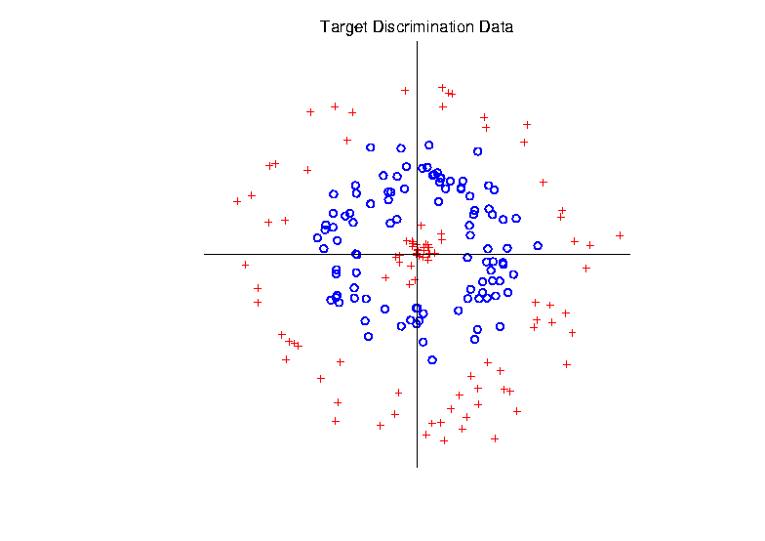
Support Vector Machines
Target Toy Data set:

Slide 113
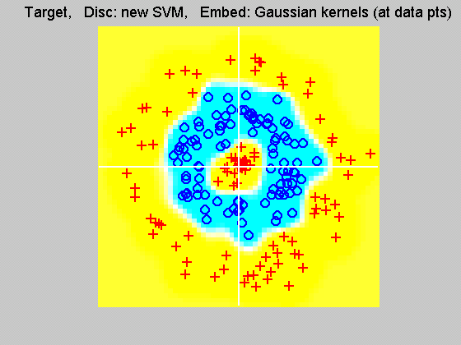
Support Vector Machines
Explicit Embedding, window σ = 0.1:
Gaussian
Kernel,
i.e.
Radial
Basis
Function

Slide 114
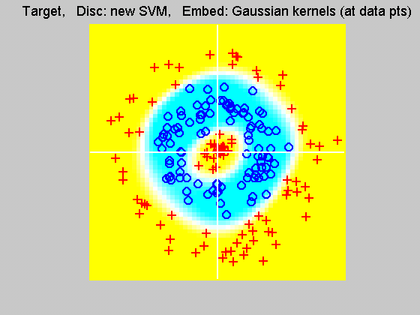
Support Vector Machines
Explicit Embedding, window σ = 1:
Pretty Big
Change
(Factor
of 10)

Slide 115
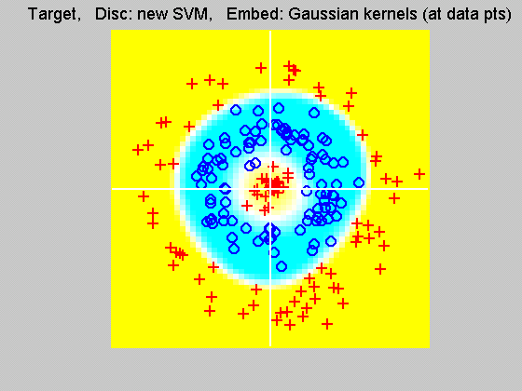
Support Vector Machines
Explicit Embedding, window σ = 10:
Not Quite
As Good
???

Slide 116
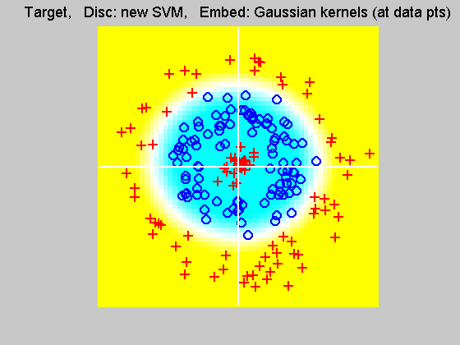
Support Vector Machines
Explicit Embedding, window σ = 100:
Note: Lost Center
(Over- Smoothed)

Slide 117
Support Vector Machines
Notes on Explicit Embedding:
Too small → Poor generalizability
Too big → miss important regions

Slide 118
Support Vector Machines
Notes on Explicit Embedding:
Too small → Poor generalizability
Too big → miss important regions
Classical lessons from kernel smoothing

Slide 119
Support Vector Machines
Notes on Explicit Embedding:
Too small → Poor generalizability
Too big → miss important regions
Classical lessons from kernel smoothing
Surprisingly large “reasonable region”
I.e. parameter less critical (sometimes?)

Slide 120
Support Vector Machines
Interesting Alternative Viewpoint:
Study Projections
In Kernel Space
(Never done in Machine Learning World)

Slide 121
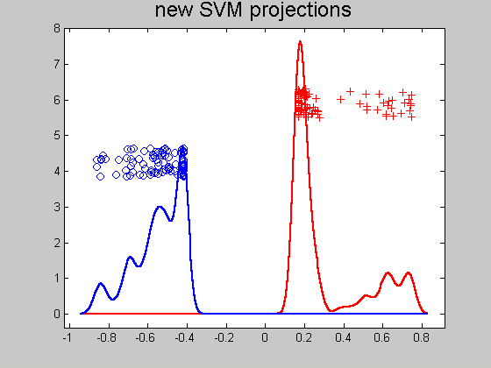
Support Vector Machines
Kernel space projection, window σ = 0.1:
Note:
Data
Piling
At
Margin

Slide 122
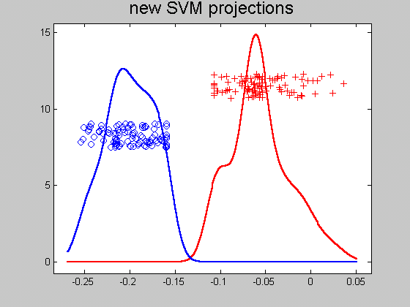
Support Vector Machines
Kernel space projection, window σ = 1:
Excellent
Separation
(but less
than σ = 0.1)

Slide 123
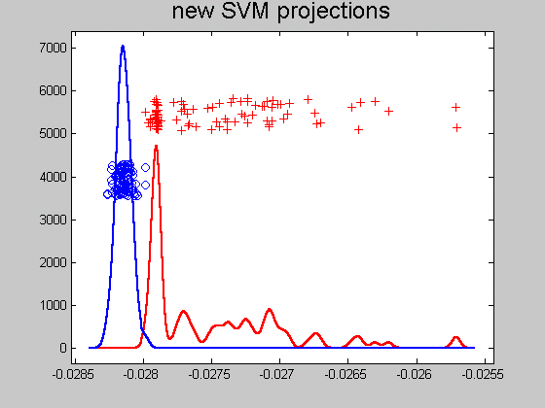
Support Vector Machines
Kernel space projection, window σ = 10:
Still Good
(But Some
Overlap)

Slide 124
Support Vector Machines
Kernel space projection, window σ = 100:
Some Reds
On Wrong
Side
(Missed
Center)

Slide 125
Support Vector Machines
Notes on Kernel space projection:
Too small →
Great separation
But recall, poor generalizability

Slide 126
Support Vector Machines
Notes on Kernel space projection:
Too small →
Great separation
But recall, poor generalizability
Too big → no longer separable

Slide 127
Support Vector Machines
Notes on Kernel space projection:
Too small →
Great separation
But recall, poor generalizability
Too big → no longer separable
As above:
Classical lessons from kernel smoothing
Surprisingly large “reasonable region”
I.e. parameter less critical (sometimes?)
Also explore projections (in kernel space)

Slide 128
Support Vector Machines
Implicit Embedding, window σ = 0.1:

Slide 129
Support Vector Machines
Implicit Embedding, window σ = 0.5:

Slide 130
Support Vector Machines
Implicit Embedding, window σ = 1:

Slide 131
Support Vector Machines
Implicit Embedding, window σ = 10:

Slide 132
Support Vector Machines
Notes on Implicit Embedding:
Similar Large vs. Small lessons
Range of “reasonable results”
Seems to be smaller
(note different range of windows)

Slide 133
Support Vector Machines
Notes on Implicit Embedding:
Similar Large vs. Small lessons
Range of “reasonable results”
Seems to be smaller
(note different range of windows)
Much different “edge” behavior
Interesting topic for future work…

