Slide 1
Detailed Look at PCA
Three Important (& Interesting) Viewpoints:
Mathematics
Numerics
Statistics
1st: Review Linear Alg. and Multivar. Prob.

Slide 2
Different Views of PCA
Solves several optimization problems:
Direction to maximize SS of 1-d proj’d data
Direction to minimize SS of residuals
(same, by Pythagorean Theorem)
“Best fit line” to data in “orthogonal sense”
(vs. regression of Y on X = vertical sense
& regression of X on Y = horizontal sense)
Notes:
2

Slide 3
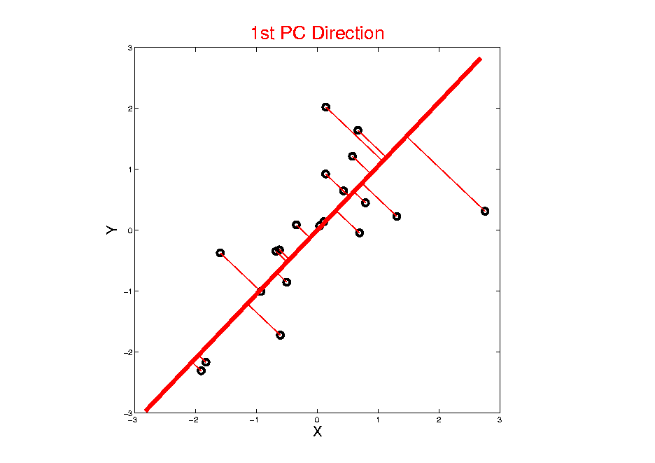
Different Views of PCA
Projected
Residuals
Notes:
3

Slide 4
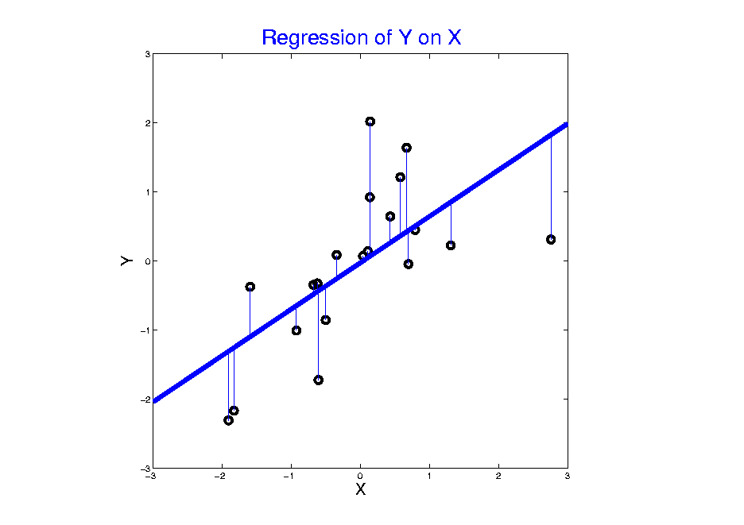
Different Views of PCA
Vertical
Residuals
(X predicts Y)
Notes:
4

Slide 5
PCA Data Represent’n (Cont.)
Now Using:
Spectral Representation (Raw Data):
Where:
Entries of are Loadings
Entries of are Scores

Slide 6
PCA Data Represent’n (Cont.)
Reduced Rank Representation:
Reconstruct Using Only Terms
(Assuming Decreasing Eigenvalues)

Slide 7
PCA Data Represent’n (Cont.)
SCREE Plot Drawbacks:
What is a Knee?
What if There are Several?
Knees Depend on Scaling (Power? log?)
Personal Suggestions:
Find Auxiliary Cutoffs (Inter-Rater Variation)
Use the Full Range (ala Scale Space)

Slide 8
Alternate PCA Computation
Another Variation: Dual PCA
Idea: Useful to View Data Matrix as
Col’ns as Data Objects

Slide 9
Alternate PCA Computation
Another Variation: Dual PCA
Idea: Useful to View Data Matrix as Both
Col’ns as Data Objects
&
Rows as Data Objects

Slide 10
Alternate PCA Computation
Dual PCA Computation:
Same as above, but replace
with
So can almost replace
with
Then use SVD, , to get:
Note: Same Eigenvalues

Slide 11
Return to Big Picture
Main statistical goals of OODA:
Understanding population structure
Low dim’al Projections, PCA …
Classification (i. e. Discrimination)
Understanding 2+ populations
Time Series of Data Objects
Chemical Spectra, Mortality Data
“Vertical Integration” of Data Types

Slide 12
Classification - Discrimination
Background: Two Class (Binary) version:
Using “training data” from
Class +1 and Class -1
Develop a “rule” for
assigning new data to a Class
Canonical Example: Disease Diagnosis
New Patients are “Healthy” or “Ill”
Determine based on measurements

Slide 13
Classification - Discrimination
Important Distinction:
Classification vs. Clustering
Useful terminology:
Classification: supervised learning
Clustering: unsupervised learning

Slide 14
Classification Basics
For Simple Toy Example:
Project
On MD
& split
at center
Notes:
HDLSStmbMdif.ps

Slide 15
Classification Basics
PCA for slanted clouds:
PC1 terrible
PC2 better?
Still misses
right dir’n
Doesn’t use
Class Labels
Notes:
HDLSSod1PCA.ps

Slide 16
Classification Basics
Mean Difference for slanted clouds:
A little
better?
Still misses
right dir’n
Want to
account for
covariance
Notes:
HDLSSod1Mdif.ps

Slide 17
Classification Basics
Better Solution: Fisher Linear Discrimination
Gets the
right dir’n
How does
it work?
Notes:
HDLSSod1FLD.ps

Slide 18
Fisher Linear Discrimination
Other common terminology (for FLD):
Linear Discriminant Analysis (LDA)
Original Paper: Fisher (1936)

Slide 19
Fisher Linear Discrimination
Careful development:
Useful notation (data vectors of length ):
Class +1: Class -1:
Centerpoints:
and

Slide 20
Fisher Linear Discrimination
Covariances, for
(outer products)
Based on centered, normalized data matrices:

Slide 21
Fisher Linear Discrimination
Covariances, for
(outer products)
Based on centered, normalized data matrices:
Note: use “MLE” version of estimated covariance matrices, for simpler notation

Slide 22
Fisher Linear Discrimination
Major Assumption:
Class covariances are the same (or “similar”)
Like this: Not this:
Notes:
HDLSSod1Raw.ps & HDLSSxd1Raw.ps

Slide 23
Fisher Linear Discrimination
Good estimate of (common) within class cov?
Pooled (weighted average) within class cov:
based on the combined full data matrix:

Slide 24
Fisher Linear Discrimination
Good estimate of (common) within class cov?
Pooled (weighted average) within class cov:
based on the combined full data matrix:
Note: Different Means

Slide 25
Fisher Linear Discrimination
Note: is similar to from before
I.e. covariance matrix ignoring class labels
Important Difference:
Class by Class Centering
Will be important later
Notes:
HDLSSod1Raw.ps

Slide 26
Fisher Linear Discrimination
Simple way to find “correct cov. adjustment”:
Individually transform subpopulations so
“spherical” about their means
For define
Notes:
HDLSSod1egFLD.ps

Slide 27
Fisher Linear Discrimination
For define
Note: This spheres the data, in the sense that
Notes:
HDLSSod1egFLD.ps

Slide 28
Fisher Linear Discrimination
Then:
In Transformed Space,
Best separating hyperplane
is
Perpendicular bisector of
line between means
Notes:
HDLSSod1egFLD.ps

Slide 29
Fisher Linear Discrimination
In Transformed Space,
Separating Hyperplane has:
Transformed Normal Vector:
Notes:
HDLSSod1egFLD.ps

Slide 30
Fisher Linear Discrimination
In Transformed Space,
Separating Hyperplane has:
Transformed Normal Vector:
Transformed Intercept:
Notes:
HDLSSod1egFLD.ps

Slide 31
Fisher Linear Discrimination
In Transformed Space,
Separating Hyperplane has:
Transformed Normal Vector:
Transformed Intercept:
Sep. Hyperp. has Equation:
Notes:
HDLSSod1egFLD.ps

Slide 32
Fisher Linear Discrimination
Thus discrimination rule is:
Given a new data vector ,
Choose Class +1 when:

Slide 33
Fisher Linear Discrimination
Thus discrimination rule is:
Given a new data vector ,
Choose Class +1 when:
i.e. (transforming back to original space)
Using, for symmetric and invertible:

Slide 34
Fisher Linear Discrimination
Thus discrimination rule is:
Given a new data vector ,
Choose Class +1 when:
i.e. (transforming back to original space)
where:

Slide 35
Fisher Linear Discrimination
So (in orig’l space) have separ’ting hyperplane with:
Normal vector: Intercept:
Notes:
HDLSSod1egFLD.ps

Slide 36
Fisher Linear Discrimination
Relationship to Mahalanobis distance
Idea: For , a natural distance measure is:

Slide 37
Fisher Linear Discrimination
Relationship to Mahalanobis distance
Idea: For , a natural distance measure is:
“unit free”, i.e. “standardized”
essentially mod out covariance structure

Slide 38
Fisher Linear Discrimination
Relationship to Mahalanobis distance
Idea: For , a natural distance measure is:
“unit free”, i.e. “standardized”
essentially mod out covariance structure
Euclidean dist. applied to &
Same as key transformation for FLD

Slide 39
Fisher Linear Discrimination
Relationship to Mahalanobis distance
Idea: For , a natural distance measure is:
“unit free”, i.e. “standardized”
essentially mod out covariance structure
Euclidean dist. applied to &
Same as key transformation for FLD
I.e. FLD is
mean difference in Mahalanobis space

Slide 40
Classical Discrimination
Above derivation of FLD was:
Nonstandard
Not in any textbooks(?)

Slide 41
Classical Discrimination
Above derivation of FLD was:
Nonstandard
Not in any textbooks(?)
Nonparametric (don’t need Gaussian data)
I.e. Used no probability distributions

Slide 42
Classical Discrimination
Above derivation of FLD was:
Nonstandard
Not in any textbooks(?)
Nonparametric (don’t need Gaussian data)
I.e. Used no probability distributions
More Machine Learning than Statistics

Slide 43
Classical Discrimination
FLD Likelihood View

Slide 44
Classical Discrimination
FLD Likelihood View
Assume:
Class distributions are multivariate
for

Slide 45
Classical Discrimination
FLD Likelihood View
Assume:
Class distributions are multivariate
for
strong distributional assumption
+ common covariance

Slide 46
Classical Discrimination
FLD Likelihood View (cont.)
At a location , the likelihood ratio, for
choosing between Class +1 and Class -1, is:
where is the Gaussian density
with covariance

Slide 47
Classical Discrimination
FLD Likelihood View (cont.)
Simplifying, using the Gaussian density:
Gives

Slide 48
Classical Discrimination
FLD Likelihood View (cont.)
Simplifying, using the Gaussian density:
Gives (critically using common covariances):

Slide 49
Classical Discrimination
FLD Likelihood View (cont.)
Simplifying, using the Gaussian density:
Gives (critically using common covariances):

Slide 50
Classical Discrimination
FLD Likelihood View (cont.)
But:
for

Slide 51
Classical Discrimination
FLD Likelihood View (cont.)
But:
so:
Note: same terms subtract off

Slide 52
Classical Discrimination
FLD Likelihood View (cont.)
But:
so:
Note: cross terms have ± cancellation

Slide 53
Classical Discrimination
FLD Likelihood View (cont.)
But:
so:
Thus when

Slide 54
Classical Discrimination
FLD Likelihood View (cont.)
But:
so:
Thus when
i.e.

Slide 55
Classical Discrimination
FLD Likelihood View (cont.)
Replacing , and
by maximum likelihood estimates:
, and
Gives the likelihood ratio discrimination rule

Slide 56
Classical Discrimination
FLD Likelihood View (cont.)
Replacing , and
by maximum likelihood estimates:
, and
Gives the likelihood ratio discrimination rule:
Choose Class +1, when

Slide 57
Classical Discrimination
FLD Likelihood View (cont.)
Replacing , and
by maximum likelihood estimates:
, and
Gives the likelihood ratio discrimination rule:
Choose Class +1, when
Same as above, so: FLD can be viewed as
Likelihood Ratio Rule

Slide 58
Classical Discrimination
FLD Generalization I
Gaussian Likelihood Ratio Discrimination
(a. k. a. “nonlinear discriminant analysis”)

Slide 59
Classical Discrimination
FLD Generalization I
Gaussian Likelihood Ratio Discrimination
(a. k. a. “nonlinear discriminant analysis”)
Idea: Assume
class distributions are
Different covariances!

Slide 60
Classical Discrimination
FLD Generalization I
Gaussian Likelihood Ratio Discrimination
(a. k. a. “nonlinear discriminant analysis”)
Idea: Assume
class distributions are
Different covariances!
Likelihood Ratio rule is straightf’d num’l calc.
(thus can easily implement, and do discrim’n)

Slide 61
Classical Discrimination
Gaussian Likelihood Ratio Discrim’n (cont.)
No longer have separ’g hyperplane repr’n
(instead regions determined by quadratics)
(fairly complicated case-wise calculations)

Slide 62
Classical Discrimination
Gaussian Likelihood Ratio Discrim’n (cont.)
No longer have separ’g hyperplane repr’n
(instead regions determined by quadratics)
(fairly complicated case-wise calculations)
Graphical display: for each point, color as:
Yellow if assigned to Class +1
Cyan if assigned to Class -1
(intensity is strength of assignment)

Slide 63
Classical Discrimination
FLD for Tilted Point Clouds – Works well
Notes:
PEod1FLDe1.ps

Slide 64
Classical Discrimination
GLR for Tilted Point Clouds – Works well
Notes:
PEod1GLRe1.ps

Slide 65
Classical Discrimination
FLD for Donut – Poor, no plane can work
Notes:
PEdonFLDe1.ps

Slide 66
Classical Discrimination
GLR for Donut – Works well (good quadratic)
Notes:
PEdonGLRe1.ps

Slide 67
Classical Discrimination
GLR for Donut – Works well (good quadratic)
(Even
though
data not
Gaussian)
Notes:
PEdonGLRe1.ps

Slide 68
Classical Discrimination
FLD for X – Poor, no plane can work
Notes:
PExd3FLDe1.ps

Slide 69
Classical Discrimination
GLR for X – Better, but not great
Notes:
PExd3GLRe1.ps

Slide 70
Classical Discrimination
Summary of FLD vs. GLR:
Tilted Point Clouds Data
FLD good
GLR good
Donut Data
FLD bad
GLR good
X Data
FLD bad
GLR OK, not great
Classical Conclusion: GLR generally better
(will see a different answer for HDLSS data)

Slide 71
Classical Discrimination
FLD Generalization II (Gen. I was GLR)
Different prior probabilities
Main idea:
Give different weights to 2 classes
I.e. assume not a priori equally likely
Development is “straightforward”
Modified likelihood
Change intercept in FLD
Won’t explore further here

Slide 72
Classical Discrimination
FLD Generalization III
Principal Discriminant Analysis
Idea: FLD-like approach to > 2 classes

Slide 73
Classical Discrimination
FLD Generalization III
Principal Discriminant Analysis
Idea: FLD-like approach to > 2 classes
Assumption: Class covariance matrices are the same (similar)
(but not Gaussian, same situation as for FLD)

Slide 74
Classical Discrimination
FLD Generalization III
Principal Discriminant Analysis
Idea: FLD-like approach to > 2 classes
Assumption: Class covariance matrices are the same (similar)
(but not Gaussian, same situation as for FLD)
Main idea:
Quantify “location of classes” by their means

Slide 75
Classical Discrimination
Principal Discriminant Analysis (cont.)
Simple way to find “interesting directions” among the means:
PCA on set of means

Slide 76
Classical Discrimination
Principal Discriminant Analysis (cont.)
Simple way to find “interesting directions” among the means:
PCA on set of means
(Think Analog of Mean Difference)

Slide 77
Classical Discrimination
Principal Discriminant Analysis (cont.)
Simple way to find “interesting directions” among the means:
PCA on set of means
i.e. Eigen-analysis of “between class covariance matrix”
Where
Aside: can show: overall

Slide 78
Classical Discrimination
Principal Discriminant Analysis (cont.)
But PCA only works like Mean Difference,
Expect can improve by
taking covariance into account.
(Recall Improvement of FLD over MD)

Slide 79
Classical Discrimination
Principal Discriminant Analysis (cont.)
But PCA only works like Mean Difference,
Expect can improve by
taking covariance into account.
Blind application of above ideas suggests eigen-analysis of:

Slide 80
Classical Discrimination
Principal Discriminant Analysis (cont.)
There are:
smarter ways to compute
(“generalized eigenvalue”)
other representations
(this solves optimization prob’s)

Slide 81
Classical Discrimination
Principal Discriminant Analysis (cont.)
There are:
smarter ways to compute
(“generalized eigenvalue”)
other representations
(this solves optimization prob’s)
Special case: 2 classes,
reduces to standard FLD
Good reference for more: Section 3.8 of:
Duda, Hart & Stork (2001)

Slide 82
Classical Discrimination
Summary of Classical Ideas:
Among “Simple Methods”
MD and FLD sometimes similar
Sometimes FLD better
So FLD is preferred

Slide 83
Classical Discrimination
Summary of Classical Ideas:
Among “Simple Methods”
MD and FLD sometimes similar
Sometimes FLD better
So FLD is preferred
Among Complicated Methods
GLR is best
So always use that?

Slide 84
Classical Discrimination
Summary of Classical Ideas:
Among “Simple Methods”
MD and FLD sometimes similar
Sometimes FLD better
So FLD is preferred
Among Complicated Methods
GLR is best
So always use that?
Caution:
Story changes for HDLSS settings

Slide 85
HDLSS Discrimination
Main HDLSS issues:
Sample Size, n < Dimension, d

Slide 86
HDLSS Discrimination
Main HDLSS issues:
Sample Size, n < Dimension, d
Singular covariance matrix
So can’t use matrix inverse

Slide 87
HDLSS Discrimination
Main HDLSS issues:
Sample Size, n < Dimension, d
Singular covariance matrix
So can’t use matrix inverse
I.e. can’t standardize (sphere) the data
(requires root inverse covariance)
Can’t do classical multivariate analysis

Slide 88
HDLSS Discrimination
Main HDLSS issues:
Can’t do classical multivariate analysis
Key Idea: Standardize
Subtract Sample Mean
Sphere the Data
And use N(0,I) dist’n for statistical inference

Slide 89
HDLSS Discrimination
An approach to non-invertible covariances:

Slide 90
HDLSS Discrimination
An approach to non-invertible covariances:
Replace by generalized inverses
Sometimes called pseudo inverses
Note: there are several

Slide 91
HDLSS Discrimination
An approach to non-invertible covariances:
Replace by generalized inverses
Sometimes called pseudo inverses
Note: there are several
Here use Moore Penrose inverse
As used by Matlab (pinv.m)

Slide 92
HDLSS Discrimination
An approach to non-invertible covariances:
Replace by generalized inverses
Sometimes called pseudo inverses
Note: there are several
Here use Moore Penrose inverse
As used by Matlab (pinv.m)
Often provides useful results
(but not always)

Slide 93
HDLSS Discrimination
Application of Generalized Inverse to FLD:
Direction (Normal) Vector:
Intercept:

Slide 94
HDLSS Discrimination
Application of Generalized Inverse to FLD:
Direction (Normal) Vector:
Intercept:
Have replaced by

Slide 95
HDLSS Discrimination
Toy Example: Increasing Dimension
data vectors:
Entry 1:
Class +1: Class –1:
Other Entries:
All Entries Independent
Look through dimensions,

Slide 96
HDLSS Discrimination
Increasing Dimension Example
Proj. on
Opt’l Dir’n
Proj. on
FLD Dir’n
Proj. on
both Dir’ns

Slide 97
HDLSS Discrimination
Add a 2nd Dimension (noise)
Same Proj. on
Opt’l Dir’n
Axes same
as dir’ns
Now See 2
Dim’ns

Slide 98
HDLSS Discrimination
Add a 3rd Dimension (noise)
Project on
2-d subspace
generated
by optimal
dir’n & by
FLD dir’n

Slide 99
HDLSS Discrimination
Movie Through Increasing Dimensions

