Slide 1
SiZer Background
Scale Space – Idea from Computer Vision
Goal: Teach Computers to “See”
Modern Research:
Extract “Information” from Images
Early Theoretical Work

Slide 2
SiZer Background
Scale Space – Idea from Computer Vision
Conceptual basis:
Oversmoothing = “view from afar”
(macroscopic)
Undersmoothing = “zoomed in view”
(microscopic)
Main idea: all smooths contain useful information, so study “full spectrum”
(i. e. all smoothing levels)
Recommended reference: Lindeberg (1994)

Slide 3
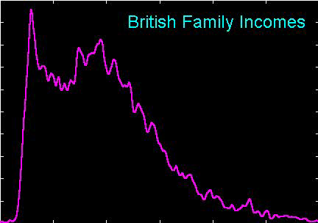
SiZer Background
Fun Scale Space Views
(of Family Incomes Data)

Slide 4
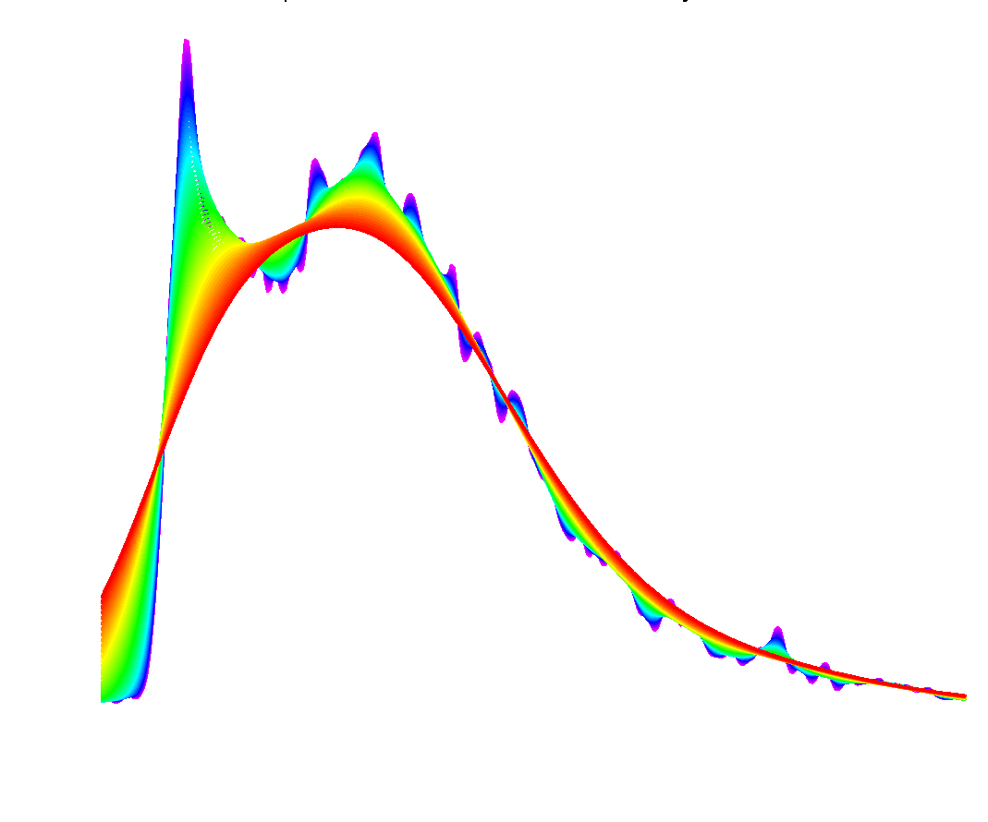
SiZer Background
Fun Scale Space Views (Incomes Data)
Spectrum Overlay

Slide 5
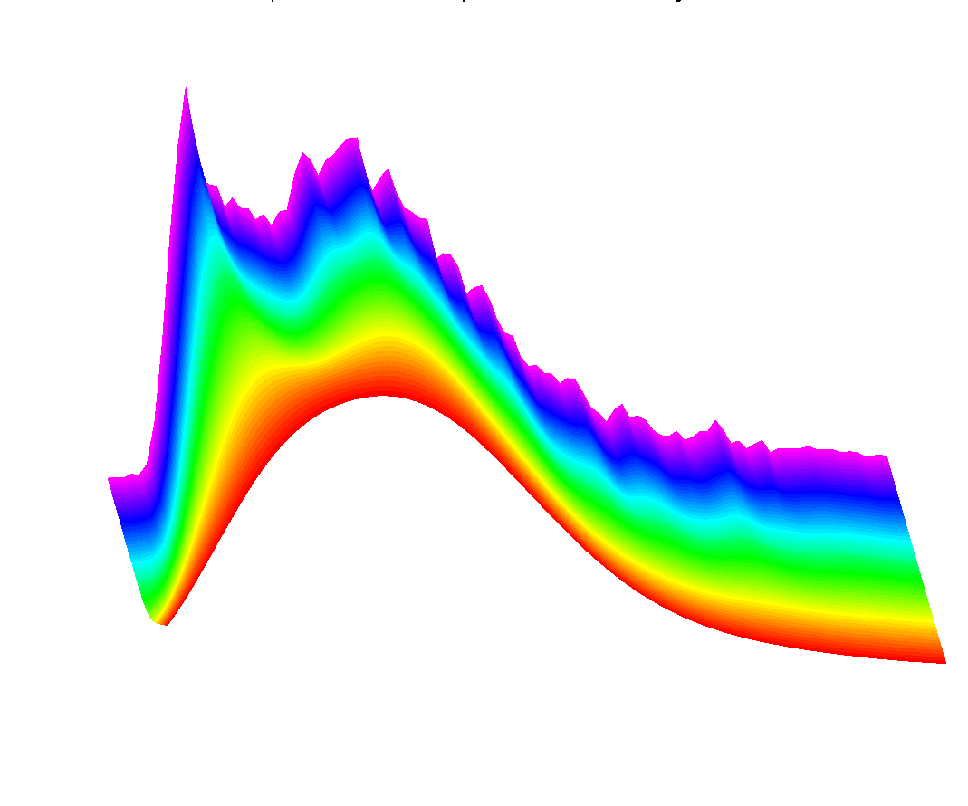
SiZer Background
Fun Scale Space Views (Incomes Data)
Surface View

Slide 6
SiZer Background
Fun Scale Space Views
(of Family Incomes Data)
Note:
The scale space viewpoint makes
Data Dased Bandwidth Selection
Much less important
(than I once thought….)

Slide 7
SiZer Background
SiZer:
Significance of Zero crossings, of the derivative, in scale space
Combines:
  needed statistical inference
  novel visualization
To get: a powerful exploratory data analysis method
Main reference:
Chaudhuri & Marron (1999)

Slide 8
SiZer Background
Basic idea: a bump is characterized by:
an increase
followed by a decrease
Generalization:
Many features of interest captured
by sign of the slope of the smooth
Foundation of SiZer:
Statistical inference on slopes,
over scale space

Slide 9
SiZer Background
SiZer Visual presentation:
Color map over scale space:
Blue: slope significantly upwards
(derivative CI above 0)
Red: slope significantly downwards
(derivative CI below 0)
Purple: slope insignificant
(derivative CI contains 0)

Slide 10
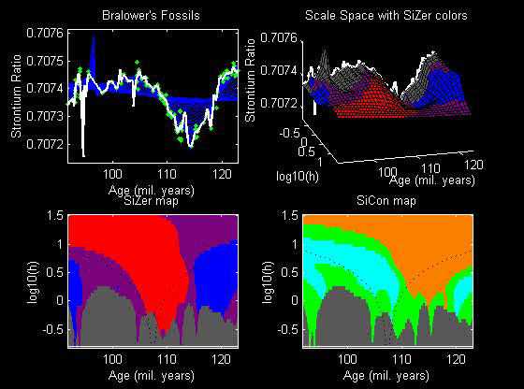
SiZer Background
SiZer analysis of Fossils data:

Slide 11
SiZer Background
SiZer analysis of Fossils data:
Upper Left: Scatterplot, family of smooths, 1 highlighted
Upper Right: Scale space rep’n of family, with SiZer colors
Lower Left: SiZer map, more easy to view
Lower Right: SiCon map – replace slope by curvature
Slider (in movie viewer) highlights different smoothing levels

Slide 12
SiZer Background
SiZer analysis of Fossils data (cont.):
Oversmoothed (top of SiZer map):
Decreases at left, not on right
Medium smoothed (middle of SiZer map):
Main valley significant, and left most increase
Smaller valley not statistically significant
Undersmoothed (bottom of SiZer map):
“noise wiggles” not significant
Additional SiZer color: gray - not enough data for inference

Slide 13
SiZer Background
SiZer analysis of Fossils data (cont.):
Common Question: Which is right?
Decreases on left, then flat
(top of SiZer map)
Up, then down, then up again
(middle of SiZer map)
No significant features
(bottom of SiZer map)
Answer: All are right
Just different scales of view,
i.e. levels of resolution of data

Slide 14
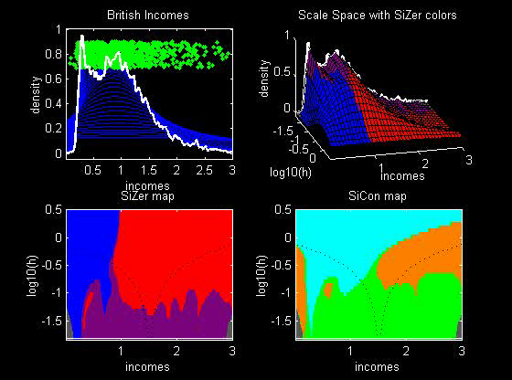
SiZer Background
SiZer analysis of British Incomes data:

Slide 15
SiZer Background
SiZer analysis of British Incomes data:
Oversmoothed: Only one mode
Medium smoothed: Two modes, statistically significant
Confirmed by Schmitz & Marron, (1992)
Undersmoothed: many noise wiggles, not significant
Again: all are correct,
just different scales

Slide 16
SiZer Background
Historical Note & Acknowledgements:
Scale Space: S. M. Pizer
SiZer: Probal Chaudhuri
Main Reference: Chaudhuri & Marron (1999)

Slide 17
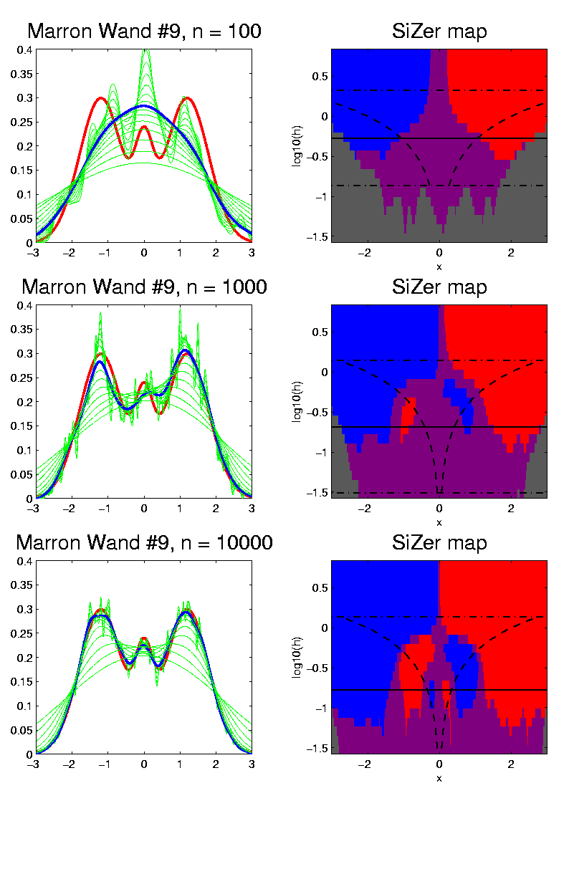
SiZer Background
Toy E.g. - Marron & Wand (1992) Trimodal #9
Increasing n
Only 1 Signif’t Mode
Now 2 Signif’t Modes
Finally all 3 Modes

Slide 18
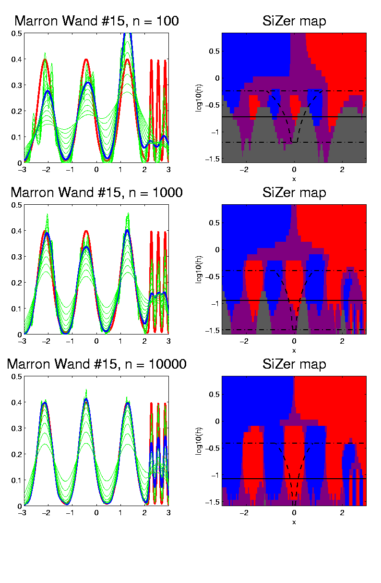
SiZer Background
E.g. - Marron & Wand Discrete Comb #15
Increasing n
Coarse Bumps Only
Now Fine bumps too
Someday: “draw” local
Bandwidth on SiZer map

Slide 19
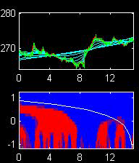
SiZer Background
Finance "tick data":
(time, price) of single stock transactions
Idea: "on line" version of SiZer
for viewing and understanding trends

Slide 20
SiZer Background
Finance "tick data":
(time, price) of single stock transactions
Idea: "on line" version of SiZer
for viewing and understanding trends
Notes:
trends depend heavily on scale
double points and more
background color transition
(flop over at top)

Slide 21
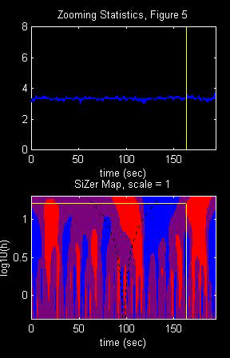
SiZer Background
Internet traffic data analysis:
SiZer analysis of
time series of
packet times
at internet hub (UNC)
Hannig, Marron,
and Riedi (2001)
Notes:
21

Slide 22
SiZer Background
Internet traffic data analysis:
SiZer analysis of
time series of packet times
at internet hub (UNC)
across very wide range of scales
needs more pixels than screen allows
thus do zooming view
(zoom in over time)
  zoom in to yellow bd’ry in next frame
  readjust vertical axis
Notes:
22

Slide 23
SiZer Background
Internet traffic data analysis (cont.)
Insights from SiZer analysis:
Coarse scales:
amazing amount of significant structure
Evidence of self-similar fractal type process?
Fewer significant features at small scales
But they exist, so not Poisson process
Poisson approximation OK at small scale???
Smooths (top part) stable at large scales?
Notes:
23

Slide 24
Dependent SiZer
Rondonotti, Marron, and Park (2007)
SiZer compares data with white noise
Inappropriate in time series
Dependent SiZer compares data with an assumed model
Visual Goodness of Fit test
Notes:
24

Slide 25
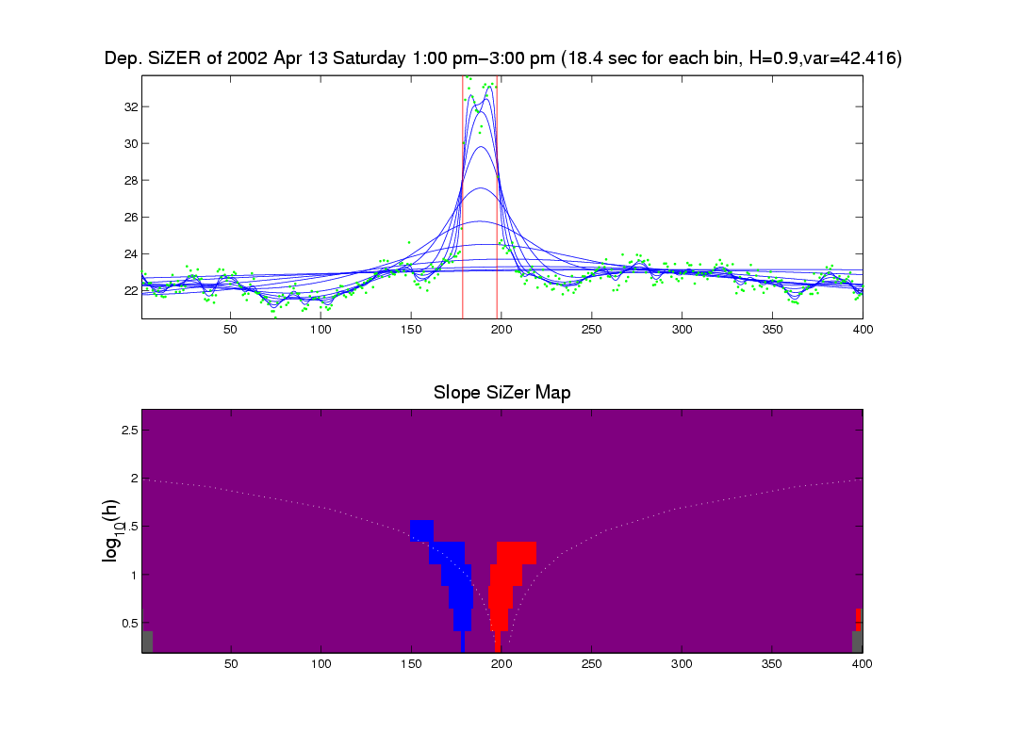
Dep’ent SiZer : 2002 Apr 13 Sat 1 pm – 3 pm
Internet Traffic At
UNC Main Link
2 hour span
Notes:
25

Slide 26
Dep’ent SiZer : 2002 Apr 13 Sat 1 pm – 3 pm
Big Spike in Traffic
Is “Really There”
Notes:
26

Slide 27
Dep’ent SiZer : 2002 Apr 13 Sat 1 pm – 3 pm
Zoom in for
Closer Look
Notes:
27

Slide 28
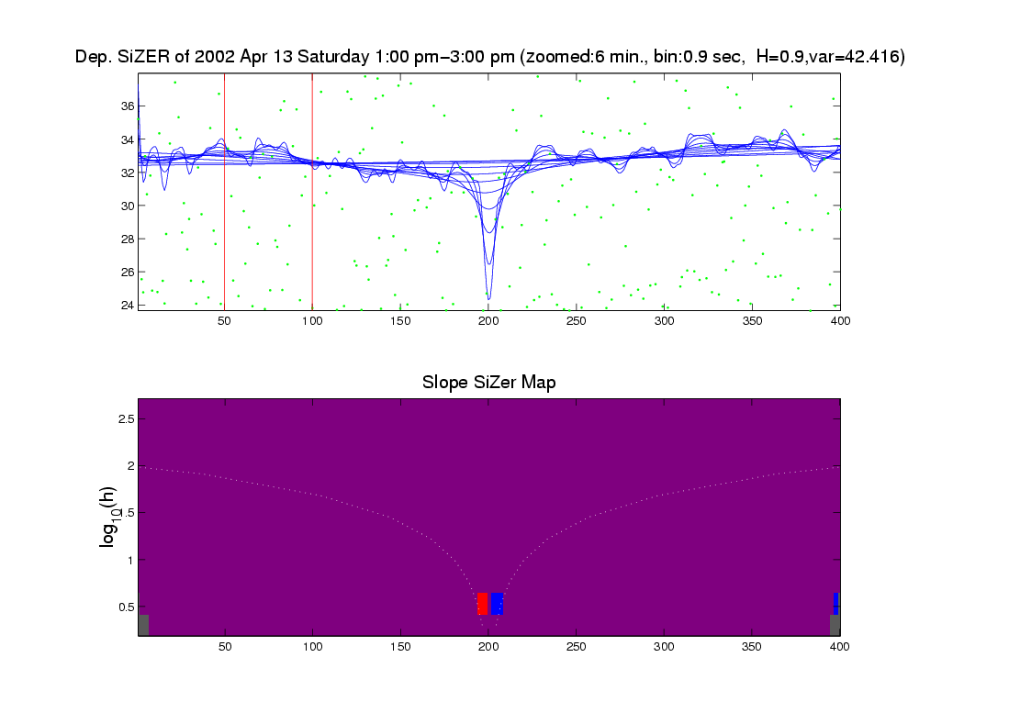
Zoomed view (to red region, i.e. “flat top”)
Strange “Hole in Middle”
Is “Really There”
Notes:
28

Slide 29
Zoomed view (to red region, i.e. “flat top”)
Zoom in for
Closer Look
Notes:
29

Slide 30
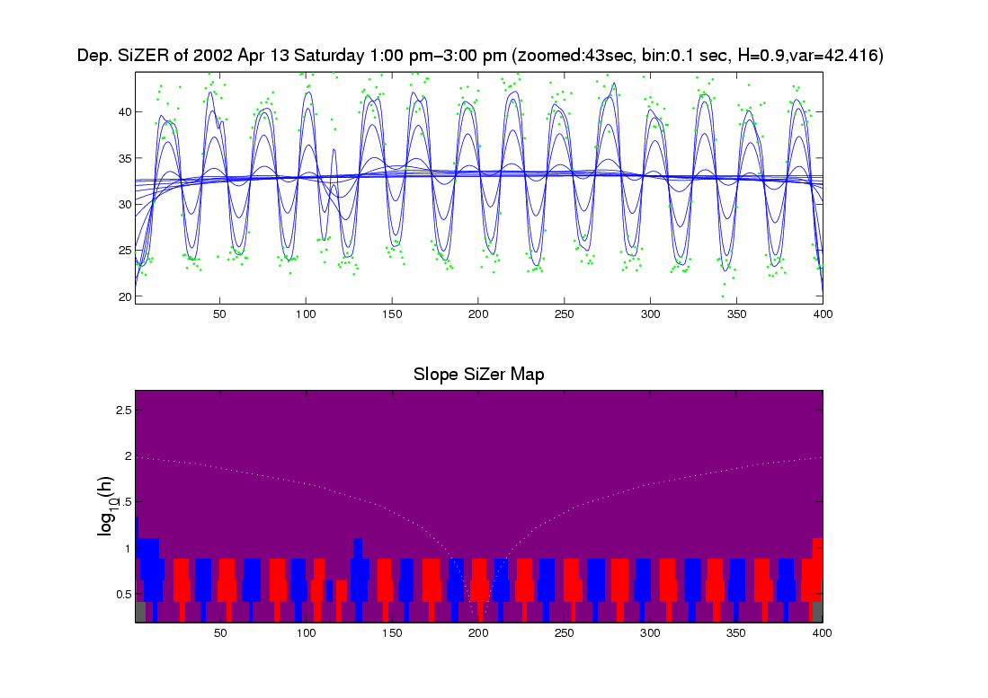
Further Zoom: finds very periodic behavior!
Notes:
30

Slide 31
Further Zoom: finds very periodic behavior!
SiZer found interesting structure, but depends on scale
Notes:
31

Slide 32
Possible Physical Explanation
IP “Port Scan”
Common device of hackers
Searching for “break in points”
Send query to every possible (within UNC domain):
  IP address
  Port Number
Replies can indicate system weaknesses
Internet Traffic is hard to model
Notes:
32

Slide 33
SiZer Overview
Would you like to try smoothing & SiZer?
Marron Software Website as Before
In “Smoothing” Directory:
  kdeSM.m
  nprSM.m
  sizerSM.m
Recall: “>> help sizerSM” for usage

Slide 34
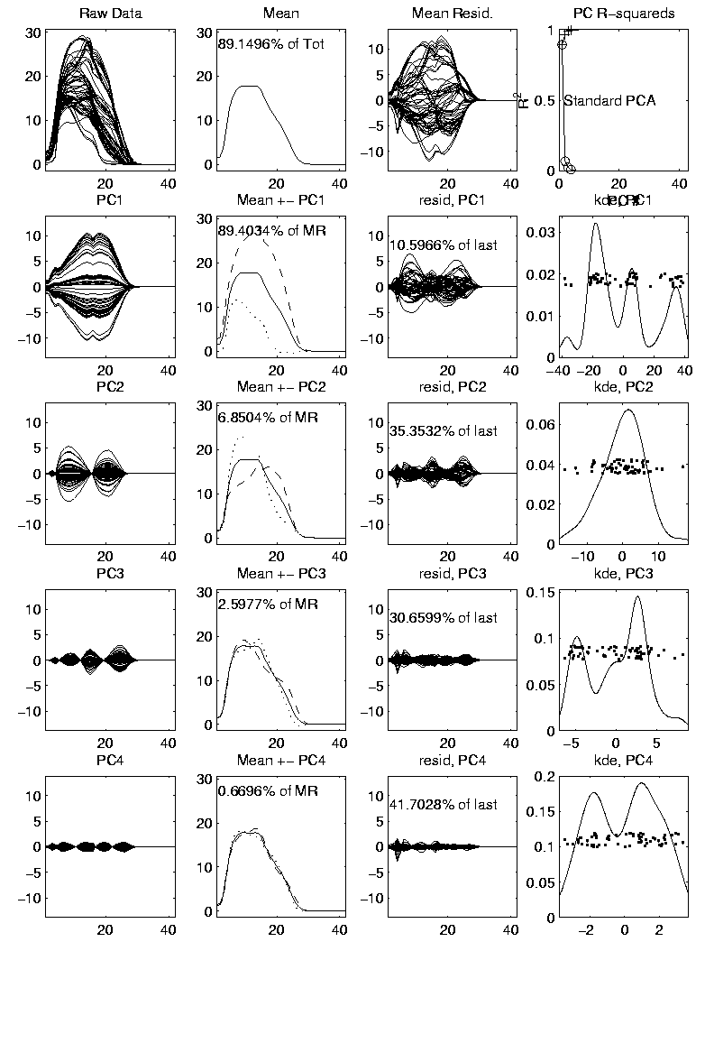
PCA to find clusters
Return to PCA of Mass Flux Data:
Notes:
MassFlux1d1p1.ps

Slide 35
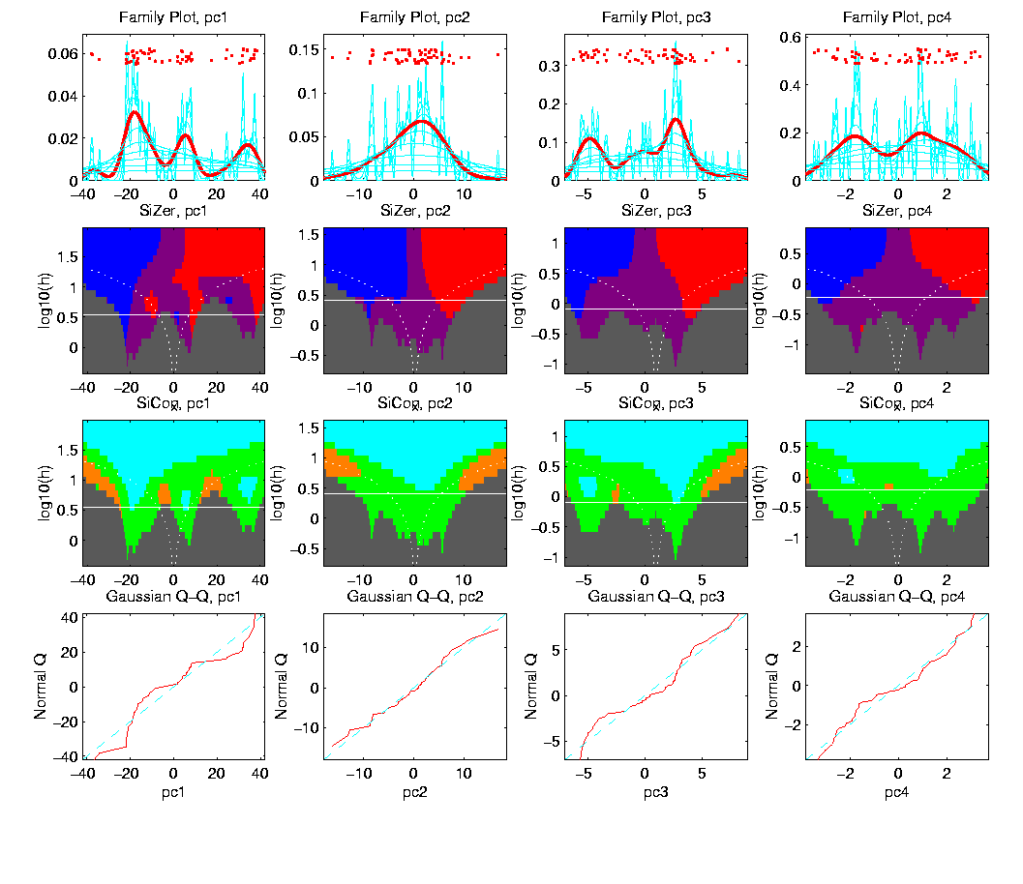
PCA to find clusters
SiZer analysis of Mass Flux, PC1
Notes:
MassFlux1d1p1s.ps

Slide 36
PCA to find clusters
SiZer analysis of Mass Flux, PC1
Conclusion:
Found 3 significant clusters!
Correspond to 3 known “cloud types”
Worth deeper investigation

Slide 37
Recall Yeast Cell Cycle Data
“Gene Expression” – Micro-array data
Data (after major preprocessing): Expression “level” of:
thousands of genes (d ~ 1,000s)
but only dozens of “cases” (n ~ 10s)
Interesting statistical issue:
High Dimension Low Sample Size data
(HDLSS)

Slide 38
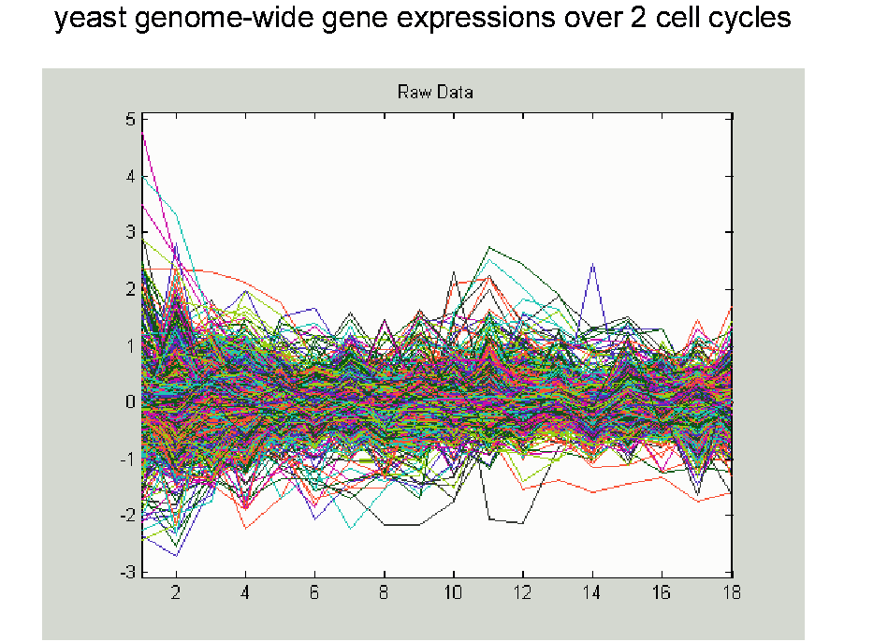
Yeast Cell Cycle Data, FDA View
Central question:
Which genes are “periodic” over 2 cell cycles?
Notes:
CellCycRaw.ps

Slide 39
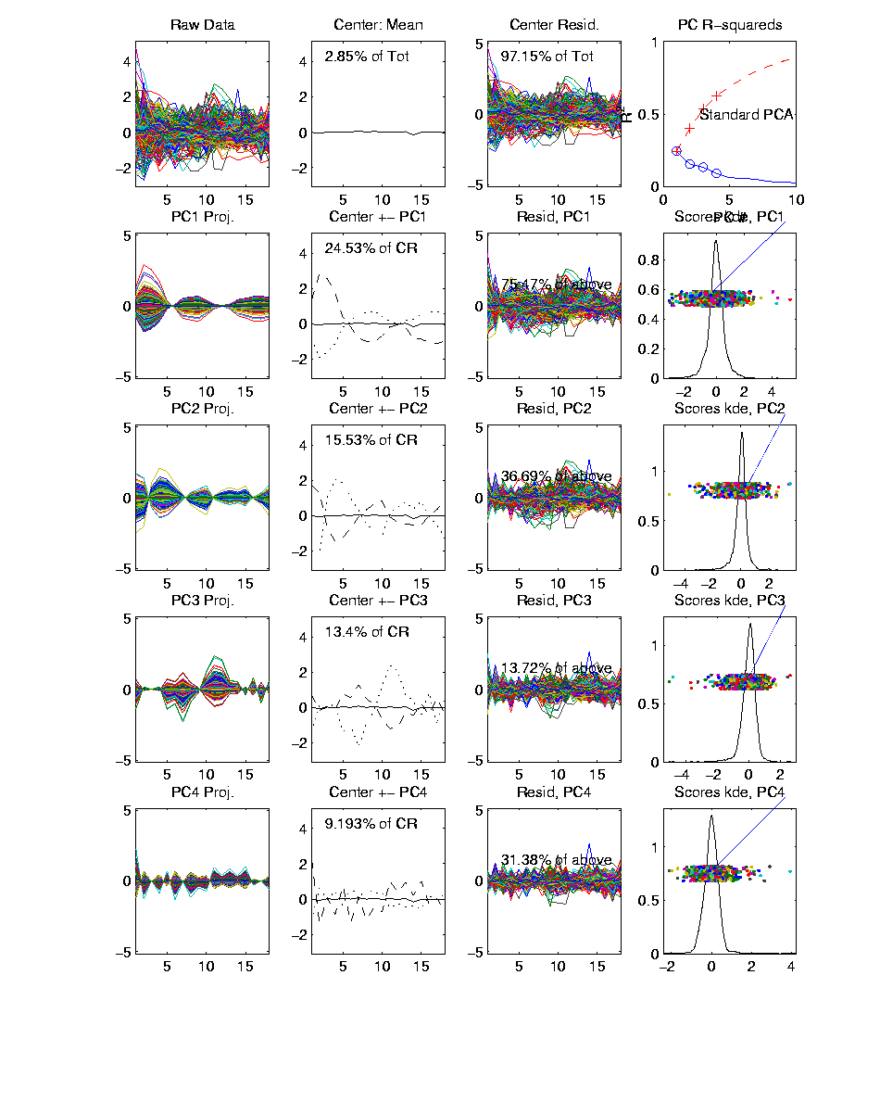
Yeast Cell Cycle Data, FDA View
Periodic
genes?
Naïve
approach:
Simple PCA
Notes:
spellman_alpah_complete_pca.ps

Slide 40
Yeast Cell Cycle Data, FDA View
Central question: which genes are “periodic” over 2 cell cycles?
Naïve approach: Simple PCA
No apparent (2 cycle) periodic structure?
Eigenvalues suggest large amount of “variation”
PCA finds “directions of maximal variation”
Often, but not always, same as “interesting directions”
Here need better approach to study periodicities

Slide 41
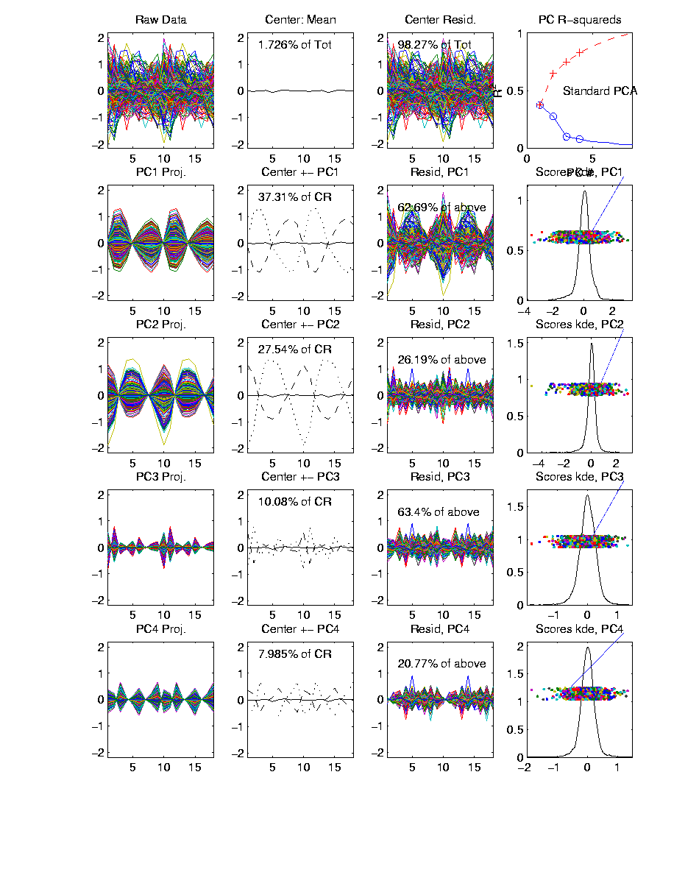
Yeast Cell Cycles, Freq. 2 Proj.
PCA on
Freq. 2
Periodic
Component
Of Data
Notes:
spellman_alpah_complete_proj_pca.ps

Slide 42
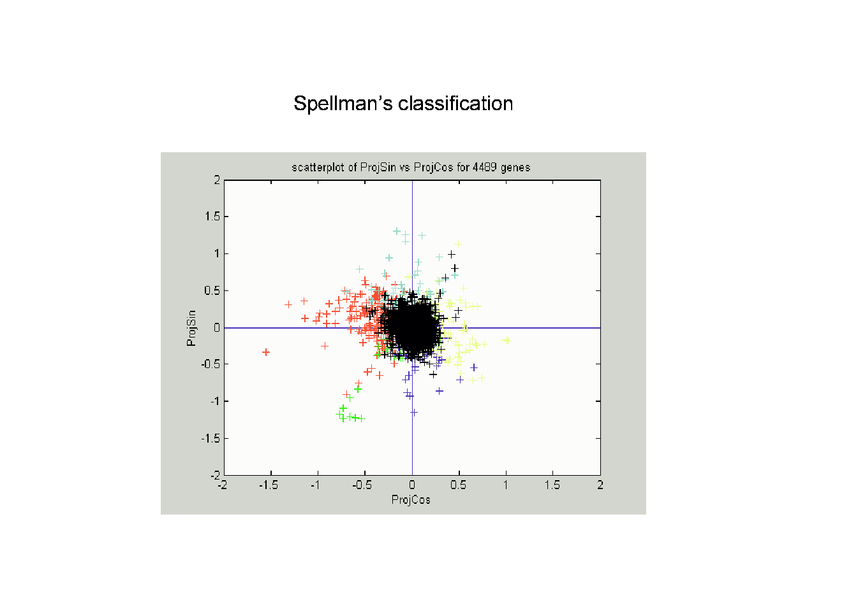
Frequency 2 Analysis
Notes:
CellCyc2dSpellClass.ps

Slide 43
Frequency 2 Analysis
Project data onto 2-dim space of sin and cos (freq. 2)
Useful view: scatterplot
Angle (in polar coordinates) shows phase
Colors: Spellman’s cell cycle phase classification
Black was labeled “not periodic”
Within class phases approx’ly same, but notable differences
Now try to improve “phase classification”

Slide 44
Yeast Cell Cycle
Revisit “phase classification”, approach:
Use outer 200 genes
(other numbers tried, less resolution)
Study distribution of angles
Use SiZer analysis
(finds significant bumps, etc., in histogram)
Carefully redrew boundaries
Check by studying k.d.e. angles

Slide 45
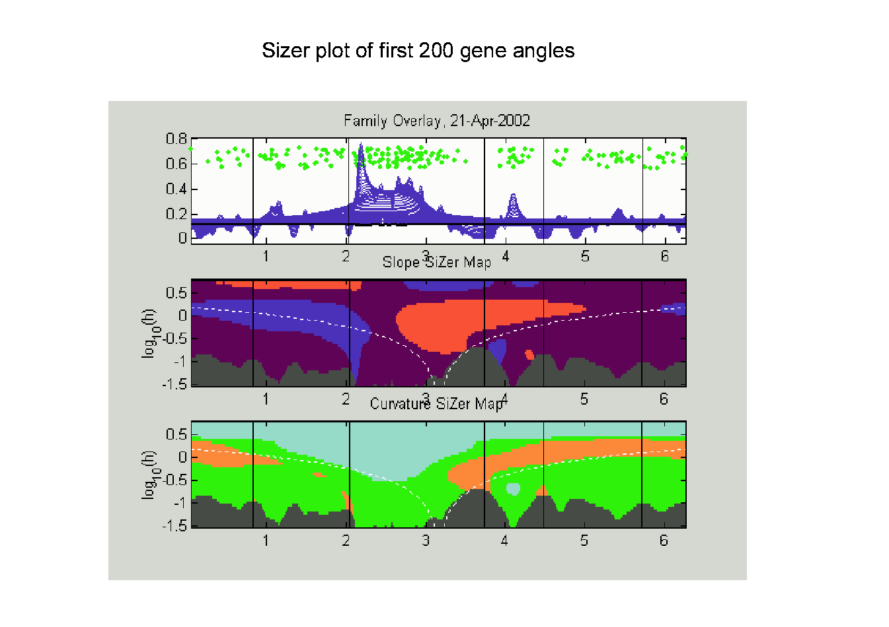
SiZer Study of Dist’n of Angles
Notes:
CellCycTh200SiZer.ps

Slide 46
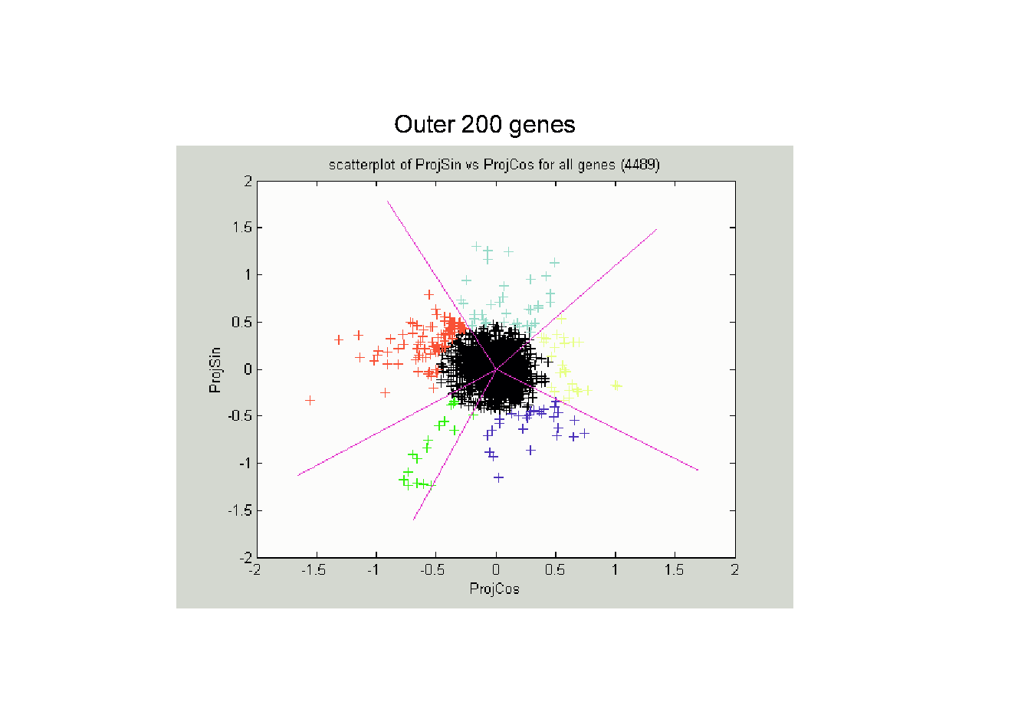
Reclassification of Major Genes
Notes:
CellCycTh200ScatPlot.ps

Slide 47
Compare to Previous Classif’n
Notes:
CellCyc2dSpellClass.ps

Slide 48
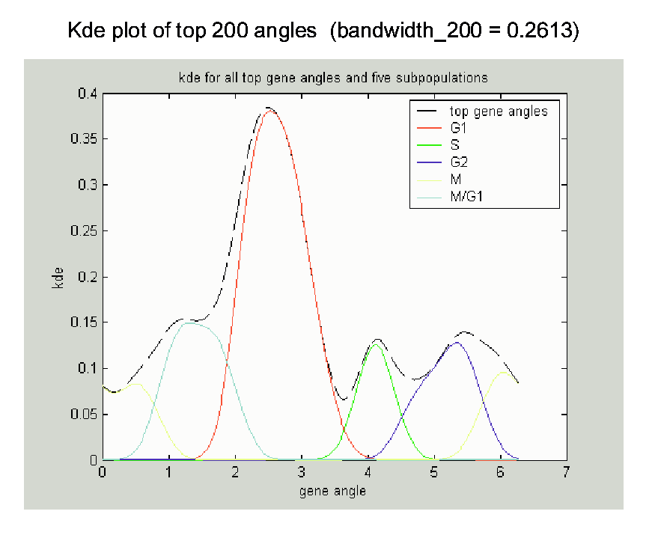
New Subpopulation View
Notes:
CellCycTh200KDE.ps

Slide 49
New Subpopulation View
Note:
Subdensities
Have Same
Bandwidth &
Proportional
Areas
(so Σ = 1)
Notes:
CellCycTh200KDE.ps

